Slide 1

Structured Streaming

Slide 2

Structured Streaming
Built on Spark SQL engine
Scalable
Fault tolerant
Fast
End-to-end exactly-once guarantee
Stream data processing engine.

Slide 3
Programming Logic
The main idea is to treat the live data stream as a continuously inserted table.
You can perform standard operations on this table as on static table.

Slide 4
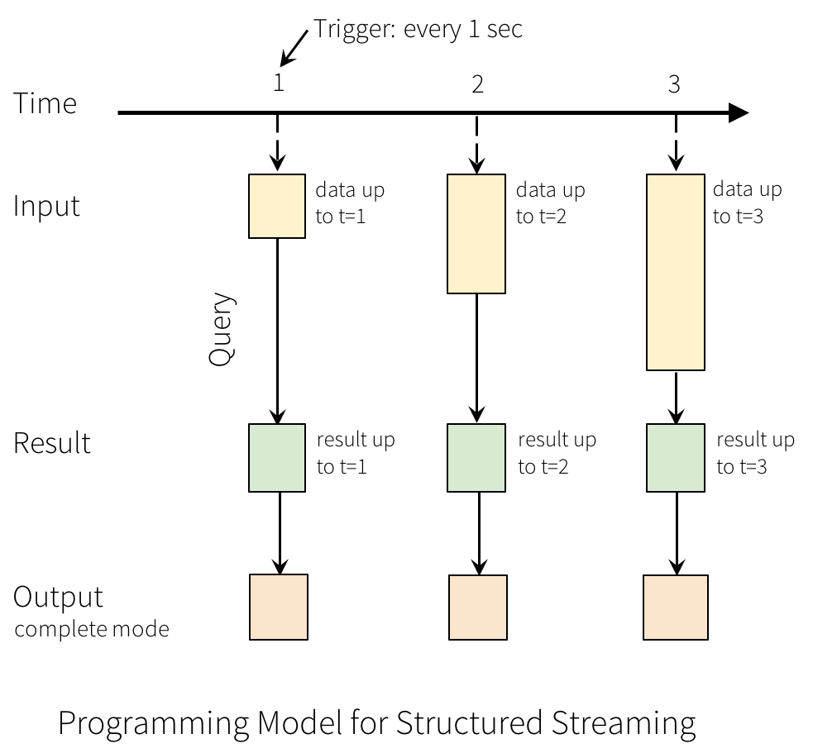
https://spark.apache.org/docs/2.3.1/structured-streaming-programming-guide.html#overview

Slide 5
Streaming Wordcount
Trigger
Trigger
Trigger
Trigger
pear apple
apple apple
pear apple
orange cherry
apple
banana
TIME
1
2
3
4
pear apple
apple apple
pear apple
apple apple
pear apple
apple apple
Unbounded Table
pear apple
orange cherry
pear apple
orange cherry
apple
banana
Wordcount Query
Result Table
apple | 3
pear | 1
apple | 4
pear | 2
apple | 5
pear | 2
orange | 1
cherry | 1
orange | 1
cherry | 1
banana | 1

Slide 6
Event-time
Event time is the time embedded in the data. It is not when Spark receives the data.
The event time is kept in a column. Thus, time-based aggregation can be made. For example, the number of signals generated in the last minute. This allows "event-time-window-based aggregation queries".

Slide 7
Event-time, Window Size, Slide
windowedCounts = lines.groupBy(
F.window(F.col("time"), "1 minutes"),
F.col("Species")
).count().orderBy("window")

Slide 8
Event-time, Window Size, Slide
10:02 | apple apple
10:03 | pear apple
10:06 | pear apple
10:09 | orange cherry
10:12 | apple
10:14 | banana
10:00
10:05
10:10
10:15
TIME
Result Table
10:00 – 10:10 | apple | 3
10:00 – 10:10 | pear | 1
10:00 - 10:10 | apple | 4
10:00 - 10:10 | pear | 2
10:00 - 10:10 | apple | 2
10:00 - 10:10 | pear | 1
10:00 - 10:10 | orange | 1
10:00 - 10:10 | cherry | 1
10:00 - 10:10 | orange | 1
10:00 - 10:10 | cherry | 1
10:15 - 10:15 | banana | 1
window length
sliding interval
These two parameters must be multiples of the batch range of the source DStream.

Slide 9

Late Data
Late data is also updated where it should be. For this, the user sets a watermark.
For example; Ignore any event later than 10 minutes.

Slide 10
Watermark
windowedCounts = lines
.withWatermark("timestamp", "10 minutes")
.groupBy(
F.window(F.col("time"), "1 minutes"),
F.col("Species")
).count().orderBy("window")

Slide 11
Watermark
10:02 | apple apple
10:03 | pear apple
10:06 | pear apple
10:09 | orange cherry
10:04 | apple
10:14 | banana
10:00
10:05
10:10
10:15
TIME
Result Table
10:00 – 10:10 | apple | 3
10:00 – 10:10 | pear | 1
10:00 - 10:10 | apple | 4
10:00 - 10:10 | pear | 2
10:00 - 10:10 | apple | 2
10:00 - 10:10 | pear | 1
10:00 - 10:10 | orange | 1
10:00 - 10:10 | cherry | 1
10:00 - 10:10 | orange | 1
10:00 - 10:10 | cherry | 1
10:15 - 10:15 | banana | 1

Slide 12
Output Modes
Append Mode (Default mode):
Only new rows from the most recent trigger are added to the Result Table. It is for stateless transformations.
Update Mode:
Only rows that have been updated in the Result Table since the last trigger are written to disk. Same as Append Mode if the query does not contain Aggregation.
Complete Mode:
The updated Result Table is written to disk. It is for stateful transformations.
Attention: Each mode is valid for certain query types.
https://medium.com/analytics-vidhya/spark-streaming-output-modes-600c689b6bf9

Slide 13
Message Delivery Reliability
at-most-once: At most one message reaches, repeated message is not possible, but message might be lost.
at-least-once: No message is lost, but might be duplicate messages.
exactly-once: The message is not copied and lost, no duplicate messages. It means a complete delivery to the receiver for each message given to the system. The message is neither lost nor repeated.

Slide 14
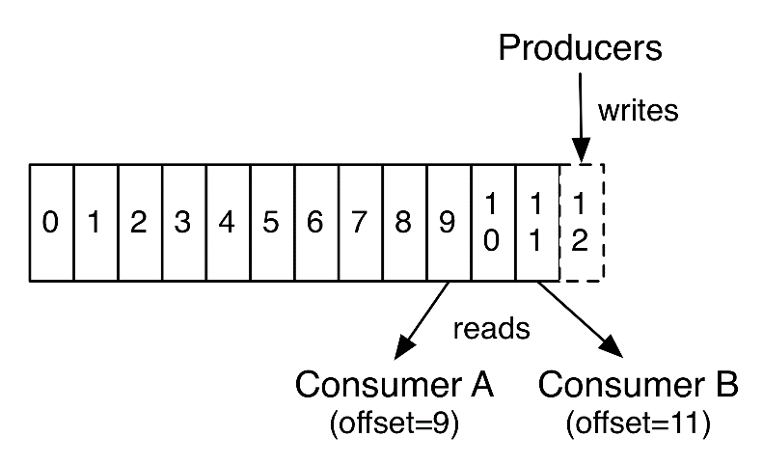

Fault tolerance
Exactly-once message transmission is one of the most fundamental goals of Structured Streaming.
Each streaming data source is assumed to have offsets to track the read position (similar to Kafka offsets or Kinesis sequence numbers).

Slide 15
Recovering from Failures
with Checkpointing
In the event of an error or user shutdown, you can recover the state of a previous query and continue where it left off.
This is possible by writing forward logs with checkpointing. Checkpoint location is specified in DataStreamWriter.
aggDF
.writeStream
.outputMode("complete")
.option("checkpointLocation", "path/to/checkpo’nt/dir")
.format("memory")
.start()

Slide 16
Recovering from Failures
with Checkpointing
In prod: Every time the application starts, it must be started with the same checkpoint.
In dev: It is better to clean before re-try.
aggDF
.writeStream
.outputMode("complete")
.option("checkpointLocation","path/to/HDFS/dir")
.format("memory")
.start()

Slide 17
Prerequisites of end-to-end exactly-once guarantee
The source data must continue to exist.
For example, you cannot transmit socket data exactly-once. Because you will not find the data previously read.
Data transformations must be deterministic.
The target system to which data is written must be idempotent. It should detect and ignore duplicate records. Exactly-once does nothing for duplicate records that were accidentally (intentionally) produced by the source (it is not for de-duplication).

Slide 18

Dataframe/Dataset API Compatibility
Structured Streaming application is also created by same SparkSession as in Dataframe api.
Therefore, static DataFrames are reachable within stream application.
Dataframe
Structured
Streaming
Dataset
SQL

Slide 19
Structured Streaming Sources

Slide 20
Sources – File (csv)
It is necessary to prepare and dress the schema manually (csv source). By reading a file in the same directory as a batch, schema extraction can be done and this schema can be used.
Each file in the source directory must be in the same format. For example, comma separated, the number of fields and the data types in it must be the same.
Each file should have a different name and should not be changed or updated after the file is created. Even if the read file is updated, it is not processed again.
Files are processed from early to late.
How many files are processed in each micro batch can be set with maxFilesPerTrigger.
Some options of Batch Dataframe read can also be used for readStream.

Slide 21
Sources – File (csv)
inputDF = (spark
.readStream
.format("csv")
.option("header", "true")
.option("sep", ",")
.schema(mySchema)
.load("hdfs://localhost:9000/user/train/input_logs"))
CSV requires pre-defined schema.

Slide 22

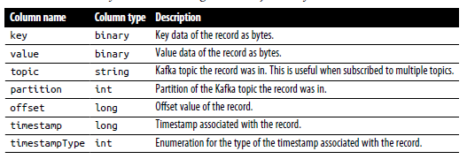
Sources - Kafka
It is possible to subscribe multiple topics.
inputDF = (spark
.readStream
.format("kafka")
.option("kafka.bootstrap.servers", "host1:port1,host2:port2")
.option("subscribe", "events")
.load())

Slide 23
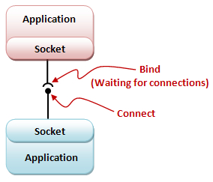
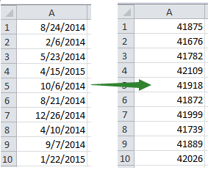
Sources – Socket and Rate
UTF8 text data from
a socket connection
test purpose
Generates data at the specified number of rows
per second, each output row contains a timestamp and value.

Slide 24
Stateless and Statefull Transformations
Stateless: select(), explode(), map(), flatMap(), filter(), where() these are stateless transformations because they are not related to/depending on the previous and next micro batch.
Stateless operations only supports append and update modes.
Stateful: The most typical example is df.groupBy().count(). Each micro batch is more costly and is used in the complete mode as it is related to the previous ones.

Slide 25
Stateful Streaming Aggregation
There is no direct aggregation like batch Dataframe in Structured Streaming. Like df.count() for example. Aggregation requires using groupBy() or groupByKey().
Aggregation 2 types:
Not tied to a timeframe: How long has it been since streaming started, how many, etc.
Depends on a time period: For example, the most tagged hashtags in the last 10 minutes (topic trends)

Slide 26
Join Operations
Structured Streaming DF/DS can be combined with both Structured Streaming DF/DS and static DF/DS.
streamingDf.join(staticDf, "type")
streamingDf.join(staticDf, "type", "right_join")

Slide 27
Stream Deduplication
You can deduplicate records in orange data streams using a unique identifier in events. This is the same as deduplicating statically using a unique identifier column.
Ankara | İstanbul
Ankara | İzmir
Ankara | İstanbul
Bursa | Mardin
Ankara | İstanbul
Ankara | İzmir
Bursa | Mardin
streamingDf.dropDuplicates("guid")

Slide 28
Structured Streaming Sinks

Slide 29
Output Sinks - File
Writes output to a storage.
text, csv, json, orc, parquet formats.
Only append mode
("path", outputDir) or start(outputDir)
streamingQuery = (resultDF.writeStream
.format("parquet")
.option("path", outputDir)
.option("checkpointLocation", checkpointDir)
.start())

Slide 30
Output Sinks - Kafka
To write to Kafka, there must be/prepared string type columns named key and value in the Dataframe.
You can write to Kafka in all three modes.
streamingQuery = (counts
.selectExpr(
"cast(word as string) as key",
"cast(count as string) as value")
.writeStream
.format("kafka")
.option("kafka.bootstrap.servers", "host1:port1,host2:port2")
.option("topic", "wordCounts")
.outputMode("update")
.option("checkpointLocation", checkpointDir)
.start())

Slide 31
Output Sinks - foreachBatch() and foreach()
ForeachBatch() can be used for sinks that do not support datastreams. A special function can be written and used for sinks where it is not possible to write with foreach and foreachBatch().
spark.conf.set("spark.cassandra.connection.host", hostAddr)
def writeCountsToCassandra(updatedCountsDF, batchId):
# Use Cassandra batch data source to write the updated counts
(updatedCountsDF
.write
.format("org.apache.spark.sql.cassandra")
.mode("append")
.options(table=tableName, keyspace=keyspaceName)
.save())
streamingQuery = (counts
.writeStream
.foreachBatch(writeCountsToCassandra)
.outputMode("update")
.option("checkpointLocation", checkpointDir)
.start())

Slide 32
Output Sinks - foreachBatch() and foreach()
foreachBatch();
batch Dataframe functionality is available.
Results can be written to multiple sinks at the same time. (In this case, it is recommended to cache the batch Dataframe.
def writeCountsToMultipleLocations(updatedCountsDF, batchId):
updatedCountsDF.persist()
updatedCountsDF.write.format(...).save() # Location 1
updatedCountsDF.write.format(...).save() # Location 2
updatedCountsDF.unpersist()
However, foreachBatch() only guarantees at-least-once.
For exactly-once; deduplicate multiple writes from re-executed micro-batches with batchId.

Slide 33
Output Sinks - foreachBatch() and foreach()
If foreachBatch() is not an option (for example, if a corresponding
batch data writer does not exist), then you can express your custom writer logic using foreach(). Specifically, you can express the data-writing logic by dividing it into three methods: open(), process(), and close(). Structured Streaming will use these methods to write each partition of the output records.
class ForeachWriter:
def open(self, partitionId, epochId):
# Open connection to data store
# Return True if write should continue
# This method is optional in Python
# If not specified, the write will continue automatically
return True
def process(self, row):
# Write string to data store using opened connection
# This method is NOT optional in Python
pass
def close(self, error):
# Close the connection. This method is optional in Python
pass
resultDF.writeStream.foreach(ForeachWriter()).start()

Slide 34
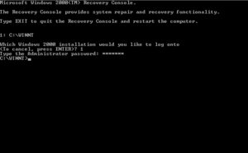
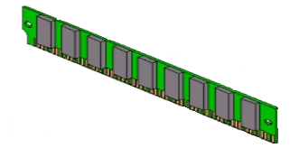
Output Sinks - Console
Console sink
It writes the output to the console on each trigger. It is suitable for development use with small data.
Output Sinks - Memory
Memory sink
The output is stored as a table in the driver memory. Not suitable for big data.

Slide 35


External Output Sinks
Many sinks such as Elasticsearch, Cassandra have written their own connectors.
With this type of connector, Spark streaming can write data to a very wide range of sinks.

Slide 36

Output Sink Examples
ES sink
Kafka sink
DF.writeStream
.format("kafka")
.option("kafka.bootstrap.servers",
"host1:port1,host2:port2")
.option("topic", "updates")
.start()
DS.writeStream
.format("org.elasticsearch.spark.sql")
.outputMode("append")
.option("checkpointLocation","checkpoint")
.option("es.nodes","cloudera")
.option("es.port","9200")
.start("online_retail")

Slide 37
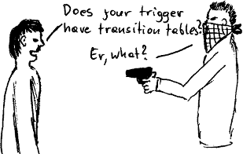
Triggers
Trigger settings define whether the query is executed as a micro-batch query or as a continuous processing query.
Default: (if not specified) micro-batch. As soon as the previous batch is processed, the next one is triggered.
Continous: Still trying (quite a long time).
https://www.cybertec-postgresql.com/en/rules-or-triggers-to-log-bulk-updates/

Slide 38
Triggers
Processing time with trigger interval: We can explicitly give a ProcessingTime trigger time. Thus, it is triggered at fixed intervals.
Once: It is resource dependent, when it comes to work, it works with a batch and stops. For example, jobs that come every 3-5 hours.
Checkpoint location: Any HDFS compatible file system will do. Required for exactly-once warranty and error recovery.

Slide 39
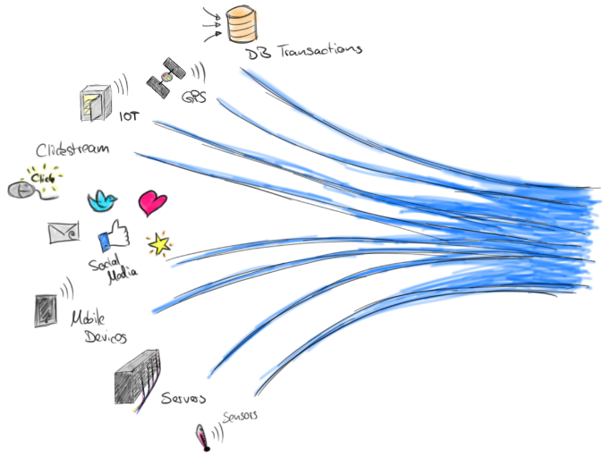
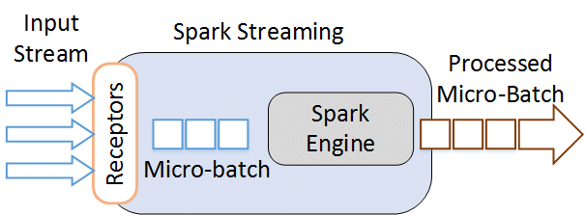
Triggers
Micro-Batch
Continuous
https://flink.apache.org/news/2017/04/04/dynamic-tables.html
import org.apache.spark.sql.streaming.Trigger
// ProcessingTime trigger with two-seconds micro-batch interval
df.writeStream
.format("console")
.trigger(Trigger.ProcessingTime("2 seconds"))
.start()
import org.apache.spark.sql.streaming.Trigger
// Continuous trigger with one-second checkpointing interval
df.writeStream
.format("console")
.trigger(Trigger.Continuous("1 second"))
.start()

Slide 40
Managing Flow Rate
maxFilesPerTrigger: maximum number of new files to be considered in every trigger (default: no max)
maxBytesPerTrigger : Specific to the delta source only.
Fixed interval micro-batches: It is triggered at specified time intervals. Trigger is delayed if previous interval is not completed. .trigger(Trigger.ProcessingTime("2 seconds"))
One-time micro-batch: It is triggered only once. Work is done with a single batch. Then the app closes itself. .trigger(Trigger.Once())
Continuous with fixed checkpoint interval: Stil experiment. .trigger(Trigger.Continuous("1 second"))

Slide 41

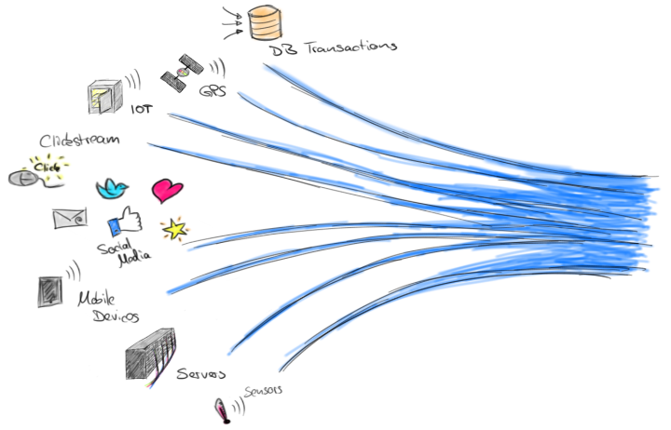
Managing Streaming Queries
The StreamingQuery object created when a query is started can be used to monitor and manage the query.
val query = df.writeStream.format("console").start() // Get query object.
query.stop() // Sorguyu durdur.
query.awaitTermination() // Wait until the query finishes, stop() or error can stop.

