Slide 1

"If a human operator needs to touch your system during normal operation, you have a bug."
Carla Geisser, Google SRE

Slide 2
A Data Pipeline

Slide 3

Pipeline sometimes gets errors

Slide 4
There are hundreds of pipelines
Impossible to manage with cron or handmade scripts!

Slide 5
What is Apache Airflow?
sophisticated workflow/job orchestration
Airflow is a platform to programmatically
author,
schedule and
monitor workflows.
http://airflow.apache.org/docs/apache-airflow/stable/index.html

Slide 6
Why use Airflow?
Data flows in and out private/public clouds or data centers like blood in our veins.
There are hundreds of job that makes happen data circulation.
Some of jobs are dependent each other.
Each job starts at a specific time and stops.
Each job repeated in different periods (hourly, daily etc.)
It is impossible to start, stop and monitor so much jobs.

Slide 7
Alternatives
Luigi (Spotify)
Apache NiFi
AWS Step Functions
Prefect
Dagster
Kedro
Apache Oozie
https://hevodata.com/learn/airflow-alternatives/

Slide 8
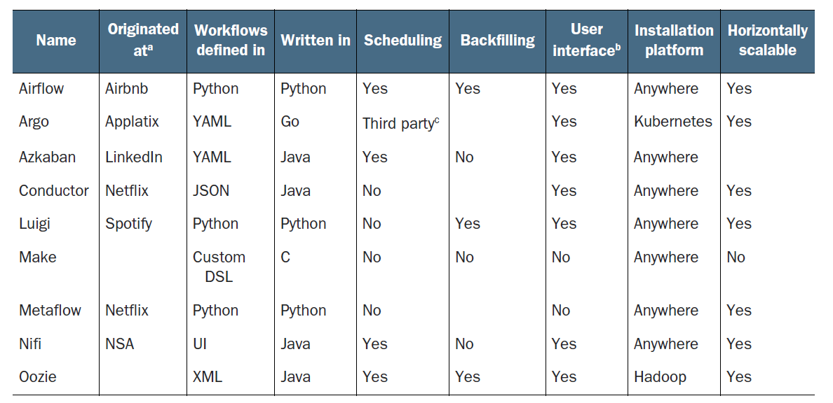
Well-known workflow managers
Data Pipelines with Apache Airflow, Manning Pub.,2021, Julian de Ruiter, Bas Harenslak

Slide 9
Benefits of Airflow
Open source, Apache 2.0 license
Fault tolerant
Scalable
Job Schedule, monitor and alert
Handles task failures
Cloud Native

Slide 10






Terminology on Use-case
SQL Ops
clean
different excels
Task
Task
Email reports
Task
Move/archive files
my-first-dag.py
Task
DAG
Notes:
.

Slide 11
Terminology/Concept
DAG (Directed Acyclic Graph): Core of Airflow. Each data pipeline is defined in DAG python file.
Operator: Task definition class in pipeline. There are many ready to use operators in Airflow.
Task: Instance of operator.
Workflow: Combination of all of them
https://airflow.apache.org/docs/apache-airflow/stable/concepts.html

Slide 12
Core Components
Web Server
Scheduler
Database
Executor
Workers
The worker is the node or processor which runs the actual tasks.
The Airflow scheduler won’t run any tasks but handle tasks over to the Executor.
The Executor acts as a middle man to handle resource utilization and how to distribute work best.

Slide 13
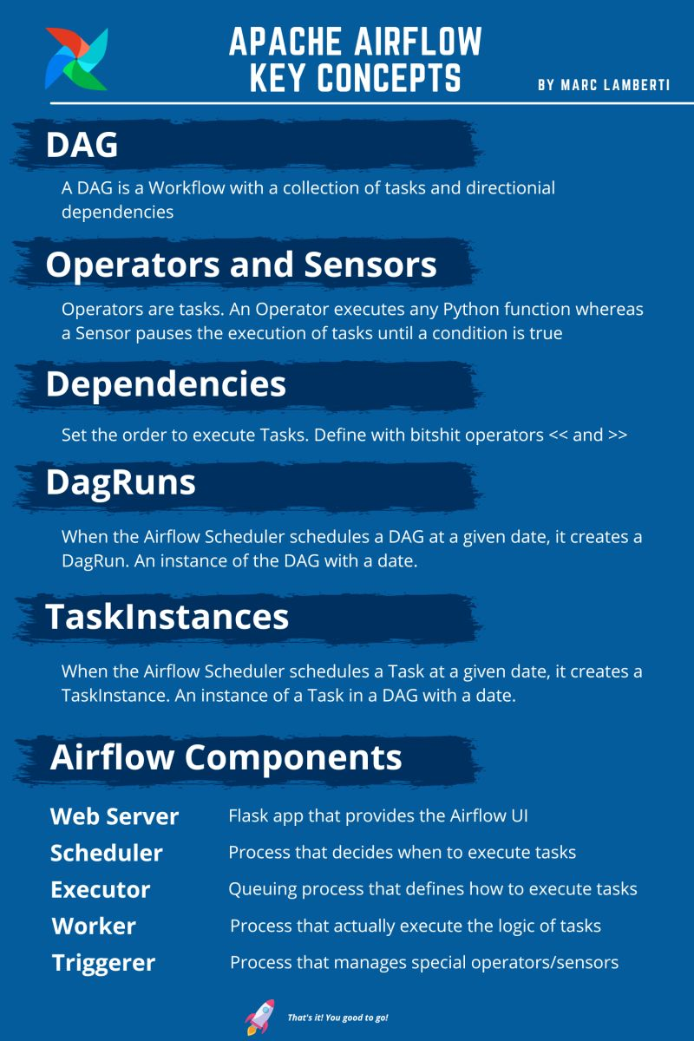
Source: https://www.linkedin.com/posts/marclamberti_airflow-dataengineering-datascience-activity-6980924089431429120-u-QE?utm_source=share&utm_medium=member_desktop

Slide 14
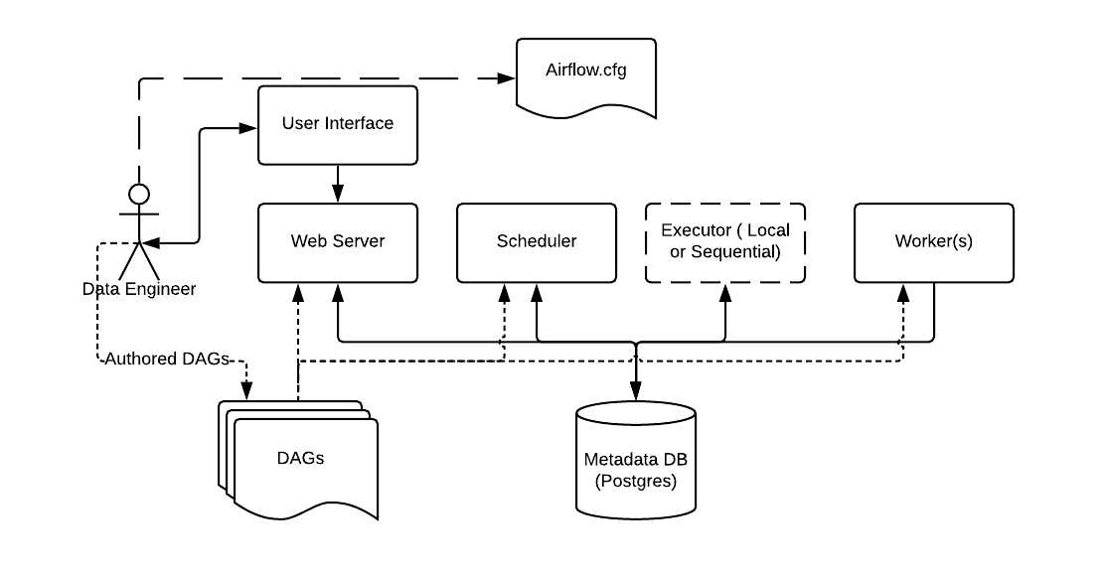
Architecture
https://airflow.apache.org/docs/apache-airflow/stable/concepts.html

Slide 15
What is not Airflow?
It is not replacement of Kafka, Spark Streaming or Flink.
It is an alternative of Apache Oozie and Azkaban or Crontab.

Slide 16
Executor Types
SequentialExecutor: No parallel tasks
LocalExecutor: Parallel tasks but single machine
CeleryExecutor: Fully distributed mode, needs message queue.
KubernetesExecutor:

Slide 17
Executor Types: SequentialExecutor
Default
Not for production
Uses SQLite, not require RDBMS (PostgreSQL or MySQL)

Slide 18
Executor Types: LocalExecutor
Executes tasks locally but in parallel
Requires RDBMS (PostgreSQL or MySQL)
It is easier, cheaper to setup and use than CeleryExecutor
Limited resources offered by single Machine
Single point of failure

Slide 19
Executor Types: CeleryExecutor
Allows to scale out workers
Distributes task load among multiple worker nodes
Celery is an asynchronous task queue system that uses queuing framework (Redis, RabbitMQ)
Requires RDBMS (PostgreSQL or MySQL) on separate node

Slide 20
Executor Types: KubernetesExecutor
The Kubernetes executor runs each task instance in its own pod on a Kubernetes cluster.
Airflow executes tasks of a DAG on different servers in case you are using Kubernetes executor or Celery executor.

Slide 21
Data sharing between tasks
XCom
A way of sharing data between tasks
Only small pickable objects like small lists
Storage
Local disks, databases or object storage like s3
Bigger data

Slide 22

Pools
7
5
12
8
DAG-1
DAG-2
DAG-3
DAG-4
Worker Node-1
Worker Node-2
Worker Node-3
Worker Node-4
Worker Node-5
POOL-2
POOL-1
worker process
worker process
worker process
worker process
worker process

Slide 23
Some Operators
SimpleHttpOperator
MySqlOperator
PostgresOperator
MsSqlOperator
OracleOperator
JdbcOperator
DockerOperator
HiveOperator
S3FileTransformOperator
PrestoToMySqlOperator
SlackAPIOperator
pip install apache-airflow-providers-docker==2.2.0

Slide 24
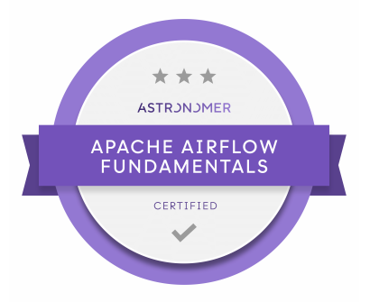
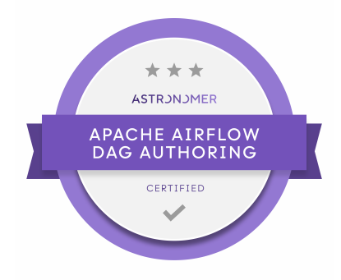
Certification
https://www.astronomer.io/certification/

