Slide 1
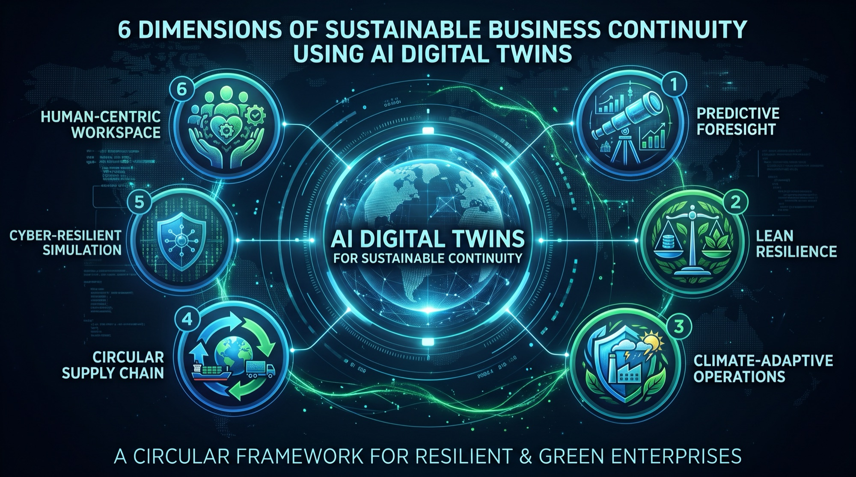

Sustainable AI Using Digital Twins
EXECUTIVE & ACADEMIC BRIEFING
From Apollo 13 to autonomous, carbon-aware twins that observe, orient, decide and act
Gökhan Tenekecioglu
Scan to connect on LinkedIn
Notes:
April 1970. Three astronauts are 320,000 kilometres from Earth. An oxygen tank has just exploded. Power is draining, and the air is turning toxic. The people who saved them never touched that spacecraft. They saved it by working on its copy, here on the ground. That copy is the subject of today's talk. Fifty-six years later we call it a digital twin. It is no longer a room full of hardware. It is software that watches, thinks and acts, in real time.

Slide 2
Rehearse the future before you have to live it
WHY IT MATTERS
−20–50%
−10–25%
−30%
−15–30%
Unplanned downtime
Energy consumption
Corridor congestion
HVAC energy
Manufacturing twins with anomaly detection and reinforcement learning
AI-optimized operations with minimal waste
About 30% in Chattanooga, with signals re-optimized every 4 minutes
Smart-city building energy management
For boardrooms: measurable gains in downtime, energy and carbon. For universities: systems that now decide, not just display.
Notes:
Here is why boardrooms should care: 20 to 50 percent less unplanned downtime. 10 to 25 percent less energy. About 30 percent less traffic congestion in a real city. And here is why universities should care: these systems now decide, not just display. That raises hard questions about trust, sustainability and control. So here is my promise for the next fifteen minutes. A digital twin lets you rehearse the future before you have to live it. And I'll argue that this is our best tool for making AI itself sustainable.

Slide 3
Six stops from a 1970 rescue to the resilient enterprise
AGENDA
01
The Origins of Digital Twins
02
Most Common Application Areas
Apollo 13 → PLM 2002 → NASA 2010
Six domains where AI twins deliver
03
Digital Twins for Smart Cities
04
OODA Loop & Digital Twins
Urban twins as a predictive OODA engine
Observe · Orient · Decide · Act
05
Sustainable AI — 12 Dimensions
06
Sustainable Business Continuity
Greening of AI and AI for greening
Six dimensions of resilient, green operations
Notes:
Six stops: where twins came from, where they work, a whole city, the decision loop that drives them, sustainable AI, and the resilient enterprise. Let's go back to 1970.

Slide 4
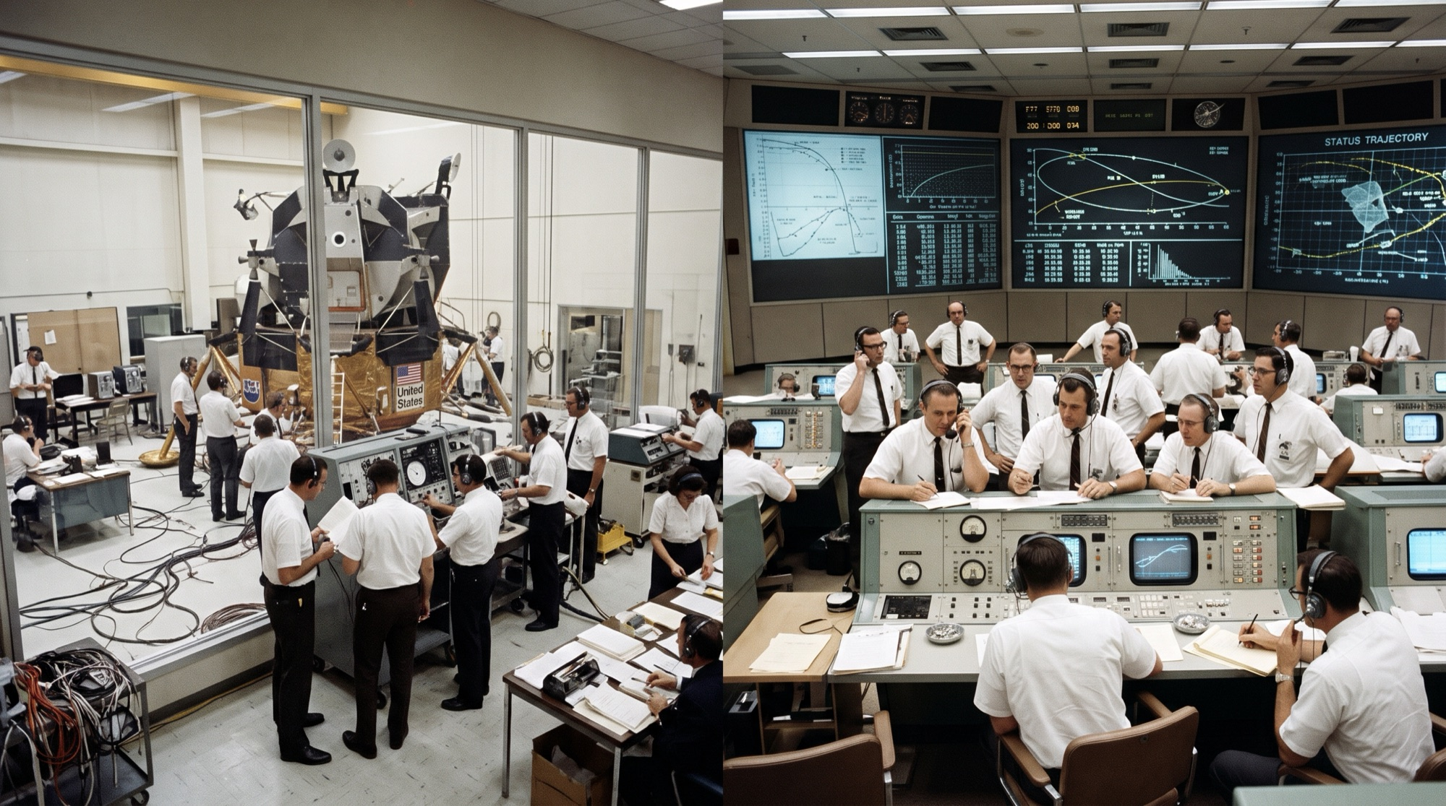
From rescue tool to prediction engine
MODULE 01 · ORIGINS
1970
The precursor: Apollo 13
Telemetry from the damaged craft fed ground simulators to test burns, power and trajectory before radioing the crew.
2002
The architecture: PLM
Dr. Michael Grieves: a physical entity, a virtual entity, and two-way data loops between them.
2010
The name: NASA roadmap
Apollo 13, 1970: ground replicas and simulators at Mission Control
John Vickers coins “Digital Twin”: one physics model per vehicle to predict fatigue and remaining life.
Notes:
Look at this room. Engineers in white shirts, an exact replica of the spacecraft, and simulators wired to it. When the tank exploded, Mission Control fed real telemetry from the damaged ship into these ground simulators. Before they radioed a single instruction to the crew, they tested it there. That was a twin before the word existed. The copy made mistakes so the crew didn't have to.
In 2002, Dr. Michael Grieves gave the idea an architecture: a physical thing, a virtual thing, and a two-way flow of data between them. In 2010, NASA's John Vickers put the name Digital Twin into NASA's technology roadmap: each vehicle gets its own twin to predict its own fatigue and remaining life.
So the arc runs from rescue, to architecture, to prediction. Today we're adding a fourth step: decision. For academics: the open question since 2002 is fidelity. How close does the copy need to be before we trust its decisions?

Slide 5
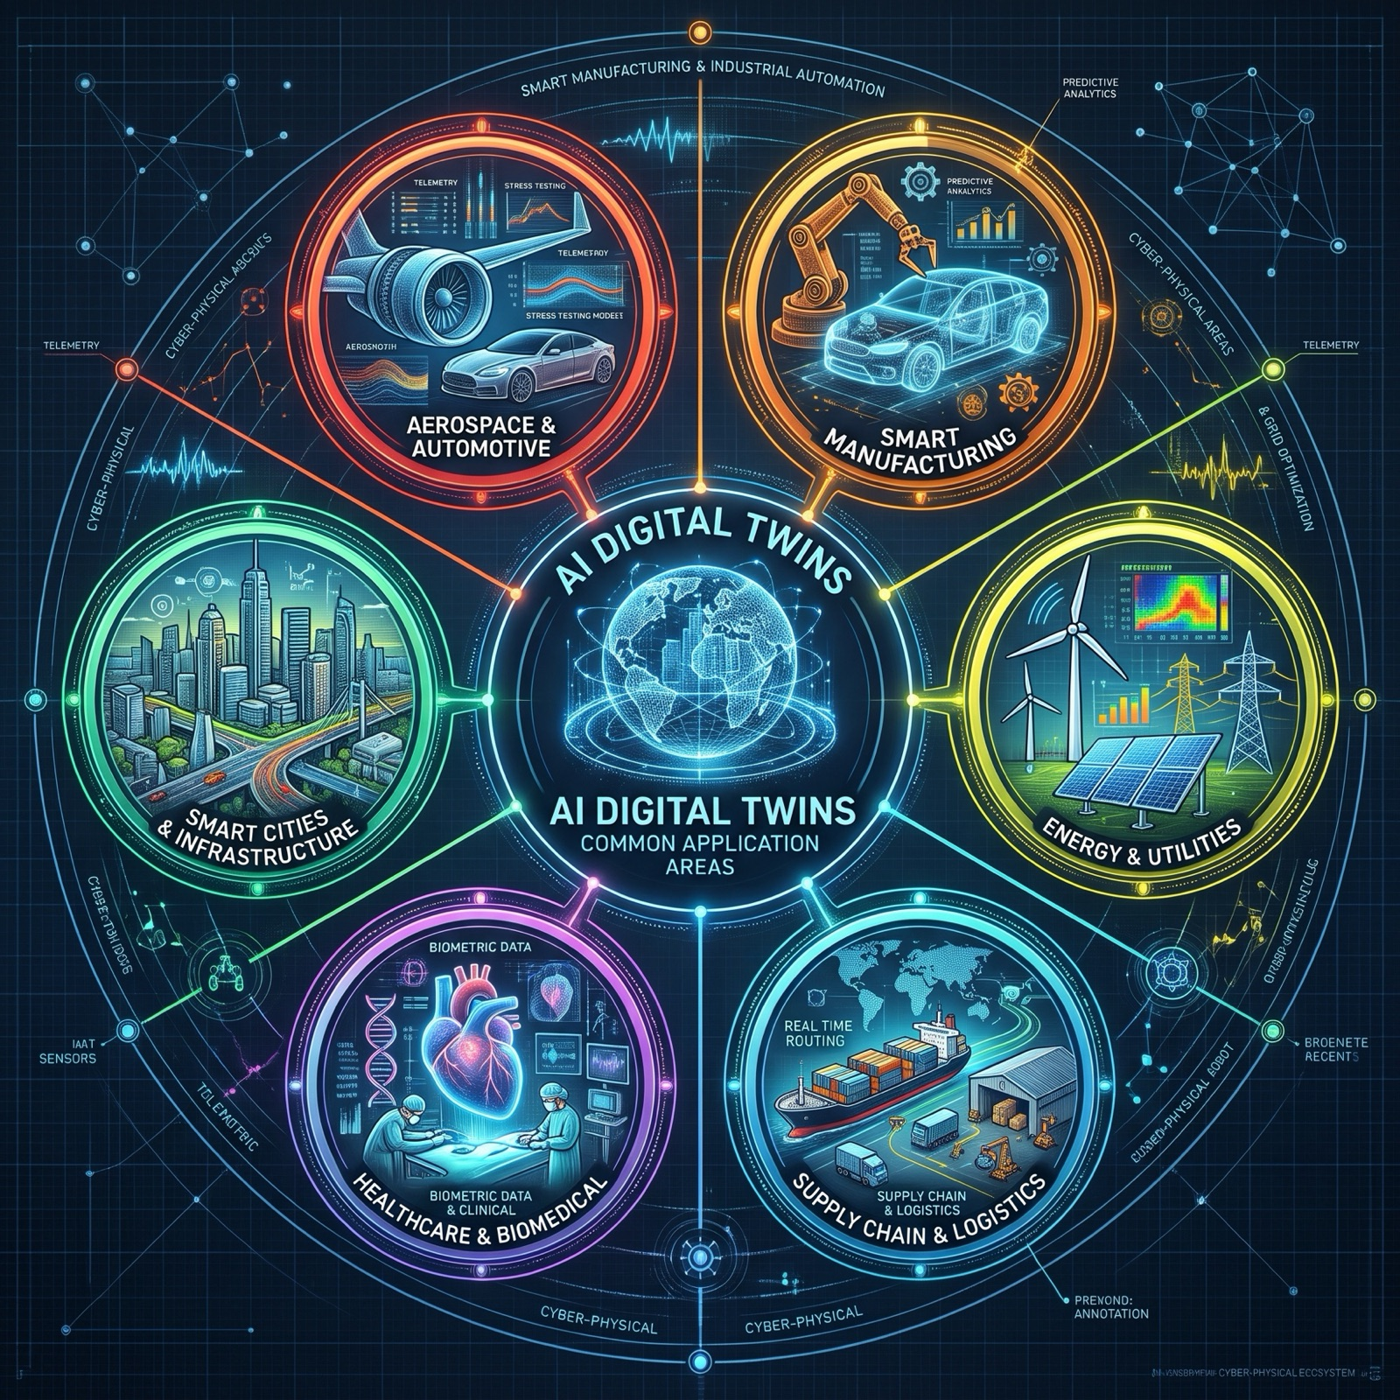
AI twins already pay off across six domains
MODULE 02 · APPLICATION AREAS
1
Smart Manufacturing
Predictive maintenance, virtual commissioning, RL-tuned lines
2
Energy & Utilities
Turbine health, dynamic grid balancing, pipeline integrity
3
Supply Chain & Logistics
Warehouse orchestration, what-if stress tests, Scope 3 tracking
4
Healthcare & Life Sciences
Patient-specific organ twins, drug discovery, hospital flow
5
Smart Cities & Infrastructure
Traffic and mobility, building energy, disaster simulation
6
Aerospace & Automotive
Engine remaining-life prediction, simulated driving miles
Notes:
What changed between NASA's twin and today's? AI. Physics simulation now sits alongside machine learning, live IoT telemetry and generative reasoning. The twin has gone from a passive 3D dashboard to a system that predicts and optimizes itself. You'll find it in six domains.
Manufacturing is the most mature: sensors catch a failing bearing weeks before it breaks, and reinforcement learning tunes the line while it runs — 20 to 50 percent less unplanned downtime. In energy, grid twins forecast supply and demand and shift load and storage in real time. In healthcare, a twin of your own heart lets surgeons test the operation before the first cut. Supply chains, smart cities and aerospace — the direct descendant of Apollo — complete the wheel.

Slide 6
Each domain ties AI to a measurable outcome
MODULE 02 · HIGH-IMPACT OVERVIEW
Domain | Primary AI technique | Key metric / business outcome
Manufacturing | Anomaly detection, reinforcement learning | Unplanned downtime reduction (typically 20–50%)
Energy & Utilities | Time-series forecasting, physics-informed neural nets (PINNs) | Up to 10–20% boost in efficiency / lower emissions
Supply Chain | Graph neural networks, Monte Carlo simulations | Reduced buffer inventory, faster lead times
Healthcare | Biomechanical modeling, generative diffusion | Lower surgical complication risk, optimized clinical flow
Smart Cities | Computer vision, multi-agent spatial simulation | Reduced transit congestion, 15–30% HVAC energy savings
The pattern turns a technology into an investment case: a clear technique, tied to an outcome you can measure.
Notes:
The pattern holds in every row: a clear AI technique tied to a measurable outcome. That's what turns a technology into an investment case. One of these domains is big enough to hold all the others: the city.

Slide 7
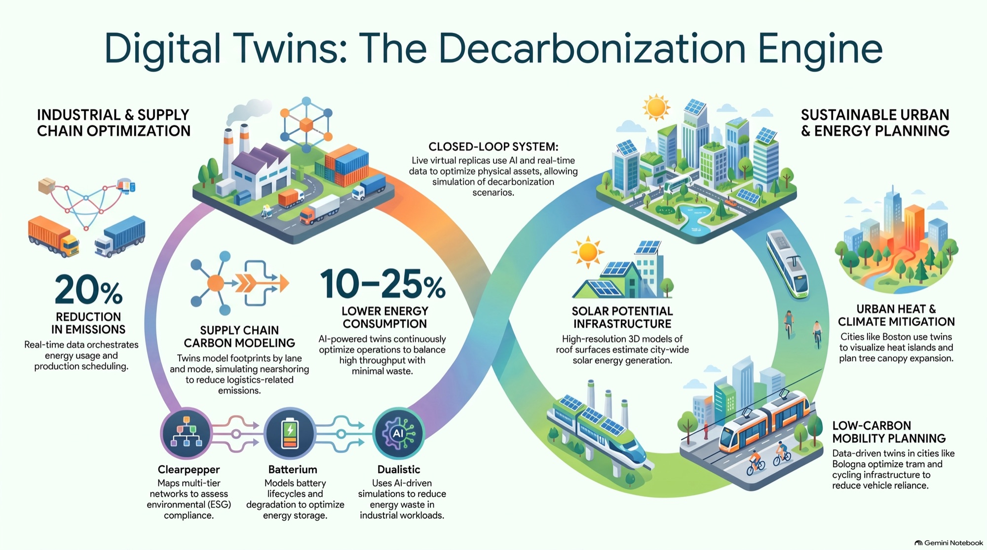
Urban twins let cities sense and respond in minutes
MODULE 03 · SMART CITIES
~30%
Chattanooga, Tennessee
500+ data sources with Oak Ridge National Laboratory; signals re-optimized every 4 minutes.
3D
Virtual Singapore
Wind-flow ventilation, telecom coverage impact and crowd-evacuation simulation.
CO₂
Helsinki 3D+
Building energy history plus solar models to prioritize retrofits block by block.
An Urban Digital Twin fuses GIS terrain, 3D BIM, municipal IoT sensors and public-service data into one living model.
Notes:
Imagine a twin of a whole city: terrain maps, building models, thousands of sensors and public-service records in one living model. Add AI, and it becomes a city that senses and responds every few minutes.
Chattanooga, with Oak Ridge National Laboratory: more than 500 data sources, signals re-timed every four minutes, downtown congestion down about 30 percent. Virtual Singapore models wind between towers, checks how new buildings affect mobile coverage, and simulates evacuations. Helsinki 3D+ combines every building's energy history with solar models to decide which block to retrofit first. The thread running through all three is carbon: every street, roof and tram line becomes a lever you can test in the twin first.

Slide 8
Four layers power a city twin, three risks hold it back
MODULE 03 · ARCHITECTURE AND RISKS
Application & Simulation
Key operational challenges
4
Unreal Engine · Cesium · Omniverse · planning sandboxes
Siloed data
Bridging utility SCADA, transit feeds and land registries into one semantic standard (OGC CityGML, Energy ADE).
3
AI Reasoning & Analytics
Hydrodynamic and microclimate solvers · forecasting · multi-agent RL
Citizen privacy
2
Data Fusion & Geospatial Storage
Balancing live computer vision with edge redaction and differential privacy.
GIS + BIM · spatial knowledge graphs · OGC · time-series DBs
Ingestion & IoT Telemetry
Model drift
1
Keeping the twin in sync with construction, sensor decay and growing trees.
SCADA · 5G edge · LoRaWAN · Kafka / MQTT streaming
Notes:
For the engineers: sensors at the bottom, data fusion above them, AI reasoning above that, and simulation and the user interface on top. For the academics, these are the hard problems: data that won't connect across departments, citizen privacy, and model drift. The city changes, and the twin has to keep up. A city that senses, thinks and acts every four minutes is running a loop. That loop has a name.

Slide 9
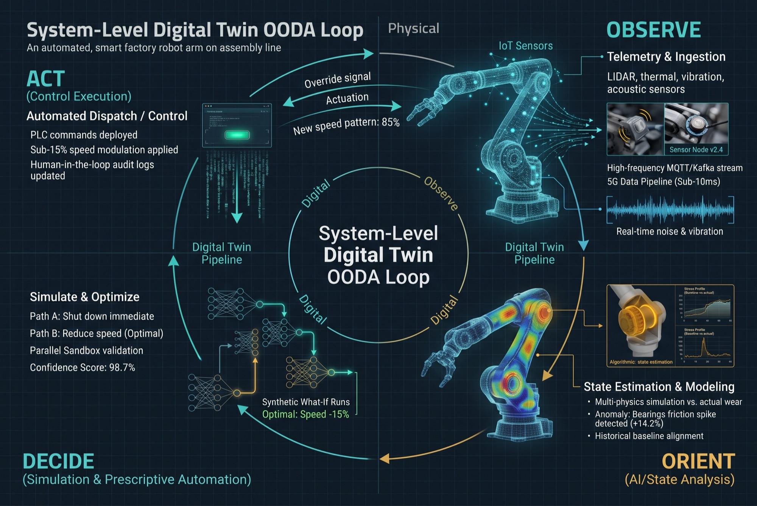
A digital twin is an OODA loop in silicon and sensors
MODULE 04 · OODA LOOP
O
Observe
IoT sensors stream vibration, heat and sound in under 10 ms.
O
Orient
Physics + ML tell normal expansion from bearing wear (+14.2% friction).
D
Decide
Parallel what-if simulations pick the best path: slow down 15%.
A
Act
PLC commands go out; the asset responds and the loop restarts.
Notes:
John Boyd was a fighter pilot and military strategist. Whoever cycles through Observe, Orient, Decide, Act faster than their environment changes, wins. You already run this loop in daily life; most of us get stuck in Orient or Decide. Industries run it too, and incumbents usually fail at Orient.
Now take the human out of the latency. Observe: sensors stream vibration, heat and sound in under 10 milliseconds. Orient: physics plus machine learning asks whether this is normal expansion or a failing bearing — friction is up 14 percent. Decide: the twin runs what-if simulations side by side. Act: it sends the command, the machine responds, and the loop starts again. A digital twin is an OODA loop made of silicon and sensors.

Slide 10
Twins close the loop in milliseconds, not months
MODULE 04 · COMPARATIVE SYNTHESIS
Dimension | Daily life | Technological waves | Digital twins
Clock speed | Hours to weeks | Months to years | Milliseconds to seconds
Primary failure mode | Biased mental models (poor Orient) | Sunk-cost fallacy and organizational inertia | Sensor noise or uncalibrated simulation models
Ultimate objective | Sustainable personal agency and clarity | Market relevance and disruptive advantage | Autonomous resilience and zero-downtime optimization
Daily life
Organizations
Fast personal loops stop small misalignments from compounding into burnout.
Modular teams re-orient in days; rigid hierarchies spend months debating the observation.
Notes:
Your loop runs in hours to weeks. An industry's runs in months to years. A twin's runs in milliseconds to seconds. The failure modes differ too: biased mental models, sunk-cost inertia, or — for twins — sensor noise and uncalibrated models.

Slide 11
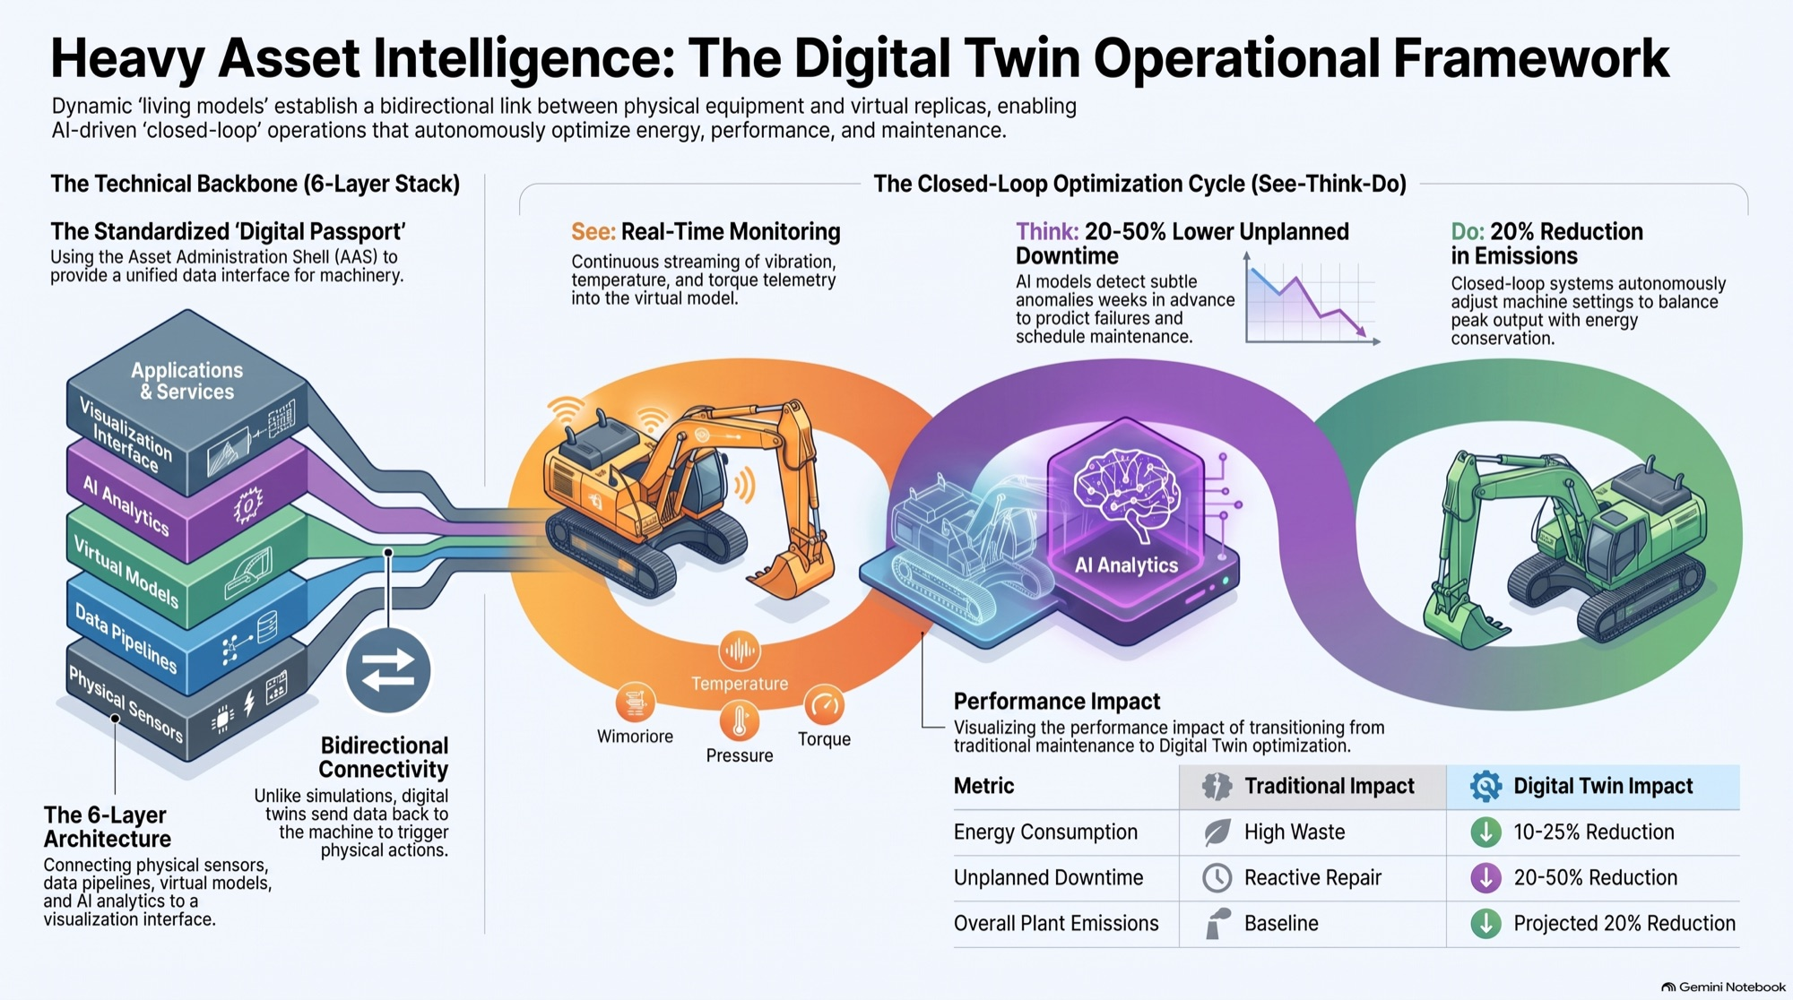
See, Think, Do pays off in energy and emissions
MODULE 04 · THE LOOP IN HEAVY INDUSTRY
10–25%
less energy
See ≈ Observe: vibration, temperature and torque streamed live
20–50%
less unplanned downtime
Think ≈ Orient + Decide: anomalies caught weeks ahead
~20%
lower plant emissions
Do ≈ Act: closed-loop control balances output and energy
Notes:
Heavy industry calls the same loop See, Think, Do, and it pays off: 10 to 25 percent less energy and about 20 percent lower emissions. That is the hinge of this talk. If twins can cut carbon, can they also make AI itself sustainable?

Slide 12
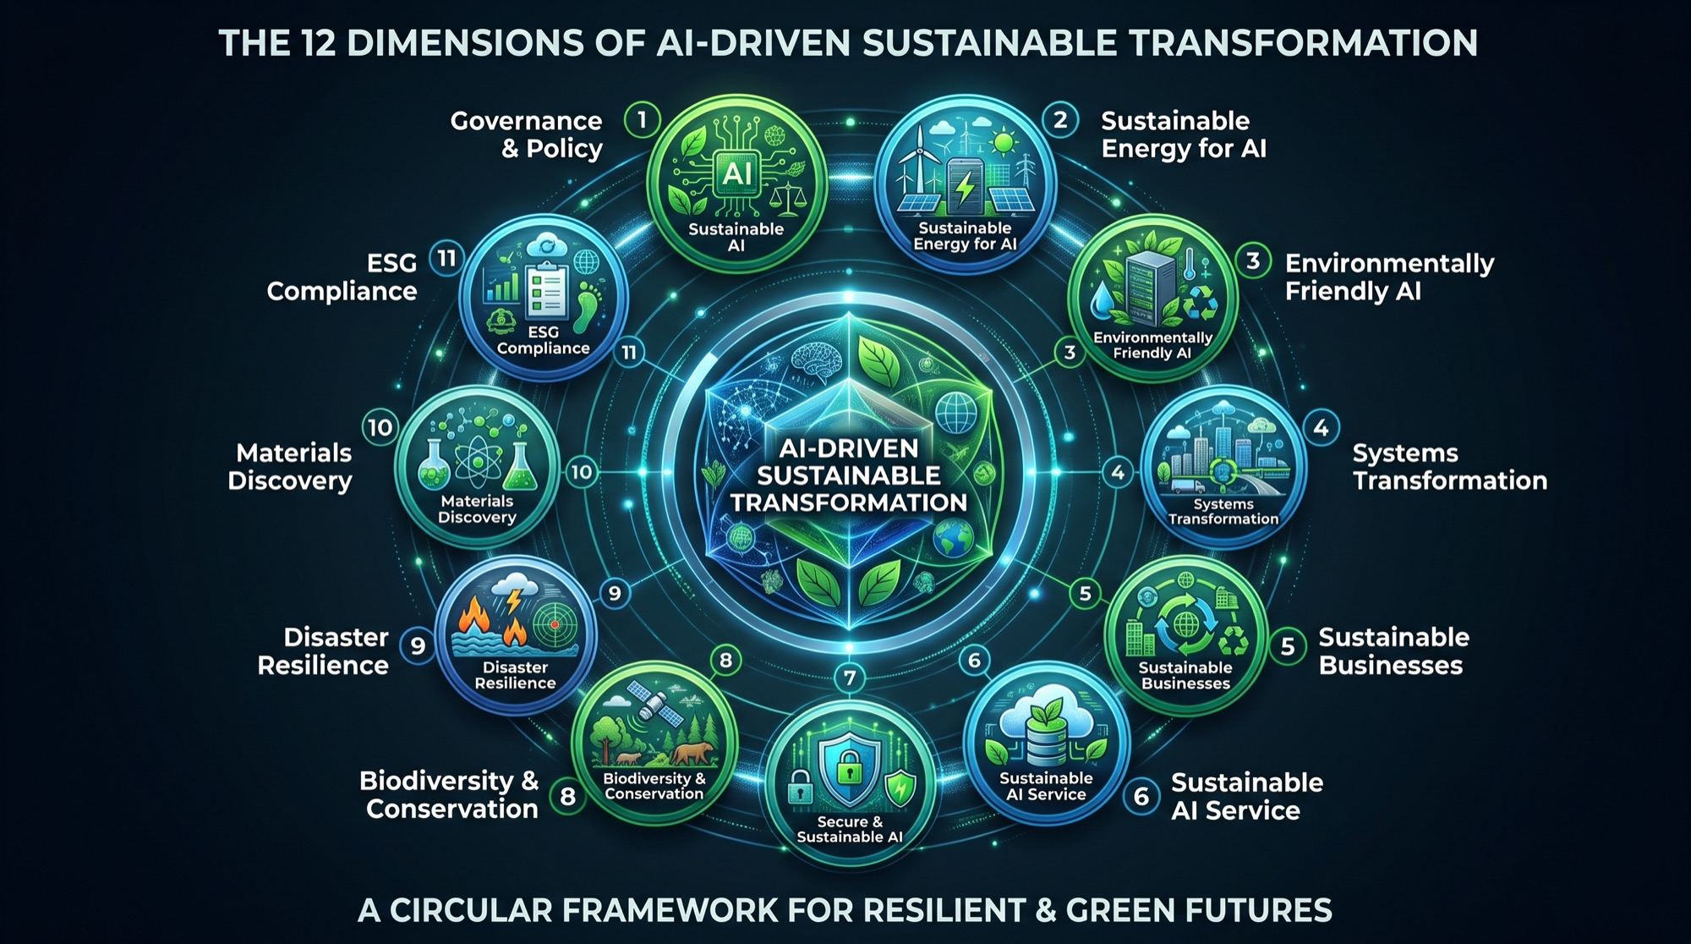
Sustainable AI has two sides of one coin
MODULE 05 · SUSTAINABLE AI
Greening of AI
Dimensions 1–3, 6–7
Shrink the footprint of computing: carbon-free power for data centres, efficient models and hardware, right-sized services, secure infrastructure.
AI for greening
Dimensions 4–5, 8–12
Use AI to transform grids, cities, businesses, ecosystems, climate adaptation, materials science, ESG reporting and policy.
Only doing the second side means running a carbon-neutral factory on a coal-powered brain.
Notes:
This is the uncomfortable part. AI can help save the planet, and AI also burns a great deal of energy doing it. So sustainable AI has two sides of one coin. The first is the greening of AI: shrinking the footprint of computing itself. The second is AI for greening: using AI to transform grids, cities, businesses and ecosystems. If you only do the second, you're running a carbon-neutral factory on a coal-powered brain.

Slide 13
Twelve dimensions, held together by governance
MODULE 05 · THE 12 DIMENSIONS
1
Sustainable AI
2
Sustainable energy for AI
3
Green AI
Ethics, equity and long-term lifecycle
24/7 carbon-free data centres
Distilled, quantized models; liquid cooling
4
Systems transformation
5
Sustainable businesses
6
Sustainable AI services
Grids, traffic and city flows
Circular supply chains, Scope 1–3 cuts
Right-sizing, carbon-aware routing
7
Secure & sustainable AI
8
Biodiversity monitoring ✦
9
Disaster resilience ✦
Defence against poisoning and injection
Satellites and vision guard ecosystems
Hyper-local early warnings
10
Materials discovery ✦
11
ESG compliance ✦
12
Governance & policy ✦
Graph networks for green chemistry
Automated carbon accounting (CSRD, ISSB)
Disclosure, accountability, reskilling
✦ new dimensions (8–12) extending the original seven
Notes:
On the greening side: run data centres on carbon-free power 24 hours a day, and build smaller, distilled, quantized models, cooled in closed loops that save water. For executives, dimension 6 is the practical one: don't send a simple question to the largest model. Right-size it, use carbon-aware routing, and put both in your contracts. Five newer dimensions widen the frame: biodiversity monitoring, early climate warnings, AI-driven materials discovery, and automated ESG accounting. At the core sits governance: without it, the other eleven drift.
For academics: the research gap lies between the two sides. How do we measure the net effect — the carbon an AI saves, minus the carbon it consumes?

Slide 14
Twins make continuity predictive, lean and green
MODULE 06 · SUSTAINABLE CONTINUITY
1
Predictive foresight
Reroute loads before the outage, not after
2
Lean resilience
Stress-test existing capacity instead of idle hot sites
3
Climate-adaptive operations
Model floods, heat and blackouts per site
4
Circular supply chain
Low-carbon rerouting over emergency air freight
5
Cyber-resilient simulation
Rehearse ransomware recovery in a sandbox
6
Human-centric workspace
Resilience has been paid for in carbon. Twins change that bargain.
Safe evacuation, air quality, burnout-free shifts
Notes:
Ask most companies where their business continuity plan is, and someone will find a binder: tested twice a year, built on idle backup data centres and warehouses full of buffer stock. Resilience has been paid for in carbon. An AI digital twin of the enterprise changes that bargain.
Predictive foresight moves the load before anything goes down. Lean resilience replaces the idle hot site with algorithms that stress-test the capacity you already have, cutting idle Scope 2 emissions and cost. Twins test sites against floods, heat and blackouts, and find the rail or sea route before a crisis forces emergency air freight. You can rehearse a ransomware attack in a sandbox. And above all, the twin protects people.

Slide 15
Resilience no longer has to be paid for in carbon
MODULE 06 · CORE VALUE MATRIX
Dimension | Traditional business continuity | AI digital twin sustainable continuity
Strategy | Reactive incident response and post-event recovery | Predictive, autonomous stress-testing and prevention
Asset redundancy | Carbon-intensive idle hardware and excess stock | Dynamic, software-orchestrated resource sharing
Testing | Disruptive, semi-annual tabletop exercises | Continuous, non-intrusive 24/7 digital simulation
Environmental cost | High-emission emergency pivots (e.g. air freight) | Carbon-optimized routing and microgrid-aware failover
Notes:
Here is the whole argument in four rows. Reactive becomes predictive. Idle hardware becomes shared, orchestrated resources. A test twice a year becomes simulation 24 hours a day, 7 days a week. Emergency air freight becomes carbon-optimized rerouting.

Slide 16
Rehearse the future before you live it
To the executives
CLOSE · CALL TO ACTION
Pick one asset or process this quarter and give it a twin with a single measurable goal: downtime, energy or carbon.
To the academics
Help measure the net effect: the carbon AI saves minus the carbon it costs.
In 1970 a copy on the ground brought three people home. Today the stakes are a grid, a city, a supply chain and a climate.
Gökhan Tenekecioglu
Thank you. Scan to connect on LinkedIn
Notes:
Let's go back to April 1970. Three people came home because a team on the ground had a copy they could break safely. Today the stakes aren't one spacecraft. They're a power grid, a city, a supply chain and a climate, and the AI we're building to run them. We can't afford to learn by failing in the real world anymore. So my message is short: rehearse the future before you live it.
To the executives: pick one asset or one process this quarter, and give it a twin with a single measurable goal. To the academics: help us measure the net effect — the carbon AI saves minus the carbon it costs. I'd love to keep the conversation going. Scan the code to connect on LinkedIn. Thank you.

