Slide 1
Algorithms: Group 6
David Arredondo, Sophie Beiers, Huijun Cui, Richard Shin, Shan Zhong

Slide 2
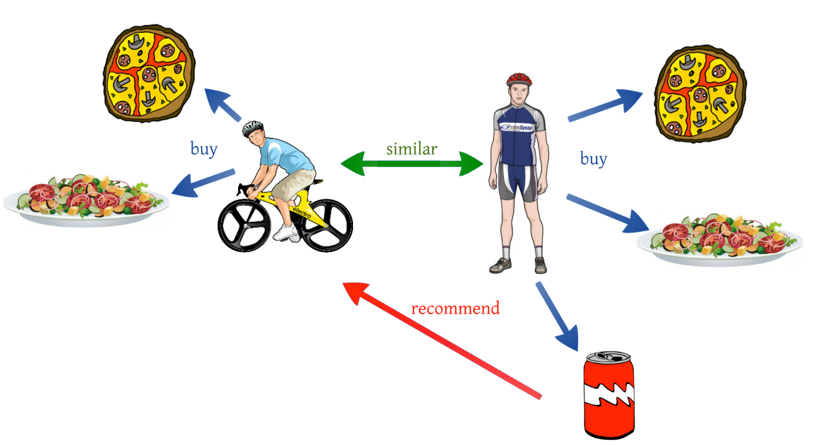
Collaborative Filtering

Slide 3




Collaborative Filtering
An automated way to make predictions about user A that utilizes collective interests and preferences from similar users. Ultimately; able to recommend something user A might like.
this or… that?
this or... that?

Slide 4

Purpose of Project: Datasets
Microsoft Web Data
4151 users, total of 33,875 vroots visited
Binary 1’s, 0’s for each vroot
EachMovie Data
5055 users rated 1597 movies
Ratings from 1-6

Slide 5
Purpose of Project: Models
Build two collaborative filtering algorithms:
Model-based clustering algorithm (EM algorithm)
Memory-based algorithm
Consider different similarity weights for memory-based model:
Spearman, Pearson, vector similarity, entropy, mean-square difference and SimRank
Compare prediction accuracies and trade-offs

Slide 6
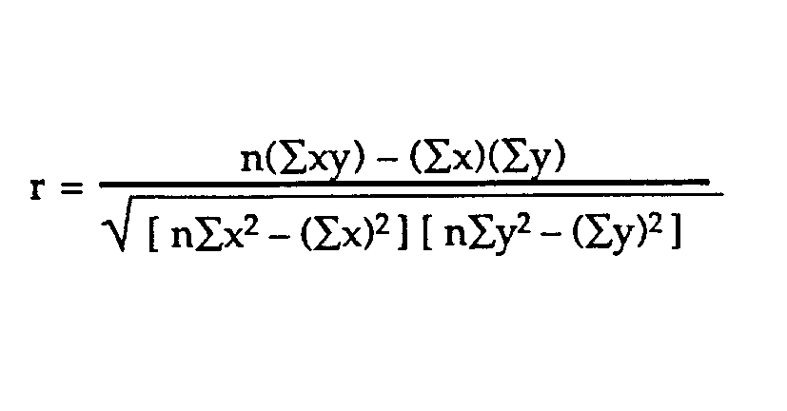
Memory-based Model
Generate prediction based on user A’s similar neighbors’ preferences and scores.
Calculate correlation/similarity weights between users and take weighted average of all users for prediction.

Slide 7
Memory-based Model
**** Huijun & Shan, something here?

Slide 8
Unique Component: Rating Normalization
**** Huijun & Shan, something here?

Slide 9
Model-based: EM Algorithm
Expectation Step
**** David, something here
2. Maximization Step
**** David, something here

Slide 10
Memory-based Predictions
MAE
**** Huijun & Shan, something here?
ROC
**** Huijun & Shan, something here?

Slide 11
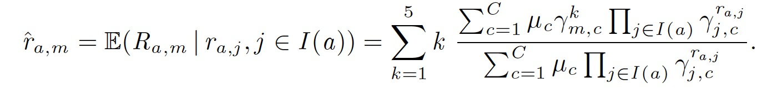
EM Predictions
Wrote EM Predictor function based on:
Idea: Transform soft assignments into hard assignments of clusters; , the prediction is a weighted avg. of the rating values weighted by the gamma probabilities of being in that cluster.

