Slide 1




Redefining Education
for the AI Generation
An AI-powered EdTech platform that diagnoses, guides, and supports every learner individually.
Bridging academic mastery, mental wellness, and career readiness in one seamless ecosystem.
A Personalized, Holistic AI Learning Companion for K12 and Beyond
Group A
Zhu Xinyi
Tu Che Wei
Guan Yongjie
Mak Sui Ling Angela
Built for Gen Z & Alpha students, trusted by teachers, transparent to parents.

Slide 2
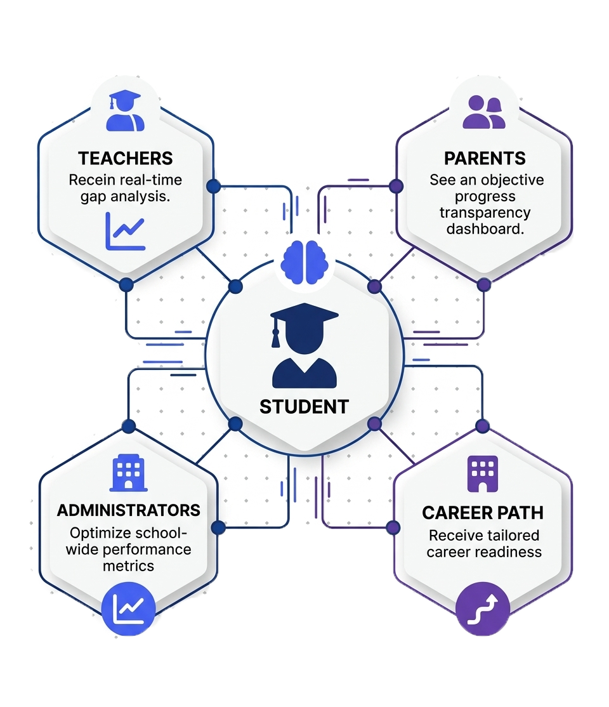
TARGET CUSTOMERS
A Multi-Stakeholder
Ecosystem

Slide 3
THE PROBLEM
The Engagement-Wellbeing Gap in EdTech
Rigid & Impersonal Tools
EdTech often mimics textbooks—rigid and impersonal, causing students to disengage.
Overwhelmed Teachers
Academic Shame
Teachers get scores without clear, qualitative insight into student misunderstandings.
Students withdraw when they feel judged, choosing avoidance over focused help.
High-Stakes Stress
Undetected Mental Health Crises
High-stakes exams raise anxiety without offering targeted, 1-on-1 support.
Early warning signs of mental health issues are missed by current tools.

Slide 4





PRODUCT WORKFLOW
How the Personalized AI Works
3. Interaction
AI-student dialogue for reasoning-based problem solving.
2. Roadmap
4. Monitoring
Dynamic path generation tailored to student mastery levels.
Real-time data visualization for parents and teachers.
1. Diagnostic
5. Intervention
Short tests pinpoint specific knowledge gaps and misconceptions.
Automatic alerts triggered by detected linguistic distress.

Slide 5






VALUE PROPOSITIONS
Five Pillars of Differentiation
Deep Diagnostic Insights
Contextualized Mastery
Invisible Safety Net
Dialogue analysis reveals exactly where logic breaks down, moving beyond simple score tracking.
Cultural localization and relatable references make complex academic concepts "sticky" and exam-ready.
Pioneering early intervention by detecting linguistic distress markers and bridging students to counselors.
Teacher Superpowers
Non-Punitive Environment
Proactive, data-driven identification of who is struggling and exactly why, enabling highly targeted 1-on-1 support in crowded classrooms.
A safe-to-fail AI persona reduces academic shame, encouraging students to persist through difficult subjects they might otherwise abandon.

Slide 6
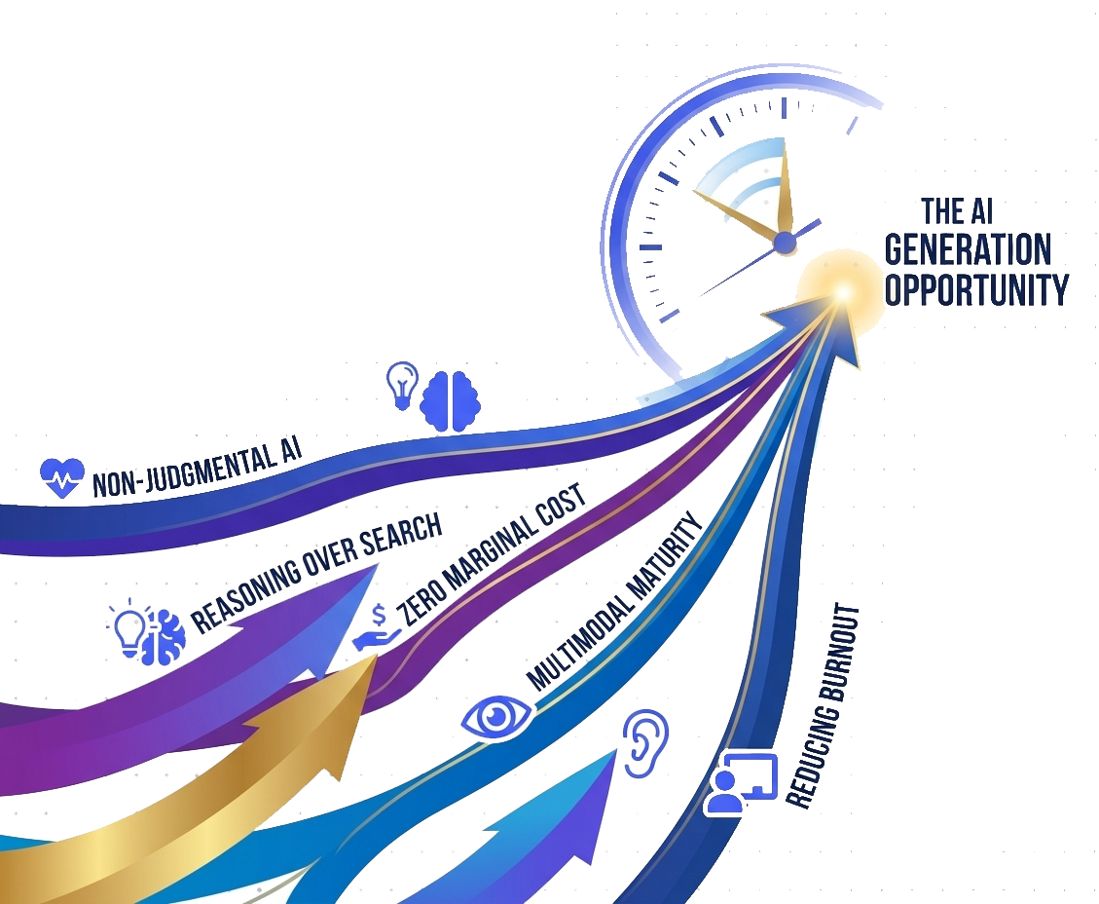





Non-Judgmental AI
WHY NOW?
LLMs create a psychologically safe space for reserved learners to ask questions without fear of judgment.
Five Macro
Tailwinds Converging
Reasoning Over Search
The shift to LLM-powered reasoning allows AI to guide students through the logic of solving problems.
Zero Marginal Cost
Elite 1-on-1 personalized tutoring expertise is now accessible at near-zero incremental cost.
Multimodal Maturity
AI can now "see" sketches and "hear" emotional cues, intervening like a human mentor would.
Reducing Burnout
Automating grading and reporting empowers teachers to refocus on high-impact mentorship.

Slide 7







KEY RESOURCES & DATA
Our Moat in the Making
Proprietary Data Assets
Regulatory Compliance
Hong Kong (Compliance & Privacy)
Structural Knowledge Graph
Modeled from high-school curricula to capture student reasoning.
PCPD Privacy Audit:
Alignment with AI Model Personal Data Framework.
EdCity Integration:
Technical gateway for local school access.
HKSTP/Cyberport Endorsement:
Official institutional backing.
Textbook & Exercise Dataset
Curated step-by-step problem-solving material.
Mainland China (Pre-Approval)
ICP License & Filing:
Basic internet operation permit.
Education App Filing (MoE):
Mandatory MoE registration.
Learning Behavior Feedback Loop
AI Algorithm Filing (CAC):
Generative AI compliance.
Error-pattern analysis and interaction signals for model tuning.
MLPS Level 3:
Cybersecurity certification for schools.

Slide 8

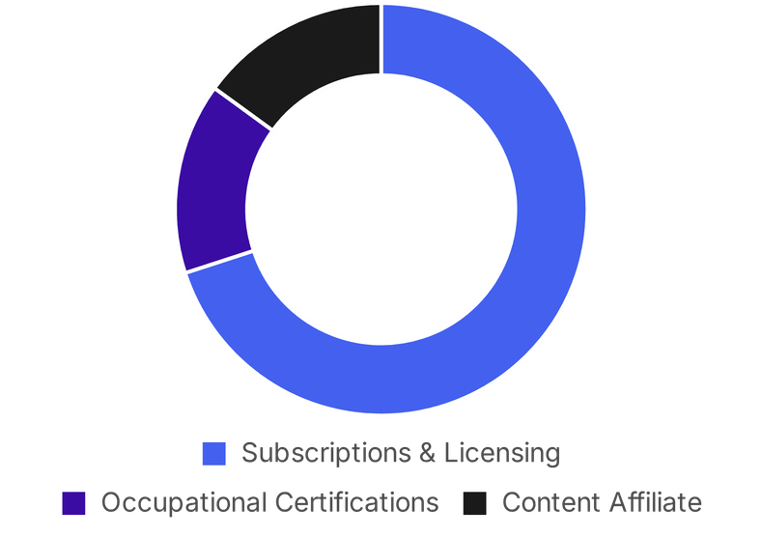




REVENUE MODEL
Diversified, Scalable, Sticky
Subscriptions & Licensing
70%
K12 B2C Freemium (monthly premium for Roadmap Tracking & AI tutoring) and B2B institutional SaaS licensing.
Occupational Certifications
15%
One-time fees for focused skill tracks (e.g., Python).
Content Affiliate Partnerships
15%
Commissions from recommending textbooks, courses, or hardware.
Strategic Advantages
Freemium-to-Premium funnel
for low-friction acquisition.
High switching costs
through verified learning history.

Slide 9




COMPETITIVE LANDSCAPE
We Own the Full Learning Arc
The Fragmented Market
Our Competitive Moat
Khan Academy (Khanmigo)
Seamless Transition
Massive K12 footprint, but lacks career roadmaps and mental health layers.
We own learner data from age 10 to 25 — no competitor spans this entire developmental arc.
Duolingo Max
Gold standard gamification, but restricted to language learning.
Data Portability Lock-in
Years of verified learning history create massive switching costs for users.
Coursera / Udemy AI Coach
Strong in occupational skills, but no K12 foundational entry point.
Industry Endorsement
Occupational roadmaps endorsed by tech companies create value-driven lock-in.
Traditional Tutoring Centers
High parental trust, but high cost and no real-time data roadmap.
Mental Health Integration
School Career Counselors
The platform combining academic AI tutoring with emotional early-warning systems.
Human empathy, but overworked and lack tech-driven mapping tools.

Slide 10
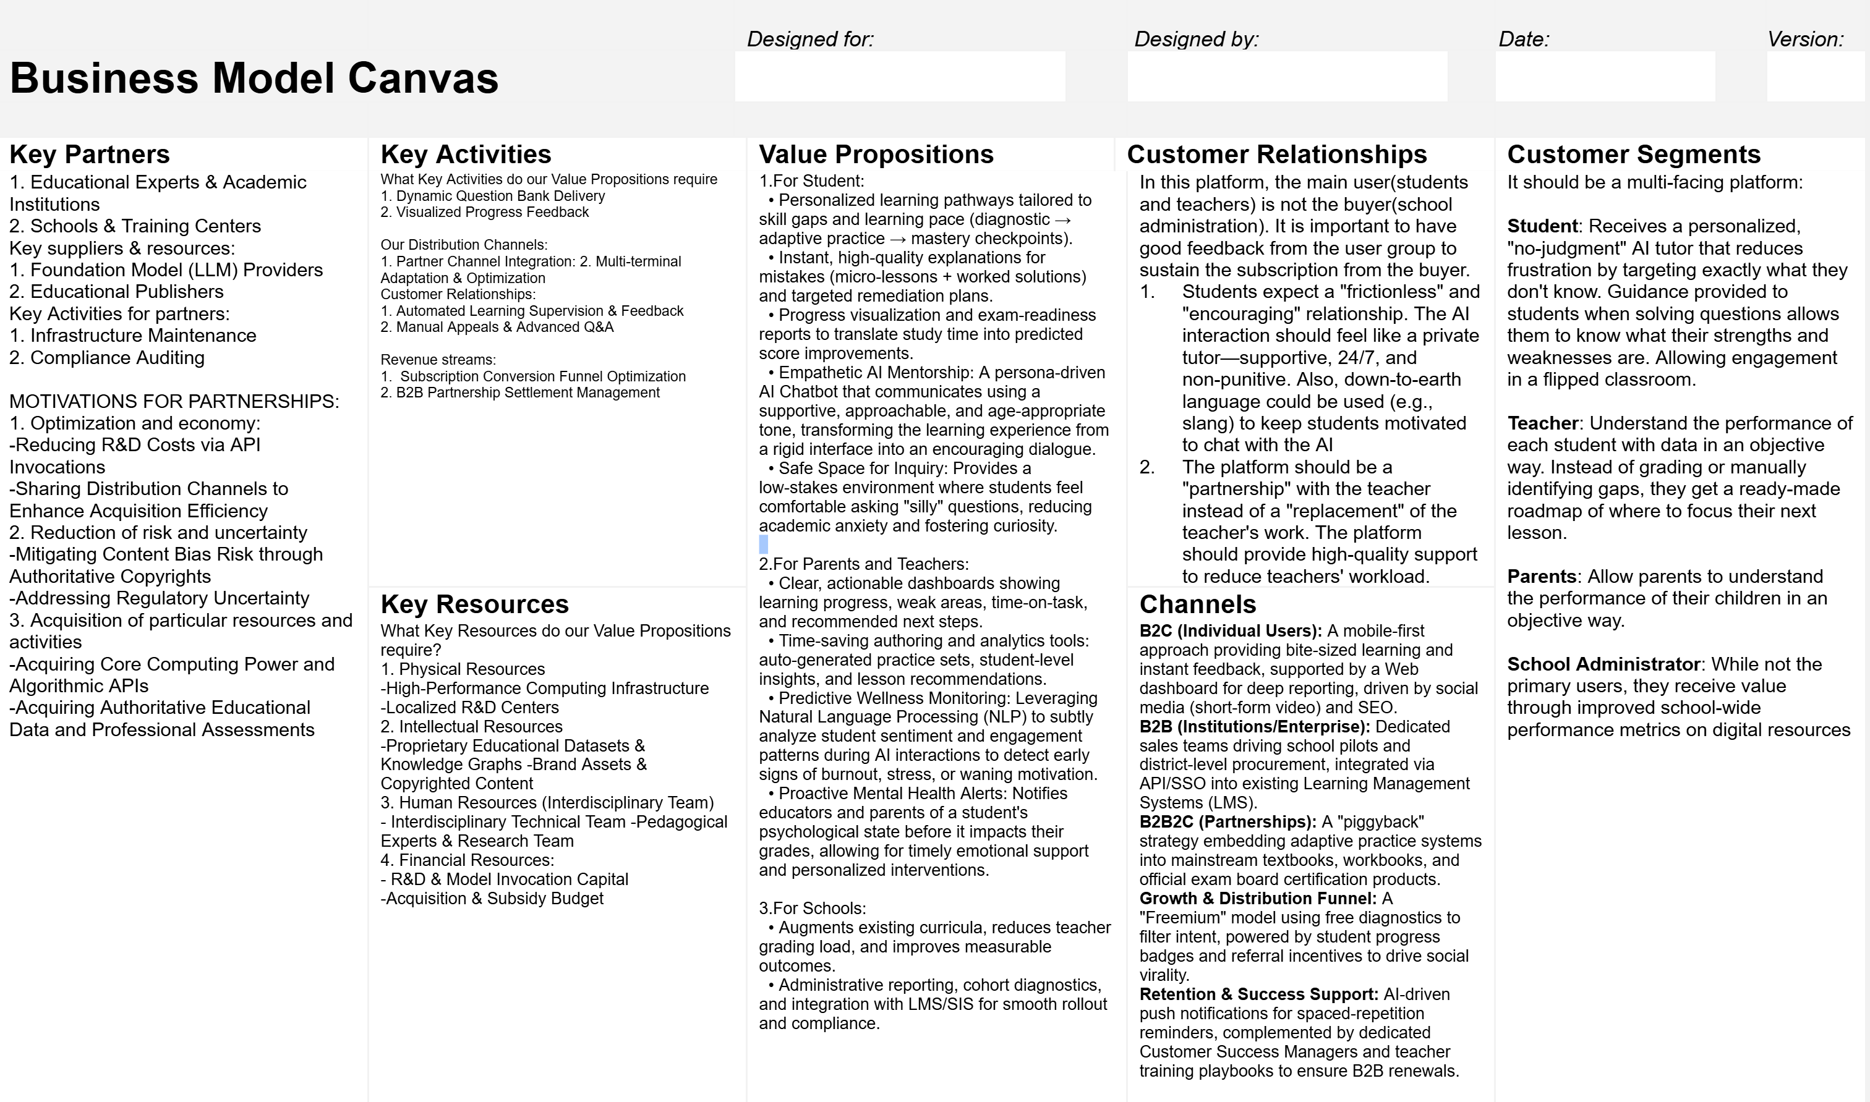
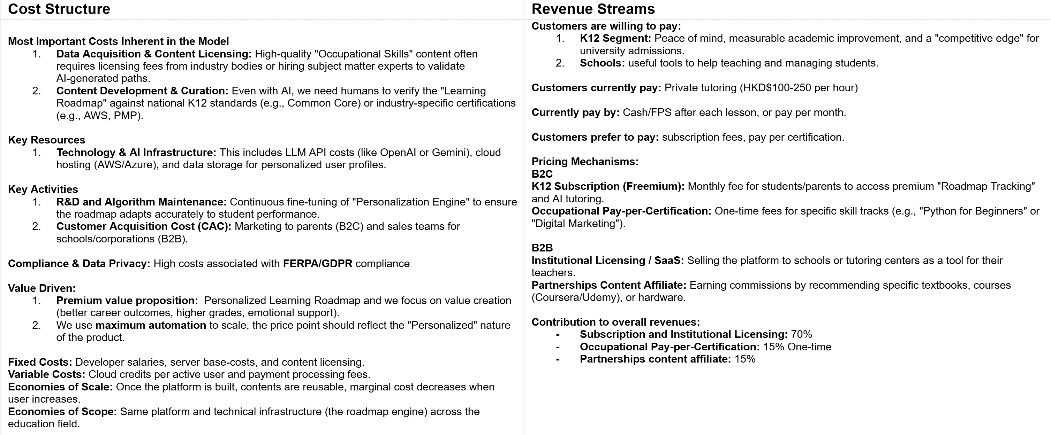
Business Model Canvas

Slide 11







CALL TO ACTION
Every Student. Every Path. Every Potential.
We are seeking strategic partners and investors to accelerate platform development, regulatory compliance, and market entry in Hong Kong and Mainland China. Join us in shaping the future of learning.
Next Steps
Get in Touch
Product demo upcoming
Ready to redefine education for the AI generation? Let's connect.
Pilot school partnerships in discussion
Regulatory roadmap in progress
Email

