Slide 1
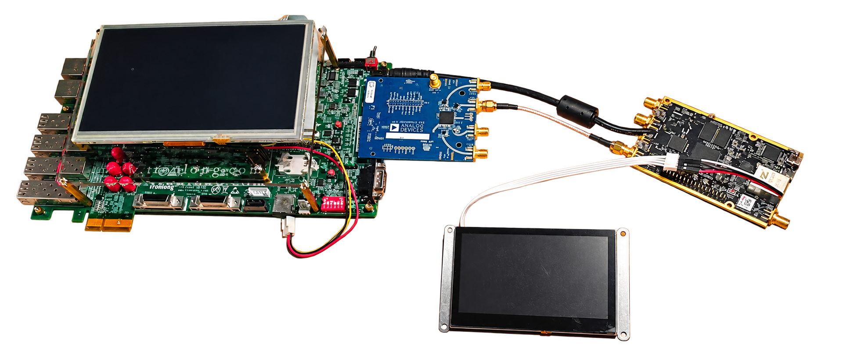

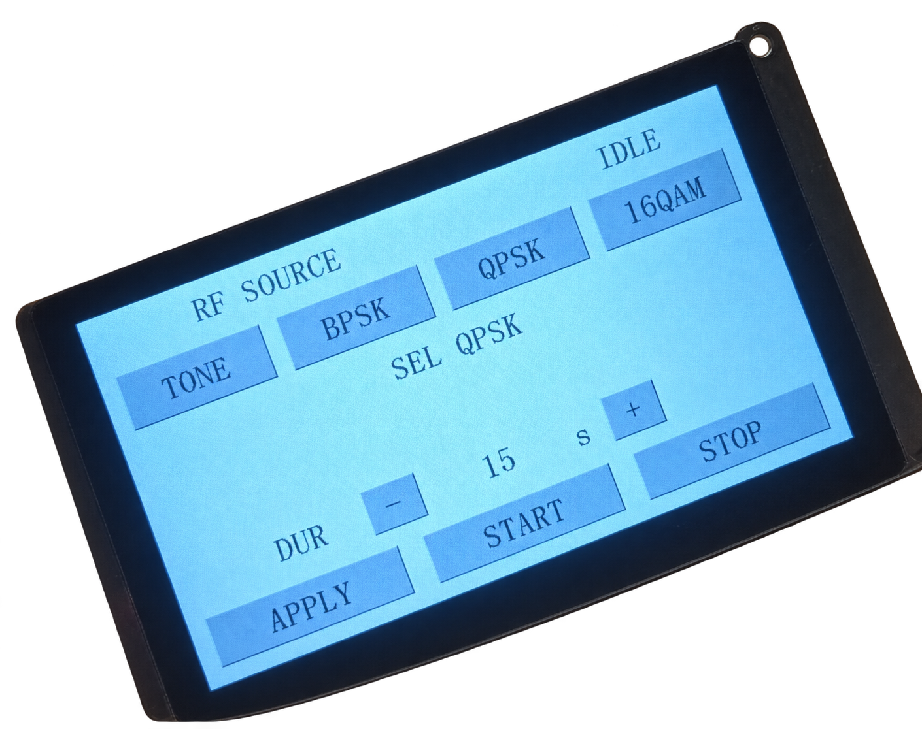
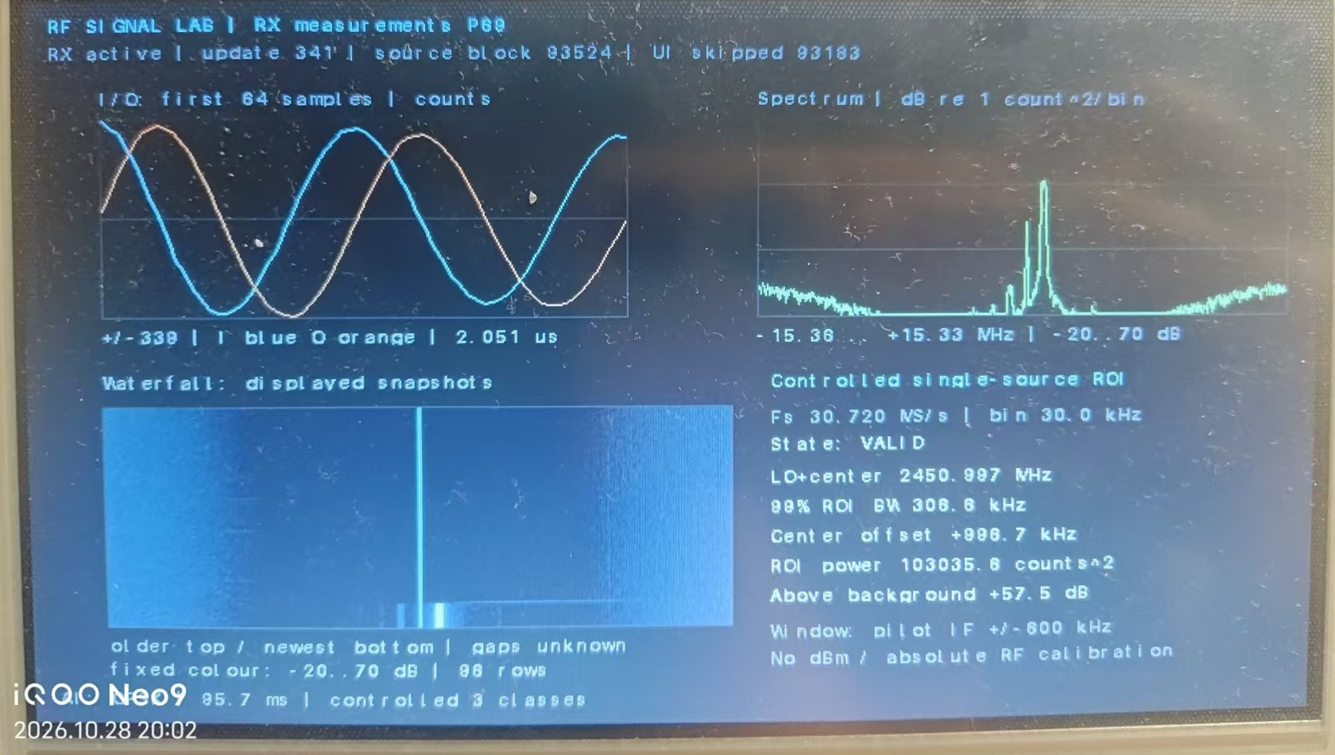
Zynq AI Signal Recognition System
INTRODUCTION
Control LCD and PC relay, calibration and archive
P201 / XC7Z020 and AD9361 transmitter
Tested on AMD Zynq-7000 boards
For channel selection and link troubleshooting in factories and live venues, the system combines RF detection, parameter analysis and modulation recognition. Channel-quality assessment is an application design.
Coaxial attenuation: TX1 to RX1A
C
R
TLZ7xH / XC7Z100: AD9361, PL and DMA
R
E
E
S
›
›
›
ARM: FFT / ROI / 115-parameter INT8 CNN
A
T
U
Touch control
Timed TX
RF receiver
LCD display
7-inch LCD: I/Q, spectrum, waterfall and labels
I
L
Controlled prototype
V
T
System Architecture
E
Application design
Channel selection: compare occupancy and background, then inspect a reference signal under matched settings.
Link troubleshooting: compare signal strength, spectrum and background changes to guide checks for attenuation or interference.
Quality assessment is a proposed method. Automatic software and field validation remain future work.
Implementation and verification
PL handles RF I/O, DMA and display. ARM runs FFT, ROI estimation and a 115-parameter INT8 CNN.
30.72 MS/s, 1024-point FFT, 30 kHz bins.
Python / C / ARM numerical checks. FIR skill: 11 recorded checks.
Receiver and On-board Analysis:
TLZ7xH / XC7Z100 and AD9361.
PL: RF, AXI-DMA and VDMA / DRM paths.
ARM: front end, FFT, ROI and a 115-parameter CNN.
The 7-inch LCD shows I/Q, spectrum, waterfall and recognition results.
D
Frozen INT8 recognition: 52/54 independent real RF frames, with 96.30% accuracy across BPSK, QPSK and 16QAM. ARM processing takes about 22.5 ms/block, excluding capture, I/O and display.
Separate FIR timing at 100 MHz: WNS improved from −5.153 ns to +1.866 ns. Its reusable verification skill contains 11 recorded checks.
Tests use fixed RF settings and a coaxial link. Later eight-phase demo regression is separate. FIR is not integrated into the deployed ADC path. Absolute power remains uncalibrated.
E
S
I
G
N
Transmitter and Control:
P201 / XC7Z020 and AD9361.
Tone, BPSK, QPSK and 16QAM.
PC relay with timed TX and START / STOP.
Notes:
作品名称：Zynq 的信号AI识别系统。English: Zynq AI Signal Recognition System. Platform: Zynq-7000 and AD9361.
Technical source: Zynq 的信号AI识别系统 design report, submission edition 2026-11-02. Channel-quality assessment is an application design, without deployed automatic software or field validation. Original frozen INT8 independent test: 52/54 frames (96.30%). ARM algorithm chain approximately 22.5 ms/block, excluding capture, I/O and display. Later eight-phase inference regression is separate. FIR is separately verified and not integrated into the deployed ADC path. OOC FIR WNS before/after: -5.153 ns / +1.866 ns at 100 MHz. Eleven recorded skill checks.
Photographs: supplied report word/media/rf_image2.jpg, rf_image4.jpg and rf_image8.jpg. Background extraction used for the hardware and control display. Receiver screen content is unchanged.
Repository: https://github.com/GUAcr7/rf-signal-lab

