Slide 1
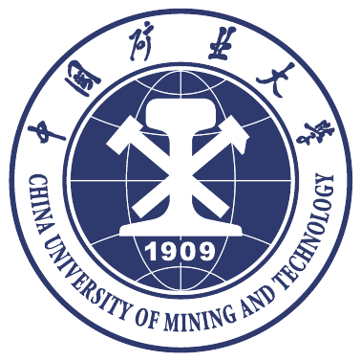
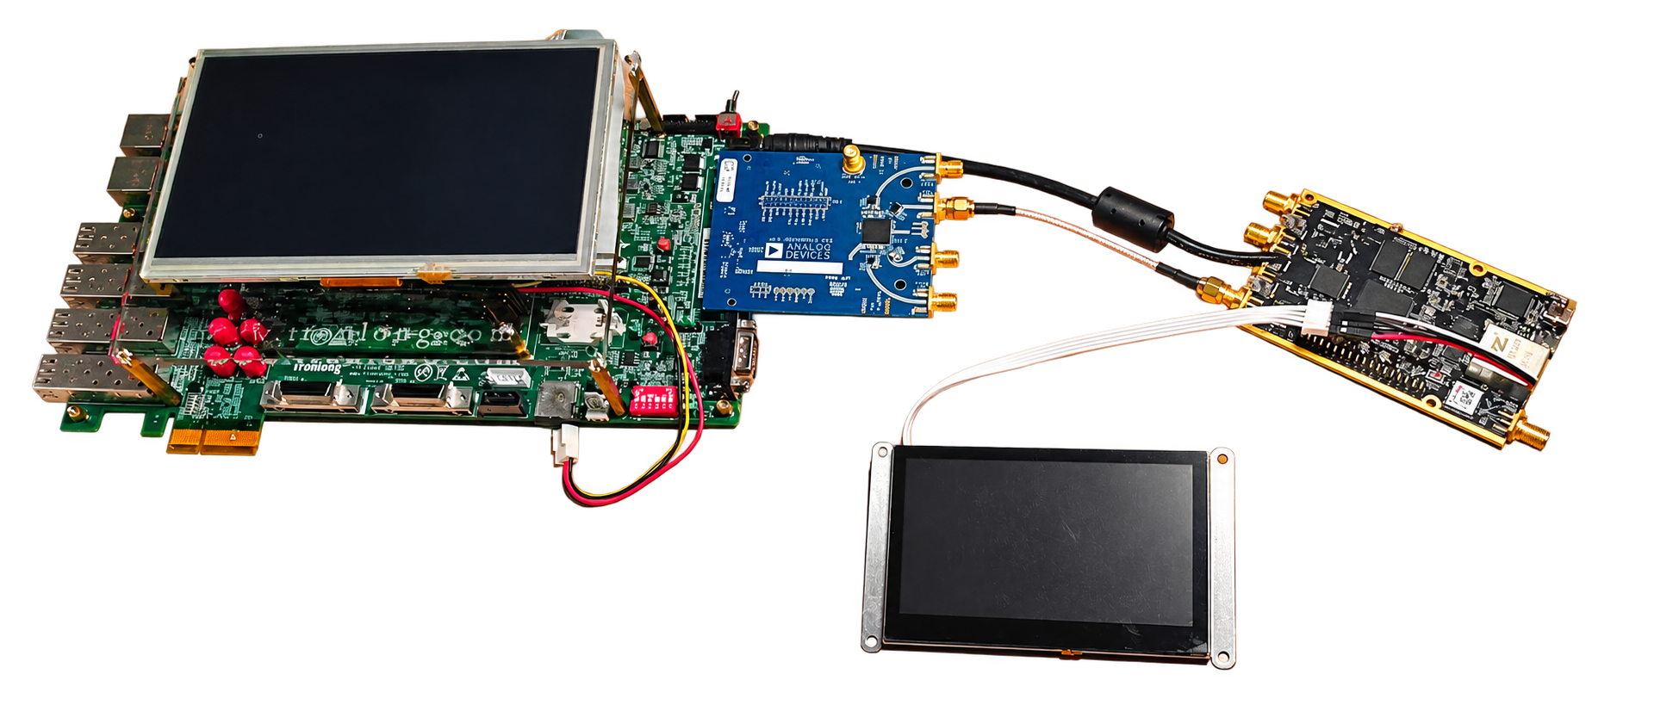

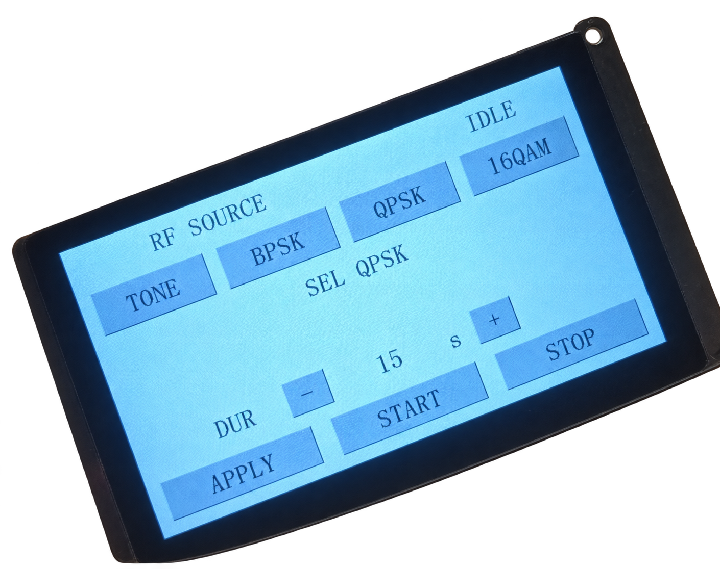
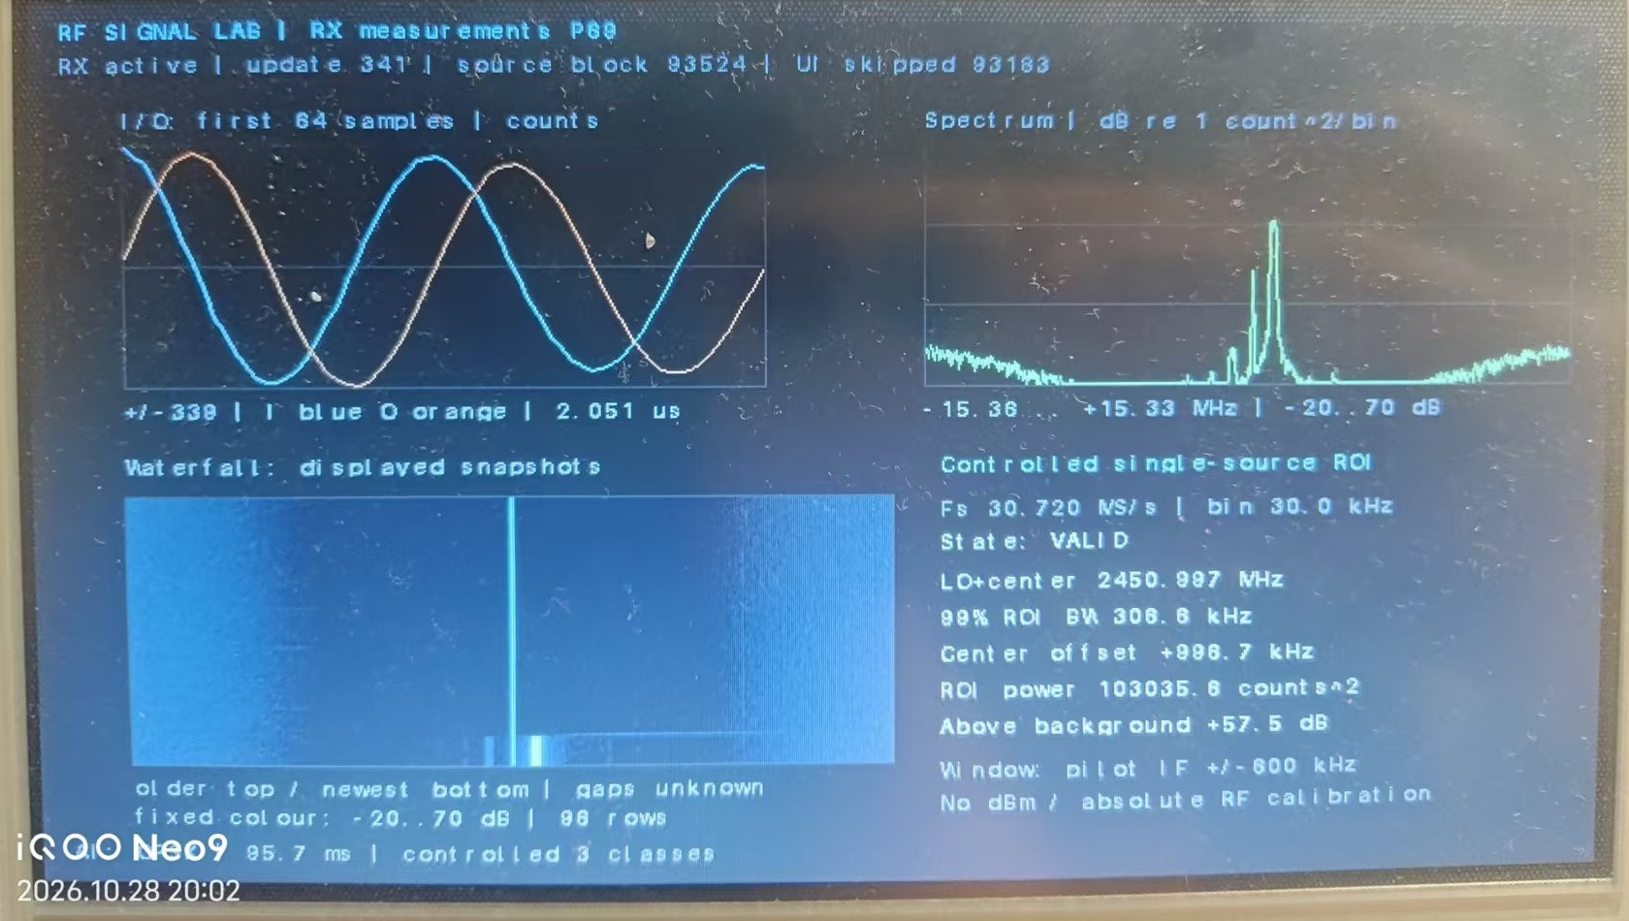
广泽放 黄冠 刘昌帅
Zynq 的信号AI识别系统
芯芯向荣队
中国矿业大学
作品简介
控制屏 + PC 中转、校准与归档
P201 / XC7Z020 + AD9361 发射
AMD Zynq-7000 双板实测平台
面向工厂与演出现场的选信道和通信排障需求，
整合射频检测、参数分析与三类调制识别，
并提出基于观测参数的信道质量分析方案。
同轴衰减链：TX1 至 RX1A
创
结
TLZ7xH / XC7Z100：AD9361、PL、DMA
新
果
设
与
›
›
›
ARM：FFT / ROI / 115 参数 INT8 CNN
计
验
触屏控制
受控发射
射频接收
板端显示
7 英寸 LCD：I/Q、频谱、瀑布图、识别
证
受控原型验证
系统架构
应用场景与分析方案
选信道：观察候选频段的背景与占用，再在同设置下比较参考信号的稳定性。
通信排障：对照目标强弱、频谱与背景变化，为衰落或干扰排查提供线索。
质量评估为分析方案，自动程序与现场验证尚未完成。
技术实现与验证
PL 承担射频接口、DMA 与显示。ARM 完成前端、FFT、ROI 与 115 参数 CNN。
30.72 MS/s 采样，1024 点 FFT，30 kHz 间隔。
INT8 量化，Python / C / ARM 逐值核对。
FIR 验证技能包已留存 11 项检查记录。
接收与板端分析：
TLZ7xH / XC7Z100 + AD9361。
PL：射频接口、AXI-DMA 与 VDMA / DRM。
ARM：前端、FFT、ROI 与 115 参数 CNN。
7 英寸 LCD 同屏显示 I/Q、频谱、瀑布图与识别结果。
系
冻结 INT8 模型在 54 帧独立真实 RF 测试中正确 52 帧，准确率 96.30%，覆盖 BPSK、QPSK 和 16QAM。ARM 算法链约 22.5 ms/块，不含采集、I/O 与显示。
独立 FIR 在 100 MHz 下优化，WNS 由 −5.153 ns 改善至 +1.866 ns。验证技能包已留存 11 项检查记录。
测试使用固定参数与同轴衰减链。后续八相位演示回归与独立测试分别报告。FIR 尚未接入整机 ADC 通路，绝对功率未标定。
统
实
现
发送与交互控制：
P201 / XC7Z020 + AD9361。
单音、BPSK、QPSK、16QAM。
PC 中转，支持限时发射与人工启停。
Notes:
作品名称：Zynq 的信号AI识别系统。English: Zynq AI Signal Recognition System. Platform: Zynq-7000 and AD9361.
Team: 芯芯向荣队 (Xinxin Xiangrong). Full member names: 广泽放 (Zefang Guang), 黄冠 (Guan Huang), 刘昌帅 (Changshuai Liu). Institution: 中国矿业大学 (China University of Mining and Technology).
Technical source: Zynq 的信号AI识别系统 design report, submission edition 2026-11-02. Channel-quality assessment is an application design, without deployed automatic software or field validation. Original frozen INT8 independent test: 52/54 frames (96.30%). ARM algorithm chain approximately 22.5 ms/block, excluding capture, I/O and display. Later eight-phase inference regression is separate. FIR is separately verified and not integrated into the deployed ADC path. OOC FIR WNS before/after: -5.153 ns / +1.866 ns at 100 MHz. Eleven recorded skill checks.
Official CUMT emblem: https://xgc.cumt.edu.cn/__local/3/3B/CB/F3833CC99C9D0095E53E957862E_D3C472C9_43ED3D.pdf , page 4 (printed page 2). University identity: https://www.cumt.edu.cn/xxgk/kdzc1/xywhybs.htm . Original emblem artwork retained.
Photographs: supplied report word/media/rf_image2.jpg, rf_image4.jpg and rf_image8.jpg. Background extraction used for the hardware and control display. Receiver screen content is unchanged.
Repository: https://github.com/GUAcr7/rf-signal-lab

Slide 2
Z. Guang, G. Huang, C. Liu
Zynq AI Signal Recognition System
Xinxin Xiangrong Team
China University of Mining
and Technology
INTRODUCTION
Control LCD and PC relay, calibration and archive
P201 / XC7Z020 and AD9361 transmitter
Tested on AMD Zynq-7000 boards
For channel selection and link troubleshooting in factories and live venues, the system combines RF detection, parameter analysis and modulation recognition. Channel-quality assessment is an application design.
Coaxial attenuation: TX1 to RX1A
C
R
TLZ7xH / XC7Z100: AD9361, PL and DMA
R
E
E
S
›
›
›
ARM: FFT / ROI / 115-parameter INT8 CNN
A
T
U
Touch control
Timed TX
RF receiver
LCD display
7-inch LCD: I/Q, spectrum, waterfall and labels
I
L
Controlled prototype
V
T
System Architecture
E
Application design
Channel selection: compare occupancy and background, then inspect a reference signal under matched settings.
Link troubleshooting: compare signal strength, spectrum and background changes to guide checks for attenuation or interference.
Quality assessment is a proposed method. Automatic software and field validation remain future work.
Implementation and verification
PL handles RF I/O, DMA and display. ARM runs FFT, ROI estimation and a 115-parameter INT8 CNN.
30.72 MS/s, 1024-point FFT, 30 kHz bins.
Python / C / ARM numerical checks. FIR skill: 11 recorded checks.
Receiver and On-board Analysis:
TLZ7xH / XC7Z100 and AD9361.
PL: RF, AXI-DMA and VDMA / DRM paths.
ARM: front end, FFT, ROI and a 115-parameter CNN.
The 7-inch LCD shows I/Q, spectrum, waterfall and recognition results.
D
Frozen INT8 recognition: 52/54 independent real RF frames, with 96.30% accuracy across BPSK, QPSK and 16QAM. ARM processing takes about 22.5 ms/block, excluding capture, I/O and display.
Separate FIR timing at 100 MHz: WNS improved from −5.153 ns to +1.866 ns. Its reusable verification skill contains 11 recorded checks.
Tests use fixed RF settings and a coaxial link. Later eight-phase demo regression is separate. FIR is not integrated into the deployed ADC path. Absolute power remains uncalibrated.
E
S
I
G
N
Transmitter and Control:
P201 / XC7Z020 and AD9361.
Tone, BPSK, QPSK and 16QAM.
PC relay with timed TX and START / STOP.
Notes:
作品名称：Zynq 的信号AI识别系统。English: Zynq AI Signal Recognition System. Platform: Zynq-7000 and AD9361.
Team: 芯芯向荣队 (Xinxin Xiangrong). Full member names: 广泽放 (Zefang Guang), 黄冠 (Guan Huang), 刘昌帅 (Changshuai Liu). Institution: 中国矿业大学 (China University of Mining and Technology).
Technical source: Zynq 的信号AI识别系统 design report, submission edition 2026-11-02. Channel-quality assessment is an application design, without deployed automatic software or field validation. Original frozen INT8 independent test: 52/54 frames (96.30%). ARM algorithm chain approximately 22.5 ms/block, excluding capture, I/O and display. Later eight-phase inference regression is separate. FIR is separately verified and not integrated into the deployed ADC path. OOC FIR WNS before/after: -5.153 ns / +1.866 ns at 100 MHz. Eleven recorded skill checks.
Official CUMT emblem: https://xgc.cumt.edu.cn/__local/3/3B/CB/F3833CC99C9D0095E53E957862E_D3C472C9_43ED3D.pdf , page 4 (printed page 2). University identity: https://www.cumt.edu.cn/xxgk/kdzc1/xywhybs.htm . Original emblem artwork retained.
Photographs: supplied report word/media/rf_image2.jpg, rf_image4.jpg and rf_image8.jpg. Background extraction used for the hardware and control display. Receiver screen content is unchanged.
Repository: https://github.com/GUAcr7/rf-signal-lab

