Slide 1

Introduction
Course Details
Motivation
Accessing the Lab Material
German University in Cairo
[CSEN 911] Data Mining
Tutorial 1
Course Instructor: Dr.Ayman Alserafi
ayman.alserafi@guc.edu.eg
Faculty of Management Technology
Department of Business Informatics & Operations Management German University in Cairo
Winter 2025
Tutorial 1

Slide 2
Introduction Course Details Motivation
Accessing the Lab Material
German University in Cairo
Outline
Introduction
Course Details
Motivation
Accessing the Lab Material
Tutorial 1

Slide 3
Introduction Course Details Motivation
Accessing the Lab Material
German University in Cairo
Introduction - TAs
Tameem Alghazaly
Email Office
Office Hours
Day-off
tameem.alghazaly@guc.edu.eg
B1.320
Monday 5th or by appointment Saturday
Nada Bakeer
Email Office
Office Hours
Day-off
nada.mohyudeen@guc.edu.eg
B1.320
Monday 3rd or by appointment Saturday
Tutorial 1

Slide 4
Introduction Course Details Motivation
Accessing the Lab Material
German University in Cairo
Introduction - TAs
Abdullah Khodary
Email Office
Office Hours
Day-off
abdullah.farag@guc.edu.eg
B1.322
Tuesday 3rd or by appointment Saturday
Sherifa Hammoud
Email Office
Office Hours
Day-off
sherifa.khaled@guc.edu.eg
B1.322
by appointment
Saturday
Tutorial 1

Slide 5
Introduction Course Details Motivation
Accessing the Lab Material
German University in Cairo
Introduction - TAs
Farah Bashir
Email Office
Office Hours
Day-off
farah.bashir@guc.edu.eg
B1.320
Sunday 4th or by appointment Saturday
Tutorial 1

Slide 6
German University in Cairo
Introduction Course Details Motivation
Accessing the Lab Material
Course Assessment
Assessment Method | Weight | Remarks
Quizzes | 10% | Best 2 out of 3
Lab Work – 3 Mini Projects | 20% | Groups of 2
Midterm Exam | 30%
Final Exam | 40%
Total | 100%
Tutorial 1

Slide 7
Introduction Course Details Motivation
Accessing the Lab Material
German University in Cairo
Why Study Data Mining/Data Science?
One of the most demanded jobs in recent times due to digitization and explosive data growth!
Extract useful insights from large amounts of data
Enable up-to-date data-driven decision making
Many different application areas you can choose from based on your personal interest: business, energy, government, healthcare, intelligence and security, logistics, etc.
Tutorial 1

Slide 8
Introduction Course Details Motivation
Accessing the Lab Material
German University in Cairo
Job titles related to the field
Analytics Engineer
Analytics Manager
Big Data Engineer
Business Analyst
Data Architect
Data Analyst
Data Engineer
Data Scientist
Data Visualization
Specialist
Business Intelligence (BI)
Architect
Business Intelligence
Engineer
Business Intelligence
Specialist
Tutorial 1

Slide 9
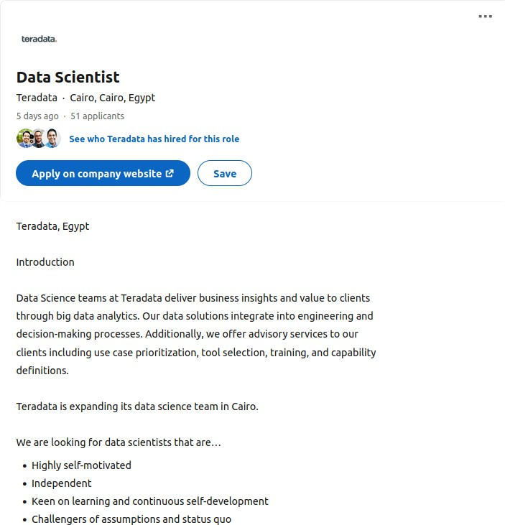
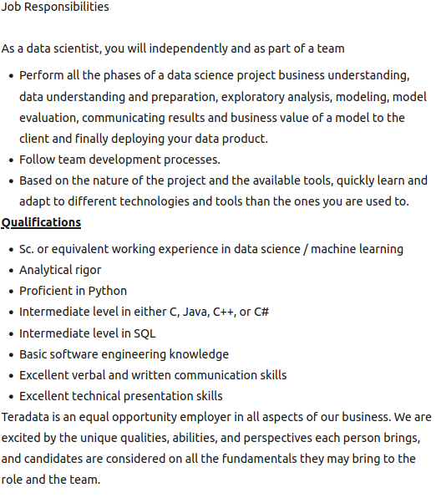
German University in Cairo
Introduction Course Details Motivation
Accessing the Lab Material
Example Job Offerings
Tutorial 1

Slide 10
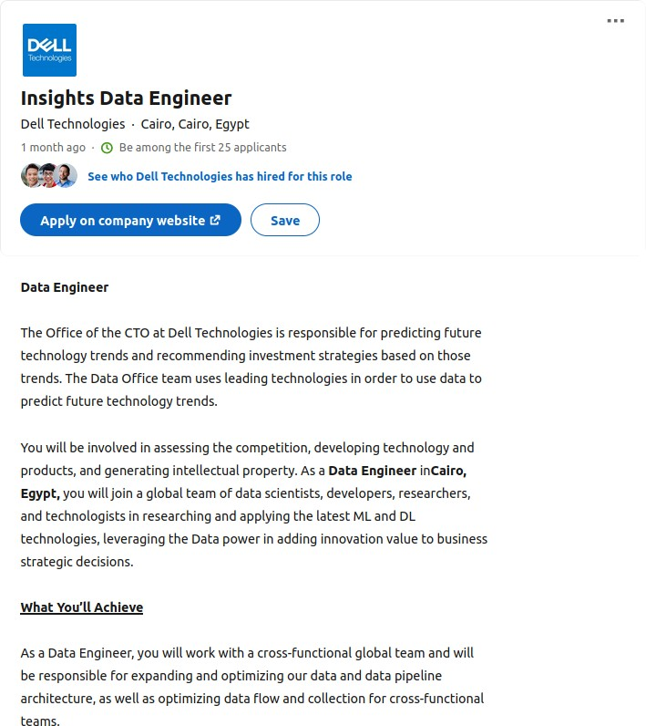
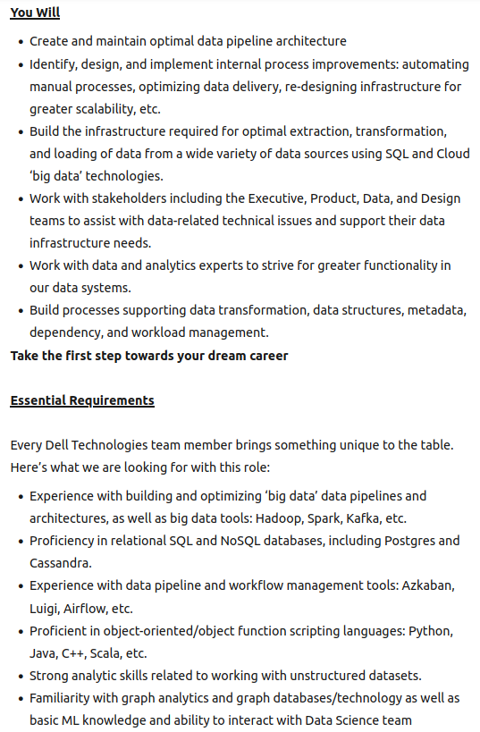
German University in Cairo
Introduction Course Details Motivation
Accessing the Lab Material
Example Job Offerings
Tutorial 1

Slide 11
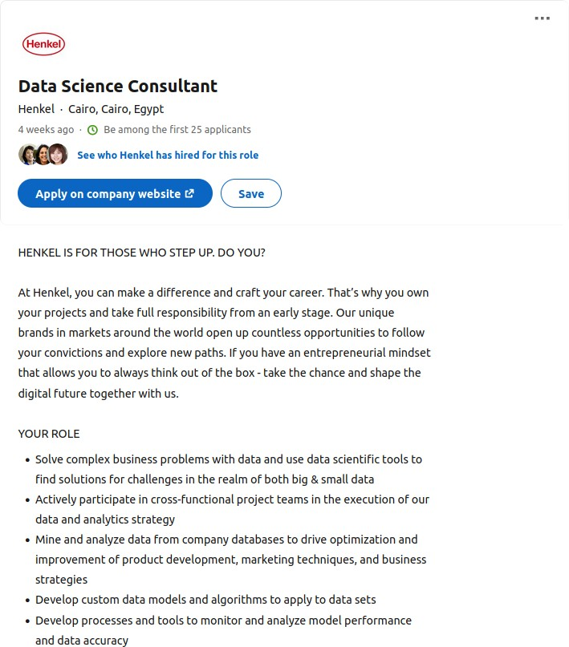
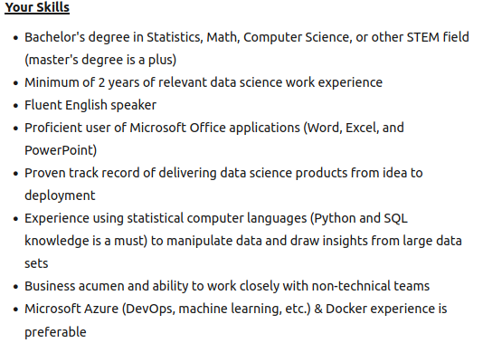
German University in Cairo
Introduction Course Details Motivation
Accessing the Lab Material
Example Job Offerings
Tutorial 1

Slide 12
German University in Cairo
Introduction Course Details Motivation
Accessing the Lab Material
Uses of Data Mining
Application | Technique
Inventory Planning | Forecasting
Music/Video/Shopping Recommendations | Recommender Systems
Automated Product Bundling | Association Rule Mining
Disease Prediction | Classification
Credit Card Fraud Detection | Anomaly Detection
Customer Segmentation | Clustering
Tutorial 1

Slide 13
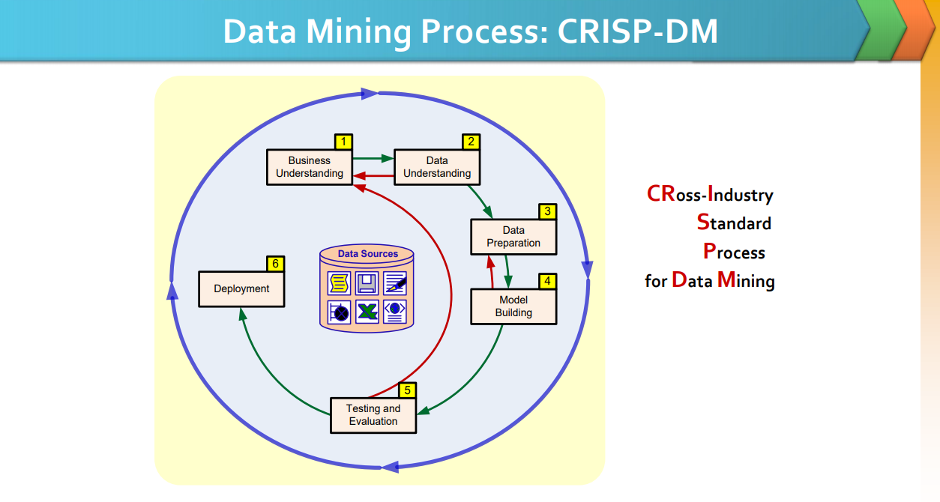
Introduction Course Details Motivation
Accessing the Lab Material
German University in Cairo
By Hazem Nabil
Winter 2025
Tutorial 1
13 / 20

Slide 14
Introduction Course Details Motivation
Accessing the Lab Material
German University in Cairo
Data Mining Tools
Graphical User Interfaces (GUIs)
Programmatic Interfaces (APIs)
Free and open-source (FOSS)
WEKA
KNIME
Orange
Commercial/Proprietary
SAS Enterprise Miner
IBM SPSS Modeller
IBM Watson
Rapidminer
Free and open-source (FOSS)
R
Python (using libraries)
WEKA APIs
Commercial/Proprietary
SAS APIs
Tutorial 1

Slide 15
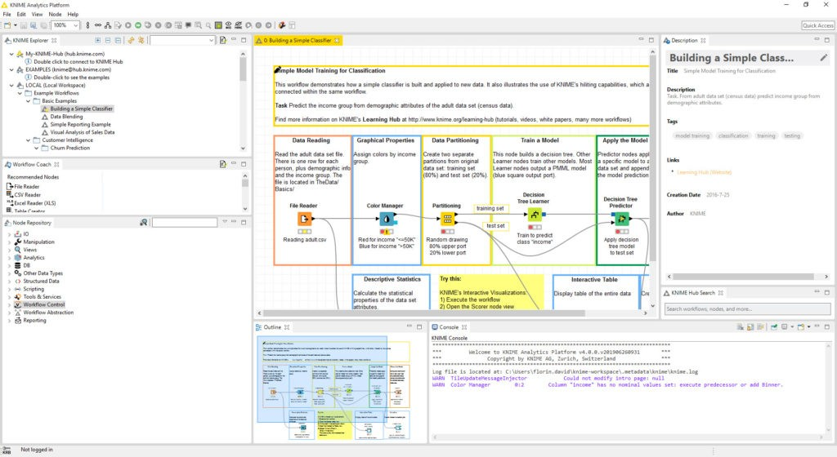
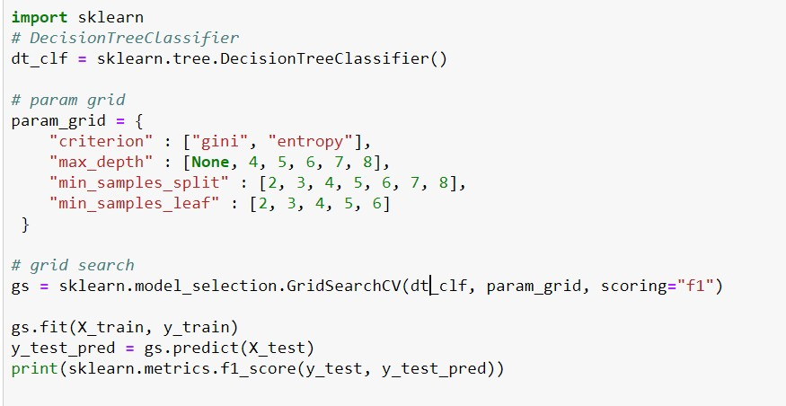
Introduction Course Details Motivation
Accessing the Lab Material
German University in Cairo
Data Mining Tools - Visual Comparison
GUI Example - KNIME
API Example - Python
Tutorial 1

Slide 16
Introduction Course Details Motivation
Accessing the Lab Material
German University in Cairo
Tool to be used throughout the tutorials
In this course, we’ll be using. . . Python!
Tutorial 1

Slide 17
Introduction Course Details Motivation
Accessing the Lab Material
German University in Cairo
Why Python?
Highly requested in job qualifications
Familiar from CSEN102
Easy-to-learn and highly readable language
General-purpose programming language
Rich and mature library ecosystem for data science tasks; large community
Also: cutting-edge ML/DL models; text mining, sentiment analysis; big data analytics, process mining
That said, the tool is just a means to an end. The process pipeline is much more important than the tool!
Tutorial 1

Slide 18
Introduction Course Details Motivation
Accessing the Lab Material
German University in Cairo
Comparison between Java and Python
Java
public class Test {
public static void main(String args[]) {
String planets[] = {"Mercury", "Venus", "Earth"}; for (String planet : planets) {
System.out.println(planet);
}
}
}
Tutorial 1

Slide 19
Introduction Course Details Motivation
Accessing the Lab Material
German University in Cairo
Comparison between Java and Python
Java
public class Test {
public static void main(String args[]) {
String planets[] = {"Mercury", "Venus", "Earth"}; for (String planet : planets) {
System.out.println(planet);
}
}
}
Python
planets = ["Mercury", "Venus", "Earth"] for planet in planets:
print(planet)
Tutorial 1

Slide 20
Introduction Course Details Motivation
Accessing the Lab Material
German University in Cairo
Interacting with the lab material
Go to the Data Mining Winter 2025 repository on GitHub:
https://github.com/GUC-DM/W2025
Interactively running the lab material can be done either by:
Cloud Opening them in Google Colab; or
Local Installing Anaconda and running jupyter lab locally
Instructions and links are provided in the repository’s readme.
Tutorial 1

Slide 21







Introduction Course Details Motivation
Accessing the Lab Material
German University in Cairo
An Overview of Python Tools & Libraries to be used
interactive development environment
data analysis and manipulation
numerical computations
data visualization and plotting
modelling and prediction
natural language processing using NLTK
deep learning
Tutorial 1

Slide 22
Introduction Course Details Motivation
Accessing the Lab Material
German University in Cairo
Useful Resources
Beginner Python Cheat Sheets: https://ehmatthes. github.io/pcc_2e/cheat_sheets/cheat_sheets/
Comprehensive Python Cheat Sheet:
https://gto76.github.io/python-cheatsheet/
Python API Quick Reference:
https://overapi.com/python
Learn X in Y Minutes - Python:
https://learnxinyminutes.com/docs/python/
Python Data Science Handbook: https:
//github.com/jakevdp/PythonDataScienceHandbook
Tutorial 1

