Slide 1
Brian Boyd
Taylor Cowan

Slide 2
Agenda
Demo
ASYDEO Ontology
Platform
Ontology Driven UI
Auto Discovery

Slide 3
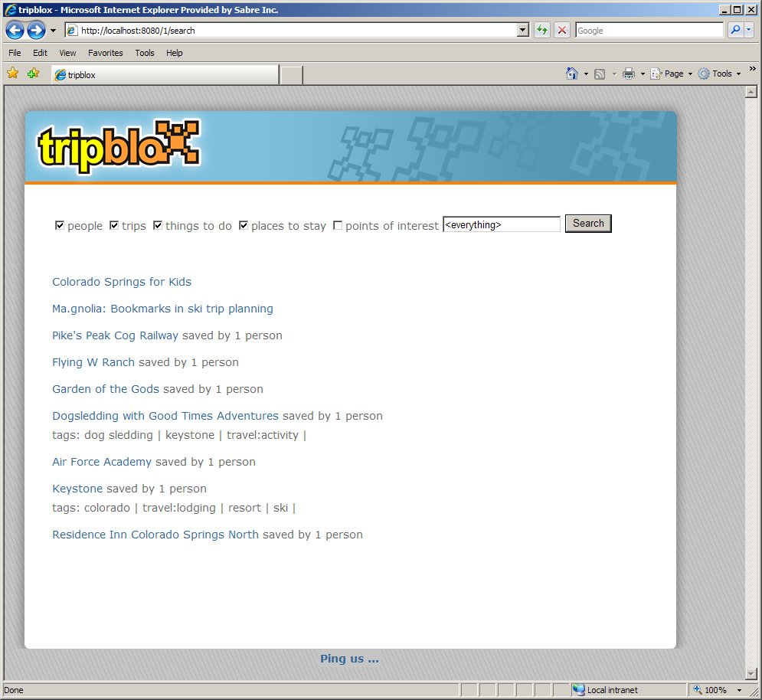
No existing data
No monetization
No money costing problem being solved

Slide 4
Problem domain (travelocity)

Slide 5
Motivators
Relational models are difficult to evolve, but software/system relationships change
Hierarchical classification (sub-class, super-class) are difficult to model in relational models.
RDF provides a simple format to transfer auto-discovered facts.
Exploit reasoning as much as possible

Slide 6
Aysdeo basics
http://asydeo.googlecode.com
Apache 2.0 license
Working software
Open to contribution
Java/Jena based

Slide 7
Platform Architecture
Jetty (or any servlet container)
Stripes 1.5
jquery
commons configuration
Jena 2.7
Jenabean
Asydeo.owl
TDB

Slide 8
How the ui works

Slide 9
Future work

