Slide 1
Applying Semantic Technologies to Asset and Configuration Management in the Enterprise
Taylor Cowan
Brian Boyd
Travelocity.com

Slide 2
Agenda
RDF intro
Problem space
Demo
ASYDEO Ontology
Platform
Ontology Driven UI
Auto Discovery

Slide 3
RDF != XML
“The site at http://www.travelocity.com, also known as Travelocity, is an online travel agency competing with expedia.com”

Slide 4
Conceptual Model
Travelocity.com
Travelocity
AKA
Online travel agency
Is a
Expedia.com
Has competitor

Slide 5
Same concepts serialized as “N3”
:OnlineTravelAgency
a owl:Class ;
rdfs:label "Travelocity"@en .
:hasCompetitor
a rdf:Property .
<http://www.travelocity.com>
a :OnlineTravelAgency ;
:hasCompetitor <http://www.expedia.com> .

Slide 6
As RDF/XML…
<rdf:RDF …>
<owl:Class rdf:about="OnlineTravelAgency">
<rdfs:label xml:lang="en">Travelocity</rdfs:label>
</owl:Class>
<rdf:Property rdf:about="hasCompetitor"/>
<OnlineTravelAgency rdf:about="http://www.travelocity.com">
<hasCompetitor rdf:resource="http://www.expedia.com"/>
</OnlineTravelAgency>
</rdf:RDF>

Slide 7
As N-Triples canonical format…
<hasCompetitor> <rdfs:type> <rdfs:Property> .
<http://www.travelocity.com> <hasCompetitor> <http://www.expedia.com> .
<http://www.travelocity.com> <rdfs:type> <OnlineTravelAgency> .
<OnlineTravelAgency> <rdf:label> "Travelocity"@en .
<OnlineTravelAgency> <rdfs:type> <owl:Class> .
Subject, Verb, Object…

Slide 8
And finally, as Java code…
OntModel m = ModelFactory.createOntologyModel();
OntClass ota = m.createClass("OnlineTravelAgency");
Individual tvly = ota.createIndividual("http://www.travelocity.com");
ota.setLabel("Travelocity", "en");
OntProperty p = m.createOntProperty("hasCompetitor");
tvly.setPropertyValue(p, m.createResource("http://www.expedia.com"));

Slide 9
“Understanding the relationships between systems, software, and the business processes they enable”.

Slide 10
Ontology
Software
People
Systems
Business processes

Slide 11
Problems ASYDEO Solves
If a change is made to an application, what could be impacted?
Rate of change exceeds our capacity to manage documentation, is there an alternative?
What URL/ports should we monitor?

Slide 12
demo

Slide 13
SPARQL #1
Question: What other software does software named “session” with version “1.0” connect to?

Slide 14
SELECT DISTINCT ?dstSoftware
WHERE {
?x rdfs:label ?srcSoftware .
?x a asydeo:ApplicationSoftware .
?x :version "1.0" .
?x :connectsTo ?sap .
?service :isAccessedBy ?sap .
?dstSoftware :providesService ?service .
FILTER regex(?srcSoftware, "session", "i")
}

Slide 15
SPARQL #2
What System Services are provided by Computer System “srvhlp550”?

Slide 16
SELECT DISTINCT ?service WHERE { ?system rdfs:label "srvhlp550" . ?system a :System . { ?system :hasInstalled ?software } UNION { ?cluster :hasMember ?system . ?cluster :hasInstalled ?software } . ?software :providesService ?service }

Slide 17
Asydeo basics
http://asydeo.googlecode.com
Apache 2.0 license
Working software
Open to contribution
Java/Jena based

Slide 18
ASYDEO Platform
Jetty (or any servlet container)
Stripes 1.5
jquery
commons configuration
Jena 2.7
Jenabean
Asydeo.owl
TDB

Slide 19
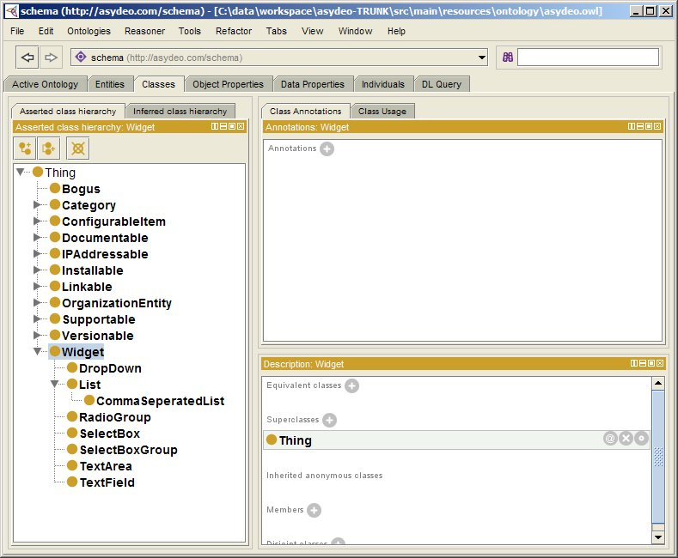
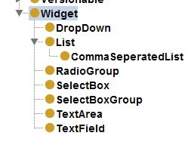
How the UI works
Our ontology declares a set of widgets

Slide 20
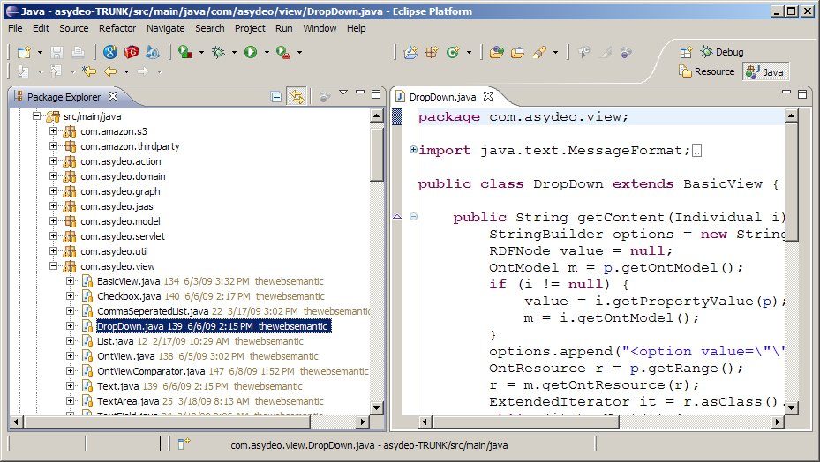
Each Widget has a Server Side representation

Slide 21
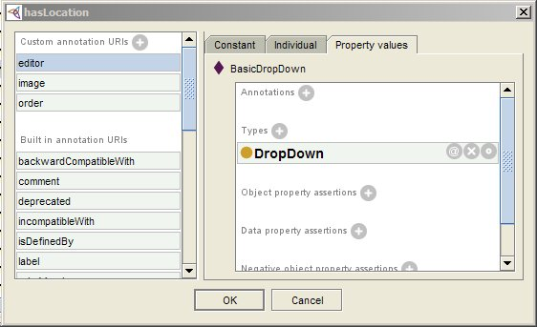
Ontology provides UI with tips for how to show each property
hasModel

Slide 22
Path from property to java…
hasModel
Has editor
Basic DropDown
Has type
DropDown
Maps to Java class

Slide 23
In Raw RDF (N3 format)
schema:hasModel a owl:FunctionalProperty , owl:ObjectProperty ;
rdfs:domain schema:System ;
rdfs:label "Model"^^xsd:string ;
rdfs:range schema:Model ;
schema:editor schema:BasicDropDown;
schema:order "94" .
schema:BasicDropDown a schema:DropDown .

Slide 24
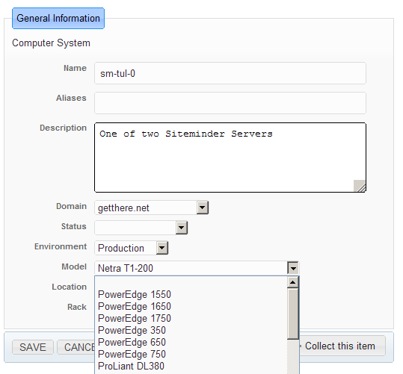
Included because RDF type is in propety’s domain.
(rdfs:domain schema:System ;)
Ordering relative to weights of other properties
(schema:order "94" . ;)
The property’s RDF Label
(rdfs:label "Model"^^xsd:string ;)
Candidates from the property’s range
(rdfs:range schema:Model)

Slide 25
Future Work

Slide 26
Auto-discovery Scripts
Systems Engineering (ASYDEO)
Network dumps
Deployed software manifests
System uptime and configuration
rdf
rdf
rdf

Slide 27
Some Advantages We Discovered
CMDB (mysql)
Flat/tabular model
Code and database cognizant of ontology
ASYDEO (Jena)
Hierarchical
Code is ontology agnostic
No restriction language
OWL provides restrictions
All data must be explicit
Some data is inferred

