Slide 1


Grand Unified
Grammar of
Graphics (GUGOG)
WHEN
Monday 9 November 2026
1:00–4:30 PM EST
WHERE
Boston, Massachusetts
A workshop at IEEE VIS 2026
CO-ORGANIZED WITH
Munich Center for
Machine Learning (MCML)
Cross-system comparison, meta-theoretical reflection and community consensus building for visualization grammars
gugog-vis.github.io/2026
Half-day workshop

Slide 2
Programme
Monday 9 November 2026 · 1:00–4:30 PM EST
Session 1
1:00–2:30 PM
Session 2
3:00–4:30 PM
1:00
Opening
3:00
Can the Grammar of Graphics Describe Data Glyphs?
Barbara Nascimento, João M. Cunha & Evgheni Polisciuc (pre‑recorded)
1:05
Balancing constriction and expansion for domain-specific grammars
Jason Cory Brunson
3:10
On the Inconsistency in Grammar Evaluations
Lemara Williams
1:15
The Grammar of Graphics Needs Verbs: Towards a GUGOG
Josh M. Pollock
3:20
Mind Your νs and Qs: A Categorical Framework for Specifying Visualization Components
Hannah Aizenman, Mikael Vejdemo-Johansson, Thomas Caswell & Michael Grossberg
1:25
Semantic Validity vs. Graphical Arrangement in Visualization Grammars
Cynthia A. Huang & Matthew Kay
3:30
Discussion group formation
1:35
Panel: Towards a Universal Visualisation Language
Andrew McNutt · Eugene Wu · Josh Pollock
3:35
Discussion groups
4:10
Report back, synthesis, call to action
4:25
Closing
Coffee break 2:30–3:00 PM

Slide 3
Acknowledgements
ORGANIZERS
PROGRAM COMMITTEE
HOSTED BY
Cynthia Huang
LMU Munich / MCML
Cynthia Huang (chair)
LMU Munich / MCML
Matthew Kay
Northwestern University
Harriet Mason
University of Queensland
Thank you to the IEEE VIS 2026 Organizing Committee for hosting GUGOG, and to all authors, panelists and participants.
Susan Vanderplas
University of Nebraska–Lincoln
Sherry Zhang
University of Texas at Austin
Heike Hofmann
University of Nebraska–Lincoln
Joyce Robbins
Columbia University
CO-ORGANIZED WITH
Evangeline Reynolds
University of Denver
GUGOG is co-organized with and supported by the Munich Center for Machine Learning (MCML), the joint AI research center of LMU Munich and TU Munich and one of six national AI Competence Centers in Germany, funded by the German Federal Ministry of Research, Technology and Space and the Free State of Bavaria.

Slide 4


MUNICH CENTER FOR MACHINE LEARNING
Co-organizer of GUGOG @ IEEE VIS 2026

Slide 5


GET TO KNOW THE MCML
  Joint AI research center of LMU & TUM
  One of six national AI Competence Centers in Germany
  Funded by the German Federal Ministry of Research, Technology and Space & Free State of Bavaria
  11 research areas in the fields of application-oriented ML and foundational research
  Developing responsible and trustworthy AI
  Supporting the next generation of AI researchers
≈80
PRINCIPAL INVESTIGATORS
2700+
PUBLICATIONS
530+
JUNIOR MEMBERS

Slide 6
MCML MISSION
VISION
Advancing machine learning methods for application-oriented fields such as medicine, biology, and ethics
RESEARCH
Interdisciplinary research at the interface of computer science and cognitive science
OUTREACH
Educational programs and outreach activities to promote machine learning and AI knowledge
Foundations of Machine Learning
Perception, Vision and Natural Language Processing
Domain-specific Machine Learning
3 RESEARCH AREAS

Slide 7
Programme
Monday 9 November 2026 · 1:00–4:30 PM EST
Session 1
1:00–2:30 PM
Session 2
3:00–4:30 PM
1:00
Opening
3:00
Can the Grammar of Graphics Describe Data Glyphs?
Barbara Nascimento, João M. Cunha & Evgheni Polisciuc (pre‑recorded)
1:05
Balancing constriction and expansion for domain-specific grammars
Jason Cory Brunson
3:10
On the Inconsistency in Grammar Evaluations
Lemara Williams
1:15
The Grammar of Graphics Needs Verbs: Towards a GUGOG
Josh M. Pollock
3:20
Mind Your νs and Qs: A Categorical Framework for Specifying Visualization Components
Hannah Aizenman, Mikael Vejdemo-Johansson, Thomas Caswell & Michael Grossberg
1:25
Semantic Validity vs. Graphical Arrangement in Visualization Grammars
Cynthia A. Huang & Matthew Kay
3:30
Discussion group formation
1:35
Panel: Towards a Universal Visualisation Language
Andrew McNutt · Eugene Wu · Josh Pollock
3:35
Discussion groups
4:10
Report back, synthesis, call to action
4:25
Closing
Coffee break 2:30–3:00 PM

Slide 8
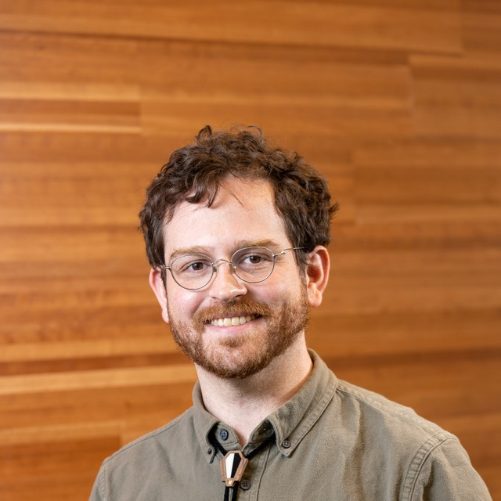
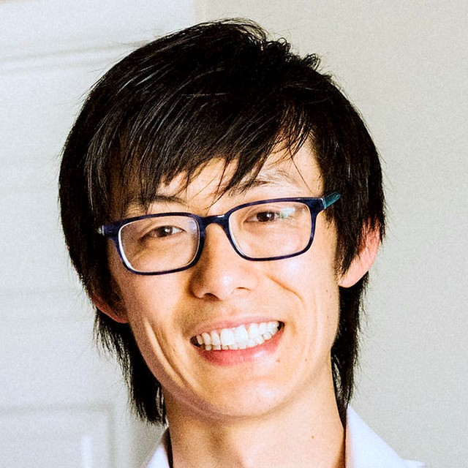

PANEL
Towards a Universal Visualisation Language
Is a universal visualisation language a coherent goal, or does the diversity of grammars reflect genuine differences in what people need to express?
Andrew McNutt
Eugene Wu
Josh Pollock
University of Utah (incoming UBC)
Columbia University
MIT VIS group (recent PhD)
PROGRAMMING INTERFACES & HCI
DATABASES & SYSTEMS
PL FOR VISUALISATION GRAMMARS
Builds tools and theories that turn domain expertise into software that is approachable, trustworthy, and respectful of user agency.
Co-director of the Data, Agents, and Processes Lab (DAPLab). Research spans visualization, HCI, and core data systems.
Applies programming language ideas to visualization grammars, looking for unifying abstractions. Creator of GoFish and Bluefish.
Moderated by Cynthia Huang, LMU Munich / MCML

Slide 9
DISCUSSION GROUPS
Which theme do you want to work on?
Pick a panel theme, or add your own, on the Excalidraw board.
1
2
3
Does universality make sense?
What do we want from other communities?
Research or engineering?
A shared core, or real differences in what people need to express?
Statistical graphics, HCI, diagrams, cartography, accessibility
Missing abstractions, shared modules, standards and tooling
4
5
QR code
Add ideas on Excalidraw
GUGOG @ IEEE VIS 2026

