Slide 1
LEAI — Learning Experience AI
Course feedback as a 5-minute chat, not a form.
Instructor sets up → Student chats → Instructor reads
GUII Lab · UC Santa Cruz
Notes:
Hi everyone. I want to show you a tool from our lab called LEAI, Learning Experience AI.
The one-line version is on the slide. A student gives course feedback by chatting with an AI for about five minutes.
The longer version: students open a link and have a short conversation. The AI asks follow-up questions the way a TA would. The instructor gets back a summary they can skim in about two minutes, and every claim in it traces back to the student who said it.
[If StudyHelper comes up] Different tool, different job. StudyHelper teaches during the course. LEAI asks about the course. LEAI does not depend on StudyHelper and is not an add-on to it.
Three parts, and I will show you each one. The instructor sets up a survey. The student chats. The instructor reads what came out.

Slide 2
Why LEAI
The gap in course feedback
End-of-term evals
Mid-semester Likert
Open-ended writing
Too late
Too shallow
Too much
LEAI sits in the middle
Notes:
There are three ways to collect course feedback today, and each one fails in its own way.
End-of-term evals arrive too late. By the time results land, the students who took the class are gone, so nothing you learn helps the people who told you.
Mid-semester Likert is too shallow. It is fast to fill out, but a 3 out of 5 tells you what and never why. You cannot act on it.
Open-ended writing is too much. It is rich, but forty long replies a week is more than anyone has time to read and turn into action. Students know that, so they stop trying. repetitve
LEAI aims at the middle. Five minutes for the student, two minutes for the instructor, and every claim traceable back to the student who said it.
[This slide is load-bearing. Do not cut it for time. The results slide has no baseline without it.]

Slide 3
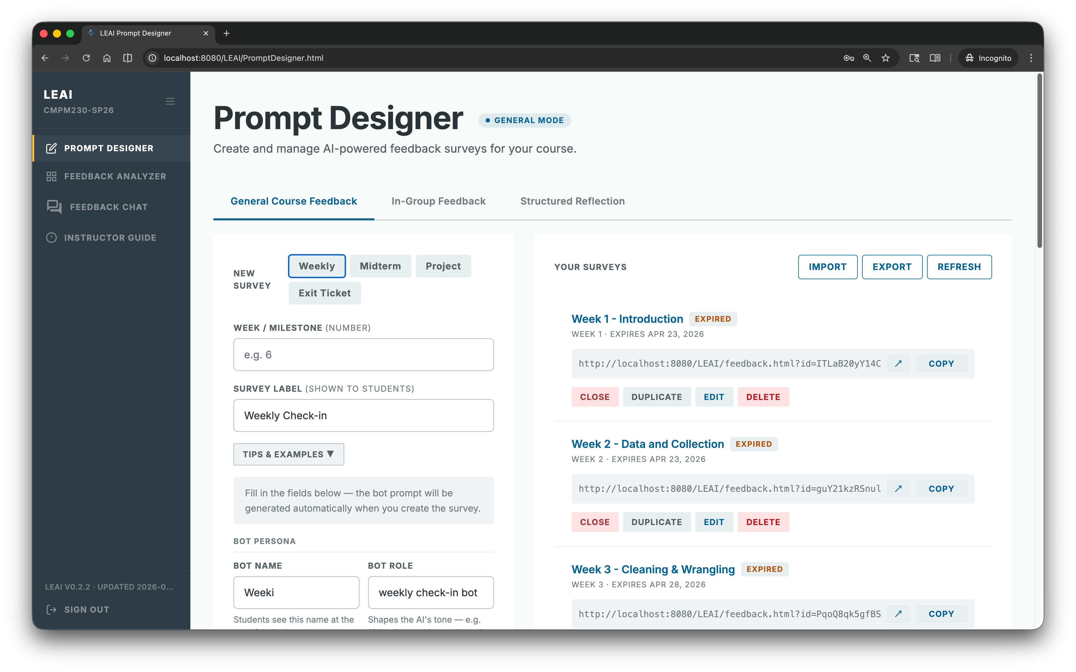
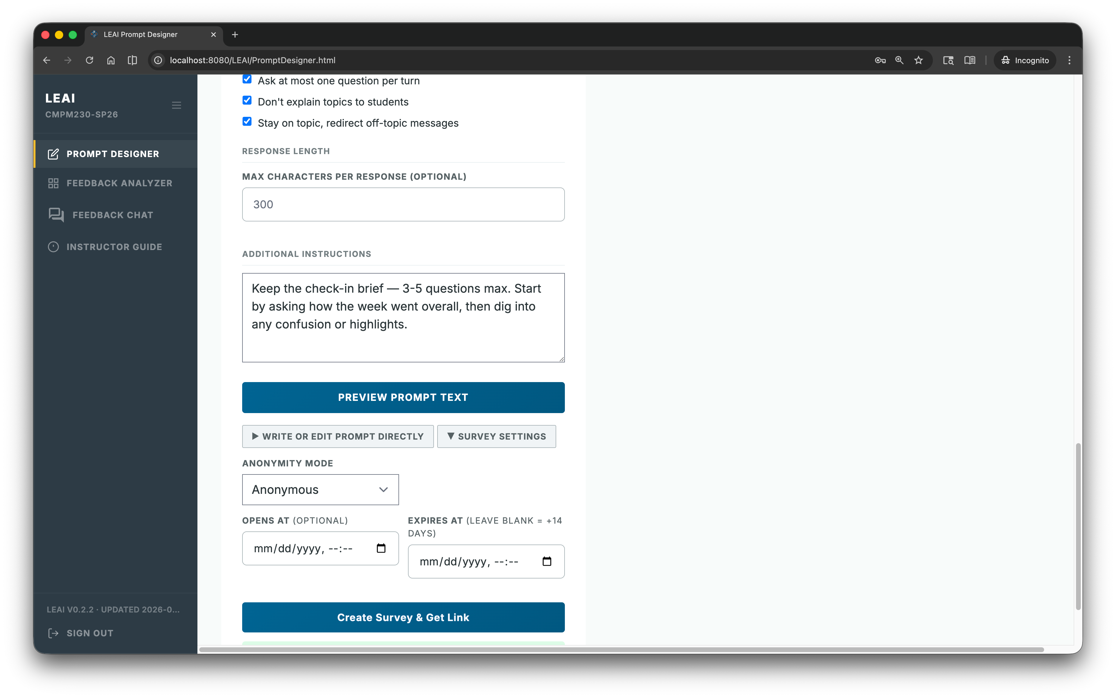
Set up a survey in minutes
Pick a template. Set how the AI talks. Share a link.
Three modes: Free-Form · In-Group · Structured Reflection
Notes:
This is the instructor side. The tool is called PromptDesigner.
You pick a template: Weekly, Midterm, Project, Exit Ticket. That way you start from something instead of a blank page. You give the bot a name and a role, and that shapes how it talks to students. The name is what they see at the top of their chat. Then you share a link. Setup takes minutes. One survey a week is a common rhythm.
Three modes. Gloss each one as you say it, because the names do not explain themselves.
Free-Form is open feedback. It is the default.
In-Group means students rate and reflect on their team. Say "rate your team" out loud. "In-Group" collides with the social-psych in-group/out-group sense and people will hear the wrong thing.
Structured Reflection means the AI walks every section in order. That is two slides from here.
[The screenshot is seeded demo data on a test course.]

Slide 4
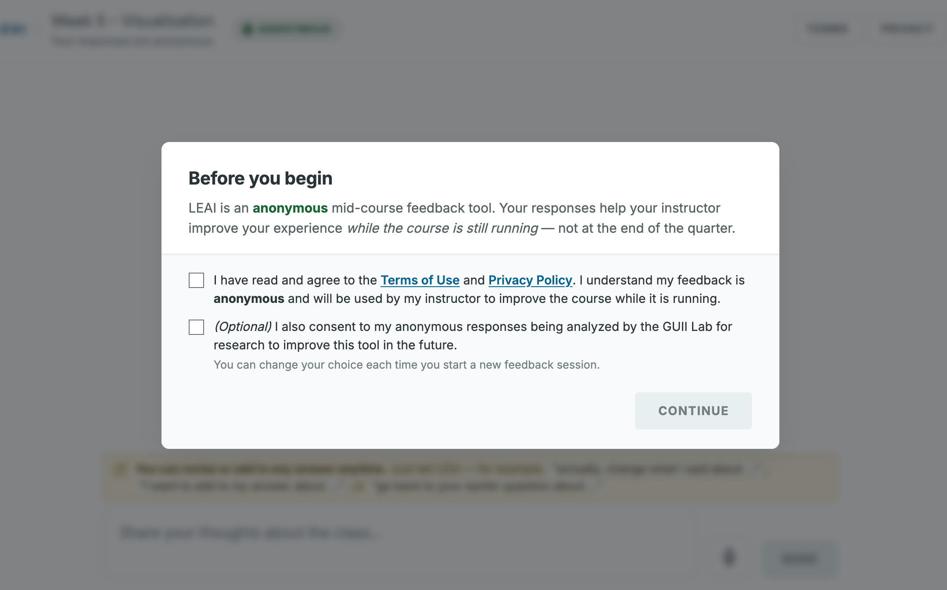
What students experience
A five-minute chat. No login, no app — just a link.
Conversational
Anonymous (per survey)
Voice or typing
Notes:
This is what a student sees. They open a link. No login, no app, no account.
The first screen is a quick consent. They agree to the terms, and a separate optional box lets our lab use the anonymised data for research. That box is optional and it is per session, so they can change their answer every time.
After that it is a chat. The AI asks a question, they answer, and it follows up. Following up is the thing a form cannot do. They can talk instead of type, which matters when they are tired or on a phone.
On anonymity: the instructor chooses it, and it is set per survey. Anonymous, or with a code. Say it that way, because it is a setting. Do not claim students are always anonymous.
LEAI collects feedback. It does not grade.

Slide 5
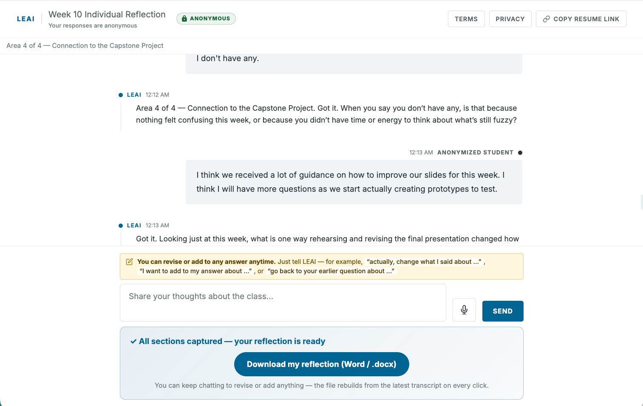
Structured Reflection
When every section must be answered
The AI walks every section in order.
Students can revise any answer, anytime.
Notes:
Structured Reflection. Same chat, guided.
On screen is the student view. It still looks like a normal chat. The header says "Area 2 of 4," so the AI is walking them through every section in order. They finish when every section is covered.
Why it exists: sometimes you need every section answered. A graded reflection, where every part of the rubric matters. So the structure lives in the engine and stays off the screen.
We added one thing after student feedback. Students can revise or add to any earlier answer at any time. They just say "actually, change what I said about..." Students told us the old flow felt like being marched through a form, and this is the fix.
[Honesty] Instructors cannot author these outlines in the app yet. We set them up by hand. Say "picks from a set of outlines we've set up." It is on the ideas slide.
[Interim art] This capture predates the revise hint, so the hint is not visible in the screenshot yet.

Slide 6
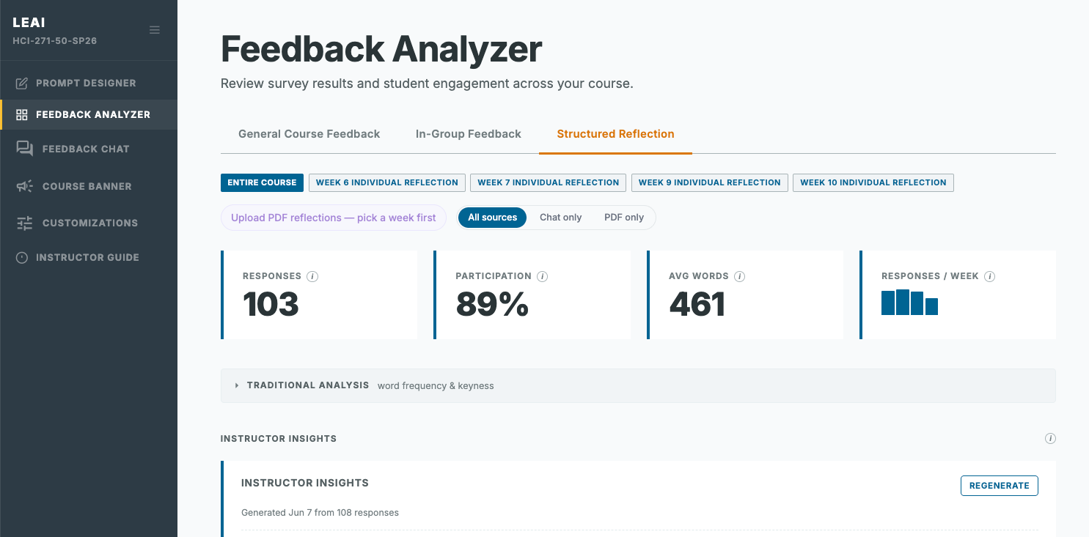
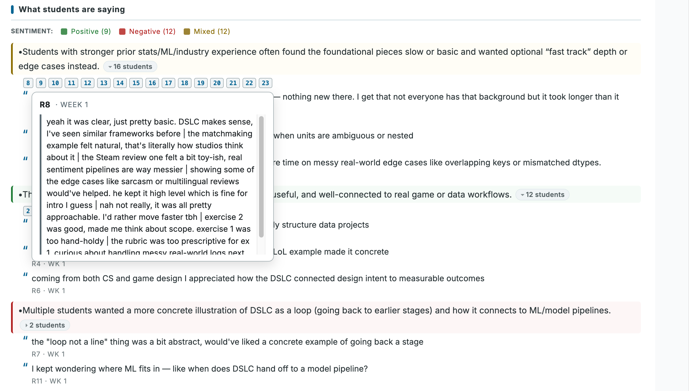
From conversations to insights
Every claim shows how many students back it.
Notes:
Now the instructor side. This is the Feedback Analyzer.
Free-form chat is rich and messy. Forty conversations is a lot to read, and for a big class it is hopeless. So we give you three views and you triangulate across them.
Instructor Insights is the AI's read. That is what is on screen now.
Raw responses is one click away from the actual student text.
Look at the bullets. Five students are overwhelmed by the stats side. Twelve found the framing clear and valuable. Seven found it too basic and want to go faster. A single summary would flatten that into "students had mixed feelings." Here you get a real disagreement, with sizes, and you can see who is on each side.
That is the change we made this quarter. Every claim carries a student count. And claims only one student made get quarantined into their own "Mentioned by one student" group, so they never get laundered into "some students feel."
[If asked whether the model generates the counts] No. The count is computed. It is the number of distinct responses the model cited, deduped, and any citation that does not resolve to a real response gets dropped, so a hallucinated ID cannot inflate it. The honest caveat is that code does the counting and the model chooses what to cite, so a count can be exact while a citation is wrong. Every citation is one click from the raw text, which is how you would catch it.
[Say this out loud once] The numbers on this screenshot are seeded demo data on a test course. The real numbers are two slides from here.

Slide 7
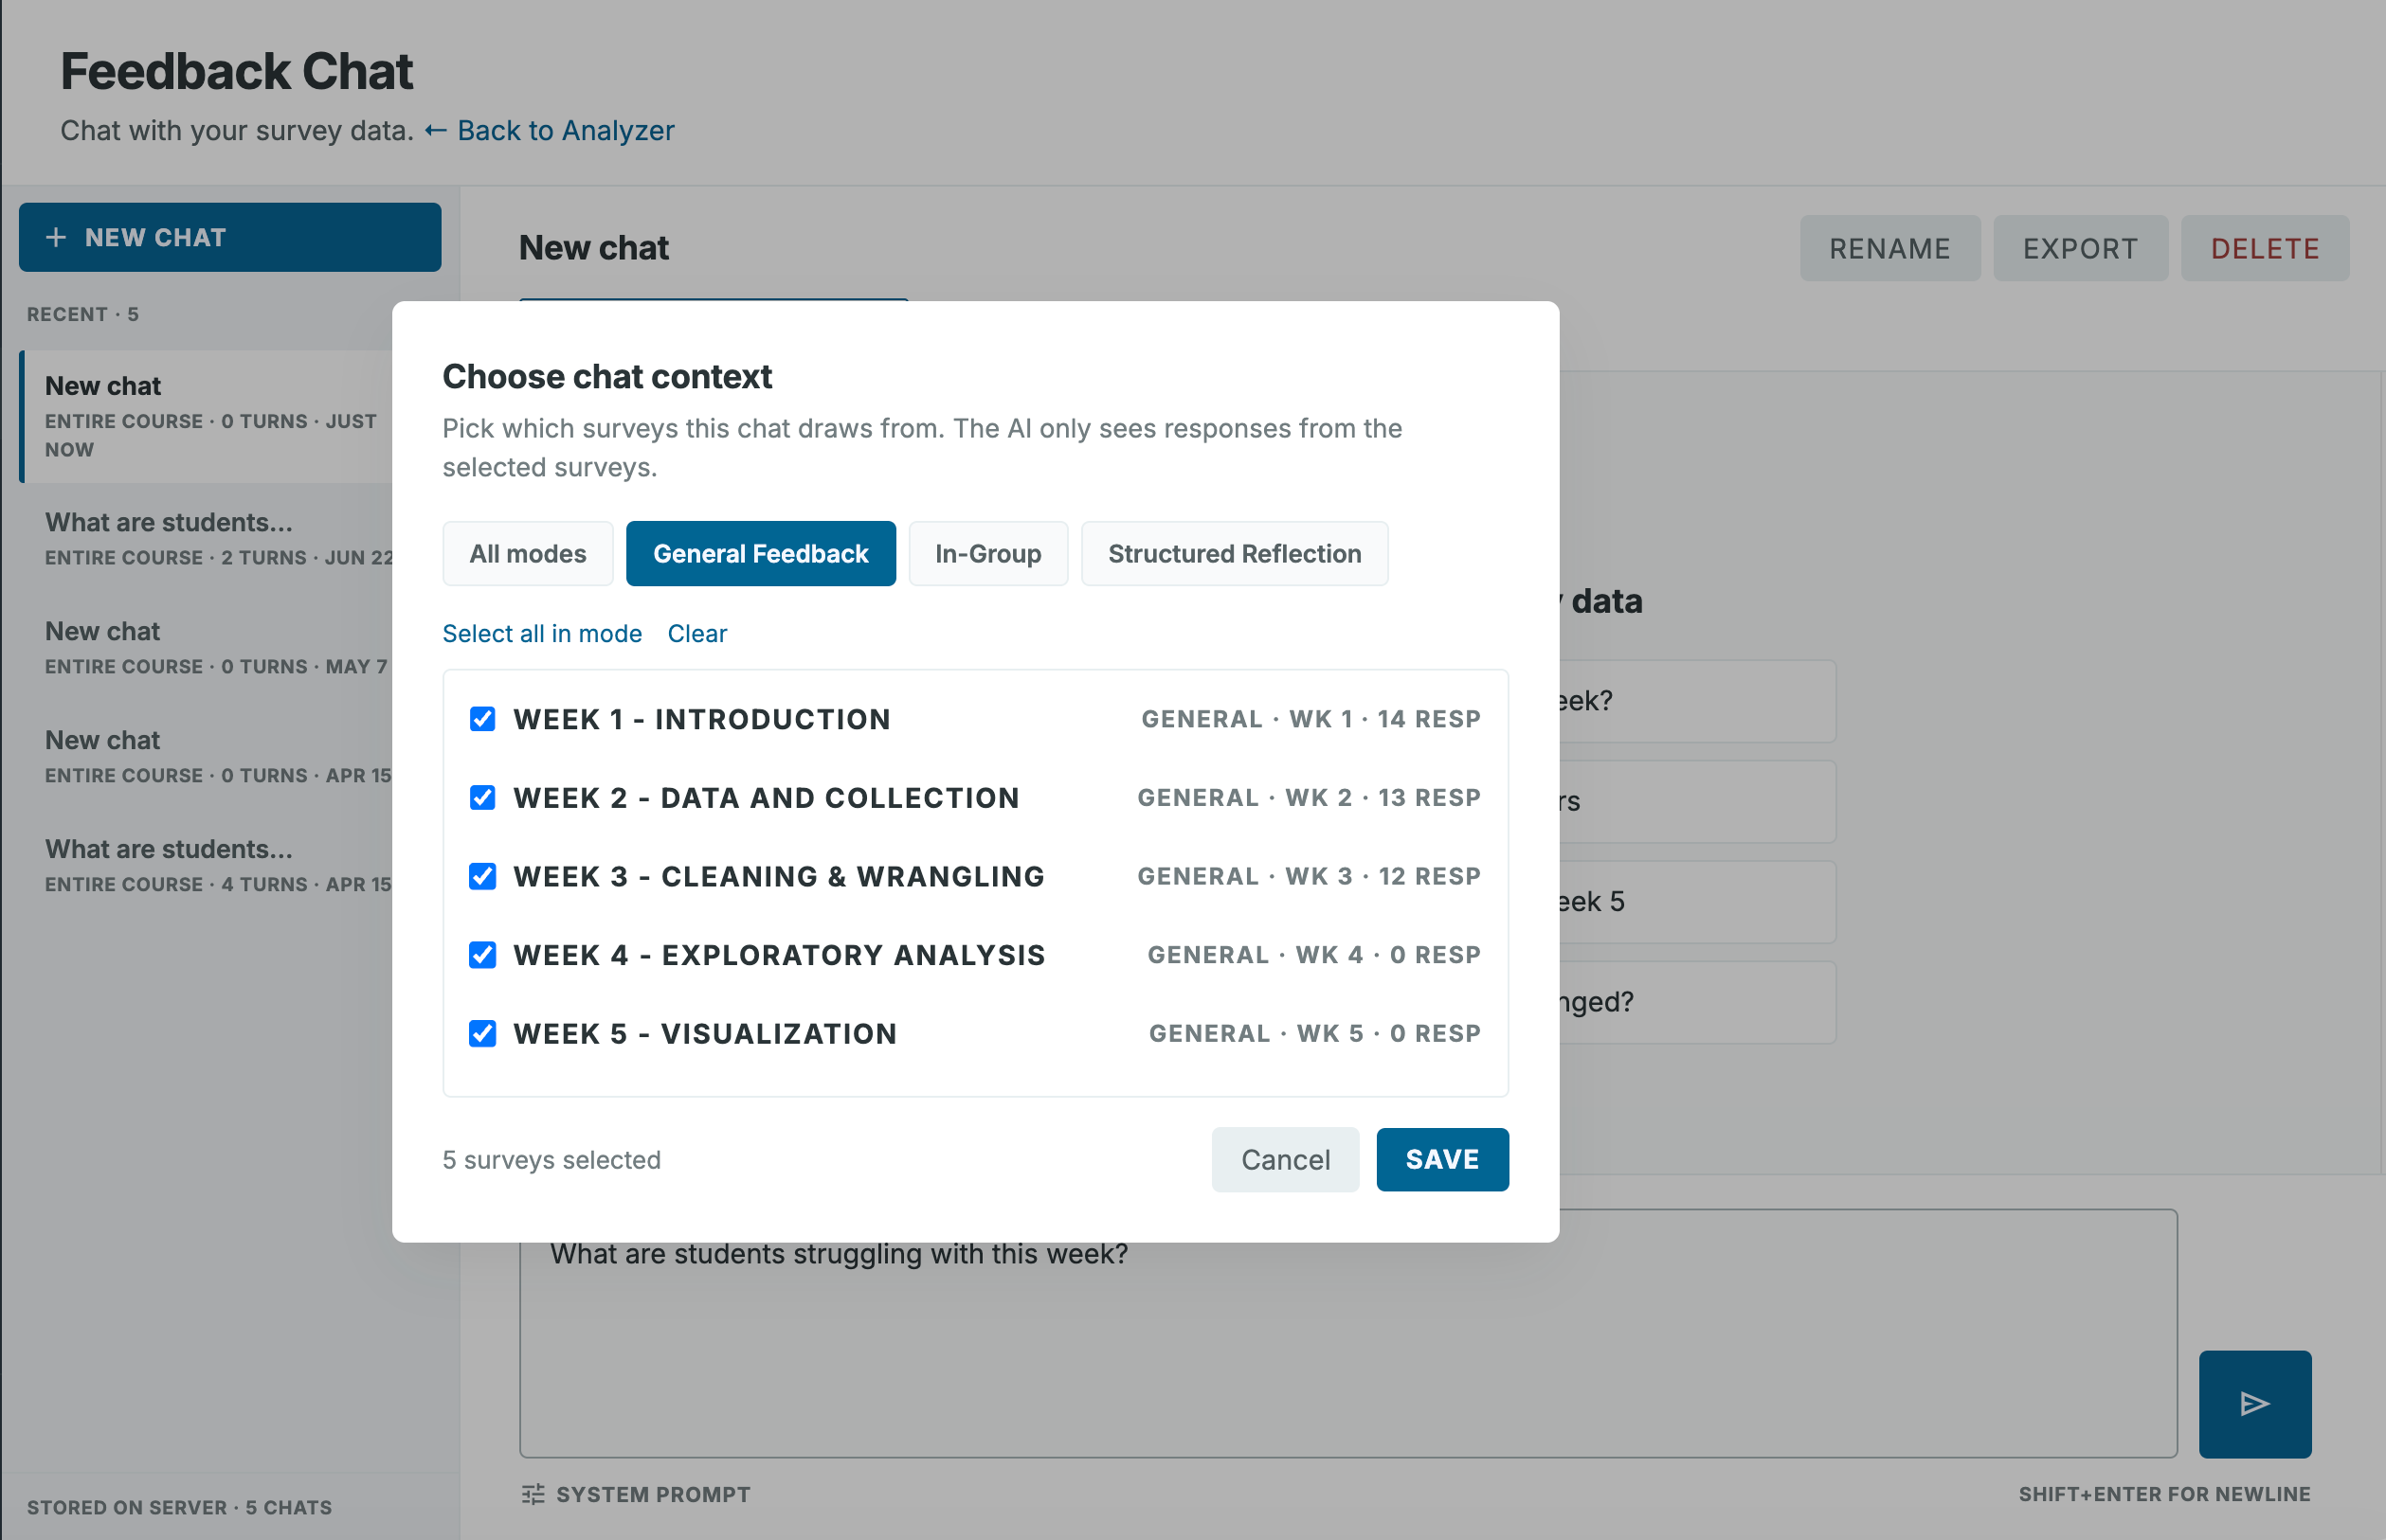
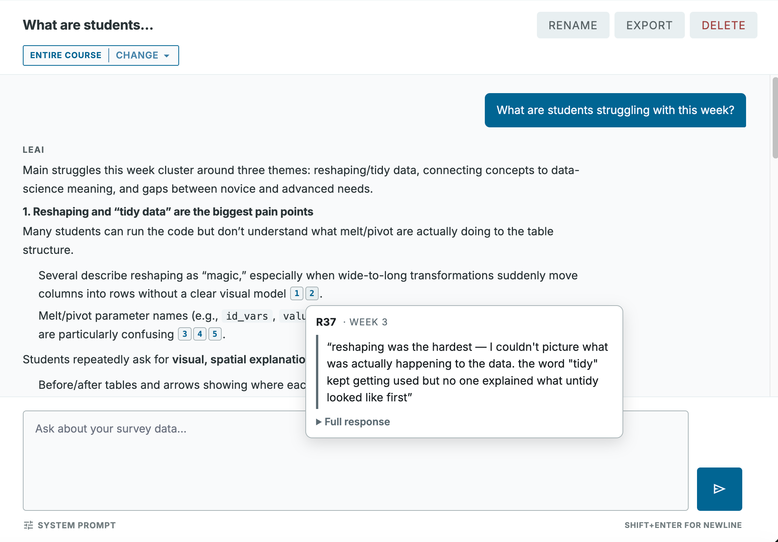
Chat on the feedbacks
Notes:
This is Feedback Chat. Insights tells you what is in the responses. This answers the specific question you came in with.
You ask something in plain language, like "what are students struggling with this week," and it answers from the responses in your course.
On the left is how you scope it. You pick which surveys the chat draws from, by mode or by week, and the AI only sees the responses from the surveys you selected. So you can ask about week 3 alone, or about the whole course.
On the right is what an answer looks like. It groups the struggles into themes, and every claim carries a numbered citation. Hover a citation and you get the student's own words. R37, week 3, saying reshaping was the hardest because they could not picture what was happening to the data. Click through and you get the full response.
That is the same rule as Insights. You are always one click from the student's words, so you can check the AI instead of trusting it.
The System Prompt control at the bottom shows the exact prompt we send. Nothing is hidden.
[The responses on this screen are seeded demo data on a test course.]

Slide 8
What happened when we deployed it
22 of 25 & 24 of 25
Week 9 & Week 10, HCI 271
Same assignment, same credit, students freely picked LEAI or the instructor's PDF form.
She used Insights to find students confused about co-design methods — and added new lecture content that quarter.
3 courses · 3 instructors | Usability (SUS): 65.0 / 67.5, n=6 — unpowered on week 7 and 8
Notes:
Three courses in the quarter of 2026 spring. HCI 271 with Magy, CMPM 230 with Reza, HCI 220 with Mahnaz. Two grad HCI, one games. All three are UCSC, same department, overlapping instructor pool. That is one context sampled three times, so do not call it three independent contexts.
The number on the left is the one I would point at. In HCI 271, weeks 9 and 10, students could choose: use LEAI, or submit through the PDF form the instructor originally designed. Same assignment, same credit, free pick. Week 9, 22 of 25 chose LEAI. Week 10, 24 of 25.
Be precise about what that shows. It is the same 25 students both weeks, so the change is two people. That is not a trend and I will not sell it as one. And choosing it is not the same as preferring it: a link is less friction than downloading, filling, and submitting a PDF, so some of this is effort. What it does show is that almost nobody opted out when opting out was free. It cleared the acceptability bar in a real graded course.
The line on the slide is the one I hang the case on, because it is behavioural. Magy used Insights to find that students were confused about co-design methods, and she added new lecture content that same quarter. The feedback turned into a teaching change while the course was still running. End-of-term evals structurally cannot do that. Behaviour beats testimony.
Magy's other read, if it helps: reflections through LEAI were "a lot more authentic" than the form, where answers were often too similar. She thinks students were copying. That is her hypothesis and we have not measured it. A text-similarity comparison of the two corpora would test it, and we could run it.
Say this before someone else says it: Magy is the instructor here and she is also our lab director. So this is an instructor's report, not an independent evaluation.
Reza, CMPM 230: he said LEAI was better than the current system and he would use it again. He said it. Nobody rated it. We administered no instrument, so do not dress a conversation up as a scale.
Mahnaz, HCI 220: a small number of students, and we never got a formal interview. The feedback came from ad-hoc Zoom conversations. I count the course in the three, so I report the thinness.
On SUS: 65.0 and 67.5, collected in weeks 7 and 8. Both sit under the 68 benchmark. n=6 out of about 25, self-selected, roughly a 24% response rate. It is unpowered and I will not over-read it. The interesting part is the tension. Adoption was near-total while usability scored average-to-below, so adoption is not tracking usability here. It is an acceptability signal, and possibly an effort signal. That is a finding, and I am fine saying it out loud.

Slide 9
Ideas we're weighing
Exploring
AI Wizards that help setup structured feedback forms Prompt sharing between instructors Integration with Canvas
Want to try it in your course next quarter? Come find me.
Notes:
Where this could go. These are ideas we are weighing. They are not commitments and they are not a roadmap. I say that because a list like this gets remembered as a promise.
AI wizards for setting up structured feedback forms. Right now we author those outlines by hand, which does not scale past a few courses. An LLM-assisted wizard puts that in the instructor's hands and takes us out of the loop.
Prompt sharing between instructors. Instructors keep reinventing the same weekly check-in, so let them pass prompts around.
[If asked what else is on the list] More student control over the conversation flow. An instructor asked for it, and students asked for it independently in their survey write-ins. Two sources that never talked to each other said the same thing, so we are listening.
[If Canvas comes up] It is the single most common request and it has not been started. I mention it so nobody thinks I have not heard it. I am not signalling that it is coming.
And the ask. If you want to try this in your course next quarter, come find me. Setup is a few minutes a week, and it costs your students five minutes.

