Slide 1
LEAI — Learning Experience AI
A sibling lab tool to StudyHelper. StudyHelper helps students learn. LEAI listens to how it went.
PromptDesigner → FeedbackCollector → FeedbackAnalyzer
GUII Lab · UC Santa Cruz

Slide 2
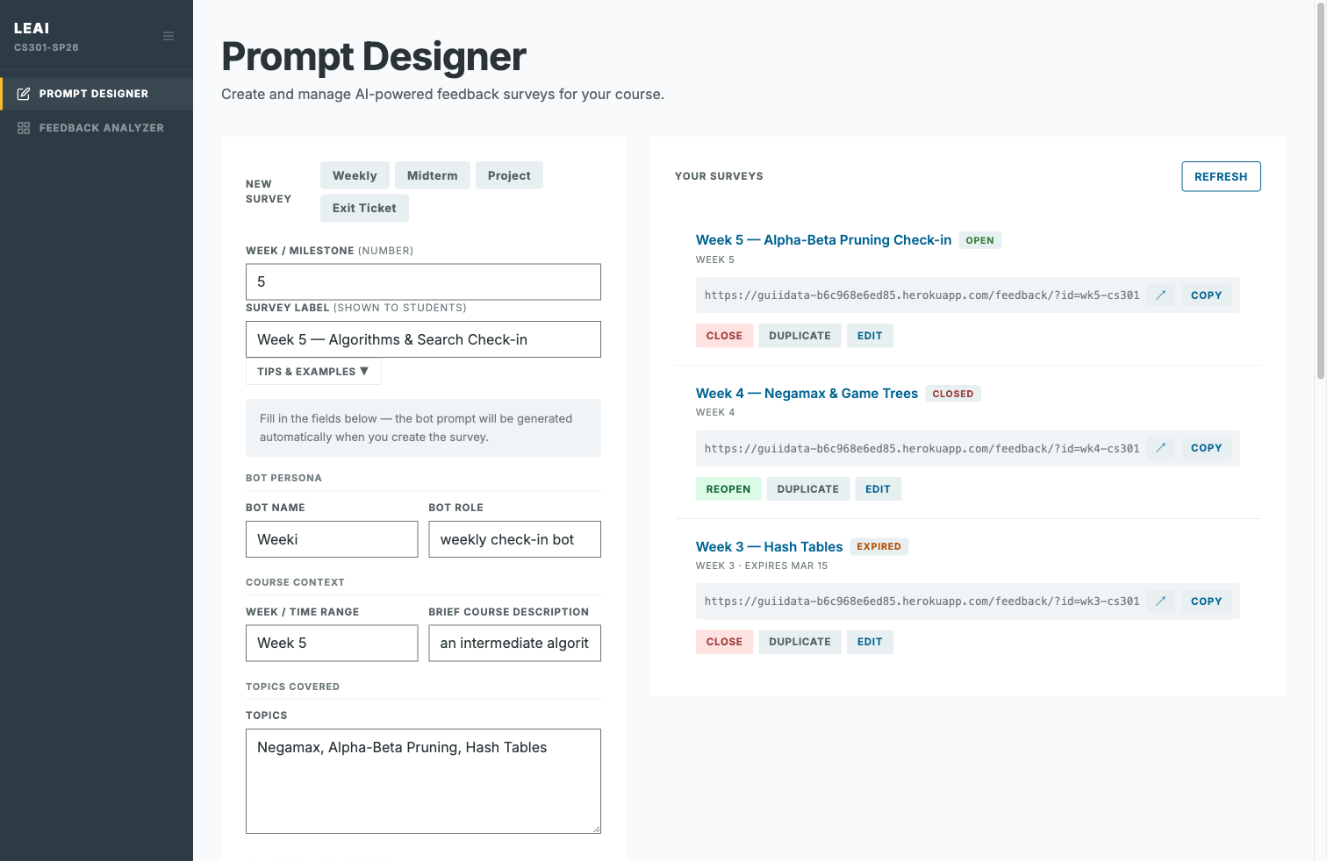
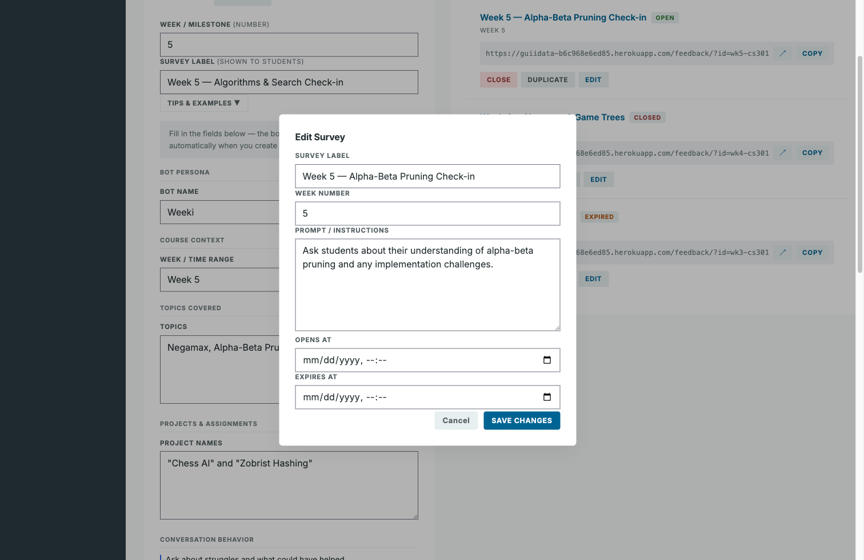
Set up a survey in minutes
Pick a template. Write the bot's voice. Share a link.
Three modes: Free-Form · In-Group · Structured Reflection

Slide 3
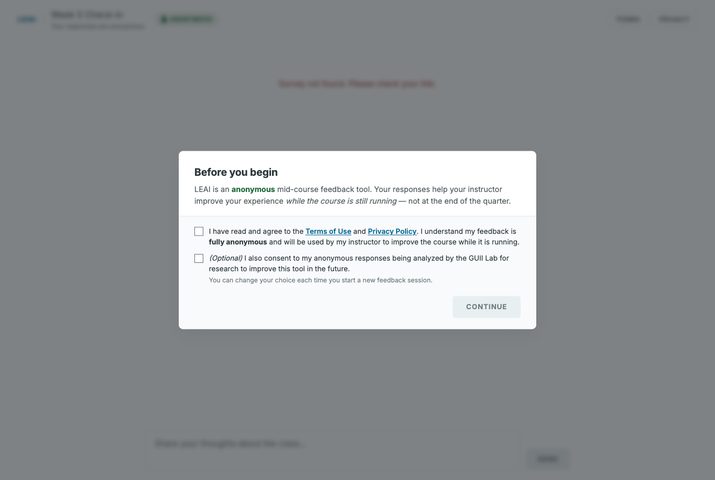
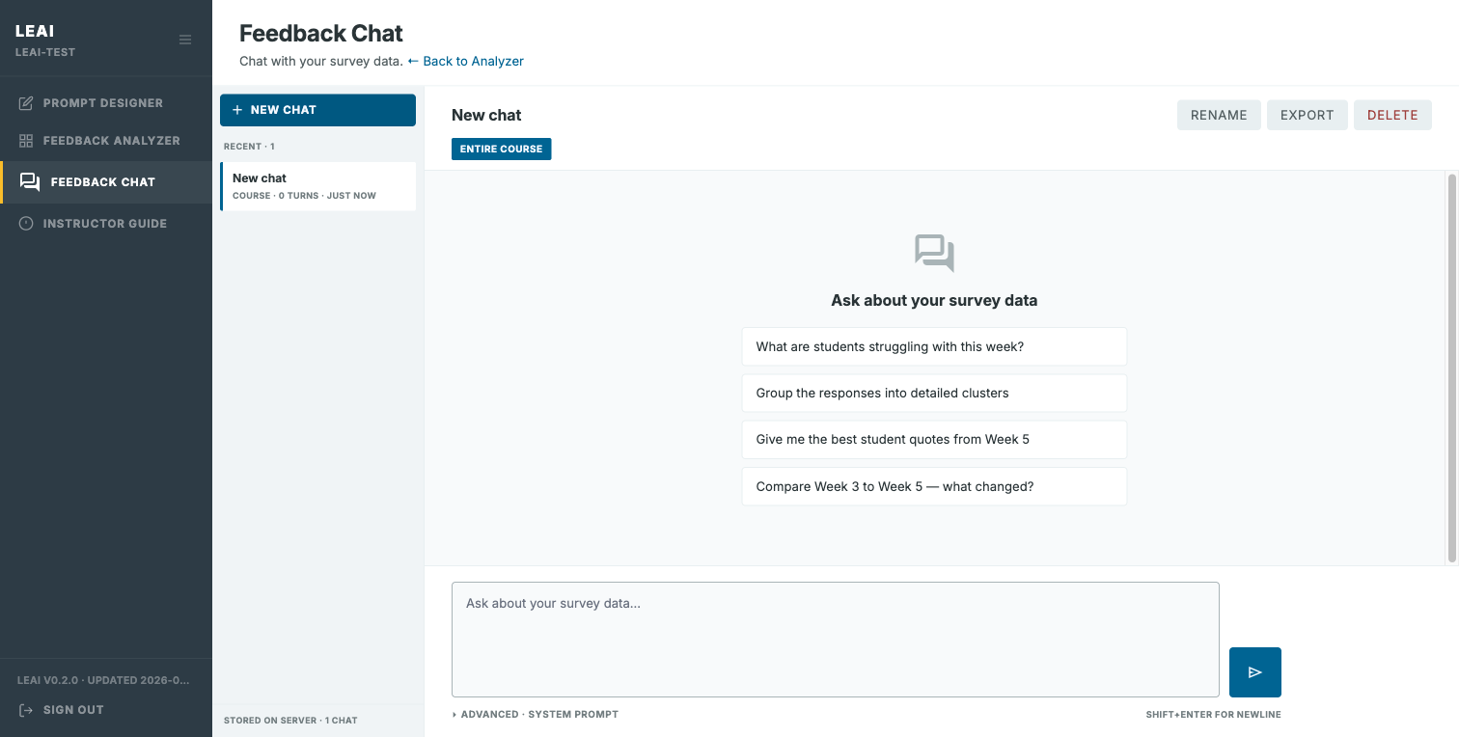
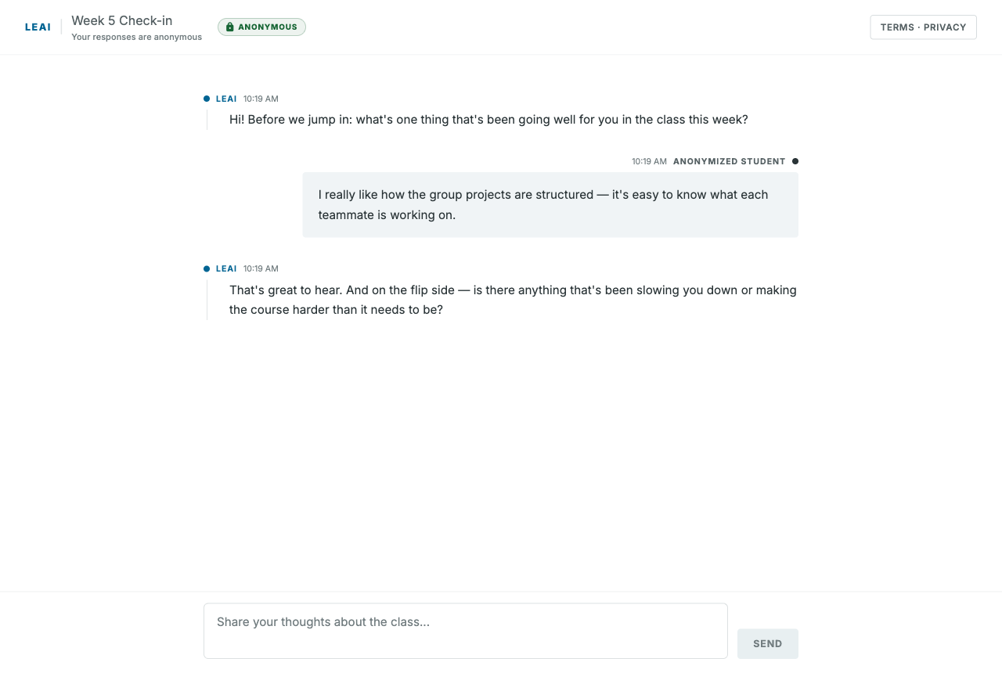
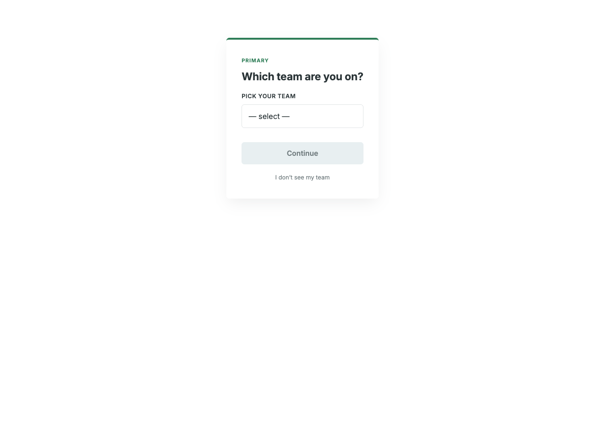
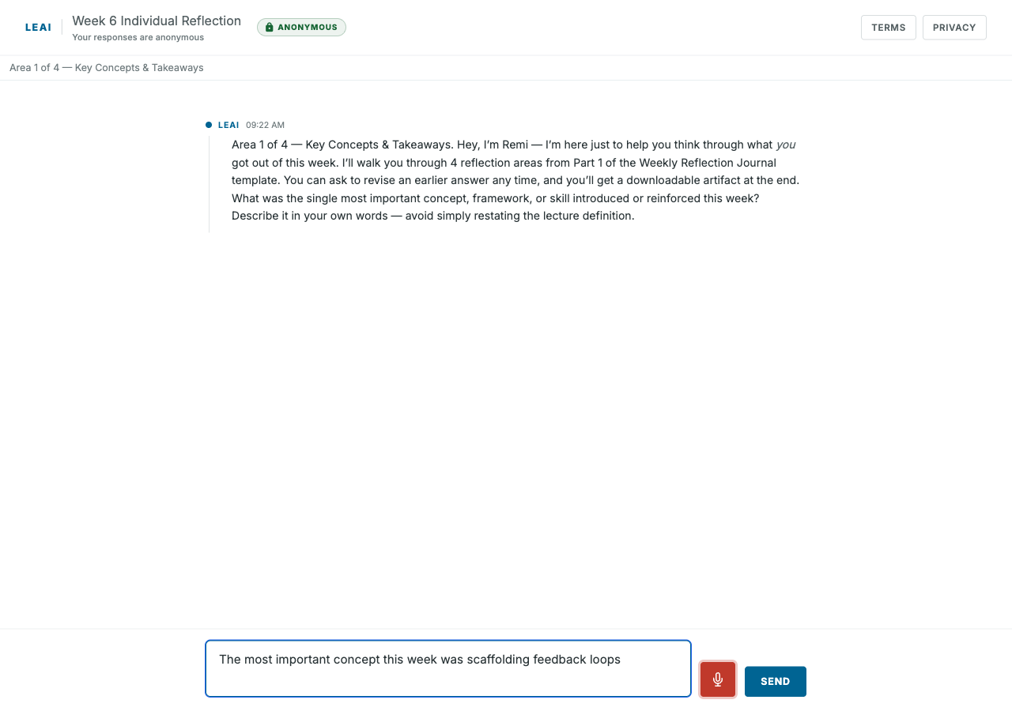
What students experience
Conversational · Anonymous · Group-aware · Voice-input

Slide 4
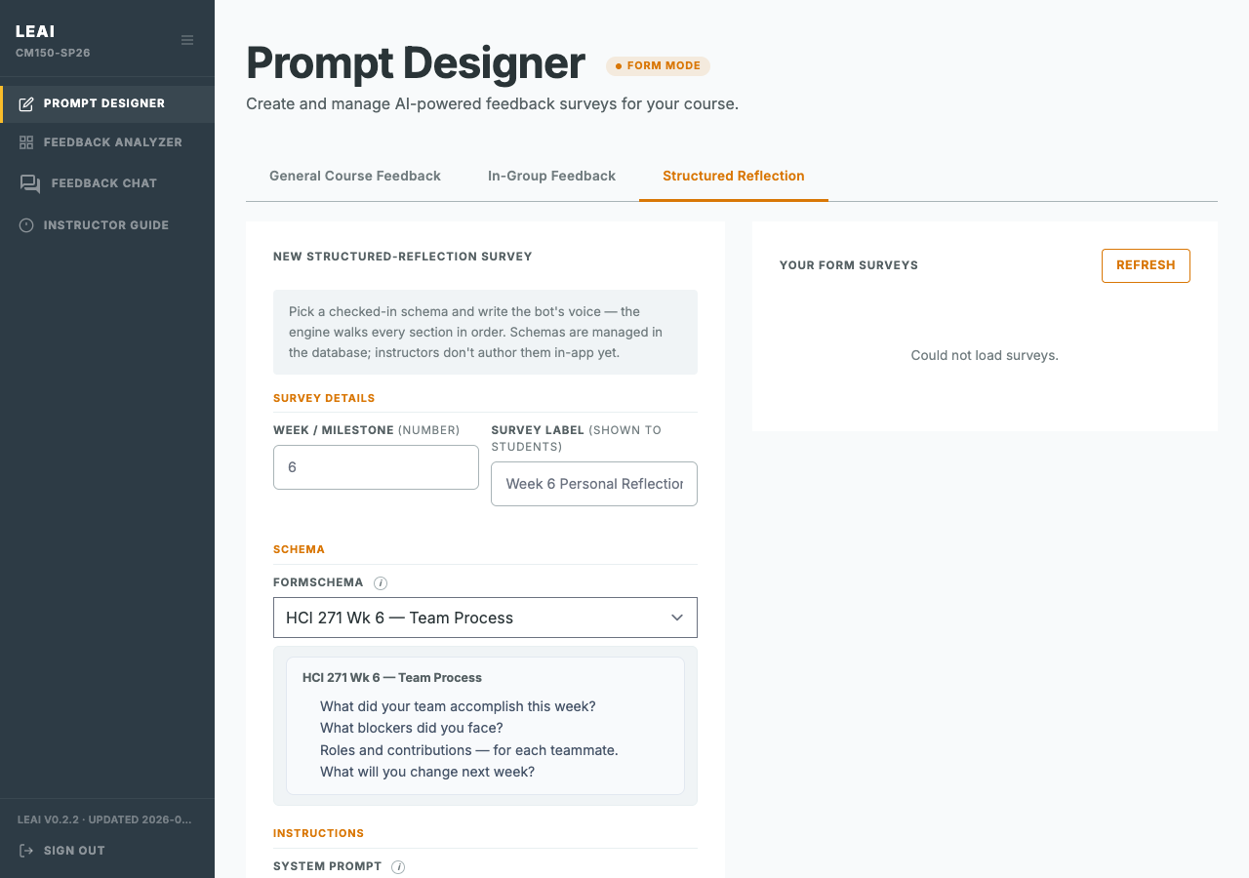
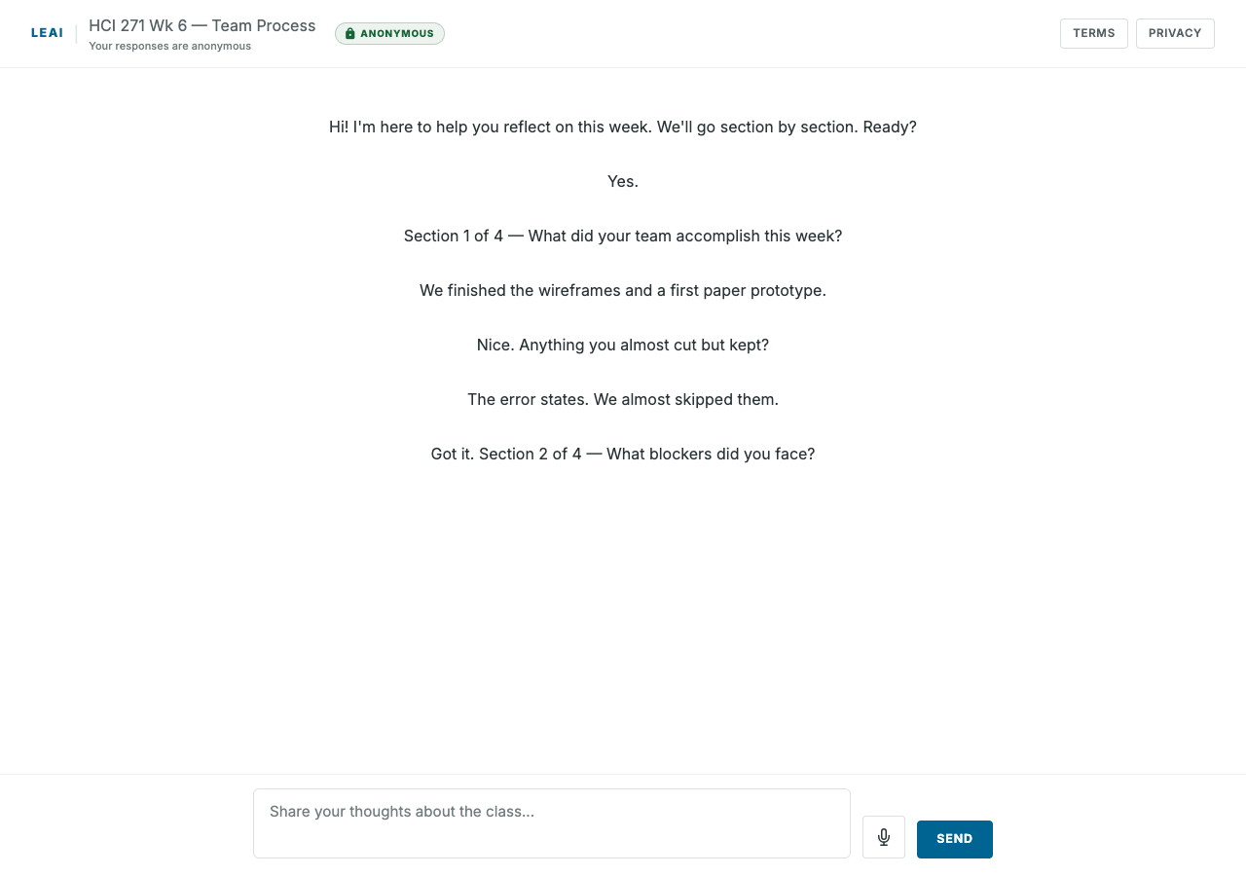
Structured Reflection — when every section must be answered
What: AI walks every section in order.
Why: When you need every section answered — for example, a graded team reflection.
How: Instructor picks a schema in Prompt Designer. Student sees a normal chat.

Slide 5
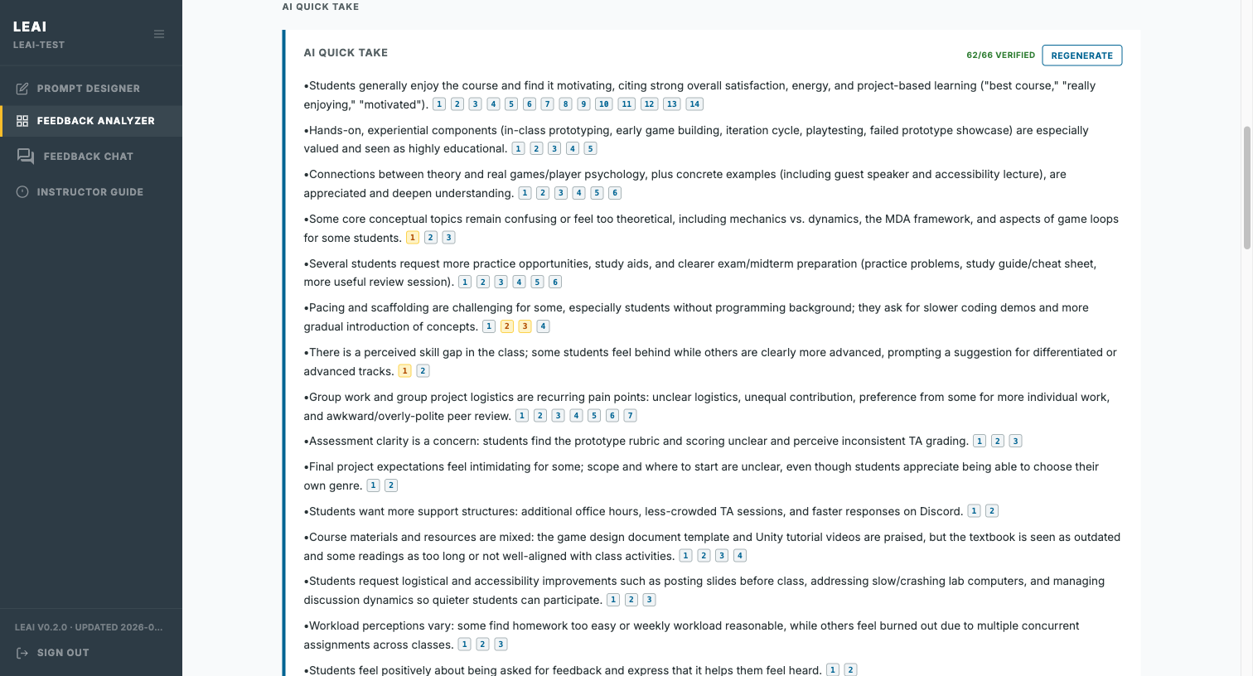
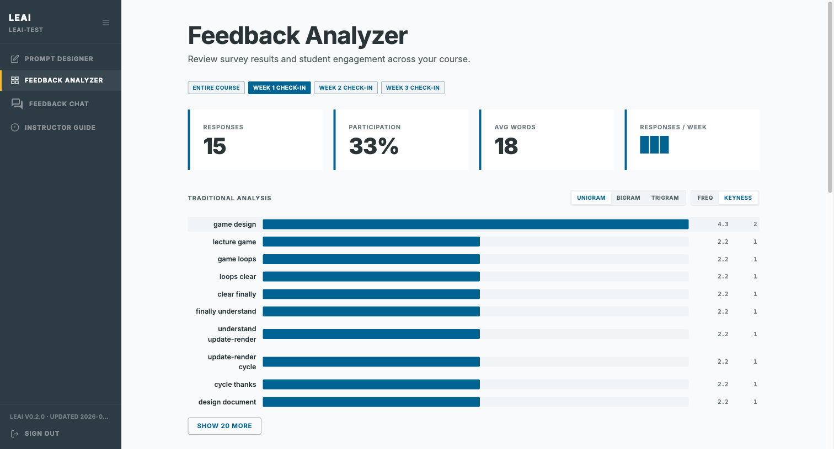
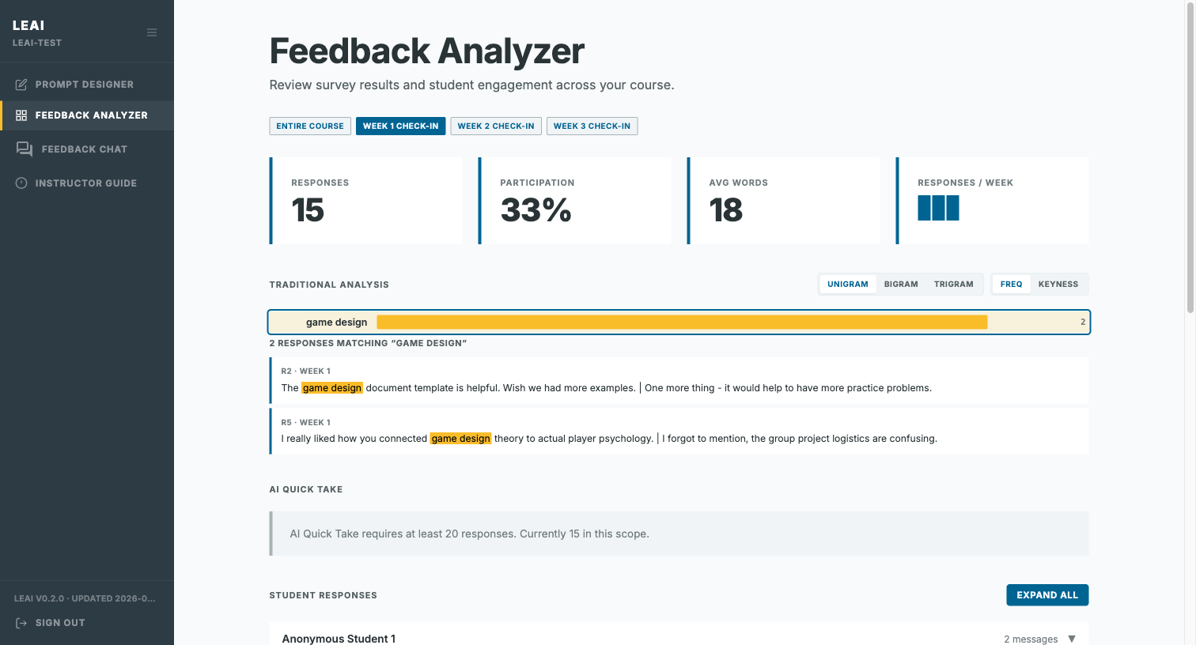
From conversations to insights
Quicktake · Keyness · Raw responses
Free-form chat is rich but messy. We did not want instructors to trust one black-box summary. Three views, so you can triangulate.
More at LEAI/instructor-guide.html

