Slide 1
CrunchBase Exploration
Find influencing factors of funding
Yi Li, Chang Sun, Jingshi Sun

Slide 2
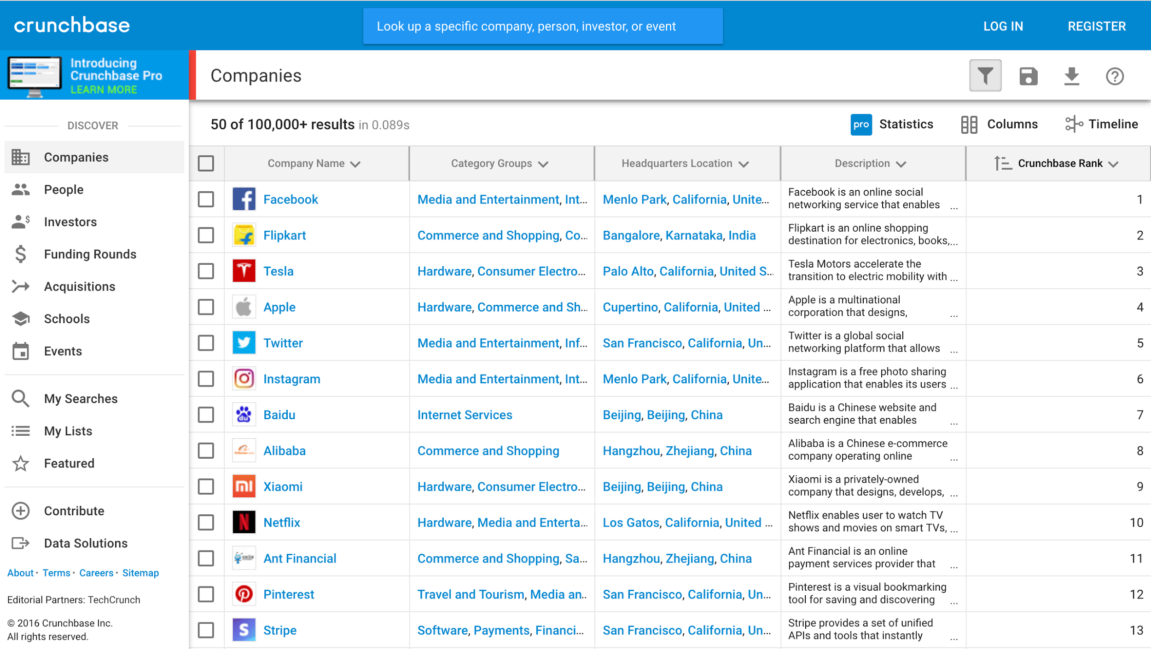
Product Screenshot
https://www.crunchbase.com/#/home/index

Slide 3
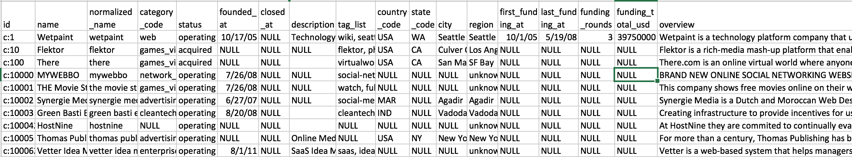
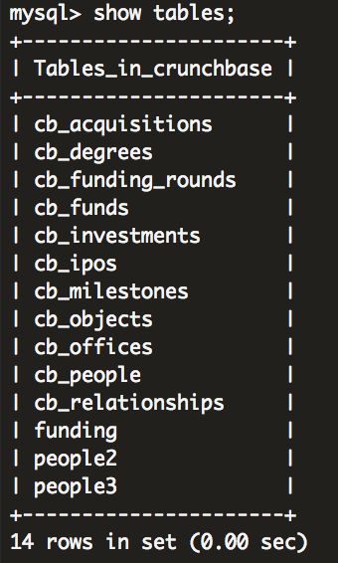
Dataset Introductions
Data problems:
Missing values
Inconsistent values
Duplicated values
Funding data choosing and cleaning
Year starts from 2000.
Funds > 1 million dollars.
Remove null values.
# Rows
9562
109610
52928
1564
80902
1259
39456
462651
112718
226709
402878

Slide 4
Literature Review
Our Goals
Methodology
Predicting investor funding behavior using crunchbase social network features by Liang, Yuxian Eugene, and Soe-Tsyr Daphne Yuan
A Supervised Approach to Predict Company Acquisition with Factual and Topic Features Using Profiles and News Articles on TechCrunch by by Xiang, Guang
Similarity Measures for Text Document Clustering by Anna Huang
Social network graph
Topic modeling
K-means clustering
Explore CrunchBase macroscopically
Find influencing factors of funding
Get insights of what companies are doing
MySQL
Data Visualization: Googlevis, matplotlib, R ggplot2
Text mining: Spark (Scala), Python, document-term matrix, tf-idf, latent semantic index (LSI), latent Dirichlet allocation (LDA), K-means and time complexity analysis.
Cluster size: 1 master, 2 cores, 4 tasks.
Time spent: 2-3 hours for LDA, 1 minute for k-means clustering, 1 minute for word counts.

Slide 5
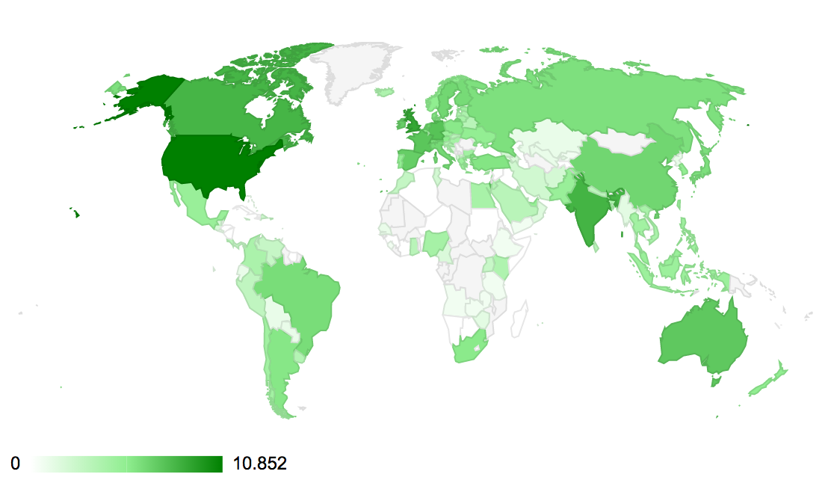
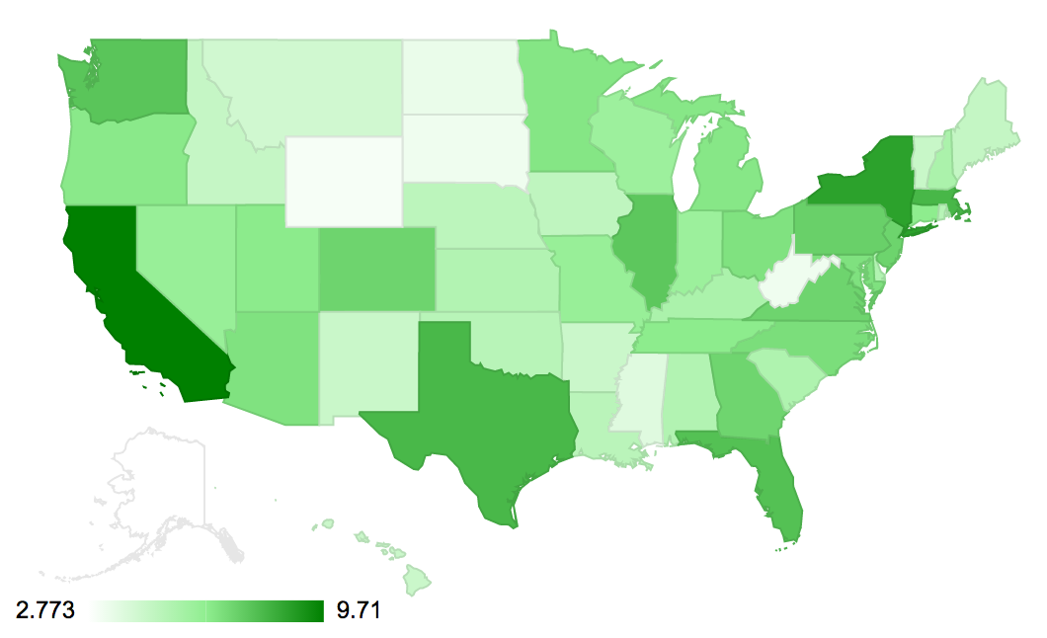
Number of Companies in Global (Countries)
Number of Companies in US (States)
Notes:
Heat maps of the number of innovative companies in our dataset.
We use log to rescale the data, because the data are so sparse.
In global, America, Britain, India, and Canada are the top four countries.
In US, California, New York, Massachusetts, and Texas are the top four states.

Slide 6
Number of Companies Created Each Year (1990-2012)
By country:
Worldwide, USA, Other Nations
US in 2011: 4294
Worldwide in 2011: 11884
By State: NY, CA
Notes:
Before 2005, companies founded in US have approximately the same number with companies founded in other nations. After 2005, there are more companies founded in other countries, but US still takes the largest proportion.
Overall trend: more companies are founded
Peak points

Slide 7
Closed Companies Boxplot: Duration (Years)
Companies founded since 2000
Company Status:
+------------+------------+
| status | count(*) |
+------------+------------+
| acquired | 9394 |
| closed | 2584 |
| ipo | 1134 |
| operating | 183441 |
+------------+------------+
Average duration: 3.63 years
Median duration: 2.92 years

Slide 8
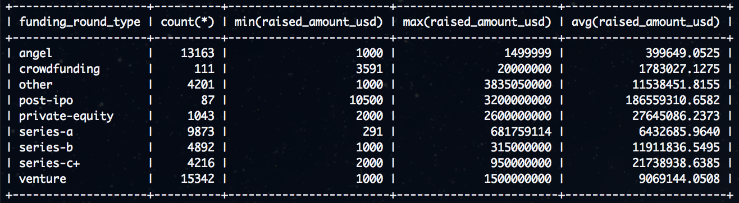
What do we most care? Fundings!
For fundings > 1 milion:
+---------------------------+-----------+
| funding_round_type | count(*) |
+---------------------------+-----------+
| angel | 801 | 6%
| crowdfunding | 36 | 32%
| other | 2006 | 48%
| post-ipo | 75 | 86%
| private-equity | 840 | 81%
| series-a | 8246 | 84%
| series-b | 4510 | 92%
| series-c+ | 4025 | 95%
| venture | 9497 | 62%
+---------------------------+-----------+
Crowdfunding: begins in 2010
Post-ipo: e.g. Zillow
Why do we choose one million as the threshold?
Because we need to cut off some small companies, and it seems to be a good threshold.
Notes:
Except post-ipo, the minimal raised amount in us dollar is similar, around 1000 dollars. According to the average raised amount, in general, the increasing order of raised amount is angel, series-a, series-b, series-c+. Other funding round type includes crowdfunding (which starts in 2010 from our dataset), post-ipo (which is very rare), private-equity, and venture.
To make our following research more meaningful, we set a threshold – one million – to cut off some small companies.

Slide 9
The Distribution of Total Fundings (million $) in US
Companies in US after 2000
total funding >= 1 million dollars
Average: $16.14m
Median: $ 3m
Notes:
The histogram of total funding is very sparse, so we used log again to rescale the data.
The mean is $16.14 million, while the median is only $ 3 million. The distribution is quite skew.

Slide 10
Industries vs. fundings
Notes:
Want to see by year? This is not meaningful, because the results are similar.
Software, web, ecommerce, and games video are the top four popular industries. However, when we look at the average funds group by the industries, we find that the relationship between the average funds and popularity is somewhat negative. This makes sense, because there are too many competitors in these industries and these industries do not need high technology or expensive equipment.
It is not surprising that industries like automotive, nanotech have high average funds. Why social ranks at the top? I don’t know. That’s what we find!

Slide 11
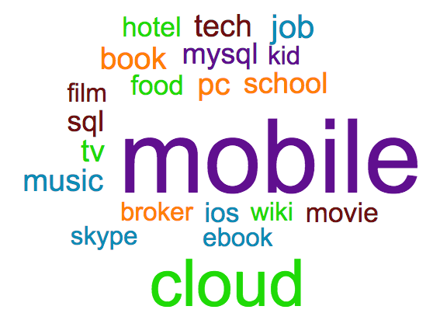
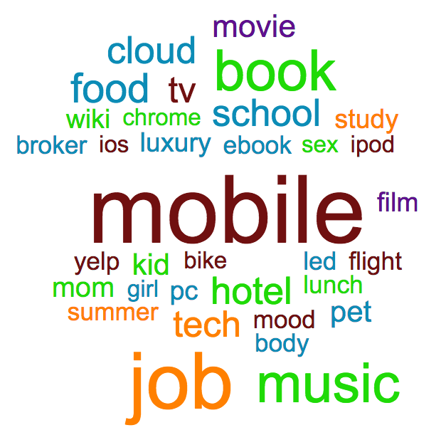
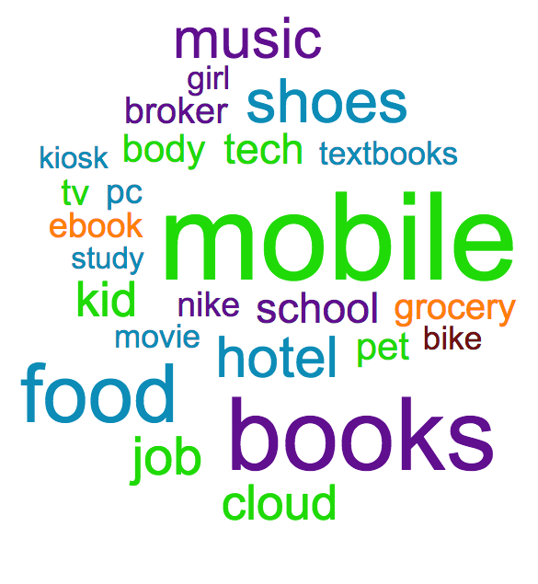
Software
Web
E-Commerce
Source: https://worditout.com/word-cloud
Notes:
Companies founded after year 2000. By categories: Software, Web, Ecommerce.
We used Scala in spark to calculate the count of each word, then we used the source website to create these graphs. Besides removing the common stop words, we also removed some meaningless words like “user” and “service”.
Our word cloud is constructed by 1) filtered out the “common words” or “stop words” 2) filtered out the words that are less relative to our topic of researching.
At this point, the rest of the words are either useful or rare.
We then pick the useful words to show and leave the rare words out.
Findings:
Companies in all three categories have “mobile” and “music” as their top 5 words.
Although all three categories are similar in terms of top 5 words, there are differences.
Companies in web categories tend to focus more on “job”, “book” and “food”.
Companies in software categories tend to focus more on “cloud”, “job” and “tv”.
Companies in e-commerce categories tend to focus more on “books”, “food” and “shoes”.

Slide 12
Funding vs. States

Slide 13
Where Do They Graduate from?
There are 1667 records of Georgetown University!
Rank 33!

Slide 14
Funding vs. Graduation Schools

Slide 15
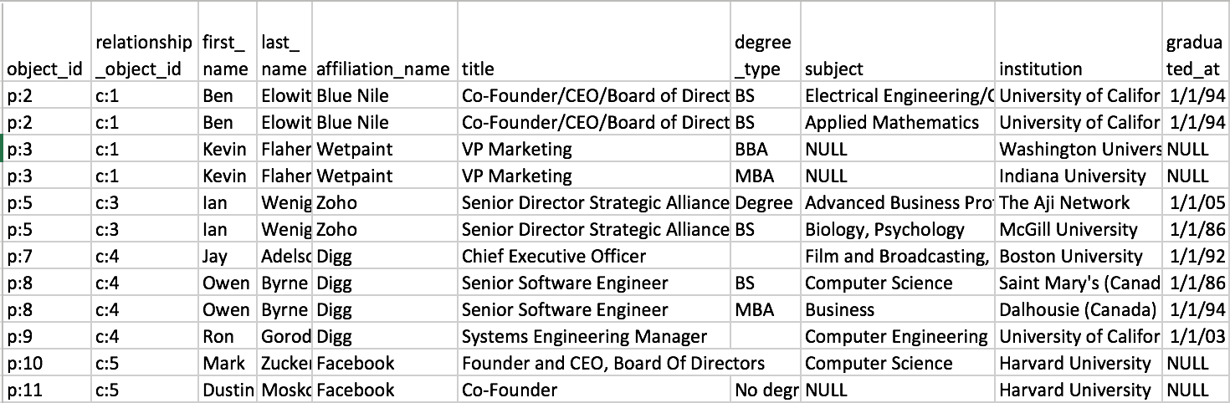
Dataset Screenshot of People
Data problems:
Duplicated values
Old information (relationship object id is not consistent with affiliation name)
Missing values ⇐ remove null values
Inconsistent values ⇐ use filter to choose “CEO”, “CFO”, et al.
Notes:
We joined the table cb_people, cb_relationship, and cb_degrees, and then exported the new table as text. The “relationship object id” comes from the table cb_relationship, and the “affiliation name” comes from the table “cb_people” itself. The “relationship object id” should be consistent with the “affiliation name”, but it sometimes does not. And we do not know which table is the newest.

Slide 16
Text Exploration on People
Latent Semantic Index
Association between MBA and titles
0.231*"mba" +
0.229*"of" +
0.228*"engineering" +
0.227*"business" +
0.212*"board" +
0.203*"bs" +
0.188*"science" +
0.180*"computer" +
0.174*"and" +
0.167*"school"
(MBA + board member) / MBA = 3864/62140 = 6.2%
(MBA + board of director) / MBA = 3602/62140 = 5.8%
(MBA + board member) / board member =
3864/16925 = 23%
(MBA + board of director) / board of director = 3602/16552 = 22%
(Founder + MBA) / Founder = 5071/46685 = 11%
(CEO + MBA) / CEO = 4745/31317 = 15%
(CFO + MBA) / CFO = 1687/6398 = 26%
(VP + MBA) / VP = 4901/23745 = 21%
Notes:
LDA too slow, no output results.
We used the latent semantic index (LSI) method to see the relation between the words. And we find a trend that MBA is combining with both engineering and business nowadays.
We also used association rule to find the relationship between the degree MBA and different titles.
23% of the board member holds a MBA degree;
22% of the board of director holds a MBA degree;
11% of the founder holds a MBA degree;
15% of the CEO holds a MBA degree;
26% of the CFO holds a MBA degree;
21% of the vice president holds a MBA degree.

Slide 17
Clustering the Overviews
Clusters | Stemmed | Not Stemmed
2 | 6.50E7 | 6.46E7
3 | 4.31E7 | 4.27E7
4 | 3.32E7 | 3.27E7
5 | 2.77E7 | 2.87E7
6 | 2.39E7 | 2.49E7
7 | 2.19E7 | 2.22E7
8 | 2.02E7 | 2.07E7
9 | 1.85E7 | 1.93E7
10 | 1.76E7 | 1.85E7
Notes:
Note: the errors are within set sum of squared errors.
Method: K-means. Time complexity: O(Nd) runs much faster than LDA
Data: 1) stemmed text. 2) unstemmed text.
As you can see, when the number of clusters increase, the errors decrease. The errors for both stemmed texts and unstemmed texts are similar. However, when looked more closely to the outputs, we found that the behaviors of stemmed texts and unstemmed texts are different. The errors for stemmed texts start to be less than errors for unstemmed texts when the number of clusters is greater than 5. When number of clusters increase from 2 to 5, the errors decrease tremendously. When the number of clusters increase from 5 to 10, the errors decrease moderately.
Thus, 5 is the elbow point. We use 5 as the number of topics for LDA.

Slide 18
Topics generated by Latent Dirichlet Allocation (LDA) vs. word cloud
0.032*"mobile" + 0.020*"develop" + 0.019*"com" + 0.018*"game" + 0.018*"application" + 0.014*"www" + 0.014*"http" + 0.011*"company" + 0.006*"android" + 0.005*"web"
0.014*"develop" + 0.011*"health" + 0.010*"company" + 0.009*"product" + 0.008*"student" + 0.008*"medicine" + 0.007*"research" + 0.007*"care" + 0.006*"educate" + 0.006*"technology" + 0.006*"use" + 0.005*"patient"
Mobile applications and games
0.017*"company" + 0.012*"provide" + 0.012*"service" + 0.011*"product" + 0.009*"offer" + 0.008*"operate" + 0.008*"found" + 0.005*"system" + 0.005*"office"
0.014*"provide" + 0.014*"business" + 0.012*"market" + 0.012*"service" + 0.011*"web" + 0.011*"management" + 0.010*"solution" + 0.009*"software" + 0.008*"technology" + 0.008*"custom" + 0.008*"develop" + 0.008*"data" + 0.007*"design" + 0.007*"media"
Healthcare and medicine
0.010*"user" + 0.009*"com" + 0.008*"online" + 0.007*"social" + 0.007*"site" + 0.006*"use" + 0.006*"make" + 0.006*"will" + 0.006*"people" + 0.006*"share" + 0.005*"new" + 0.005*"create" + 0.005*"find"
Services focus on office system
Services focus on market, data and media
Online social networks
Notes:
Note: this page contains animation.
Time complexity: O(N^2KM). It is NP-hard when number of topics is large. So we want to reduce the number of topics (i.e. find an elbow point that both produce the reasonable amount of the topics and make sense). Given the size of our data set is large, there is no way to run LDA itself and determine the optimal number of topics. We instead chose k-means clustering and its evaluations as a reference, because it only takes O(Nd) which is much faster than LDA.
5 major topics:
Mobile applications and games.
Healthcare and medicine.
Services focus on office system.
Services focus on market, data and media.
Online social networks.

Slide 19
Conclusion & Discussion
Total fundings have more to do with industries than regions and the universities that people graduate from
Mobile and cloud are becoming popular in new startups.
Major topics include mobile applications and games, healthcare and medicine, office system, market, data, media, and online social networks.
Management people typically hold a MBA degree.
Future work:
Investors vs. fundings
Study fundings by rounds
Crawl newest data from CrunchBase

