Slide 1
Code
Global.R
Load data
Ui.R - layout
shinyUI: sidebarPanel, mainPanel
Server.R
Yi Li, March 13, 2017

Slide 2
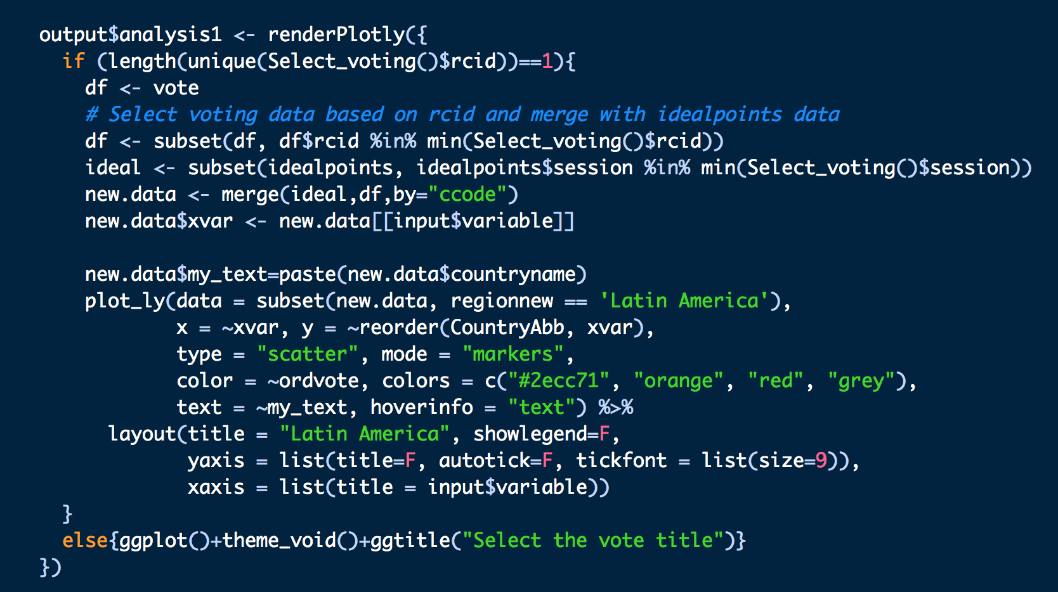
Analysis
“If … else …” is useful!

Slide 3
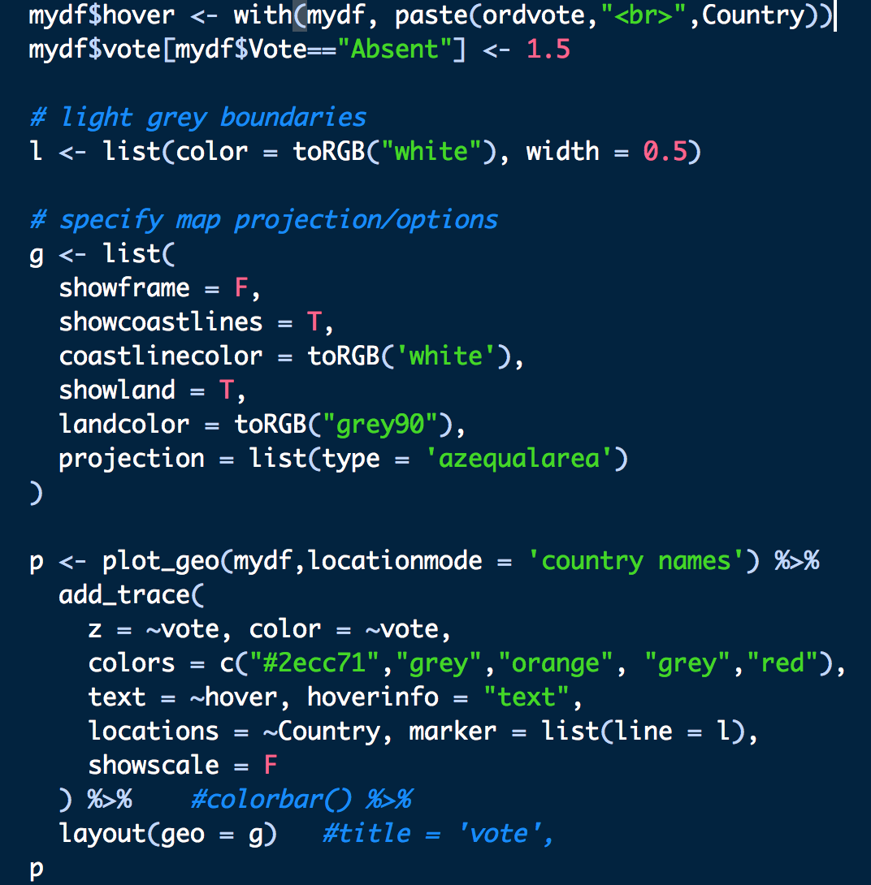
Map
"ploy_geo" uses color bar (Choropleth maps) to show the color of the variable with different values. So I set "yes" as the lowest color value - green, set "no" as the highest color value - red, and set the other two "abstain and DNV" in the middle.
If there are four vote situations: "yes, no, abstain, DNV", the color is right. (abstain - orange, DNV - grey.)
If there are two vote situations: "yes, no", the color is also right.

Slide 4
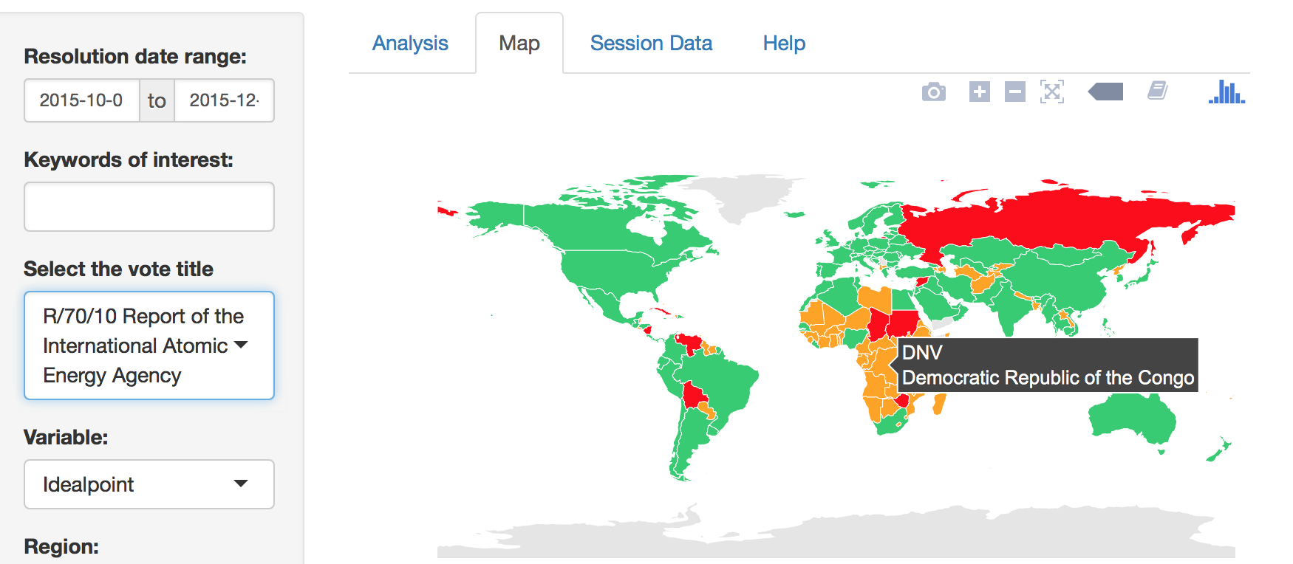
But if there are three vote situations: "yes, no, DNV", the color of "DNV" becomes orange.

Slide 5
Prediction Analysis
1. Use the data of a selected year to build a model. For example, choose the variable "Data of Year" (data.year) as 2014.
oprobit <- polr(as.factor(Vote) ~ xvar1, data = subset(new.data, new.data$year == input$data.year & new.data$regionnew == input$region), Hess = T, model = TRUE, method = "probit")
2. Use the full dataset to do prediction.
probs <- predict(oprobit, new.data, type = "probs")
3. Plot the data of the year one wants to predict. For example, choose the variable "Prediction of Year" (pred.year) as 2015.
plot_ly (data = subset(new.data, new.data$year == input$pred.year & new.data$regionnew == input$region), x = ~probs.yes, y=~reorder(CountryAbb, probs.yes), color = ~ordvote)
As I use the full dataset to do prediction in the step2, we can choose any year to make the plot. If we choose pred.year = data.year = 2014, then the training dataset and the validation dataset are the same. Usually, we choose pred.year > data.year to test the model.

Slide 6
Other Challenges
When I used the package "coefplot", there is a conflict.
"coefplot" is created based on an old version of "ggplot2", since the "ggplot2" is updated, we cannot use "coefplot" as usual. I tried to install an old version of "ggplot2" to solve the problem, but then there is another conflict of "plotly". So instead, I used another package "arm" to do the coefplot.
If there are only two observed choices, I used the probit model as following:
opglm(as.factor(Vote) ~ xvar1, data = subset(new.data, new.data$year robit <- == input$data.year & new.data$regionnew == input$region), family = binomial(link = "probit"))
Then I set "probs.no = 1 - probs.yes" without considering "probs.abstain". In this case, I suppose there is always at least one country vote yes. Here is the code:
probs <- predict(oprobit, new.data, type = "response")
new.data$probs.yes <- probs
new.data$prob.no <- 1 - probs

