Slide 1

DSA0302 - Natural Language Processing
SLOT-A
Designing Efficient Regular Expression Patterns for Information Extraction
Supervised by:
Dr. T. DEVI
Presented by:
192325038 - GUNALAN V

Slide 2


INTRODUCTION
What is a Regular Expression (Regex)?
A Regular Expression (Regex) is a sequence of characters used to search and match text patterns.
It helps extract structured information from unstructured text.
Regex is supported in many programming languages such as Python, Java, JavaScript, and C#.
Examples
Email Validation
Phone Number Extraction
URL Detection
Date Extraction

Slide 3
Common Regex Patterns
Information | Regex Pattern | Example
Email | [A-Za-z0-9._%+-]+@[A-Za-z0-9.-]+\.[A-Za-z]{2,} | student@gmail.com
Phone | \d{10} | 9876543210
Date | \d{2}/\d{2}/\d{4} | 15/07/2026
URL | https?://\S+ | https://google.com
The table shows some of the most commonly used regular expression (Regex) patterns for extracting structured information from text. Each pattern is designed to identify a specific type of data, such as email addresses, phone numbers, dates, and URLs. For example, the email pattern matches valid email formats, the phone pattern identifies 10-digit phone numbers, the date pattern recognizes dates in the DD/MM/YYYY format, and the URL pattern detects web addresses beginning with http or https. These regex patterns are widely used in Natural Language Processing (NLP) for data validation, information extraction, text preprocessing, and automating the retrieval of meaningful information from unstructured text.

Slide 4
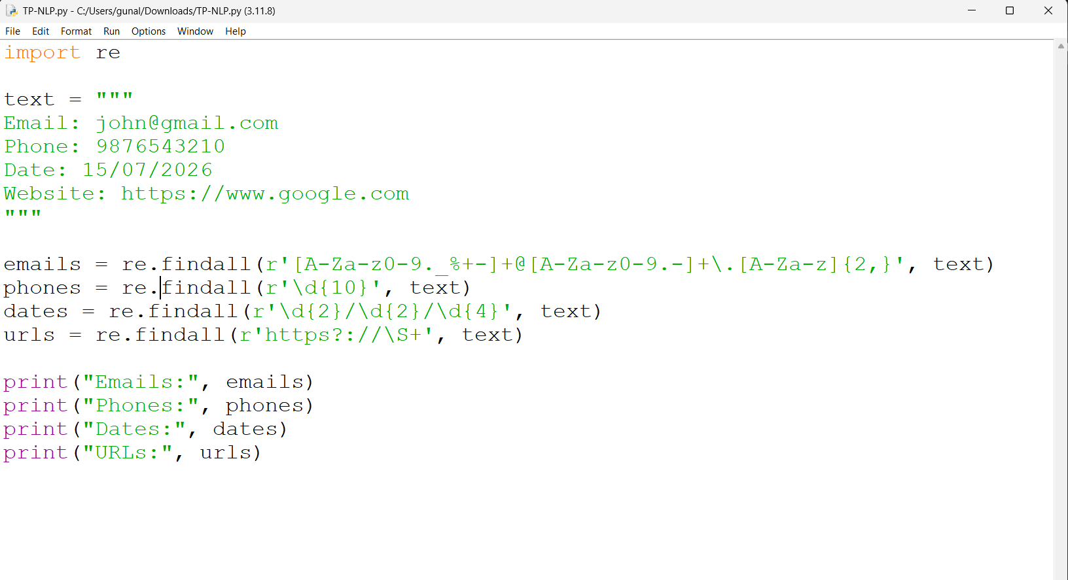
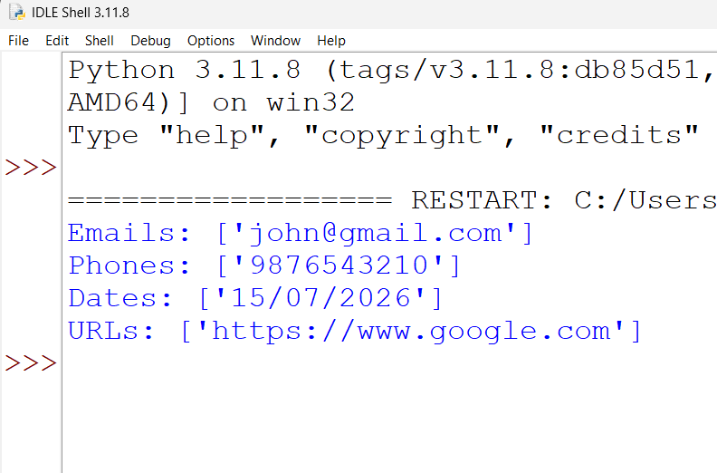
Python Implementation
What is the re Library?
re stands for Regular Expression it also built-in Python library (no installation required). It provides functions to search, match, extract, and replace text patterns and It is widely used in Natural Language Processing (NLP) and text preprocessing.

Slide 5
Applications
Regular Expressions (Regex) are widely used to extract, validate, and process text data in various real-world applications.
Email Validation – Verify email addresses during user registration.
Phone Number Extraction – Identify and extract contact numbers from documents.
URL Detection – Recognize and retrieve website links from text.
Data Preprocessing – Clean and prepare text data for NLP and Machine Learning.
Web Scraping – Extract structured information from websites.
Log File Analysis – Search and analyze system or server logs.
Search Engines – Improve keyword searching and text filtering.
Chatbots and Information Retrieval – Identify patterns in user input for faster responses.
Key Insights
Regex automates the extraction of structured information from unstructured text.
It reduces manual effort and minimizes human errors.
Efficient regex patterns improve the speed and accuracy of text processing.
Regex is an essential preprocessing technique in Natural Language Processing (NLP).
It is simple to implement and supported by most programming languages.

Slide 6
Advantages & Conclusion
Advantages
Fast pattern matching
Easy to implement
Reduces manual work
Supports automation
Works across many programming languages
Conclusion
Regex is an essential NLP preprocessing tool.
It efficiently extracts structured information from text.
It improves the accuracy and speed of text-processing applications.

Slide 7
Thank you

