Slide 1
Study Buddy
A Canvas Application

Slide 2
Group Introduction
Sai Naga Anu Teja Gunda
- Developer
Bala Shankar Malladi
- Developer
Roopin Vipparthi
- Testing

Slide 3
How to find Application on web
We can find the application by clicking the link : study-buddy-frontend.herokuapp.com/

Slide 4
Why this application
This application mainly used for students to work on assignments and receive notifications regarding course information provided by instructor.
This application also helps Instructor to communicate with students about examinations, meetings, grades and assignments.
EDUCATION is the main purpose of the application by making students and instructors to do all the tasks at a single place.

Slide 5
Tech Stack
React Js for the front-end application.
Node Js for the back-end application.
Mongo dB for the storage.
Heroku for app deployment.
Html and CSS for language and style sheets.

Slide 6
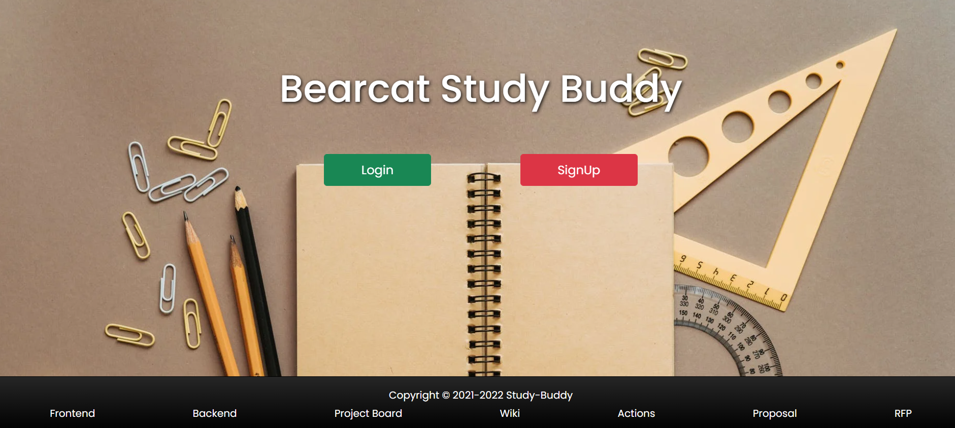
Demo Show

Slide 7
Lessons Learnt
React js and Node js
Codacy
Github
Mongodb and heroku
Auth0 Authentication.
Responsive
Teamwork

Slide 8
Links
Repo
Codacy
Wiki
Project Board
Proposal
RFP
Deployment link
Back-end Repo
Front end Repo
Actions
Issues
Milestones

Slide 9
Thank You

