Slide 1
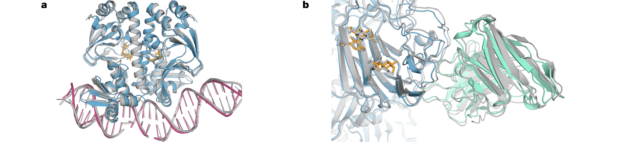
From Target Chemistry to AI-Assisted PD
Use what you know about target structure and chemical recognition.
Ask how AI helps choose molecules and the experiments that test them.
Published AF3 complexes: different molecules require different recognition models.
Abramson et al., Nature 630, 493–500 (2024).
7
Notes:
Connect to prior target classes without reteaching the pharmacology chapters. These are published predictions, not calculations made for this lesson. Source: Abramson et al., Nature 630, 493–500 (2024).

Slide 2
Follow a Drug–Target Research Question
Define the interaction or effect before choosing a tool.
Move from a target to a testable chemical decision.
Target
What biological question?
↓
Structure / pocket
Where could it bind?
↓
Candidate molecules
What should be tested?
↓
Experiments
Binding and function
↓
Next choice
Use the new evidence
Target → structure → candidates → experiments → next decision.
Teaching workflow.
8
Notes:
Source: Teaching workflow.

Slide 3
AI Tools for Pharmacodynamic Research
Choose by the question, the available data and the meaning of the output.
Research question | Example tool | Typical result
What could the complex look like? | AlphaFold 3 | Predicted 3D arrangement
Where might a ligand bind? | P2Rank / PrankWeb | Candidate binding pockets
How might a ligand fit? | GNINA | Docked poses and scores
Which pairs look promising? | Boltz-2 | Structure and binding outputs
Which analogue may be active? | Chemprop | Assay-trained predictions
What could we make next? | REINVENT 4 | Candidate chemical structures
Examples of useful research tools—not a popularity or performance ranking.
Official documentation and original tool papers; details in notes.
9
Notes:
Sources: https://www.nature.com/articles/s41586-024-07487-w ; https://prankweb.cz/ ; https://github.com/gnina/gnina ; https://github.com/jwohlwend/boltz/blob/main/docs/prediction.md ; https://chemprop.readthedocs.io/ ; https://doi.org/10.1186/s13321-024-00812-5 . Tools differ in training needs, licensing and setup. Source: Official documentation and original tool papers; details in notes.

Slide 4
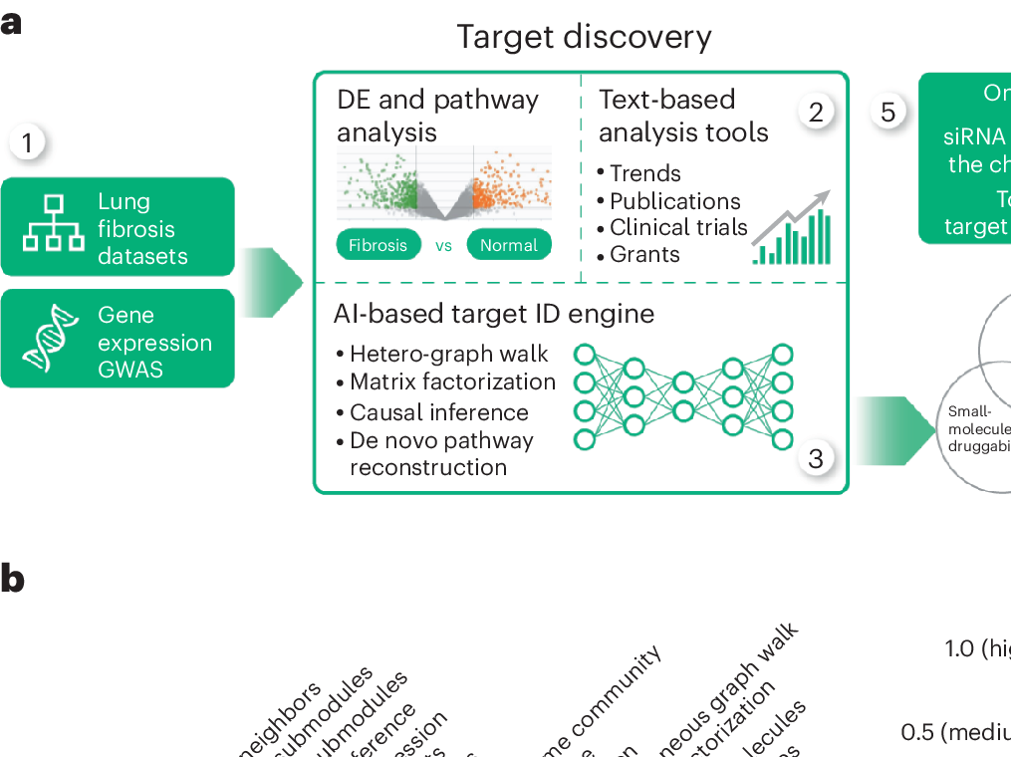
Use Disease Evidence to Prioritize Targets
Combine disease-related measurements with established biological knowledge.
AI ranking proposes a target; it does not validate the target.
TNIK study: biological evidence used in target prioritization.
Ren et al., Nat. Biotechnol. 43, 63–75 (2025; online 2024).
10
Notes:
Input-evidence panel from the published workflow. Explain genes, proteins and disease associations, not the model architecture. Source: Ren et al., Nat. Biotechnol. 43, 63–75 (2025; online 2024).

Slide 5
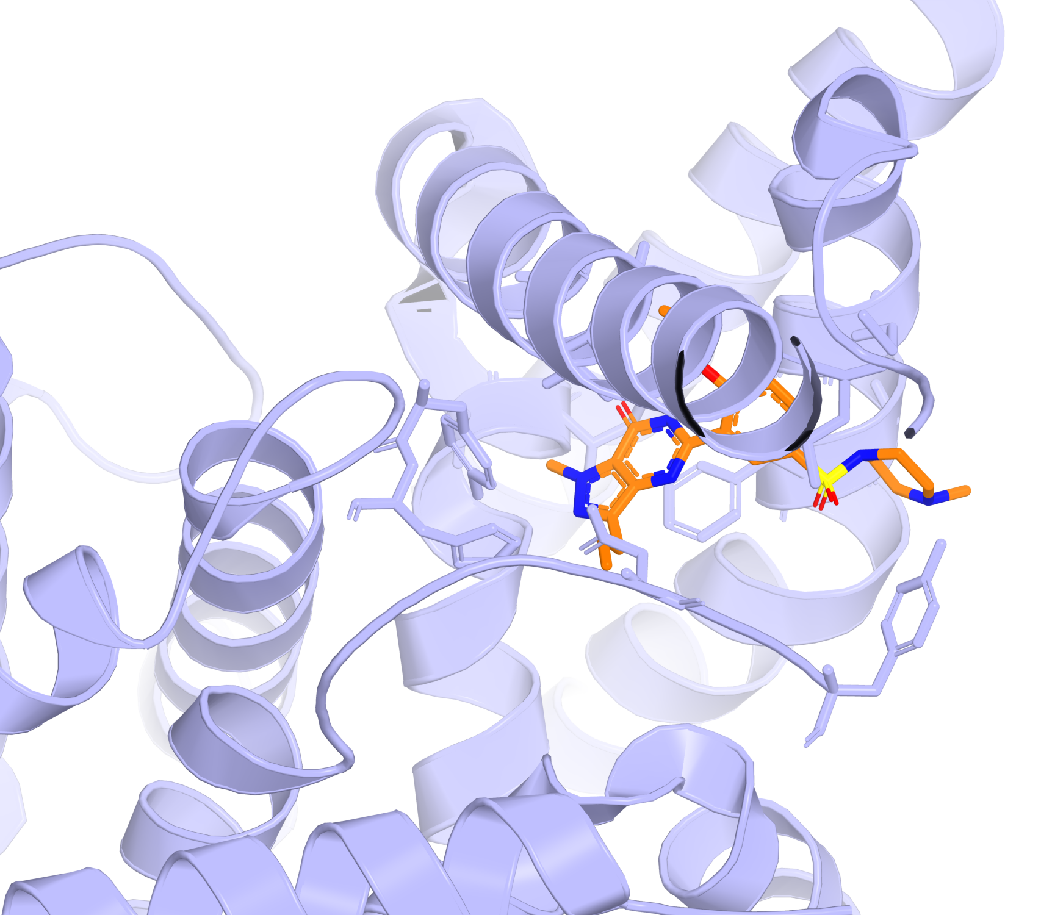
Enzymes: Start from a Real Binding Complex
Sildenafil–PDE5 provides a known inhibitor and a defined pocket.
Use that reference to prepare an AI-assisted screening question.
Experimental sildenafil–PDE5 structure, PDB 1UDT.
RCSB PDB 1UDT.
11
Notes:
Sildenafil was not discovered by the AI methods taught here. This experimental reference is specific to the stated enzyme project. Source: RCSB PDB 1UDT.

Slide 6
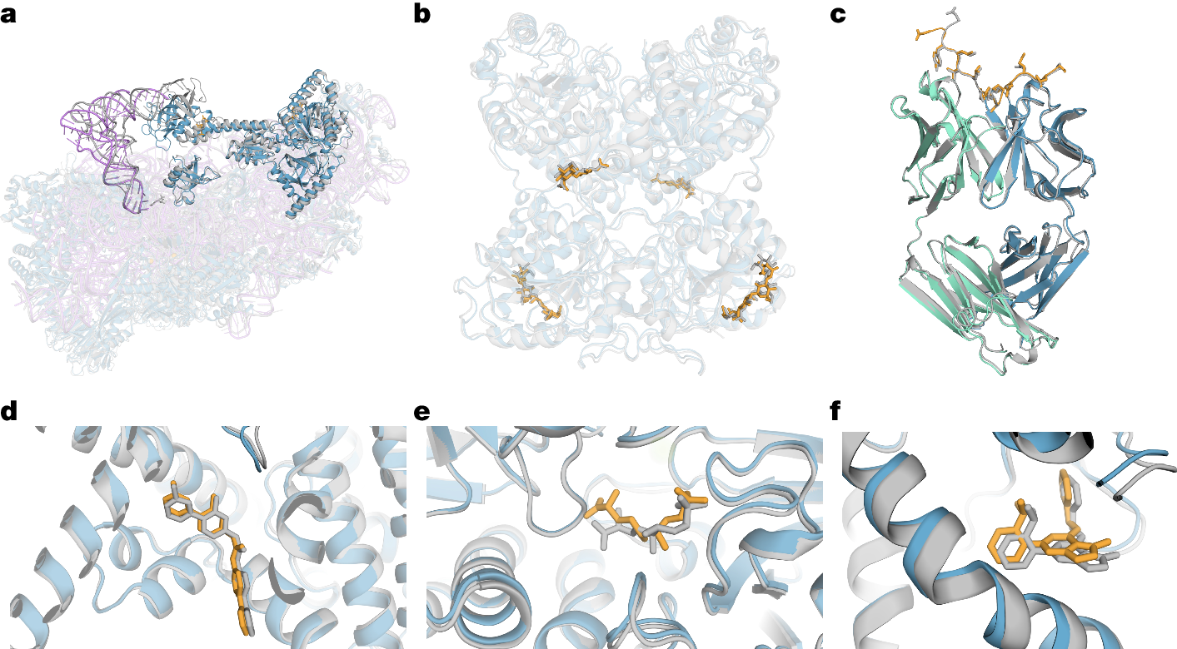
Predict a Complex When a Structure Is Missing
Provide the identities of the interacting molecules.
Use predicted geometry as a starting hypothesis—not measured activity.
AF3 examples include protein–RNA, antibody and small-molecule complexes.
Abramson et al., Nature 630, 493–500 (2024).
12
Notes:
Published Figure 3. Blue/green: predicted proteins; orange: predicted ligands/glycans; purple: predicted RNA; grey: experimental comparison. Explain selected examples, not numerical structure metrics. Source: Abramson et al., Nature 630, 493–500 (2024).

Slide 7
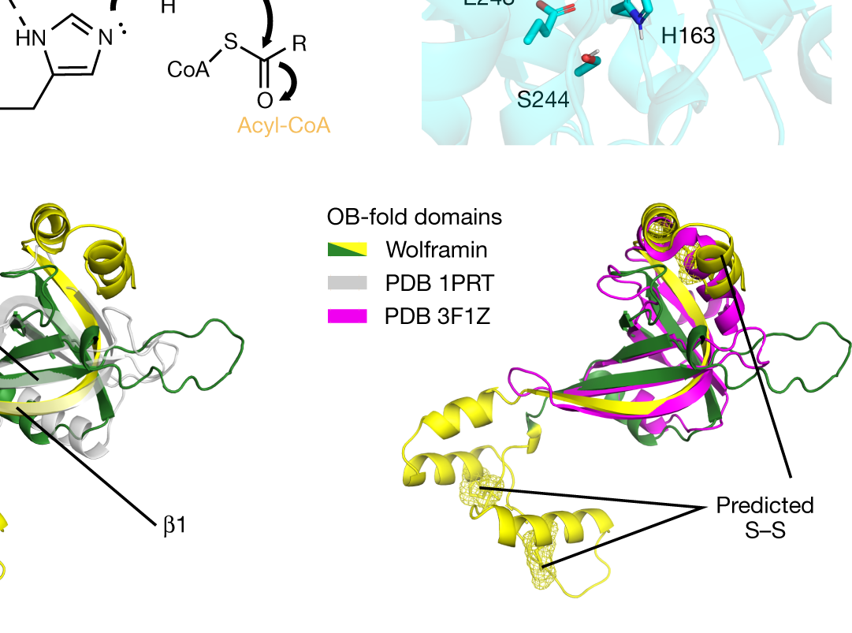
Find Candidate Pockets with P2Rank
A pocket predictor highlights regions that may bind a ligand.
Known chemistry and experiments help decide which site matters.
Published DGAT2 pocket illustration; a candidate region is not a confirmed drug site.
Tunyasuvunakool et al., Nature 596, 590–596 (2021); P2Rank.
13
Notes:
The panel concerns DGAT2 and predicted pocket features. P2Rank/PrankWeb proposes binding regions, not affinity or cellular efficacy. Source: Tunyasuvunakool et al., Nature 596, 590–596 (2021); P2Rank.

Slide 8
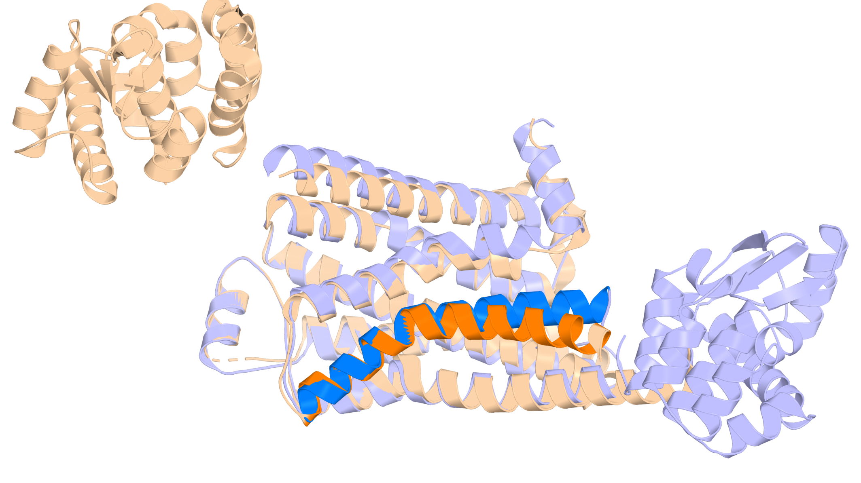
GPCRs: Choose the Relevant Receptor State
Active and inactive receptors present different binding environments.
Choose the state relevant to the prediction and functional assay.
β₂-adrenoceptor: inactive and active experimental structures; TM6 highlighted.
RCSB PDB 2RH1 and 3SN6; Rasmussen et al., Nature 477, 549–555 (2011).
14
Notes:
Inactive blue; active wheat/orange. The overlay is a comparison of experimental states, not a computed transition or thermodynamic ensemble. Source: RCSB PDB 2RH1 and 3SN6; Rasmussen et al., Nature 477, 549–555 (2011).

Slide 9
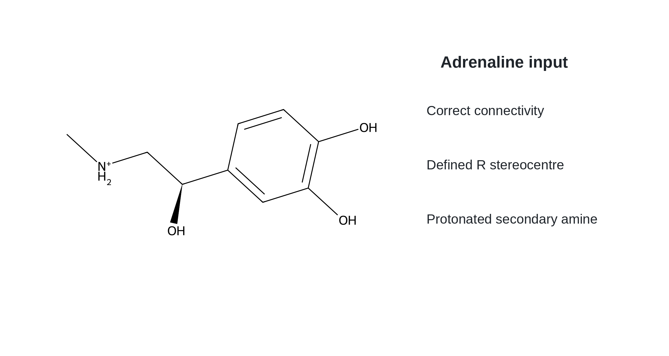
Give the Tool the Correct Chemical Structure
Keep connectivity, charge and stereochemistry explicit.
Adrenaline illustrates why those chemical details cannot be ignored.
R-adrenaline shown with a protonated secondary amine.
Original chemical illustration; molecular identity checked computationally.
15
Notes:
The input form is a teaching example. No numerical affinity or activity is assigned. Source: Original chemical illustration; molecular identity checked computationally.

Slide 10
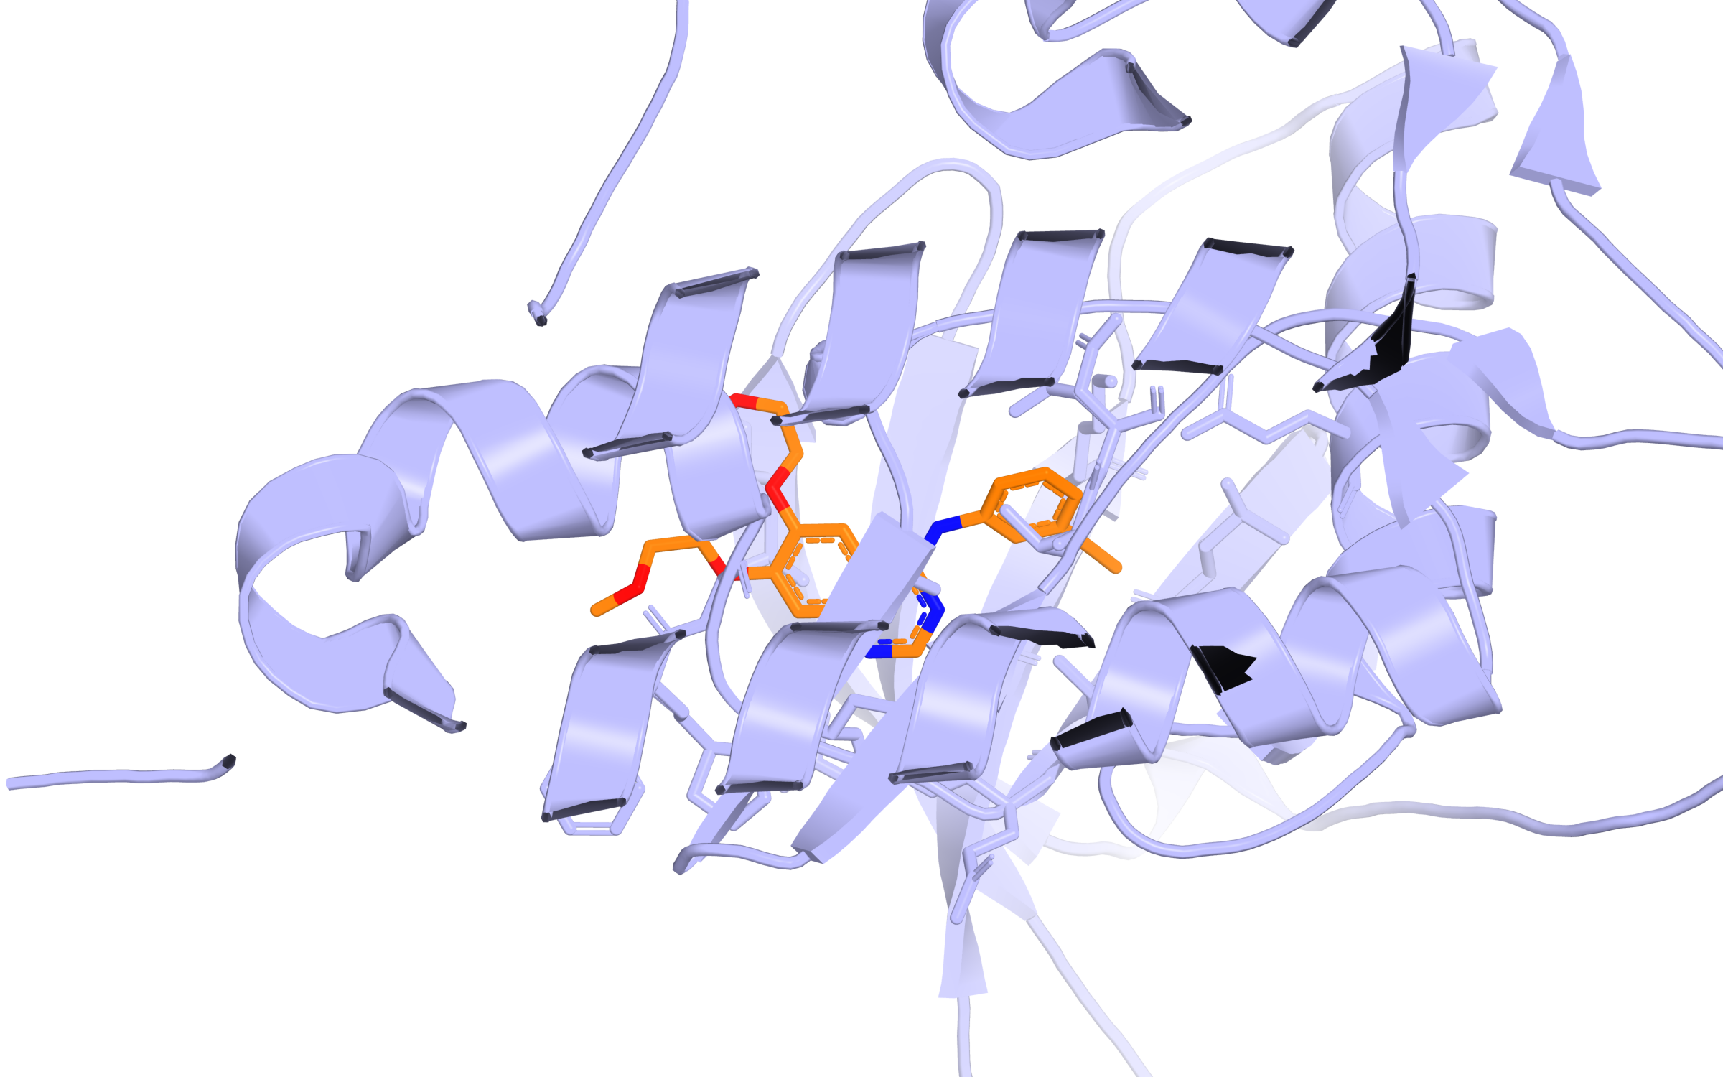
Docking: Propose and Test a Binding Pose
GNINA can rank proposed ligand arrangements with learned scoring.
Use this experimental EGFR complex as a reference—not a new prediction.
Experimental erlotinib–EGFR reference, PDB 1M17; not a new GNINA result.
McNutt et al., J. Cheminform. 17, 28 (2025). RCSB PDB 1M17.
16
Notes:
This defined kinase–inhibitor complex explains what a pose is and what redocking would try to recover. Conventional sampling and AI scoring are different operations. Source: McNutt et al., J. Cheminform. 17, 28 (2025). RCSB PDB 1M17.

Slide 11
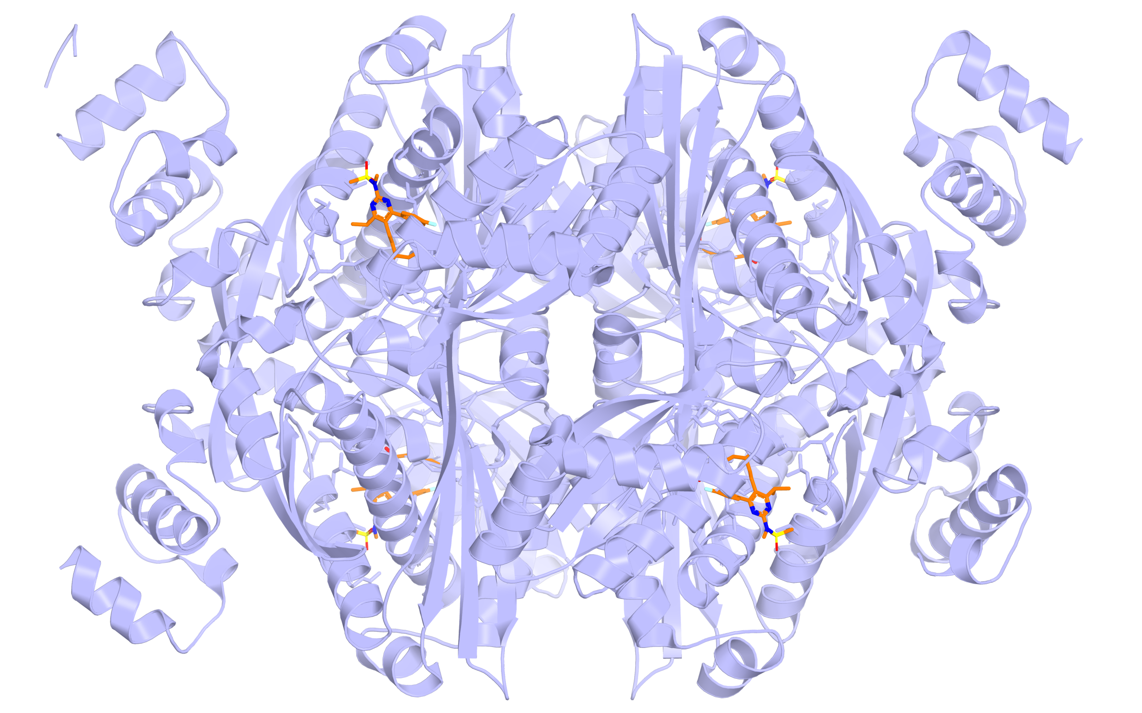
Use Chemical Contacts to Inspect a Prediction
Check whether polar and nonpolar groups face suitable regions.
A plausible contact pattern is not a measurement of binding strength.
Rosuvastatin in the experimental HMG-CoA reductase complex, PDB 1HWL.
Istvan & Deisenhofer, Science 292, 1160–1164 (2001); PDB 1HWL.
17
Notes:
The experimental statin complex is used as a chemically specific reference for inspecting model predictions. The drug is not described as AI-discovered. Source: Istvan & Deisenhofer, Science 292, 1160–1164 (2001); PDB 1HWL.

Slide 12
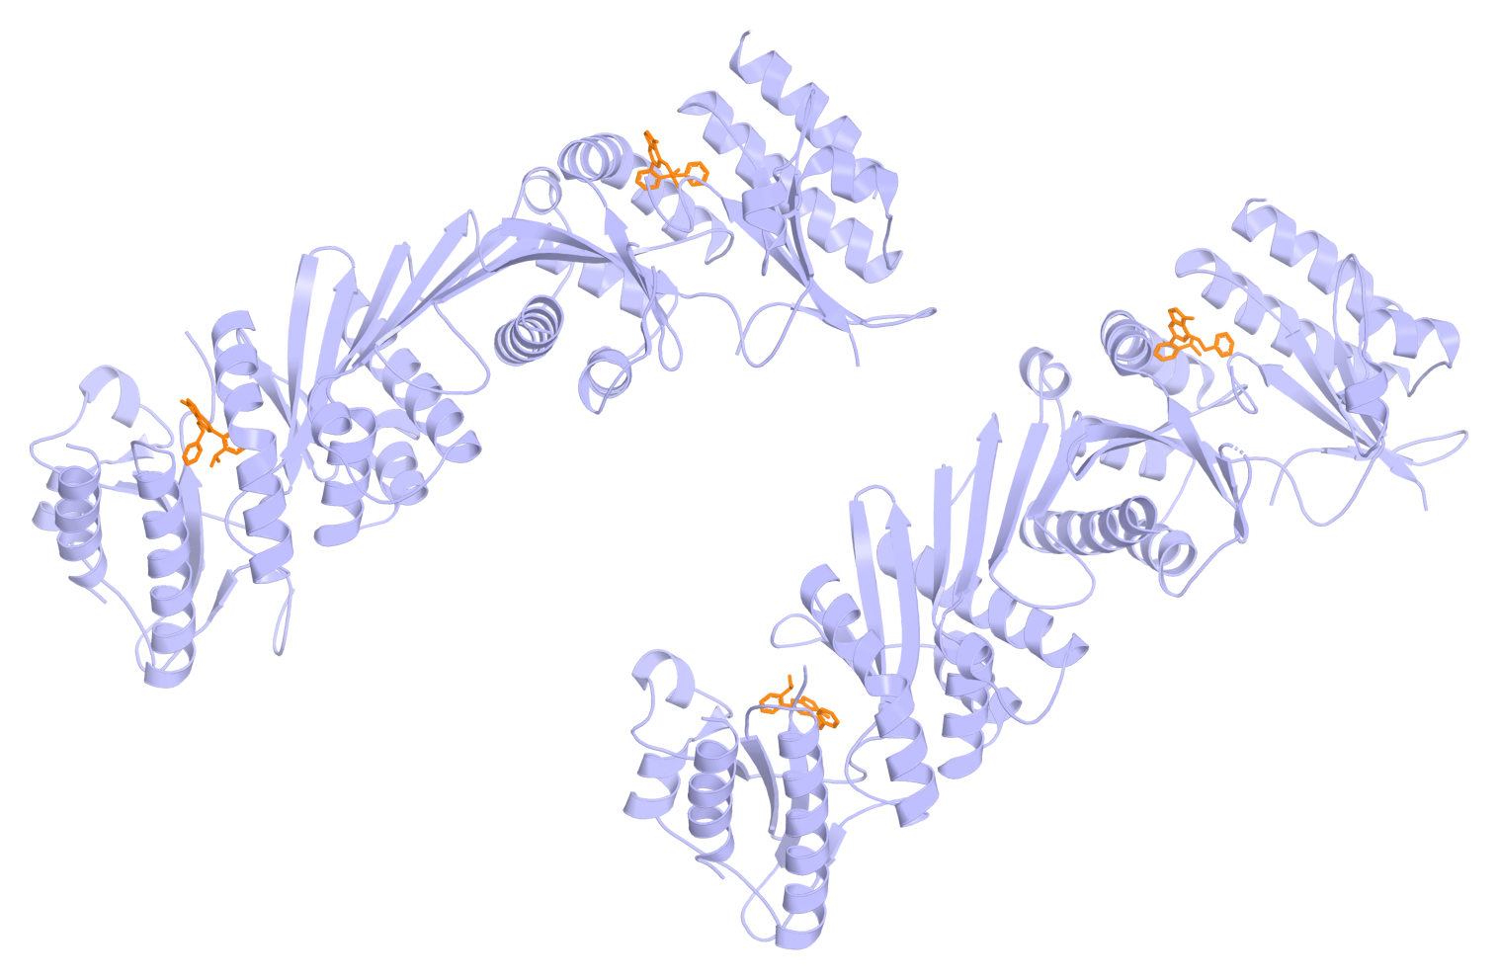
Search Beyond the Usual Active Site
An allosteric ligand can act at a different pocket.
Specify the intended site when predicting or scoring binding.
Experimental allosteric inhibitor complex of PI5P4Kγ, PDB 7QIE.
Abramson et al., Nature 630, 493–500 (2024). RCSB PDB 7QIE.
18
Notes:
The AF3 paper includes this allosteric-site example. This new rendering uses experimental coordinates; it is not the published AF3 prediction. Source: Abramson et al., Nature 630, 493–500 (2024). RCSB PDB 7QIE.

Slide 13
Boltz-2: Read the Right Output
Structural confidence, binding likelihood and activity estimates are different.
Validate the particular claim represented by each output.
Structure
Is this molecular arrangement plausible?
Binding-related prediction
What precisely was the model trained to predict?
Experimental result
Which binding or functional assay checks it?
A confident-looking structure is not an experimental binding measurement.
Boltz-2 original paper and official prediction documentation (2025).
19
Notes:
Do not teach logarithmic score conversion. Do not rename predicted activity as experimental Kd. Model setup and its documented applicability matter. Source: Boltz-2 original paper and official prediction documentation (2025).

Slide 14
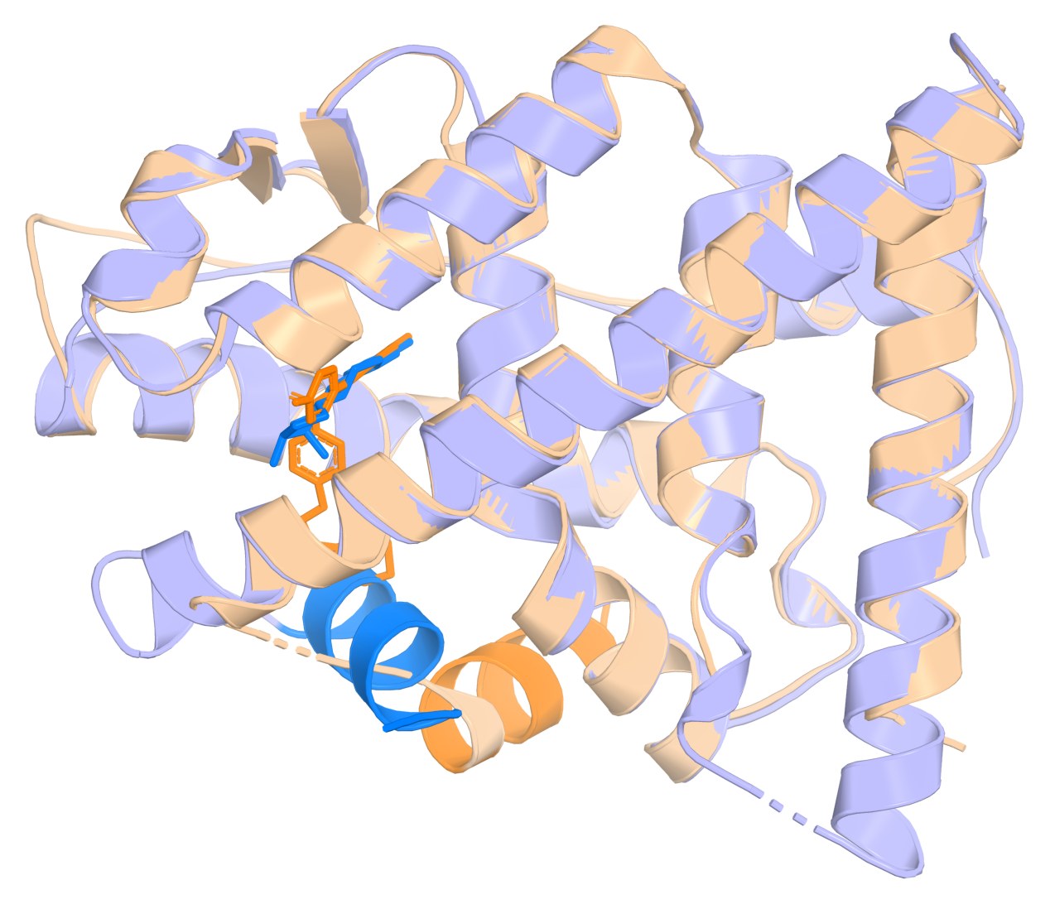
Nuclear Receptors: A Pose Does Not Define Function
Oestradiol and raloxifene stabilize different receptor arrangements.
An AI binding pose still needs a matching receptor-response assay.
Oestrogen receptor comparison: oestradiol blue; raloxifene wheat/orange.
Brzozowski et al., Nature 389, 753–758 (1997); PDB 1ERE/1ERR.
20
Notes:
Helix 12 is highlighted. Raloxifene is a selective oestrogen receptor modulator with tissue-dependent effects, not a universal antagonist. Source: Brzozowski et al., Nature 389, 753–758 (1997); PDB 1ERE/1ERR.

Slide 15
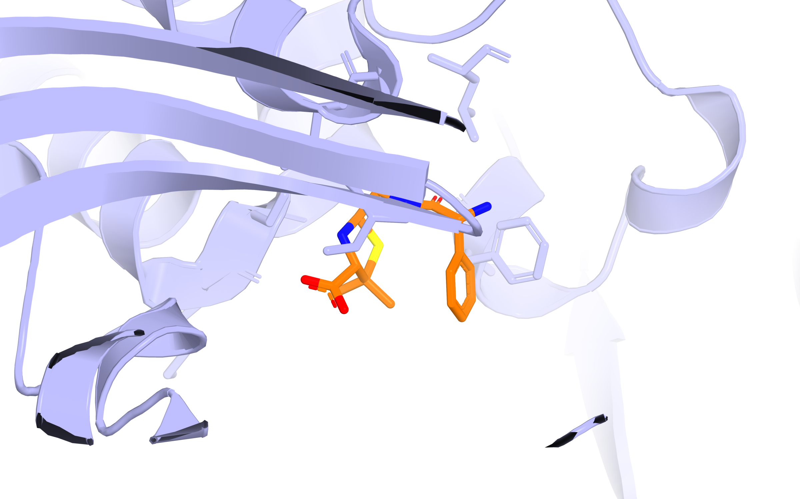
Covalent Inhibitors: Model the Bound Chemistry
Ampicillin forms a covalent acyl-enzyme complex with a PBP.
Use covalent-aware preparation; docking does not predict the reaction.
Experimental covalent ampicillin–PBP4 complex, PDB 2EX6.
Kishida et al., Biochemistry 45, 783–792 (2006). McNutt et al., J. Cheminform. 17, 28 (2025).
21
Notes:
PBP4 is a cell-wall-remodelling DD-peptidase, not the bifunctional PBP1b. GNINA covalent docking requires the bound form; it does not predict the reaction. Its CNN was not trained on covalent complexes. Source: Kishida et al., Biochemistry 45, 783–792 (2006). McNutt et al., J. Cheminform. 17, 28 (2025).

Slide 16
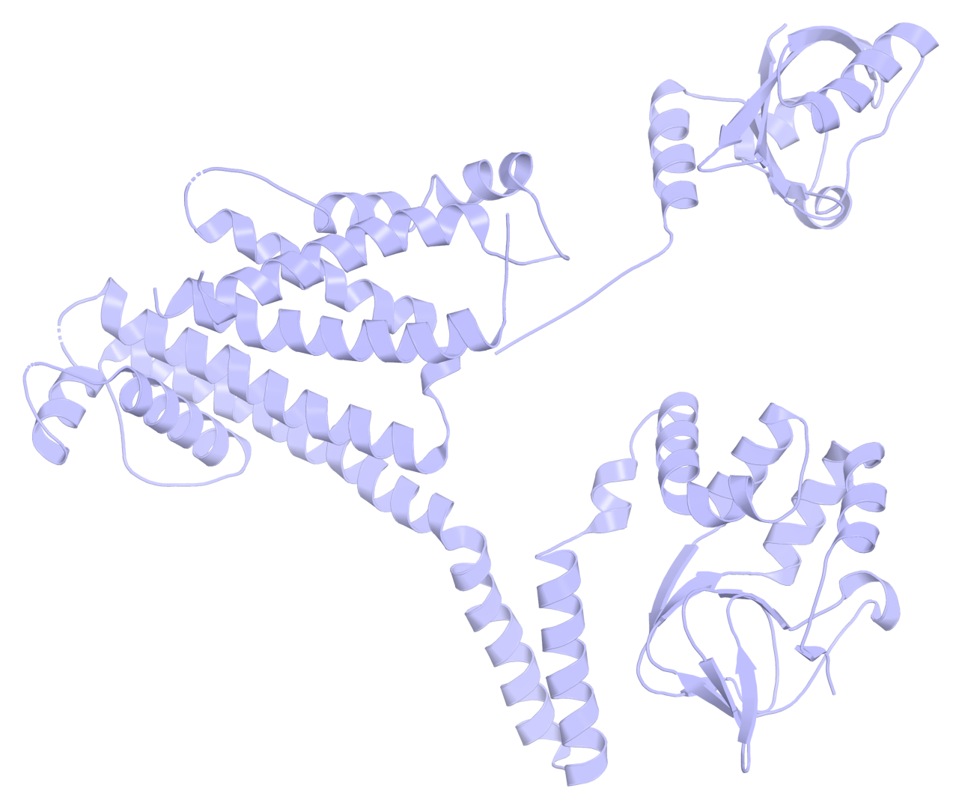
Ion Channels: Flag Possible hERG Blockers
HERGAI predicts hERG inhibition from molecule–channel information.
Use the prediction to prioritize electrophysiology tests.
Experimental hERG channel structure, PDB 5VA1; no blocker pose is asserted.
Tran-Nguyen et al., J. Cheminform. 17, 110 (2025); PDB 5VA1.
22
Notes:
hERG is a potassium channel. A blocker prediction is not a probability of clinical arrhythmia. No architecture or threshold calculations are needed. Source: Tran-Nguyen et al., J. Cheminform. 17, 110 (2025); PDB 5VA1.

Slide 17
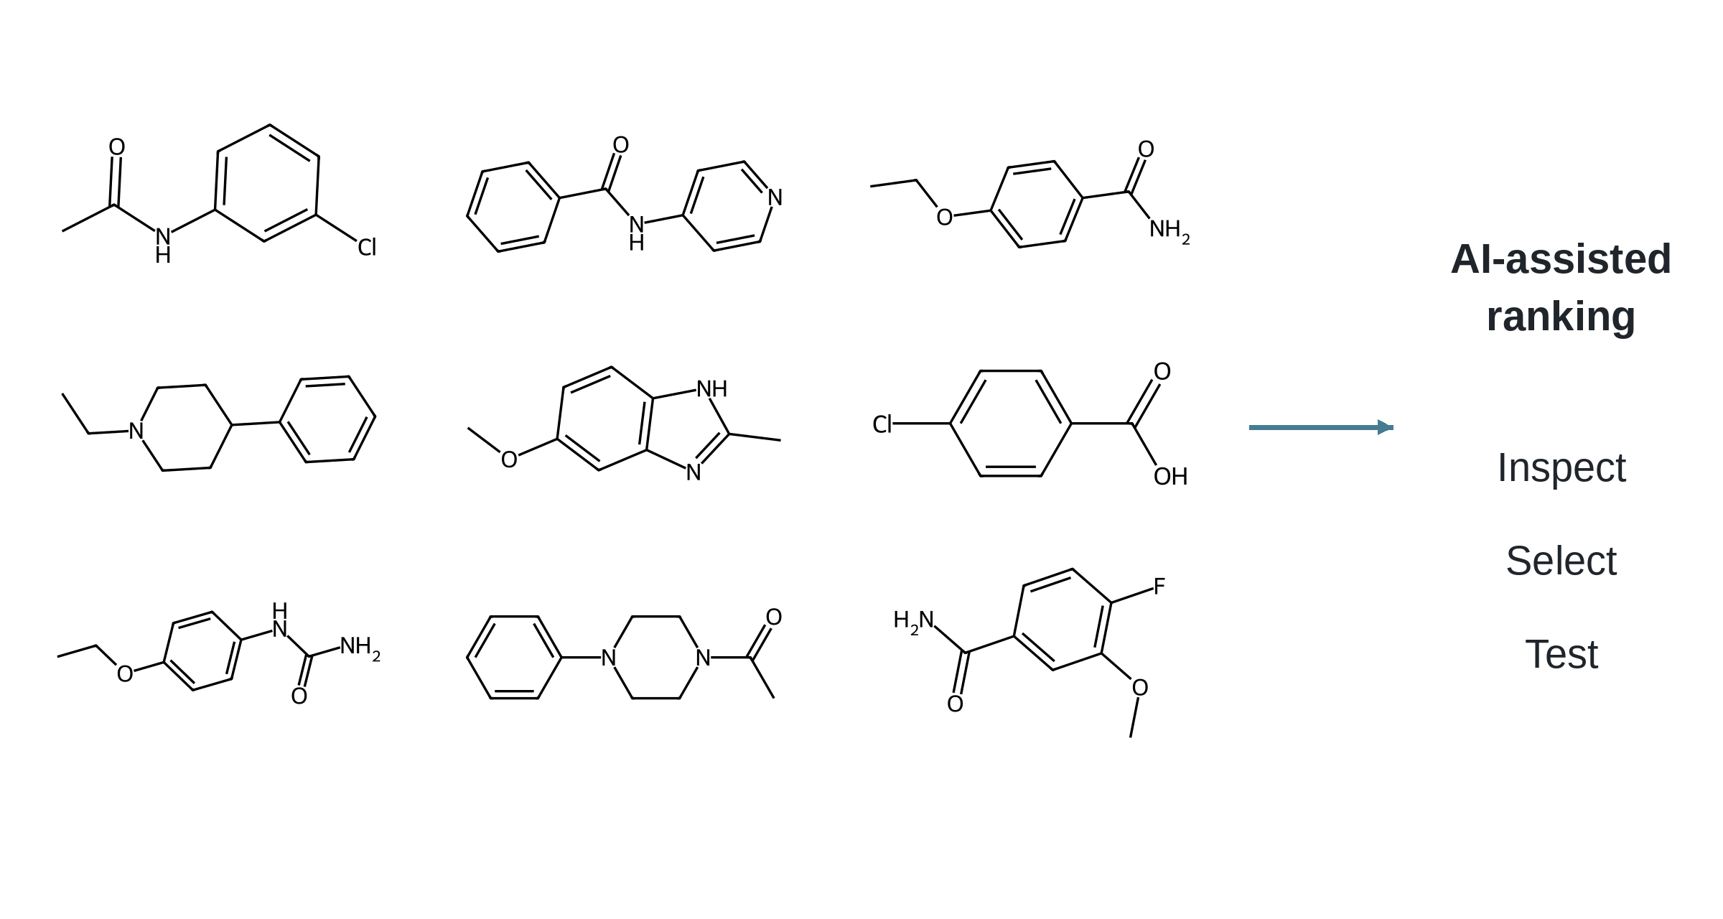
Screen Broadly; Test a Manageable Shortlist
AI-assisted ranking can reduce the number of compounds sent to the laboratory.
Keep chemically sensible and sufficiently diverse candidates.
Illustrative candidate collection; no activities or model scores are assigned.
McNutt et al., J. Cheminform. 17, 28 (2025).
23
Notes:
The structures are distinct synthetic teaching candidates, not compounds from a claimed experiment. Source: McNutt et al., J. Cheminform. 17, 28 (2025).

Slide 18
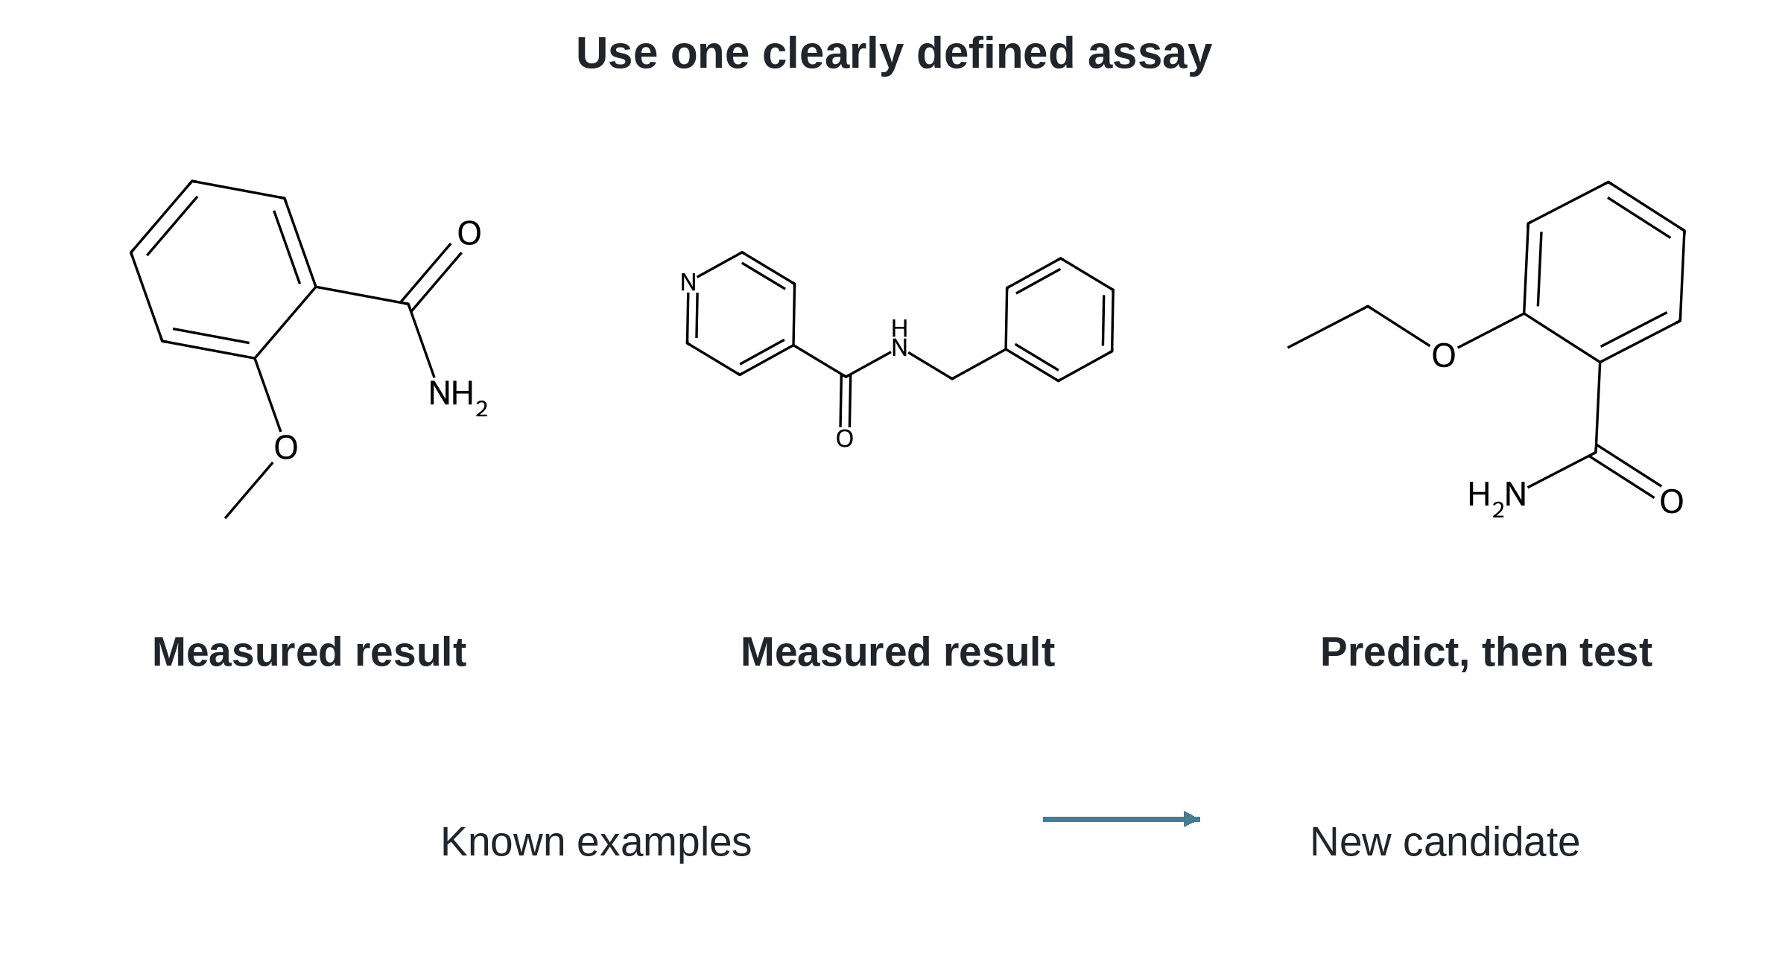
Predict Activity from Measured Examples
Chemprop can learn a defined activity endpoint from appropriate assay data.
Test predictions on compounds not used to build the model.
A structure and an assay result form a learning example.
Heid et al., J. Chem. Inf. Model. 64, 9–17 (2024).
24
Notes:
Only an input–output explanation is needed. Chemprop needs relevant data or a suitable existing model; it is not universally pretrained for every target. Source: Heid et al., J. Chem. Inf. Model. 64, 9–17 (2024).

Slide 19
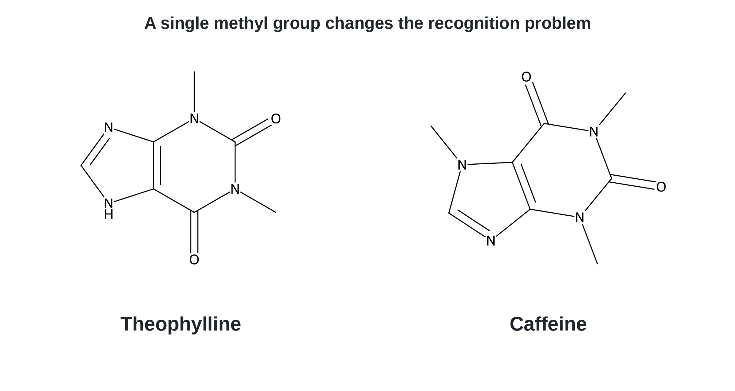
Small Changes: Theophylline versus Caffeine
These molecules differ by one methyl group.
The RNA-recognition example shows why a model must distinguish them.
A theophylline-binding RNA aptamer discriminates against caffeine.
Zimmermann et al., Nat. Struct. Biol. 4, 644–649 (1997).
25
Notes:
This is a documented molecular-recognition example, not a new AI prediction or a general rule about methylation. Source: Zimmermann et al., Nat. Struct. Biol. 4, 644–649 (1997).

Slide 20
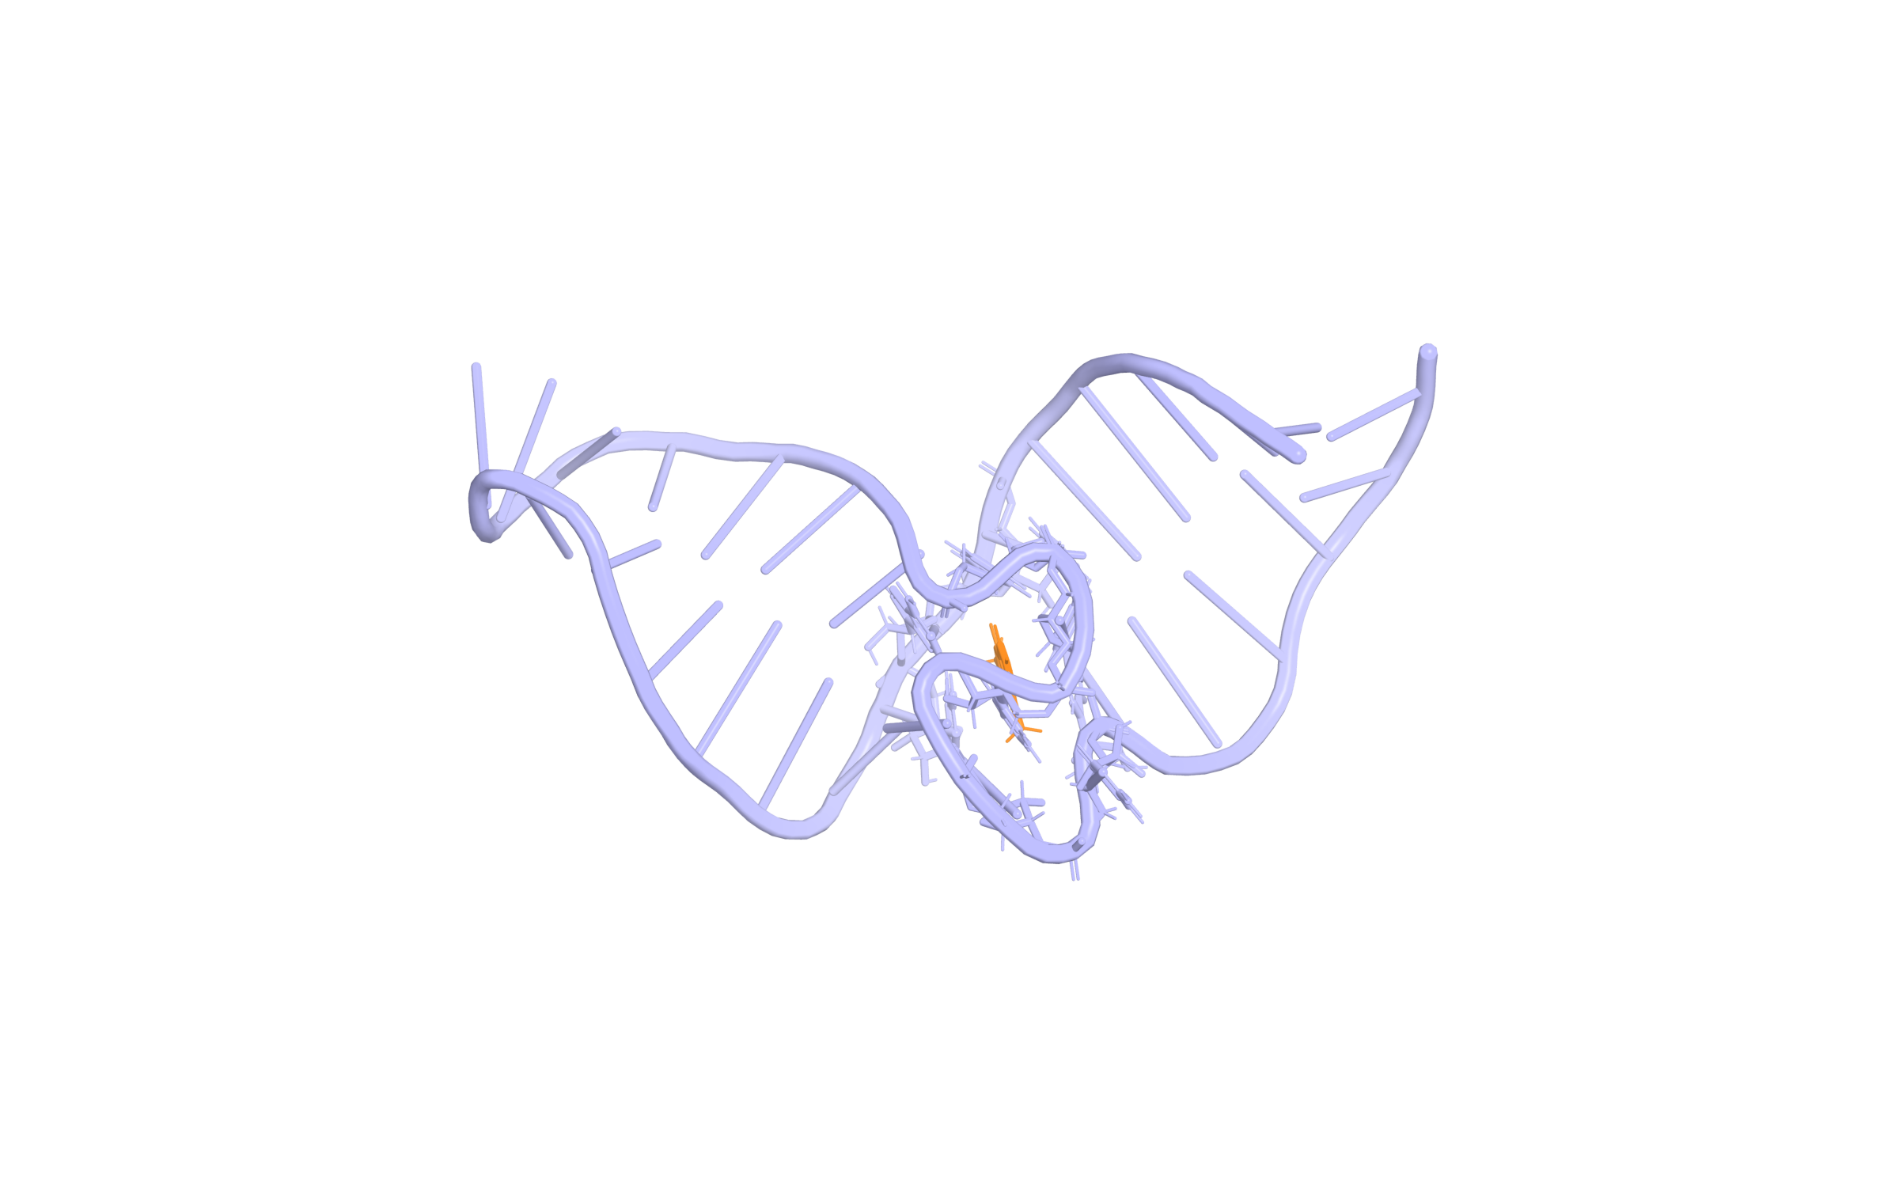
RNA Targets Need RNA-Relevant Models
SMRTnet combines RNA sequence/secondary structure with the candidate molecule.
Protein-trained binding predictions should not be transferred to RNA without testing.
Experimental theophylline–RNA aptamer, PDB 1EHT; one NMR model.
Fei et al., Nat. Biotechnol. (2026), doi:10.1038/s41587-025-02942-z. PDB 1EHT.
26
Notes:
The specific aptamer illustrates RNA recognition; SMRTnet studied theophylline-related discrimination. This rendering is experimental reference geometry, not a model output. Source: Fei et al., Nat. Biotechnol. (2026), doi:10.1038/s41587-025-02942-z. PDB 1EHT.

Slide 21
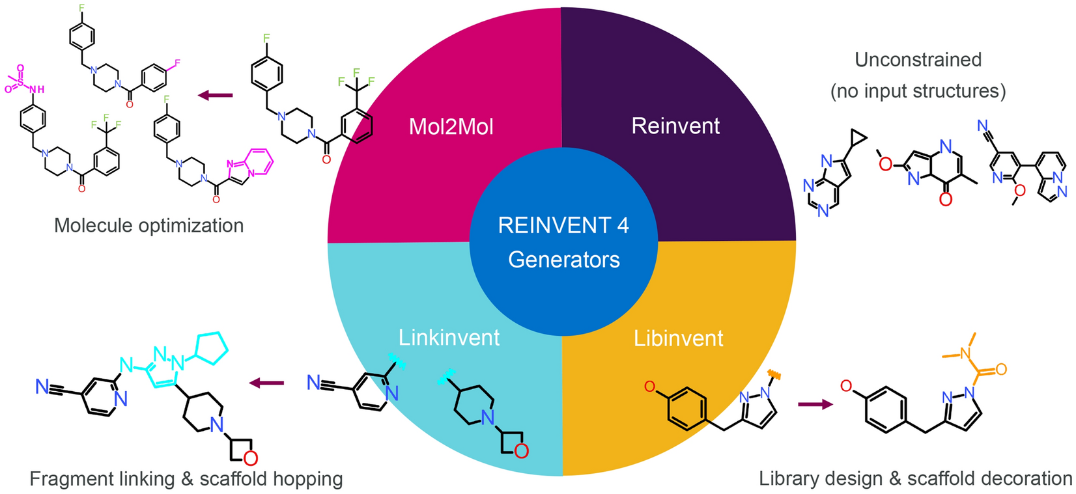
Ask AI to Propose New Chemical Ideas
REINVENT 4 can decorate a scaffold, link fragments or propose new molecules.
Design goals guide proposals; synthesis and assays determine their value.
Four molecular-design tasks in REINVENT 4.
Loeffler et al., J. Cheminform. 16, 20 (2024).
27
Notes:
Original Figure 4. Explain the chemical changes and fixed starting information; omit neural architectures and optimization equations. Source: Loeffler et al., J. Cheminform. 16, 20 (2024).

Slide 22
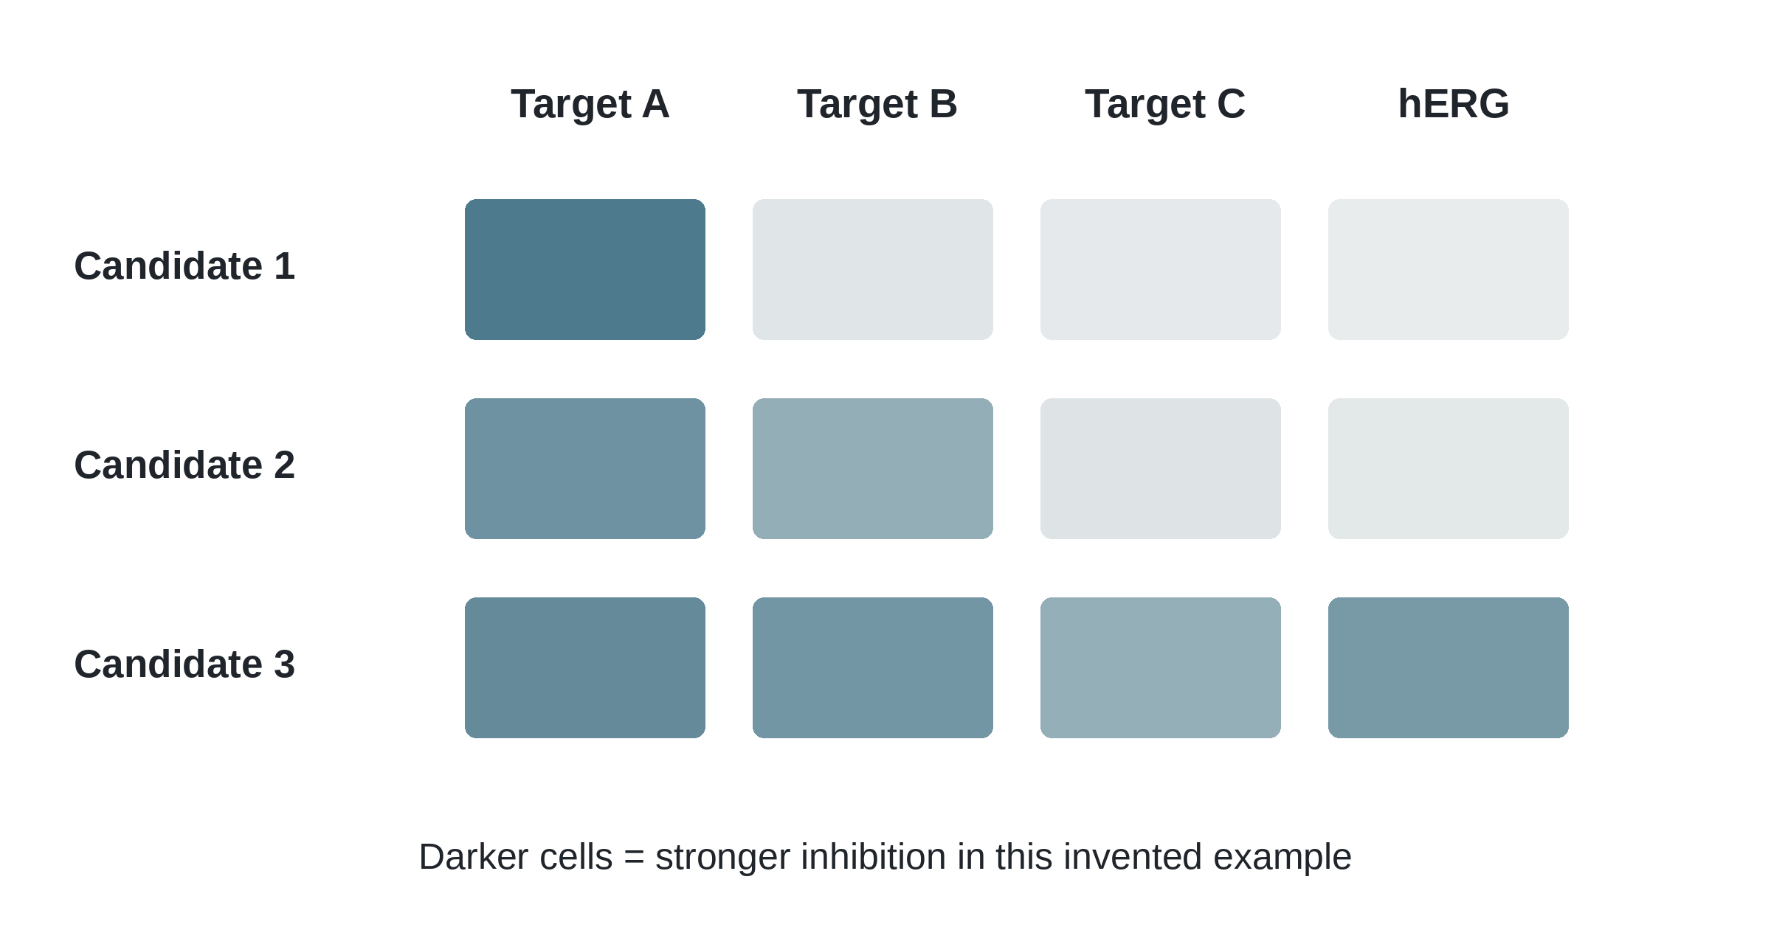
Predict a Target Profile, Not Just One Score
Related proteins and unwanted targets may also interact with the molecule.
Follow promising predictions with an appropriate target panel.
Hypothetical matched-assay inhibition patterns—not measured candidates.
Hopkins, Nat. Chem. Biol. 4, 682–690 (2008).
28
Notes:
Some multi-target effects are useful. Selectivity is not sufficient to establish clinical safety. Source: Hopkins, Nat. Chem. Biol. 4, 682–690 (2008).

Slide 23
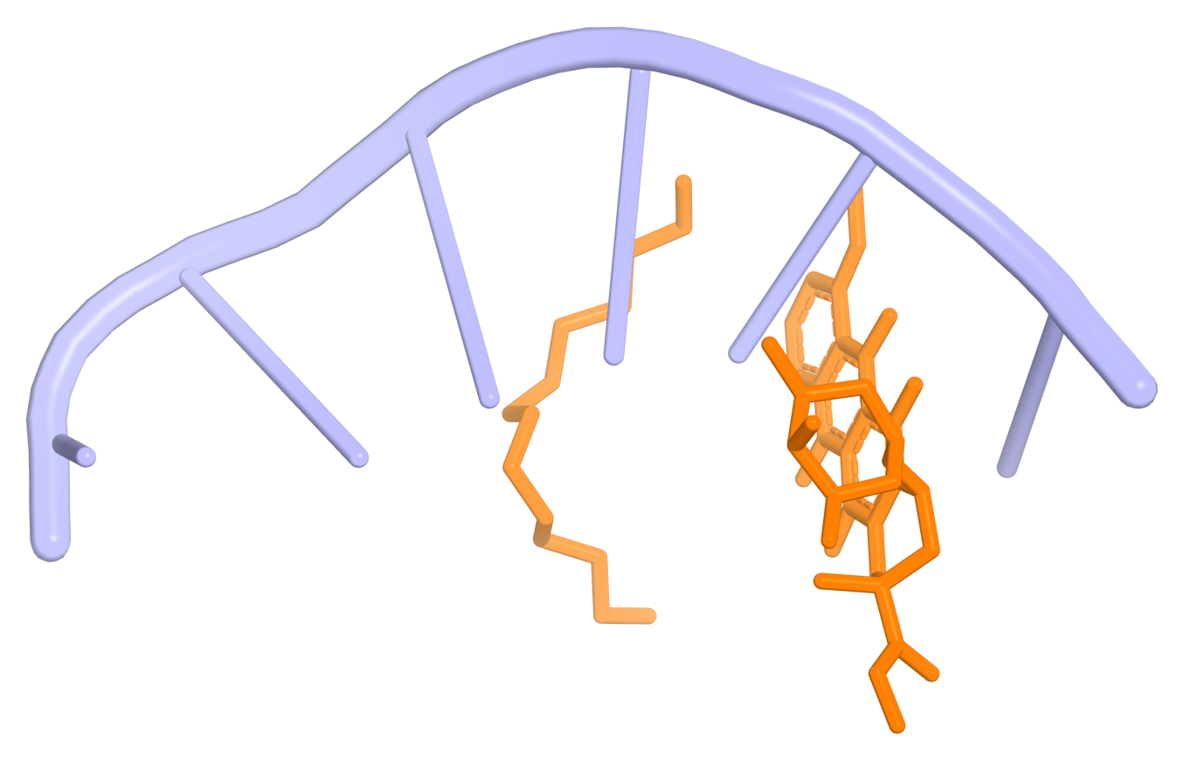
DNA Targets Need a Relevant Binding Model
Intercalation and groove binding pose different recognition problems.
Use DNA-relevant inputs and binding tests—not assumed protein-model transfer.
Experimental anthracycline–DNA complex, PDB 1D12.
RCSB PDB 1D12; drug–nucleic-acid recognition context.
29
Notes:
This extends the previous nucleic-acid course to model choice. No universal AI DNA-affinity tool or sequence selectivity is claimed. Source: RCSB PDB 1D12; drug–nucleic-acid recognition context.

Slide 24
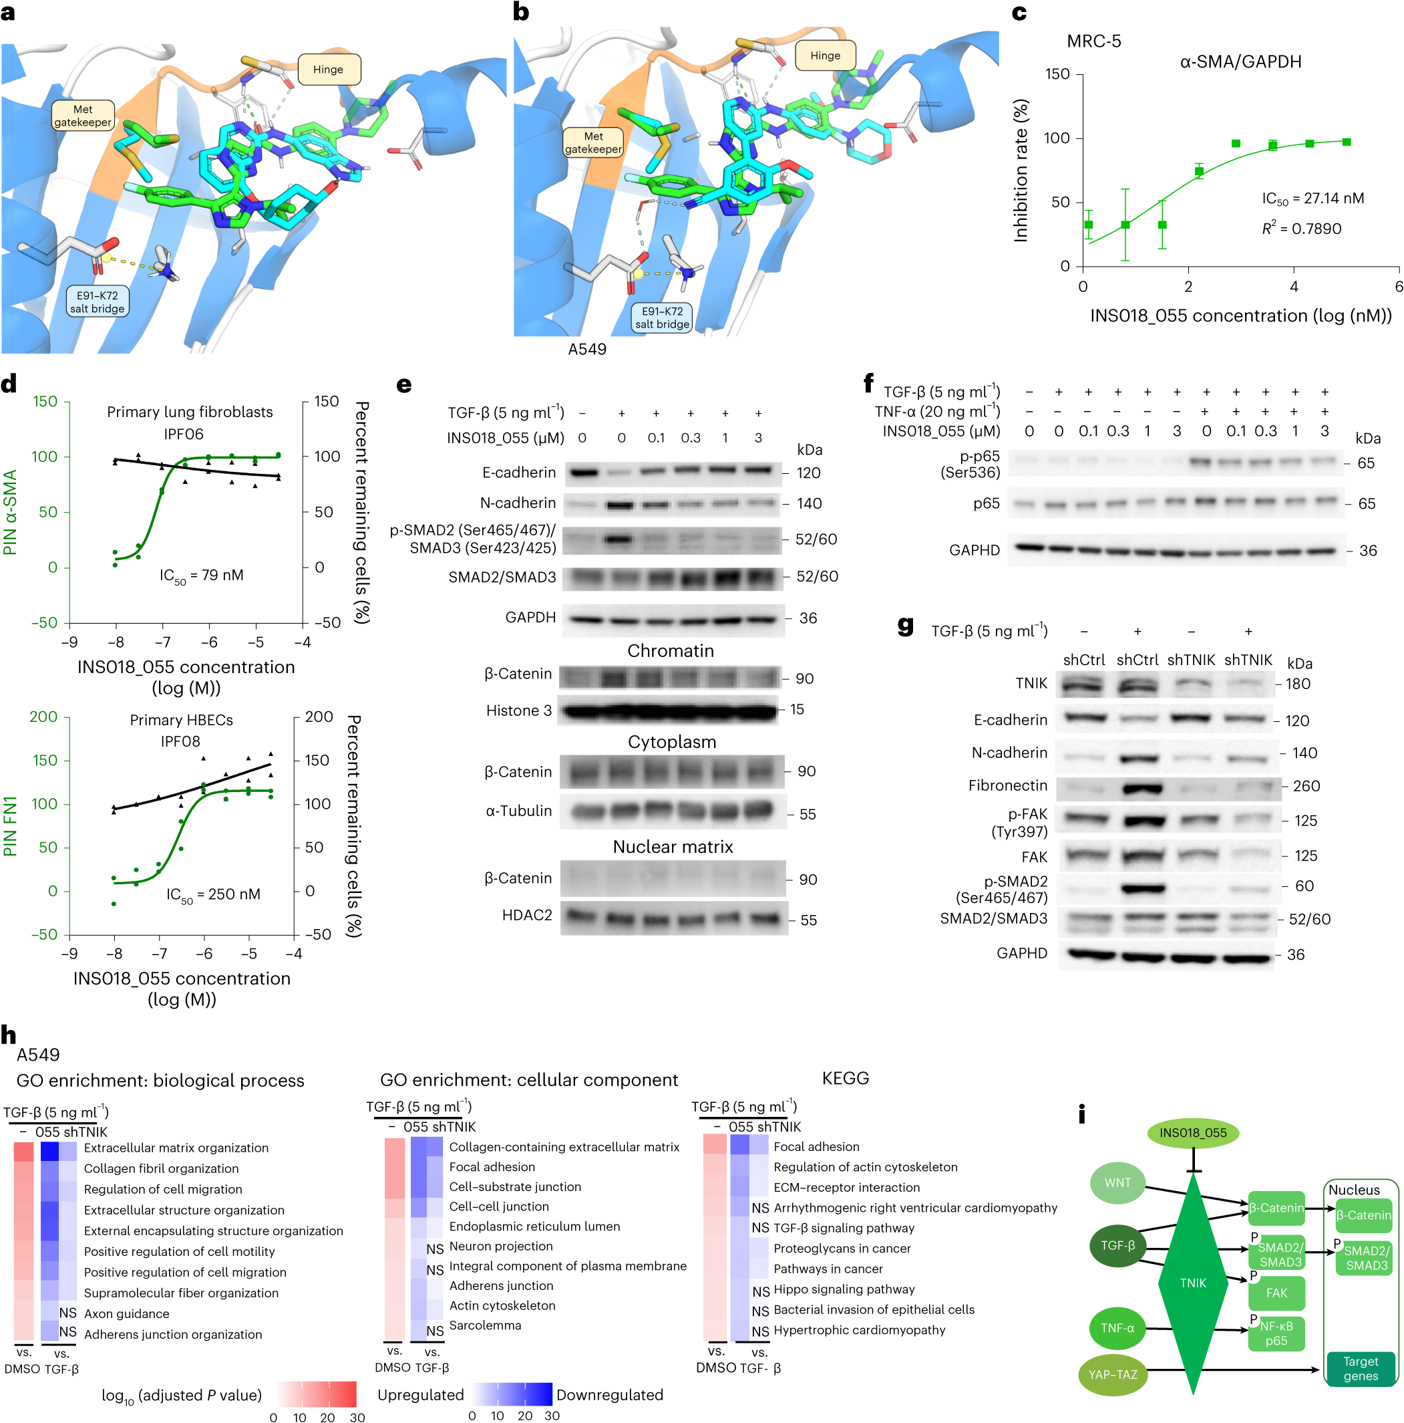
Check Target Function with Experiments
A predicted binding arrangement needs independent experimental tests.
Enzyme and cellular assays test function—not equilibrium binding alone.
Ren et al., Figure 2: predicted structures and distinct functional measurements.
Ren et al., Nat. Biotechnol. 43, 63–75 (2025; online 2024).
30
Notes:
Figure 2 does not provide the direct SPR binding evidence. The SPR experiment is Extended Data Figure 3a. The displayed data concern TNIK enzymatic inhibition and cellular functional readouts. Source: Ren et al., Nat. Biotechnol. 43, 63–75 (2025; online 2024).

Slide 25
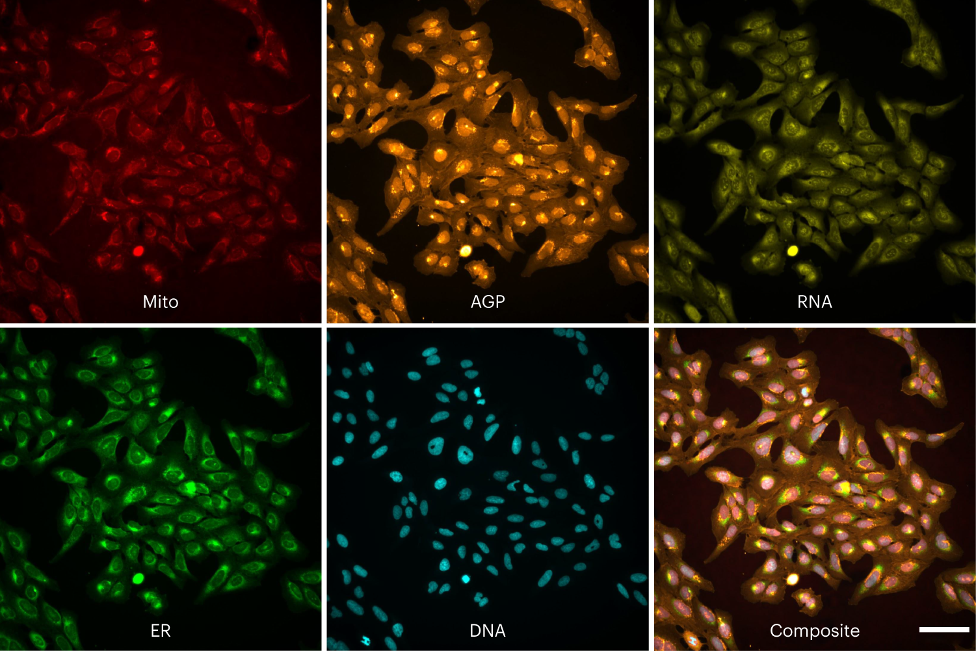
Use Cell Images to Measure the Response
Images capture changes in cell shape and internal organization.
AI-assisted image analysis needs controls and a clearly defined biological question.
Published Cell Painting example; images are experimental inputs.
Chandrasekaran et al., Nat. Methods 21, 1114–1121 (2024).
31
Notes:
Do not describe a fluorescence image as a direct binding assay or infer an unstated cell identity. Cell Painting and image segmentation are not equivalent to target identification. Source: Chandrasekaran et al., Nat. Methods 21, 1114–1121 (2024).

Slide 26
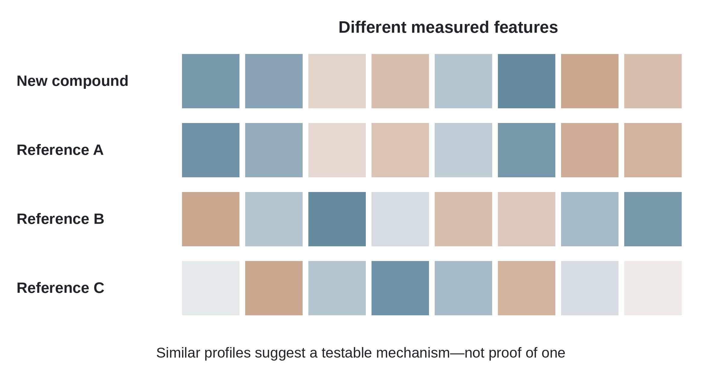
Work Backwards from an Unexplained Cell Effect
Compare the compound’s profile with well-characterized references.
A similar pattern suggests a mechanism to test, not a proven shared target.
Simulated profiles show how reference matching can generate a hypothesis.
Chandrasekaran et al., Nat. Methods 21, 1114–1121 (2024).
32
Notes:
Transcriptomic and morphological profiles are complementary sources, not mandatory sequential stages. Distinguish shared stress from shared target action. Source: Chandrasekaran et al., Nat. Methods 21, 1114–1121 (2024).

Slide 27
Let Experiments Change the Next Design
Use both successful and unsuccessful compounds to refine the next choice.
The best next experiment may test a new chemical idea, not the highest score.
Design
→
Make
↑
↓
Measurements change the next chemical decision.
Learn
←
Test
Design → make → test → learn: AI supports the experimental cycle.
Loeffler et al., J. Cheminform. 16, 20 (2024).
33
Notes:
Do not introduce acquisition functions or claim that synthesis and biological validation have been automated in this teaching example. Source: Loeffler et al., J. Cheminform. 16, 20 (2024).

Slide 28
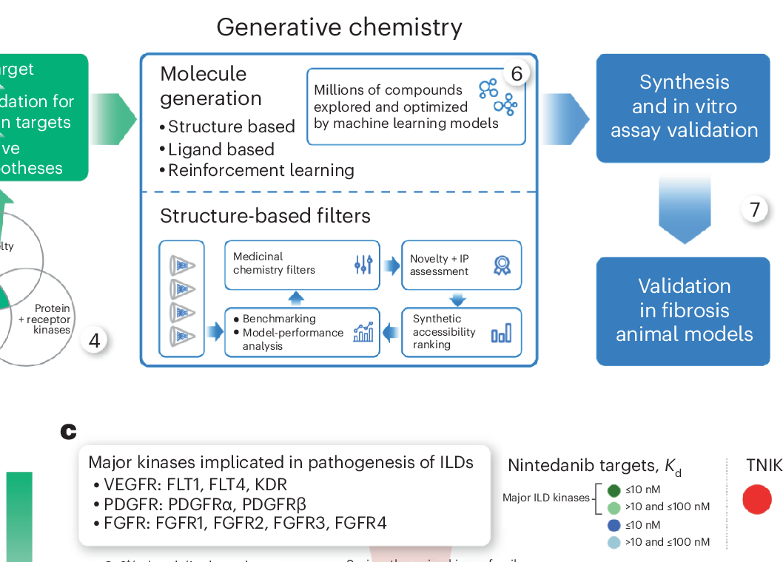
Case 1: AI Helped Design TNIK Inhibitors
After target prioritization, Chemistry42 proposed candidate structures.
Synthesis and experimental filtering guided candidate selection.
Published structure-based design inputs and filters—not a fully automated discovery.
Ren et al., Nat. Biotechnol. 43, 63–75 (2025; online 2024).
34
Notes:
The approximately eighteen-month milestone was preclinical candidate nomination, not first-in-human testing. It is not a controlled estimate of the time saved by AI. Source: Ren et al., Nat. Biotechnol. 43, 63–75 (2025; online 2024).

Slide 29
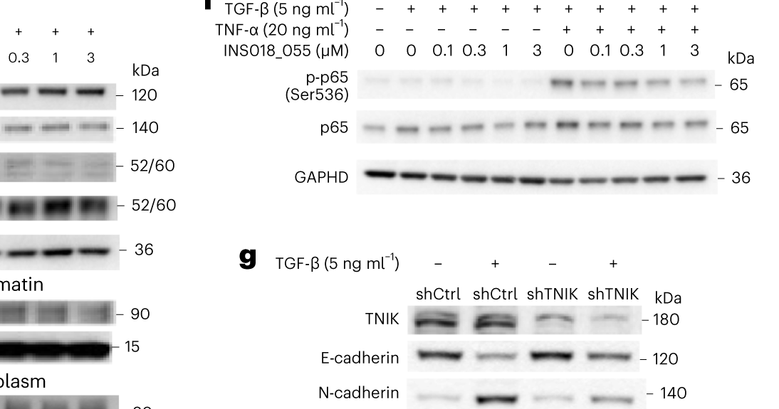
Case 1: Separate Prediction from Measured PD
The candidate bound TNIK and inhibited the enzyme.
Cell assays showed fibrosis-related effects; those need mechanistic interpretation.
Published cellular assay evidence for INS018_055.
Ren et al., Nat. Biotechnol. 43, 63–75 (2025; online 2024).
35
Notes:
Broader kinase activity prevents attributing every cellular effect exclusively to TNIK. A predicted pose is not an experimental co-crystal. No clinical approval is claimed. Source: Ren et al., Nat. Biotechnol. 43, 63–75 (2025; online 2024).

Slide 30
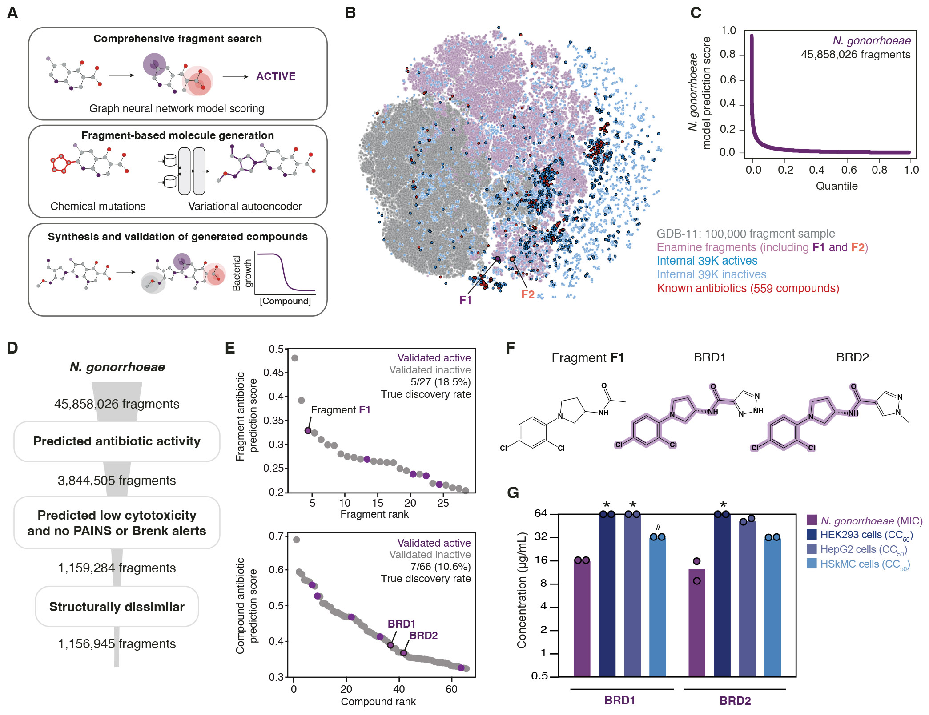
Case 2: Expand a Fragment into New Candidates
The published fragment route starts from an antibacterial chemical clue.
Predicted activity and toxicity help choose compounds for synthesis.
Published generative-antibiotic strategy; candidate generation precedes validation.
Krishnan et al., Cell 188, 5962–5979.e22 (2025).
36
Notes:
Do not teach VAE, genetic-algorithm or graph-network details. Large computational candidate pools are not experimentally tested compounds. Source: Krishnan et al., Cell 188, 5962–5979.e22 (2025).

Slide 31
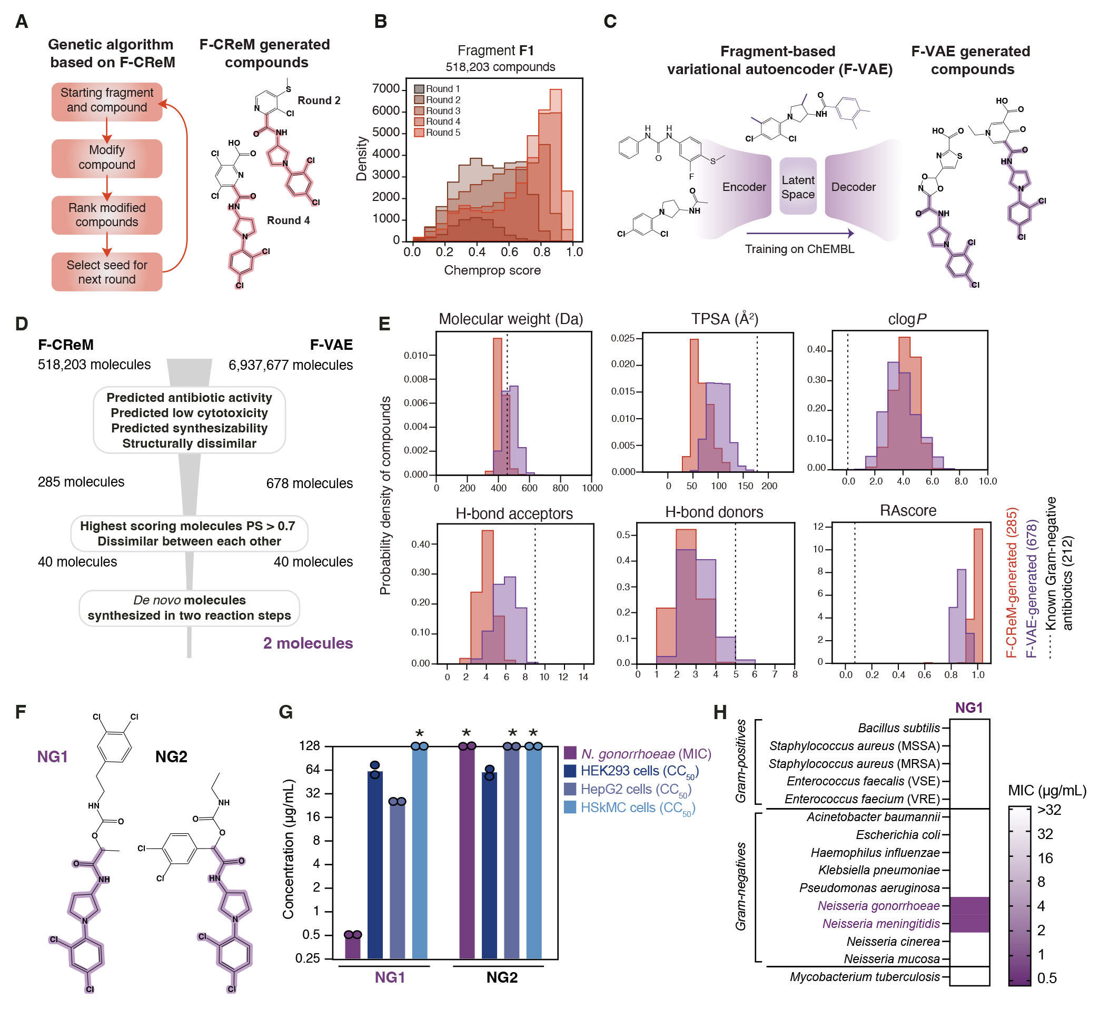
Case 2: Test the Designed Antibiotics
The full study synthesized 24 compounds; seven were selectively antibacterial.
The displayed NG series links generated structures to antibacterial tests.
Published antibacterial study: chemistry and experiments, not human efficacy.
Krishnan et al., Cell 188, 5962–5979.e22 (2025).
37
Notes:
NG1 was investigated against Neisseria gonorrhoeae and DN1 against Staphylococcus aureus. Mechanistic follow-up is not direct proof of a resolved drug–target complex. Source: Krishnan et al., Cell 188, 5962–5979.e22 (2025).

Slide 32
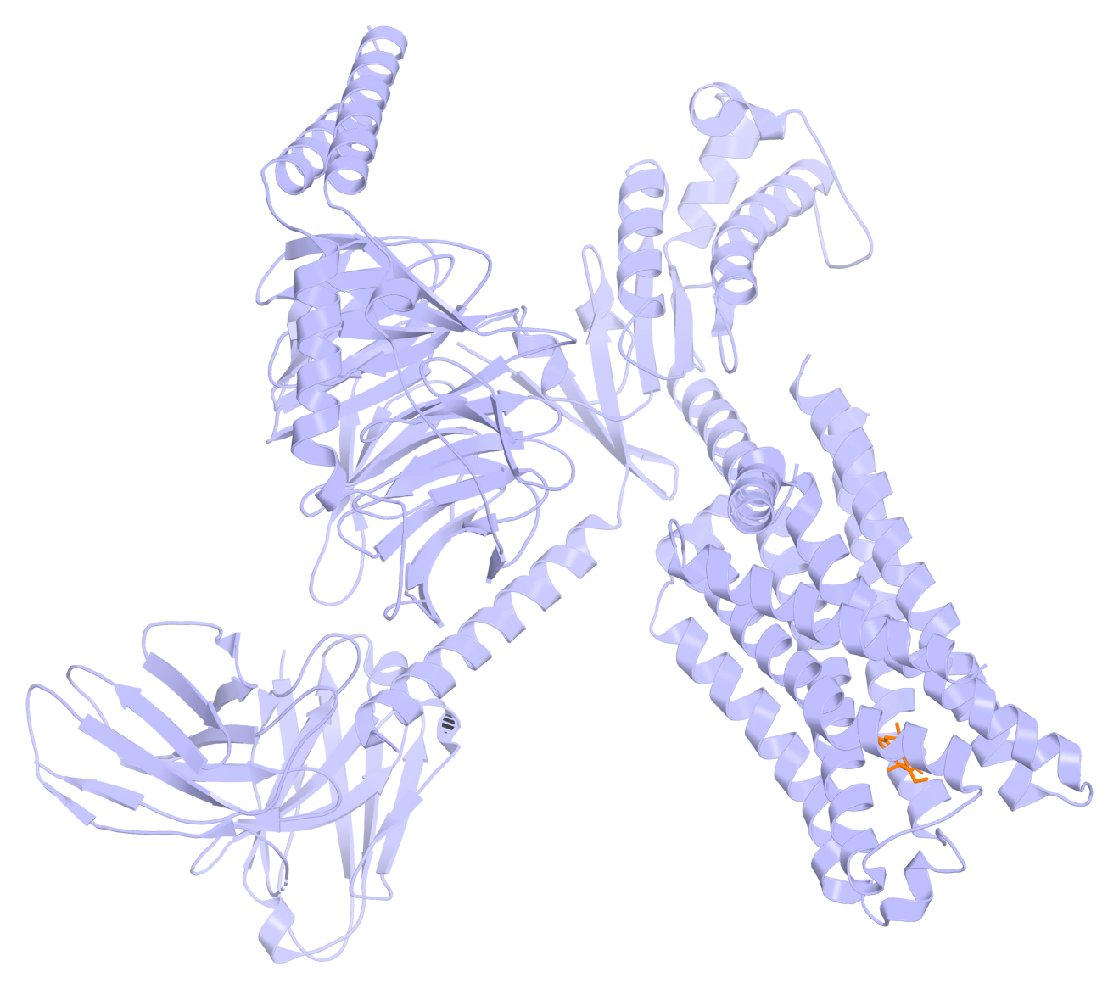
Case 3: Predict the Receptor, Then Screen Ligands
AlphaFold2 supplied receptor models; docking selected candidate molecules.
Experiments checked binding and followed up selected complexes.
Experimental 5-HT₂A complex from the study’s structural follow-up, PDB 8UWL.
Lyu et al., Science 384, eadn6354 (2024).
38
Notes:
The pictured structure is explicitly experimental follow-up. AI predicted the receptor; the screened molecules were not generated by AlphaFold2. Source: Lyu et al., Science 384, eadn6354 (2024).

Slide 33
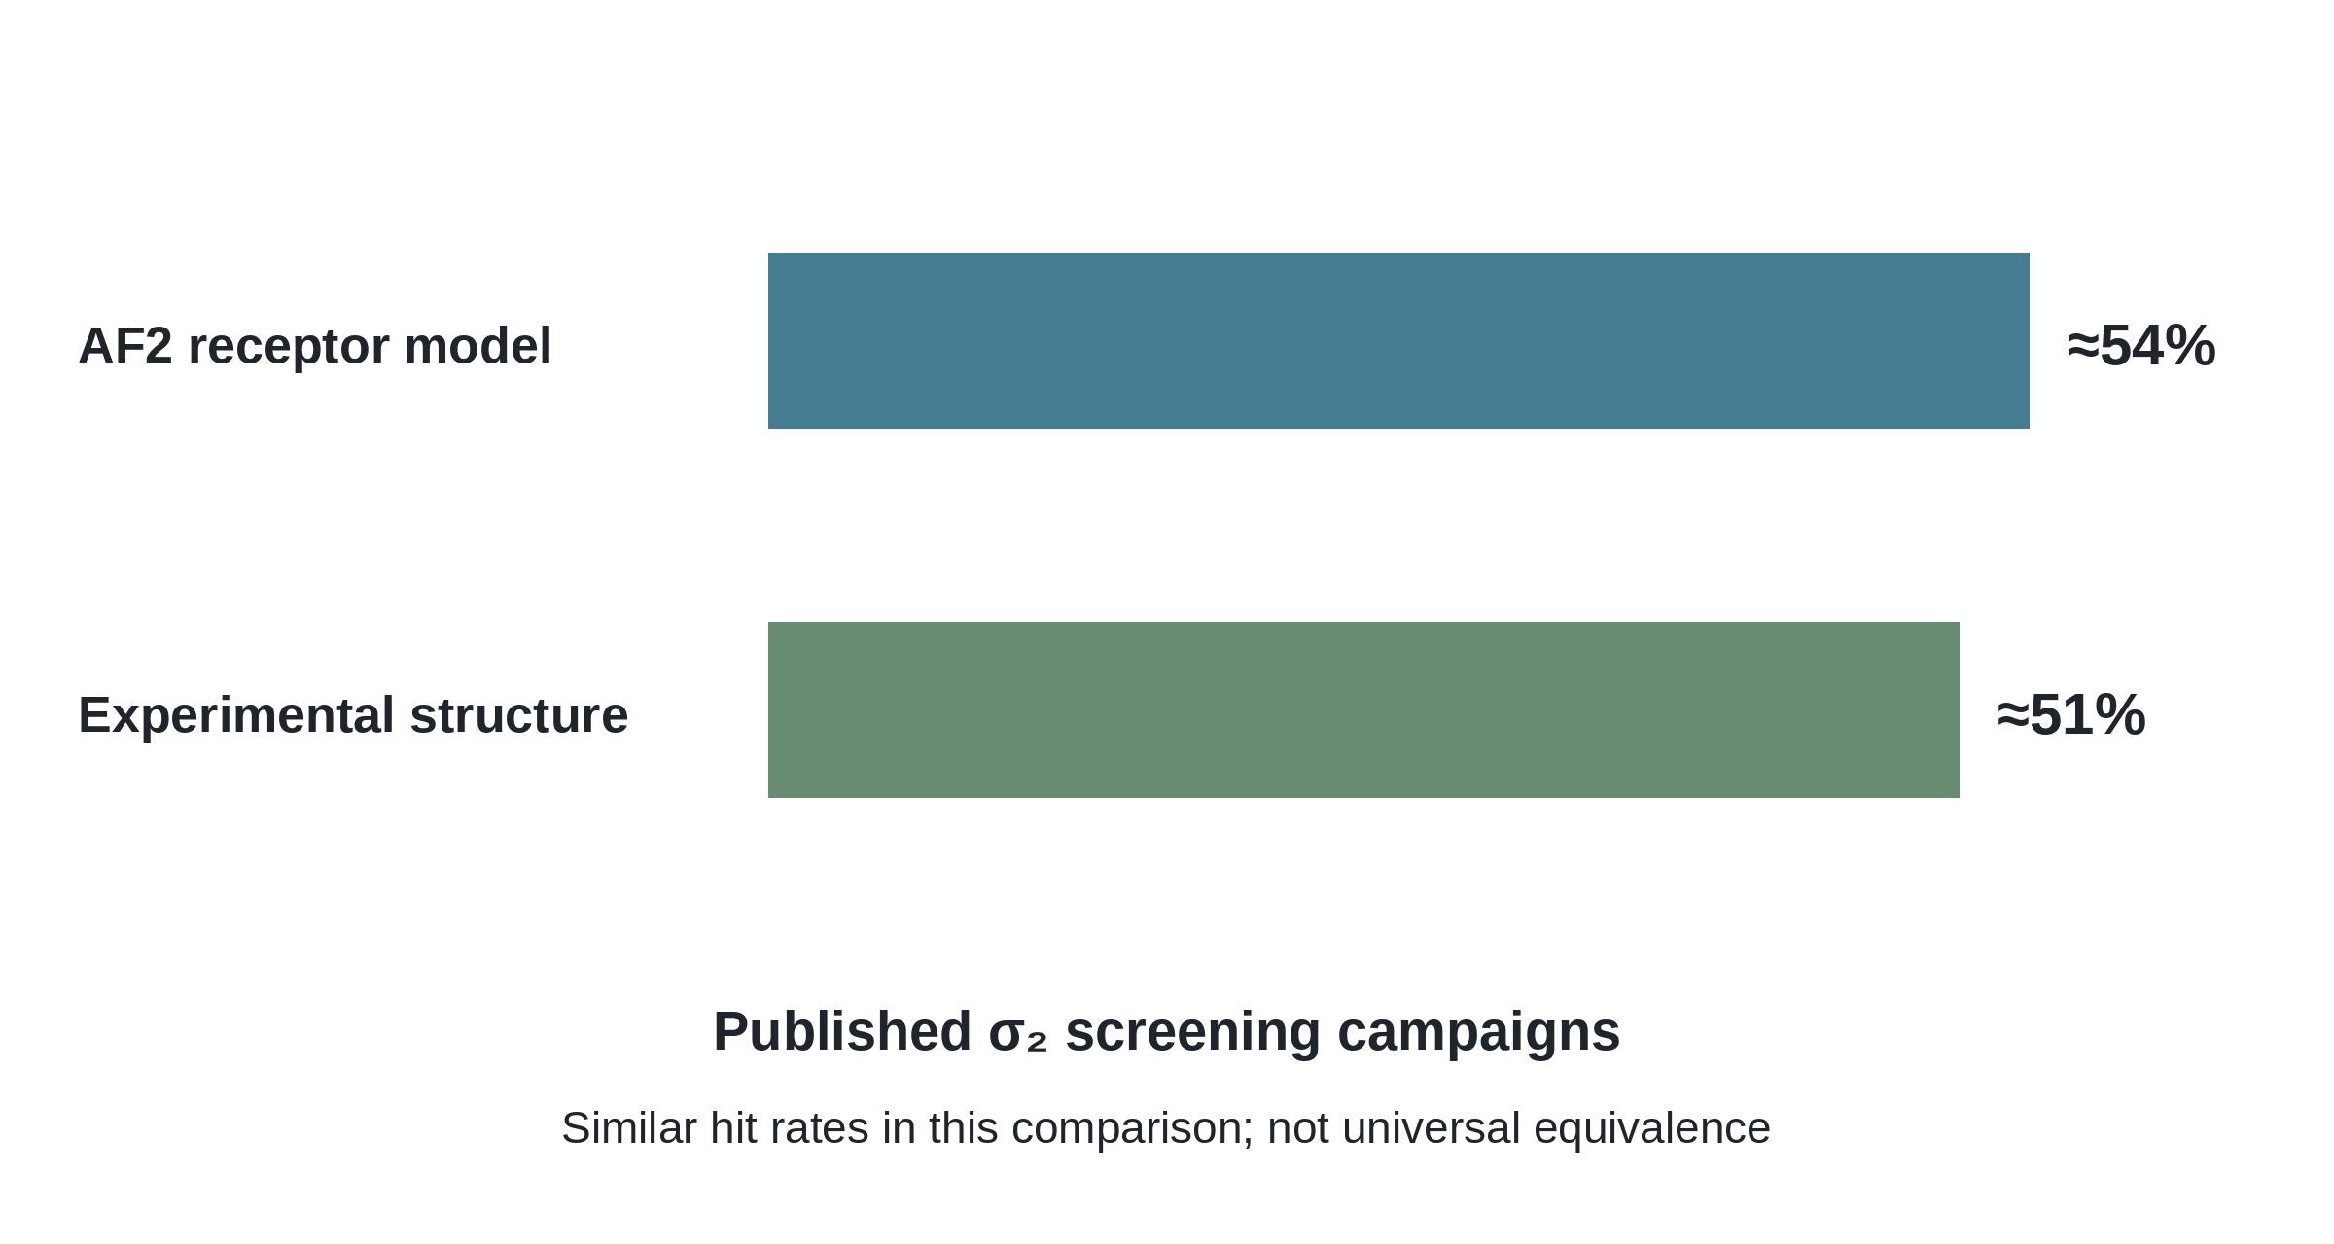
Case 3: Did Model-Based Screening Help?
Both predicted-structure and experimental-structure campaigns found binders.
Similar results in this comparison do not guarantee success on every target.
Rounded published hit rates refer to compounds actually tested.
Lyu et al., Science 384, eadn6354 (2024).
39
Notes:
The model-based sigma-2 campaign found 64 hits among 119 tested compounds. The roughly 54% versus 51% difference was not significant. Do not claim superiority. Source: Lyu et al., Science 384, eadn6354 (2024).

Slide 34
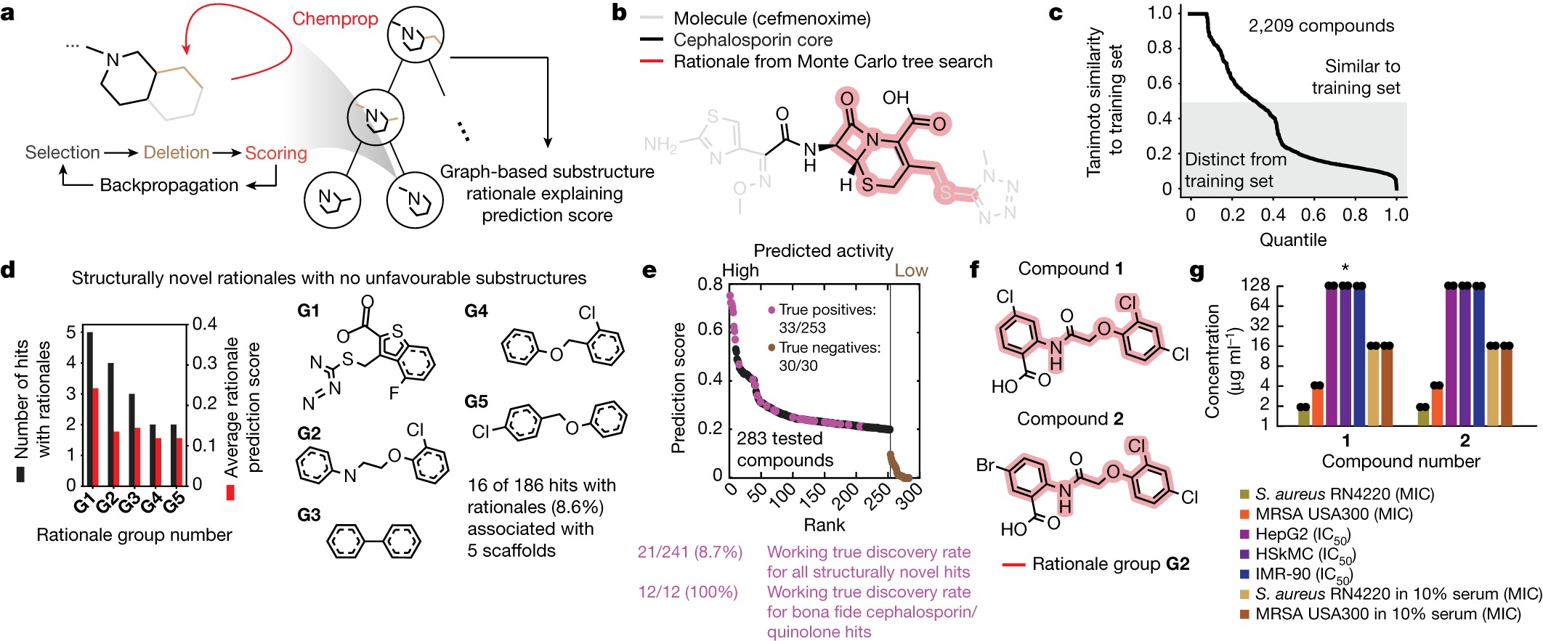
Case 4: Use Chemical Clues to Select Antibiotics
Models learned from antibacterial activity and human-cell toxicity.
Highlighted substructures helped guide prospective compound selection.
Published chemical rationales and candidate scaffolds.
Wong et al., Nature 626, 177–185 (2024).
40
Notes:
The source’s real chemical substructures replace unrelated teaching molecules. Explain a rationale as a model-associated chemical clue, not a proven biological mechanism. Source: Wong et al., Nature 626, 177–185 (2024).

Slide 35
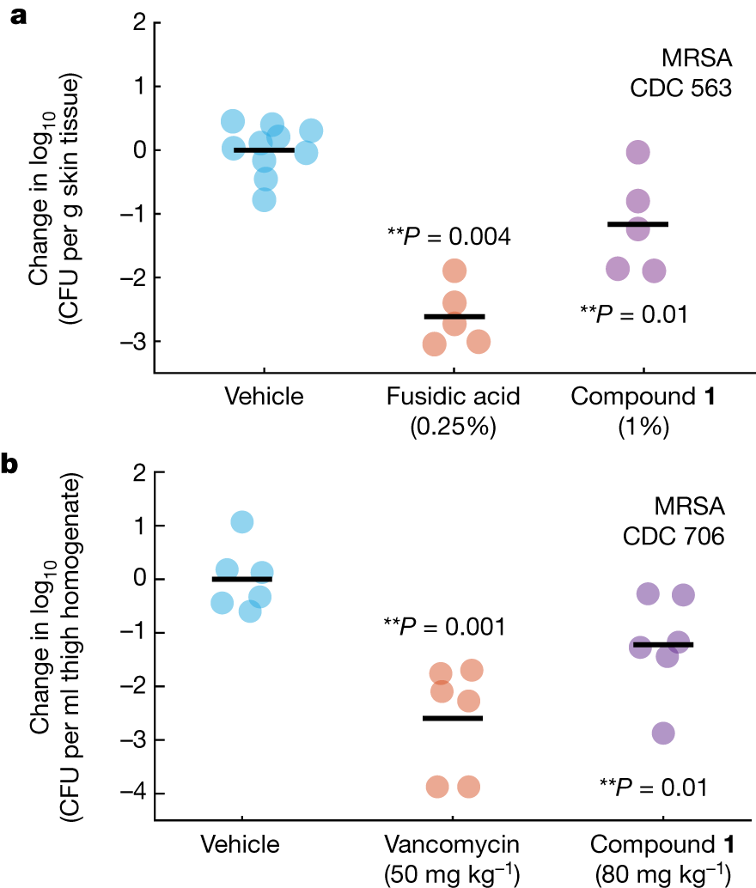
Case 4: Laboratory Evidence Goes Beyond a Score
The study experimentally tested 283 selected compounds.
A discovered chemical class received mechanistic and mouse-infection studies.
Published preclinical efficacy evidence; not a human clinical result.
Wong et al., Nature 626, 177–185 (2024).
41
Notes:
No claim that all 283 were active. Selected subgroup comparisons were not randomized tests of the value of explainability. Explain the named animal readout simply. Source: Wong et al., Nature 626, 177–185 (2024).

Slide 36
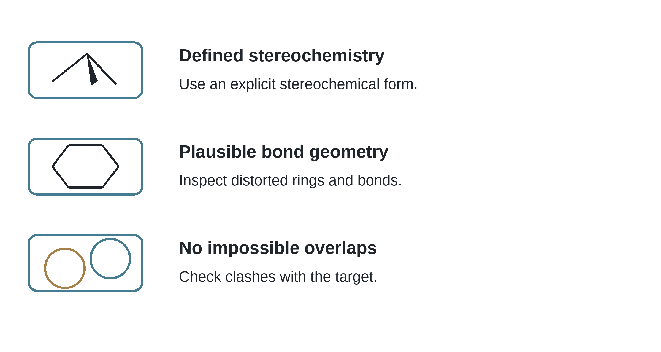
Inspect Chemical Validity Before Trusting a Pose
Check stereochemistry, bond geometry and impossible atomic overlaps.
High confidence does not replace those chemical checks.
Illustrative invalid-versus-valid input checks; not results from a named model.
Buttenschoen et al., Chem. Sci. 15, 3130–3139 (2024).
42
Notes:
The illustration is explicitly hypothetical. Do not invent measured benchmark results or attribute a synthetic geometry error to a specific software package. Source: Buttenschoen et al., Chem. Sci. 15, 3130–3139 (2024).

Slide 37
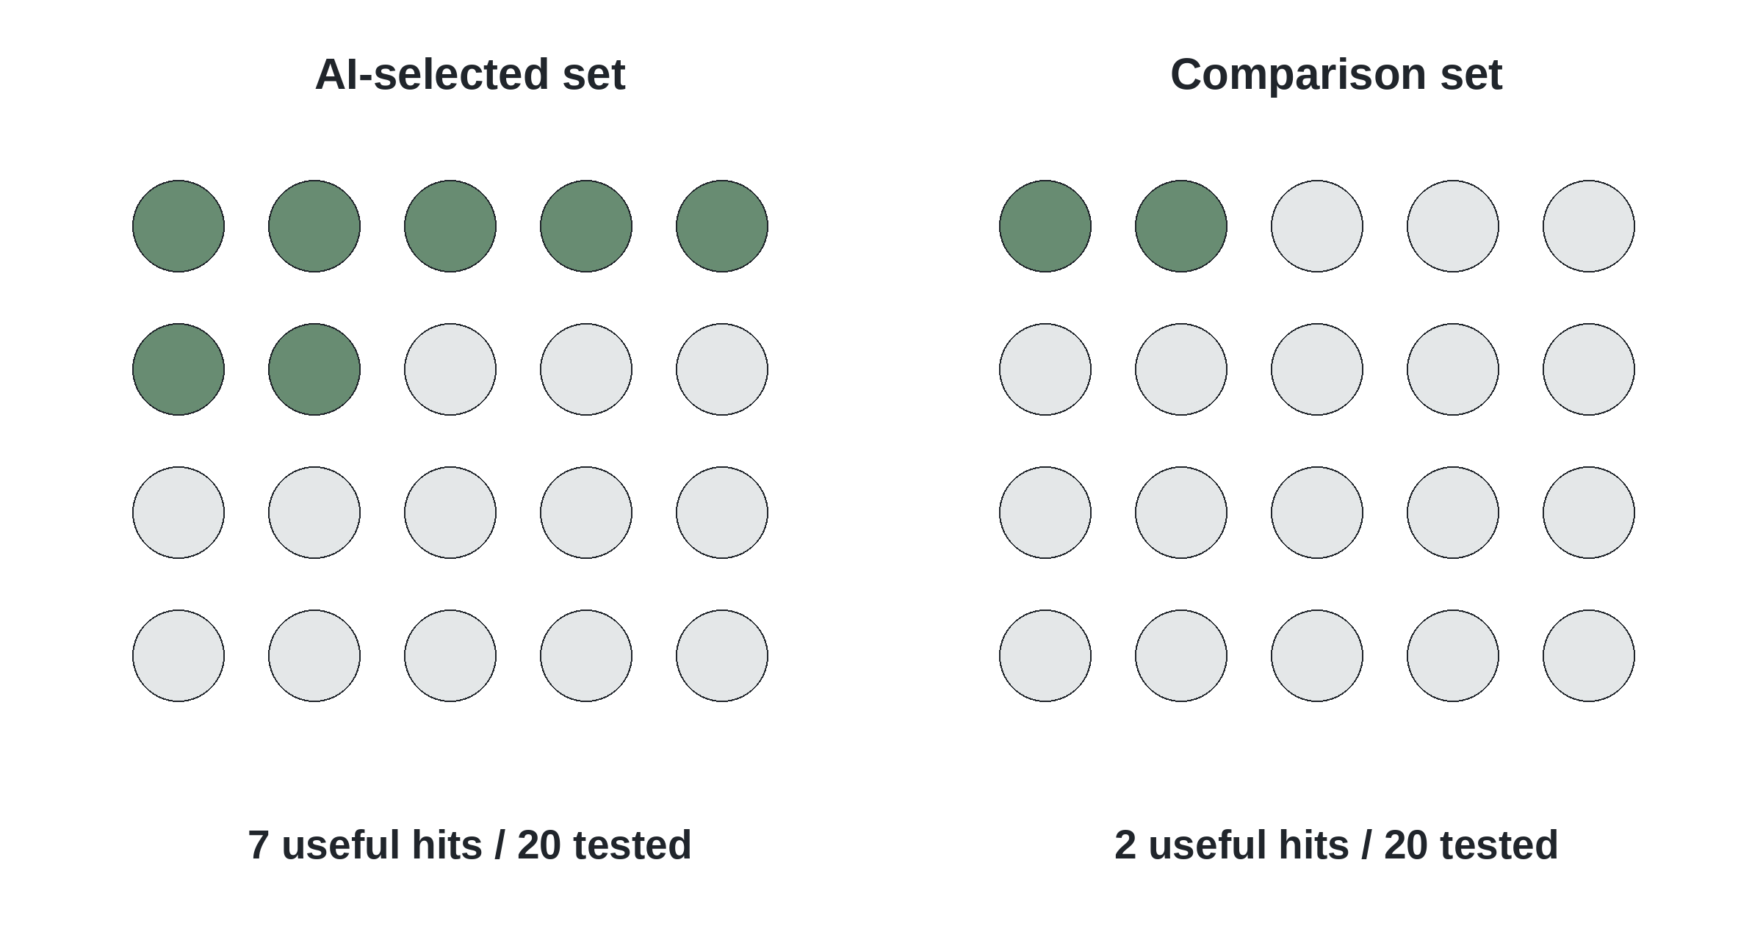
Measure Whether AI Improved the Decision
Count useful hits among compounds actually tested.
Compare with a sensible alternative under comparable conditions.
Hypothetical example: twenty experimentally tested compounds per group.
Teaching comparison; no claimed performance for a named model.
43
Notes:
The 7/20 and 2/20 counts are invented. They illustrate the denominator and do not establish statistical significance. Source: Teaching comparison; no claimed performance for a named model.

Slide 38
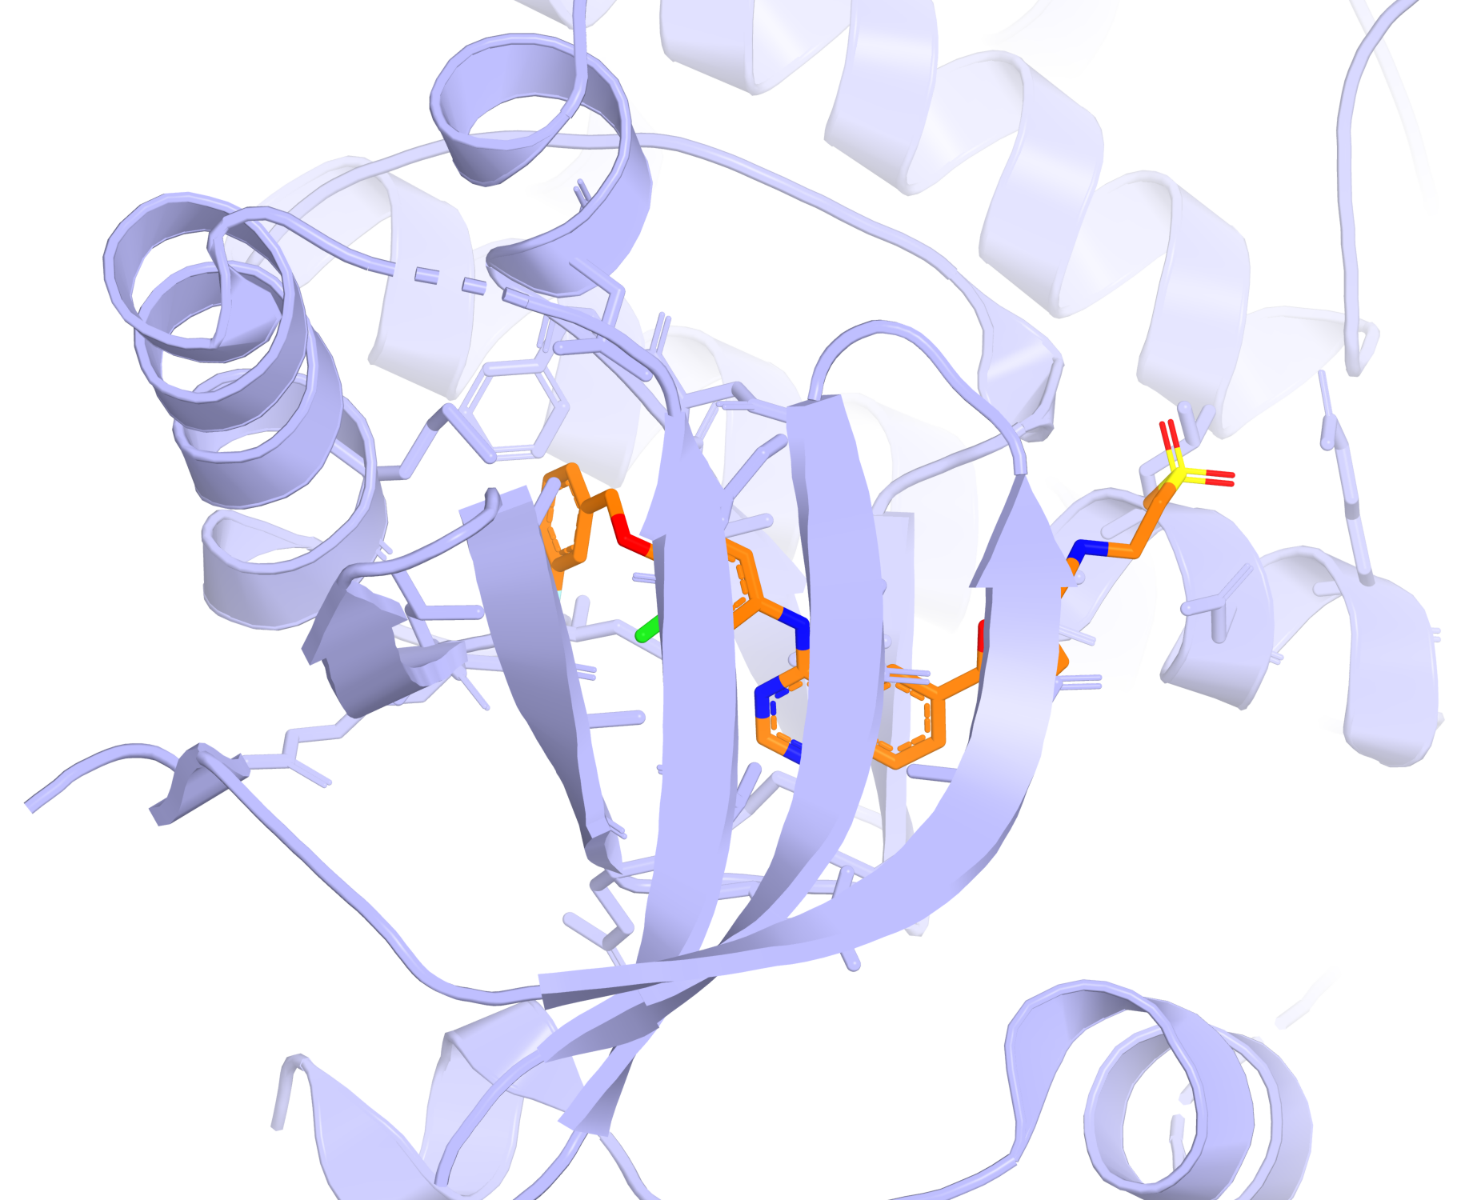
Exercise: Choose the Next EGFR Experiment
You have an EGFR structure and a shortlist of candidate inhibitors.
Which tool addresses the pose—and which assay addresses inhibition?
Experimental lapatinib–EGFR complex, PDB 1XKK, as the exercise reference.
Wood et al., Cancer Res. 64, 6652–6659 (2004); PDB 1XKK.
44
Notes:
A suitable docking/scoring workflow can propose poses; a kinase assay tests inhibition. Discuss receptor conformation and target selectivity. Lapatinib is not presented as AI-discovered. Source: Wood et al., Cancer Res. 64, 6652–6659 (2004); PDB 1XKK.

Slide 39
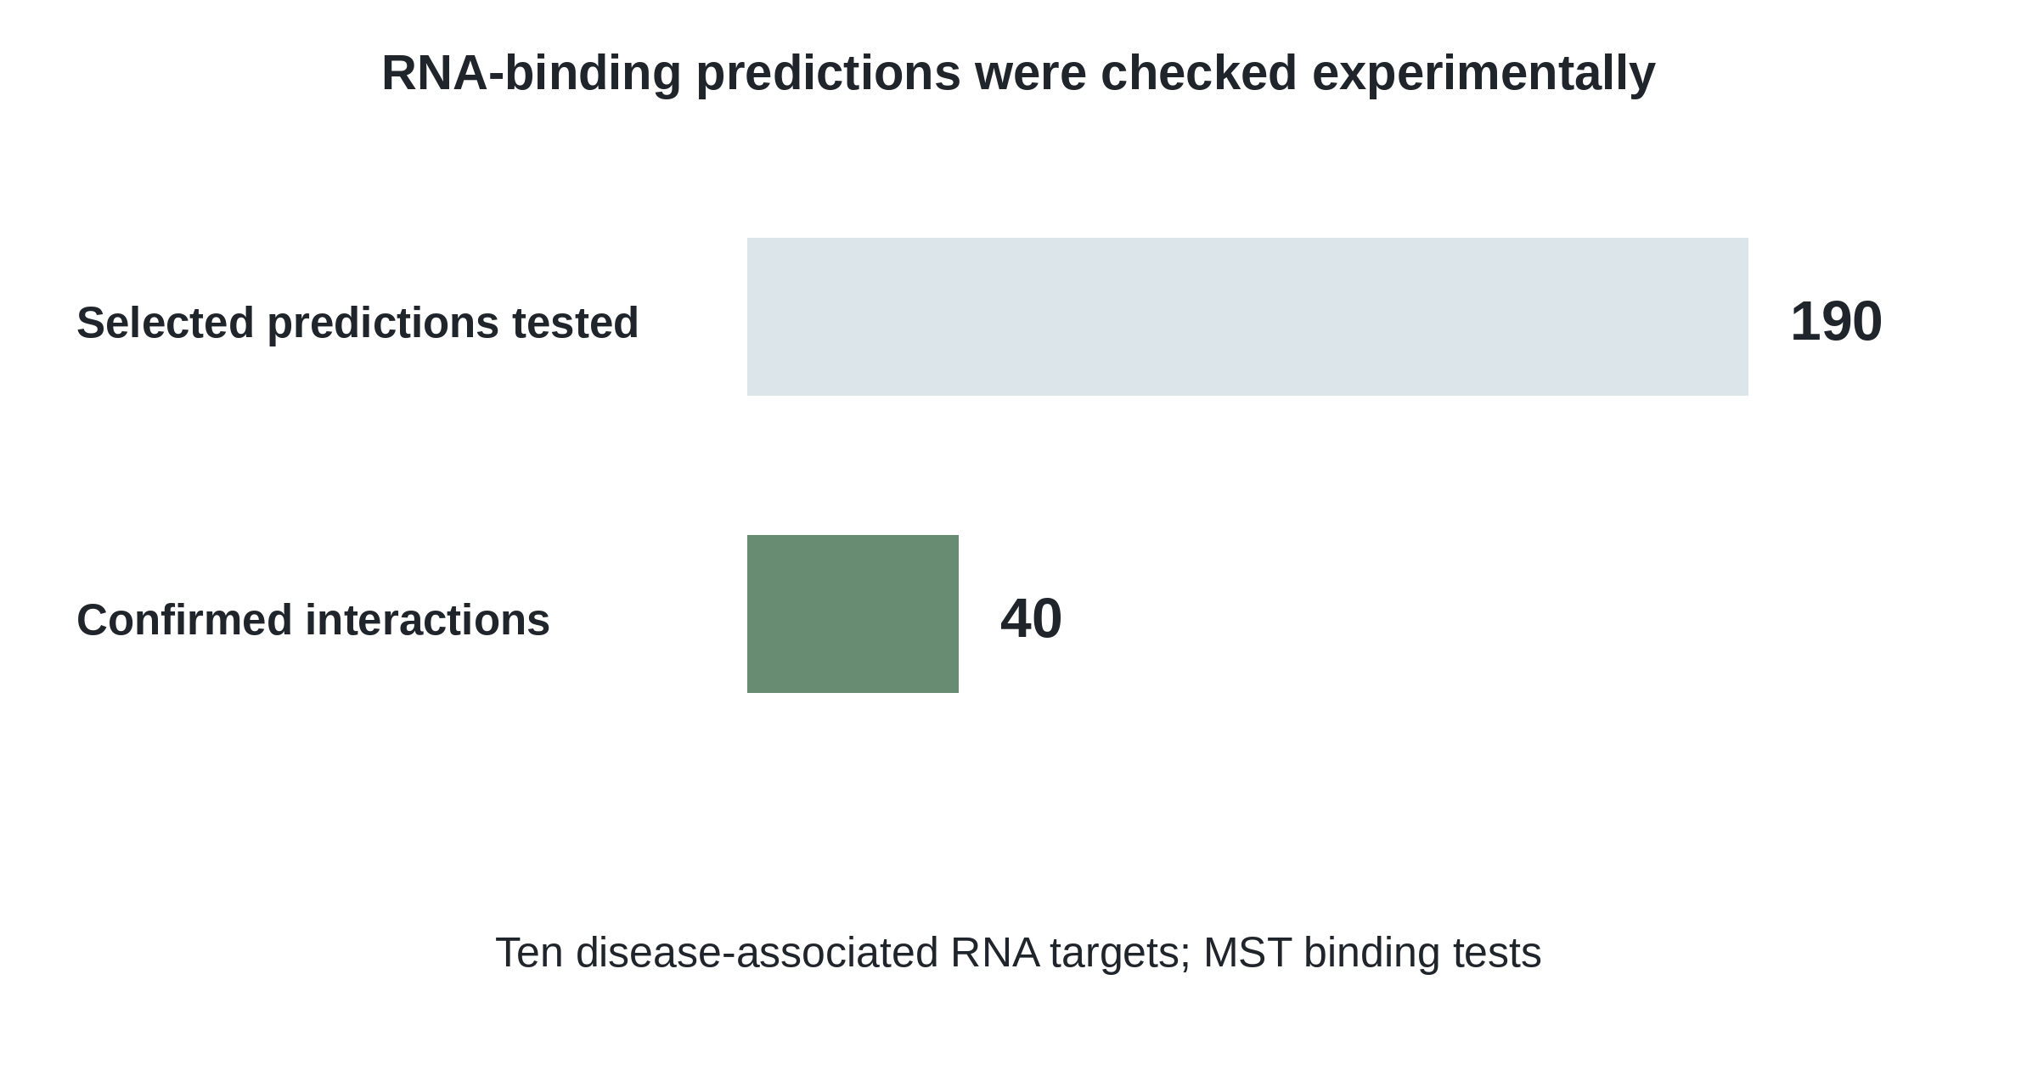
Exercise: What Did an RNA Binding Screen Prove?
SMRTnet nominated interactions across ten disease-associated RNA targets.
What additional evidence is needed to connect binding to a cellular effect?
Published counts: 190 predicted interactions tested; 40 confirmed by MST.
Fei et al., Nat. Biotechnol. (2026), doi:10.1038/s41587-025-02942-z.
45
Notes:
Count interactions, not necessarily unique compounds. Binding validation does not alone establish cellular specificity, causality or therapeutic benefit. Ask for a functional experiment and a specificity control. Source: Fei et al., Nat. Biotechnol. (2026), doi:10.1038/s41587-025-02942-z.

Slide 40
From Target Knowledge to Better PD Decisions
Define the target interaction or biological effect.
Choose a suitable AI tool, inspect the chemistry and test the claim.
A specific PD question
Target • pocket • binding • function
An appropriate AI output
Structure • ranked candidates • chemical proposals
A matching experiment
Binding test • functional assay • causal follow-up
Chemical knowledge makes AI predictions useful—not automatically true.
Summary of the cited research examples.
46
Notes:
Close the link to enzymes, GPCRs, nuclear receptors, ion channels and nucleic acids. Students should name the question, model output and matching experiment. Source: Summary of the cited research examples.

