Slide 1
Comparing text representations：
Document clustering using four categories
from 20 Newsgroups dataset
Which representation preserves useful semantic structure?
Notes:
This project compares four text representations for document clustering. I use the same documents and clustering protocol throughout. The central question is whether a representation separates meaningful categories, rather than merely producing visually separated points. The most informative result is the contrast between sentence embeddings and a reconstruction-trained VAE.

Slide 2
20 Newsgroups dataset：3295 texts
Category | Documents
alt.atheism | 779
comp.graphics | 955
sci.space | 955
talk.religion.misc | 606
K-means: K = 4, n_init = 20, seed = 42, and labels used for scoring
Notes:
The corpus contains graphics, space, atheism and religion discussions. We remove headers, footers and quoted text, then discard ninety-two empty documents. This leaves three thousand two hundred and ninety-five aligned documents. Every saved representation carries the same original document IDs. K-means uses four clusters, twenty initializations and seed forty-two. Category labels are used only after fitting for evaluation and plotting. Importantly, the models and vocabulary are fitted on the same corpus that we evaluate. These are descriptive unsupervised results, not test-set generalization scores. The atheism and religion categories also overlap in content, so category agreement is informative but not a complete definition of topic quality.

Slide 3
4 text representation methods：
Method | Main idea | Output dimensions
TF-IDF | Gives higher weights to words that are frequent in a document but rare across documents. | 5,000
Sentence Transformer（all-MiniLM-L6-v2） | Uses a pretrained model to turn text into vectors that capture meaning. | 384
Autoencoder (AE) | Learns to compress the input and reconstruct it. | 32
Variational Autoencoder (VAE) | Learns a latent distribution and reconstructs the input using sampled vectors. | 20
Notes:
TF-IDF represents documents using weighted word frequencies. Sentence Transformer produces embeddings using a pretrained model. The AE learns a compressed representation by reconstructing its input. The VAE learns a latent distribution using reconstruction loss and a KL-divergence term.
then I apply K-means to each representation to compare the clustering results.

Slide 4
Sentence embeddings best match category labels
Representation | ARI | NMI | Silhouette
TF-IDF（baseline） | 0.1765 | 0.3602 | 0.0050
Sentence Transformer | 0.5025 | 0.5306 | 0.0421
AE latent | 0.3193 | 0.3995 | 0.0741
VAE mean | 0.0066 | 0.0085 | 0.4072
TF-IDF: captured some topic structure, but substantial mixing remained
Sentence Trandsformer: obtained higher ARI and NMI scores than TF-IDF
AE: achieved higher ARI and NMI than the TF-IDF baseline
VAE: strongest geometric separation, almost no category agreement

Slide 5
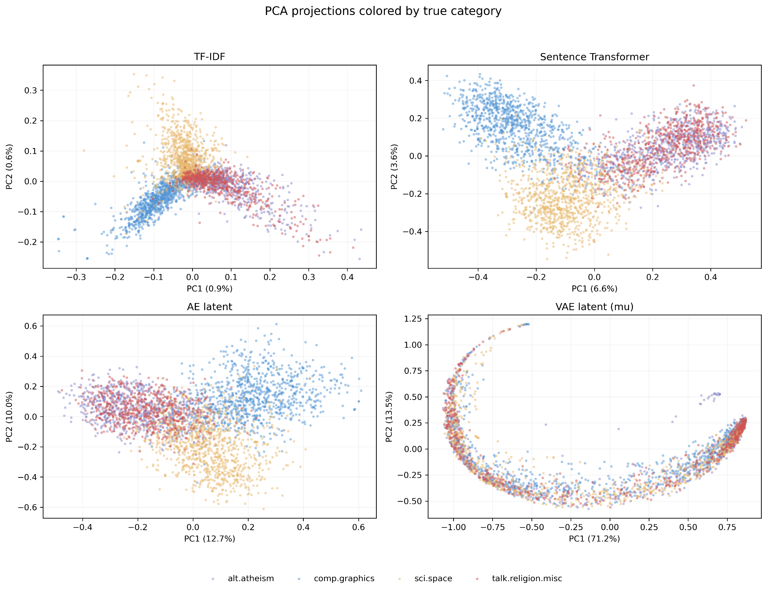
PCA reveals category structure and mixed geometry
Atheism & religion overlap
Sentence embeddings:
clearer graphics / space regions
VAE:
curved structure,
mixed category colors

Slide 6
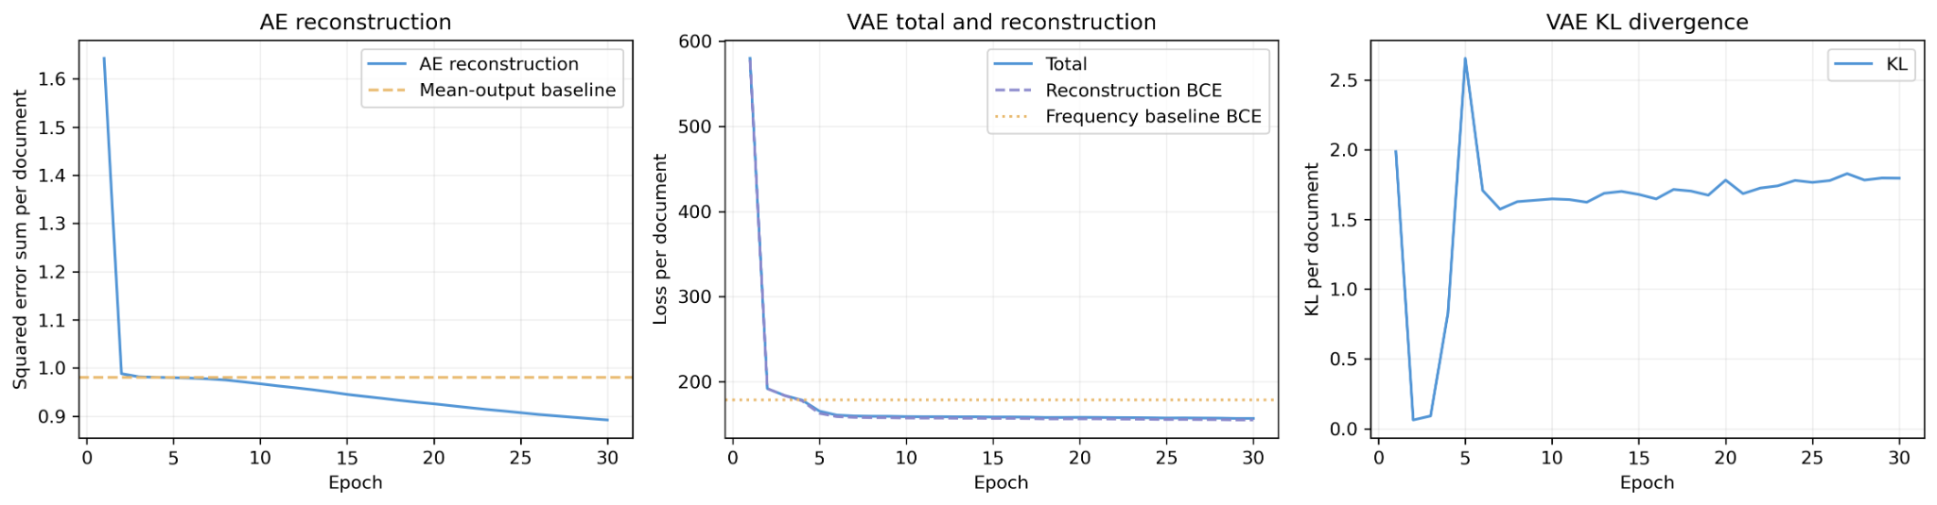
Reconstruction improves without ensuring semantics
AE: 0.9805 mean baseline → 0.8882 final squared error
VAE: 178.6654 frequency BCE → 154.4293 final BCE
Final KL = 1.8179

Slide 7
Conclusions
Representation | ARI | NMI | Silhouette
TF-IDF（baseline） | 0.1765 | 0.3602 | 0.0050
Sentence Transformer | 0.5025 | 0.5306 | 0.0421
AE latent | 0.3193 | 0.3995 | 0.0741
VAE mean | 0.0066 | 0.0085 | 0.4072
1. Sentence Transformer achieved the best agreement with the true categories.
2. AE compressed the input and improved clustering agreement over TF-IDF in this experiment.
3. A high silhouette score does not guarantee meaningful topic clusters.

Slide 8
Limits define the next useful experiments
Current limits
Next experiments
1. Different experimental settings
2. Limited stability evaluation
3. No held-out evaluation
1. Repeat with different random seeds
2. Use the same input and latent size for AE and VAE
3. Test different KL weights
4. Evaluate on unseen documents

