Slide 1
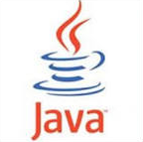
EE基础与应用 翁秀木

Slide 2
第三回 JUnit
JUnit简介
JUnit的使用
Notes:
参考资料
# http://junit.org/
# http://www.ibm.com/developerworks/java/library/j-junit4/
# http://www.vogella.com/tutorials/JUnit/article.html
# 来自JUnit的体验对测试驱动开发是很重要的，所以一些 JUnit知识经常 和测试驱动开发的讨论融合在一起。可以参考Kent Beck的 《Test-Driven Development: By Example》一书（有中文版和影印版）
# http://www.asjava.com/junit/junit-tutorials-and-example/

Slide 3
学习目标
掌握JUnit的作用。
掌握JUnit的使用。

Slide 4
什么是JUnit
在Java程序开发中，JUnit是事实上的标准的单元测试框架。它的主要开发者是由Kent Beck（肯特·贝克）和Erich Gamma（埃里克·伽玛），开发语言java，开源，基于测试驱动开发（Test-driven Development，TDD）思想。JUnit属于xUnit框架，其类似产品有PHPUnit、OCUnit和NUnit等。
JUnit使得Java代码更加健壮和可靠，正如
马丁· 福勒（Martin Flower）所说：“在软件开发领域，从未有像JUnit这般，用这么少的代码就给这么多人带来这么多的获益。”
Notes:
Erich Gamma (born 1961 in Zürich) is Swiss computer scientist and co-author of the influential software engineering textbook, Design Patterns: Elements of Reusable Object-Oriented Software. He co-wrote the JUnit software testing framework with Kent Beck and led the design of the Eclipse platform's Java Development Tools (JDT). He also worked on the IBM Rational Jazz project.
He joined Microsoft's Visual Studio team in 2011 and will lead a development lab in Zürich, Switzerland
++++++++++++++++++++++
http://martinfowler.com/
http://en.wikipedia.org/wiki/Martin_Fowler
Martin Fowler (born 1963) is a British software engineer, author and international speaker on software development, specializing in object-oriented analysis and design, UML, patterns, and agile software development methodologies, including extreme programming.
+++++++++++++++
JUnit, developed by Kent Beck and Erich Gamma, is almost indisputably the single most important third-party Java library ever developed. As Martin Fowler has said, "Never in the field of software development was so much owed by so many to so few lines of code." JUnit kick-started and then fueled the testing explosion. Thanks to JUnit, Java code tends to be far more robust, reliable, and bug free than code has ever been before. JUnit (itself inspired by Smalltalk's SUnit) has inspired a whole family of xUnit tools bringing the benefits of unit testing to a wide range of languages. nUnit (.NET), pyUnit (Python), CppUnit (C++), dUnit (Delphi), and others have test-infected programmers on a multitude of platforms and languages.
http://www.ibm.com/developerworks/java/library/j-junit4/

Slide 5
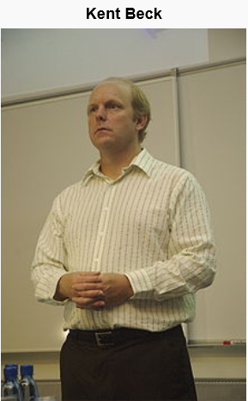
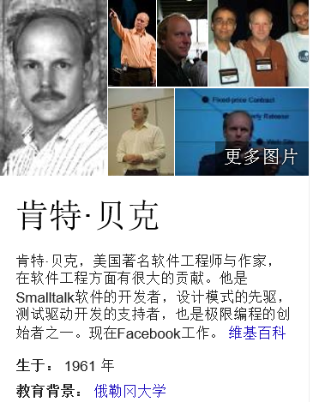

Slide 6
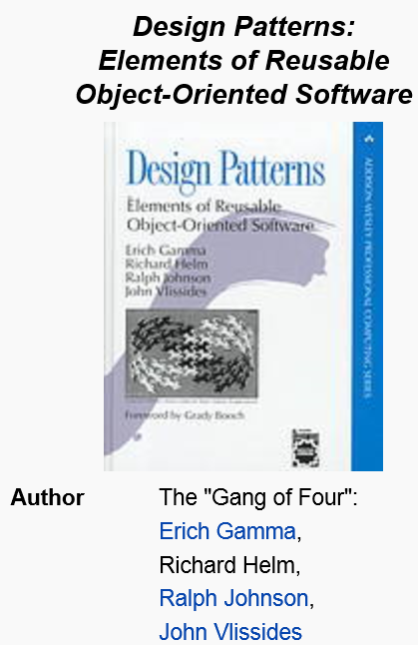
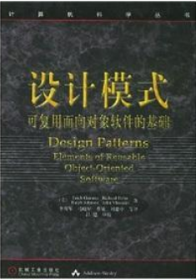

Slide 7
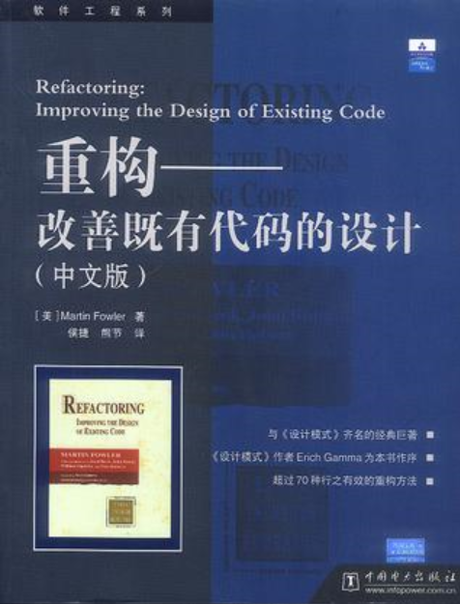
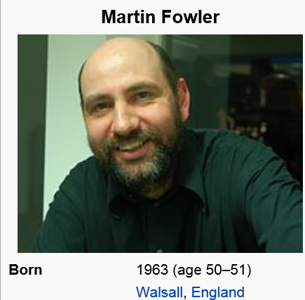

Slide 8
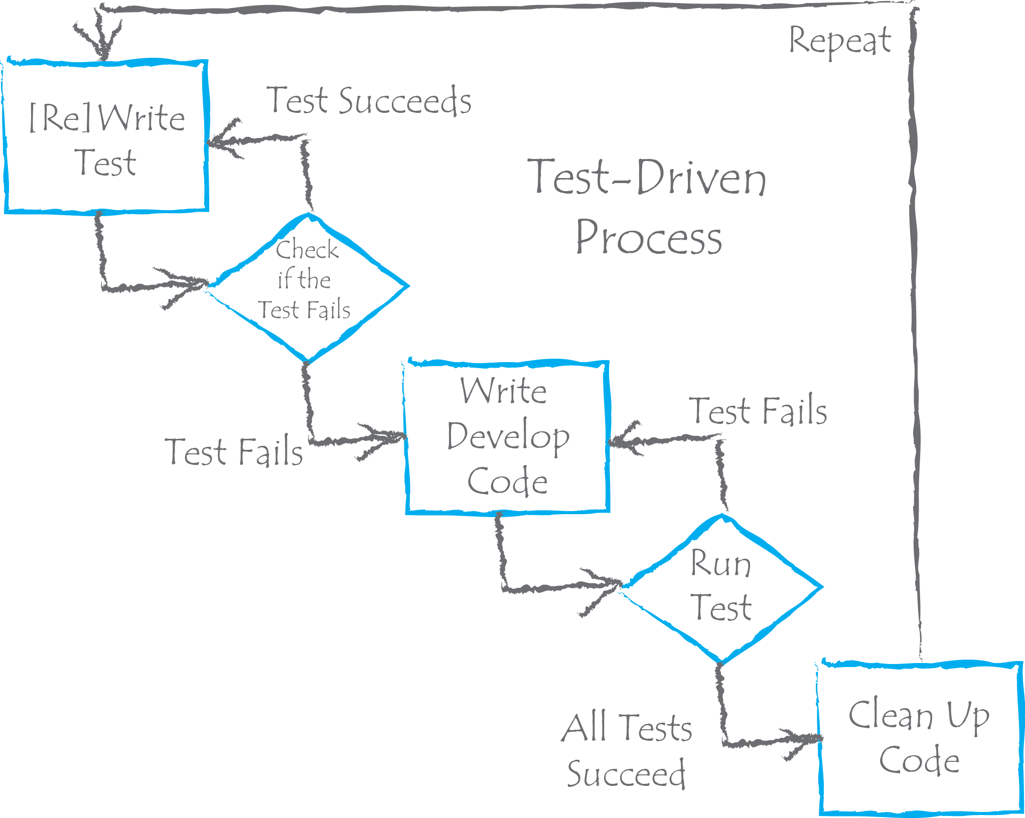
测试驱动开发（TDD）

Slide 9
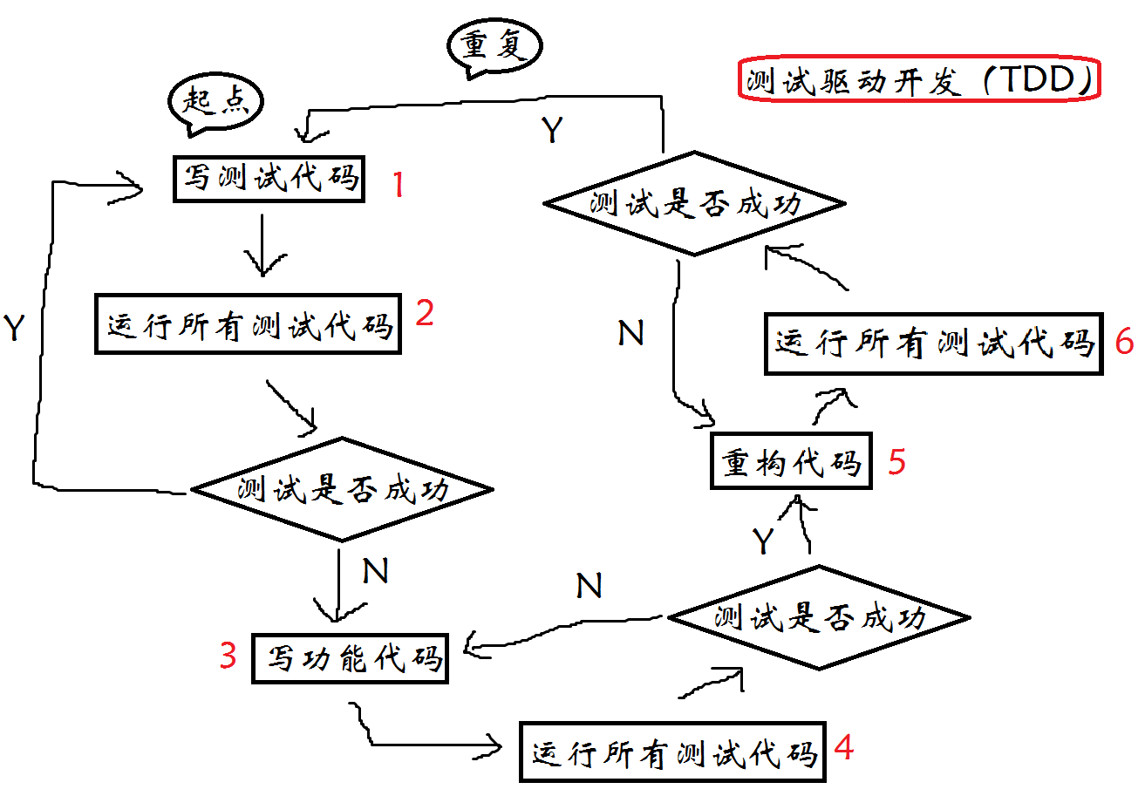
测试驱动开发（TDD）
Notes:
参考http://en.wikipedia.org/wiki/Test-driven_development#cite_note-Beck-1中的The following sequence is based on the book Test-Driven Development by Example.^{[1}
Test-driven development (TDD) is a software development process that relies on the repetition of a very short development cycle: first the developer writes an (initially failing) automated test case that defines a desired improvement or new function, then produces the minimum amount of code to pass that test, and finally refactors the new code to acceptable standards. Kent Beck, who is credited with having developed or 'rediscovered' the technique, stated in 2003 that TDD encourages simple designs and inspires confidence
http://en.wikipedia.org/wiki/Test-driven_development

Slide 10
测试驱动开发（TDD）的好处
提高了单元测试的效率。
提高了代码的测试覆盖率。
更好地保证新增代码不会影响现有代码的正确性。
提倡在编写功能代码前编写测试代码，可促使开发者在编写功能代码前更好地理解需求。
促使开发者编写一些小粒度的、单一职责的、便于单元测试的组件（比如方法、类）。

Slide 11
JUnit的使用
见JUnit Guide
方法的访问标识符必须public，返回值为void
JUnit代码应像业务逻辑代码那般，加注释、进行代码版本管理、代码移交等。
不是所有类，所有方法都必须被JUnit。
测试时，应尽量覆盖各种隐含bug的情况（case），比如边界值测试、返回true和false的情况都要测试。

Slide 12
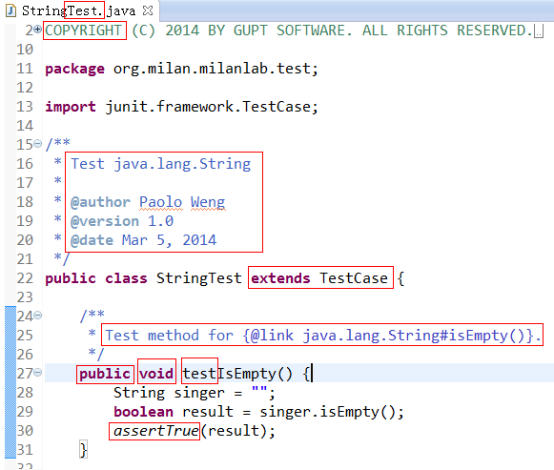
JUnit3

Slide 13
JUnit4与JUnit3的不同
测试方法都附有标注@Test。不需要如JUnit3那般，测试方法命名必须以test为前缀。
测试类不需要继承junit.framework.TestCase，无论直接或间接。
无须用junit.framework或junit.extensions里的任何类。
Notes:
Notes
All test methods are annotated with @Test. Unlike JUnit3 tests, you do not need to prefix the method name with "test" (and usually don't)
Do not have your test classes extend junit.framework.TestCase (directly or indirectly). Usually, tests with JUnit4 do not need to extend anything (which is good, since Java does not support multiple inheritance)
Do not use any classes in junit.framework or junit.extensions
(From https://github.com/junit-team/junit/wiki/Getting-started)

Slide 14
未完待续，谢谢！

