Slide 1

EE基础与应用 翁秀木
Notes:
参考资料
# The Java EE 6 Tutorial Basic Concepts Fourth Edition，Eric Jendrock, Ian Evans, Devika Gollapudi, Kim Haase, Chinmayee Srivathsa著, (据说他们都是Oracle Java EE6 文档团队成员），中文版：Java EE 6权威指南基础篇（第4版）李鹏 韩智译，人民邮电出版社。

Slide 2
第六回 Servlet+JSP+JSTL+EL
JSP
Servlet
JSTL
EL

Slide 3
学习目标
掌握什么是JSP、为什么用JSP、JSP怎么运作
掌握JSP的脚本元素（Scripting Element）
掌握JSP的隐含对象（implicit object)，重点request/response/session
掌握JSP的指令
掌握JSP的动作
掌握什么是Servlet、为什么用Servlet、怎么用Servlet，即Servlet运作原理
掌握什么是Filter、为什么用Filter、怎么用Filter
掌握什么是JSTL、为什么用JSTL、怎么用JSTL
掌握什么是EL、为什么用EL、怎么用EL

Slide 4
JSP的简介
什么是JSP （What）
为什么用JSP （Why）
JSP怎么运作、怎么用JSP （hoW)

Slide 5
什么是JSP
Java 技术
Server 端
动态的 web Page

Slide 6
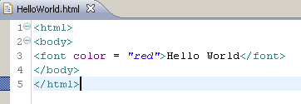
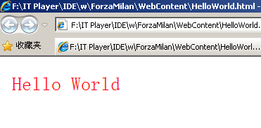
为什么用JSP
HTML

Slide 7
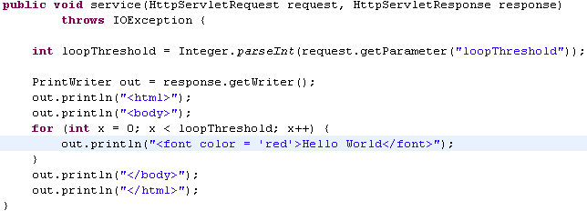

为什么用JSP
Servlet

Slide 8
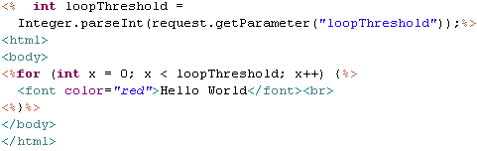
为什么用JSP
JSP
HTML + Java

Slide 9
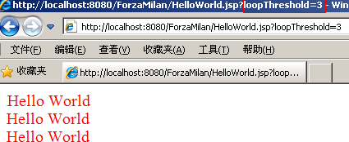
为什么用JSP
JSP

Slide 10
为什么用JSP
更便利地在服务器端动态地生成HTML
更清晰地将呈现逻辑与其他逻辑分开

Slide 11
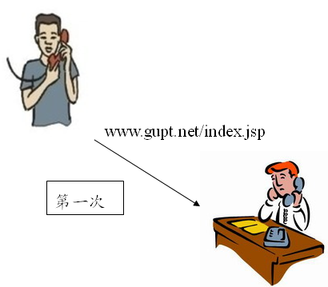
JSP怎么运作
1> 转化 （translate）
index.jsp > index.java
2> 编译 （compile）
index.java > index.class
3> 运行 （execute)
运行index实例，处理请求。

Slide 12
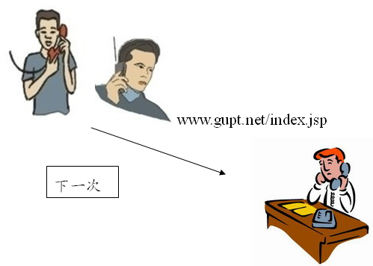
JSP怎么运作
运行 （execute)
运行index实例，处理请求。

Slide 13
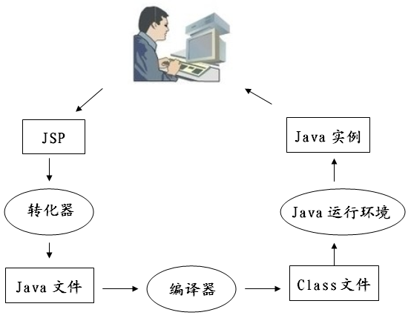
JSP怎么运作

Slide 14
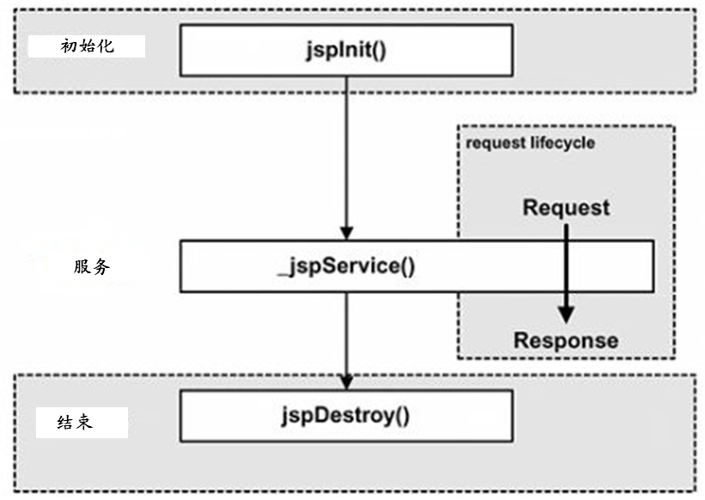
JSP怎么运作

Slide 15
怎么用JSP
JSP脚本元素
JSP指令
JSP动作
JSP隐含对象

Slide 16
JSP的脚本元素 Scripting element
声明 declaration
<%! %>
脚本 Scriptlet
<% %> <%-- --%>
表达式 expression
<%= %>

Slide 17
JSP的指令 directive
page 页面
<%@page %>
include 包含
<%@include %>
taglib 标签库
<%@taglib %>
Notes:
Directives are messages to the JSP container. Directives have this syntax:
<%@ directive { attr=”value” }* %>
For JSP pages in standard syntax,
the character encoding for the JSP page is the charset given
by the pageEncoding attriute if it is present, otherwise the
charset given by the contentType attribute if it is present,
otherwise “ISO-8859-1”.
这两属性都会变成类似response.setContentType("text/html;charset=UTF-8");
jsp-2_2-mrel-spec.pdf

Slide 18
// JSP中的对象的范围 scope，
page 页面
request 请求
session 会话
application 应用
Notes:
Objects are created within a JSP page instance that is responding to a request
object. There are several scopes:
• page - Objects with page scope are accessible only within the page where they
are created. All references to such an object shall be released after the response
is sent back to the client from the JSP page or the request is forwarded somewhere else. References to objects with page scope are stored in the pageContext
object.
request - Objects with request scope are accessible from pages processing the
same request where they were created. References to the object shall be released
after the request is processed. In particular, if the request is forwarded
to a resource in the same runtime, the object is still reachable. References to
objects with request scope are stored in the request object.
session - Objects with session scope are accessible from pages processing requests
that are in the same session as the one in which they were created. It is
not legal to define an object with session scope from within a page that is not
session-aware (see Section JSP.1.10.1, “The page Directive”). All references
to the object shall be released after the associated session ends. References to
objects with session scope are stored in the session object associated with the
page activation.
application - Objects with application scope are accessible from pages processing
requests that are in the same application as they one in which they were created.
Objects with application scope can be defined (and reached) from pages
that are not session-aware. References to objects with application scope are
stored in the application object associated with a page activation. The application
object is the servlet context obtained from the servlet configuration object.
All references to the object shall be released when the runtime environment reclaims
the ServletContext.
jsp-2_2-mrel-spec.pdf

Slide 19
JSP的隐含对象 implicit object
request 请求 : HttpServletRequest (request scope)
response 响应 : HttpServletResponse (request scope)
session 会话 : HttpSession (session scope)
out 输出 : PrintWriter (request scope)
application 应用 : ServletContext (application scope)
config 配置 : ServletConfig (page scope)
pageContext 页面环境 : PageContext (page scope)
page 页面 : this (page scope)
exception 异常 : Throwable (page scope)

Slide 20
+Page箱++++++
方式1)
pageContext.setAttribute(name, object);
pageContext.getAttribute(name);
方式2)
pageContext.setAttribute(name, object, PageContext.PAGE_SCOPE);
pageContext.getAttribute(name, PageContext.PAGE_SCOPE);
+Request箱++++++++++++++++++++++++++++++
方式1）
request.setAttribute(name, object)
request.getAttribute(name)
方式2）
pageContext.setAttribute(name, object, PageContext.REQUEST_SCOPE);
pageContext.getAttribute(name, PageContext.REQUEST_SCOPE);

Slide 21
+Session箱++++++++++++++++++++++
方式1）
session.setAttribute(name, object)
session.getAttribute(name)
方式2）
pageContext.setAttribute(name, object, PageContext.SESSION_SCOPE);
pageContext.getAttribute(name, PageContext.SESSION_SCOPE);
+Application箱++++++++++++++++++++++
方式1）
application.setAttribute(name, object)
application.getAttribute(name)
方式2）
pageContext.setAttribute(name, object, PageContext.APPLICATION_SCOPE);
pageContext.getAttribute(name, PageContext.APPLICATION_SCOPE);

Slide 22
// JSP的动作 action *
forward
<jsp:forward>
<jsp:param>
include
<jsp:include>
<jsp:param>
useBean
<jsp:useBean>
<jsp:setProperty> <jsp:getProperty>
Notes:
JSP.5.4 <jsp:include>
A <jsp:include .../> action provides for the inclusion of static and dynamic
resources in the same context as the current page. See Table JSP.1-10 for a summary
of include facilities.
Inclusion is into the current value of out. The resource is specified using a relativeURLspec
that is interpreted in the context of the web application (i.e. it is
mapped).
jsp-2_2-mrel-spec.pdf

Slide 23
JavaBean *
可序列化 implements Serializable
public的get/set方法，以访问实例属性（field）
public的无参数构造器
Notes:
JSP.5.4 <jsp:include>
A <jsp:include .../> action provides for the inclusion of static and dynamic
resources in the same context as the current page. See Table JSP.1-10 for a summary
of include facilities.
Inclusion is into the current value of out. The resource is specified using a relativeURLspec
that is interpreted in the context of the web application (i.e. it is
mapped).
jsp-2_2-mrel-spec.pdf

Slide 24
Servlet的简介
什么是Servlet （What）
为什么用Servlet（Why）
Servlet怎么运作，怎么用Servlet（hoW)

Slide 25
什么是Servlet
Java applet是在客户（client）端web浏览器（browser）里运行的小程序，Servlet则可理解为在服务器（server）端运行的小程序
其目的是处理各种互联网request请求（主要是http请求，并将结果返回给客户端。
javax.servlet 和javax.servlet.http 包（packages）提供了写Servlet的接口和类。对提供通用服务的Servlet，可继承GenericServlet；对提供Http服务的Servlet，可继承HttpServlet（定义了doGet和doPost方法）

Slide 26
为什么用Servlet
支持服务器端计算，扩展服务器端的能力，可理解为从客户端到服务器端的入口，接收客户端请求，处理后，返回结果到客户端。
在Model-View-Controller（MVC）模式中，可当Controller的角色，主要职责是根据请求以控制页面流转、控制业务模块调度。

Slide 27
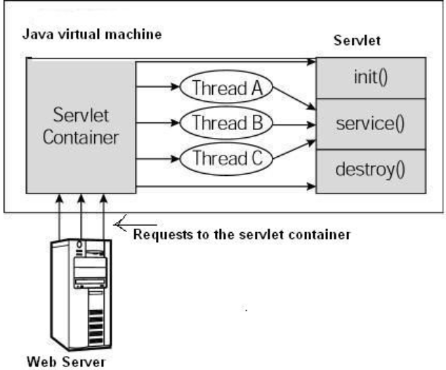
// Servlet怎么运作
容器接收到对请求后，会指派给某个Servlet处理，此时会先创建并初始化该Servlet的实例（即调用init方法），再调用service方法。随后对该Servlet的请求，都不会再调用init方法，而直接调用该Servlet实例（单例）的service方法。destroy方法在销毁该Servlet实例时用，如关闭服务器时。
Notes:
# The following figure depicts a typical servlet life-cycle scenario.
First the HTTP requests coming to the server are delegated to the servlet container.
The servlet container loads the servlet before invoking the service() method.
Then the servlet container handles multiple requests by spawning multiple threads, each thread executing the service() method of a single instance of the servlet.
http://www.tutorialspoint.com/servlets/servlets-life-cycle.htm
# The web container initializes a servlet after loading and instantiating the servlet class and before delivering requests from clients.
http://docs.oracle.com/javaee/6/tutorial/doc/bnafu.html

Slide 28
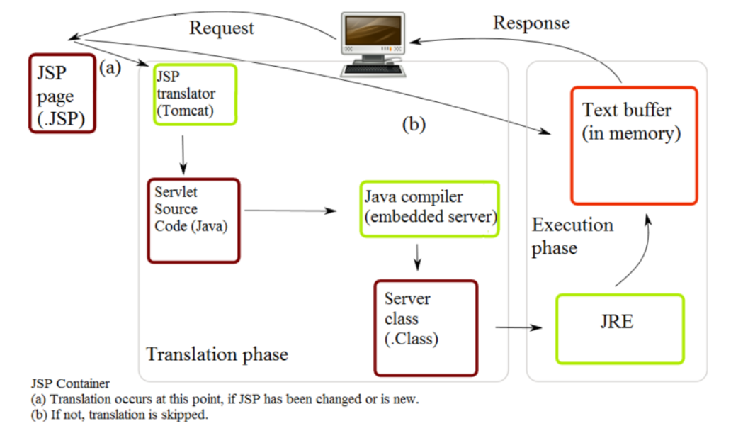
Servlet怎么运作 - Servlet与JSP

Slide 29
怎么用Servlet - 配置Servlet
法1 web xml配置
<servlet>
<servlet-name>helloServlet</servlet-name>
<servlet-class>net.gupt.cs.jee.servlet.HelloServlet</servlet-class>
</servlet>
<servlet-mapping>
<servlet-name>helloServlet</servlet-name>
<url-pattern>/hello</url-pattern>
</servlet-mapping>
注意：url-pattern 必须以 "/" or "*."起头
法2 标注（annotation）
@WebServlet(name = "helloServlet", urlPatterns = { "/hello" })
public class HelloServlet extends HttpServlet {...}

Slide 30
怎么用Servlet - 定义Servlet类
public class HelloServlet extends HttpServlet {
protected void doGet(HttpServletRequest request,
HttpServletResponse response)
throws ServletException, IOException {...}
protected void doPost(HttpServletRequest request,
HttpServletResponse response)
throws ServletException, IOException {...}
}

Slide 31
Filter的简介
什么是Filter （What）
为什么用Filter （Why）
Filter怎么运作、怎么用Filter （hoW)

Slide 32
什么是Filter
过滤器Filter，在Servlet2.3规范中引入，主要功能是拦截http请求，在该请求传递给目标资源（jsp、servlet或其他静态资源，如html）之前，或在结果返回给客户端之前，执行所需要的预处理。

Slide 33
// 为什么用Filter
过滤器Filter，其用途主要包括国际化时的编码设置、核对安全信息并将它转发给登录页面、记录系统日志（logging）、记录用户行为（tracing）、压缩下载数据、图像转化等。
Notes:
# Filters can perform many different types of functions. We'll discuss examples of the italicized items in this paper:
Authentication-Blocking requests based on user identity.
Logging and auditing-Tracking users of a web application.
Image conversion-Scaling maps, and so on.
Data compression-Making downloads smaller.
Localization-Targeting the request and response to a particular locale.
XSL/T transformations of XML content-Targeting web application responses to more that one type of client.
http://www.oracle.com/technetwork/java/filters-137243.html
# There are are various types of filters suggested by the specifications:
Authentication Filters.
Data compression Filters.
Encryption Filters.
Filters that trigger resource access events.
Image Conversion Filters.
Logging and Auditing Filters.
MIME-TYPE Chain Filters.
Tokenizing Filters .
XSL/T Filters That Transform XML Content.
http://www.tutorialspoint.com/servlets/servlets-writing-filters.htm

Slide 34
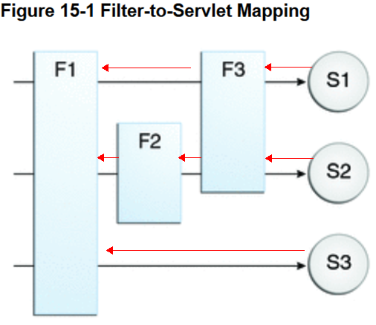
Filter怎么运作
F表示Filter，S表示Servlet。对S1的请求先要经过F1->F3这个Filter chain（过滤器链）的处理，S1处理完后在依照F3->F1而返回给客户端
Notes:
http://docs.oracle.com/javaee/6/tutorial/doc/bnagb.html

Slide 35
怎么用Filter - 配置Filter
法1 web xml配置
<filter>
<filter-name>myFaceFilter</filter-name>
<filter-class>net.gupt.cs.jee.filter.MyFaceFilter</filter-class>
</filter>
<filter-mapping>
<filter-name>myFaceFilter</filter-name>
<url-pattern>/*</url-pattern>
</filter-mapping>
注意：url-pattern 必须以 "/" or "*."起头
法2 标注（annotation）
@WebFilter(filterName = "myFaceFilter", urlPatterns = {"/*" })
public class MyFaceFilter implements Filter {...}

Slide 36
怎么用Filter - 定义Filter类
public class MyFaceServlet extends Filter {
public void doFilter(ServletRequest request,
ServletResponse response,
FilterChain chain)
throws IOException, ServletException {
// 解决中文乱码
request.setCharacterEncoding("UTF-8");
// 调用下一个filter，若没有filter就会调用所请求的资源
chain.doFilter(request, response);}
}

Slide 37
JSTL的简介
什么是JSTL （What）
为什么用JSTL（Why）
怎么用JSTL（hoW)

Slide 38
什么是JSTL
JSTL=JavaServer Pages Standard Tag Library
提供标签库，在JSP中封装通用功能，包括核心标签库、国际化标签库、SQL标签库、XML标签库、函数标签库

Slide 39
什么是JSTL
核心标签库：包括变量支持（如定义变量）、流程控制、URL管理及其他。
国际化标签库：包括地域设置（如中文支持）、输出地域性字符串、格式化地域性数字和日期等。
SQL标签库：包括设置数据源、事务管理和数据操作（查找和更新）
XML标签库：包括输出、解析和设置XML元素等
函数标签库：包括主要的字符串操作函数，类似length(), contains(), startsWith()等

Slide 40
为什么用JSTL
提供标准的标签库，提高软件质量（如可读性、可维护性）
尽量减少在JSP中使用嵌套的java代码，以更清晰地将呈现逻辑与其他逻辑分开
便于习惯tag的web页面开发人员使用
提高安全性，可避免一些XSS攻击（XSS=Cross Site Scripting）

Slide 41
怎么用JSTL
使用JSTL等自定义的标签库，需要在网页前面声明Tag标记，例如若要用JSTL的core标签，则需要加入以下标记。
<%@ taglib prefix="c" uri="http://java.sun.com/jsp/jstl/core" %>

Slide 42
// 怎么用JSTL
<%@ taglib prefix="c" uri="http://java.sun.com/jsp/jstl/core"%>
<html>
<body>
<c:set var="userName" value="zhang san" />
<c:set value="16" var="age" />
欢迎您，
<c:out value="${userName}" /><hr>
<!--从1到5依次取一个数字赋于变量i-->
<c:forEach var="i" begin="1" end="5">
${i}&nbsp;&nbsp;
</c:forEach>
<br>
<c:if test="${age<18}">
对不起，你不能访问这个网页
</c:if><br>
</body>
</html>

Slide 43
// 怎么用JSTL
JSTL核心标签库
1、表达式操作out、set、remove
<c:out>：输出一个特定范围里面的属性。 类似jsp的 out.println()。有两种方式：
Without a body
<c:out value=“value” [escapeXml=”{true|false}”]
[default=”defaultValue”] />
或者With a body
<c:out value=”value” [escapeXml=”{true|false}”]>
default value
</c:out>
Notes:
Value = Expression to be evaluated.
escapeXml = Deterrmines whether characters <,>,&,’,” in the
resulting string should be converted to their
corresponding character entity codes. Default value is
true.
Default = Default value if the resulting value is null.If value is null, the default value takes over. If no default value is specified, it
itself defaults to an empty string. 若不设置，则当value为null时，默认值为空字符串。
(From jstl-1_2-mrel2-spec.pdf)

Slide 44
怎么用JSTL
JSTL核心标签库
<c:out>
例1 <c:out value=“Hello JSTL”/> 打印出Hello JSTL
例2 <jsp:useBean id="singer" class="net.gupt.cs.jee.vo.Singer">
</jsp:useBean>
<jsp:setProperty name="singer" property="name" value="动力火车"/>
<c:out value="Hi ${singer.name}"/>
打印出Hi 动力火车

Slide 45
// 怎么用JSTL
(2) <c:set>设置某个特定对象的一个属性（默认scope=page）
<c:set value="value" var="varName" [scope= "{page|request|session|application}"]/ >
例1 <c:set value="Kaka" var="name"/>
给属性name赋值Kaka，并把它放入"page"箱子里（page scope）
例2<c:set value="Pippo" var="name" scope="session"/>
给变量name赋值Pippo，并存入session
Notes:
Syntax 1: Set the value of a scoped variable using attribute value
<c:set value=”value”
var=”varName” [scope=”{page|request|session|application}”]/>
Syntax 2: Set the value of a scoped variable using body content
<c:set var=”varName” [scope=”{page|request|session|application}”]>
body content
</c:set>
Syntax 3: Set a property of a target object using attribute value
<c:set value=”value”
target=”target” property=”propertyName”/>
Syntax 4: Set a property of a target object using body content
<c:set target=”target” property=”propertyName”>
body content
</c:set>
Syntax 5: Set a deferred value
<c:set var=”varName” value="deferred-value"/>
Target object whose property will be set. Must evaluate to
a JavaBeans object with setter property property, or to a
java.util.Map object.
If value is null
■ Syntax 1: the scoped variable defined by var and scope is removed.
■ If attribute scope is specified, the scoped variable is removed according to
the semantics of PageContext.removeAttribute(varName, scope).
■ Otherwise, there is no way to differentiate between syntax 1 and syntax 5.
The scoped variable is removed according to the semantics of
PageContext.removeAttribute(varName), and the variable is removed
from the VariableMapper as well.
(From jstl-1_2-mrel2-spec.pdf)

Slide 46
// 怎么用JSTL
(2) <c:set>
例3 <c:set value="${name1}" var="name2" />
取出name1的值，赋给name2
例4：<c:set value="${param.name1}" var="name3" />
取出request中参数name1值，赋给name3
例5 <jsp:useBean id= "singer" class=“gupt.Singer"></jsp:useBean>
<c:set target="${singer}" property="name" value="GEM" />
<c:set target="${singer}" property="rank" value="1" />
给名为singer的属性对应的对象赋值，该对象可以是JavaBean（即给其属性赋值），也可以是Map（即给其中key赋值）。
Notes:
Syntax 1: Set the value of a scoped variable using attribute value
<c:set value=”value”
var=”varName” [scope=”{page|request|session|application}”]/>
Syntax 2: Set the value of a scoped variable using body content
<c:set var=”varName” [scope=”{page|request|session|application}”]>
body content
</c:set>
Syntax 3: Set a property of a target object using attribute value
<c:set value=”value”
target=”target” property=”propertyName”/>
Syntax 4: Set a property of a target object using body content
<c:set target=”target” property=”propertyName”>
body content
</c:set>
Syntax 5: Set a deferred value
<c:set var=”varName” value="deferred-value"/>
Target object whose property will be set. Must evaluate to
a JavaBeans object with setter property property, or to a
java.util.Map object.
If value is null
■ Syntax 1: the scoped variable defined by var and scope is removed.
■ If attribute scope is specified, the scoped variable is removed according to
the semantics of PageContext.removeAttribute(varName, scope).
■ Otherwise, there is no way to differentiate between syntax 1 and syntax 5.
The scoped variable is removed according to the semantics of
PageContext.removeAttribute(varName), and the variable is removed
from the VariableMapper as well.
(From jstl-1_2-mrel2-spec.pdf)

Slide 47
// 怎么用JSTL
(3) <c:remove>它的作用是删除某个变量或者属性
<c:remove var="varName"
[scope= "{page|request|session|application}"]/ >
如<c:remove var="singer" scope="session"/>从session中删除属性名为singer的对象。
Notes:
The <c:remove> action removes a scoped variable.
If attribute scope is not specified, the scoped variable is removed according to the
semantics of PageContext.removeAttribute(varName). If attribute scope is
specified, the scoped variable is removed according to the semantics of
PageContext.removeAttribute(varName, scope)
(From jstl-1_2-mrel2-spec.pdf).

Slide 48
怎么用JSTL
JSTL核心标签库
2、流程控制<c:if>、<c:choose>、<c:when>、<c:otherwise>、<c:forEach>

Slide 49
怎么用JSTL
(1) <c:if>; 它用来做条件判断，相当于java中的if
<%@ taglib prefix="c" uri="http://java.sun.com/jsp/jstl/core"%>
<html>
<body>
<c:set var="score" value="81"/>
<c:if test="${score>=90}">
成绩优秀
</c:if>
<c:if test="${score>=80 && score<90}">
成绩良好
</c:if>
<c:if test="${score>=60 && score<80}">
成绩及格
</c:if>
<c:if test="${score<60}">
成绩不及格
</c:if>
</body>
</html>

Slide 50
怎么用JSTL
<c:choose><c:when><c:otherwise>; 它用来做条件判断，相当于Java中的switch case default
<%@ taglib prefix="c" uri="http://java.sun.com/jsp/jstl/core"%>
<html>
<body>
<c:set var="score" value="81"/>
<c:choose>
<c:when test="${score>=90}">成绩优秀</c:when>
<c:when test="${score>=80 && score<90}">成绩良好</c:when>
<c:when test="${score>=60 && score<80}">成绩及格</c:when>
<c:otherwise>成绩不及格</c:otherwise>
</c:choose>
</body>
</html>

Slide 51
怎么用JSTL
（3）迭代操作forEach、forTokens
<c:forEach>是最常用的，几乎能够完成所有的迭代任务，类似于JSP脚本中的for(int i=j;i<k;i++)
基本语法：
<c:forEach [var="varName"] items="collection" [varStatus="varStatusName"]
[begin="begin"] [end="end"] [step="step"]>
Body 内容
</c:forEach>

Slide 52
怎么用JSTL
<%@ taglib prefix="c" uri="http://java.sun.com/jsp/jstl/core"%>
<html>
<body>
固定次数的循环
<c:forEach var="count" begin="50" end="60“ >
<c:out value="${count}"/>
</c:forEach>
</body>
</html>

Slide 53
怎么用JSTL
<%@ taglib prefix="c" uri="http://java.sun.com/jsp/jstl/core"%>
<%
List <String> users =new ArrayList<String>();
users.add("user1");
users.add("user2");
}
pageContext.setAttribute(“userList”,users); // 把对象users放入page scope
%>
<table border="1">
<c:forEach var="user" items="${userList}" >
<tr>
<td><c:out value="${user}"/></td>
</tr>
</c:forEach>
</table>

Slide 54
怎么用JSTL
假设存在User类，其属性为name，方法为getName()和setName(String)
<%@ taglib prefix="c" uri="http://java.sun.com/jsp/jstl/core"%>
<%
List <User> users =new ArrayList<User>();
users.add(new User().setName("user1"));
users.add(new User() .setName("user2"));
}
pageContext.setAttribute("userList",users);
%>
<table border=“1”>
<c:forEach var="user" items="${userList}" >
<tr>
<td><c:out value="${user.name}"/></td>
</tr>
</c:forEach>
</table>

Slide 55
EL的简介
什么是EL （What）
为什么用EL（Why）
怎么用EL（hoW)

Slide 56
什么是EL
EL= Expression Language （又叫Unified Expression Language） 表达式语言
出现于JSTL1.0，最初是为了支持JSTL的使用，现在可以不依赖于JSTL来使用EL。

Slide 57
为什么用EL
使得web页面的作者可以更方便地访问各种数据对象。
使用EL，web页面的作者可以减少页面内的脚本代码量，从而提高生产率，提高可维护性，并且易学习。

Slide 58
怎么用EL
例1 ${singer.name}， 访问id为singer的JavaBean对象，并调用其getName方法取得name值
例2 嵌套于JSTL，取得request中name参数值，并打印出来，相当于request.getParameter(“name”)
<c:out value="${param.name}" />
${param.name}

Slide 59
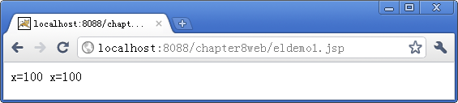
怎么用EL
<%
int x=100 ;
pageContext.setAttribute("ax",x);
%>
<!--使用JSP脚本输出-->
<%
out.println("x="+ pageContext.getAttribute("ax"));
%>
<!--使用EL表达式输出-->
x=${ax}

Slide 60
怎么用EL
1、输出某一个范围内的变量值
${name}。它的意思是读出某一范围中名称为name的变量。
因为我们并没有指定哪一个范围的name，所以它会依序从Page、Request、Session、Application范围查找。
我们要取得session中储存一个属性name的值，可以利用下列方法：
<%=session.getAttribute("name")%> 取得name的值，
在EL中则使用下列方法
${sessionScope.name}
sessionScope是EL中与范围有关的隐含对象。与范围有关的EL 隐含对象包含以下四个：pageScope、requestScope、sessionScope 和applicationScope。

Slide 61
怎么用EL
2、输出页面之间传的值
与输入有关的隐含对象有两个：param和paramValues，它们是EL中比较特别的隐含对象。
例如我们要取得用户的请求参数时，可以利用下列方法：
String name = request.getParameter(String name)
String[] names = request.getParameterValues(String name)
在EL中则可以使用param和paramValues两者来取得数据。
${param.name}
${paramValues.name}

Slide 62
怎么用EL
EL运算符
算术运算符有5个：+、-、*或$、/或div、%或mod
关系运算符有6个：==或eq、!=或ne、<或lt、>或gt、<=或le、>=或ge
逻辑运算符有3个：&&或and、||或or、!或not
其它运算符有3个：Empty运算符、条件运算符、()运算符

Slide 63
怎么用EL
EL输出JavaBean中属性值
1、输出JavaBean中的属性
<jsp:useBean id="singer" class="gupt.Singer"></jsp:useBean>
<jsp:setProperty name="singer" property="name" param="name"/>
<jsp:setProperty name="singer" property="rank" param="rank"/>
歌手: <jsp:getProperty name="singer" property="name" /><br />
排名: <jsp:getProperty name="singer" property="rank" /><br />
若用EL:
歌手 : ${singer.name}
排名: ${singer.rank}

Slide 64
未完待续，谢谢！

