Slide 1

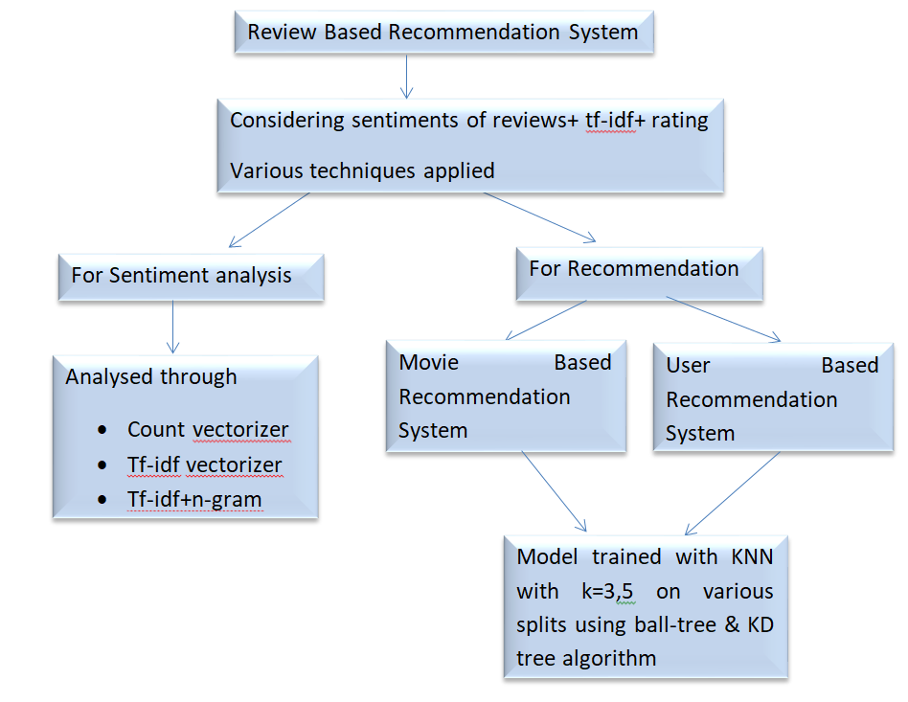
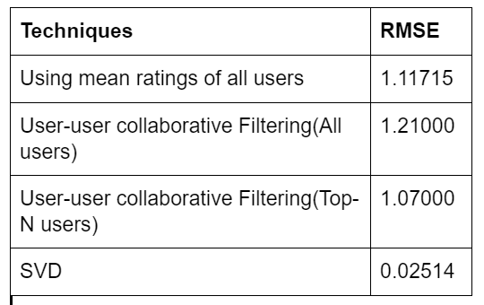
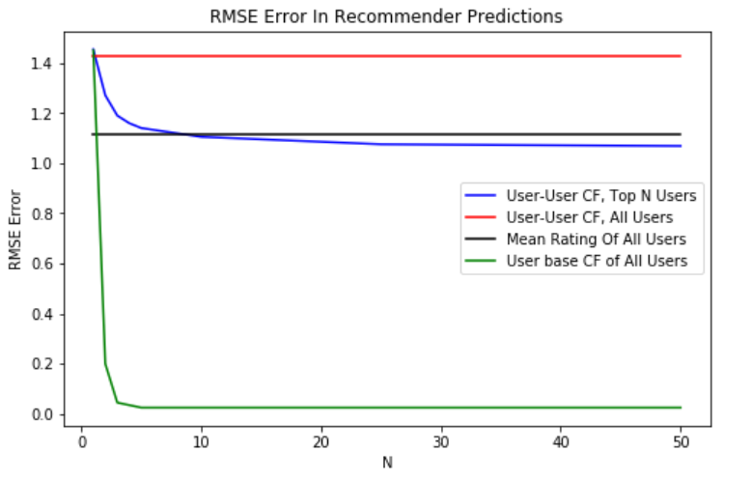
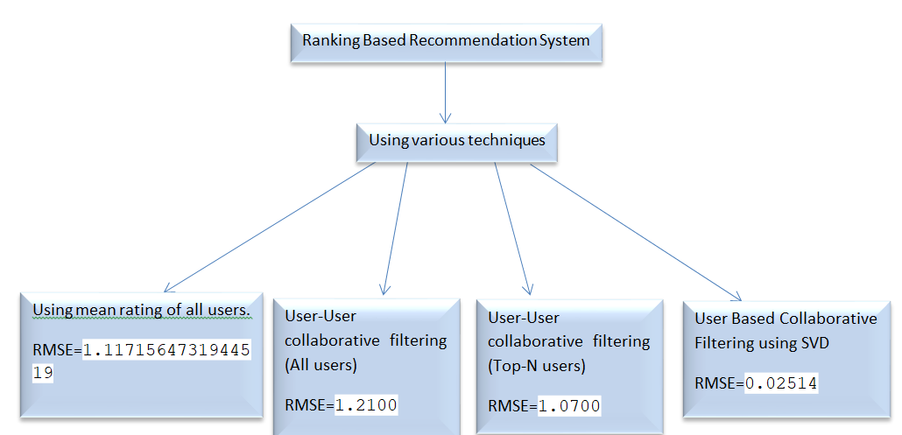
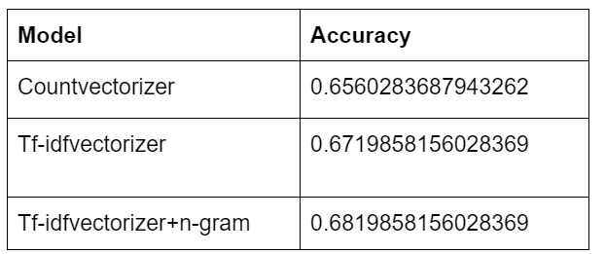
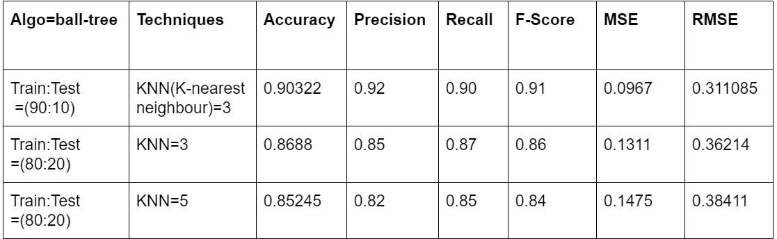
MOVIE RECOMMENDATION SYSTEM
Reecha Kumari Giri (MT19134), Shalini Bhardwaj (MT19045), Naman(2017069)
Literature Review
Problem Definition
Various methods are stated and tested for movie recommendation on the basis of numeric rating .It has been identified in studies that better recommendations are possible if review are also considered to get these emotions and feedback by users accurately. Reviews can be included by extracting the sentiment of the reviews.In the paper “Sentiment Analysis of Amazon Mobile Reviews” sentiment is analysed by using countvectorizer and tfidf vectorizer .We have further updated vector from countvectorizer by multiplying the polarity of different words. Logistic Regression is used in training model for analyzing the sentiment.
Result based on Rating
While watching movies online on various platforms we get various recommendations as per various algorithms applied by websites. Websites and user both would be benifited by the quality of recommendation. If user will be engaged for more time while getting good recommendations website would have profit .Similarly user would also prefer the website as he can happily invest his time in movie watching as per his taste. We can recommend user on the basis of other users, trending movies. Similar user recommendation could be done by other user rating or reviews. Trending recommendation could be done by watching the maximum movies watched in that duration. Therefore, best movie recommendation would be that engages user and is more similar to user’s taste.
Results
Dataset Used
Flowchart showing procedure followed for recommending movie based on Review
Recommending a movie to the audiences solely on the quantitative review could results in recommendation of an irrelevant movie. There are two goals of for the recommender system,
first is to be able to effectively predict quantitative reviews based on qualitative reviews;
second is to provide each audiences with relevant movies using textual mining;
third is to combine the first and second step to allow for recommendation of similar movies, which are likely to be purchased and enjoyed by the audiences. We found that finding links between the quantitative and qualitative review and using the correlation between two review types are effective in finding a relevant and positive movies for the users.
In order to do so, the techniques applied are:
● Step 1: attempts to find similar movies based on rating given by users.
● Step 2: attempts to find similar movies based on qualitative reviews.
Movie Based Collaborative Filtering: ● Step 3, compares quantitative review and qualitative review to create a connection between the two distinctive scales ● Step 4: User Based Collaborative Filtering:
It also uses KNN model to predict ratings based on reviews on various parameters to recommend the movie.
The dataset chosen is the Amazon movie & TV-5 core file, covering over 3,410,019 reviews. The 5 core implies that each video/movie has at least 5 ratings and each user has rated at least 5 videos/movies. This dataset includes asin value, helpfulness score (e.g., ⅔), overall rating (out of 5), reviewText, ReviewTime, reviewerID, reviewerName, summary. The asin value for each review is the actual "id" of the movie or video on Amazon.
Proposed Solution
Overview of the procedure:
Result based on Movie Based Collaborative Filtering
Result based on User Based Collaborative Filtering
Flowchart showing procedure followed for recommending movie based on Rating
1st one is giving best result

