Slide 1
OTT PLATFORM & TV SHOW ANALYSIS
CAPESTONE PROJECT:EXCEL DATA ANALYSIS
NAME:C.GURUCHARAN
DATE:30-12-2025

Slide 2
PROJECT OBJECTIVE
To analyze Movies & TV Shows data using excel.
To understand trends in : Content type(Movies & Shows),Release years, Genres , IMDB ratings.
To clean , process and visualize data using pivot.
To create interactive dashboard for decision making.

Slide 3
DATASETS OVERVIEW
Datasets contains information about
Movies and Tv Shows
Release year
Genres
Runtime
IMDB scores and votes

Slide 4
DATA DESCRIPTION
Raw unprocessed data imported from Kaggle
Contains missing and inconsistent values
Text fields like genres ,countries ,imdb_id needs cleaning
Requires pure data cleaning and handle missing values

Slide 5
DATA CLEANING & CURING
Removed duplicate records
Handled missing values
Use average to handle numerical values

Slide 6
PIE CHART
By content wise “Movies” outnumbers “Tv Shows” on the platform
Tv are the least prefrred and consumed by users.
After analysing by age certification “Not rated” certifications is more consumed and dominates other age certification.

Slide 7
BAR CHART
The first represents the comparison of type of content and average imdb scores.
The insights can inferred is that imdb scores is more for “Tv Shows” as compared to “Movies”
The next chart infers that relation between the released year and count of titles.

Slide 8
HISTOGRAM
The most common runtime interval is 80-120 minute range is the clear mode with more than 2000 titles.
The data set is right skewness type as frequency drops sharply after 120 minutes.
Bins are set 40 mins interaval.
BIN | Frequency
40 | 935
80 | 1365
120 | 2120
160 | 596
200 | 94
240 | 9
More | 0

Slide 9
LINE CHART
The first chart infers that there is explosive growth started at year 2014.
The average imdb votes over time infers there is fall of votes sharply since 2011 likely due to new films having less time.

Slide 10
SCATTER PLOT
The correlation coefficient is -0.16 indicates almost no relationship between movies length and its score.
The highest density films sets between 80-120 minutes with scores ranging from 5 to 8.
There is no strong linear correlation between how long a movie is and how well it is rated.
Highly rated movies are most frequently found in the "standard" 90–110 minute runtime window.
The correlation coefficient of -0.16 proves that runtime is a poor predictor of success.

Slide 11
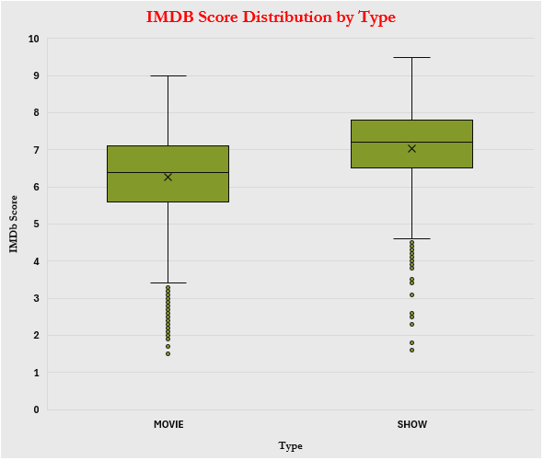
BOXPLOT
The data here shows outliers which disrupts the data.
The given boxplot shows the imdb score distribution by type of content.
Most of the outliers lies below the lower whiskers of boxplot.

Slide 12
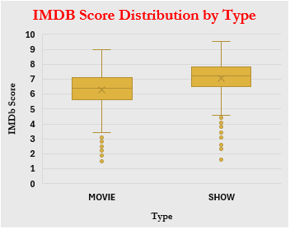
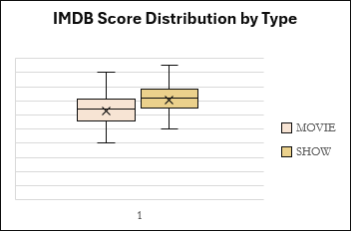
OUTLIER TREATMENT
Before Outlier Treatment | Distribution
 | MOVIE | SHOW
Mean | 6 | 7
Median | 6 | 7
Mode | 6 | 8
IQR Table | Distribution
 | MOVIE | SHOW
Q1 | 6 | 6.5
Q3 | 7 | 7.8
IQR | 1 | 1 .3
Lower Fence | 4 | 5
Upper Fence | 9 | 10
KEY OBSERVATIONS
Both distributions are negatively skewed due to long tail of low-score outliers.
Shows genrally perform better than movie with higher Mean/Median compared to Movies.
The most frequent score for shows is 8.0 indicates a strong high ratings.
If we exclude the outliers the middle 50% is symmetrical as the mean and median are identical before and after outliers treatment.
After Outlier Treatment | Distribution
 | MOVIE | SHOW
Mean | 6 | 7
Median | 6 | 7
Mode | 6 | 8
Skewness | Negative | Negative

Slide 13
CENTRAL TENDENCY AND SPREAD
 | Total
 | MOVIE | SHOW
Mean | 27,504 | 18,157
Median | 2,858 | 1,892
Mode | 43 | 148
Comparision | Mean>Median>Mode | Mean>Median>Mode
Skewness | Right Skewness | Right Skewness
Measures of Spread | Total
 | MOVIE | SHOW
Range | 2268283 | 1727689
Variance | 9280257751 | 5278628641
Standard Deviation | 96334.09 | 72654.17
KEY OBSERVATIONS
In both categories the mean is much higher than the median indicatinf the data is heavily right skewed.
Movies have significantly higher mean and median as compared to Shows suggesting more engagement is shown towards movies
The median is a better representation of typical performance than mean.
KEY OBSERVATIONS
Movies have significantly higher standard deviation than Shows indicates that movie spending is more.
The range for movies is larger than the range of shows suggesting the gap between the most expensive and least expensive movies.
The variance for movies is nearly double than the shows.

Slide 14
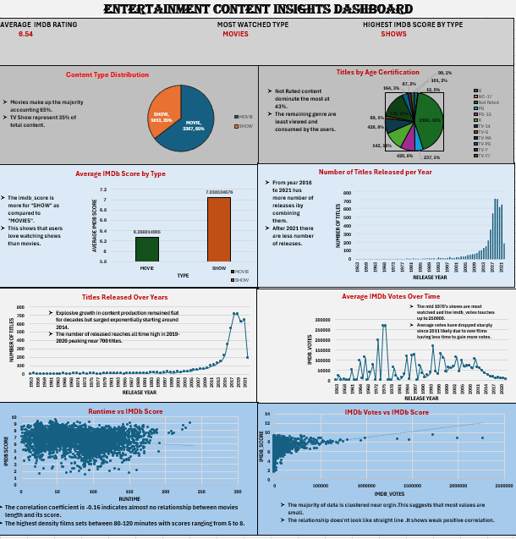
DASHBOARD

Slide 15
THANK YOU

