Slide 1


Spring Framework
CONTENTS
→What is Spring Framework?
→Why use Spring?
→Core Features of Spring
→How Spring works.
→Spring Terminilogies
→Inversion of control
→Dependency Injection
→ Simple Spring Application.

Slide 2
What is Spring Framework?
→Spring is an open Source software development framework that provides
Support for builiding Java based applications on the top of Jakarta EE
(J2EE) Enterprise Edition platform.
Its first version written by Rod Johonson and released on 2003. Current
Version of Spring 6.2.5 it requires Java 17+
Why Spring?
→ simplifies java development, reduces boilerplate code,support for annotation-
Based configuration for easy project setup.
→Modular and LightWeight,can be used for small and large applications.
→Supports Multiple Architecture like Monolithic apps, microservices and
Cloud based architectures.
→rapid development: provides built-in support for transaction management
Security,database itegrations, integration with Hibernate, JPA.

Slide 3
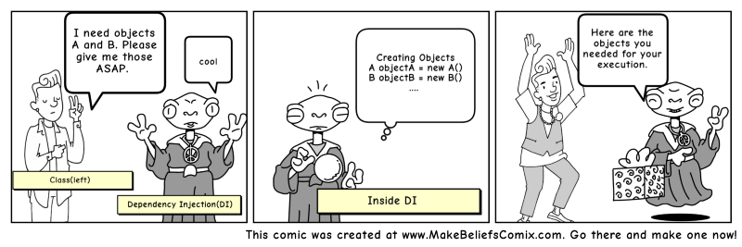
How Spring Works Under the Hood?
What does spring do for us?
It helps us with creation of java
Objects and maintain it lifecyle
Injection of objects wherever we
Need.
It helps us to create decoupled
Application, We don’t worry about
Object creation, wiring the object
Spring will take care of that.
Spring
Spring
Spring
Spring
Spring
Spring

Slide 4
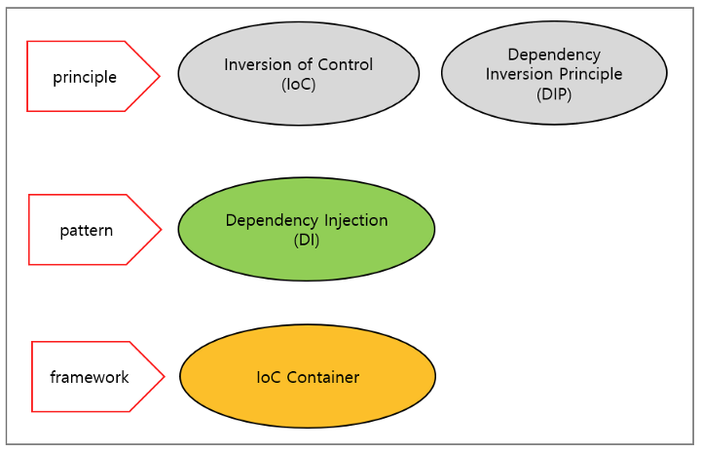
How Spring Does it
We need to Understand some
terminlogies.
→Inversion of Control
→Spring Bean(java object)
→spring Core container
→Ioc container

Slide 5
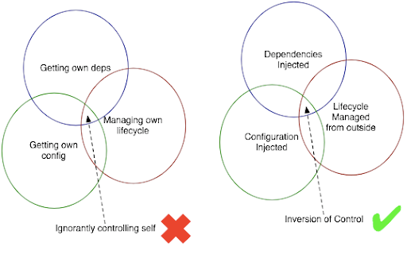
Inversion Of Control
Inversion of control is design principle
Where the control of creation, configuration
Is shifted from application code to a
Framework or container, which is achieved
Through Depedency Injection
Benefits
Loose Coupling
In spring Container acts as Invversion
Of control it takes the control from the
Developer, so developer can focus
Of Business logic.
Spring Does with the help of configuration
File in which we define our beans.

Slide 6
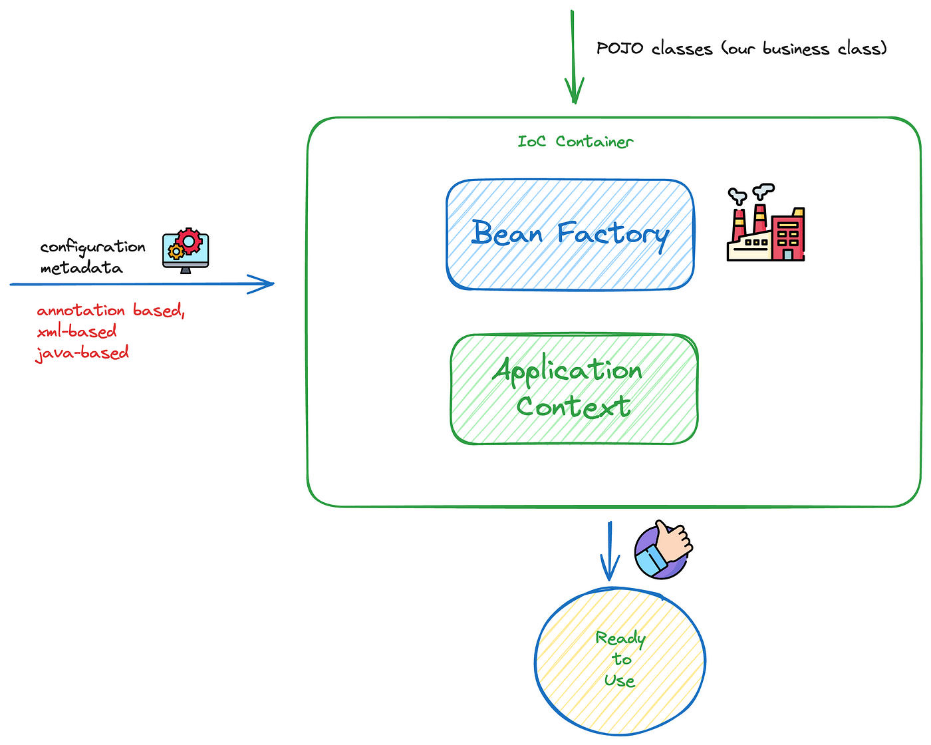
IOC Container
It is one component in Spring
Core, it is one which helps us
To create object for our
Depedencies.
Role
IOC takes the creation,
Instantiation,
Types of Ioc Container
→ Bean Factory (deprecated)
→ Application Context.
Ioc Container knows what are object needs to
Be created and where its needed and how to create
It, do post processing on object and predestroy things
Like cleanup and it destroy the bean when its not needed.

Slide 7
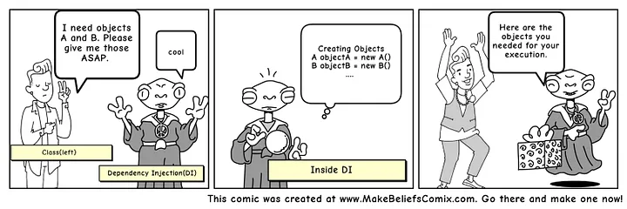
Dependency Injection
In Depedency Injection is a design pattern where
Objects receive their depedencies from an external
source(Spring Container) rather than creating them
By themselves.
It is used by Spring Container uses it to achieve Inversion of control
Types of Depedency Injection
→Constructor Based
→Setter Based
→ Field based
Ioc Container

Slide 8
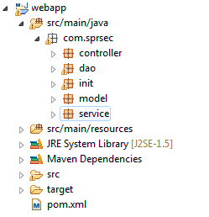
Spring Project Structure
What are the things needs to create Spring project
→Java jdk 17+for spring 6
→IDE(Eclipse ee Edtion/Intelji community editon/Sts)
→Maven Build tool

Slide 9
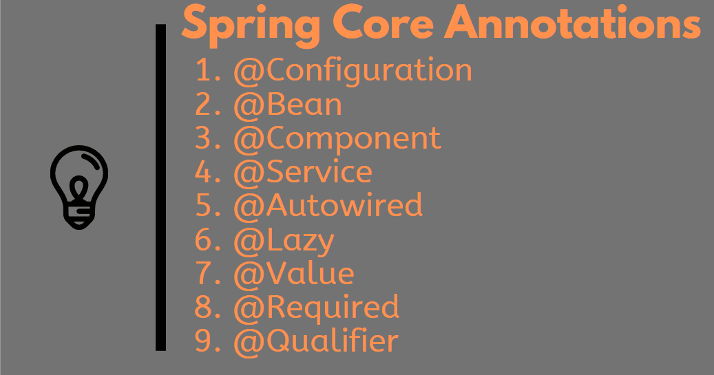
Spring Annotations

Slide 10
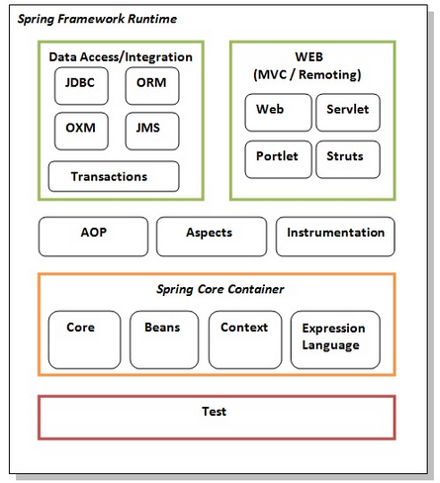
Spring Modules

