Slide 1
Python
Notes:
Explain about Miles

Slide 2

Looking Back
General Introduction
Language Syntax-
Identifiers
Naming rules
Reserved keywords
Comments
Python block Indentation
Python Data Types
Numbers
Strings
List
Tuples
Dictionary
Bool

Slide 3
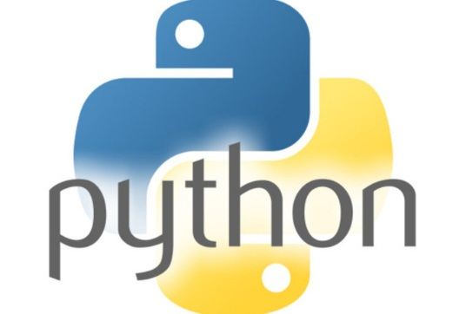
Input techniques
Inside every well-written large program is a well-written small program. -- Charles Antony Richard Hoare, computer scientist

Slide 4
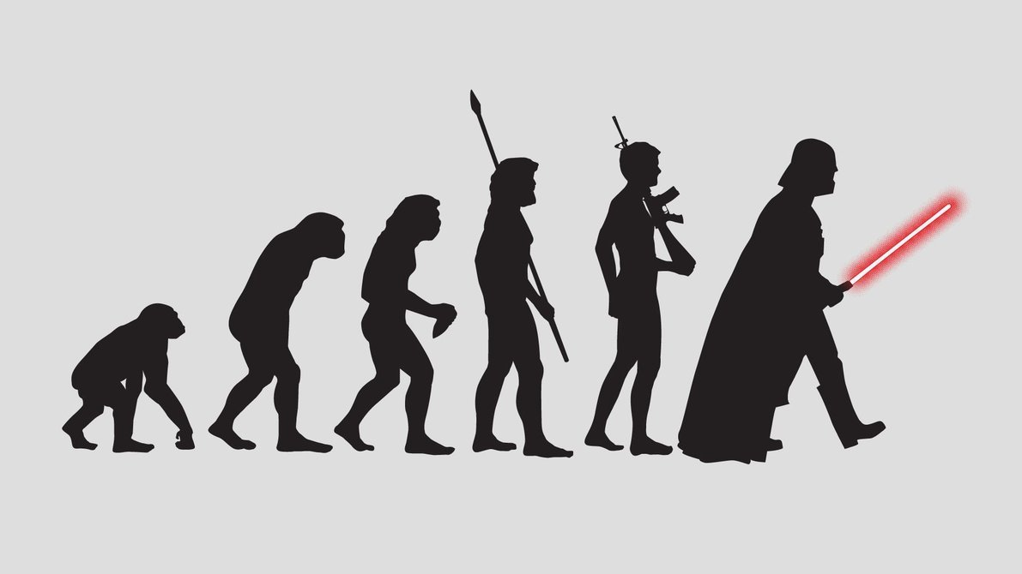
INPUT TECHNIQUES
Way to pass user defined input to a program.
Remember the scanf function in C?
That scanf evolved into input function in python.
The input(string) method returns a line of user input as a string.
The parameter is used as a prompt
The string can be converted by using the conversion methods int(string), float(string), etc.

Slide 5
INPUT TECHNIQUES
Try and Learn
print("What's your name?“)
name = input("> ")
print("What year were you born?“)
birthyear = int(input("> "))
print("Hi %s! You are %d years old!“
% (name, 2015 - birthyear))
Raw_input
Older version of the input function.

Slide 6
Decision Making
When a programming language is created that allows programmers to program in simple English, it will be discovered that programmers cannot speak English. -- unknown

Slide 7

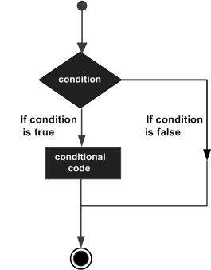
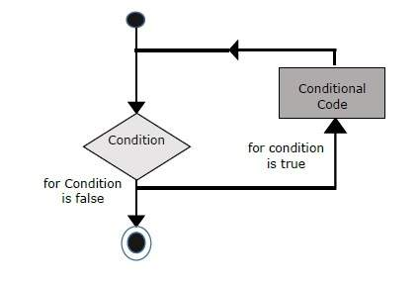
Decision Making & Looping
Decision making structures allow programmers to test one or more conditions and take actions accordingly.
if
elif
else
DO
DO
WHILE
IF-ELSE

Slide 8
Decision Making – IF-ELSE conditions
Try and Learn
var1 = int(input(">"))
if var1:
print("True")
else:
print("False")
Input 3 Values : 10,0, -1 and check the Output.
Hint : Python programming language assumes any non-zero and non-null values as TRUE, and any zero or null values as FALSE value.
Try and Learn
Design and develop a IT calculation system for a company, such that when employee salary is entered, the Income Tax is calculated. Income tax slabs as follows:-
Lower Limit(INR) | Upper Limit(INR) | Income Tax %
100,000 | 300,000 | 0%
300000 | 500,000 | 5%
500,000 | 100,000,0 | 10%
>1000000 |  | 20%
Notes:
Objects are instances of classes which follow certain rules.

Slide 9
Decision Making – IF-ELSE conditions
At runtime, you need to enter atleast 4 employee salaries in all the four income range.
EmpName | Salary(INR)
A | 10,000
B | 100,000
C | 3,99,000
D | 20,00,000
How do you do range test within an IF-ELSE condition?
Range() function is used to iterate through a loop , format being range(start,stop,seq).
Range test can also be done as follows if(a<=b<=c):
Range test can also be done as follows : if(a >= b and a <=c)
Notes:
Objects are instances of classes which follow certain rules.

Slide 10
Decision Making – WHILE & FOR LOOP
WHILE LOOP
While loop, repeats a statement or group of statements while a given condition is TRUE. It tests the condition before executing the loop body.
>>> count = 0
>>> while (count < 9):
print(count is:', count)
count ='The count + 1
FOR LOOP
Executes a sequence of statements multiple times and abbreviates the code that manages the loop variable.
for letter in 'Python': # First Example
print('Current Letter :', letter)
fruits = ['banana', 'apple', 'mango']
for fruit in fruits: # Second Example
print('Current fruit :', fruit)
Notes:
Objects are instances of classes which follow certain rules.

Slide 11
Decision Making –FOR LOOP
FOR LOOP(Contd)
Before we check out this example, we will take up the function range().
A lot of looping and decision making is done based on this function.
The built-in function range() is the right function to iterate over a sequence of numbers. It generates an iterator of arithmetic progressions.
range() generates an iterator to progress integers starting with 0 upto n-1. To obtain a list object of the sequence, it is typecasted to list(). Now this list can be iterated using the for statement.
Example :-
>>> range(5)
range(0, 5)
>>> list(range(5))
[0, 1, 2, 3, 4]
Try and learn
>>> fruits = ['banana', 'apple', 'mango']
>>> for i in range(len(fruits)):
print(fruits[i])

Slide 12
Decision Making – MORE of LOOPS
Nested Loops:
Python programming language allows the usage of one loop inside another loop. The following section shows a few examples to illustrate the concept.
You can put any type of loop inside any other type of loop. For example a for loop can be inside a while loop or vice versa.
Try and learn:
# Program to implement Tables from 1 to 10:-
#Trying a Nested Loop. Printing Multiplication tables from 1 to 10
i = 0
j = 0
for i in range(1,11):#First Loop to input the Table
print("Starting Generating Table, for %d"%(i))
for j in range(1,11): #Second Loop to take the Multiplicants
print("%d X %d ="%(i,j),(i*j))

Slide 13

SNOOZE MODE

Slide 14
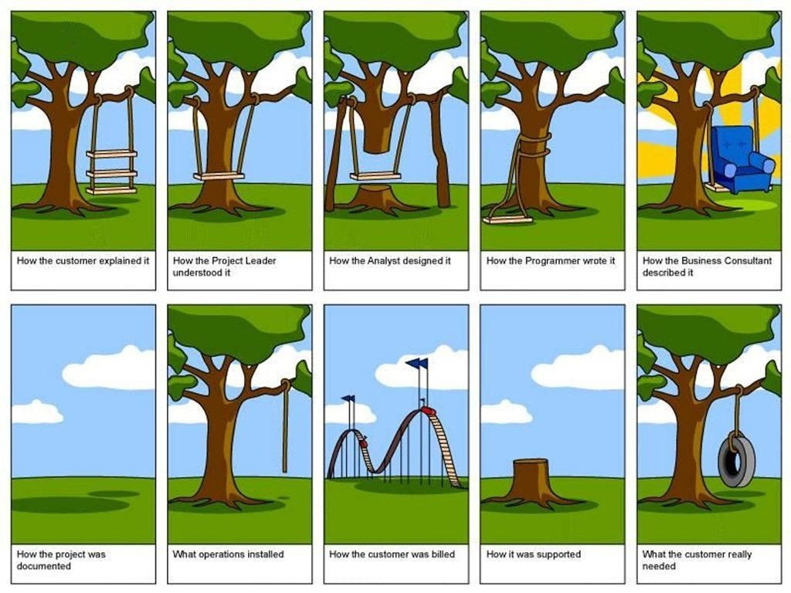
A Joke a Day, Keeps Boredom Away!!
Inside the World of Software Development

Slide 15
More Looping Techniques
Looping through Dictionaries
When looping through dictionaries, the key and corresponding value can be retrieved at the same time using the items() method.
>>> fruits= {’apple’: ’red’, ‘mango’: ’yellow’}
>>> for k, v in fruits.items():
... print(k, v) ... apple red mango yellow
Looping through multiple sequences
A quick look at the Zip function is needed to understand this section.
Zip function, Zips together two Sequences into a sort of Key/Value pair.
Try and Learn
>>> names = ['ben', 'chen', 'yaqin']
>>> names
['ben', 'chen', 'yaqin']
>>> gender = [0, 0, 1]
`

Slide 16

More Looping Techniques
>>> name_age = list(zip(names,gender))
>>> name_age
[('ben', 0), ('chen', 0), ('yaqin', 1)]
>>> name_age = tuple(zip(names,gender))
>>> name_age
(('ben', 0), ('chen', 0), ('yaqin', 1))
>>> name_age = dict(zip(names,gender))
>>> name_age
{'ben': 0, 'chen': 0, 'yaqin': 1}
Can you explain what happened in each of these cases?

Slide 17
More Looping Techniques
Now, how do we loop through such multiple sequences, obtained as part of zip?
Try and Learn
>>> name_age = zip(names,gender)
>>> name_age
<zip object at 0x0231DEE0>
>>> for i,j in name_age:
print(i,j)
ben 0
chen 0
yaqin 1

Slide 18
Loop control Techniques
The Loop control statements change the execution from its normal sequence. When the execution leaves a scope, all automatic objects that were created in that scope are destroyed.
Python supports the following control statements:-
Break: Terminates the loop statement and transfers execution to the statement immediately following the loop.
Continue : Causes the loop to skip the remainder of its body and immediately retest its condition prior to reiterating.
Pass : The pass statement is a null operation; nothing happens when it executes. The pass statement is also useful in places where your code will eventually go, but has not been written yet i.e. in stubs.
Example of pass statement:
for letter in 'Python':
if letter == 'h':
pass
print('This is pass block‘)
print('Current Letter :', letter)

Slide 19
Loop control Techniques
Iterator :
Iterator is an object which allows a programmer to traverse through all the elements of a collection, regardless of its specific implementation. In Python, an iterator object implements two methods, iter() and next().
String, List or Tuple objects can be used to create an Iterator.
list = [1,2,3,4]
it = iter(list) # this builds an iterator object
print (next(it)) #prints next available element in iterator
Iterator object can be traversed using regular for statement
for x in it:
print (x, end=" ")
or using next() function
while True:
try:
print (next(it))
except StopIteration:
sys.exit() #you have to import sys module for this

Slide 20
Loop control Techniques
Generator :
A generator is a function that produces or yields a sequence of values using yield method.
When a generator function is called, it returns a generator object without even beginning execution of the function. When the next() method is called for the first time, the function starts executing until it reaches the yield statement, which returns the yielded value. The yield keeps track i.e. remembers the last execution and the second next() call continues from previous value.
Saves a lot of memory in the process

Slide 21
Loop control Techniques
Generator :
Example
The following example defines a generator, which generates square numbers
>>> def square_numbers(nums):
for i in nums:
yield (i*i)
>>> my_nums = square_numbers([1,2,3,4,5])
>>> type(my_nums)
<class 'generator'>
>>> next(my_nums)
1

Slide 22
PYTHON LOOPING CONCEPTS
Stimulants

Slide 23
What is the output of the following?
x = ['ab', 'cd']
for i in x:
x.append(i.upper())
print(x)
a) [‘AB’, ‘CD’].
b) [‘ab’, ‘cd’, ‘AB’, ‘CD’].
c) [‘ab’, ‘cd’].
d) none of the mentioned
2. What is the output of the following?
i = 1
while True:
if i%3 == 0:
break
print(i)
i = i+1
a) 1 2
b) 1 2 3
c) error
d) none of the mentioned

Slide 24
3. What is the output of the following?
i = 2
while True:
if i%3 == 0:
break
print(i)
i = i + 2
a) 2 4 6 8 10 …
b) 2 4
c) 2 3
d) Error
4. What is the output of the following?
x = "abcdef"
i = "i"
while i in x:
print(i, end=" ")
a) no output
b) i i i i i i …
c) a b c d e f
d) abcdef

Slide 25
5. What does print(i) return in the following?
x = 'abcd'
for i in x:
print(i)
x.upper()
a) a B C D
b) a b c d
c) A B C D
d) error
6. What is the output of the following?
x = 'abcd'
for i in range(x):
print(i)
a) a b c d
b) 0 1 2 3
c) error
d) none of the mentioned

Slide 26
7. What will be the output of the below :
for i in range(float('inf')):
print (i)
a) 0.0 0.1 0.2 0.3 …
b) 0 1 2 3 …
c) 0.0 1.0 2.0 3.0 …
d) none of the mentioned
8. What is the output of the following?
x = 'abcd'
for i in range(x):
print(i)
a) a b c d
b) 0 1 2 3
c) error
d) none of the mentioned

Slide 27
FUNCTIONS
"To err is human, but to really foul things up you need a computer." (Paul R. Ehrlich)

Slide 28
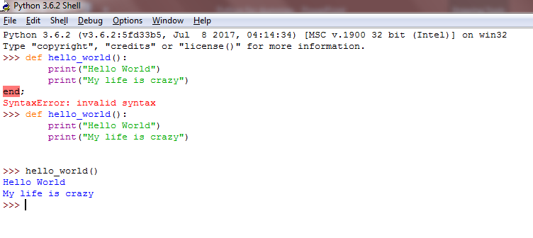
What is a Function?
Lets try writing a function and calling it. We will get to understand a function first hand , by writing it.
As the above example proves, a function is thus a group of statements clubbed together , reusable and used to perform a specific task.
Function begins with a keyword def(remember reserved keywords in the previous sections?? ) and are enclosed with parantheses() and a :

Slide 29
What is a Function?

Slide 30
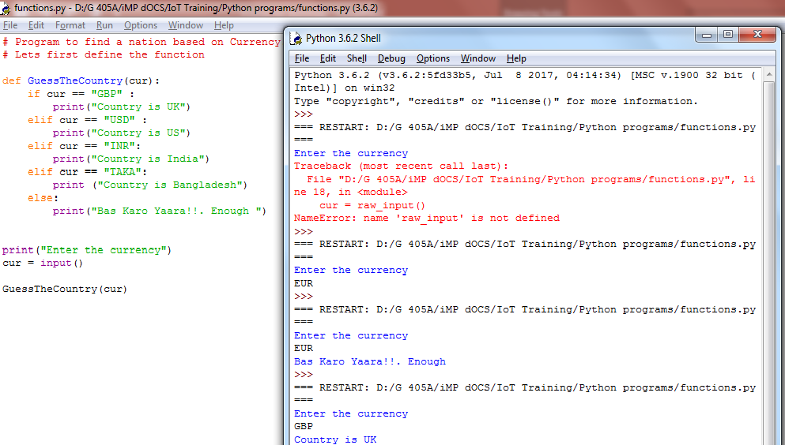
What is a Function?
Now lets consider a scenario, you are required to find out a Country’s name based on its Currency. And you need to do this time and again, how would you take it up?

Slide 31
What is a Function?
Why did we do all this? Just to show how functions “function”, how we can pass certain inputs , and then invoke a function.
Defining a function only gives it a name, specifies the parameters that are to be included in the function and structures the blocks of code.
Once the basic structure of a function is finalized, you can execute it by calling it from another function or directly from the Python prompt.
You can call it again and again. You pass inputs to a function by means of passing by reference or by values. We will come to these details shortly. Quick few more points.
Any input parameters or arguments should be placed within these parentheses.
A function can also invoke another function from within it.
A function can also return back values.(more of it in the next few pages).
The statement return [expression] exits a function, optionally passing back an expression to the caller. A return statement with no arguments is the same as return None.

Slide 32
Calling a function
Defining a function only gives it a name, specifies the parameters that are to be included in the function and structures the blocks of code.
Once the basic structure of a function is finalized, you can execute it by calling it from another function or directly from the Python prompt.
# Function definition is here
def printme( str ):
print(str)
return
# Now you can call printme function
printme("I'm first call to user defined function!")
printme("Again second call to the same function")

Slide 33
Pass by ref Vs Pass by reference
All parameters in the Python language are passed by reference. Any change within a function also reflects back in the calling function.
Example of pass by reference:
>>> l =[1,2,3]
>>> def changeList(list):
print(id(list))
list = list.append('A')
return
>>> l
[1, 2, 3]
>>> id(l)
38227080
>>> changeList(l)
38227080
>>> l
[1, 2, 3, 'A']
Notes:
Let's assume, we are passing a list to a function. We expect that the function is not changing this list. First let's have a look at a function which has no side effects. As a new list is assigned to the parameter list in func1(), a new memory location is created for list and list becomes a local variable.>>> def func1(list): ... print list ... list = [47,11] ... print list ... >>> fib = [0,1,1,2,3,5,8] >>> func1(fib) [0, 1, 1, 2, 3, 5, 8] [47, 11] >>> print fib [0, 1, 1, 2, 3, 5, 8] >>> This changes drastically, if we include something in the list by using +=. To show this, we have a different function func2() in the following example:>>> def func2(list): ... print list ... list += [47,11] ... print list ... >>> fib = [0,1,1,2,3,5,8] >>> func2(fib) [0, 1, 1, 2, 3, 5, 8] [0, 1, 1, 2, 3, 5, 8, 47, 11] >>> print fib [0, 1, 1, 2, 3, 5, 8, 47, 11] >>>

Slide 34
Keyword Arguments
Keyword arguments are related to the function calls. When you use keyword arguments in a function call, the caller identifies the arguments by the parameter name.
This allows you to skip arguments or place them out of order because the Python interpreter is able to use the keywords provided to match the values with parameters. You can also make keyword calls to the printme() function in the following ways −
Try and Learn:
def printinfo( name, age ):
"This prints a passed info into this function"
print ("Name: ", name)
print ("Age ", age)
return
# Now you can call printinfo function
printinfo( age = 50, name = "miki" )

Slide 35
Default Arguments
A default argument is an argument that assumes a default value if a value is not provided in the function call for that argument. The following example gives an idea on default arguments, it prints default age if it is not passed −
Try and Learn
def printinfo( name, age = 35 ):
"This prints a passed info into this function"
print ("Name: ", name)
print ("Age ", age)
return
# Now you can call printinfo function
printinfo( age = 50, name = "miki" )
printinfo( name = "miki" )

Slide 36
Variable Arguments
User may need to process a function for more arguments than specified while defining the function. They are called variable-length arguments
An asterisk (*) is placed before the variable name that holds the values of all non-keyword variable arguments. This tuple remains empty if no additional arguments are specified during the function call.
# function definition
def print_student_marks( name, *student_marks):
print(name)
for marks in student_marks:
print(marks)
# function invocation
print_student_marks(‘xyz’, 90,80,70)
print_student_marks(‘abc’, 90, 88)

Slide 37
Anonymous Functions
You can use the lambda keyword to create small anonymous functions. These functions are called anonymous because they are not declared in the standard manner by using the def keyword.
Lambda forms can take any number of arguments but return just one value in the form of an expression. They cannot contain commands or multiple expressions.
An anonymous function cannot be a direct call to print because lambda requires an expression.
Lambda functions have their own local namespace and cannot access variables other than those in their parameter list and those in the global namespace.
Although it appears that lambda's are a one-line version of a function, they are not equivalent to inline statements in C or C++, whose purpose is by passing function stack allocation during invocation for performance reasons.

Slide 38
Anonymous Functions
Syntax:
lambda [arg1 [,arg2,.....argn]]:expression
Example:
# Function definition is here
sum = lambda arg1, arg2: arg1 + arg2
# Now you can call sum as a function
print("Value of total : ", sum( 10, 20 ))
print("Value of total : ", sum( 20, 20 ))

Slide 39
Return statement
Syntax:
The statement return [expression] exits a function, optionally passing back an expression to the caller. A return statement with no arguments is the same as return None.
Try and learn :-
Write a function which takes the length and breath of a rectangle and returns the area.

Slide 40
Scope of variables
All variables in a program may not be accessible at all locations in that program. This depends on where you have declared a variable.
The scope of a variable determines the portion of the program where you can access a particular identifier. There are two basic scopes of variables in Python −
Global variables : Variables defined outside all functions are global
Local variables : Variables defined in a function are local and cannot be accessed outside it
Therefore same names can be used for local and global variables. Local variable shadows global variable.

Slide 41
Global variable Vs Local variable
Try and learn:
a = 99 # Global variable
def func():
a= 88#Local variable
print(a)
func()
print(a)
Invoking a global variable inside a function:
To access a global variable inside a function, use the statement global <<Variable Name>>.
Try and learn:
Try the above example again, only make sure that this time the value of “a” is same as the global a

Slide 42
MAP()
The map() function applies a given function to each item of an iterable (list, tuple etc.) and returns a list of the results.
The syntax of map() function is:
map() Parameters
function - map() passes each item of the iterable to this function.
iterable iterable which is to be mapped
We can pass multiple iterable to the map() function.
Return Value from map()
The map() function applies a given to function to each item of an iterable and returns a list of the results.
The returned value from map() (map object) then can be passed to functions like list() (to create a list), set() (to create a set) and so on.
map(function, iterable)

Slide 43
EXAMPLE OF MAP()
How map() works
def calculateSquare(n):
return n*n
numbers = (1, 2, 3, 4)
result = map(calculateSquare, numbers)
print(result)
# converting map object to list
numbersSquare = list(result)
print(numbersSquare)
Result :
<map object at 0x7f722da129e8>
[16, 1, 4, 9]
Using Lambda function with map()
numbers = (1, 2, 3, 4)
result = map(lambda x: x*x, numbers)
print(result)
# converting map object to set
numbersSquare = list(result)
print(numbersSquare)
Result :
<map object at 0x7f722da129e8>
[16, 1, 4, 9]

Slide 44
EXAMPLE OF MAP()
Passing multiple iterators to map()
In this example, corresponding items of two lists are added.
num1 = [4, 5, 6]num2 = [5, 6, 7]
result = map(lambda n1, n2: n1+n2, num1, num2)
print(list(result))
Result :
[9, 11, 13]

Slide 45
FILTER()
The filter() function constructs an iterator from elements of an iterable for which a function returns true.
In simple words, the filter() method filters the given iterable with the help of a function that tests each element in the iterable to be true or not.
The syntax of filter() method is:
filter() Parameters
The filter() method takes two parameters:
function - function that tests if elements of an iterable returns true or false
If None, the function defaults to Identity function - which returns false if any elements are false
iterable - iterable which is to be filtered, could be sets, lists, tuples, or containers of any iterators
filter(function, iterable)

Slide 46
FILTER()
Return Value from filter()
The filter() method returns an iterator that passed the function check for each element in the iterable.
The filter() method is equivalent to:
# when function is defined
(element for element in iterable if function(element))
# when function is None
(element for element in iterable if element)
# list of alphabets = ['a', 'b', 'd', 'e', 'i', 'j', 'o']# function that filters vowels
def filterVowels(alphabet):
vowels = ['a', 'e', 'i', 'o', 'u']
if(alphabet in vowels):
return True
else:
return False
filteredVowels = filter(filterVowels, alphabets)
print('The filtered vowels are:')
for vowel in filteredVowels:
print(vowel)

Slide 47
Reduce()
Reduce()
from functools import reduce
>>> nums = (1,2,3,4,5,6)
>>> sum = reduce(lambda a,b: a+b, nums)
>>> sum
21

Slide 48
Stimulants

Slide 49
Write a Python program to check if a list is empty (Hint : Try using a Lambda Function)
Consider a Fish Tuple as follows :- 'blowfish', 'clownfish', 'catfish', 'octopus‘. Write a program that creates a list of all fish except ‘octopus’.
Read in an alphabet. Write a program to check if it is a Vowel or a Consonant.
Write a Python program to construct the following pattern, using a nested loop number.
1
2 2
3 3 3
4 4 4 4
5. What does the following lines of code do?
A0 = dict(zip(('a','b','c','d','e'),(1,2,3,4,5)))
A1 = range(10)
A2 = sorted([i for i in A1 if i in A0])
A3 = sorted([A0[s] for s in A0])
A4 = [i for i in A1 if i in A3]
A5 = {i:i*i for i in A1}
A6 = [[i,i*i] for i in A1]

Slide 50
6. Which are the advantages of functions in python?
a) Reducing duplication of code
b) Decomposing complex problems into simpler pieces
c) Improving clarity of the code
d) All of the mentioned
7. What is the output of the below program?
x = 50
def func():
global x
print('x is', x)
x = 2
print('Changed global x to', x)
func()
print('Value of x is', x)
a) x is 50
Changed global x to 2
Value of x is 50
b) x is 50
Changed global x to 2
Value of x is 2
c) x is 50
Changed global x to 50
Value of x is 50
d) None of the mentioned

Slide 51
8. What is the output of below program?
def say(message, times = 1):
print(message * times)
say('Hello')
say('World', 5)
a) Hello
WorldWorldWorldWorldWorld
b) Hello
World 5
c) Hello
World,World,World,World,World
d) Hello
9. Where can a function be defined?
a) Module
b) Class
c) Another function
d) All of the mentioned

