Slide 1
Course Knowledge Graph from USC, UCLA, UCB
Zi Gu, zigu@usc.edu
Haili Wang, hailiwan@usc.edu

Slide 2
Outline
Building a Distributed web crawler
Master & spiders structure
Guaranty politeness and priority
Base on Apache Kafka, Redis, MongoDB and scrapy
Building a knowledge Graph
PDF syllabus extraction
Instructor entity matching
Elasticsearch & python GUI

Slide 3
Building a Distributed web crawler

Slide 4
Building a knowledge graph
Ontology

Slide 5
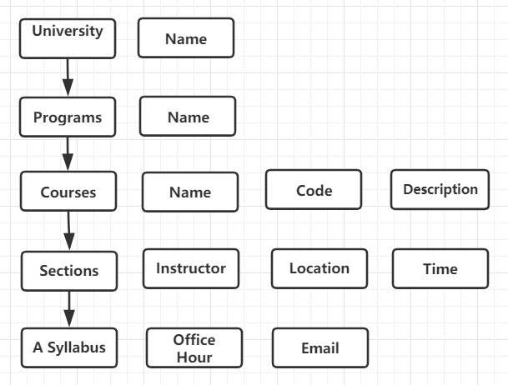
Building a knowledge graph
Real world entities

Slide 6
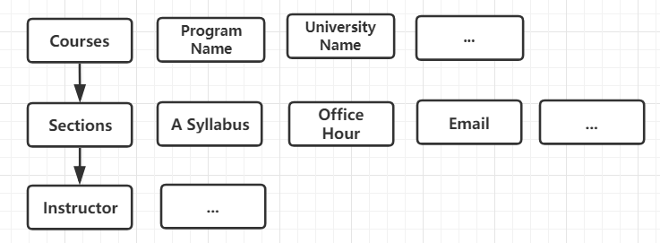
Building a knowledge graph
Implementation

Slide 7
Building a knowledge graph
PDF syllabus extraction
Instructor email
Section office hour
Instructor entity matching
Similarity of instructor name

Slide 8
Building a knowledge graph
Application
BFS query – Ranked by similarity score
DFS
Tkinter Python GUI

