Slide 1
Course Knowledge Graph from USC, UCLA, UCB
Zi Gu, zigu@usc.edu
Haili Wang, hailiwan@usc.edu

Slide 2
Outline
Building a Distributed web crawler
Building a knowledge Graph

Slide 3
Outline
Building a Distributed web crawler
Master & spiders structure
Guaranty politeness and priority
Base on Apache Kafka, Redis, MongoDB and scrapy

Slide 4
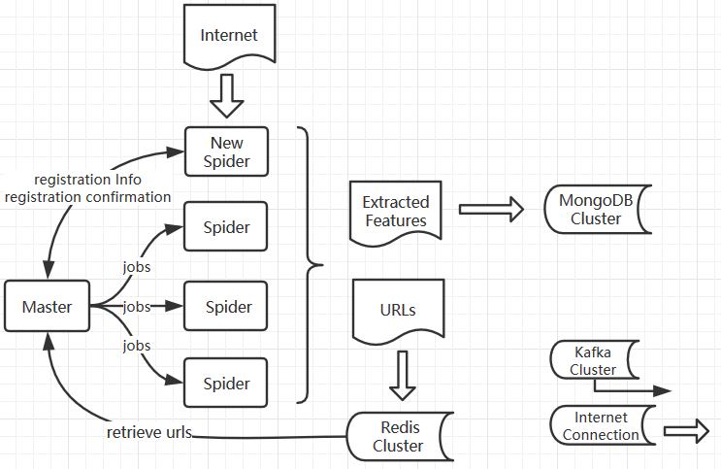
Building a Distributed web crawler
General Framework

Slide 5
Building a Distributed web crawler
Priority & Politeness - Master
Master configuration: domain priority, num pages/second
Randomly distribute jobs with care of priority & politeness

Slide 6
Building a Distributed web crawler
Internal service reasoning
Distributed cluster service
Apache Kafka – Robust message send/receive platform
Redis – Memory based DB, fast for short message exchange
MongoDB – NoSQL persistence

Slide 7
Outline
Building a Distributed web crawler
Building a knowledge Graph
Ontology
PDF extraction
Instructor entity matching
Elasticsearch & queries

Slide 8
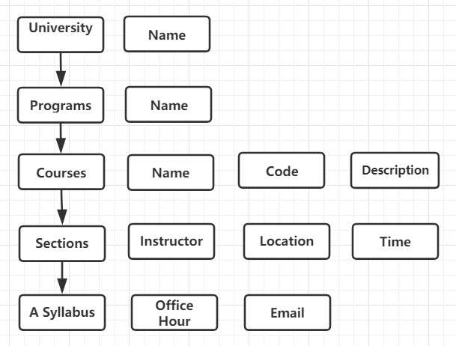
Building a knowledge graph
Real world entities

Slide 9
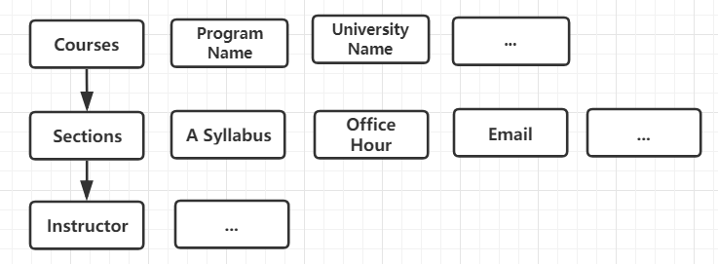
Building a knowledge graph
Implementation

Slide 10
Building a knowledge graph
Course
Course Abbreviation, Course Name, Description
Program Name, University Name
Section IDs
Section
Days, Time, Location, Syllabus Link, Email, Session Type, Office Hour
Instructor ID
Instructor
Instructor Name, Instructor Link

Slide 11
Building a knowledge graph
PDF syllabus extraction
Instructor email, Section office hour
PDF => text
Regular expression
Instructor entity matching
Similarity of instructor name
Edit distance

Slide 12
Building a knowledge graph
Application
Elasticsearch
Tkinter Python GUI, JSON Viewer
Breadth query – Same type ranked by similarity score
Depth query – Linked objects

Slide 13
Course Knowledge Graph from USC, UCLA, UCB
Building a Distributed web crawler
Master & spiders structure
Guaranty politeness and priority
Base on Apache Kafka, Redis, MongoDB and scrapy
Building a knowledge Graph
Ontology
PDF extraction
Instructor entity matching
Elasticsearch & queries

