Slide 1
Cloud Computing Techniques for Cloud Bursting
Name : Godina Venkata Akhil Chandra
Reg no.:
Roll No.:
Class : k20md

Slide 2
What is Cloud bursting
Cloud bursting is an application deployment technique in which an application that runs on onsite, private cloud or data centre and bursts into a public cloud when the demand for computing capacity spikes and reaches the threshold values.
This deployment model gives an organization access to more computing resources when needed.
Cloud Bursting was first proposed by Amazon's Jeff Barr.
Cloud bursting provides a company with more flexibility to handle spikes in IT demand when compute demand surpasses a private cloud's capacity.
Cloud bursting also makes local resources available for other crucial applications.

Slide 3
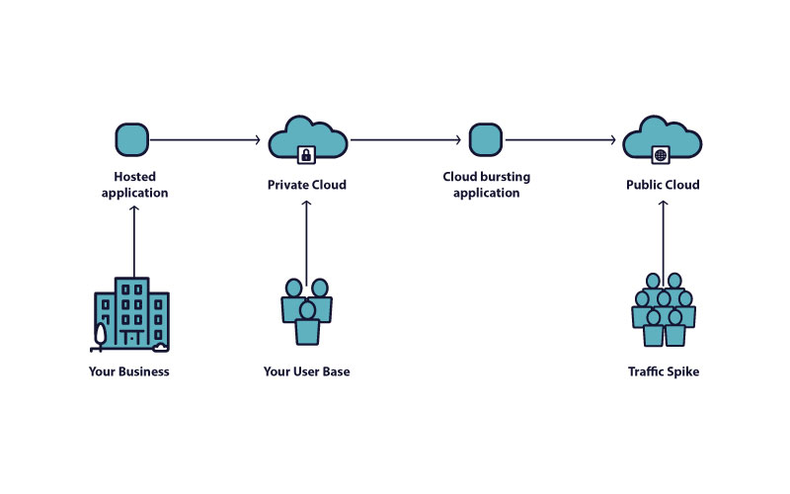
Cloud Bursting Visualized

Slide 4
Cloud bursting Benefits
Cost - Only when additional computing resources are required does an organisation pay for them. Like public cloud infrastructure, private cloud infrastructure costs can be reduced by using few resources.
Flexibility - Cloud bursting can easily adapt to changes in cloud capacity. Moreover, private cloud resources are freed.
Business Continuity - Without disturbing its users, a programme has the ability to burst over into the public cloud.
High traffic times - Cloud bursting can be utilised to accommodate any anticipated or unanticipated peaks in compute resource demands in the event that a company anticipates a sudden increase in traffic, such as during a holiday.

Slide 5
Challenges involved in cloud computing
Although the idea behind this application-tier cloud bursting appears straightforward, there are some crucial technical and commercial factors to consider if you wish to make use of this architecture.
Managing Configurations: there may be significant differences between the cloud service providers you select, necessitating the configuration and administration of your apps and their technology stacks across two distinct environments. For e.g.: OS, hypervisor version, APIs, kind of network, etc.
Communication Latency: When application needs to transport a large quantity of data between your application tier and database when they are in different clouds, latency and throughput can become a problem. When communication takes place over the open Internet, the latency problem is very noticeable. Even tiny latencies can quickly accumulate since app-to-database communication can require numerous round trips for each front-end request.
Security Handling: The issue of securing the communication line between the clouds is the last one to be addressed, which entails setting up encrypted channels, resolving the inescapable routing concerns, and meeting compliance and audit requirements, which raises the complexity of the routing process and raises the price of the equipment and provided pipes. Due to the requirement that new servers added to the array dynamically join your VPN, dynamic server allocation adds additional complexity.

Slide 6
Thank you

