Slide 1
Fire Department Incidents for the City of Las Vegas
An Analysis by Team 4:
George Alonzo
Anji Asthana
Saeger Godson
Margot Rudy

Slide 2
Agenda
Project Background
Our Hypothesis
Retrieving, Assembling, and Cleaning Data
Project Scope
Limitations
Telling the Story
Hypothesis Testing
Conclusion

Slide 3
Project Background
Data Availability
Kaggle
Direct from Source
Project Selection Criteria
Initial Analysis -> Validate Data Quality/Quantity -> Develop a Hypothesis

Slide 4
Our Hypothesis
Response times for the Las Vegas Fire Department (LVFD) have improved (were reduced) over 2011 to 2018.
Continuous Improvement?
Department Sizing?

Slide 5
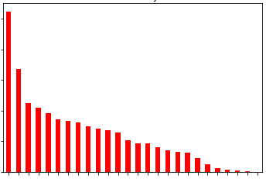
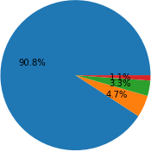
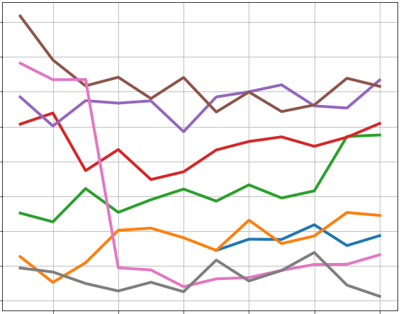
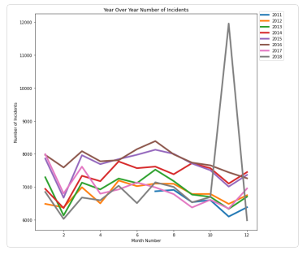
Retrieving, Assembling, and Cleaning Data
Las Vegas Open Data Portal
Incident Data
Station Data
Las Vegas
Surrounding Counties
City of Las Vegas
> 100Mb max on GitHub
2017 & 2018
2015 & 2016
2011 to 2014
ITERATIONS:
- Empty First_Unit Arrived
- String -> DateTime - Timezone
- Calculate Response Time (minutes)
- Arrival before Assigned
- Duplicate Rows
Dataframe
Dataframe

Slide 6

Project Scope
July 2011 – December 2018
City of Las Vegas only
EXCLUSIONS:
Census Data (Correlation w/ Population)
Per Capita data included; No significant variation throughout the years
Residents (Full-Time vs. Seasonal)
Tourists
Distances (Correlation w/ Distances)
Google Distance Matrix API limits & pricing (5.00 USD per 1000)
https://developers.google.com/maps/documentation/distance-matrix/overview
Haversine Formula

Slide 7
Limitations
No data dictionary or metadata
Ambiguous or incomplete data was excluded from analysis (No Assumptions!)
No data prior to 2011
Historical trends
Impacts of the construction of new stations

Slide 8
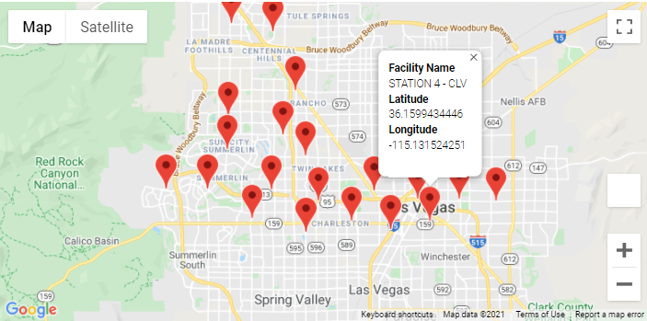
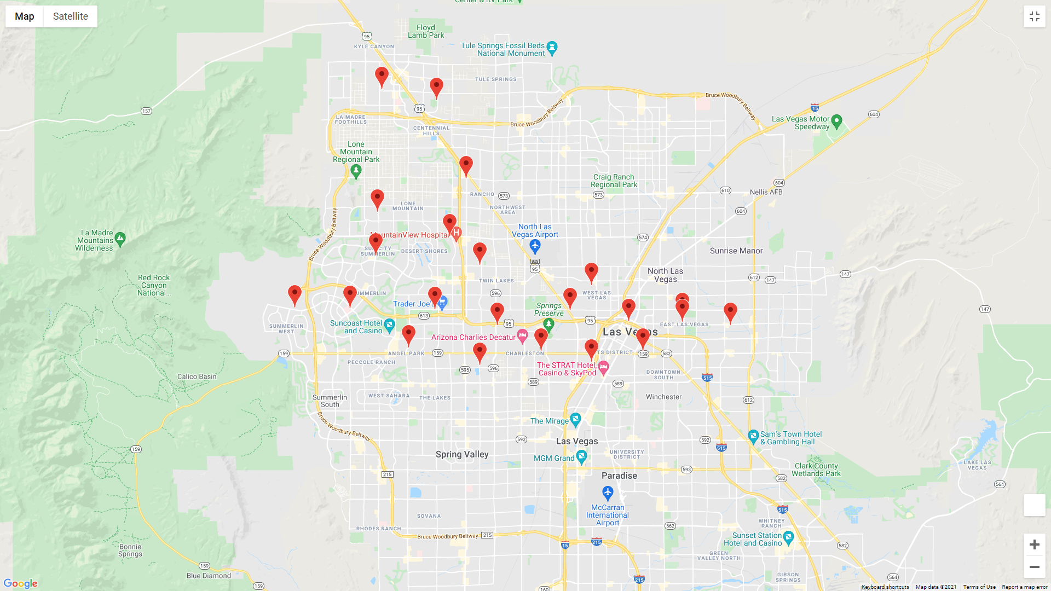
Telling the Story
Fire Station Locations (City of Las Vegas)

Slide 9
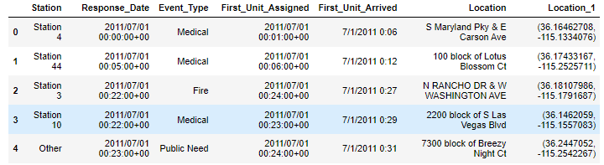
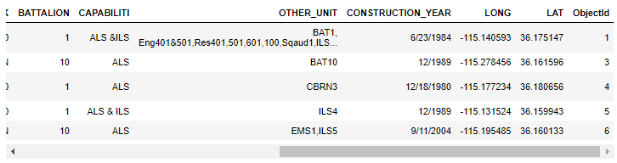
Telling the Story
Fire Station Locations (City of Las Vegas)
BEFORE:
AFTER:

Slide 10
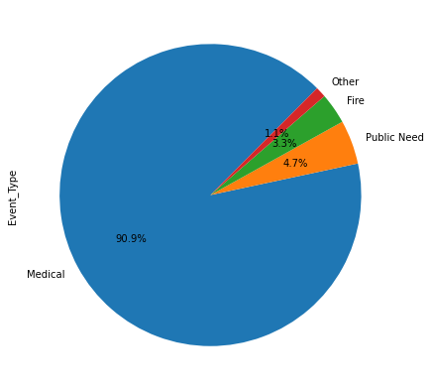
Telling the Story
Types of Responses

Slide 11
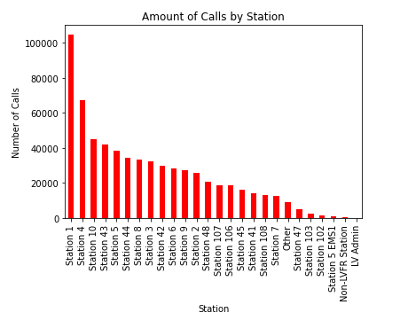
Telling the Story
Busiest Stations

Slide 12
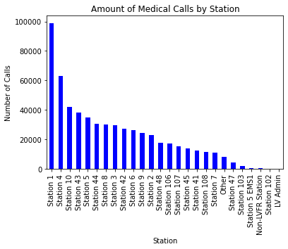
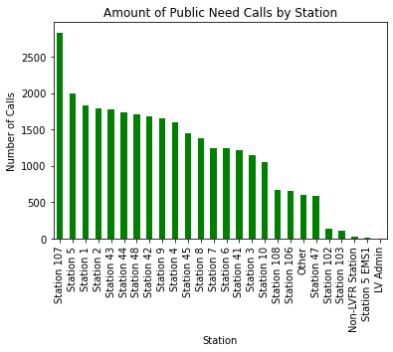
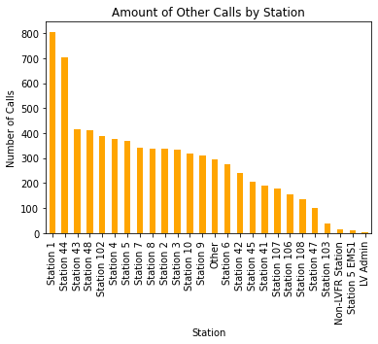
Telling the Story
Busiest Stations
Newest Stations:
Station 108 (August 2014)
Station 106 (July 2012)
Station 107 (June 2012)

Slide 13
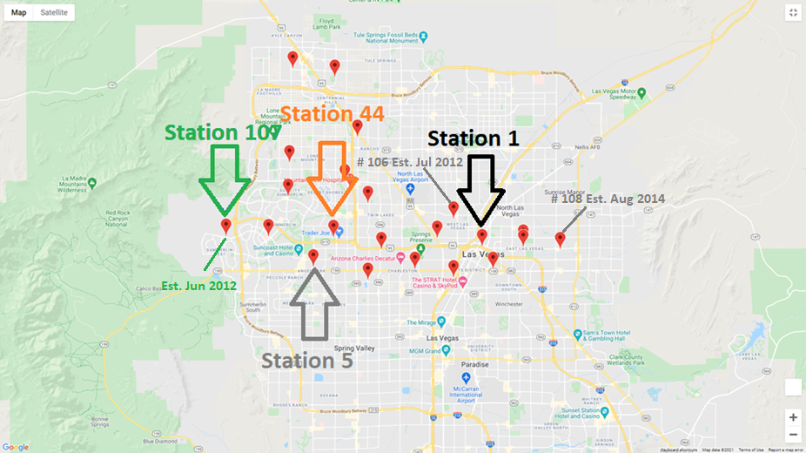
Telling the Story
Busiest Stations (and Outlier)

Slide 14
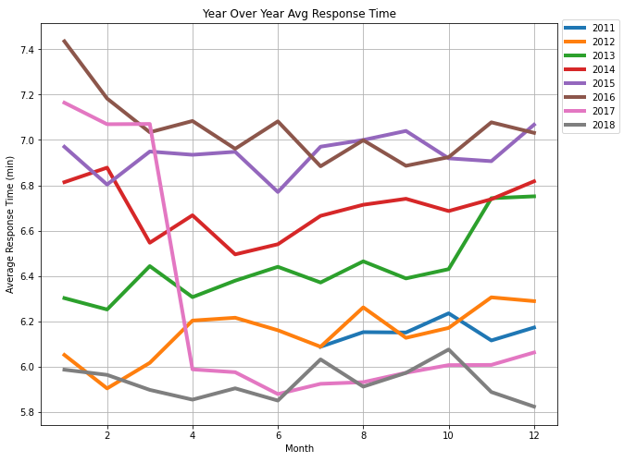
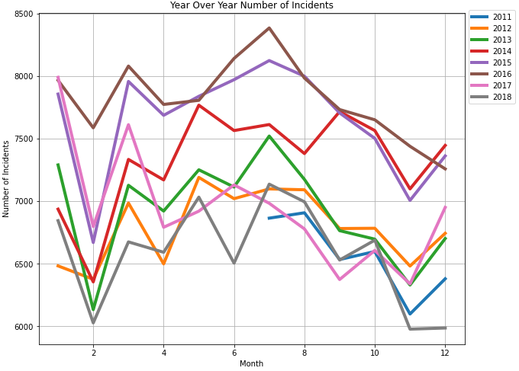
Telling the Story
Year-Over-Year Comparisons

Slide 15
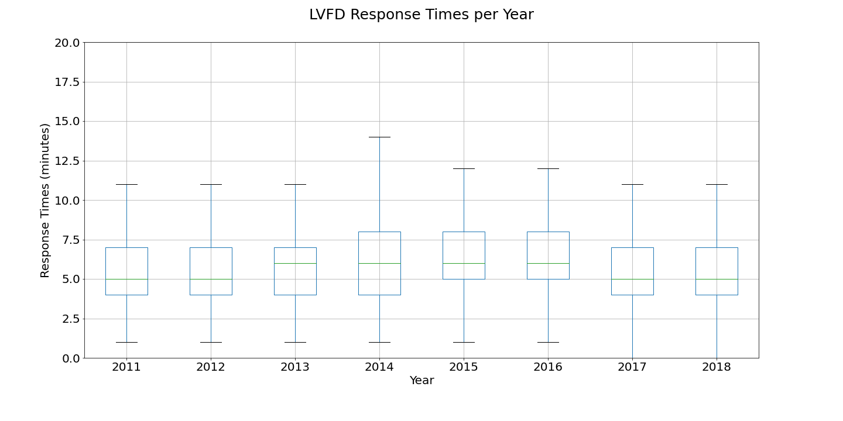
Hypothesis Testing

Slide 16
Conclusion
H_{a}: Response times for the Las Vegas Fire Department (LVFD) have improved (were reduced) over 2011 to 2018.
H₀: There is no difference in response times for the LVFD over 2011 to 2018.
ANOVA p-value: <0.001
We reject the H₀ that there is no difference in response times for the LVFD over 2011 to 2018.

