Slide 1
Fire Department Incidents for the City of Las Vegas
An Analysis by Team 4:
George Alonzo
Anji Asthana
Saeger Godson
Margot Rudy

Slide 2
Agenda
Project Background
Retrieving, Assembling, and Cleaning Data
Project Scope
Limitations
Telling the Story
Hypothesis Testing
Conclusion

Slide 3
Project Background
Data Availability
Project Selection Criteria
Initial Analysis to Develop a Hypothesis

Slide 4
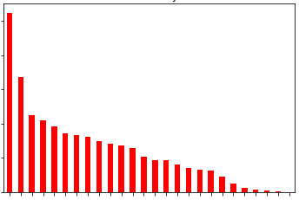
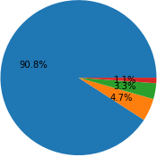
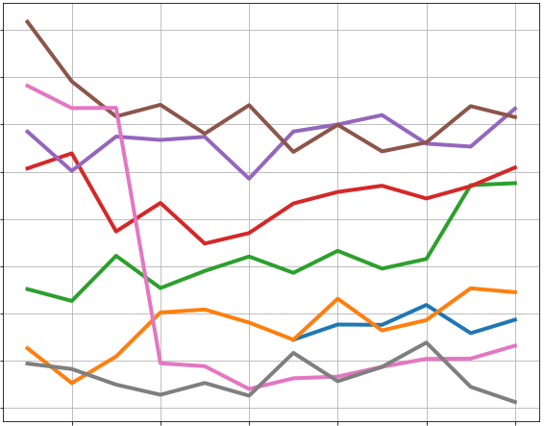
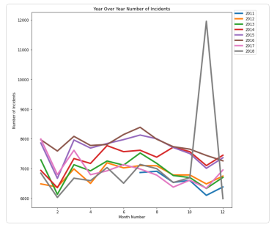
Retrieving, Assembling, and Cleaning Data
Las Vegas Open Data Portal
Incident Data
Station Data
> 100Mb max on GitHub
2017 & 2018
2015 & 2016
2011 to 2014
ITERATIONS:
- Empty First_Unit Arrived
- String -> DateTime - Timezone
- Calculate Response Time (minutes)
- Arrival before Assigned
- Duplicate Rows
Dataframe
Dataframe

Slide 5
Project Scope
July 2011 – December 2018
City of Las Vegas only
EXCLUSIONS:
Census Data (Correlation w/ Population)
Residents (Full-Time vs. Seasonal)
Tourists
Distances (Correlation w/ Distances)
Google Distance Matrix API limits & pricing:
https://developers.google.com/maps/documentation/distance-matrix/overview

Slide 6
Limitations
No data dictionary
Ambiguous or incomplete data was excluded from analysis (No Assumptions!)

Slide 7
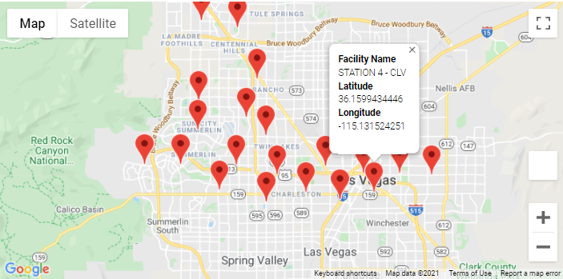
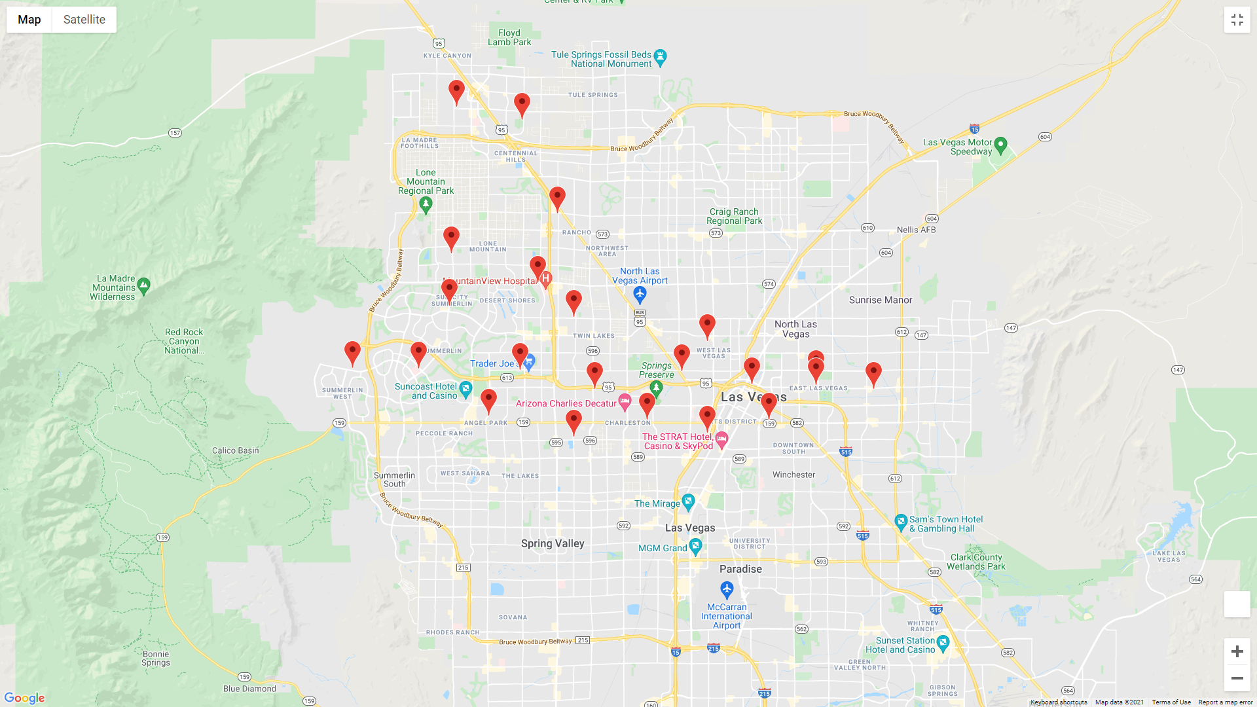
Telling the Story
Fire Station Locations (City of Las Vegas)

Slide 8
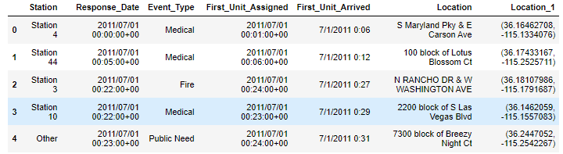
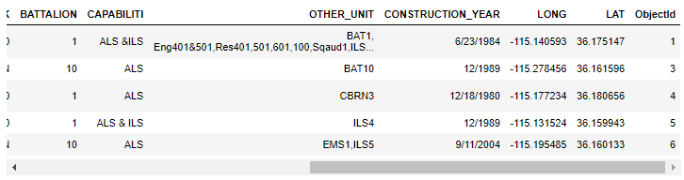
Telling the Story
Fire Station Locations (City of Las Vegas)
BEFORE:
AFTER:

Slide 9
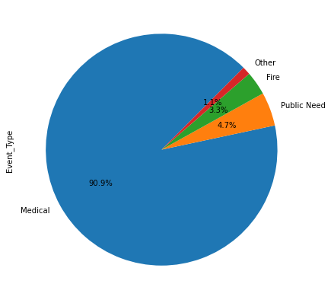
Telling the Story
Types of Responses

Slide 10
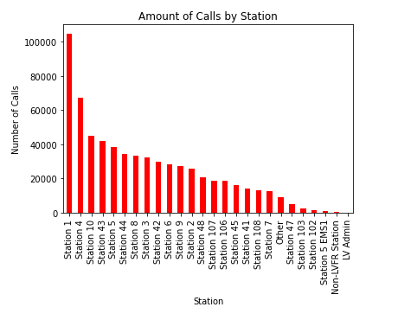
Telling the Story
Busiest Stations

Slide 11
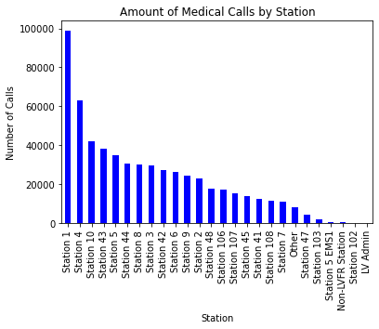
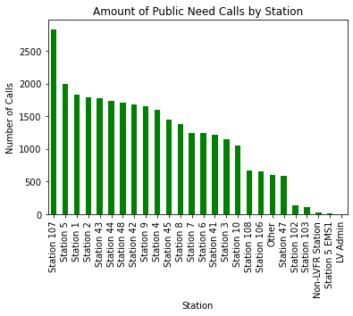
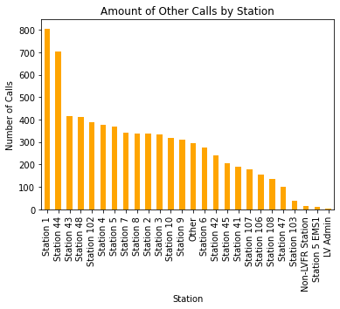
Telling the Story
Busiest Stations
Newest Stations:
Station 108 (August 2014)
Station 106 (July 2012)
Station 107 (June 2012)

Slide 12
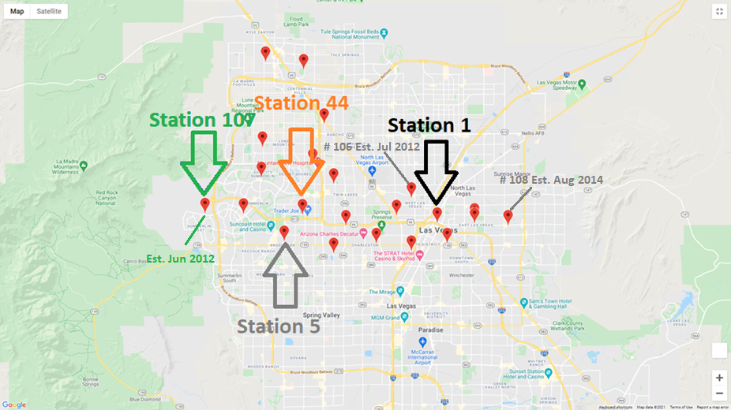
Telling the Story
Busiest Stations (and Outlier)

Slide 13
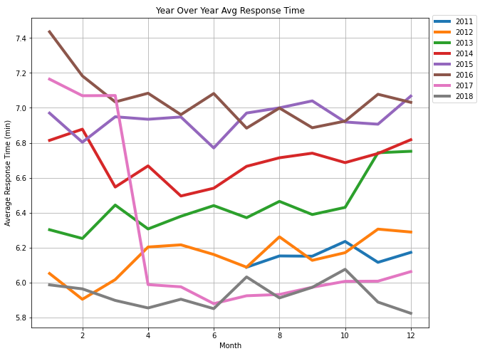
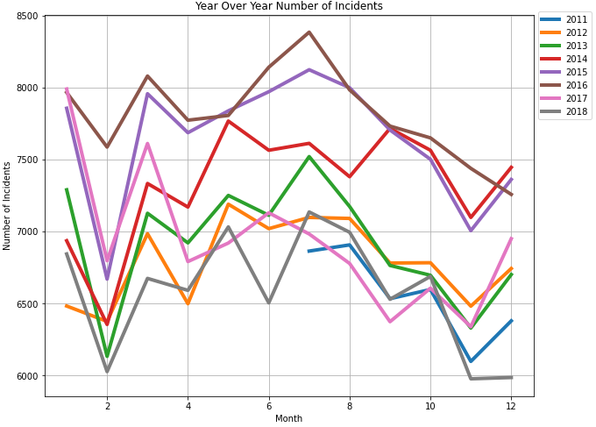
Telling the Story
Year-Over-Year Comparisons

Slide 14
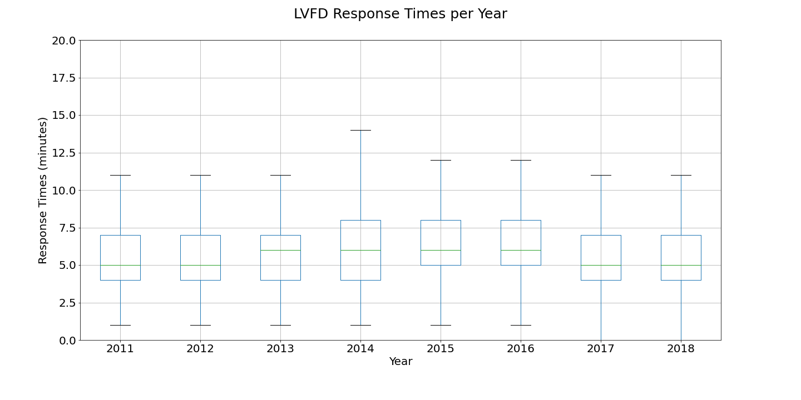
Hypothesis Testing

Slide 15
Conclusion
H_{a}: Response times for the Las Vegas Fire Department (LVFD) have improved (were reduced) over 2011 to 2018.
H₀: There is no difference in response times for the LVFD over 2011 to 2018.
ANOVA p-value: <0.001
We reject the H₀ that there is no difference in response times for the LVFD over 2011 to 2018.

