Slide 1
STM32F401CCU6
ARM Cortex M4 Series MCU

Slide 2
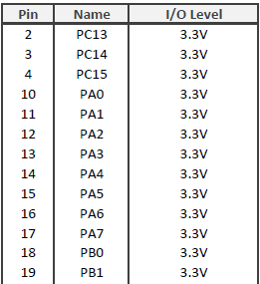
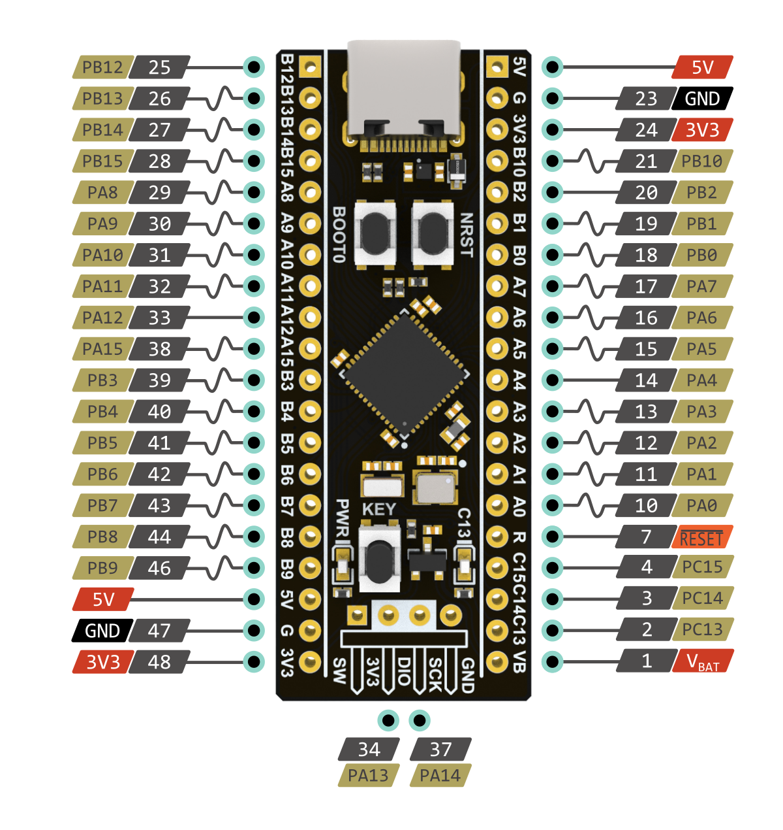
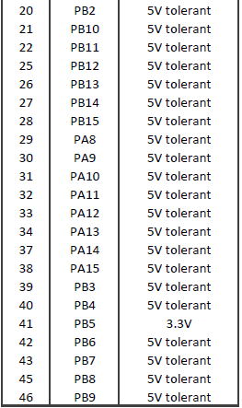

Slide 3
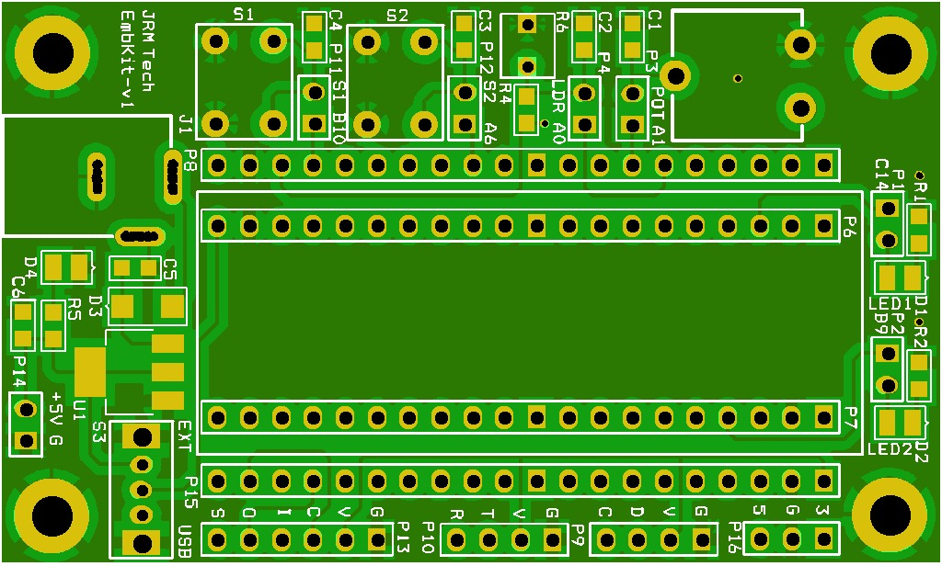

Slide 4
STM32F401-Refmanual.pdf
Refer Section 8 – GPIO 8.4
STM32F411 Black Pill Pinout, Schematic, Datasheet (Dev. Board) (deepbluembedded.com)

Slide 5
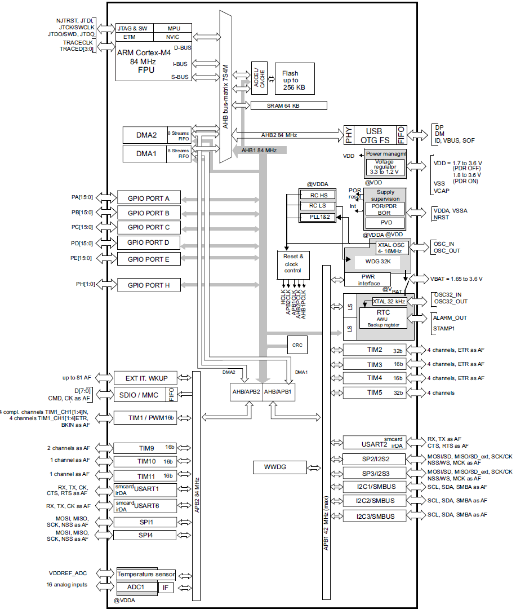
Arm® Cortex®-M4 with FPU core with embedded Flash and SRAM
Memory protection unit
Embedded Flash memory
CRC (cyclic redundancy check) calculation unit
Embedded SRAM
Multi-AHB bus matrix
DMA controller (DMA)
Nested vectored interrupt controller (NVIC)
External interrupt/event controller (EXTI)
Clocks and startup
General-purpose input/outputs (GPIOs)
Analog-to-digital converter (ADC)
Temperature sensor
Serial wire JTAG debug port (SWJ-DP)
Embedded Trace Macrocell

Slide 6
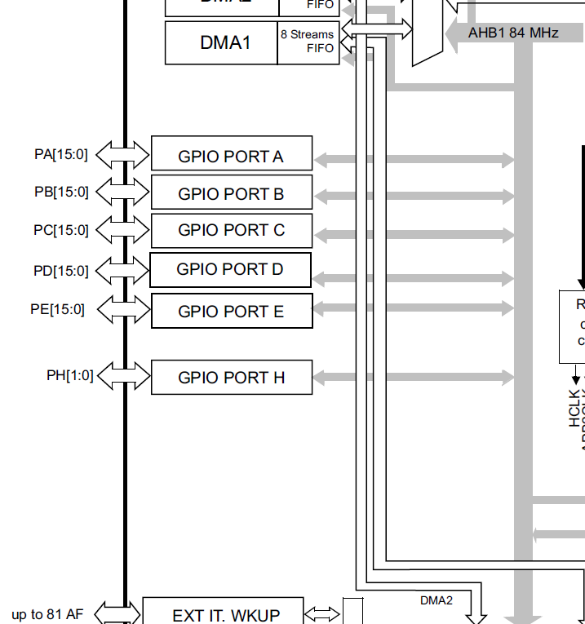
General-purpose I/Os (GPIO)
GPIO F/G/H/I/J/K (except GPIOH0 and GPIOH1) are not available in STM32F401

Slide 7
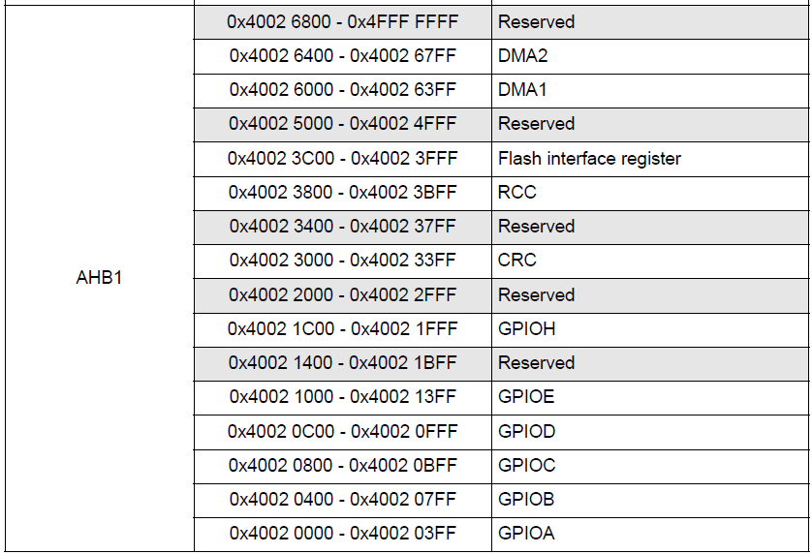
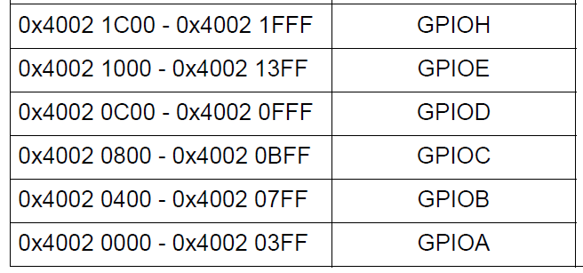
GPIO Registers Address

Slide 8
Registers need to be configured:-
RCC_AHB1ENR //Enable clock for GPIOC
GPIOx_MODER // Configure PC13 as output
GPIOx_ODR // Turn on LED connected to PC13

Slide 9
WRITE A DRIVER TO Turn ON LED on GPIOC PIN13

Slide 10

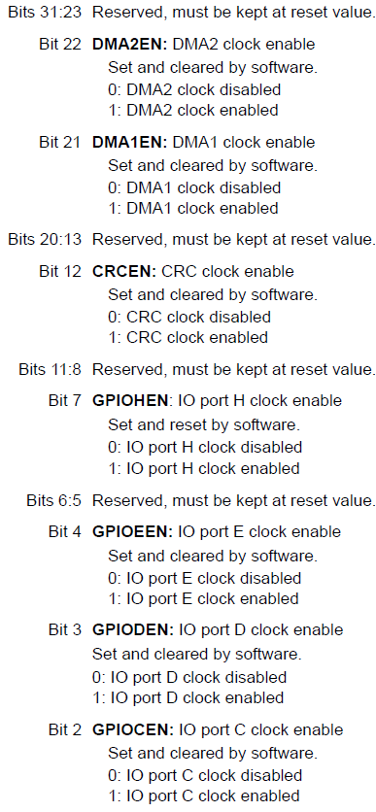
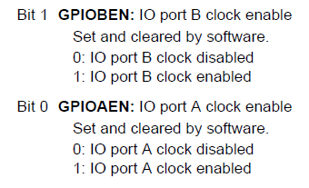
/*1. Enable GPIOC clock by Writing 1 to bit2 of AHB1ENR*/
RCC->AHB1ENR |=(1U<<2);

Slide 11


/*2. Set PC13 to output mode by writing 1 to bit26 of MODER*/
GPIOC->MODER |=(1U<<26);

Slide 12
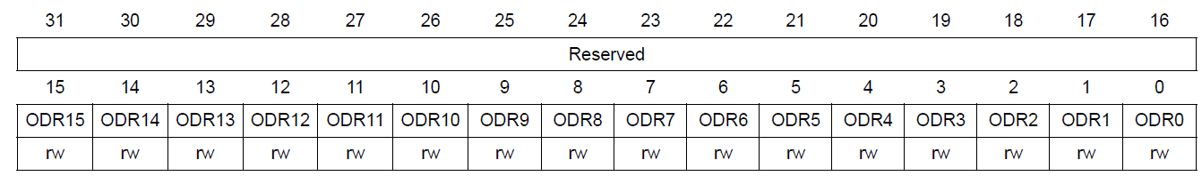
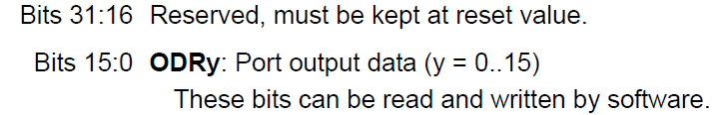

/*5. Turn ON PC13 by writing 0 to bit13 of ODR*/
GPIOC->ODR &=~(1U<<13);
On the black pill board LEDs cathode is connected to PC 13. So ‘0’ need to set on PC13 to turn on led

Slide 13
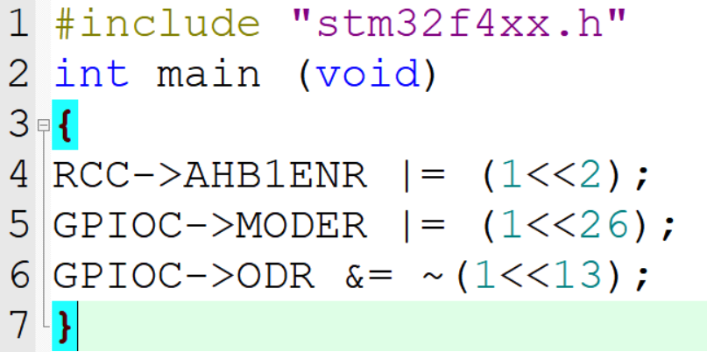
Code for LED ON PC13

Slide 14
Additional Tasks
WRITE A DRIVER TO Turn ON LED on GPIOC PIN14
WRITE A DRIVER TO Turn ON LED on GPIOB PIN9

