Slide 1
UART - TX

Slide 2
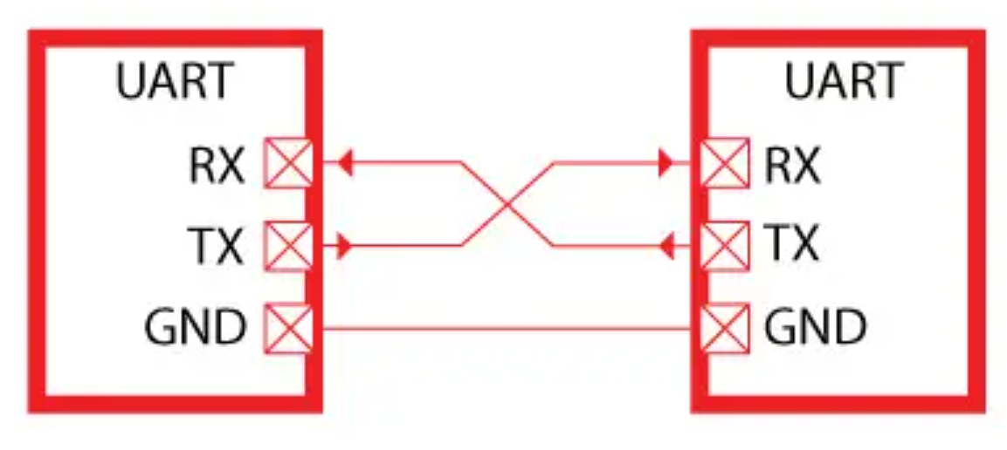
Universal synchronous asynchronous receiver transmitter (USART)
The universal synchronous asynchronous receiver transmitter (USART) offers a flexible means of full-duplex data exchange with external equipment requiring an industry standard NRZ asynchronous serial data format.
The USART offers a very wide range of baud rates using a fractional baud rate generator.
Two Device Communicate through UART
Only two pins are used to transfer and receive data such as a transmit pin (Tx) and a receiver pin (Rx).
The other two pins are just power supply pins such as ground and Vcc (usually a power source of the device).
But one important point to consider here is that the ground terminal or reference point of both devices should be common.

Slide 3
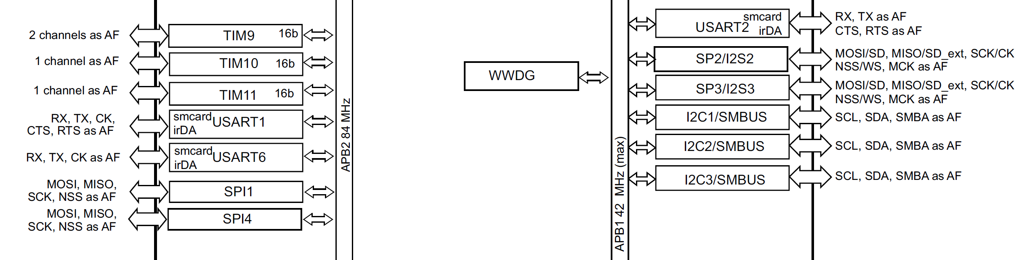
Universal synchronous asynchronous receiver transmitter (USART)

Slide 4
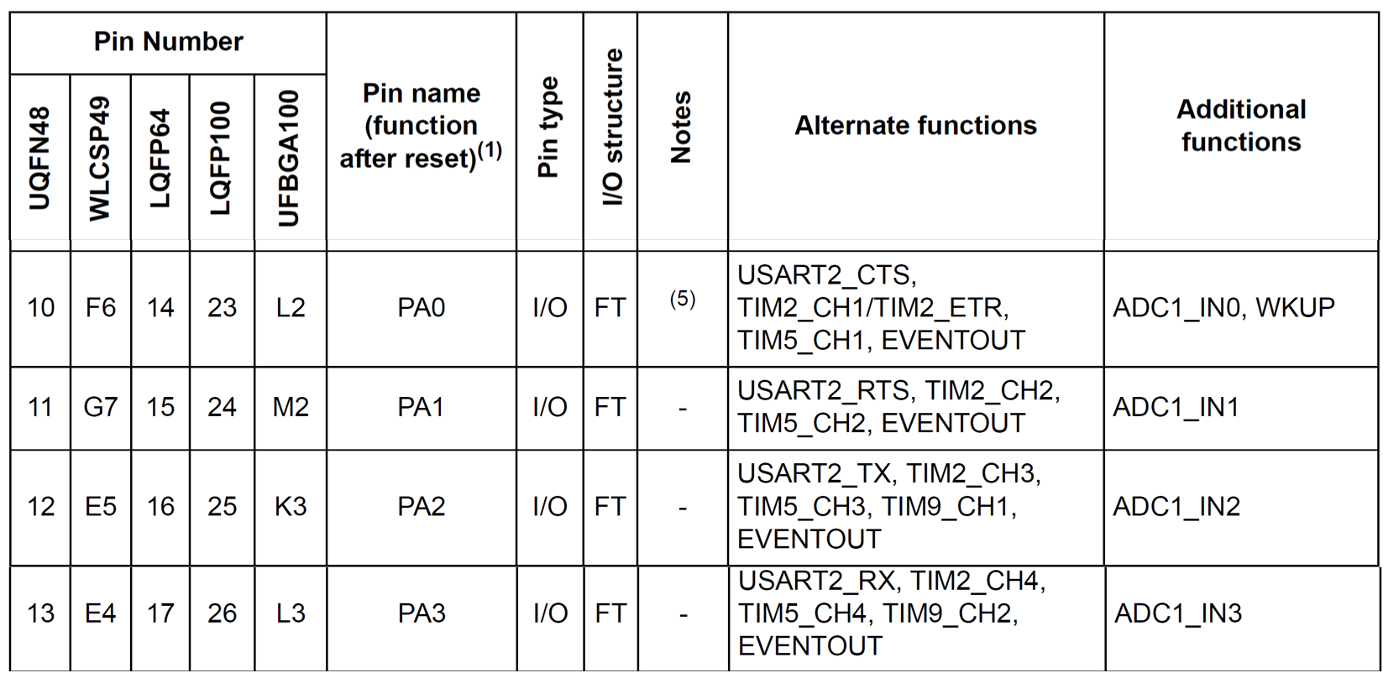
UART Ports

Slide 5
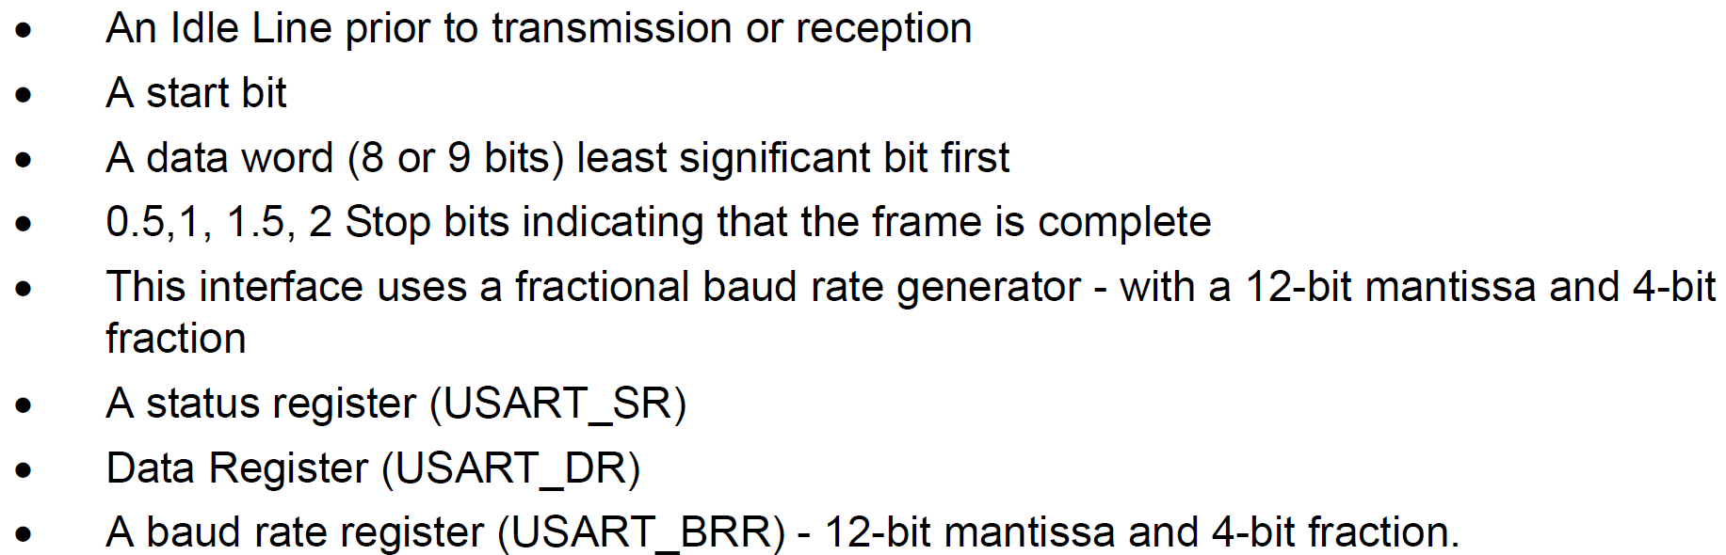
USART functional description
Serial data is transmitted and received in normal USART mode as frames comprising:

Slide 6
USART registers

Slide 7
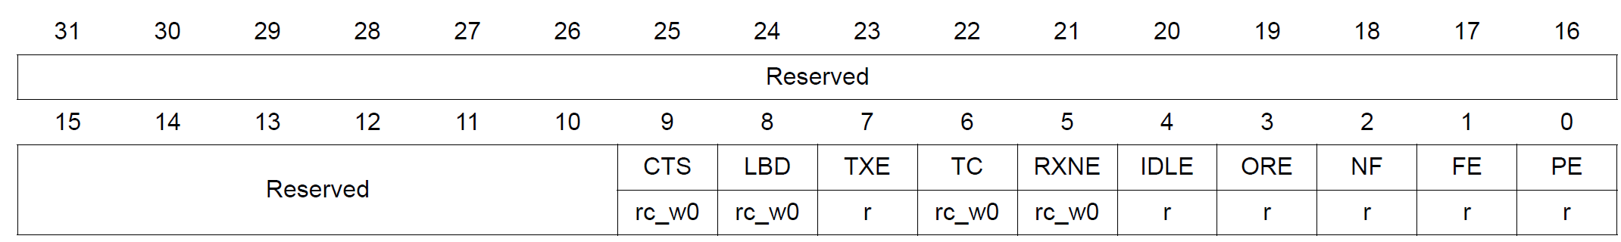
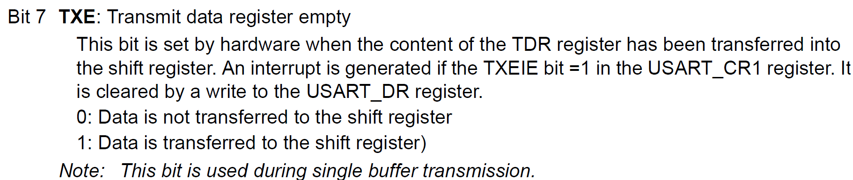
Status register (USART_SR)

Slide 8
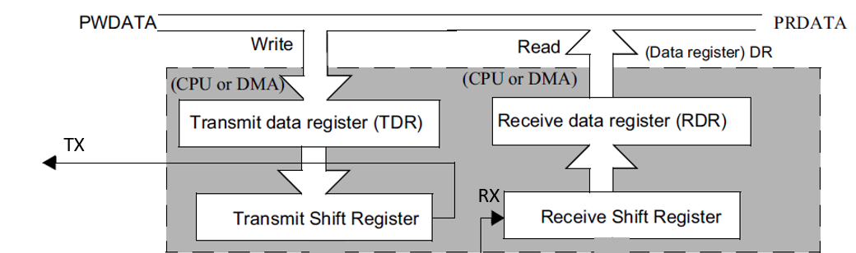
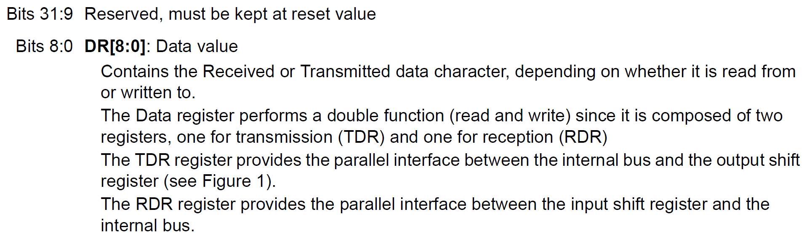
Data register (USART_DR)

Slide 9
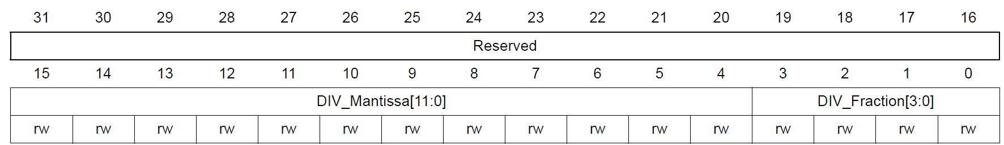
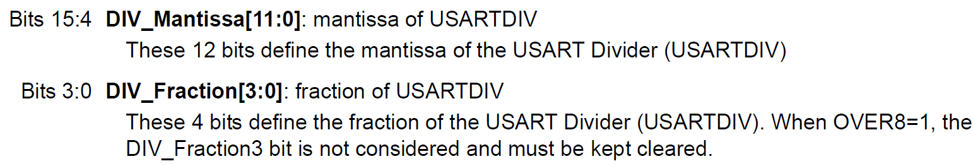

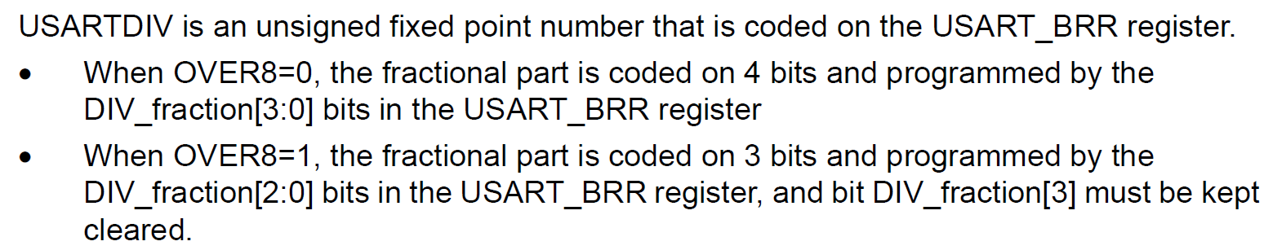
Baud rate register (USART_BRR)
The choice of 16 or 8 oversampling is done via the CR1 Control register.

Slide 10
Baud rate register (USART_BRR)
Assume the clock source of 16 MHz is fed to USART Baud rate generator with oversampling rate of 16. Find the values for the USART_BRR register for baud rates of (a) 9,600, (b) 115,200.
USARTDIV = fck / 16 x Baud
16MHz / 16 x 9,600 = 104.166.
Now, 104 = 0x68 for upper 12-bits.
For fraction part, 0.166 x 16 = 2.656 and we use 3 for the lower 4 bits.
Therefore BRR = 0x0683.
16MHz / 16 x 115,200 = 8.68.
Now, 08 = 0x008 for upper 12-bits.
For fraction part, 0.68 x 16 = 10.88 and we use 11 = 0xB for lower 4-bits.
Therefore BRR = 0x008B.

Slide 11
Baud rate register (USART_BRR)
Assume the clock source of 16 MHz is fed to USART Baud rate generator with oversampling rate of 8. Find the values for the USART_BRR register for baud rates of (a) 9,600, (b) 115,200.
USARTDIV = fck / 8 x Baud
16MHz / 8 x 9,600 = 280.33. Now, we use 280 = 0x118 for upper 12-bits.
For fraction part, 0.33 x 8 = 2.64 and we use 3 for 3 lower bits.
Therefore BRR = 0x1183. (Notice the 4th bit must be 0 in oversampling of 8.)
16MHz / 8 x 115,200 = 17.36. We use 17 = 0x011 for upper 12bits.
For fraction part, 0.36 x 8 = 2.88 and we use 3 for lower 3 bits.
Therefore BRR = 0x0113

Slide 12
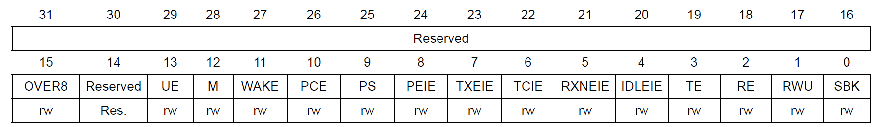
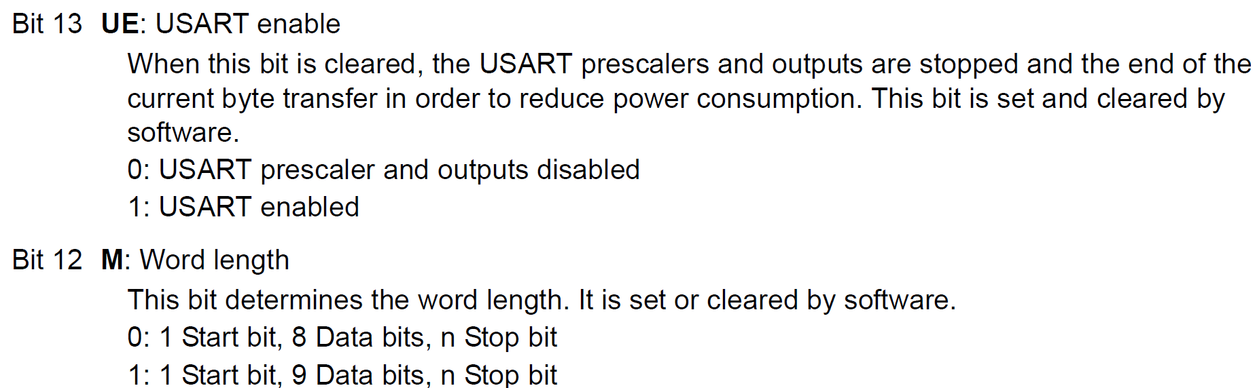
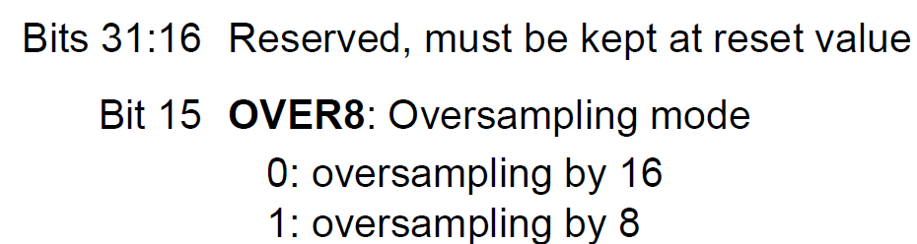
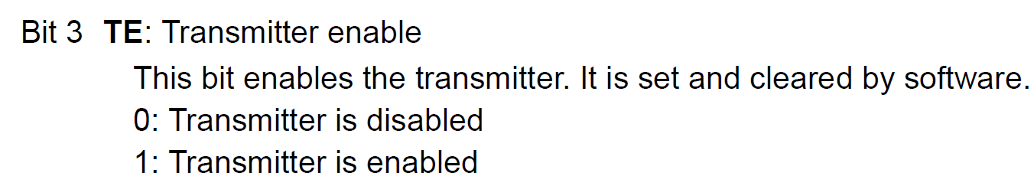
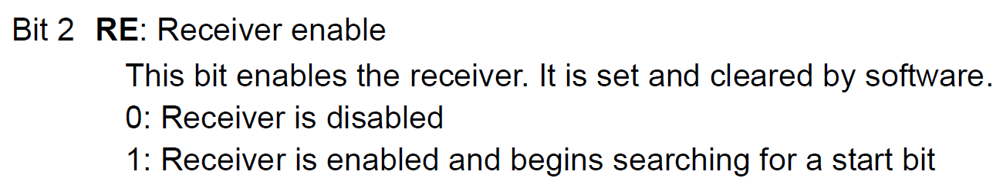
Control register 1 (USART_CR1)

Slide 13
USART2 PA2 - Tx

Slide 14
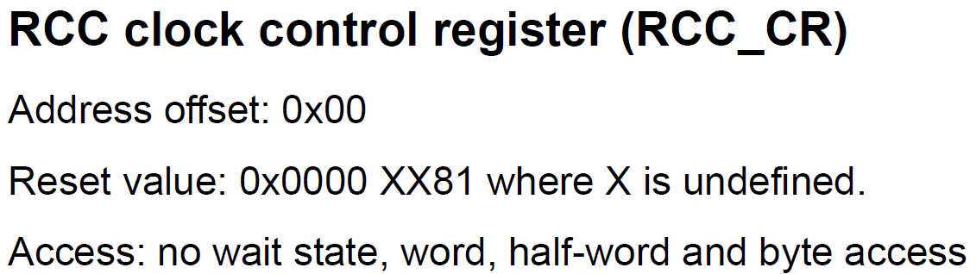
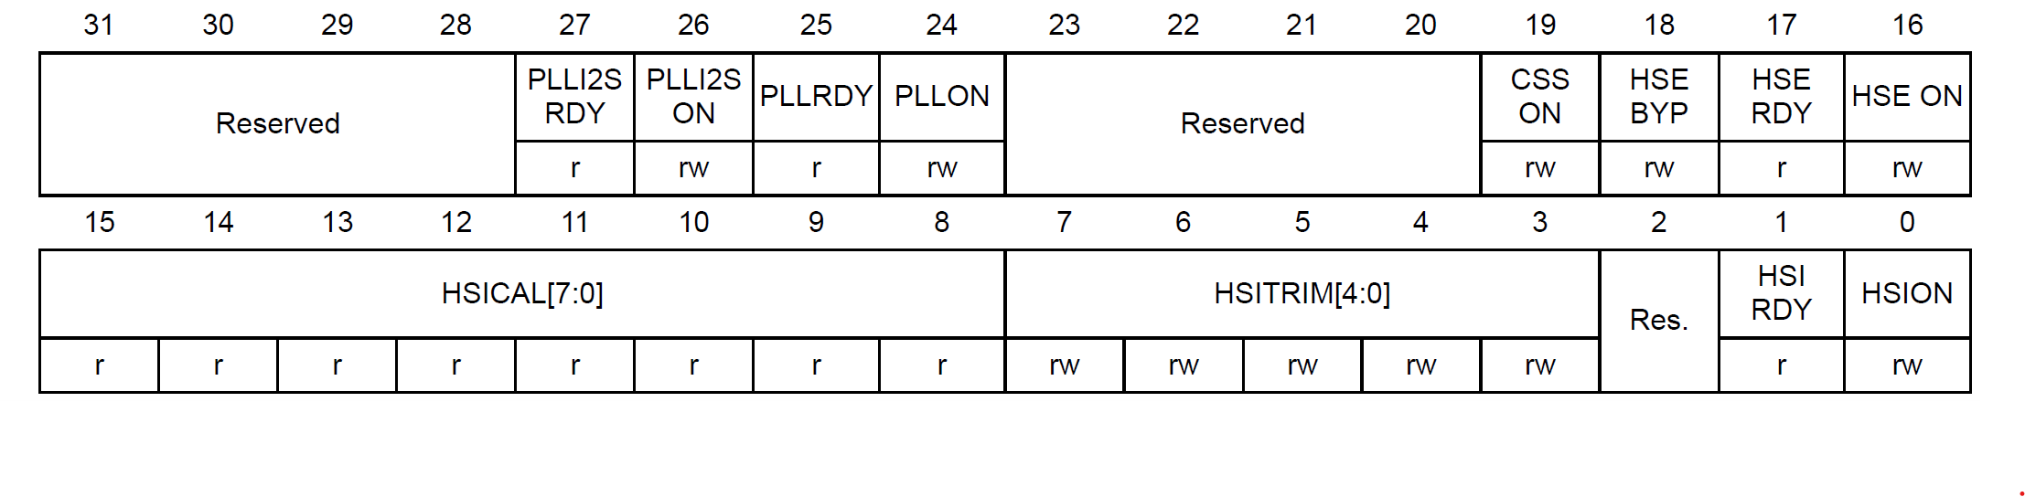
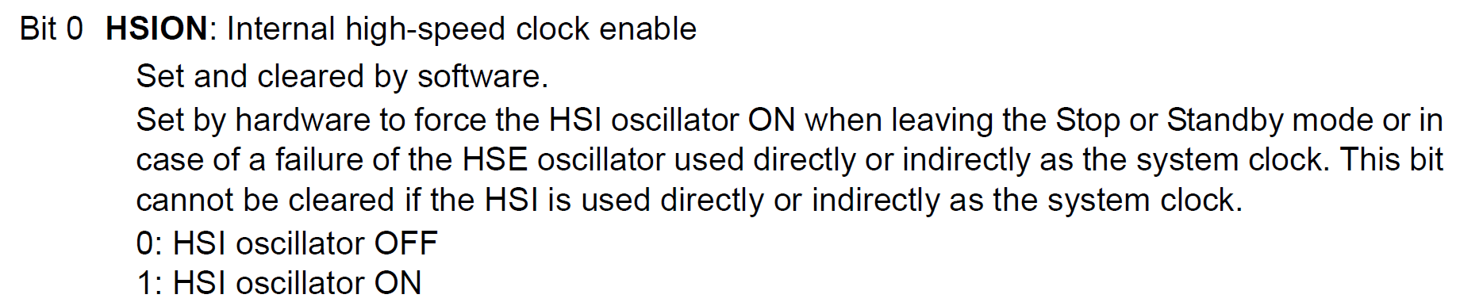
Internal Oscillator for system clock of STM32F4 (16MHz)
No need to configure this since the reset value itself enable HSION bit.

Slide 15

GPIO clock enabled for UART Tx Pin PA2 - GPIOA
/*1. Enable GPIOA clock by Writing 1 to bit0 of AHB1ENR*/
RCC->AHB1ENR |=(1U<<0);

Slide 16


Alternate function mode select for USART2 Tx Pin PA2
/*2. Set PA2 to alternate function mode by writing 1 to bit of MODER*/
GPIOA->MODER |=(1U<<5);

Slide 17
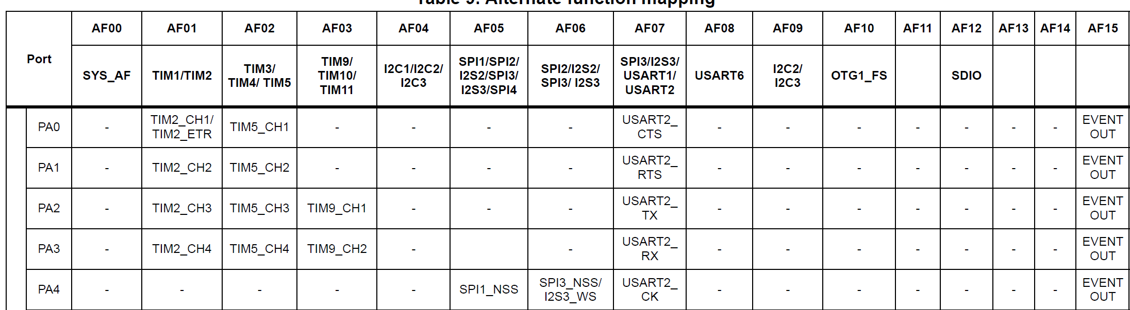
Alternate function mode select for USART2 Tx Pin PA2
Alternate function mapping

Slide 18
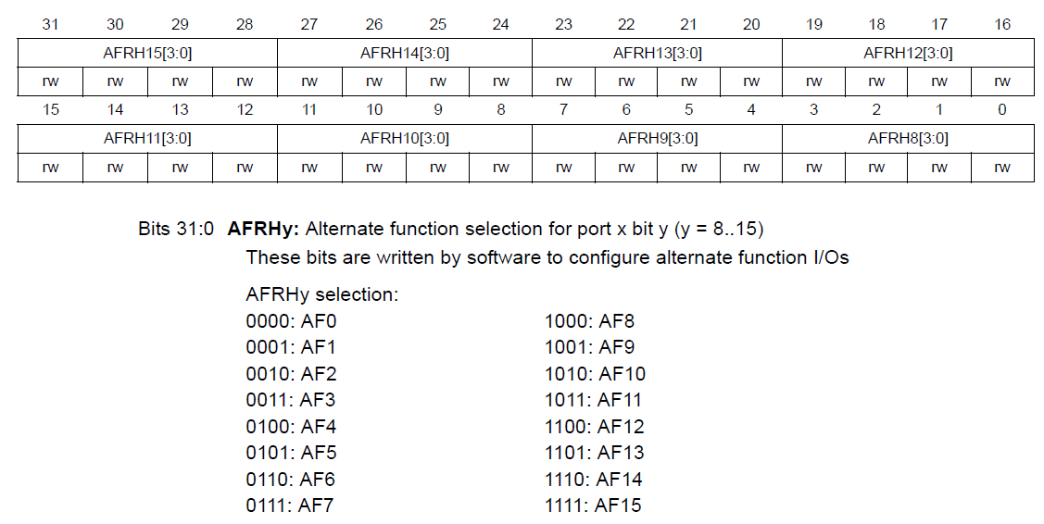
Alternate function mode select for USART2 Tx Pin PA2
GPIO alternate function high register (GPIOx_AFRH)

Slide 19
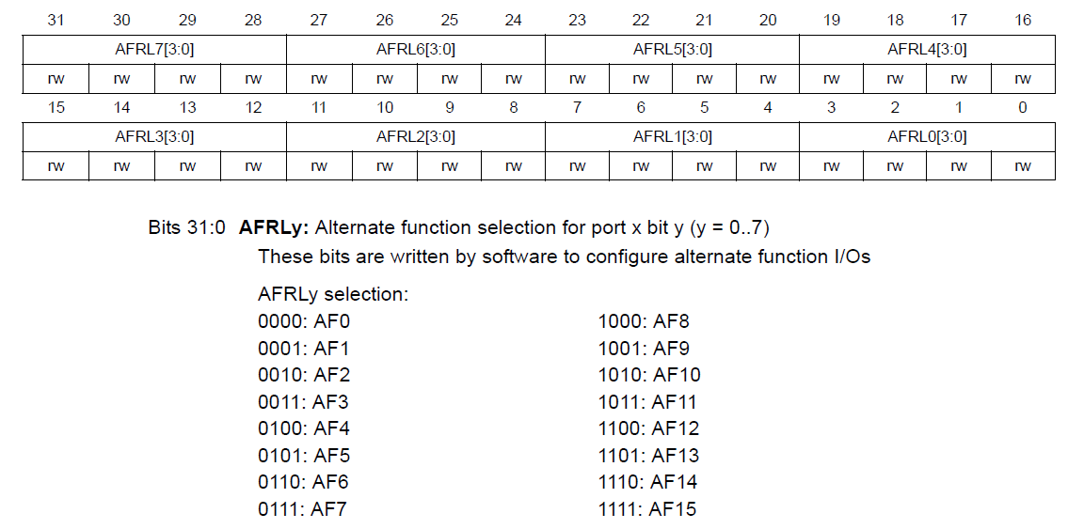
Alternate function mode select for USART2 Tx Pin PA2
GPIO alternate function low register (GPIOx_AFRL) (x = A..E and H)
GPIOA->AFR[0] &= (~(1<<11));
GPIOA->AFR[0] |= (1<<10) | (1<<9) | (1<<8);

Slide 20
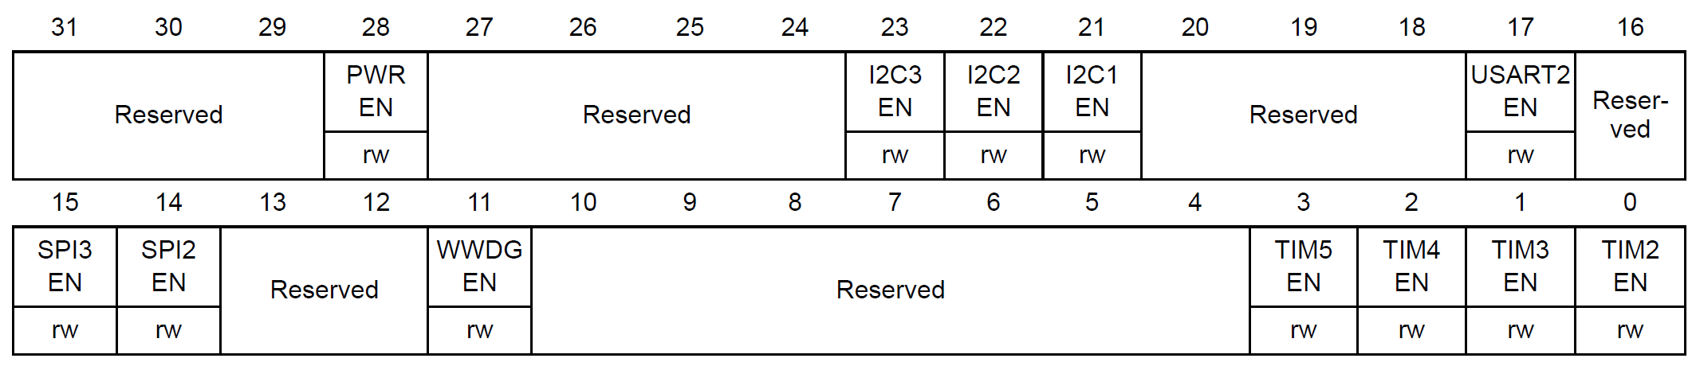
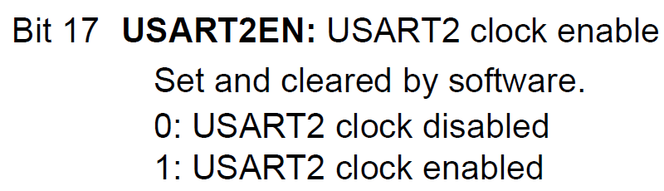
USART2 clock enable
RCC APB1 peripheral clock enable register (RCC_APB1ENR)
RCC->APB1ENR |= (1<<17);

Slide 21
Baudrate of USART2 to be 115200
OVER8=0
with oversampling rate of 16
USARTDIV = f_{ck} / (16 x baud)
16MHz / 16 x 115,200 = 8.68
Now, 08 = 0x008 for upper 12-bits.
For fraction part, 0.68 x 16 = 10.88 and we use 11 = 0xB for lower 4-bits.
Therefore BRR = 0x008B.
USART2->BRR = 0x008B;
Baudrate of USART2 to be 115200 @ 16 Mhz

Slide 22
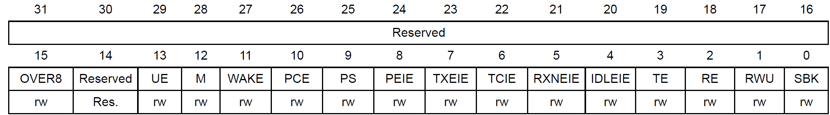
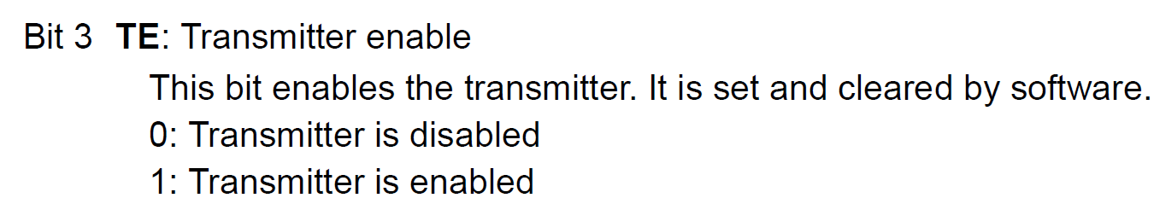
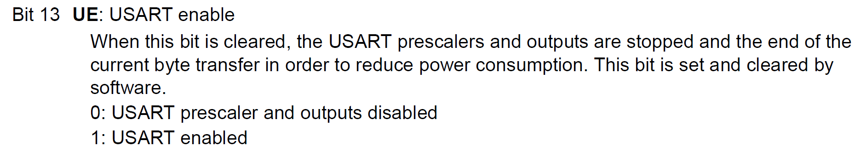
Control register 1 (USART_CR1)
Tx enable
USART2 enable
USART2->CR1 |= (1<<3);
USART2->CR1 |= (1<<13);

Slide 23
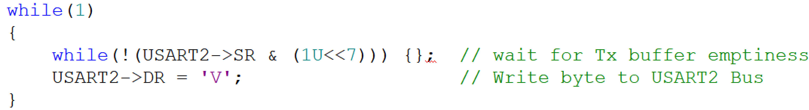
Sending Character Through USART2 TX

Slide 24
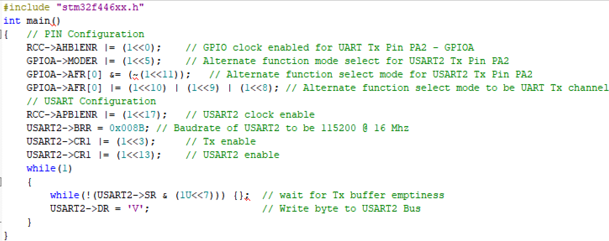
Sending Character Through USART2 TX

Slide 25
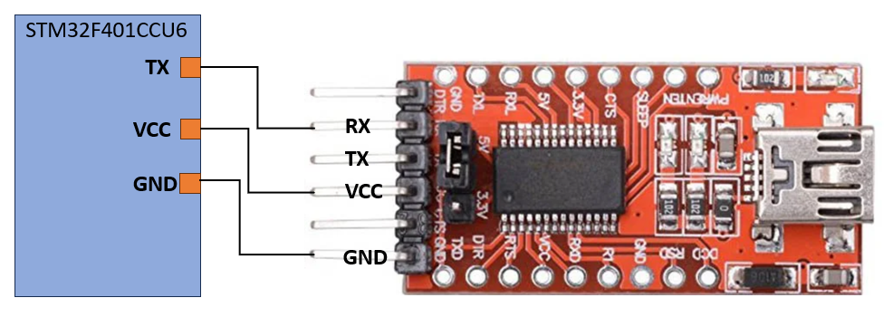
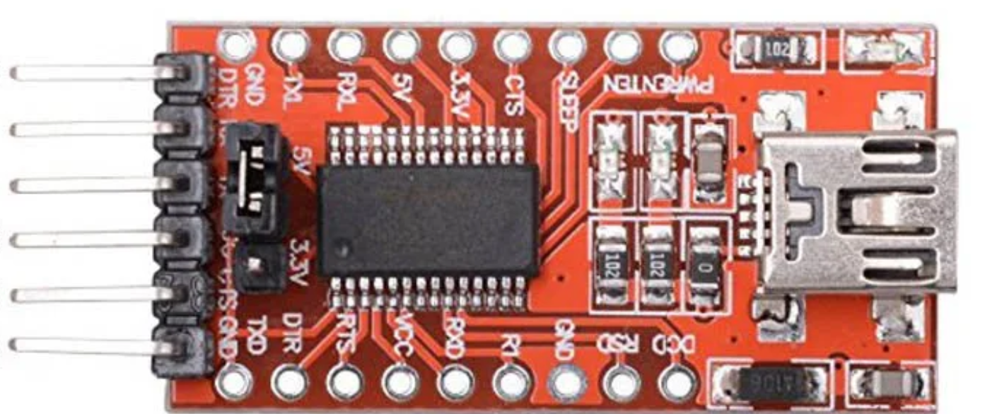
How to view UART output using FT232RL USB-to-serial UART module
Procedure to check the output
The FT232RL module is a mini USB to serial UART TTL 5V 3.3V converter circuit board designed for communication between a computer's USB port and the microcontroller's programming port.
STM32F401CCU6
TX
VCC
RX
TX
GND
VCC
GND

Slide 26
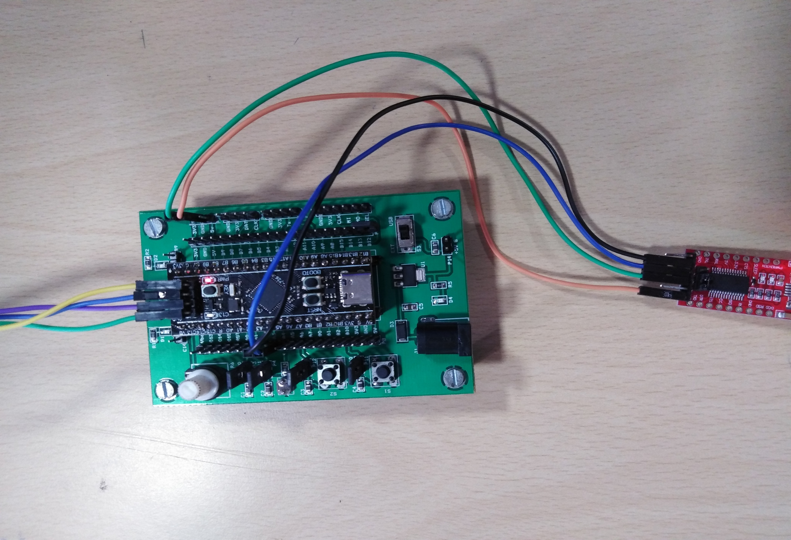
Sending Character Through USART2 TX

Slide 27
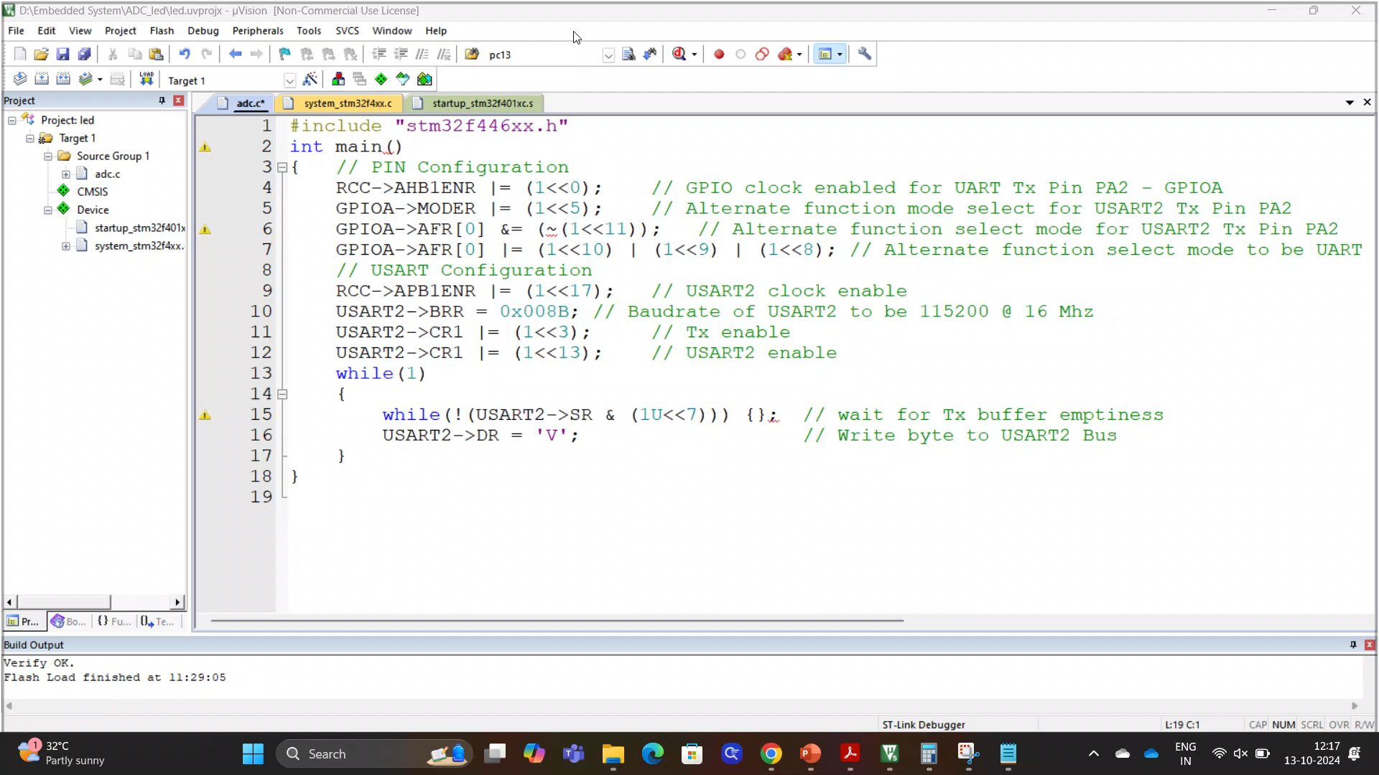
How to view UART output using HW-417 (USB to TTL converter)
Procedure to check the output
Install Docklight V2.4
https://docklight.de/downloads/

Slide 28
Thank You

