Slide 1
The Arm Cortex-M4 Processor Architecture

Slide 2
Quick recap…
What is an ARM processor?
  ARM processors are a family of central processing units (CPUs) based on a reduced instruction set computer (RISC) architecture.
  ARM stands for Advanced RISC Machine.
  ARM processor is basically a 32 bit processor, meant particularly for high end applications which involve more complex computation and calculations

Slide 3
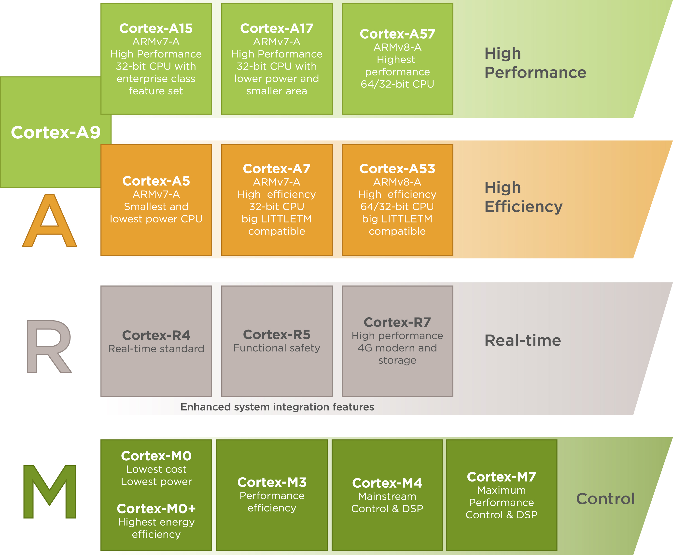
Cont…

Slide 4
Cont…
Category | Cortex-A | Cortex-R | Cortex-M
Target Application Type | Application-level processing | Real-time, safety-critical systems | Embedded control, low-power devices
Typical End Products | Smartphones, tablets, smart TVs, Raspberry Pi, automotive infotainment | ABS, engine control units, industrial drives, medical devices | IoT sensors, smartwatches, wearables, low-cost MCUs
Instruction Set Architecture | Armv7-A / Armv8-A / Armv9-A | Armv7-R / Armv8-R | Armv6-M / Armv7-M / Armv8-M
Operating System Support | Full OS (Linux, Android, Windows) | RTOS / Bare-metal | RTOS (e.g., FreeRTOS, Zephyr) or bare-metal
Real-Time Determinism | No (non-deterministic, complex pipelines) | Yes (predictable timing) | Yes (fast interrupt response)
Interrupt Controller | GIC (Generic Interrupt Controller) | Vectored interrupt system | NVIC (Nested Vectored Interrupt Controller)
Memory System | MMU for virtual memory | TCM (Tightly Coupled Memory), optional MPU | Optional MPU (no MMU)
Bare metal refers to programming directly on the hardware without using an operating system (OS)

Slide 5
Cont…
Category | Cortex-A | Cortex-R | Cortex-M
FPU / DSP Support | Advanced SIMD/NEON + FPU | Optional FPU and basic SIMD | Optional (M4/M7/M33/M55)
Multicore Support | Common | Some cores (lock-step for safety) | Rare
Performance Level | High (GHz-range, superscalar) | Medium (hundreds of MHz, deterministic) | Low (10s–100s MHz, small core area)
Power Efficiency | Lower (mobile-class CPUs) | Balanced (industrial-class) | Very high (ultra-low-power MCUs)
Fault Tolerance / Safety | Not designed for high integrity | ISO 26262, DO-178C support | Basic support; safety depends on MCU vendor
Cost / Area | High | Medium | Very low

Slide 6
What u mean by ARM Cortex-M?
Designed Specifically for Microcontrollers: The Cortex-M series is optimized for microcontroller applications — small, low-power devices embedded in systems like IoT, automotive, consumer electronics, and industrial control.
Uses the Thumb-2 instruction set, which provides a good balance of code density (smaller program size) and performance. This helps reduce memory requirements and cost.
Low Power Consumption: Designed with power efficiency in mind, making it ideal for battery-operated devices.
Integrated Nested Vectored Interrupt Controller (NVIC): The NVIC supports fast, deterministic interrupt handling, allowing real-time responsiveness with low latency and low overhead.
Simple and Efficient Pipeline: Typically, a 3-stage pipeline (fetch, decode, execute), which is simpler and consumes less power compared to more complex cores.
Memory Protection Unit (MPU): Some Cortex-M models have an MPU to enhance safety and security by restricting access to memory regions.
Scalable Performance: Different Cortex-M variants exist (M0, M0+, M3, M4, M7, M23, M33, M55) that balance power, performance, and features, like DSP instructions or TrustZone security.

Slide 7
Cont…(IN simple term)
The ARM Cortex-M series is uniquely built for low-cost, low-power, real-time embedded applications with a focus on efficient interrupt handling, compact code, and scalability across performance needs.

Slide 8
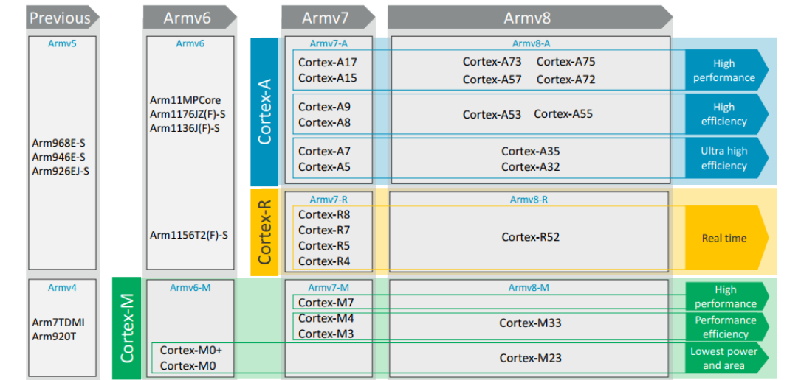
Cont …(Instruction Set Architecture)

Slide 9
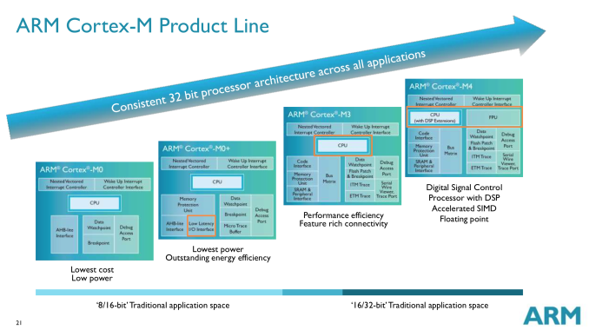
Cont…

Slide 10
ARM cortex M4 architecture

Slide 11
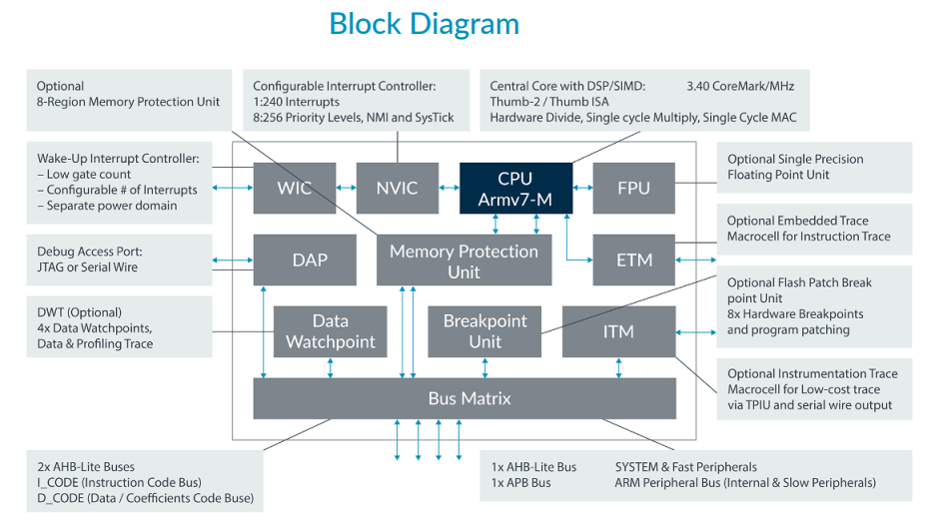

Slide 12
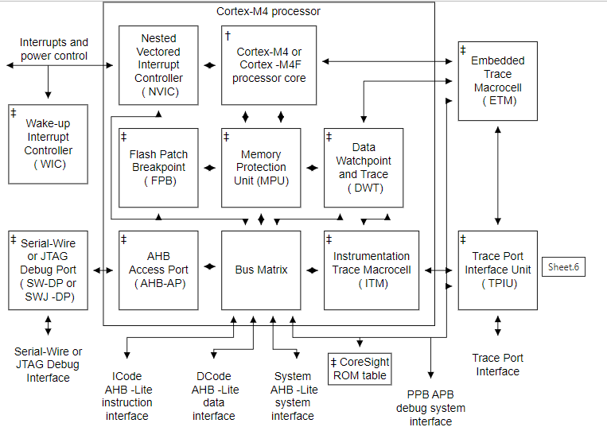

Slide 13
Key features of Arm Cortex-M4 core
Processor Core Architecture
ARMv7-M Architecture
  The Cortex-M4 core implements the ARMv7-M architecture, a modern 32-bit RISC architecture designed for microcontrollers. It supports little-endian data format, suitable for most embedded applications.
3-Stage Pipeline
  The core features a 3-stage pipeline:
  This pipeline is designed to maximize throughput while keeping power consumption low and latency minimal.

Slide 14
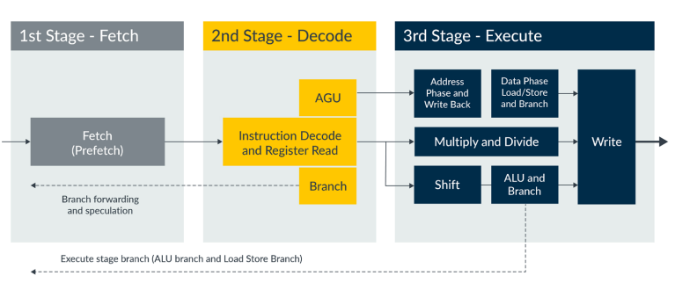
Cont…

Slide 15
Cont…
Instruction Set and Execution
Thumb-2 Technology:
  Mixes 16-bit and 32-bit instructions.
  Offers high code density compared to 32-bit only ISAs, reducing flash memory size needed.
  ARM's original ISA had two modes (ARM and Thumb instruction)
  Thumb-2 blends both
DSP Extensions:
  DSP instructions added on top of Thumb-2 for signal processing:
  Multiply-Accumulate (MAC) instructions: Multiply two values and add to accumulator in a single instruction cycle.
  SIMD (Single Instruction Multiple Data): Operate on multiple data values packed into registers (e.g., parallel 8-bit or 16-bit operations).
  SIMD means doing the same operation on many pieces of data at once — all in a single instruction.
  The processor packs multiple 8-bit or 16-bit values into a single 32-bit register.

Slide 16
Cont…
Optional Floating Point Unit (FPU):
  IEEE-754 single-precision floating-point unit.
  If included: The MCU can do floating-point math (add, subtract, multiply, divide) much faster and more accurately.
  If not included: It must use software emulation, which is slower.
Memory System
Memory Map and Bus Interface
  Uses AMBA (Advanced Microcontroller Bus Architecture) AHB-Lite bus interface to connect to memory and peripherals.
  It uses Harvard architecture with separate buses for code/data.
  Memory map includes:
    Code region (flash/ROM).
    SRAM.
    Peripheral registers.
    System control space (SCS) for NVIC, SysTick timer, MPU, etc.

Slide 17
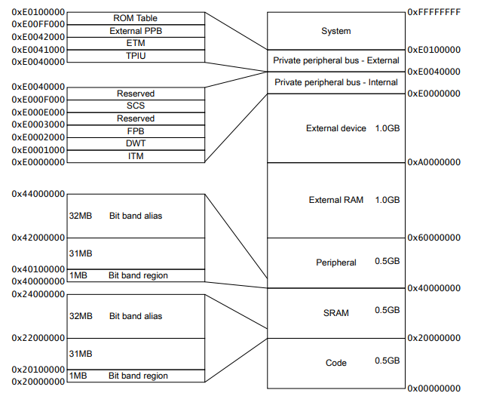
Cont…
Flash memory
Holds the program code.
Usually read-only at runtime.
Mapped to address 0x08000000 (common in STM32).
SRAM
Fast read/write memory for variables and stacks.
Located starting at 0x20000000.
System Control Space
Mapped at 0xE0000000.
Contains important registers:
  NVIC (interrupt controller)
  SysTick timer
  SCB (System Control Block)
  FPU control (if present)

Slide 18
Cont…
Bit-Band Regions
Allows atomic bit-level access via memory-mapped aliasing.
Regions:
SRAM bit-band: 0x20000000 – 0x200FFFFF
Peripheral bit-band: 0x40000000 – 0x400FFFFF
Peripheral Space
Mapped at 0x40000000.
Includes UART, GPIO, ADC, timers, etc.
Each peripheral has its own register block.

Slide 19
Cont…
Memory System
Memory Protection Unit (MPU):
A Memory Protection Unit (MPU) in the ARM Cortex-M4 processor is a hardware feature that allows control over how memory regions are accessed. It enhances system reliability, security, and robustness by restricting access to memory regions based on predefined rules.
  Allows defining up to 8 memory regions.
  Each memory region can have:
    A starting address (base address)
    A size (must be a power of two: 32B, 64B, 128B, ..., up to 4GB)
    Access permissions (e.g., read-only, read/write, execute never)
    Privilege level (privileged/unprivileged access)
    Memory type/attributes (e.g., cacheable, shareable)
  Improves system reliability by preventing errant code from overwriting critical memory or data.

Slide 20
Cont…
complete example with all 8 MPU regions
Region # | Base Address | Size | Access | Description
0 | 0x00000000 | 512 KB | Read-only | Flash memory (code)
1 | 0x20000000 | 128 KB | Read/Write | Main SRAM (global variables, stacks)
2 | 0x20020000 | 4 KB | Read-only | Shared configuration area
3 | 0x20021000 | 4 KB | No access | Guard region (stack overflow detect)
4 | 0x40000000 | 1 MB | Read/Write | Peripheral registers
5 | 0x60000000 | 8 MB | Read-only | External NOR Flash (memory-mapped)
6 | 0x60080000 | 1 MB | Read/Write | External RAM (e.g., for buffers)
7 | 0x20022000 | 16 KB | Read/Write | Task-specific heap (for RTOS task)
The MPU in Cortex-M4 can handle up to 8 such regions at once.
You can create up to 8 distinct rules for different parts of memory.
Each region can protect a specific memory area like:
  Flash memory (code)
  RAM (data)
  Peripheral address space
  Stack region
  Heap or buffers used by tasks in an RTOS

Slide 21
Cont…
Data and Instruction Caches:
  Cortex-M4 core typically does not include caches to keep latency predictable (important in real-time systems).
  Instead, it relies on fast SRAM and tightly-coupled memory (TCM) in some implementations.
Feature | Present? | Notes
Instruction Cache | Not present | Fetches instructions directly from Flash
Data Cache | Not present | Data is accessed directly from SRAM/Flash
MPU (Memory Protection Unit) | Yes | Used for protection, not caching
FPU (Floating Point Unit) | Optional | Single-precision (if included by vendor)
Prefetch Buffer | Yes | Helps improve instruction fetch efficiency
A Prefetch Buffer is a small hardware feature in the ARM Cortex-M4 that fetches instructions ahead of time (before the CPU actually needs them) and stores them temporarily to speed up instruction execution, especially when executing code from slower memory like Flash

Slide 22
Cont… (What about performance?)
Many Cortex-M4 MCUs rely on:
  Flash acceleration techniques like instruction prefetch, buffering, and branch speculation.
  Tightly Coupled Memory (TCM) in some implementations for deterministic, low-latency access. (Direct Memory Access, is a hardware feature that allows certain hardware components to access main system memory without involving the CPU. )
  Fast on-chip SRAM, avoiding the need for data caching.

Slide 23
AHB-Lite bus interface
For the ARM Cortex-M4 architecture, the AHB-Lite (Advanced High-Performance Bus) bus interface is the main interconnect used by the processor core to communicate with memory and peripherals. The Cortex-M4 uses the AMBA AHB-Lite (Advanced Microcontroller Bus Architecture) interface because:
  It is a single-master system (the CPU core is the only master).
  It simplifies bus design by eliminating arbitration logic (Bus Arbitration - The process of selecting the next bus master.)
  It's optimized for low-latency and low-complexity embedded systems.
What is a Multi-AHB Bus Matrix?
The AHB Bus Matrix allows multiple bus masters to access multiple AHB slaves simultaneously by providing a non-blocking interconnect.
Instead of one shared bus (as in simpler AHB-lite), the matrix enables parallel access paths, improving overall system performance.

Slide 24
Cortex-M4 AHB-Lite Bus Interface Overview
The Cortex-M4 connects to the rest of the system through a bus matrix (or crossbar) that connects:
Masters:
  Cortex-M4 Core (instruction and data access)
  DMA Controller (if present)
    Direct Memory Access, is a hardware feature that allows certain hardware components to access main system memory without involving the CPU.
Slaves:
  Flash memory
  SRAM
  Peripheral space
  System control space
  External memory (optional)

Slide 25
Purpose of the Multi-AHB Bus Matrix
Efficient Resource Sharing: Multiple AHB masters (e.g., CPU cores, DMA controllers) can access different slaves (e.g., SRAM, peripherals) simultaneously without bottlenecking at a single bus interface.
Flexible Configuration: Allows for complex system architectures where different bus masters have varying access priorities and bandwidth requirements.
Performance Optimization: Reduces latency and improves throughput by managing how access is distributed among different masters and slaves

Slide 26
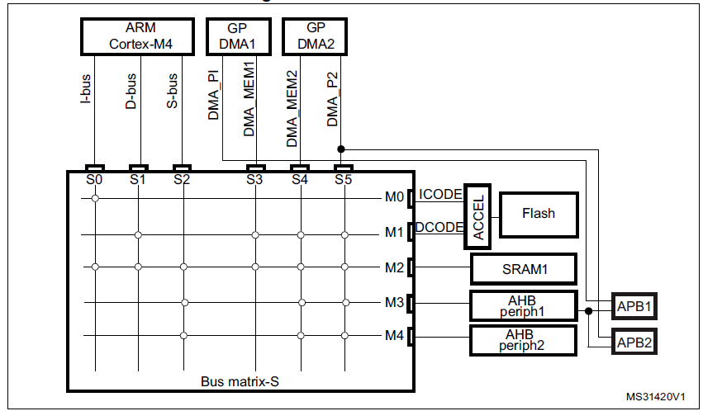
Multi-AHB bus matrix
masters
slaves

Slide 27
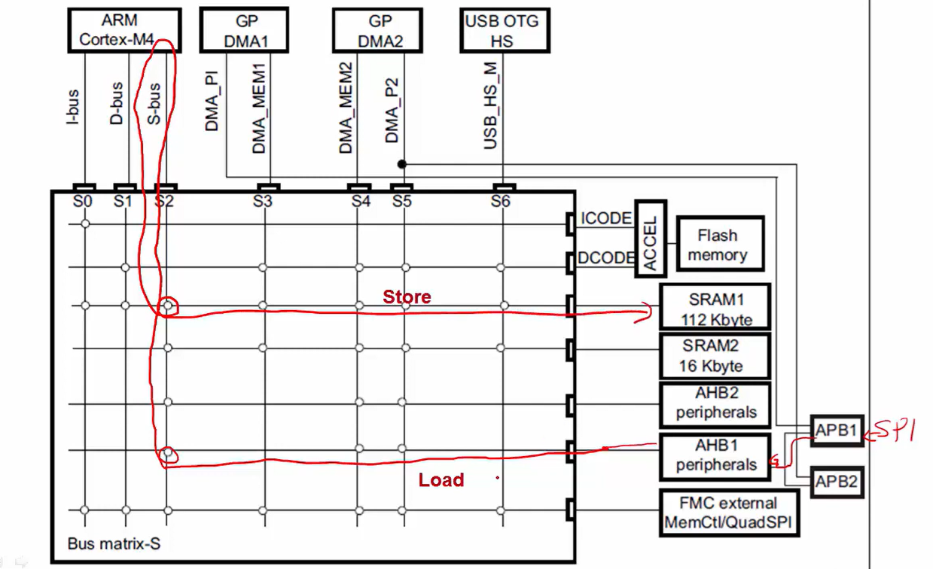
Example for SPI communication through bus matrix

Slide 28
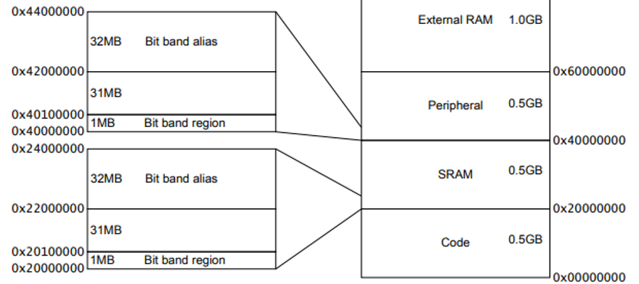
Bit-Banding
Bit-banding is a powerful feature of the ARM Cortex-M4 architecture that allows bit-level access to memory-mapped peripherals and SRAM using regular word-aligned addresses — effectively letting you set or clear individual bits with a single instruction.
Why Use Bit-Banding?
  Avoid read-modify-write race conditions.
  Set or clear individual bits without masking.
  Improves code readability and speed.
  Useful in interrupt handlers and critical sections.

Slide 29
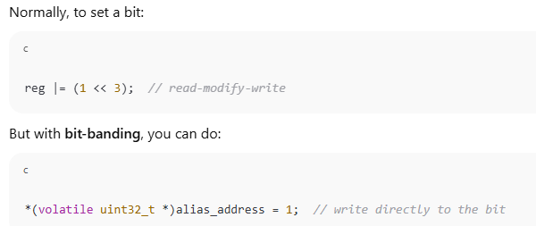
Cont…
dedicated alias address
  A special, separate memory address that represents one specific bit of a word in normal memory or peripheral space — mapped by hardware.
  When you read or write to this alias address, the processor automatically accesses the corresponding bit in the original memory, without needing bit-masking or shifting.
The alias address is a 32-bit-wide memory location, but only one bit is affected — the one it maps to in the original memory.

Slide 30
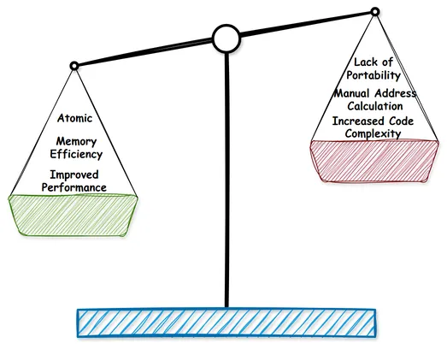
Cont…

