Slide 1
STM32F401CCU6
ADC
ARM Cortex M4 Series MCU

Slide 2
In electronics, an analog-to-digital converter (ADC, A/D, or A-to-D) is a system that converts an analog signal, such as a sound picked up by a microphone or light entering a digital camera, into a digital signal that can be read by STM32.
ADCs can vary greatly between microcontroller. The ADC on the STM32F411 is a 12-bit ADC meaning that it has the ability to detect 4096(2^12) discrete analog levels (which is also called Resolution). Some microcontrollers have 8-bit ADCs (2^8 = 256 discrete levels) and some have 16-bit ADCs (2^16 = 65,536 discrete levels).
The ADC reports a ratio metric value. This means that the ADC assumes 3.3V is 4095 and anything less than 3.3V will be a ratio between 3.3V and 4095.
For example if the sensor has output voltage of 1.66V hence the ADC output will be (4095/3.3)*1.66=2059.

Slide 3
ADC Introduction
The 12-bit ADC is a successive approximation analog-to-digital converter.
It has up to 19 multiplexed channels allowing it to measure signals from 16 external sources, two internal sources, and the VBAT channel.
The A/D conversion of the channels can be performed in single, continuous, scan or discontinuous mode.
The result of the ADC is stored into a left or right-aligned 16-bit data register.
ADC2 and ADC3 are not available in STM32F401ccu6

Slide 4
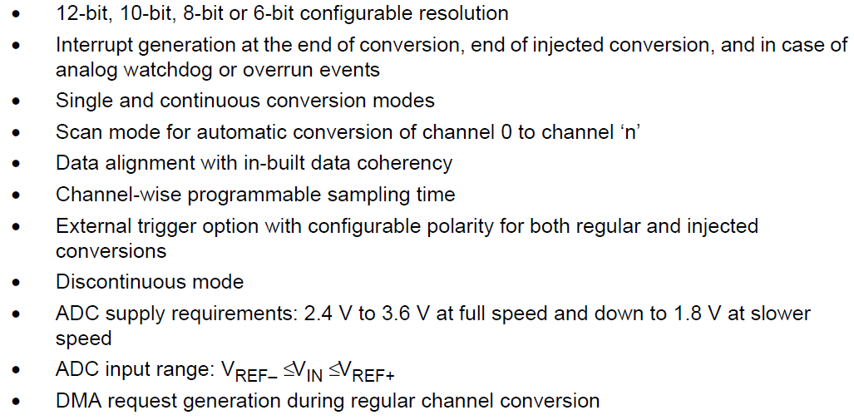
ADC main features
ADC2 and ADC3 are not available in STM32F401ccu6

Slide 5
In STM32 microcontrollers, the ADC (Analog-to-Digital Converter) has two groups of channels:
Regular Channels handle standard, continuous, or periodic sampling of up to 16 channels in a predefined sequence. They share a single, global data register, usually requiring DMA for multi-channel arrays.
Injected Channels handle time-critical measurements (like motor control feedback). They can interrupt regular conversions to execute immediately. Each injected channel has its own dedicated data register, preventing data overwrites.

Slide 6
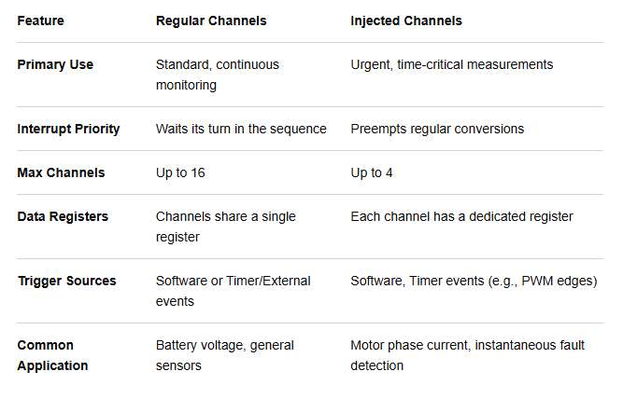
The table below outlines their main differences:

Slide 7
STM32 ADC Modes of Operation
There are so many operating modes for the STM32 ADC to give us, the system designers/programmers, the flexibility to configure it in any way imaginable that suits the application’s needs.
Single Conversion Mode
In Single Conversion mode, the ADC does one conversion. This mode is started either by setting the ADON bit in the ADC_CR2 register (for a regular channel only) or by an external trigger (for a regular or injected channel), while the CONT bit is 0. Once the conversion of the selected channel is complete:
  If a regular channel was converted:
  – The converted data is stored in the 16-bit ADC_DR register
  – The EOC (End Of Conversion) flag is set
  – and an interrupt is generated if the EOCIE is set.
  If an injected channel was converted:
  – The converted data is stored in the 16-bit ADC_DRJ1 register
  – The JEOC (End Of Conversion Injected) flag is set
  – and an interrupt is generated if the JEOCIE bit is set.
The ADC is then stopped.

Slide 8
Continuous Conversion Mode
In continuous conversion mode, ADC starts another conversion as soon as it finishes one. This mode is started either by an external trigger or by setting the ADON bit in the ADC_CR2 register, while the CONT bit is 1. After each conversion:
  If a regular channel was converted:
  – The converted data is stored in the 16-bit ADC_DR register
  – The EOC (End Of Conversion) flag is set
  – An interrupt is generated if the EOCIE is set.
  If an injected channel was converted:
  – The converted data is stored in the 16-bit ADC_DRJ1 register
  – The JEOC (End Of Conversion Injected) flag is set
  – An interrupt is generated if the JEOCIE bit is set.
Scan Mode
This mode is used to scan a group of analog channels. A single conversion is performed for each channel of the group. After each end of conversion, the next channel of the group is converted automatically. If the CONT bit is set, conversion does not stop at the last selected group channel but continues again from the first selected group channel
When using scan mode, DMA bit must be set and the direct memory access controller is used to transfer the converted data of regular group channels to SRAM after each update of the ADC_DR register. The injected channel converted data is always stored in the ADC_JDRx registers.

Slide 9
Discontinuous Mode
This mode is enabled by setting the DISCEN bit in the ADC_CR1 register. It can be used to convert a short sequence of n conversions (n <=8) which is a part of the sequence of conversions selected in the ADC_SQRx registers. The value of n is specified by writing to the DISCNUM[2:0] bits in the ADC_CR1 register.
When an external trigger occurs, it starts the next n conversions selected in the ADC_SQRx registers until all the conversions in the sequence are done. The total sequence length is defined by the L[3:0] bits in the ADC_SQR1 register.

Slide 10
STM32 ADC External & Internal Triggers
The default option to trigger the STM32 ADC to start the conversion process is the Software Trigger source. Therefore, we had to manually call the HAL_ADC_Start() function whenever we wanted to start a new ADC conversion. However, the ADC can also be automatically triggered by internal or external trigger sources in the STM32 microcontroller itself.

Slide 11

Two of the most important characteristics to consider during the selection process for analog-to-digital converters (ADCs) are the resolution and the sampling rate.
Quantisation
An analog-to-digital converter converts a continuous signal, either a voltage or a current, into a sequence of numbers represented by discrete logic levels. The quantizing of an analog signal is done by discretizing the signal with a number of quantization levels. Quantization is representing the sampled values of the amplitude by a finite set of levels, which means converting a continuous-amplitude sample into a discrete-time signal. The term quantisation refers to the process of converting a large set of values to a smaller set, or discrete set, of values.
Mathematically, an ADC can be described as quantising a function with a large domain to produce a function with a smaller domain.
The equation above describes the analog-to-digital conversion process mathematically.
Here we are describing the input voltage V_{in} as a series of bits b_{N-1}...b₀. In this formula 2^{N} represents the number of quantisation levels.
It is intuitive that more quantisation levels result in a more precise digital representation of the original analog signal.
For example, if we can represent the signal with 1024 quantisation levels instead of 256 levels, we have increased the precision of the ADC because each quantisation level represents a smaller amplitude range.
Vref represents the maximum input voltage that can be successfully converted to an accurate digital representation. As such, it is important that V_{ref} be larger, or the same as, the maximum value of V_{in}.

Slide 12
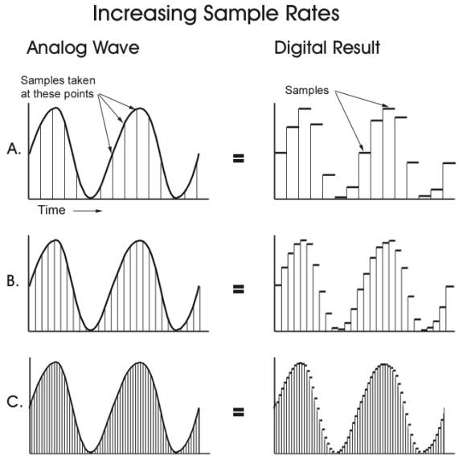
Two of the most important characteristics to consider during the selection process for analog-to-digital converters (ADCs) are the resolution and the sampling rate.
Sampling Rate
The sampling rate of an analog-to-digital converter (ADC) is the number of samples it takes per second to convert an analog signal to a digital signal. The sampling rate is measured in samples per second (sps) or Hertz (Hz), which are equivalent units.
Sample rate is the number of samples per second that are taken of a waveform to create a discete digital signal. The higher the sample rate, the more snapshots you capture of the audio signal. The audio sample rate is measured in kilohertz (kHz) and it determines the range of frequencies captured in digital audio.
The ADC’s sampling rate, also known as sampling frequency, can be tied to the ADC’s speed. The sampling rate is measured by using “samples per second”, where the units are in SPS or S/s (or if you’re using sampling frequency, it would be in Hz). This simply means how many samples or data points it takes within a second. The more samples the ADC takes, the higher frequencies it can handle.
What is the sampling rate of a 10 bit ADC?
Assuming the adc is putting out in digitally all the samples that is most do. So if 10 bits, then that would be 1250 kbit per second , or another way 1.25 Mbit per second, But it's still 125k samples per second.

Slide 13
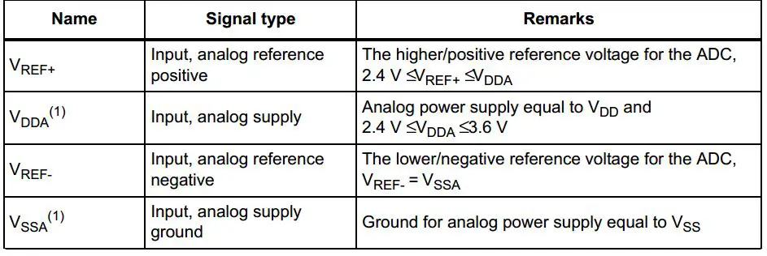
STM32 ADC Resolution
The STM32 ADC has a resolution of 12-bit which results in a total conversion time of SamplingTime+12.5 clock cycles. However, higher sampling rates can be achieved by sacrificing the high resolution. Therefore, the resolution can be dropped down to 10-bit, 8-bit, or 6-bit, and hence the conversion time is much shorter, and the sampling rate increases.
This can be configured and implemented in software by the programmer and the STM32 HAL does provide APIs to set all the ADC parameters including its resolution.
ADC Reference Voltage
The ADC reference voltage pins are defined in the datasheet and assumed to be connected to a voltage level in a certain range. This is shown in the table below. You can choose to set the reference voltage to its maximum allowable level for a wider range of conversion but less voltage measurement resolution. Alternatively, you can set the reference voltage to the minimum allowable value for better voltage reading resolution.

Slide 14
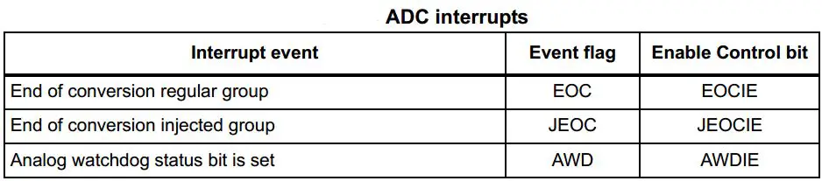
STM32 ADC Interrupts
An interrupt can be produced at the end of conversion for regular and injected groups and when the analog watchdog status bit is set. Separate interrupt enable bits are available for flexibility.

Slide 15
Reading ADC in STM32 (Poll, Interrupt, DMA)
There are mainly three different ways to read the STM32 ADC conversion result upon conversion completion.
1) STM32 ADC Polling
It’s the easiest way in code to perform an analog-to-digital conversion using the ADC on an analog input channel. However, it’s not an efficient way in all cases as it’s considered to be a blocking way of using the ADC. Because in this way we start the A/D conversion and wait for the ADC until it completes the conversion so the CPU can resume processing the main code.
2) STM32 ADC Interrupt
The interrupt method is an efficient way to do ADC conversion in a non-blocking manner, so the CPU can resume executing the main code routine until the ADC completes the conversion and fires an interrupt signal so the CPU can switch to the ISR context and save the conversion results for further processing.
However, when you’re dealing with multiple channels in a circular mode or so, you’ll have periodic interrupts from the ADC that are too much for the CPU to handle. This will introduce jitter injection, interrupt latency, and all sorts of timing issues to the system. This can be avoided by using DMA.
3) STM32 ADC DMA
Lastly, the DMA method is the most efficient way of converting multiple ADC channels at very high rates and still transfers the results to the memory without CPU intervention which is so cool and time-saving technique.
Direct Memory Access (DMA) offloads the CPU by automatically moving conversion results from the ADC Data Register into a designated RAM buffer. Once configured, the ADC triggers the DMA after every conversion, leaving the CPU free to perform other tasks while data continuously accumulates.

Slide 16
The ADC Registers
There are several registers associated with each ADC unit. At first you may feel like getting lost in an ocean of 32-bit registers. However things aren’t so.
Of these there are two ADC control registers called ADC_CR1 and ADC_CR2 that set ADC properties and mode of operation.
There’s a status register, ADC_SR which flags important ADC events like end of a conversion, etc. These are the most important ones.
The next set of registers are responsible for specifying channel sequence, sequence length, sampling times, offset and holding ADC conversion results.
ADC_SQRx registers specify channel sequences. There are three of these registers and of them ADC_SQR1 also specifies the number of channels in a regular sequence. ADC_SQR3 through ADC_SQR1 are sequentially feed with channel numbers according to position in a given sequence.
ADC_SMPR1 and ADC_SMPR2 registers specify the sampling times of each channel. The sampling time is common to both regular and injected groups. ADC_LTR and ADC_HTR registers hold the lower and upper analogue watchdog ADC count limits respectively. Again these are common for both groups.
Lastly the ADC_DR and ADC_JDRx registers hold ADC conversion results for regular and injected groups respectively. ADC_DR is common for all regular group channels.

Slide 17
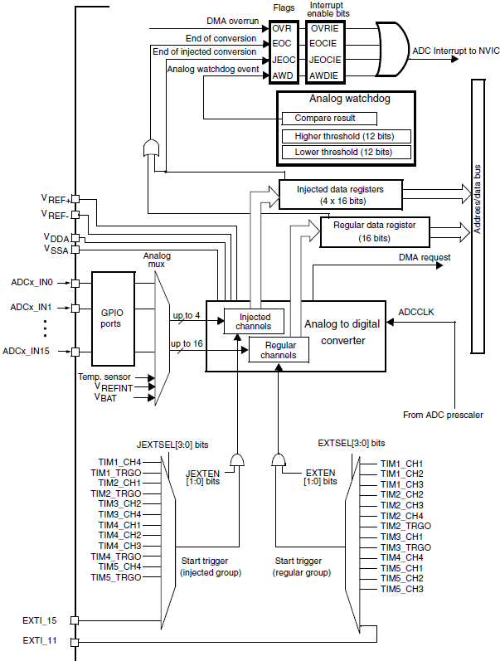
Single ADC block diagram
The ADC has 16 external channels (ADCx_IN0 to ADCx_IN15) and multiple internal channels, such as temperature sensors and reference voltages.
These inputs are connected to a multiplexer that selects which channel to sample during the conversion cycle.
The channel is selected by programming the ADC_SQRx registers.

Slide 18
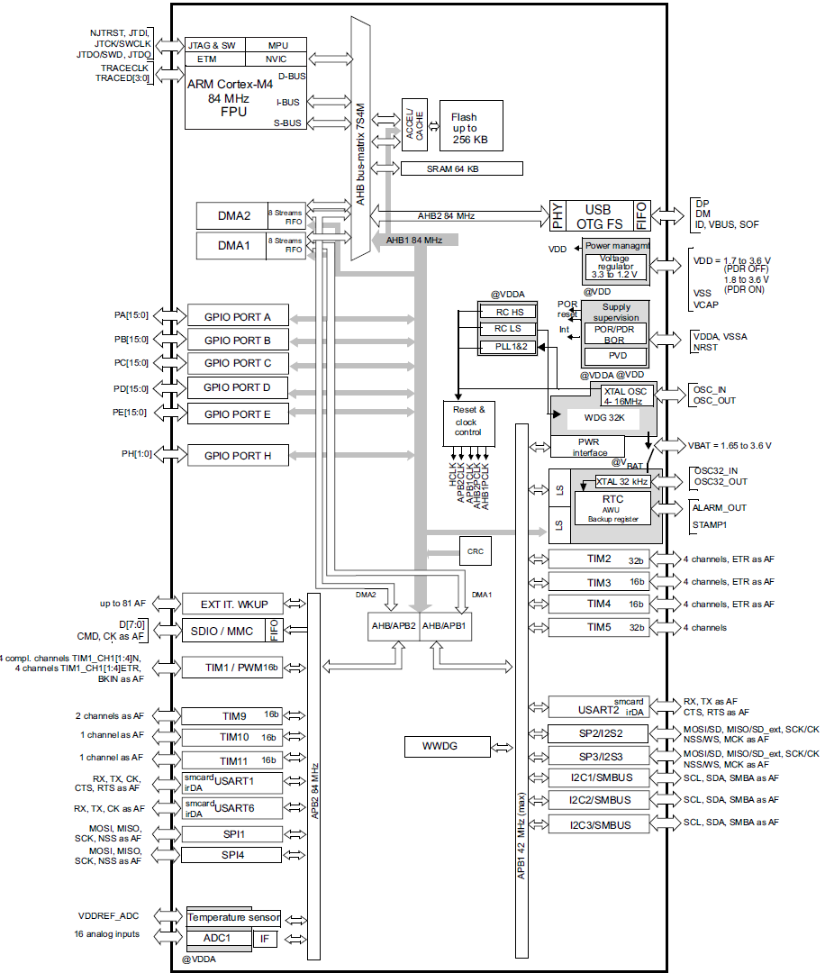
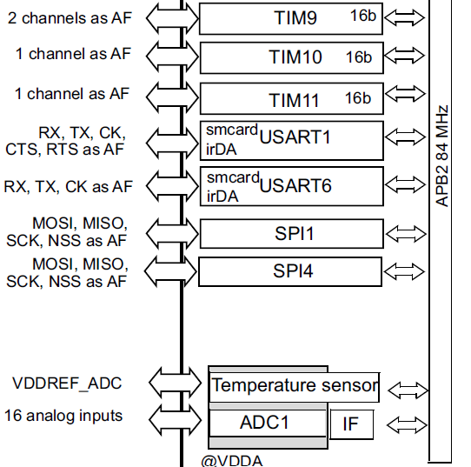
ADC Block Diagram

Slide 19
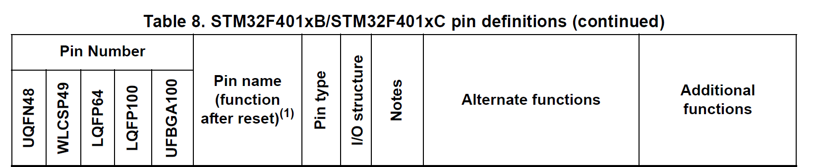
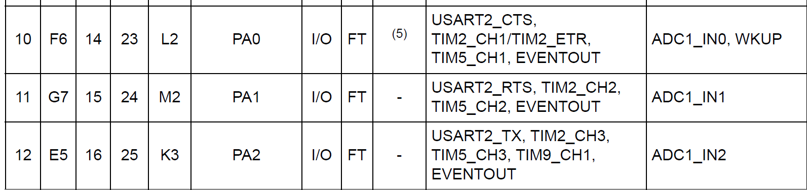
In our STM board, Potentiometer is connected with PA0 and LDR is connected with PA1

Slide 20
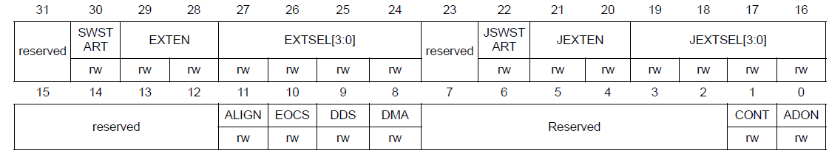
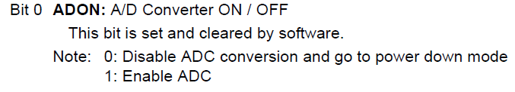
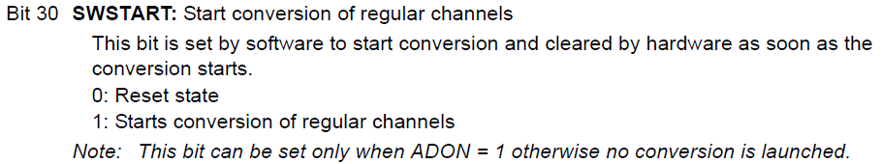
ADC on-off control (in ADC_CR2 register)
The ADC is powered on by setting the ADON bit in the ADC_CR2 register.
When the ADON bit is set for the first time, it wakes up the ADC from the Power-down mode.
Conversion starts when either the SWSTART or the JSWSTART bit is set.
You can stop conversion and put the ADC in power down mode by clearing the ADON bit.
Bit 1 CONT : Continuous conversion
This bit is set and cleared by software.
0: Single conversion mode
1: Continuous conversion mode

Slide 21
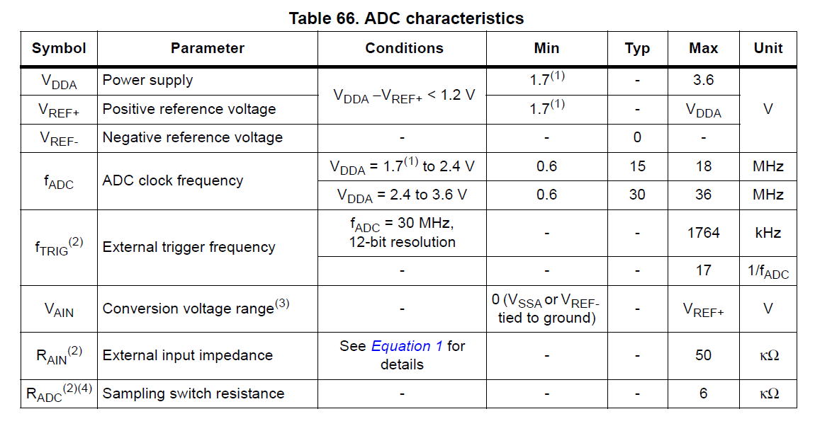
ADC clock
The maximum ADC clock frequency is 36 MHz for accurate conversions.
When configuring the clock, always ensure that the ADC clock (after prescaling) does not exceed this maximum frequency to avoid erroneous readings.

Slide 22
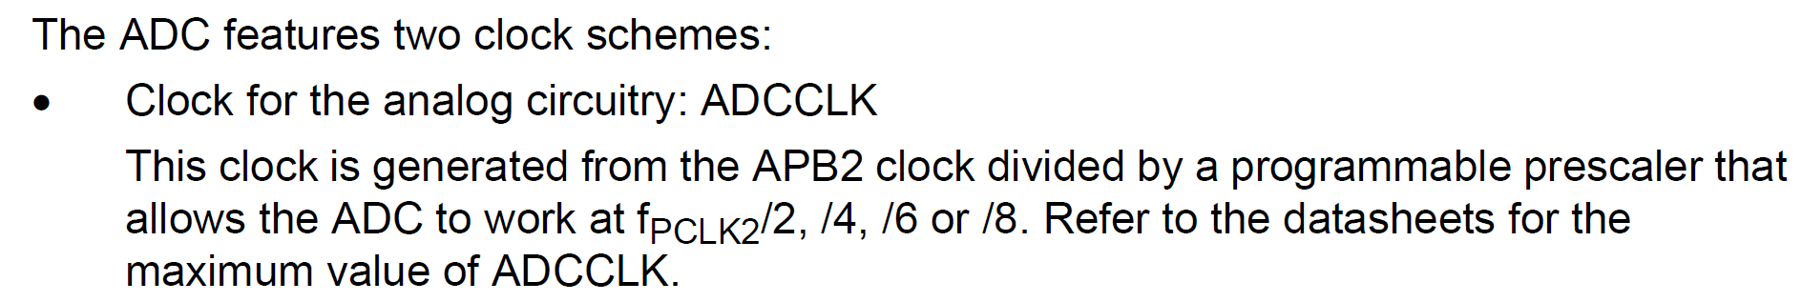
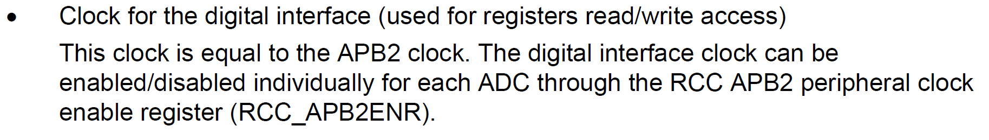
ADC clock Cont.
The maximum ADC clock frequency is 36 MHz for accurate conversions.
When configuring the clock, always ensure that the ADC clock (after prescaling) does not exceed this maximum frequency to avoid erroneous readings.

Slide 23
An ADC prescaler is a circuit that divides down the system clock frequency to generate a slower clock signal specifically for the Analog-to-Digital Converter (ADC).
This is necessary because the ADC often requires a clock frequency lower than the system's main clock speed to operate accurately, especially when achieving maximum resolution.
Clock Speed and Resolution:
ADCs have an optimal clock speed range for their specified resolution. If the clock is too fast, the ADC might not be able to accurately convert the analog input signal, leading to errors or reduced resolution.
Prescaling:
The prescaler acts as a divider. For example, if the system clock is 84 MHz and the prescaler is set to divide by 4, the ADC would receive a clock signal of 21 MHz.
Why use a prescaler?
Without a prescaler, the ADC might not be able to accurately convert the input signal, especially when using a high-frequency system clock.

Slide 24
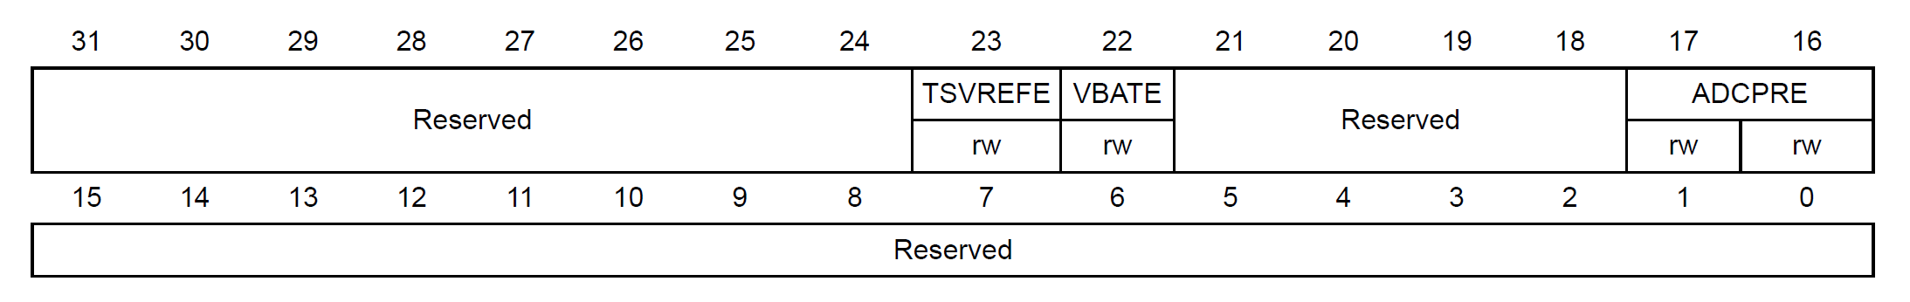
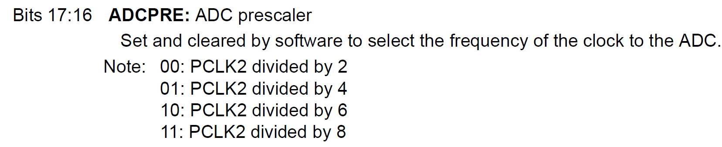
ADC clock Cont.
ADC common control register (ADC_CCR)

Slide 25
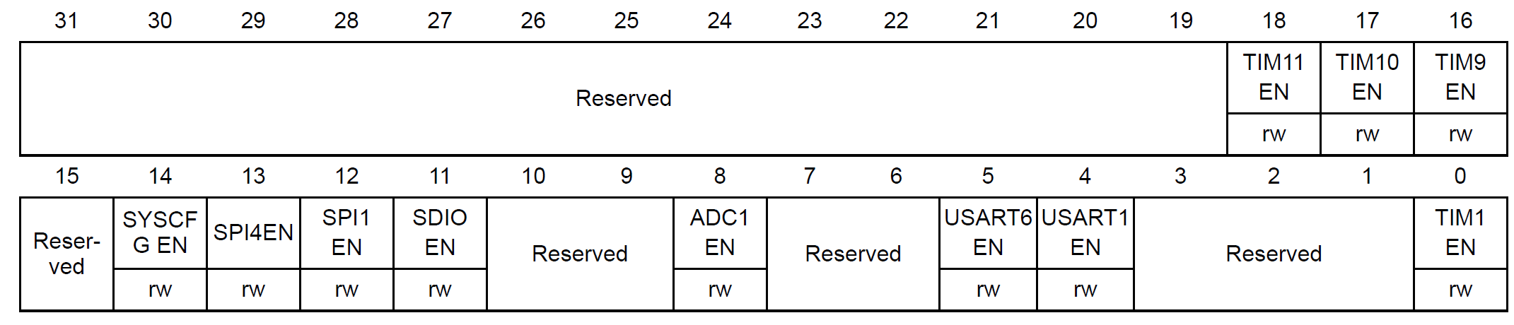
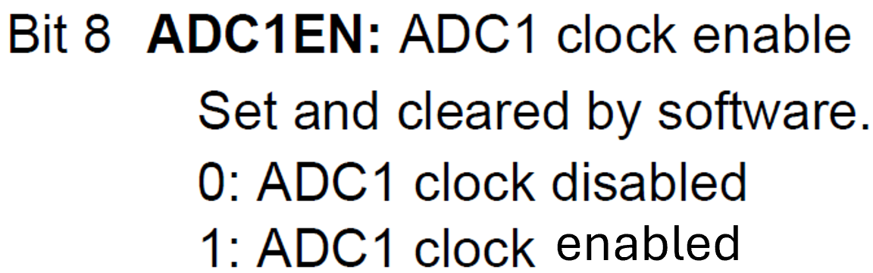
ADC clock Cont.
RCC APB2 peripheral clock enable register(RCC_APB2ENR)

Slide 26
Channel selection
There are 16 multiplexed channels. It is possible to organize the conversions in two groups: regular and injected.
A group consists of a sequence of conversions that can be done on any channel and in any order.
For instance, it is possible to implement the conversion sequence in the following order: ADC_IN3, ADC_IN8, ADC_IN2, ADC_IN2, ADC_IN0, ADC_IN2, ADC_IN2, ADC_IN15.
A regular group is composed of up to 16 conversions.
The regular channels and their order in the conversion sequence must be selected in the ADC_SQRx registers.
The total number of conversions in the regular group must be written in the L[3:0] bits in the ADC_SQR1 register.

Slide 27
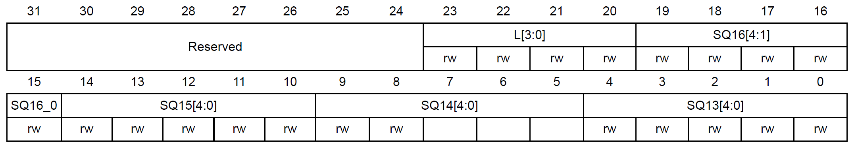
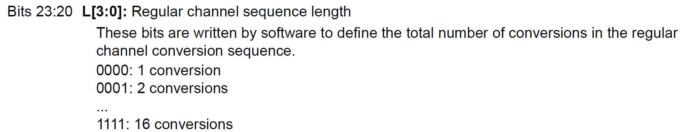
ADC regular sequence register 1 (ADC_SQR1)
In the STM32 ADC_SQR1 register, the L bit tells the ADC how many input channels to convert. The value in L is one less than the channel count. For example, if you're converting only one channel, you would set L to zero and to convert two channels, you would set the value to 1 for nChannels.
The ADC sequencer allows you to configure a sequence of up to 16 channels in different orders and with different sampling times. The regular channels and their order in the conversion sequence are selected in the ADC_SQRx registers.

Slide 28
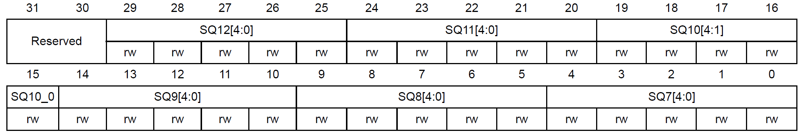
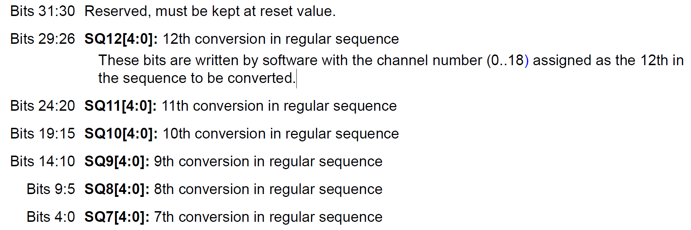
ADC regular sequence register 2 (ADC_SQR2)

Slide 29
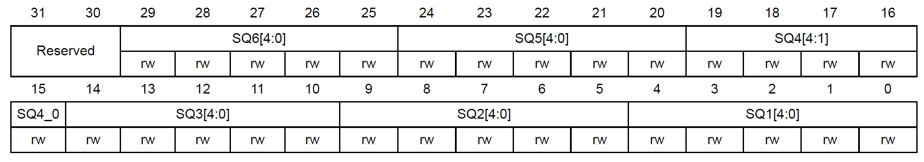
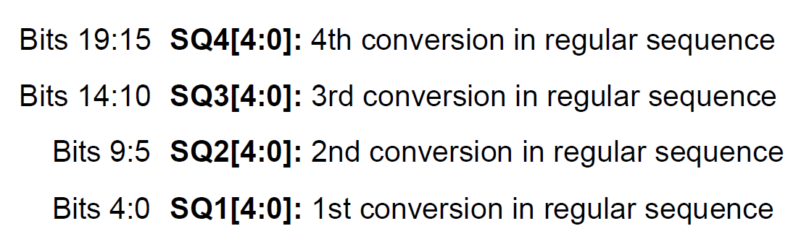
ADC regular sequence register 3 (ADC_SQR3)
We have to mention the channel number in the 1st, 2nd … conversions to specify the order of channels to be processed

Slide 30
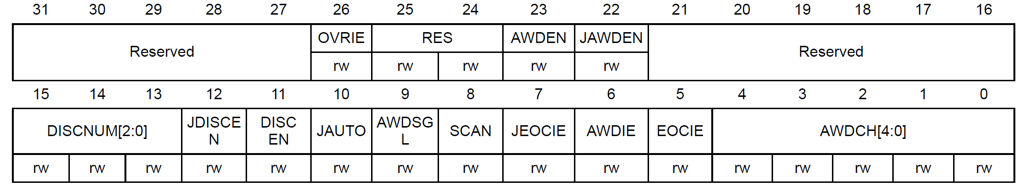
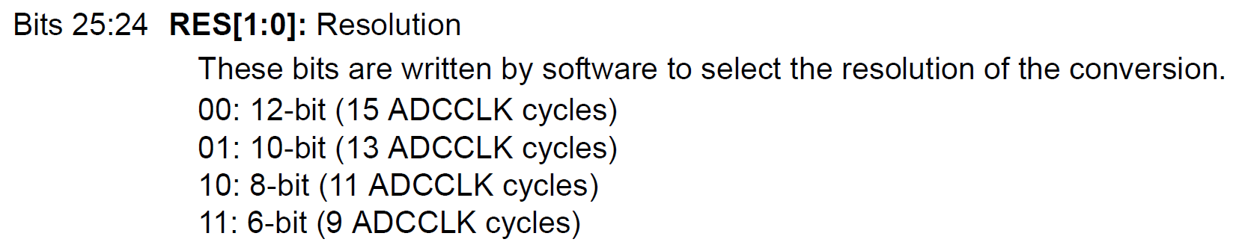
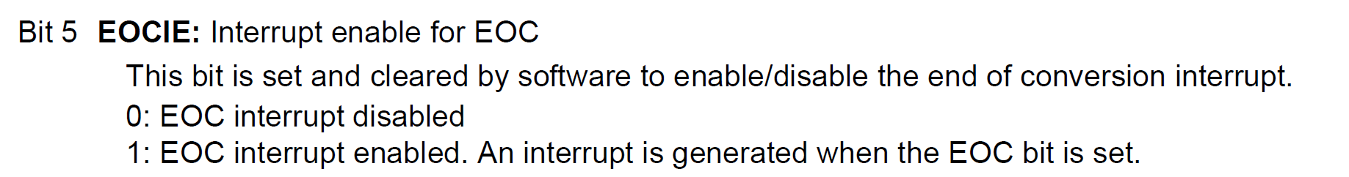
ADC control register 1 (ADC_CR1)
For 12-bit ADC, One clock cycle for each bit so as 12 cycles + sampling time ( 000 – 3 cycles in SMPR2 register) = 15 cycles

Slide 31
The ADC (Analog-to-Digital Converter) needs to sample the input voltage for a certain duration to charge an internal capacitor, which is then used for the conversion.
The sampling time, controlled by the SMPR register, directly impacts the accuracy and speed of the ADC conversion.
The ADC_SMPR register in STM32 microcontrollers is used to set the sampling time for each ADC channel.
The sampling time determines how long the ADC samples the analog input voltage before converting it to a digital value.
By configuring the SMPR register, you can adjust the conversion time and potentially improve accuracy or reduce noise.
Bits and Channels:
The SMPR register typically contains multiple bits (e.g., SMP[2:0]) for each ADC channel. These bits allow you to select different sampling time durations for each channel, enabling you to optimize the ADC performance based on the characteristics of each input signal.
Trade-offs:
Longer sampling times generally lead to more accurate conversions as the capacitor has more time to charge, but it also increases the overall conversion time, potentially affecting the ADC's throughput. Conversely, shorter sampling times result in faster conversions but may introduce noise or inaccuracies if the input signal is noisy or changes rapidly.

Slide 32
If you are measuring a slowly varying analog signal, you might choose a longer sampling time to ensure accurate readings.
For a fast-changing signal, a shorter sampling time might be necessary to capture the changes quickly, even if it means accepting a slight reduction in accuracy.

Slide 33
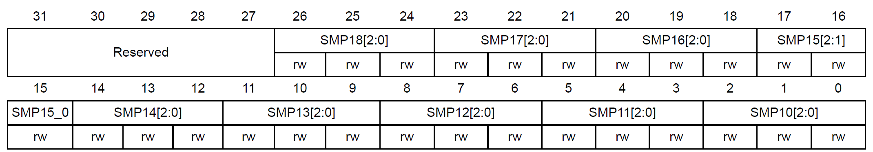
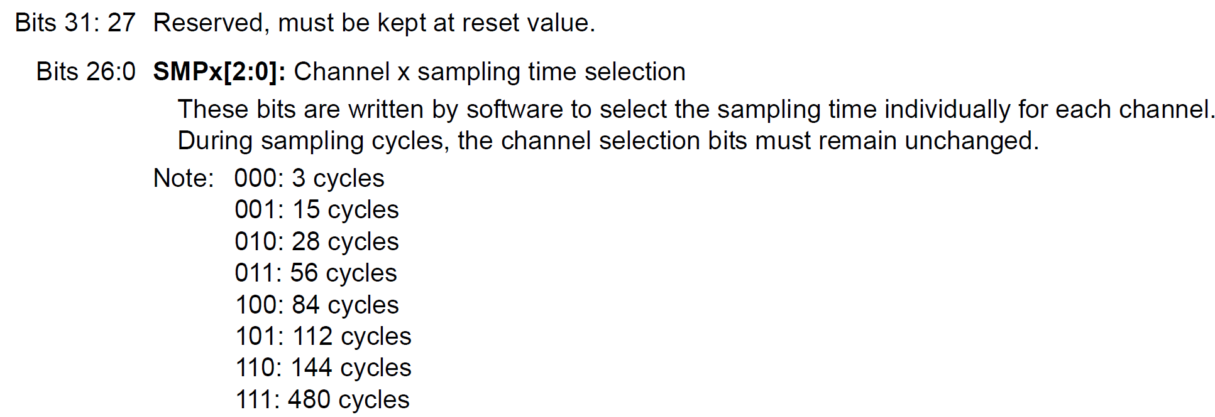
ADC sample time register 1 (ADC_SMPR1)
SMP18 for channel 18, …., SMP10 for channel 10

Slide 34
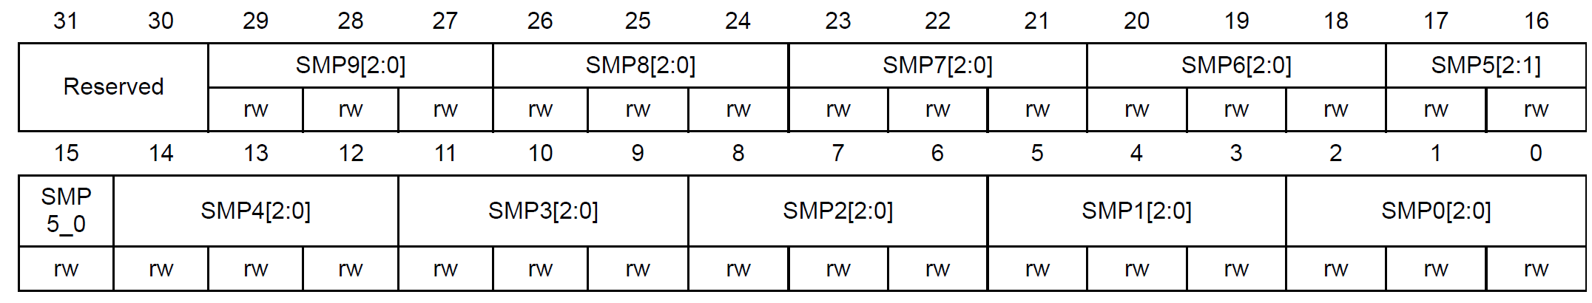
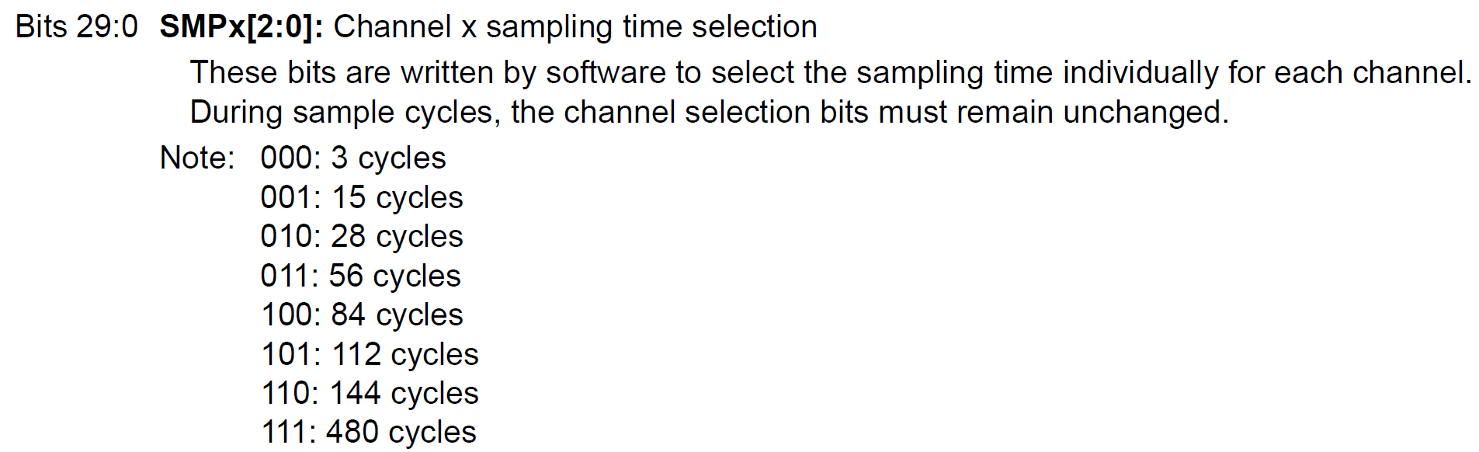
ADC sample time register 2 (ADC_SMPR2)
SMP9 for channel 9, …., SMP0 for channel 0

Slide 35
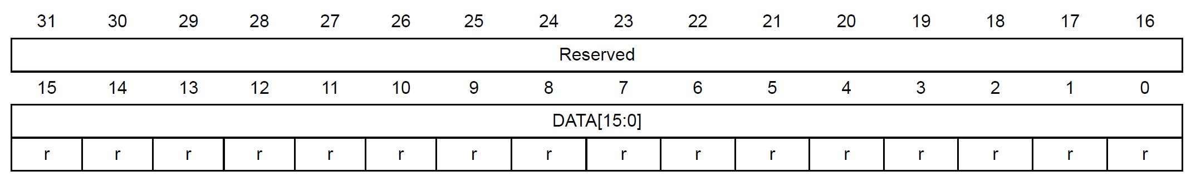
ADC regular data register (ADC_DR)
Bits 15:0 DATA[15:0]: Regular data
These bits are read-only.
They contain the conversion result from the regular channels.

Slide 36
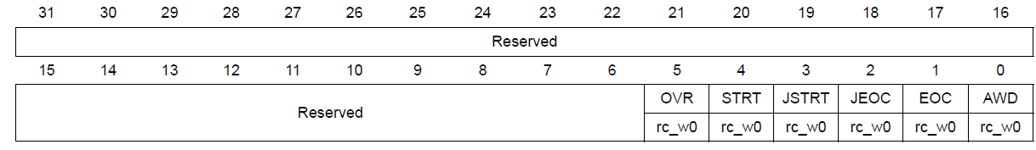
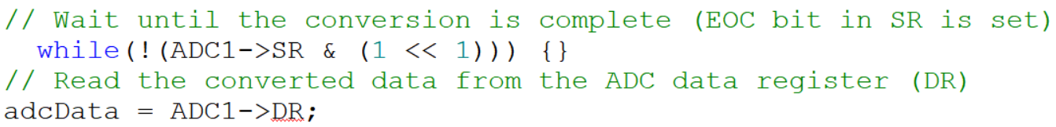
ADC status register (ADC_SR)
Bit 1 EOC: Regular channel end of conversion
This bit is set by hardware at the end of the conversion of a regular group of channels. It is cleared by software or by reading the ADC_DR register.
0: Conversion not complete or sequence of conversions not complete
1: Conversion complete or sequence of conversions complete

Slide 37
The ADC resolution can be defined as the smallest input voltage at the analog pin that an ADC can identify and increments its digital value.
The maximum and minimum digital output value of ADC depends on the number of bits of the ADC.
For example, for a 8-bit ADC, the digital output value will be between 0-255, for a 10-bit ADC, the digital output value will be between 0-1023 and for a 12-bit ADC, the digital output value will be between 0-4095.
ADC Resolution
Resolution = (Operating voltage of ADC ) / 2^(number of bits ADC)
The operating voltage of STM32F401 series microcontroller is 3.3V and if we configure the ADC in 12-bit mode:
Resolution = 3.3V/2^12 = 3.3/4095 = 0.8mV
Therefore, for every 0.8mV on ADC input, the digital value will increment and if we apply 3.3V to the input pin of ADC, the digital output value of ADC will be 4095.
Similarly, if we measured a digital value of ADC with an STM32F401 microcontroller, we can convert it back into a voltage by multiplying it with the resolution value.
For example, the measured digital output value is 3500, we can convert it into a voltage by multiplying it by 0.8mV.
Input Voltage = 3500 x 0.8mV = 2800mV or 2.8V
ADC resolution can be defined as :

Slide 38
Interfacing a Potentiometer with STM32F401 ADC on PA0 (Channel 0)
Experiment 4.1

Slide 39
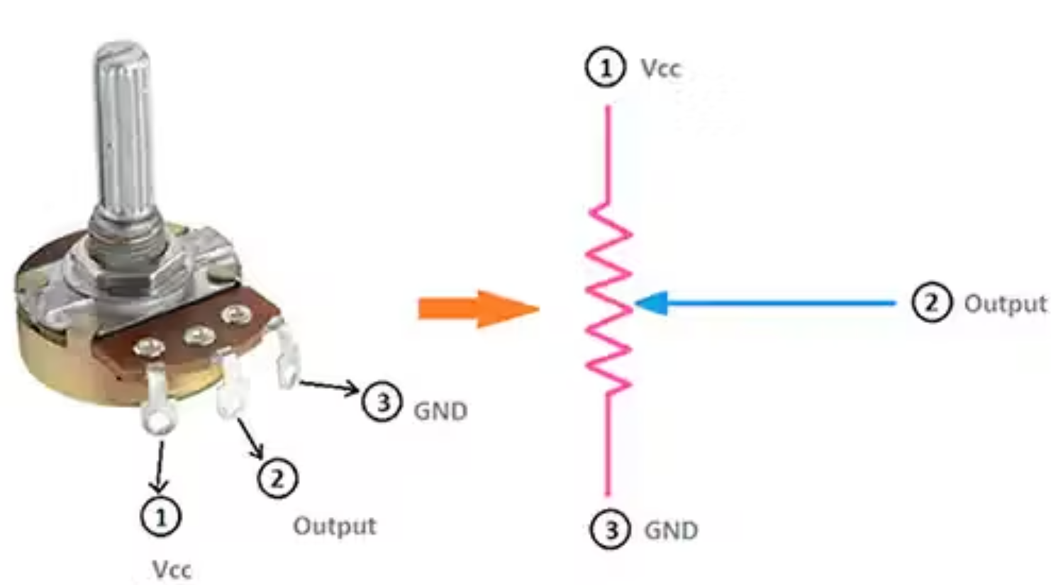
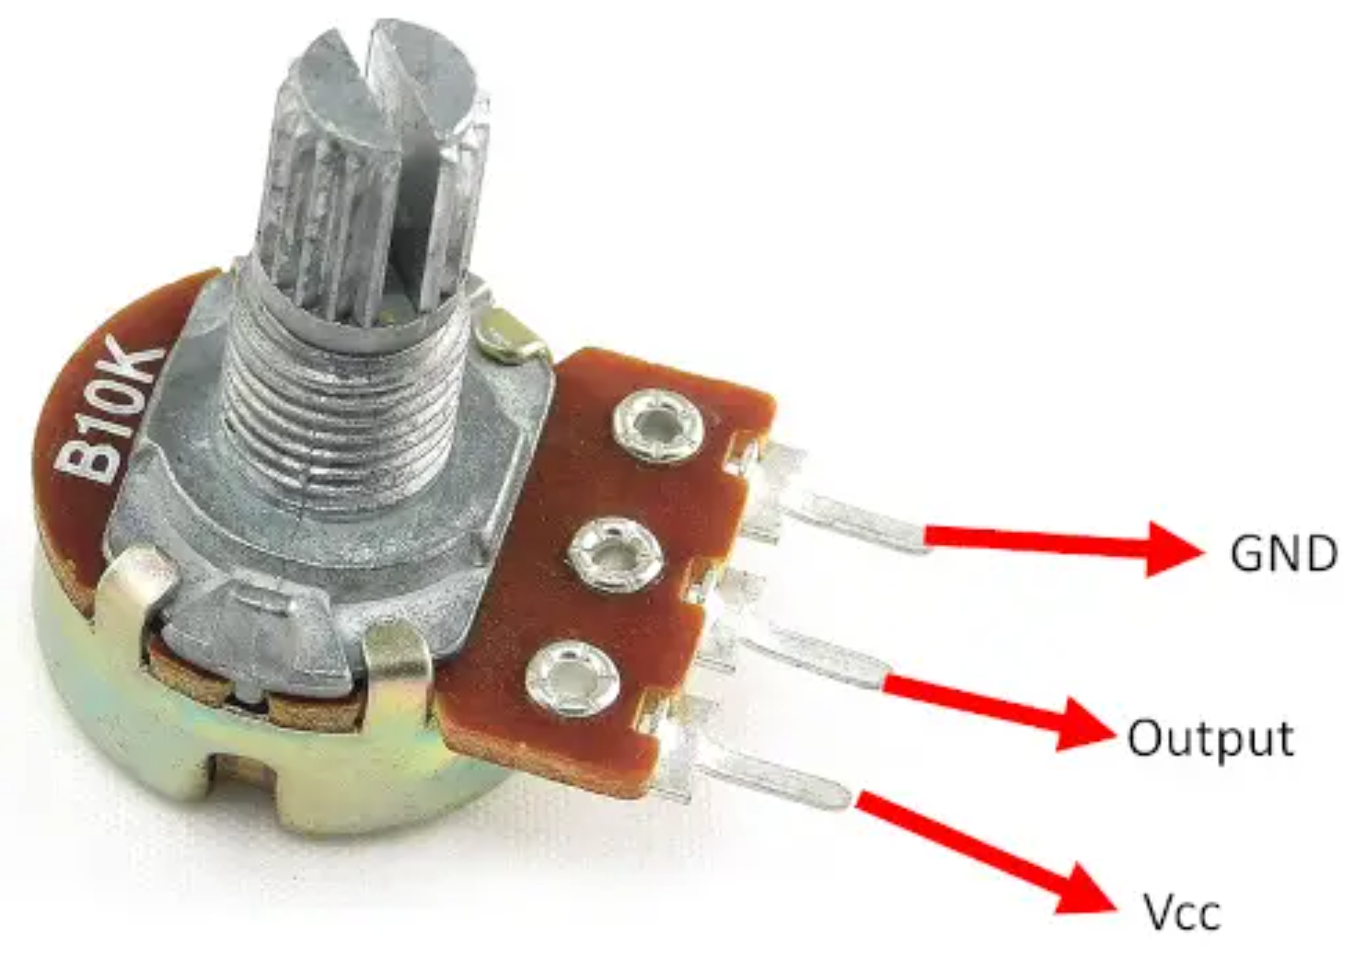
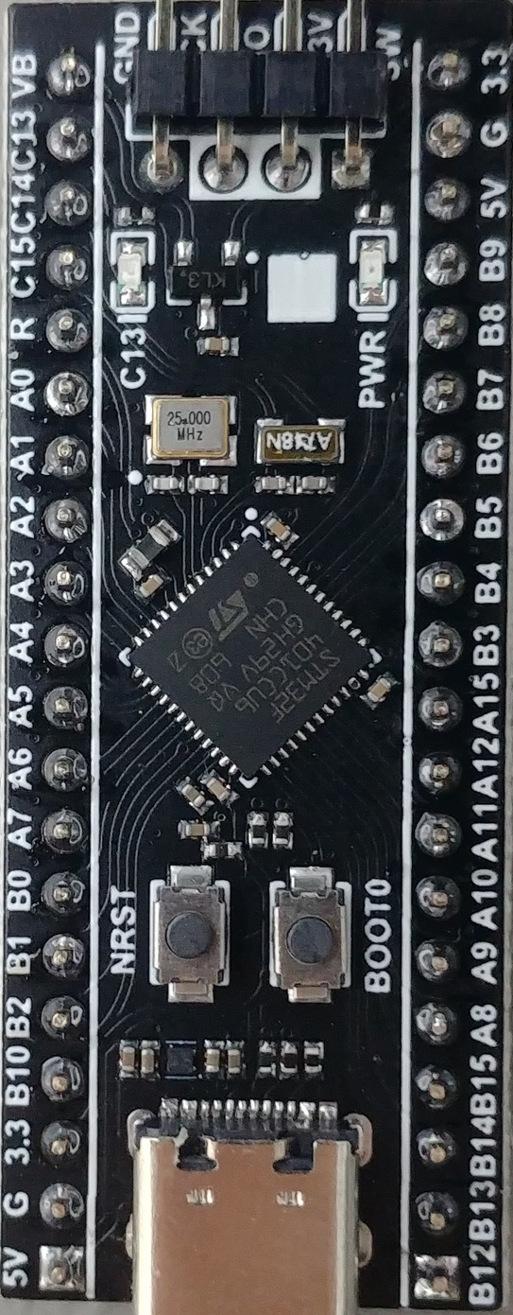
Experiment 4.1
The potentiometer is basically a variable resistor.
It has a total of 3 Terminals, where the outermost terminals need to be connected to VCC and GND, and the terminal in the middle will give us our analog output.
It consists of a knob that is turned to control the resistance value of the potentiometer, this value of resistance will, in turn, affect the voltage drop across it, and that voltage will act as our analog value which needs to be converted into a digital form.

Slide 40
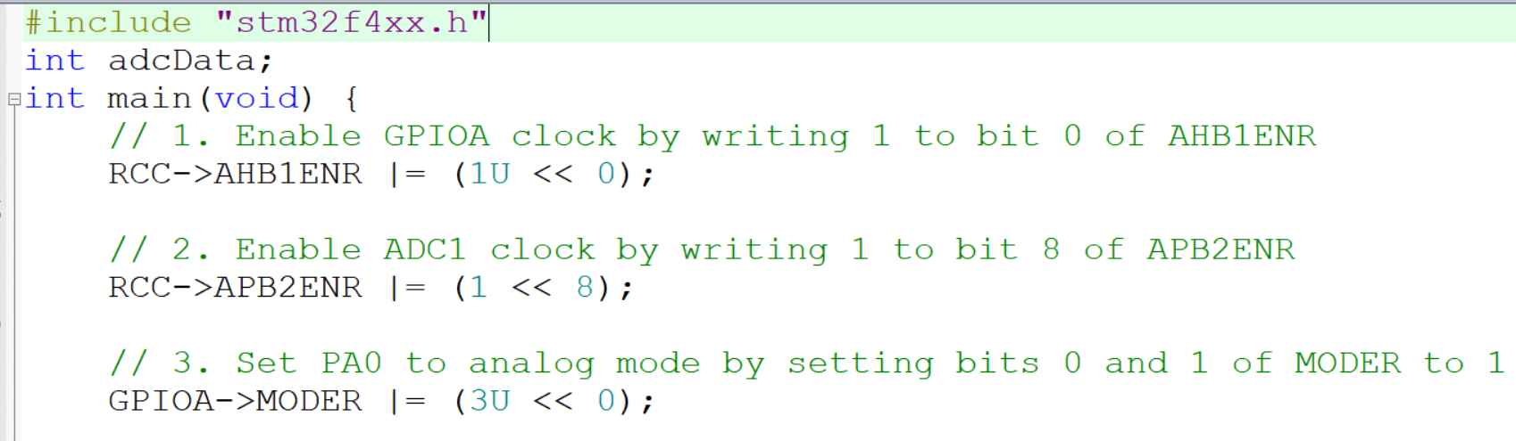
Interfacing a Potentiometer with STM32F401 ADC on PA0 (Channel 0)

Slide 41
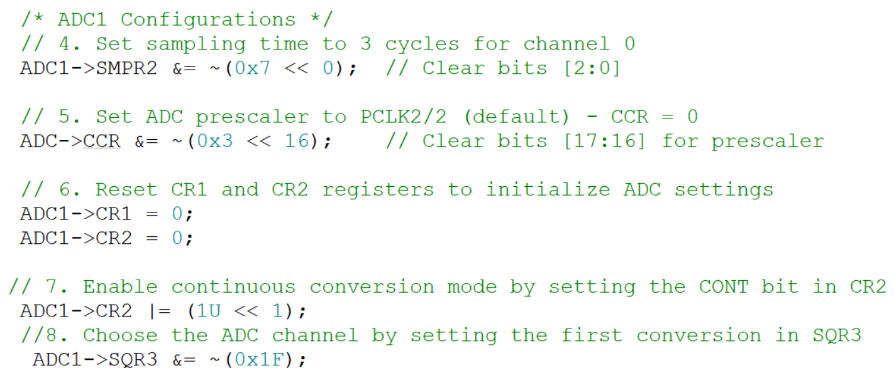
Interfacing a Potentiometer with STM32F401 ADC on PA0 (Channel 0)

Slide 42
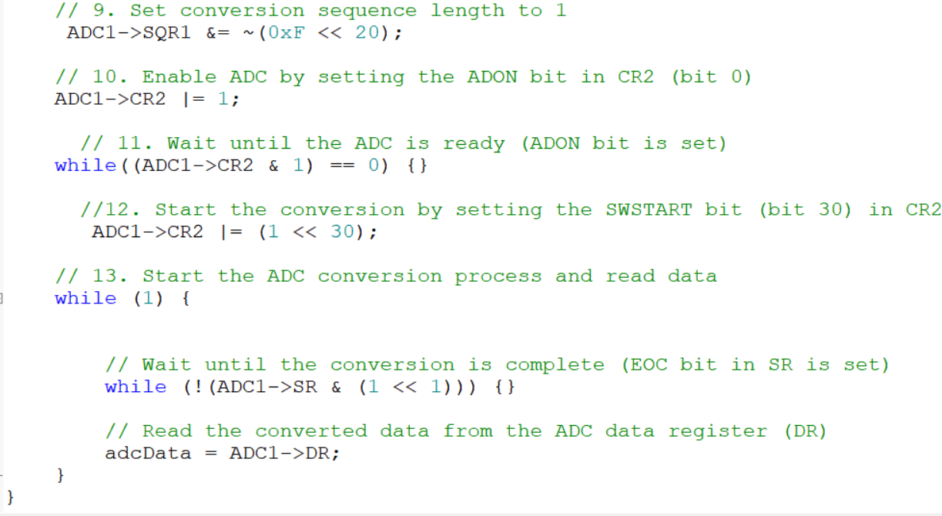
Interfacing a Potentiometer with STM32F401 ADC on PA0 (Channel 0)

Slide 43
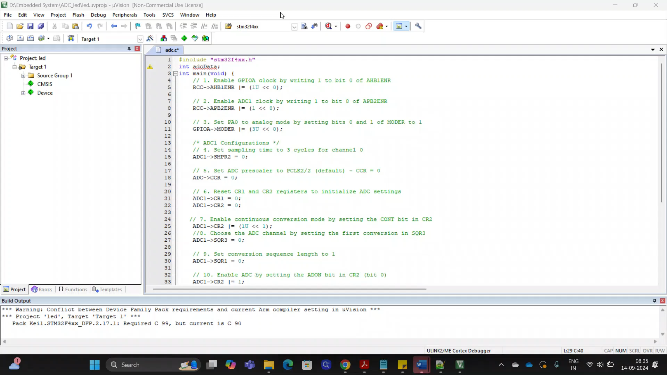
Interfacing a Potentiometer with STM32F401 ADC on PA0 (Channel 0)
Reading the ADC value
Video

Slide 44
Interfacing a Potentiometer with STM32F401 ADC on PA0 (Channel 0) and Control the LED on PC14
Experiment 4.2

Slide 45
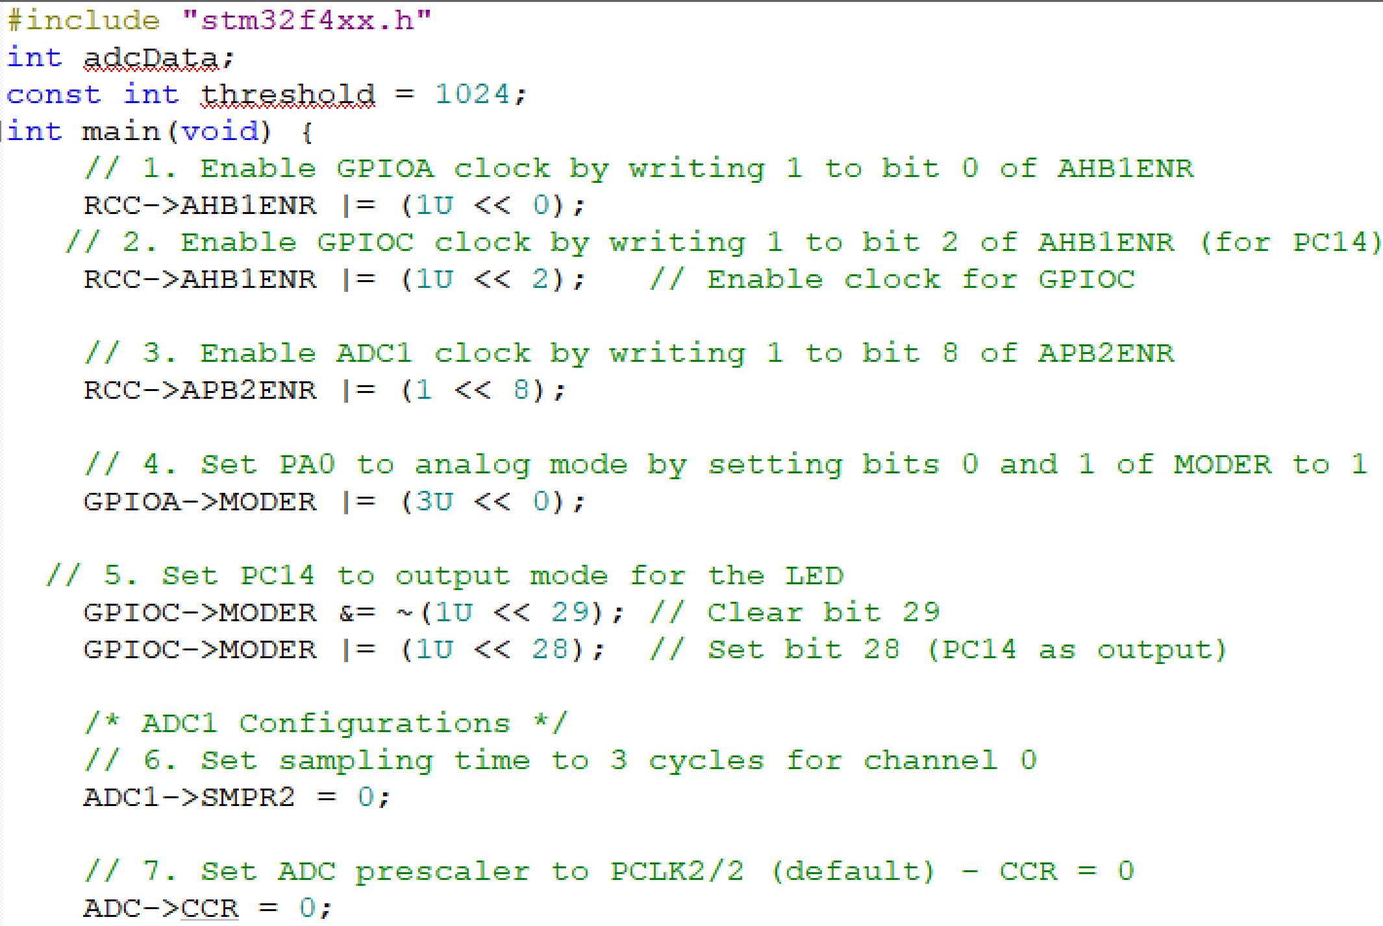
Experiment 4.2

Slide 46
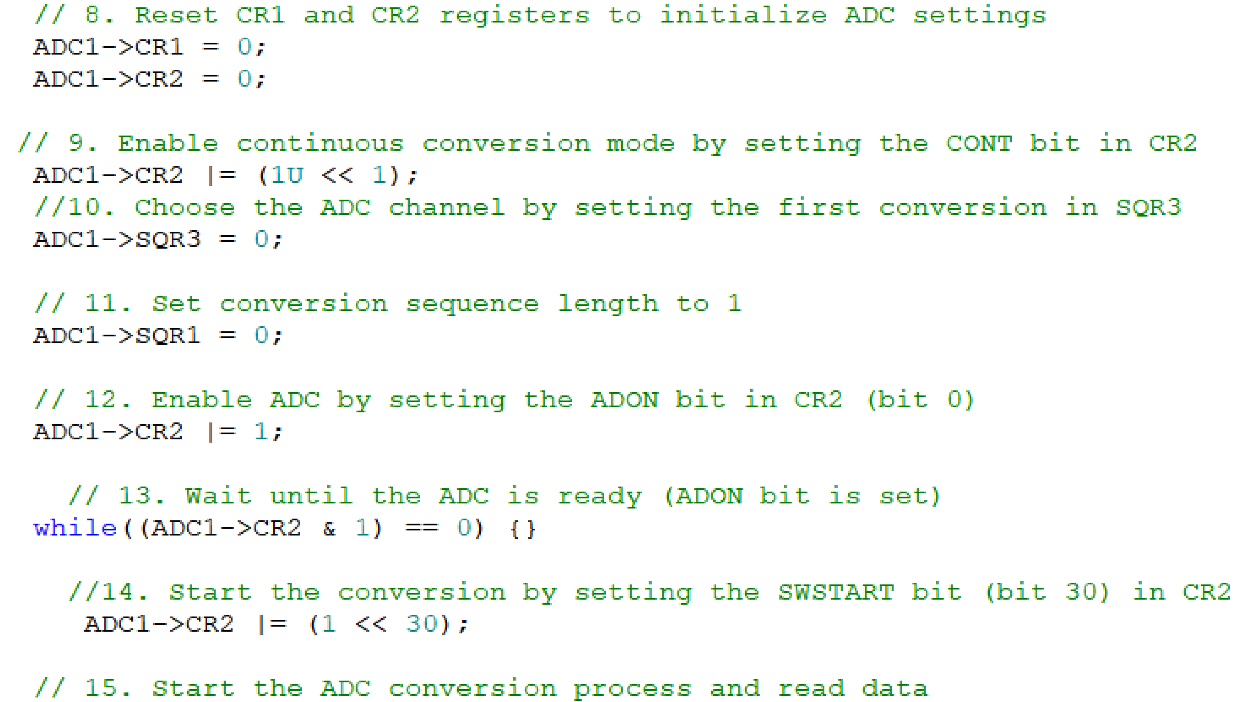
Experiment 4.2

Slide 47
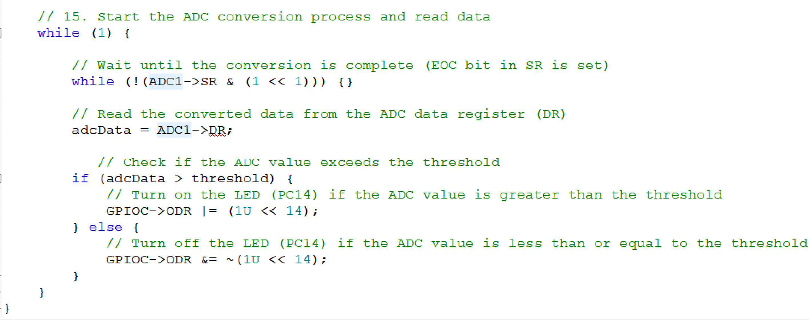
Experiment 4.2

Slide 48
Interfacing a LDR (Light Dependent Resistor) with STM32F401 ADC on PA1 (Channel 1) and Control the LED on PC14
Experiment 4.3

Slide 49
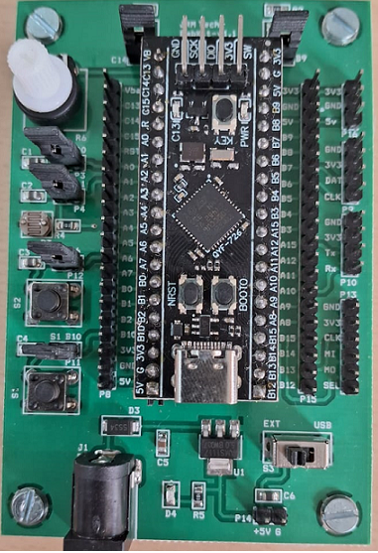
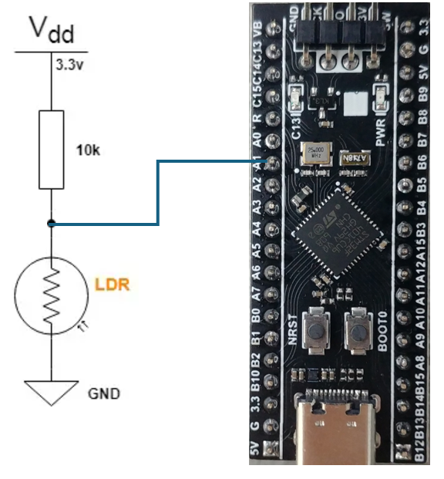
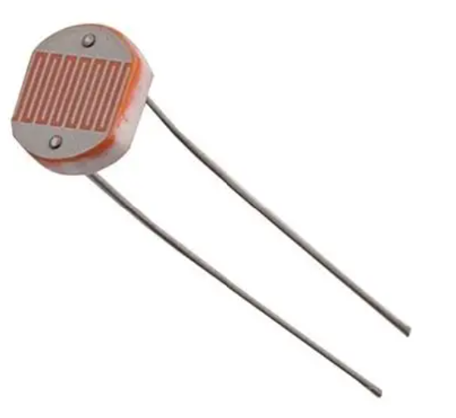
Experiment 4.3
Jumper to PA1
LDR
LDR
An LDR is a light-dependent resistor, it’s an electronic device that is being used for light intensity sensing applications.
The LDR has a relatively low resistance in light, and when the surrounding gets darker the LDR’s resistance significantly increases.
Hence, we can make a voltage divider circuit using the LDR and a fixed resistor and use the microcontroller’s ADC to measure the voltage which indicates the resistance value or the light intensity level.

Slide 50
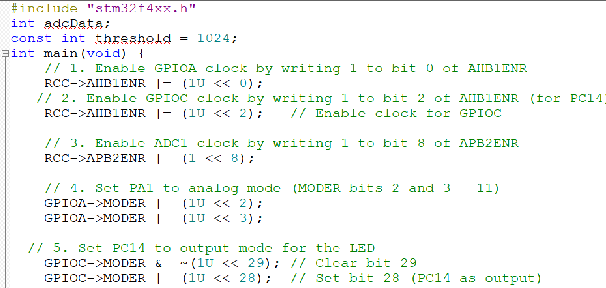
Interfacing a LDR with STM32F401 ADC on PA1 (Channel 1)

Slide 51

Interfacing a LDR with STM32F401 ADC on PA1 (Channel 1)

Slide 52

Interfacing a LDR with STM32F401 ADC on PA1 (Channel 1)

Slide 53
Thank You

