Slide 1
Analog-to-Digital Converter (ADC)

Slide 2
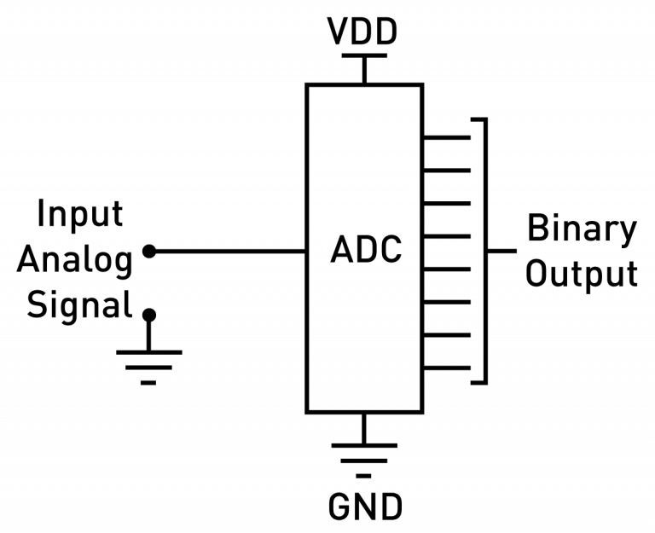
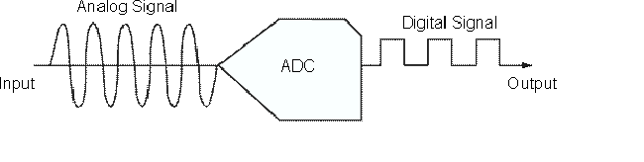
What is ADC?
An analog-to-digital converter (ADC) is a peripheral that converts a continuous analog voltage to a discrete digital number.
It is impossible for the microcontroller to directly understand these analog signals because microcontrollers only understand digital signals formed by 1’s and 0’s

Slide 3
How ADC Works – Step-by-Step
Step 1. Sampling
Sampling is the process of measuring the amplitude of an analog signal at regular time intervals to convert it into a digital form.
It is the first step in the analog-to-digital conversion process.
Sampling is the act of capturing the value of a changing analog signal at fixed time intervals to begin converting it into a digital format.

Slide 4
Cont…
Step 2: Quantization
Quantization is the process of mapping a continuous range of analog signal amplitudes into a finite set of discrete digital levels.
Digital systems can only store numbers in fixed steps depending on the ADC's resolution (in bits).
Quantization rounds each sampled value to the nearest available digital level.
ADC resolution refers to the number of distinct digital values (or steps) an Analog-to-Digital Converter (ADC) can produce to represent an analog input signal.
It is expressed in bits, and it determines how precisely the analog input can be converted into digital form.

Slide 5
Cont…
The resolution determines the minimum change in the analog input voltage that makes the output change by one count
Resolution determines the precision of a measurement
Resolution | Ideal Dynamic range | Minimum Voltage Increment
8 Bit | 256:1 | 3.92 mV
10 Bit | 1024:1 | 0.98 mV
12 Bit | 4096:1 | 0.244 mV
14 Bit | 16384:1 | 61 µV
16 Bit | 65536:1 | 15 µV

Slide 6
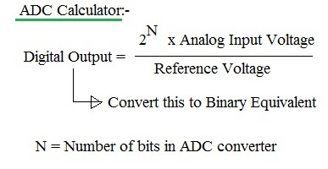
Cont…

Slide 7
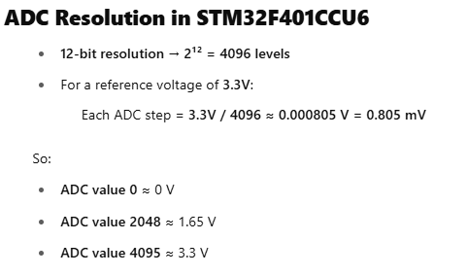
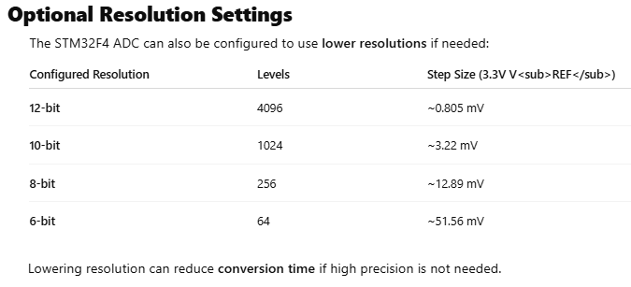
Cont…
Note: Can be configured to lower resolutions (10, 8, 6 bits) if needed

Slide 8
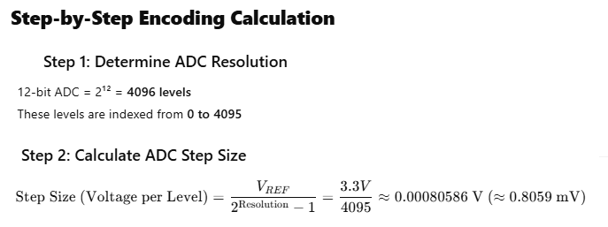
Cont…
Step 3:Encoding
Encoding is the final step in the Analog-to-Digital Conversion (ADC) process, where the quantized analog value is converted into a binary number that digital systems (like microcontrollers or computers) can understand and store.

Slide 9
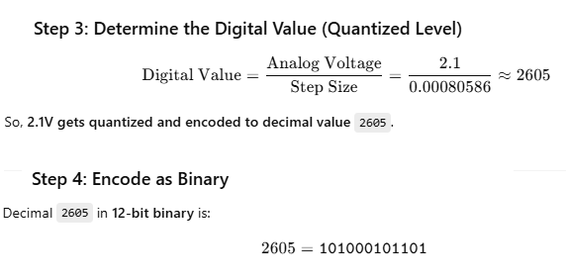
Cont…

Slide 10
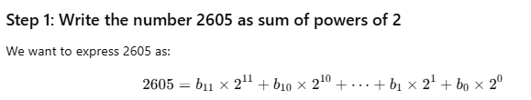
Cont…

Slide 11
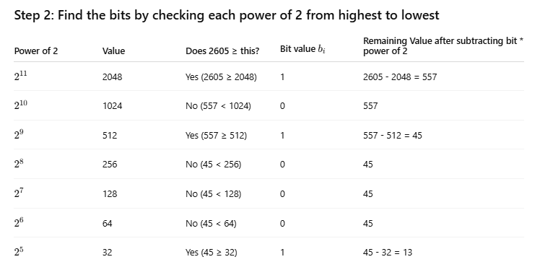
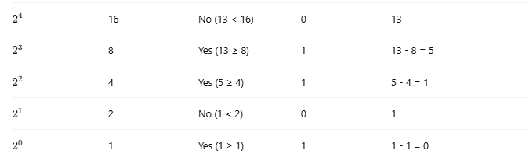
Cont…
Each bit corresponds to a power of 2.
If your number is ≥ that power of 2, assign the bit = 1 and subtract the power of 2.
Else, assign the bit = 0.
Repeat for all bits from highest power to lowest.
Finally, write the bits together to get the binary number.

Slide 12
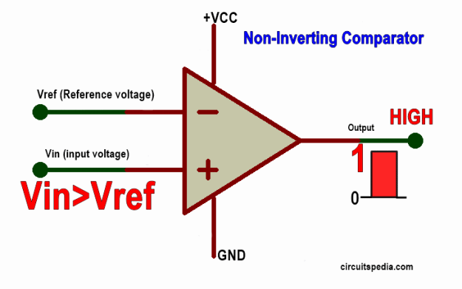
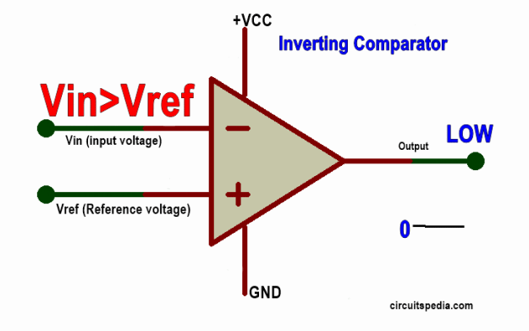
Voltage comparator circuit.
A comparator is a circuit that compares two input voltages or currents and gives output High or Low as per the input signal.
Basically, a comparator is used in electronics to compare the two Analog input signals given on both input terminals, and we get the Digital output as High level or Low level.

Slide 13
Types of ADCs
Flash ADC (Parallel Comparator ADC)
A Flash ADC (Analog-to-Digital Converter), also known as a parallel ADC, is a type of analog-to-digital converter that converts an analog input signal into a digital output very quickly.
Key Characteristics:
  Very fast: Flash ADCs are the fastest type of ADCs.
  Uses comparators: It employs a large number of comparators to compare the input signal with reference voltages.
  Parallel operation: All comparisons happen simultaneously, which allows for high-speed conversion.

Slide 14
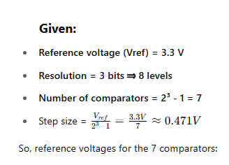
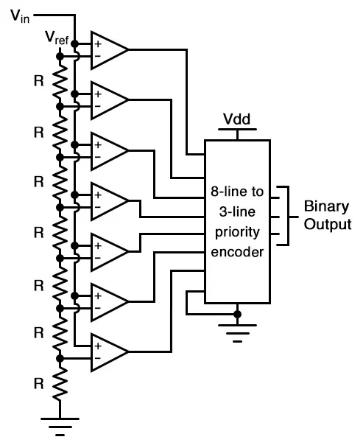
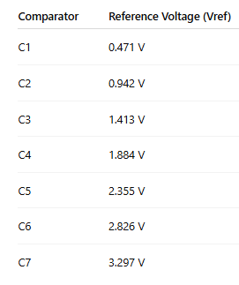
Cont… (Flash ADC : 3-bit flash ADC circuit)

Slide 15
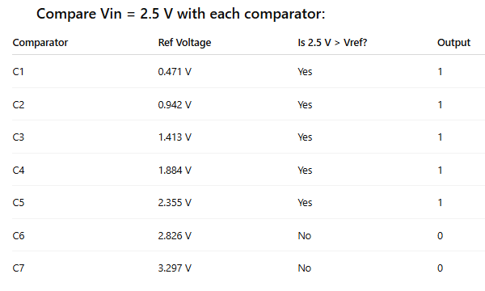

Cont… (Flash ADC : 3-bit flash ADC circuit)

Slide 16
Encoding
The thermometer code 1111100 corresponds to the level index 5 (count of ones = 5),
so the digital binary output is:
Binary: 101 (which is decimal 5)
Result & error
Digital output = 101 (5)
Quantized voltage = 5.0 V
Quantization error = Vin − 5.0 = 0.2 V

Slide 17
Cont…
Successive Approximation Register (SAR) ADC
A Successive Approximation Register (SAR) ADC is a type of analog-to-digital converter that converts an analog input signal into a digital output by iteratively approximating the signal one bit at a time using a binary search algorithm.
SAR ADC works by guessing each bit of the digital output starting from the most significant bit (MSB) down to the least significant bit (LSB), adjusting each guess based on comparisons with the analog input.

Slide 18
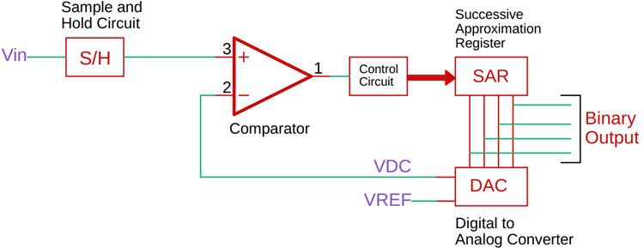
Cont… (SAR)
4-bit ADC examples

Slide 19
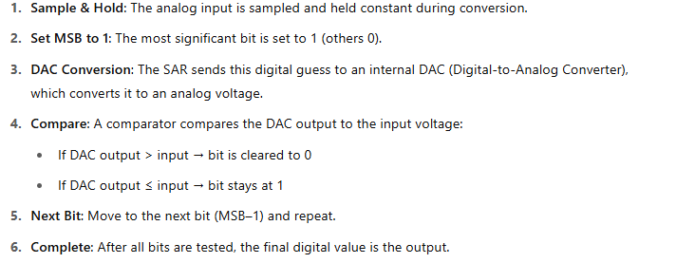
Cont…(SAR)
How It Works: Step-by-Step

Slide 20

Example Problem
We have:
Reference Voltage (Vref) = 8 V
Number of bits = 3 bits
Input voltage (Vin) = 5.2 V
ADC type: Successive Approximation ADC (SAR-ADC)
Step 1 – Bit Weights for 3-bit ADC
In 3-bit ADC, the output ranges from 000 (0 V) to 111 (Vref).
Each bit’s weight in volts:
So:
Bit 2 (MSB): 4 V
Bit 1: 2 V
Bit 0 (LSB): 1 V

Slide 21
Step 2 – Iteration Process
We start with all bits = 0.
Iteration 1 (MSB test)
Try (Make the MSB as 1) : 100 → DAC output = 4 V
Compare: 4 V vs Vin (5.2 V) → 4 V < 5.2 V → Keep MSB as 1.
Current code: 100
Iteration 2 (Next bit)
Try: 110 → DAC output = 4 V + 2 V = 6 V
Compare: 6 V vs 5.2 V → 6 V > 5.2 V → Too high → Reset this bit to 0.
Current code: 100
Iteration 3 (LSB test)
Try: 101 → DAC output = 4 V + 1 V = 5 V
Compare: 5 V vs 5.2 V → 5 V < 5.2 V → Keep bit as 1.
Final code: 101
Step 3 – Result
Digital Output: 101 (binary) = 5 (decimal)
Quantized Voltage: 5 V
Quantization Error: 5.2 V − 5.0 V = 0.2 V

Slide 22
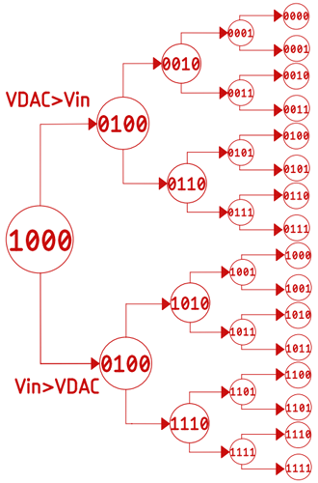
Cont… (SAR)

Slide 23
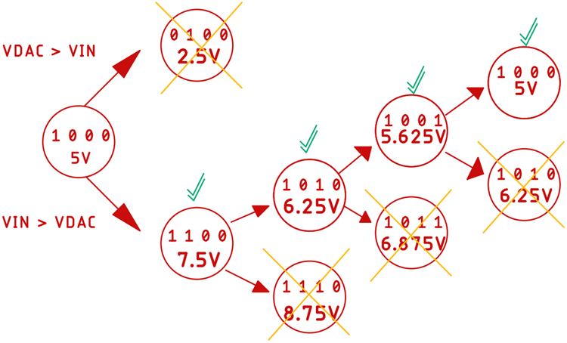
Cont… (SAR)
sampled input signal is 5.8V.
The reference of the ADC is 10V.
When the conversion starts, the successive approximation register sets the most significant bit to 1 and all other bits to zero. This means the value becomes 1, 0, 0, 0
Vin is greater than the output of the DAC, the most significant bit will stay as it is, and the next bit will be set for a new comparison
Otherwise, if the input voltage is less than the DAC value, the most significant bit will be set to zero

Slide 24
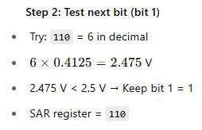
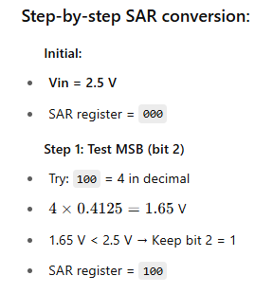
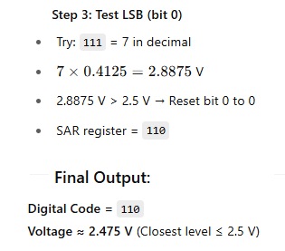
Cont… (SAR)
Ref.Volt is 3.3
Step size is
3.3/resolution,,
Which is
3.3/2³ =0.4125
110 is 6
6*0.4125 is
2.475 v

Slide 25
Cont…
Dual Slope (Integrating) ADC
Speed: Slow
Resolution: High (used in digital multimeters)
How it works: Integrates the input voltage over time and then measures the time it takes for a known reference voltage to cancel it out.
Pros: Very accurate, good noise immunity
Cons: Slow conversion rate

Slide 26
Cont…
Sigma-Delta (ΔΣ) ADC
Speed: Low to moderate
Resolution: Very high (up to 24 bits)
How it works: Oversamples the signal and uses digital filtering and noise shaping to achieve high resolution.
Pros: Excellent resolution and noise performance
Cons: Slower than SAR; requires digital filtering

Slide 27
Cont…
Pipelined ADC
Speed: High
Resolution: Moderate to high (8–16 bits)
How it works: Divides the conversion into stages (pipeline stages), where each stage processes part of the conversion.
Pros: High throughput, suitable for high-speed data acquisition
Cons: More complex; some latency

Slide 28
Cont…
Delta-Sigma Modulation ADC (a variant of Sigma-Delta)
Used in: Audio, precision measurement
Pros: High resolution, good for low-frequency signals

Slide 29
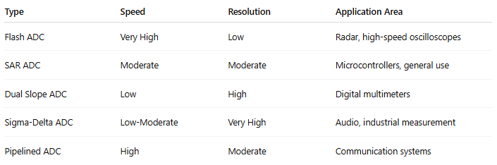
Cont…

