Slide 1
I2C

Slide 2
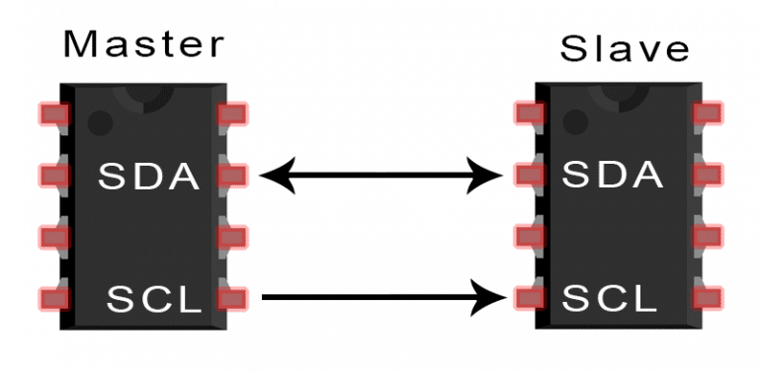
Basics of the I2C Communication Protocol
It is called ‘Inter-Integrated Circuit’, or I2C.
With I2C, you can connect multiple slaves to a single master (like SPI) and you can have multiple masters controlling single, or multiple slaves.
I2C only uses two bi-directional wires to transmit data between devices:
    SDA (Serial Data) – The line for the master and slave to send and receive data.
    SCL (Serial Clock) – The line that carries the clock signal.
I2C is a serial communication protocol, so data is transferred bit by bit along a single wire (the SDA line).
I2C is synchronous, so the output of bits is synchronized to the sampling of bits by a clock signal shared between the master and the slave. The clock signal is always controlled by the master.

Slide 3
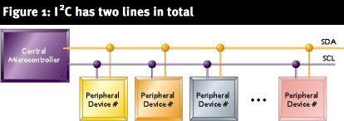
What does I2C consist of?
I2C is a 2 wire serial bus as shown above. The 2 signals are
SDA→ Serial Data
SCL → Serial Clock
Together these signals make it possible to support serial transmission.

Slide 4
I2C BUS
The device that initiates the transaction on the I2C bus is termed the master. The master normally controls the clock signal.
A device being addressed by the master is called the slave.
There needs to be at least one master( a microcontroller or a DSP) on the bus, but there can be more than one master. All the masters on a bus have equal priority.

Slide 5
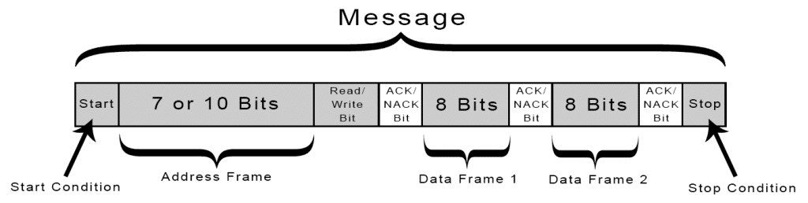
How I2C Works
With I2C, data is transferred in messages.
Messages are broken up into frames of data.
Each message has an address frame that contains the binary address of the slave, and one or more data frames that contain the data being transmitted.
The message also includes start and stop conditions, read/write bits, and ACK/NACK bits between each data frame:

Slide 6
Every device on the I2C bus has a unique 7 bit (or 10 bit) I2C address.
Typically the 4 most significant bits are fixed and assigned to specific categories of devices. Ex: 1010 is assigned to serial EEPROM.
The lower 3 bits are programmable allowing 8 devices of one kind to be present on a single I2C bus.

Slide 7
Terminology for bus transfer
SCL and SDA are bi-directional !
F(free) – Bus is idle or free. Both SDA and SCL are in a high state
S(Start) or R(Restart) – SDA changes from high to low with the SCL line remaining high. All data transfers begin with S(Start) condition.
C(Change) – SCL line is low. Data bit to be transferred is applied to the SDA line.
D(Data) – high or low bit of information on SDA line is valid during the high level of the SCL line.
P(Stop) – SDA line changes from low to high with SCL line remaining high. All data transfers end with P(Stop) condition.

Slide 8
F(free) – Bus is idle or free. Both SDA and SCL are in a high state
Start Condition: The SDA line switches from a high voltage level to a low voltage level before the SCL line switches from high to low.
Stop Condition: The SDA line switches from a low voltage level to a high voltage level after the SCL line switches from low to high.
Address Frame: A 7 or 10 bit sequence unique to each slave that identifies the slave when the master wants to talk to it.
Read/Write Bit: A single bit specifying whether the master is sending data to the slave (low voltage level) or requesting data from it (high voltage level).
ACK/NACK Bit: Each frame in a message is followed by an acknowledge/no-acknowledge bit. If an address frame or data frame was successfully received, an ACK bit is returned to the sender from the receiving device.
I2C operates in 2 modes
  Master mode
  Slave mode

Slide 9
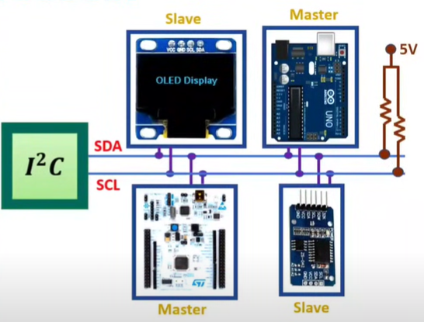
Basics of I2C Protocol
I2C is Inter Integrated Circuit Bus protocol.
Only Two lines are required for the communication using I2C protocol.
Here main advantage of I2C protocol is interfacing simplicity and with the use of Two lines we can interface 128 devices.
It is simple, low bandwidth protocol used for short range communication.
Most I2C devices operate up to speed of 400Kbps.
  I2C lines:
    Serial Data SDA
    Serial Clock SCL
Both of these lines are pulled up at 5V, explains that no communication is happening.
Addressing is done by 7 bits to communicate with 128 devices at max.
Here number of devices is also limited by the total allowed bus capacitance of 400pF.
Master is initiating data transfer and controls the clock normally and the device being addressed is slave.

Slide 10

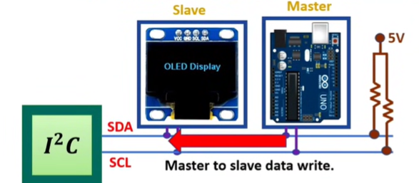

Data Transmission in I2C Protocol
Master to Slave Data Write in I2C Protocol

Slide 11
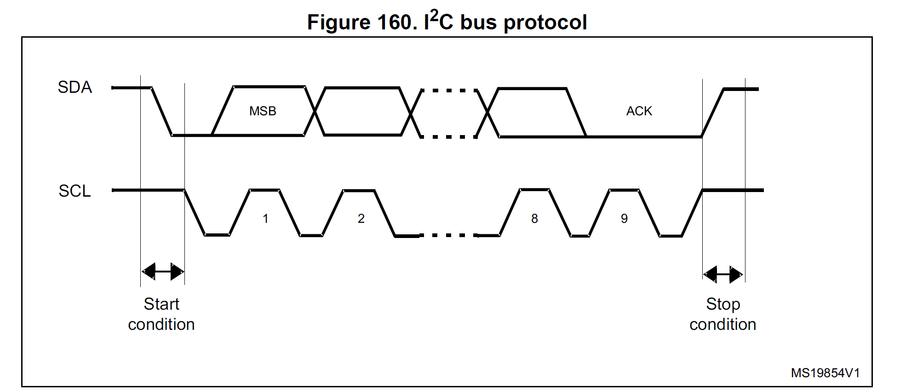
Working Principle
The transmission starts when a START condition is generated by the Master.
This condition occurs when SDA goes from a HIGH to a LOW state when SCL is HIGH.
Similarly, a STOP condition ends the transmission, when SDA goes from a LOW to a HIGH state when SCL is HIGH.

Slide 12

Data transfer
Data is transferred in sequences of 8 bits.
Bits are placed on SDA line with MSB first.
SCL line is then pulsed high and then low.
For every 8 bits transferred, the device receiving the data sends back an acknowledge bit.

Slide 13
Writing to a slave device
Master sends a start sequence. This alerts all the slave devices to an impending transaction and they should listen , in case its for them.
Next the master sends out the device address with read/write bit low. The slave that matches this address will continue the transaction , while others ignore.
Master can now send data byte(s).
Master sends the stop sequence.

Slide 14
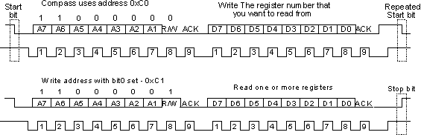
Reading from a slave
Master sends a start sequence.
Master sends the device address with read/write bit high.
Master reads data from the device.
Master sends the stop sequence

Slide 15
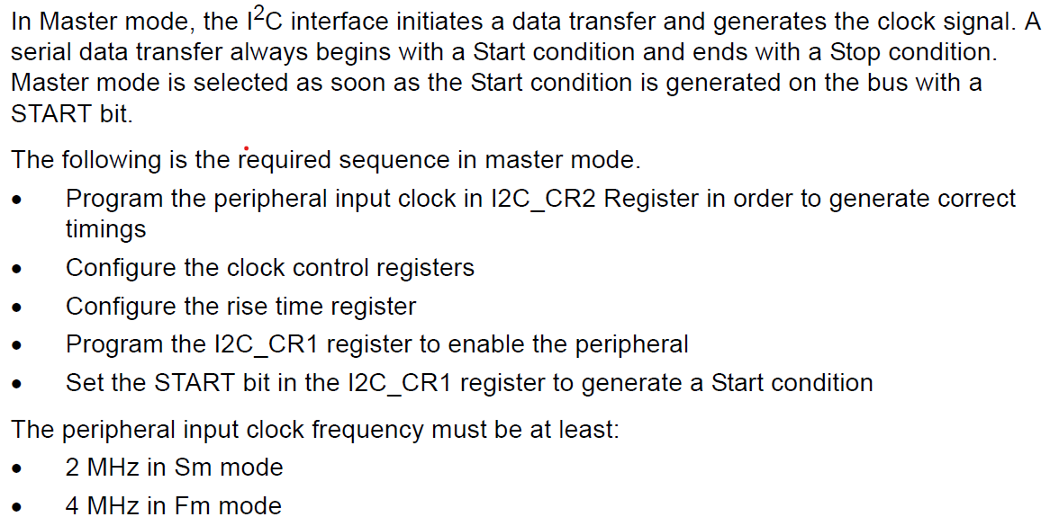
I2C master mode
Sm Mode – Standard Mode
Fm Mode – Fast Mode

Slide 16
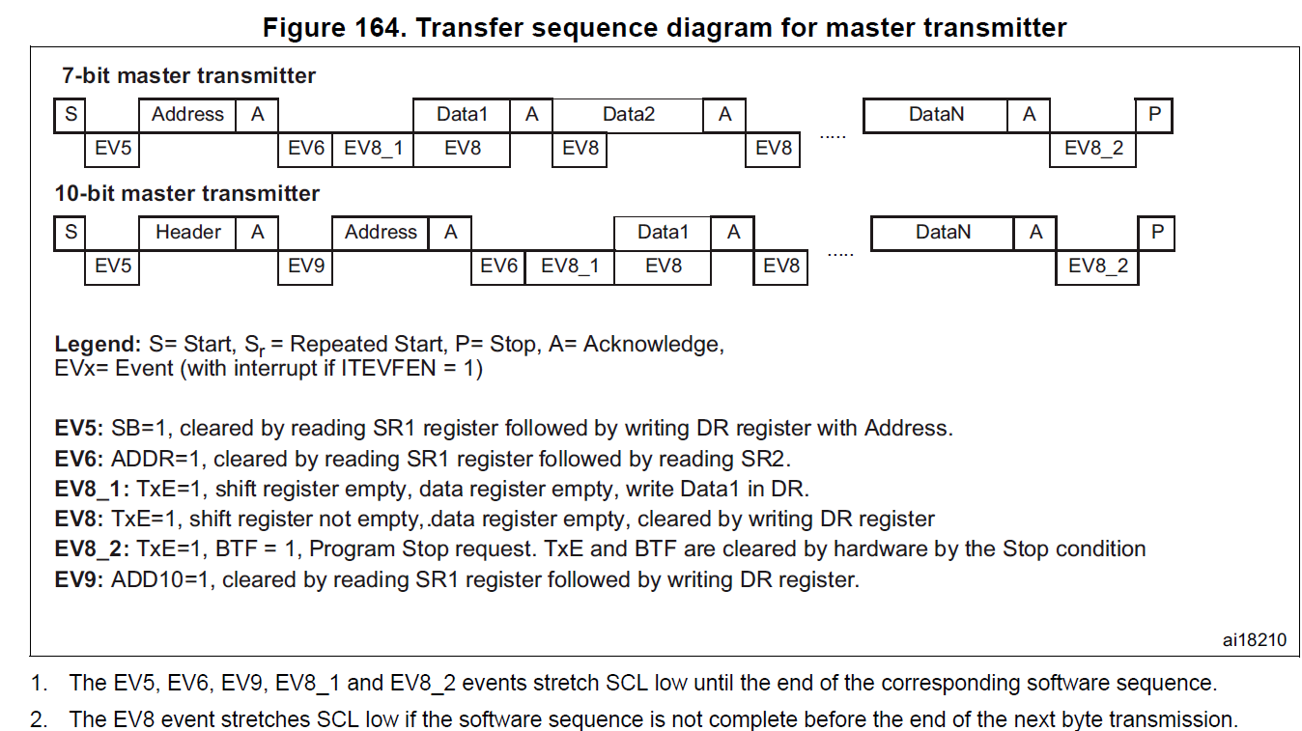
I2C master mode

Slide 17
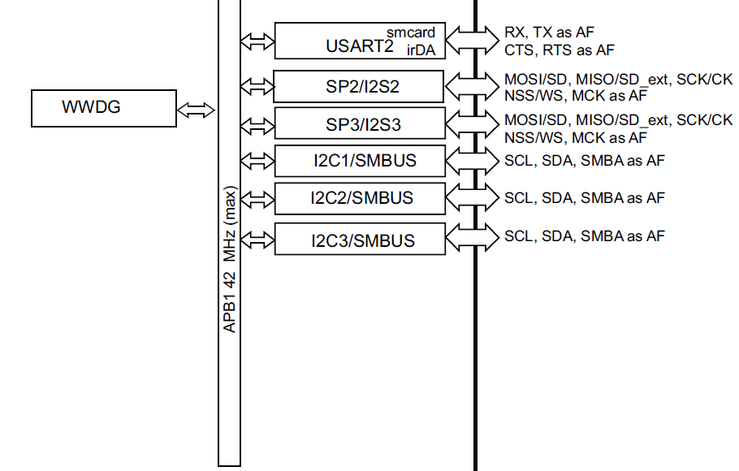
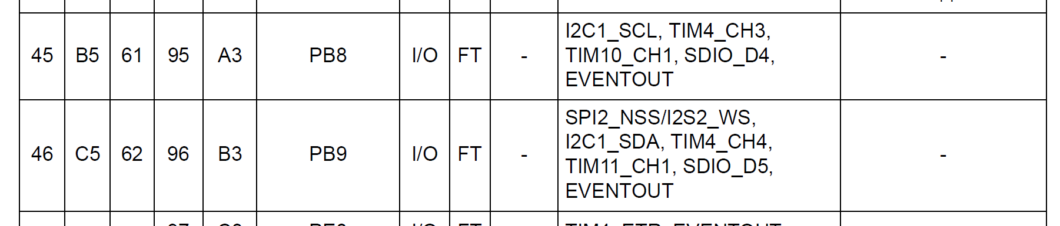
I2C Pin Configuration (GPIO Configuration)

Slide 18
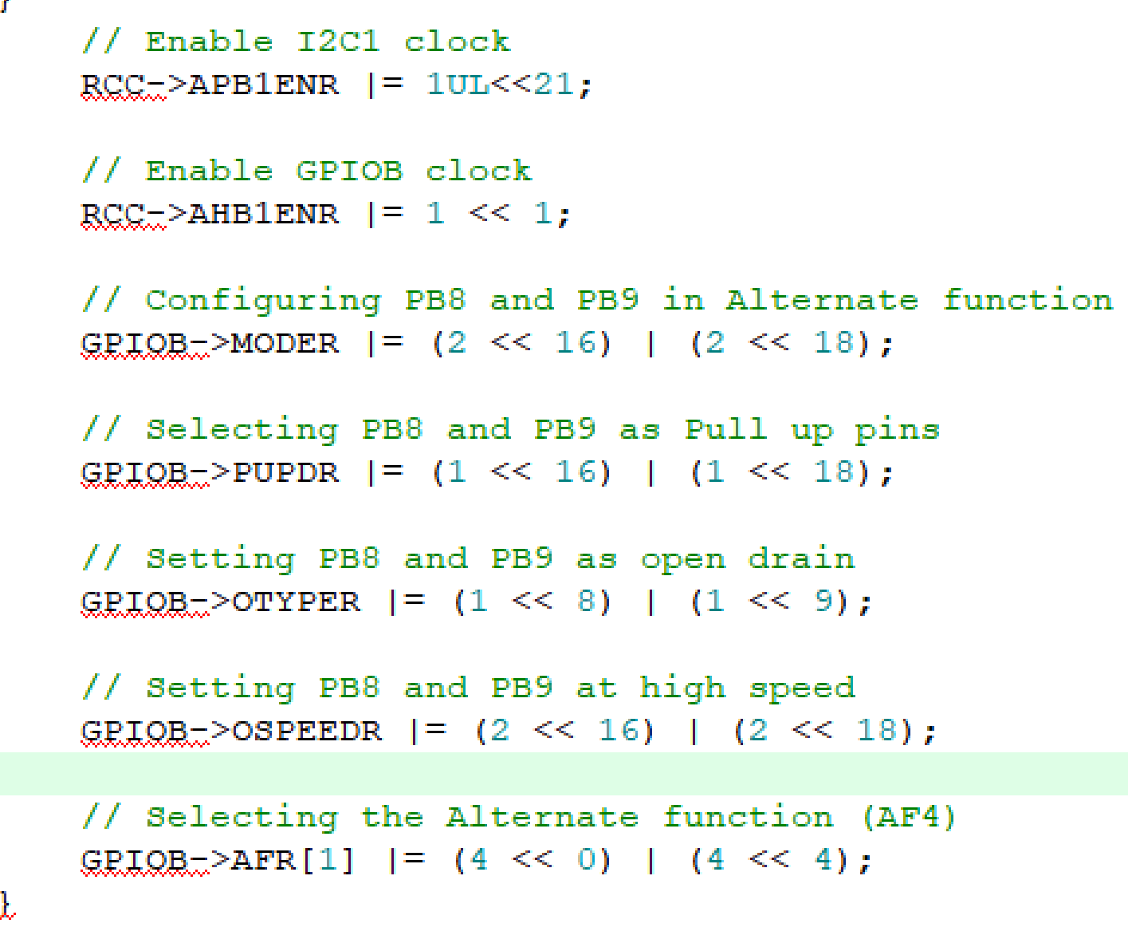
I2C Pin Configuration (GPIO Configuration)
Refer Datasheet for individual register configurations

Slide 19
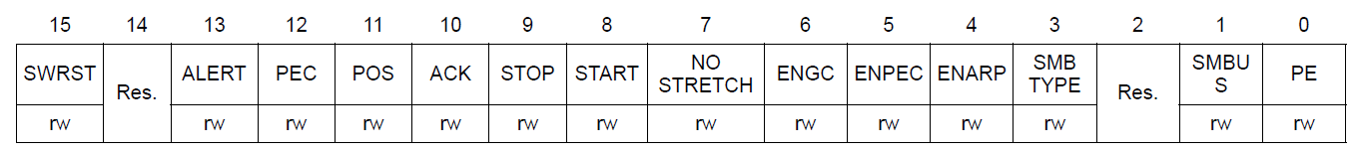
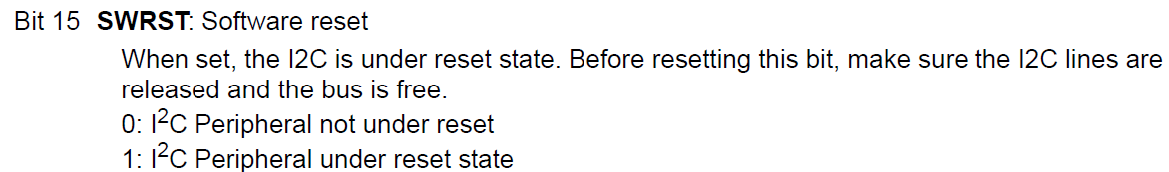
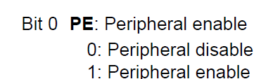
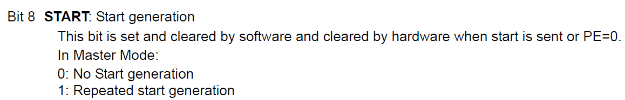
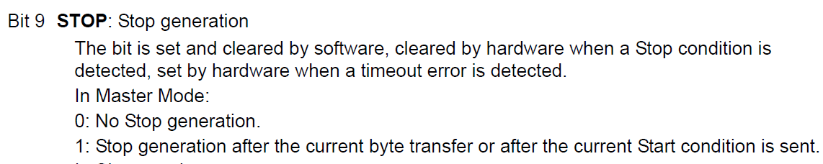
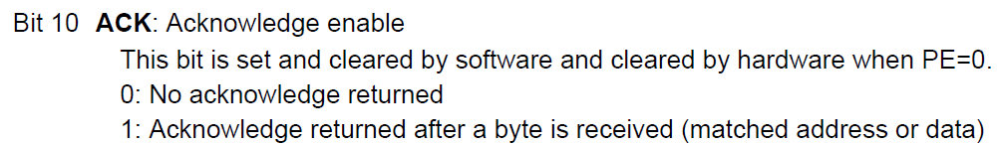
I2C Control register 1 (I2C_CR1)
// Reset I2C
I2C1->CR1 |= 1UL<<15;
I2C1->CR1 &= ~(1UL<<15);

Slide 20
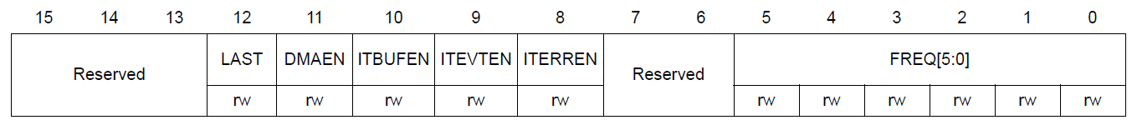
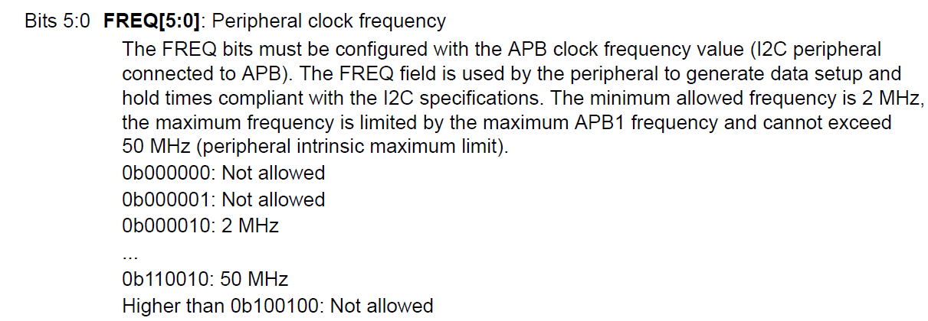
I2C Control register 2 (I2C_CR2)
// // Set I2C clock at 16MHz I2C
I2C1->CR2 |= (16<<0);

Slide 21
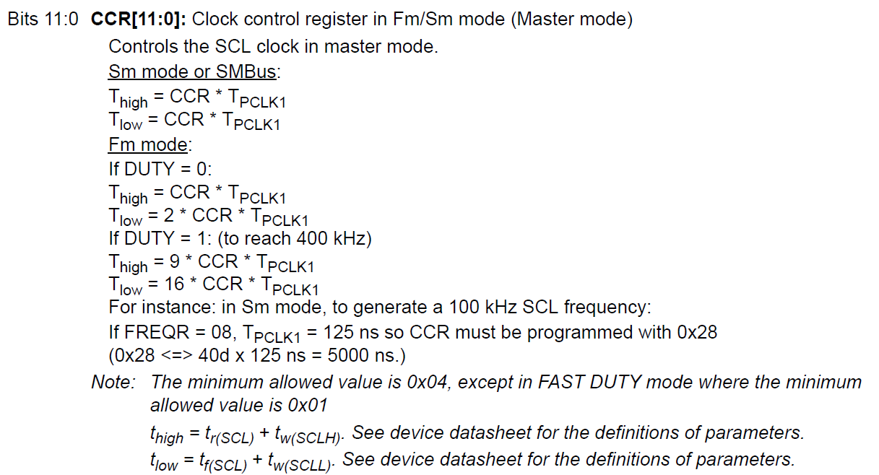
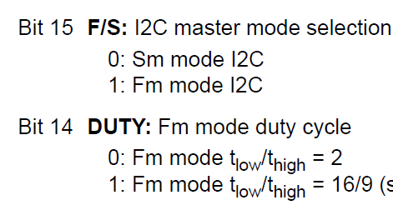
I2C Clock control register (I2C_CCR)

Slide 22
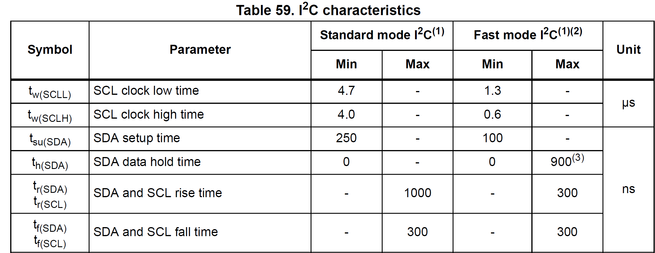

Slide 23
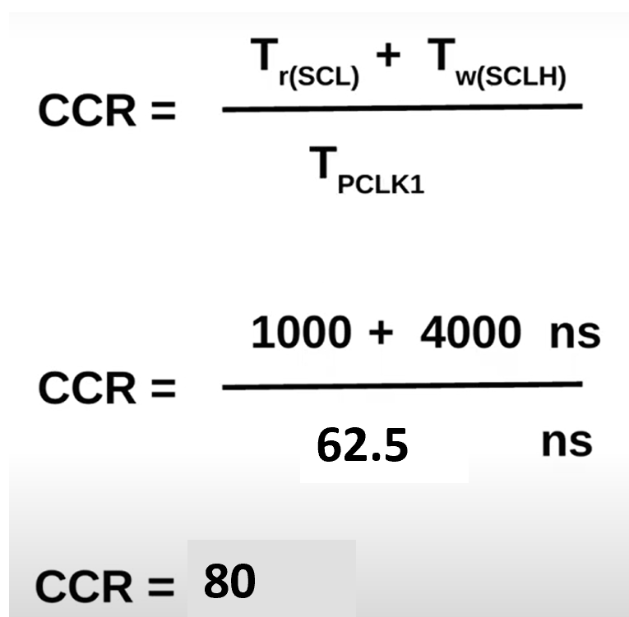
I2C Clock control register (I2C_CCR)
Our peripheral clock is running at 16 MHz, so
// Configure the clock control register
I2C1->CCR = 80;

Slide 24
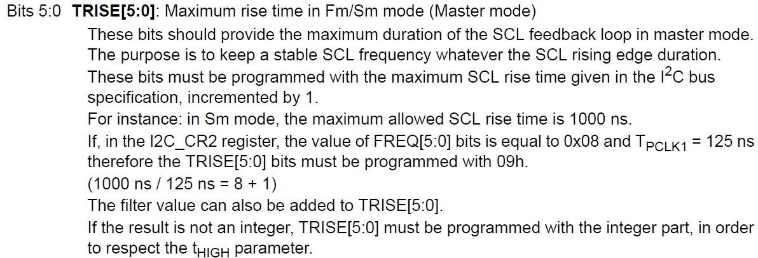
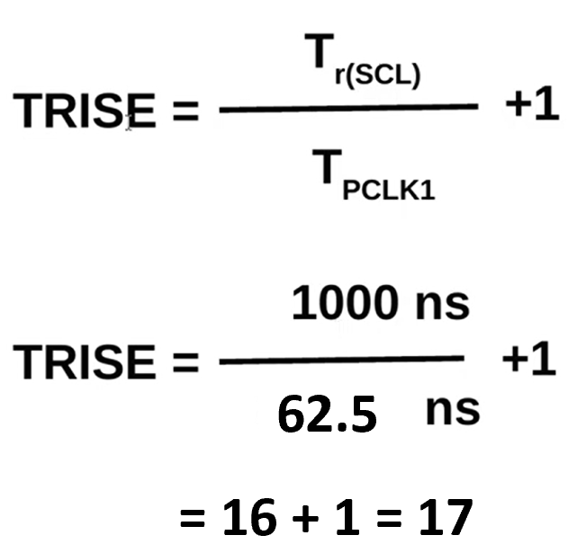
I2C TRISE register (I2C_TRISE)
// Configure the rise time register
I2C1->TRISE |= 17;

Slide 25
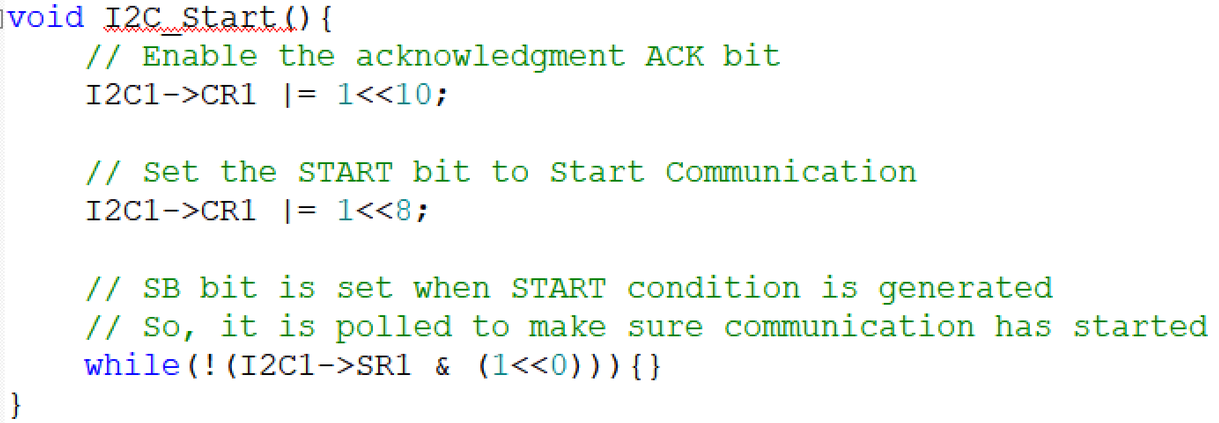
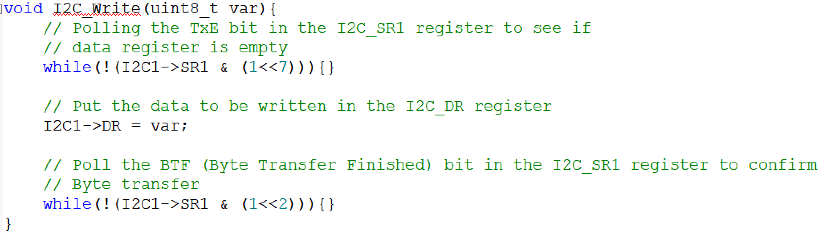
Configurations to transmit data
// Enable I2C
I2C1->CR1 |= 1<<0;

Slide 26
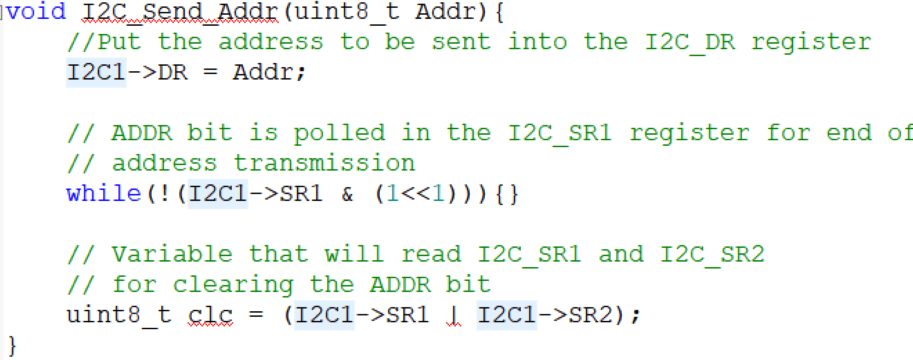
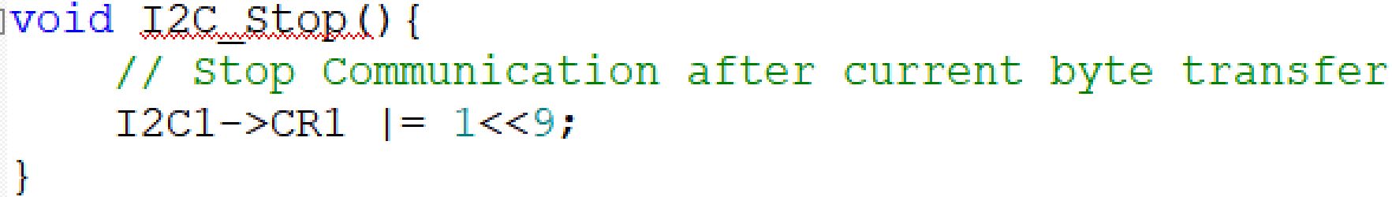
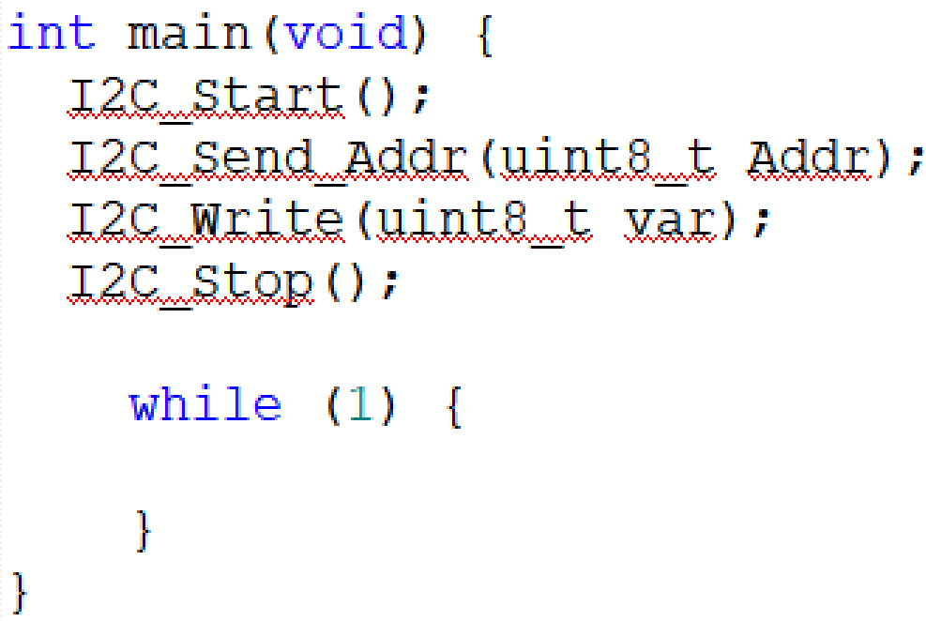
Configurations to transmit data

Slide 27
Thank You

