Slide 1
UART / USART
(General Information)

Slide 2
Serial Vs Parallel Communication
In Embedded Systems, Telecommunication, and Data Transmission applications, Serial Communication is known to be the process of sending data one bit at a time (bit-by-bit) sequentially, over the serial bus.
It takes a complete clock cycle in order to transfer each bit from an end to the other.
Conversely, parallel communication is known to be the process of sending several bits, even bytes, as a whole only in a single clock cycle.
However, even if you transfer fewer data per cycle with a serial transmission, you can do it at much higher frequencies which results in higher net transfer rates than of the parallel communication.
Feature | Serial Communication | Parallel Communication
Relative Speed | Faster | Slower
Distance Range | Much Farther | Shorter
Transfer Method | One bit is transmitted at a time | Bytes are transmitted in parallel, One byte or more at a time
Applications | Computer small peripherals, modules interfacing, and sensors measuring & sending simple data frames | Short distance High-Speed communication such as Computer printers, etc
Wires Inside | Few wires, all data bits pass only through the same data line | Multiple, more wires, each bit has a dedicated wire. So as to be transmitted all at once

Slide 3
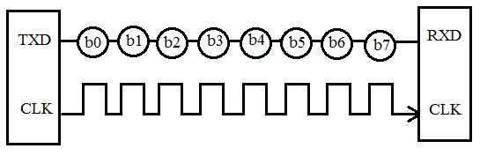
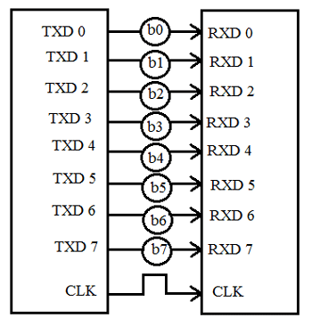
Serial Transmission
There are several types of serial communication depending on the type of transmission mode and data transfer. The transmission modes are classified as Simplex, Half Duplex, and Full Duplex.
Parallel Transmission

Slide 4
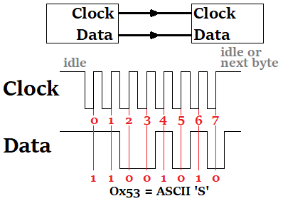
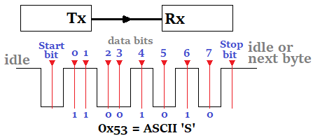
Clock Synchronization
The clock is different for serial devices, and it is classified into two types, viz. Synchronous Serial Interface and Asynchronous Serial Interface.
Synchronous Serial Interface
Asynchronous Serial Interface
Synchronous type of serial protocols, such as SPI, I2C, CAN, and LIN
Examples of Asynchronous Receiver-Transmitter (UART) for serial communication are RS232, RS422, RS485 etc.

Slide 5
Applications Of Serial Communication Protocols
There are countless situations in which we do use one or more of the serial communication protocols.
Some major purposes of serial communication tasks are
  External devices/modules communications
  Downloading / Updating The Firmware
  Console io
  Data Transmission
  Debugging interface
Serial communication protocols are of fundamental importance for each embedded systems application.
And as embedded systems engineers, we must have a very solid experience with almost all of the commonly used serial communication protocols.

Slide 6
Examples Of Serial Communication Protocols
There are many serial communication protocols that are existent and being used in various domains and sub-domains of embedded systems.
Some of which are more likely to be used in the automotive industry such as LIN & CAN, some of which is more likely to be used for external memory interfacing as I2C, high-speed computer interfacing as USB, and for audio applications such as I2S.
Here is a list of the most common serial communication protocols in the industry.
Example: RS-232 UART
RS-232 (Recommended Standard 232) is a standard for serial binary data signals connecting between a Data Terminal Equipment (DTE) and a Data Communication Equipment (DCE).
USB | CAN | I2C
I2S | LIN | SPI
Ethernet | 1-Wire | UART/USART
And many more…
I2C – Inter-Integrated Circuit
SPI – Serial Peripheral Interface
CAN – Controller Area Network
USB – Universal Serial Bus

Slide 7
UART Introduction
Universal Asynchronous Receiver/Transmitter or UART for short represents the hardware circuitry (module) being used for serial communication.
UART is sold/shipped as a standalone integrated circuit (IC) or as an internal module within microcontrollers. In this tutorial, we’re concerned with the internal UART module within STM32 Microcontrollers.
There is a couple of IO pins dedicated to the UART serial communication module highlighted in the following figure. Namely, RX (data input – receiving end) & TX (data output – transmitting end).
There are actually two forms of UART hardware as follows:
  UART – Universal Asynchronous Receiver/Transmitter
  USART – Universal Synchronous/Asynchronous Receiver/Transmitter
  The Synchronous type of transmitter generates the data clock and sends it to the receiver which works accordingly in a synchronized manner.
  On the other hand, the Asynchronous type of transmitter generates the data clock internally. There is no incoming serial clock signal, so to achieve proper communication between the two ends, both of them must be using the same baud rate. The baud rate is the rate at which bits are being sent bps (bits per second).

Slide 8
UART | USART
Standalone Communication Protocol | It can support multiple protocols like LIN, RS-485, IrDA, etc
Commonly used for low-speed applications | More suitable for high-speed applications
The data rate is relatively low | The data rate is much higher
The clock is generated locally and both devices are configured to run at the same baud rate | The clock signal is generated by the transmitter and sent to the receiver during data transmission
The baud rate of the receiver module must be known prior to any communication | The baud rate is useless as the receiver module will be using the clock coming from the transmitter device
Offer reduced low energy footprint even in sleep mode | Operates at high energy consumption modes
So, is UART and USART are the same?
Technically, NO! A USART generally has much more capabilities than a generic UART. Being able to generate clocked data allows the USART to operate at much higher baud rates way more than what a typical UART can handle.

Slide 9
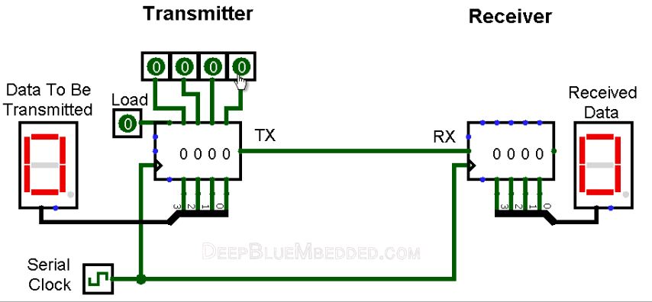

Slide 10
Advantages Of UART Serial Communication
Only two wires are required for a full-duplex data transmission (excluding the power lines).
The structure of the data packet can be changed with coordination between both ends.
No need for a serial clock signal (in asynchronous mode).
Parity bit provides a hardware-level error detection.
Well-documented and widely-used protocol.
Relatively easy to set-up and run.
Disadvantages Of UART Serial Communication
Speed for data transfer is less compared to parallel communication or even USARTs.
The baud rates of each UART must be the same within a limited small error margin.
The size of the data frame is limited to a maximum value of 9-Bits.
Doesn’t support multiple slaves or multiple masters capability.

Slide 11
Modes Of UART Communication
The communication over the UART bus can be configured (set) to be on one of the following modes:
  Simplex – One direction only, a transmitter to a receiver
  Half Duplex – Devices take turns transmitting and receiving
  Full Duplex – Devices can send and receive simultaneously (at the same time)
Modes Of Operation For UART Devices
The UART serial communication bus can only have 2 devices communicating with each other in one of the 3 modes as shown above. Which necessarily means, each device can either be a transmitter or a receiver during the data transmission process.
  Transmitter
  Receiver
  The transmitter in synchronous mode must generate the serial data clock for the receiver. On the other hand, in asynchronous mode, there is no need to do so.
  There can’t be more than 2 devices on the UART serial bus.

Slide 12
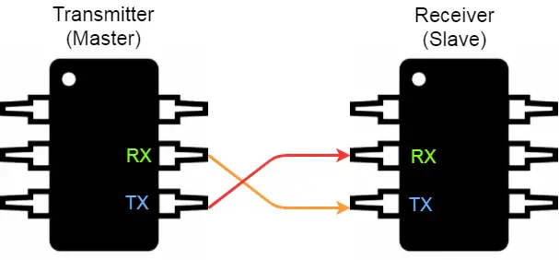
The proper connection for any 2 devices for UART serial communication goes as follows: the transmitter’s TX goes to the receiver’s RX and the receiver’s TX goes to the transmitter’s RX. Frankly speaking, the 2-wires are basically crossed!

Slide 13
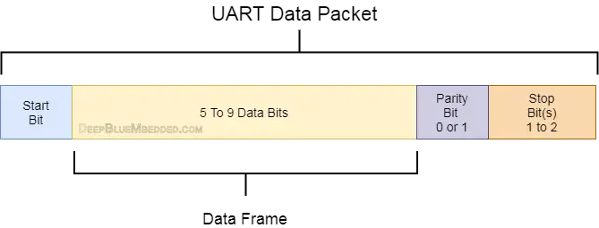
UART Data Packet
The data being transmitted/received in UART serial communication is organized into specific blocks called Packets.
In the idle state, UART lines are pulled high. This allows the receiver side to recognize that there is a transmitter device on the other end which is connected to the serial bus.
UART Packets usually start with “Start Bit” which is a logic low and is used to signal the receiver that there is a new coming packet. The structure of a typical UART Data Packet is shown in the figure down below.

Slide 14
Start Bit
The UART data transmission line (TX) is normally held High (1) logic-level when there is no data transmission on the line. To start data transfer, the transmitting UART pulls-down the transmission line from high to low for one clock cycle. When the receiving UART module detects the high to low voltage transition, it begins reading the incoming bits of the entire data frame at the same frequency of the specified baud rate.
Data Frame
These are the actual data bits being transmitted from transmitter to receiver. The length of the data frame can be anywhere between 5 and 9 (9-Bits if parity is not used and 8-Bits if parity is used). In general settings, the LSB is the first bit to be shifted-out, transmitted, (unless otherwise specified).
Parity Bit
Parity bit allows the receiver to check the correctness of the received data. Parity is a low–level error checking mechanism and has two different options to choose from: Even Parity and Odd Parity. After the receiver UART reads the data frame, it counts the number of bits with a value of 1 and checks if the total value is an even or odd number.
The parity bit is optional and it’s actually not widely used.
Stop Bit
This bit is used to signal the end of the data packet being sent. The sending UART drives the data transmission line from low to high for at least two-bit durations but most often only one bit is used. The data line is held high back to the idle state and ready for any future transmission.

Slide 15
Baud Rate
The Baud Rate specifies how fast the data is sent over the bus and it is specified in bits-per-second or bps.
You can actually choose any speed for the baud rate.
However, there are some specific values that are known to be the industry standards.
The most common and widely-used standardized value is 9600.
Other standard baud rates include: 1200, 2400, 4800, 19200, 38400, 57600 and 115200.
Obviously, baud rates are always multiples of 300.
Baud rates higher than 115200(bps) can be used with an additional probability of having, at best, missing data packets.
The rule of thumb in UART communication is, both the transmitter and the Receiver UART must agree on the exact same Baud Rate for a successful data transmission.

Slide 16
STM32 UART / USART Hardware
The universal synchronous asynchronous receiver transmitter (USART) offers a flexible means of full-duplex data exchange with external equipment requiring an industry-standard NRZ (Non-Return-To-Zero) asynchronous serial data format.
The USART offers a very wide range of baud rates using a fractional baud rate generator.
It supports synchronous one-way communication and half-duplex single-wire communication.
It also supports the LIN (local interconnection network), Smartcard Protocol, IrDA (infrared data association) SIR ENDEC specifications, and modem operations (CTS/RTS).
It allows multiprocessor communication. High-speed data communication is possible by using the DMA for multi-buffer configuration.

Slide 17
STM32 UART Main Features
    Full duplex, asynchronous communications
    Fractional baud rate generator systems – A common programmable transmit and receive baud rates up to 4.5 MBits/s
    Parity control
    Programmable data word length (8 or 9 bits)
    Configurable stop bits – support for 1 or 2 stop bits
    LIN Master Synchronous Break send capability and LIN slave break detection capability
    Transmitter clock output for synchronous transmission
    IrDA SIR Encoder-Decoder – Support for 3/16 bit duration for normal mode
    Smartcard Emulation Capability
    Single-wire half-duplex communication
    Configurable multi-buffer communication using DMA (direct memory access) – Buffering of received/transmitted bytes in reserved SRAM using centralized DMA
    Separate enable bits for Transmitter and Receiver
    Transfer detection flags: (Receive buffer full – Transmit buffer empty – End of Transmission flags)
    4 error detection flags: (Overrun error – Noise error – Frame error – Parity error)
    10 interrupt sources with flags

Slide 18
USART Data Transmission Steps (Procedure)
  Enable the USART by writing the UE bit in USART_CR1 register to 1.
  Program the M bit in USART_CR1 to define the word length.
  Program the number of stop bits in USART_CR2.
  Select DMA to enable (DMAT) in USART_CR3 if Multi buffer Communication is to take place. Configure the DMA register as explained in multi-buffer communication.
  Select the desired baud rate using the USART_BRR register.
  Set the TE bit in USART_CR1 to send an idle frame as the first transmission.
  Write the data to send in the USART_DR register (this clears the TXE bit). Repeat this for each data to be transmitted in case of a single buffer.
  After writing the last data into the USART_DR register, wait until TC=1. This indicates that the transmission of the last frame is complete. This is required for instance when the USART is disabled or enters the Halt mode to avoid corrupting the last transmission.

Slide 19
When a transmission is taking place, a write instruction to the USART_DR register stores the data in the TDR register and which is copied in the shift register at the end of the current transmission.
When no transmission is taking place, a write instruction to the USART_DR register places the data directly in the shift register, the data transmission starts, and the TXE bit is immediately set.
If a frame is transmitted (after the stop bit) and the TXE bit is set, the TC bit goes high. An interrupt is generated if the TCIE bit is set in the USART_CR1 register. After writing the last data into the USART_DR register, it is mandatory to wait for TC=1 before disabling the USART or causing the microcontroller to enter the low-power mode.
The TC bit is cleared by the following software sequence:
  A read from the USART_SR register
  A write to the USART_DR register
The TC bit can also be cleared by writing a ‘0’ to it.
The timing sequence diagram down below will show you the exact behavior of the USART transmitter hardware, the TC bit, and the TXE flag bit.

Slide 20
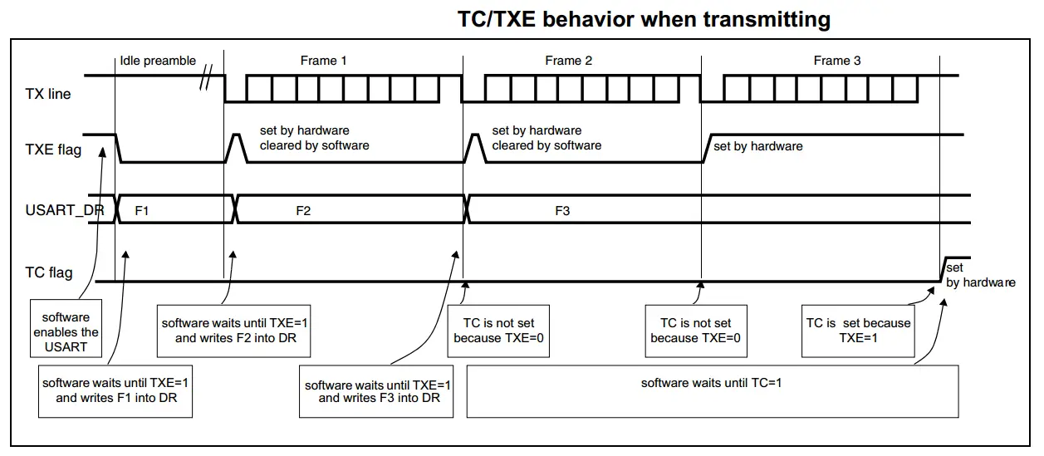
The timing sequence diagram down below will show you the exact behavior of the USART transmitter hardware, the TC bit, and the TXE flag bit.

Slide 21
UART – TX
(STM32F Series)

Slide 22
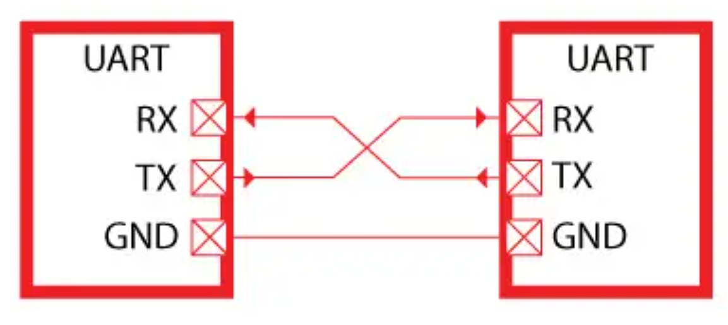
Universal synchronous asynchronous receiver transmitter (USART)
The universal synchronous asynchronous receiver transmitter (USART) offers a flexible means of full-duplex data exchange with external equipment requiring an industry standard NRZ asynchronous serial data format.
The USART offers a very wide range of baud rates using a fractional baud rate generator.
Two Device Communicate through UART
Only two pins are used to transfer and receive data such as a transmit pin (Tx) and a receiver pin (Rx).
The other two pins are just power supply pins such as ground and Vcc (usually a power source of the device).
But one important point to consider here is that the ground terminal or reference point of both devices should be common.

Slide 23
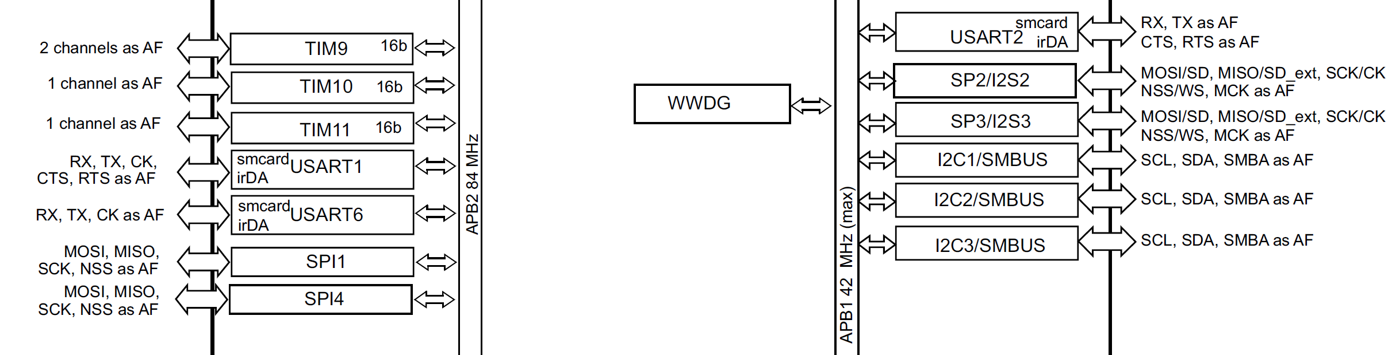
Universal synchronous asynchronous receiver transmitter (USART)

Slide 24
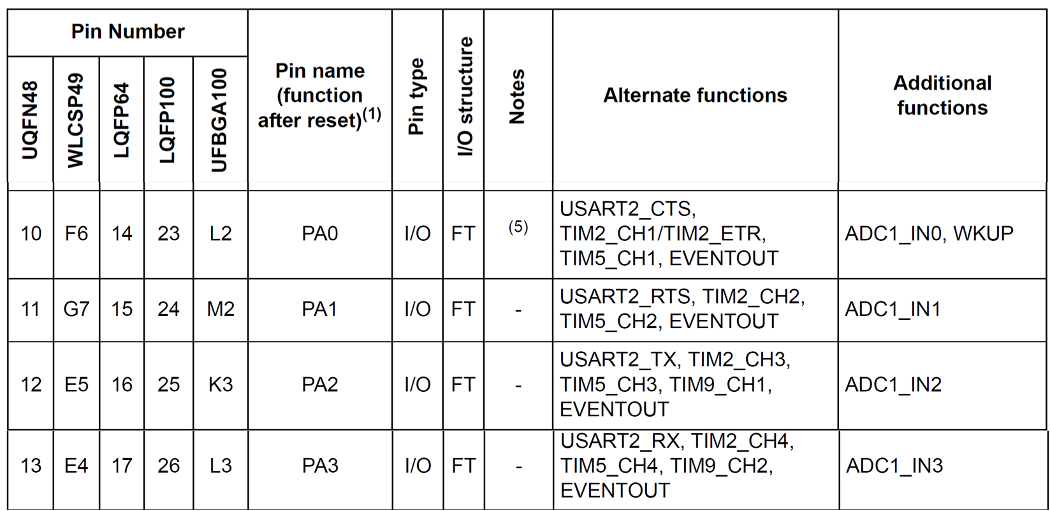
UART Ports

Slide 25
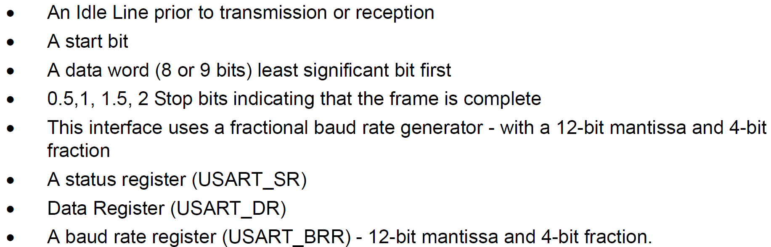
USART functional description
Serial data is transmitted and received in normal USART mode as frames comprising:

Slide 26
USART registers

Slide 27
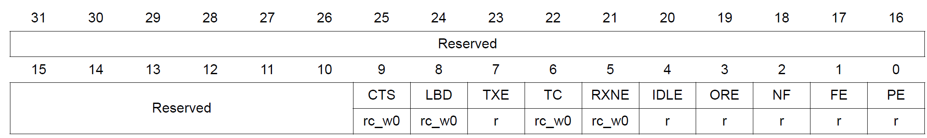
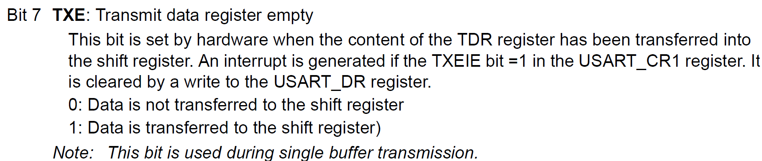
Status register (USART_SR)

Slide 28
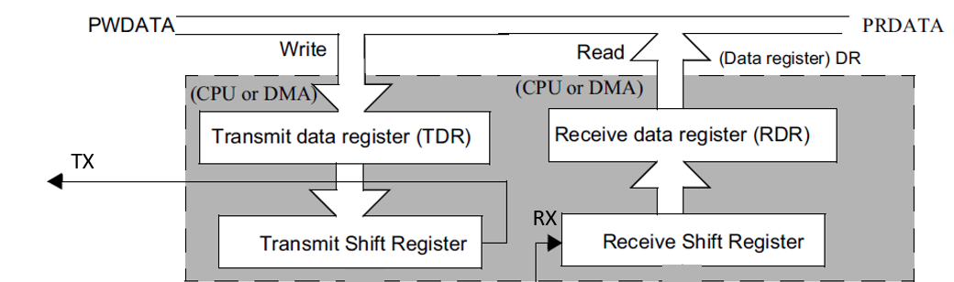
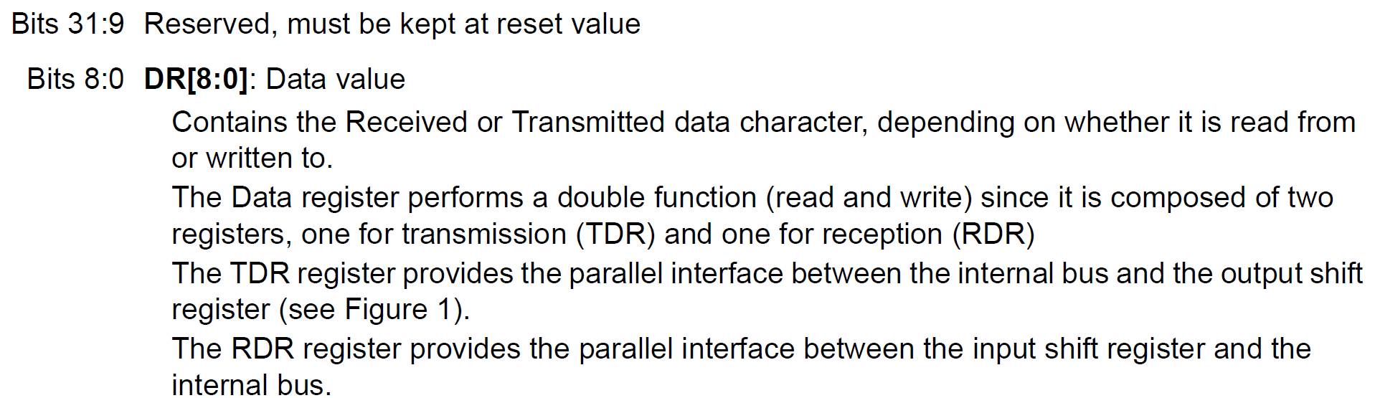
Data register (USART_DR)

Slide 29
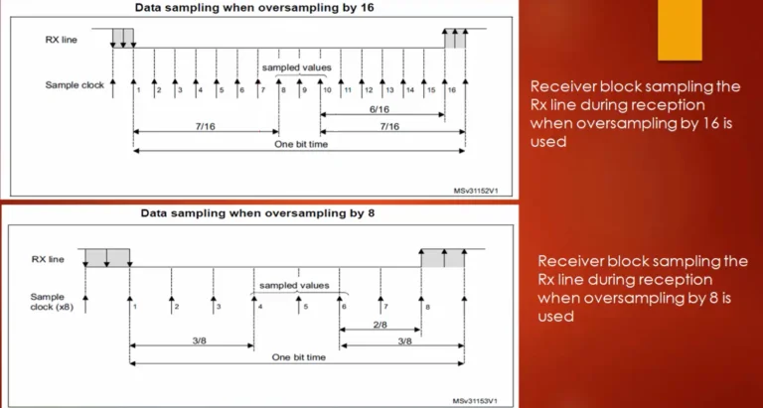
USART oversampling
Oversampling is a technique, which is used by the receive engine of the USART peripheral
Basically, the oversampling technique talks about the sampling frequency of the USART peripheral’s receive engine to recover the data coming on the RX line of the USART.
The receiver of the USART peripheral implements different user-configurable oversampling techniques (except in synchronous mode) for data recovery by discriminating between the valid incoming data and noise.

Slide 30
16x Oversampling (Default) - The receiver samples each bit 16 times, then reads the data using a majority vote around the center (samples 8, 9, and 10).
To understand whether the bit is 1 or 0, a receiver engine takes 16 samples, in which the samples taken at the position of 8, 9, and 10 will be analyzed.
8x Oversampling - The receiver samples each bit 8 times, taking the core majority vote around samples 4, 5, and 6.
If oversampling by 8 is used, then the receiver engine takes 8 samples in a 1-bit period or 1-bit time, and the samples taken at the position of 4, 5, and 6 (or sampled values) will be compared to understand whether this bit is 1 or 0. By using these sampled values, the USART engine understands whether it is valid data or noise.

Slide 31
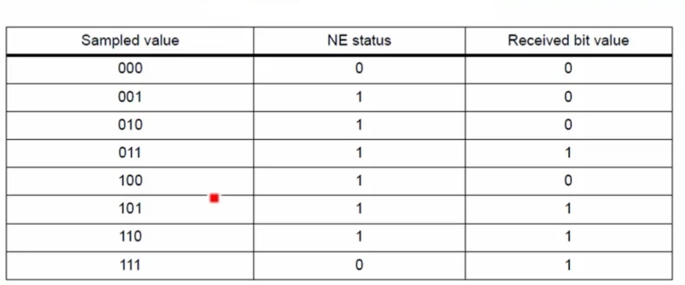
For example, Look at abover Figure . If all sampled values are 000, then the receiver engine considers that as bit value 0, and if the sampled values are all 111, then the receiver engine confirms that the received bit value is 1. But if you see all the remaining sampled values in Figure 2, they make the noise error (NE) as 1. So, the noise error will be triggered

Slide 32
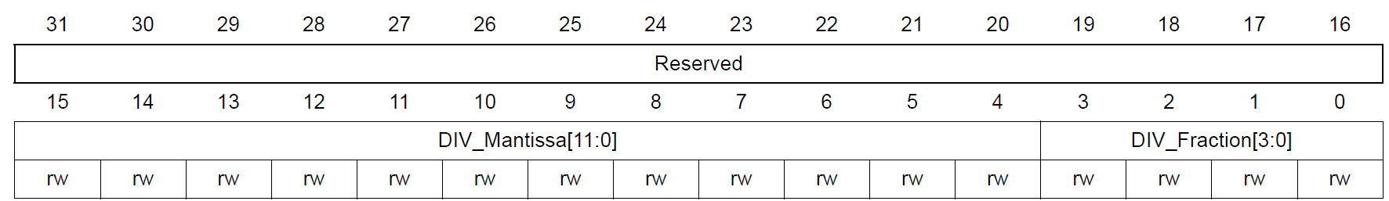
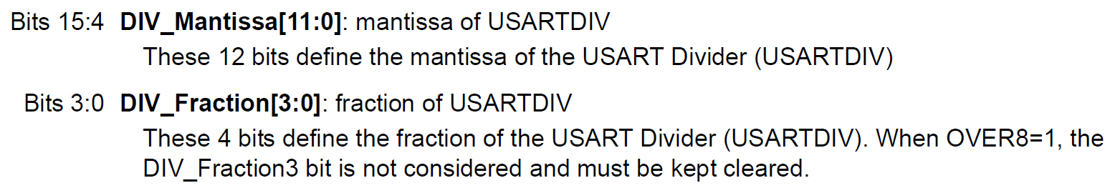

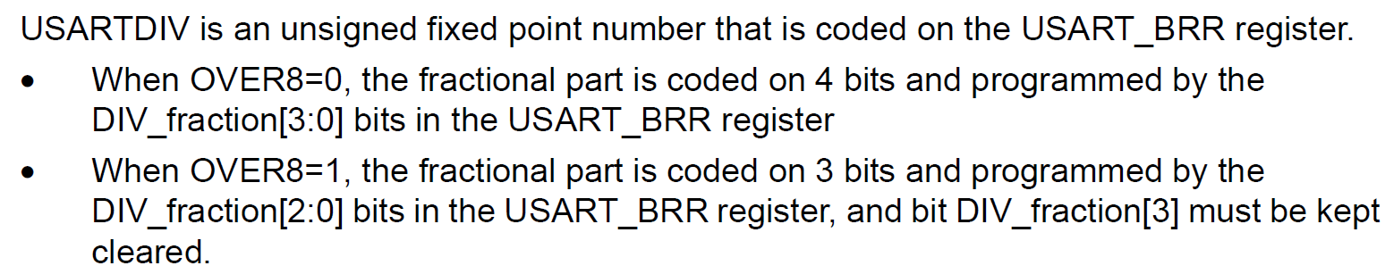
Baud rate register (USART_BRR)
The choice of 16 or 8 oversampling is done via the CR1 Control register.

Slide 33
Baud rate register (USART_BRR)
Assume the clock source of 16 MHz is fed to USART Baud rate generator with oversampling rate of 16. Find the values for the USART_BRR register for baud rates of (a) 9,600, (b) 115,200.
USARTDIV = fck / 16 x Baud
16MHz / 16 x 9,600 = 104.166.
Now, 104 = 0x68 for upper 12-bits.
For fraction part, 0.166 x 16 = 2.656 and we use 3 for the lower 4 bits.
Therefore BRR = 0x0683.
16MHz / 16 x 115,200 = 8.68.
Now, 08 = 0x008 for upper 12-bits.
For fraction part, 0.68 x 16 = 10.88 and we use 11 = 0xB for lower 4-bits.
Therefore BRR = 0x008B.

Slide 34
Baud rate register (USART_BRR)
Assume the clock source of 16 MHz is fed to USART Baud rate generator with oversampling rate of 8. Find the values for the USART_BRR register for baud rates of (a) 9,600, (b) 115,200.
USARTDIV = fck / 8 x Baud
16MHz / 8 x 9,600 = 280.33. Now, we use 280 = 0x118 for upper 12-bits.
For fraction part, 0.33 x 8 = 2.64 and we use 3 for 3 lower bits.
Therefore BRR = 0x1183. (Notice the 4th bit must be 0 in oversampling of 8.)
16MHz / 8 x 115,200 = 17.36. We use 17 = 0x011 for upper 12bits.
For fraction part, 0.36 x 8 = 2.88 and we use 3 for lower 3 bits.
Therefore BRR = 0x0113

Slide 35
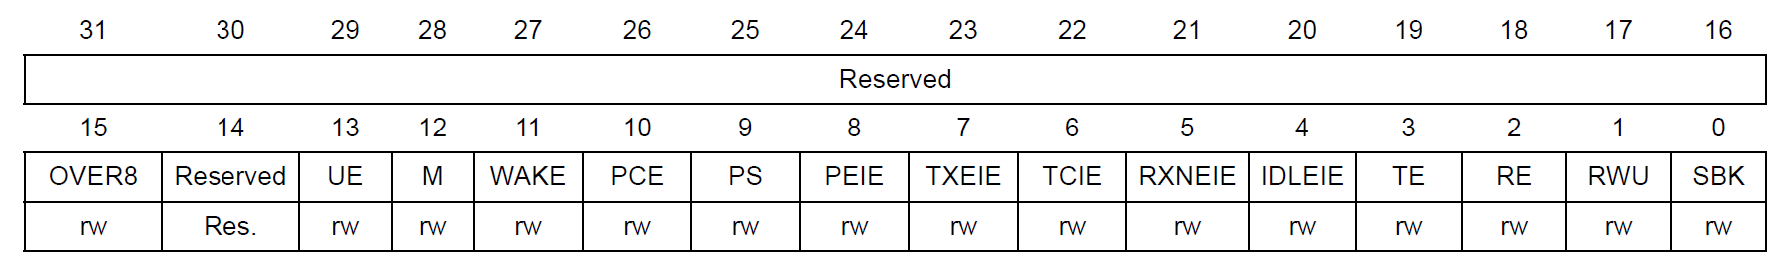
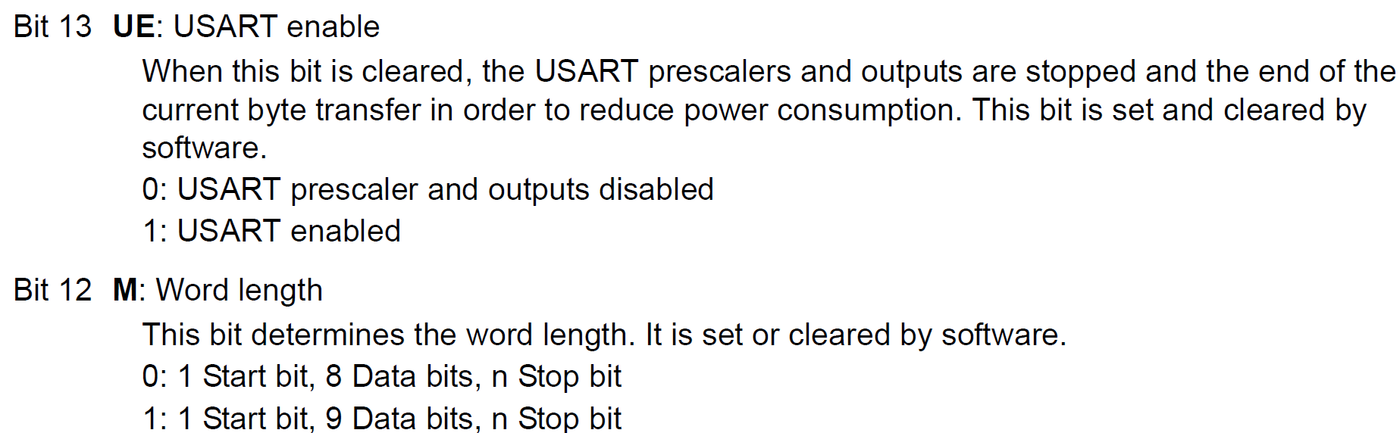
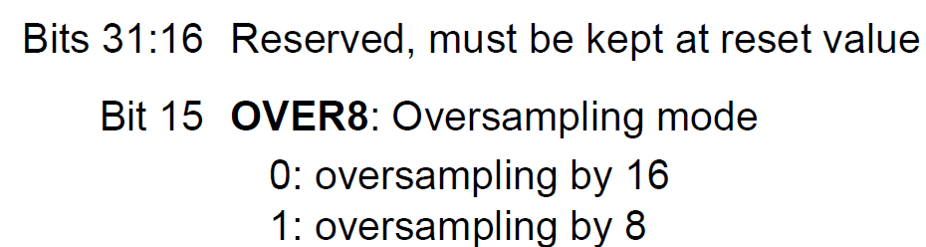
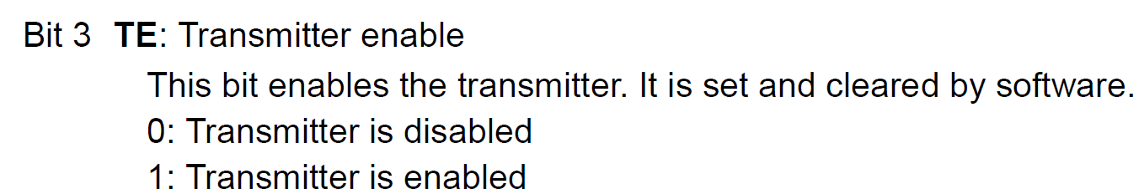
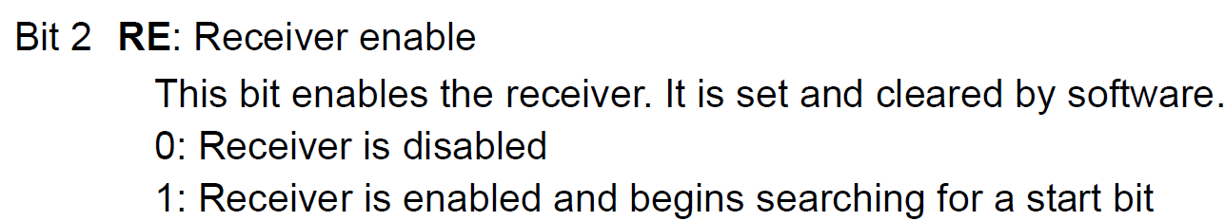
Control register 1 (USART_CR1)

Slide 36
USART2 PA2 - Tx

Slide 37
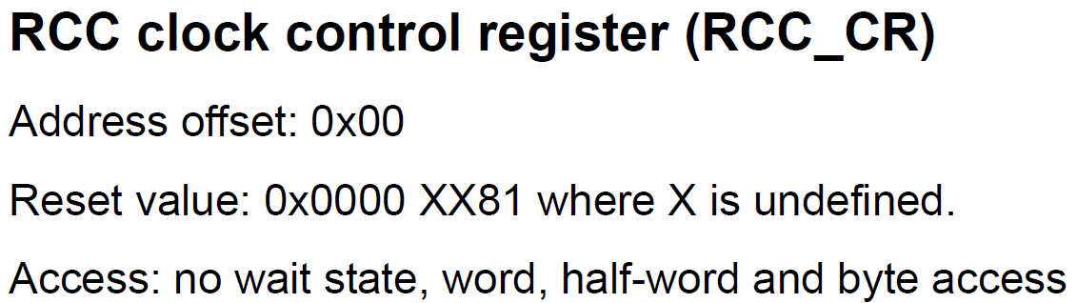
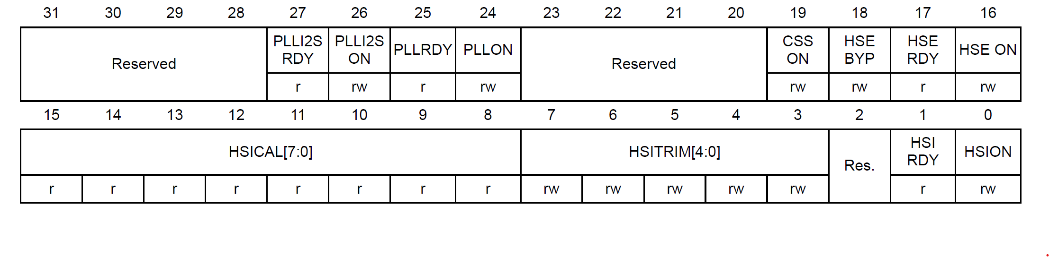
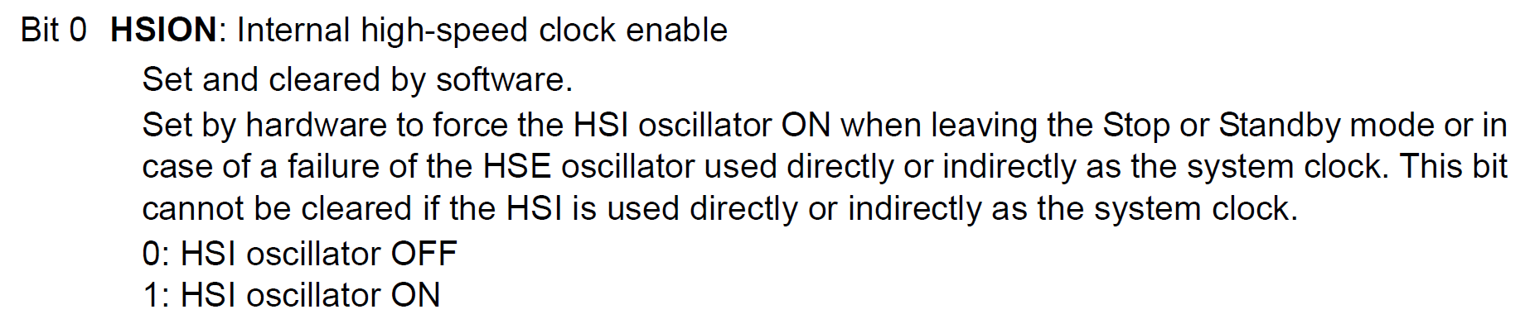
Internal Oscillator for system clock of STM32F4 (16MHz)
No need to configure this since the reset value itself enable HSION bit.

Slide 38

GPIO clock enabled for UART Tx Pin PA2 - GPIOA
/*1. Enable GPIOA clock by Writing 1 to bit0 of AHB1ENR*/
RCC->AHB1ENR |=(1U<<0);

Slide 39


Alternate function mode select for USART2 Tx Pin PA2
/*2. Set PA2 to alternate function mode by writing 1 to bit of MODER*/
GPIOA->MODER |=(1U<<5);

Slide 40
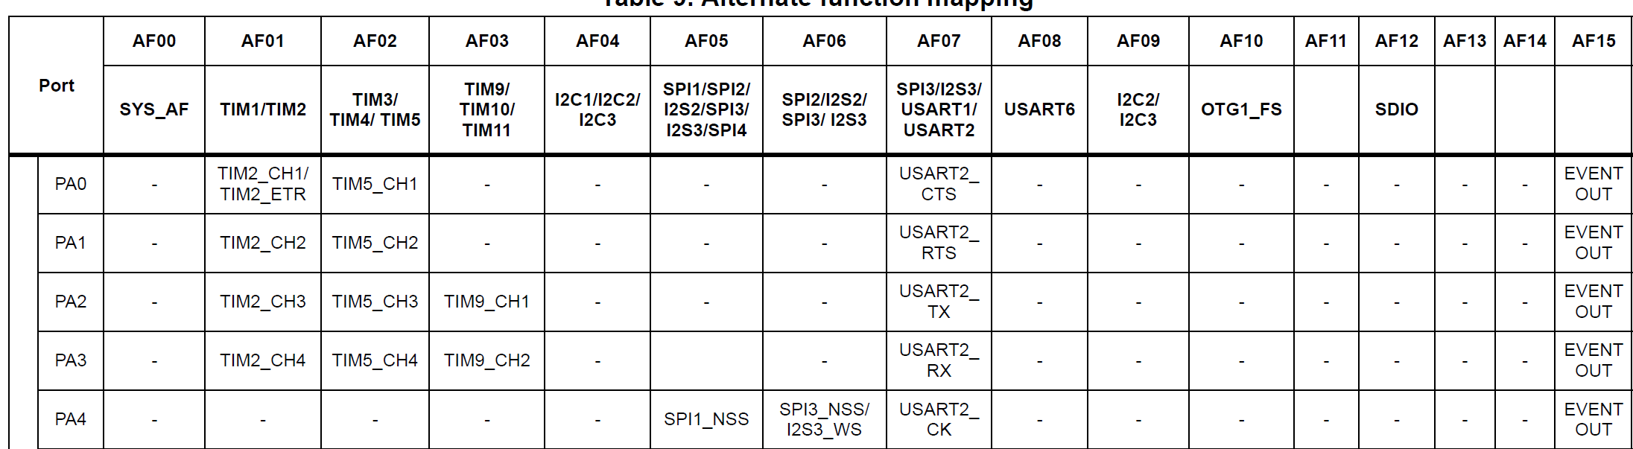
Alternate function mode select for USART2 Tx Pin PA2
Alternate function mapping

Slide 41
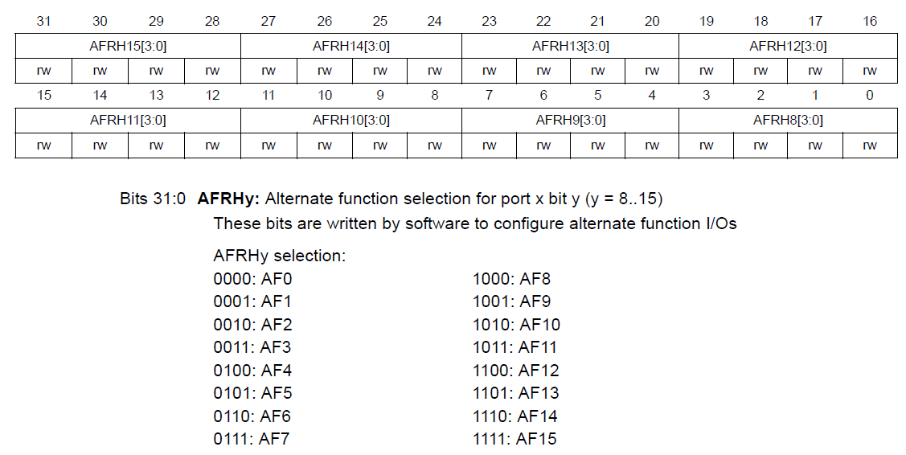
Alternate function mode select for USART2 Tx Pin PA2
GPIO alternate function high register (GPIOx_AFRH)
Pins 8 to 15 functionality should be defined in AFRH register

Slide 42
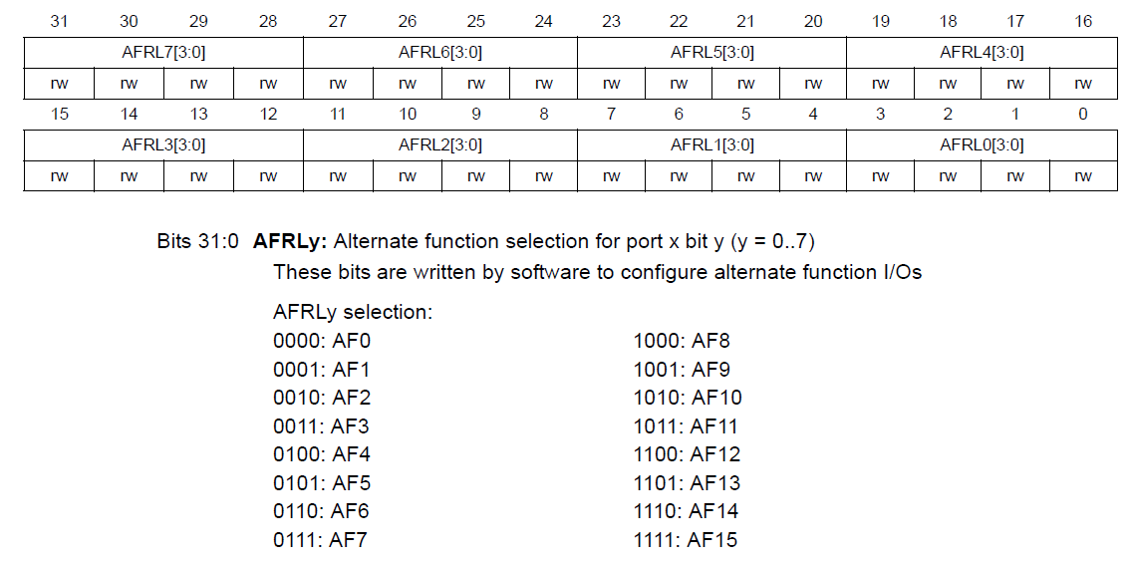
Alternate function mode select for USART2 Tx Pin PA2
GPIO alternate function low register (GPIOx_AFRL) (x = A..E and H)
Writing into AFRL2 because of PA2 pin
Pins 0 to 7 functionality should be defined in AFRL register
GPIOA->AFR[0] &= (~(1<<11));
GPIOA->AFR[0] |= (1<<10) | (1<<9) | (1<<8);

Slide 43
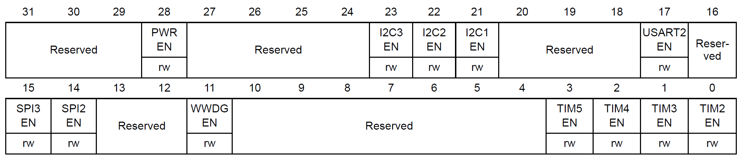
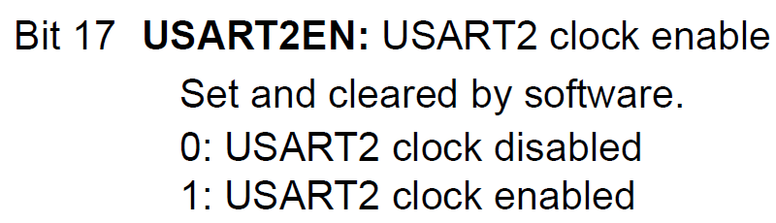
USART2 clock enable
RCC APB1 peripheral clock enable register (RCC_APB1ENR)
RCC->APB1ENR |= (1<<17);

Slide 44
Baudrate of USART2 to be 115200
OVER8=0
with oversampling rate of 16
USARTDIV = f_{ck} / (16 x baud)
16MHz / 16 x 115,200 = 8.68
Now, 08 = 0x008 for upper 12-bits.
For fraction part, 0.68 x 16 = 10.88 and we use 11 = 0xB for lower 4-bits.
Therefore BRR = 0x008B.
USART2->BRR = 0x008B;
Baudrate of USART2 to be 115200 @ 16 Mhz

Slide 45
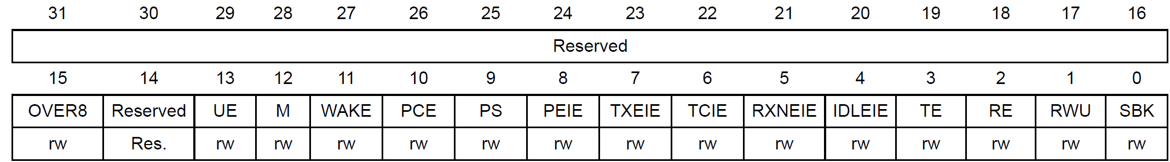
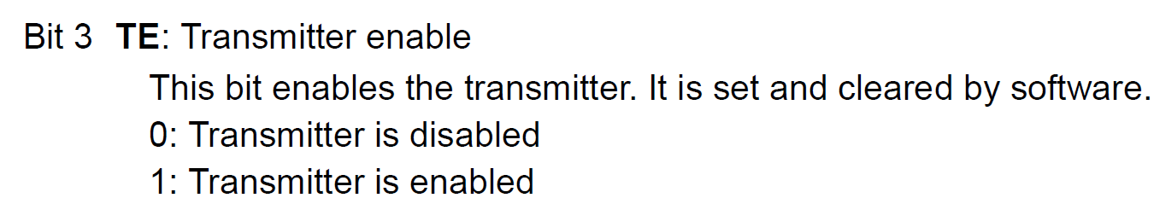
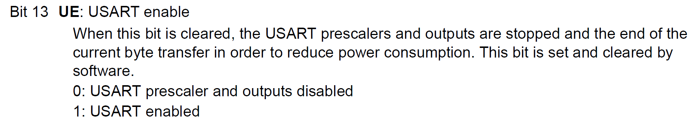
Control register 1 (USART_CR1)
Tx enable
USART2 enable
USART2->CR1 |= (1<<3);
USART2->CR1 |= (1<<13);

Slide 46
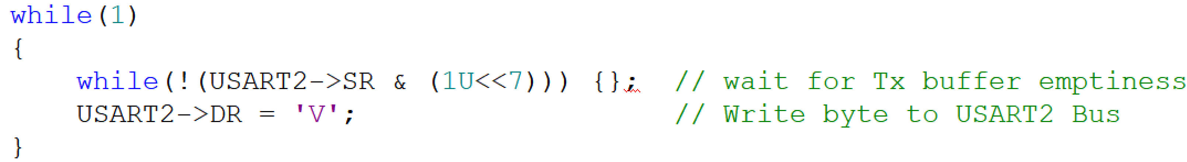
Sending Character Through USART2 TX

Slide 47
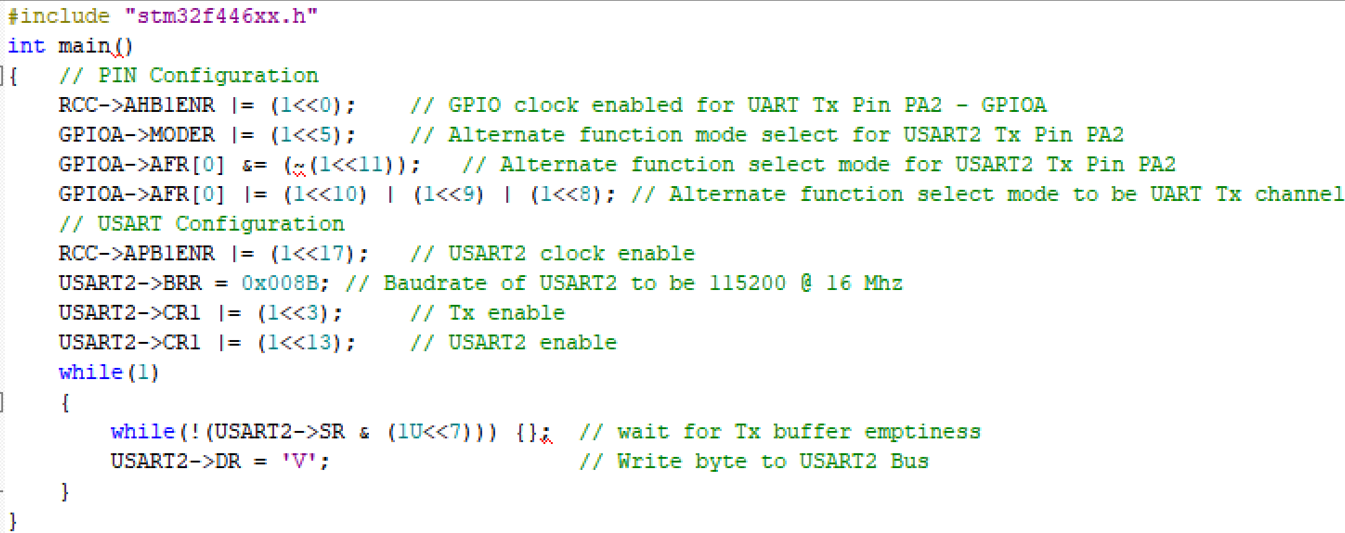
Sending Character Through USART2 TX

Slide 48
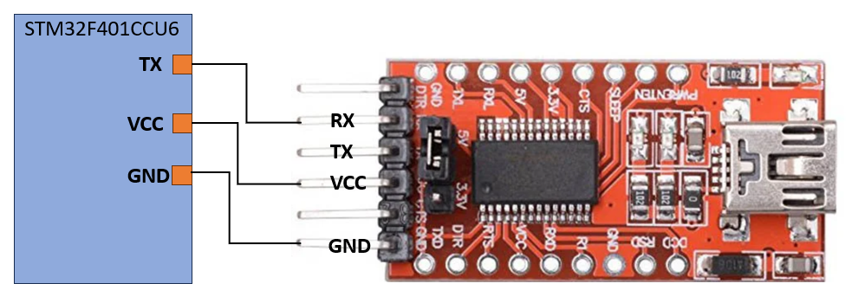
How to view UART output using FT232RL USB-to-serial UART module
Procedure to check the output
The FT232RL (USB to TTL Serial Converter) module is a mini USB to serial UART TTL 5V 3.3V converter circuit board designed for communication between a computer's USB port and the microcontroller's programming port.
This tool acts as a bridge between the STM32 microcontroller's UART hardware peripheral and a desktop computer's USB port.
RX
TX
VCC
GND
FT232 USB UART Board is a UART module that converts the USB interface to the TTL level. This module enables data communication by connecting the USB interface of a computer or other device to TTL logic-level devices such as microcontrollers, sensors, etc.

Slide 49
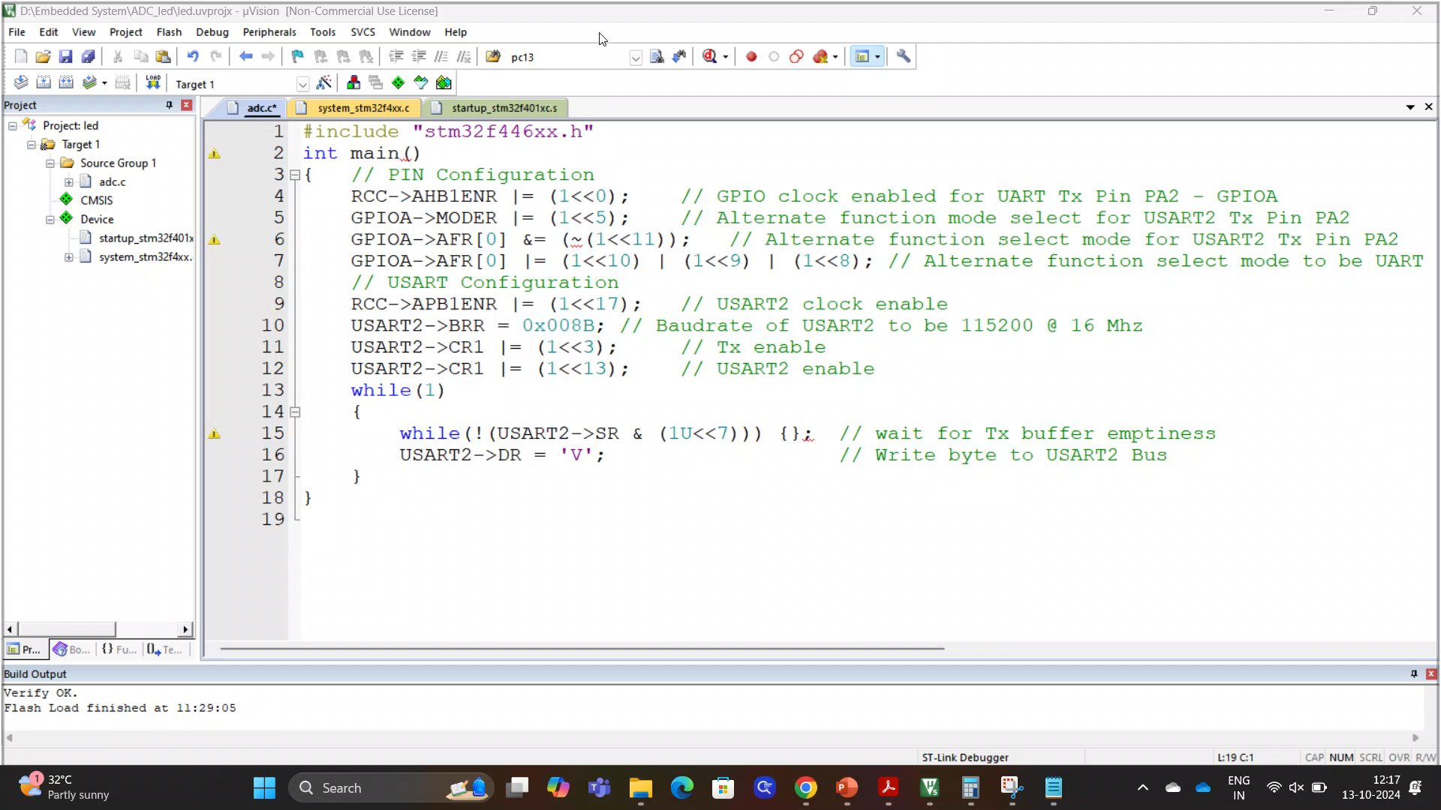
How to view UART output using HW-417 (USB to TTL converter)
Procedure to check the output
Install Docklight V2.4
https://docklight.de/downloads/

Slide 50
Thank You

