Slide 1
I2C
(Inter-Integrated Circuit) using STm32f401ccu6

Slide 2
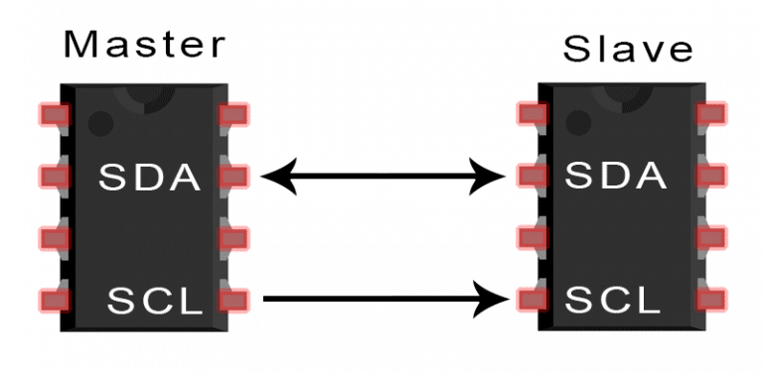
Basics of the I2C Communication Protocol
It is called ‘Inter-Integrated Circuit’, or I2C.
With I2C, you can connect multiple slaves to a single master (like SPI) and you can have multiple masters controlling single, or multiple slaves.
I2C only uses two bi-directional wires to transmit data between devices:
    SDA (Serial Data) – The line for the master and slave to send and receive data.
    SCL (Serial Clock) – The line that carries the clock signal.
I2C is a serial communication protocol, so data is transferred bit by bit along a single wire (the SDA line).
I2C is synchronous, so the output of bits is synchronized to the sampling of bits by a clock signal shared between the master and the slave. The clock signal is always controlled by the master.

Slide 3
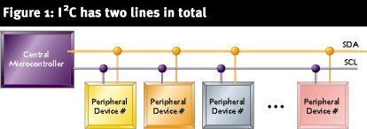
What does I2C consist of?
I2C is a 2 wire serial bus as shown above. The 2 signals are
SDA→ Serial Data
SCL → Serial Clock
Together these signals make it possible to support serial transmission.

Slide 4
I2C BUS
The device that initiates the transaction on the I2C bus is termed the master. The master normally controls the clock signal.
A device being addressed by the master is called the slave.
There needs to be at least one master( a microcontroller or a DSP) on the bus, but there can be more than one master. All the masters on a bus have equal priority.

Slide 5
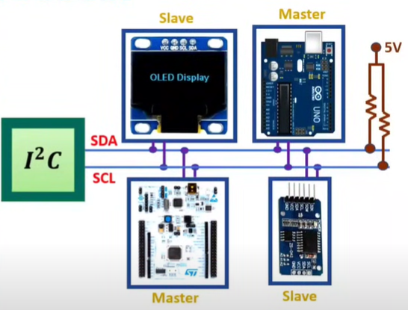
I2C is a popular communication protocol used for connecting low-speed peripherals to microcontrollers in embedded systems.
It was originally designed by Philips Semiconductor in 1982
It is a widely used protocol for short-distance communication
I2C is a two-wire serial communication protocol, which means it uses only two wires for communication:
  SCL (Serial Clock Line): This line carries the clock signal generated by the master device to synchronize data transfer between devices.
  SDA (Serial Data Line): This line carries the data between the master and slave devices.
I2C protocol is interfacing simplicity and with the use of Two lines we can interface 128 devices.
In I2C communication, the pull-up resistors are essential components for ensuring proper signal levels and reliable data transfer on the SDA (Serial Data) and SCL (Serial Clock) lines.
Master-Slave Architecture:
Master: The master device controls the communication. It generates the clock signal (SCL) and initiates data transfers.
Slave: Slave devices listen to the master and respond to its requests. Each slave has a unique address.

Slide 6
I2C is Inter Integrated Circuit Bus protocol.
Only Two lines are required for the communication using I2C protocol.
Here main advantage of I2C protocol is interfacing simplicity and with the use of Two lines we can interface 128 devices.
It is simple, low bandwidth protocol used for short range communication.
Most I2C devices operate up to speed of 400Kbps.
  I2C lines:
    Serial Data SDA
    Serial Clock SCL
Both of these lines are pulled up at 5V, explains that no communication is happening.
Addressing is done by 7 bits to communicate with 128 devices at max.
Here number of devices is also limited by the total allowed bus capacitance of 400pF.
Master is initiating data transfer and controls the clock normally and the device being addressed is slave.

Slide 7
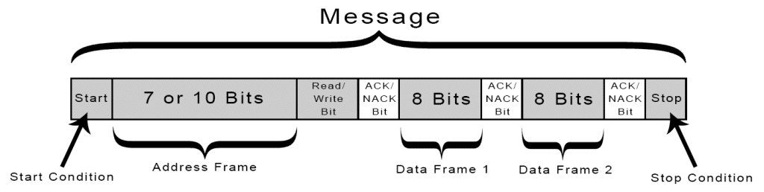
How I2C Works
With I2C, data is transferred in messages.
Messages are broken up into frames of data.
Each message has an address frame that contains the binary address of the slave, and one or more data frames that contain the data being transmitted.
The message also includes start and stop conditions, read/write bits, and ACK/NACK bits between each data frame:

Slide 8

How I2C works? (how data is transmitted between devices on an I2C bus)
F(free) – Bus is idle or free. Both SDA and SCL are in a high state
Start Condition:
  Start Condition: This is the first part of the I2C communication. The master device sends a start signal to indicate the beginning of a communication session.
  It is represented by the SDA line going from high to low while SCL is high. (The SDA line switches from a high voltage level to a low voltage level before the SCL line switches from high to low)
Address Frame:
  7 or 10 Bits: The master device sends the address of the slave device it wants to communicate with. This address can be either 7 bits or 10 bits, depending on the addressing mode.
  Read/Write Bit: This bit indicates whether the master wants to write data to the slave (0) or read data from the slave (1).
  After sending the address and the read/write bit, the slave device will acknowledge (ACK) or not acknowledge (NACK) the message. The ACK/NACK bit ensures that the address was received correctly.

Slide 9
Every device on the I2C bus has a unique 7 bit (or 10 bit) I2C address.
Typically the 4 most significant bits are fixed and assigned to specific categories of devices. Ex: 1010 is assigned to serial EEPROM.
The lower 3 bits are programmable allowing 8 devices of one kind to be present on a single I2C bus.

Slide 10
How I2C workS? (how data is transmitted between devices on an I2C bus)
Data Frames:
  Data Frame 1 and Data Frame 2: These frames carry the actual data to be transferred between the master and the slave. Each frame is 8 bits of data.
  ACK/NACK Bit: After each byte of data, an ACK or NACK bit is sent, allowing the receiving device to acknowledge whether it successfully received the data. If it sends an ACK, the communication continues; if it sends a NACK, the communication is stopped.
Read/Write Bit: A single bit specifying whether the master is sending data to the slave (low voltage level) or requesting data from it (high voltage level).
Stop Condition:
  Stop Condition: This indicates the end of the I2C communication. The master sends a stop signal by making the SDA line go from low to high while SCL is high (i.e. after the SCL line switches from low to high.)
  . This tells all devices on the bus that the communication session has ended.

Slide 11
Terminology for bus transfer
SCL and SDA are bi-directional !
F(free) – Bus is idle or free. Both SDA and SCL are in a high state
S(Start) or R(Restart) – SDA changes from high to low with the SCL line remaining high. All data transfers begin with S(Start) condition.
C(Change) – SCL line is low. Data bit to be transferred is applied to the SDA line.
D(Data) – high or low bit of information on SDA line is valid during the high level of the SCL line.
P(Stop) – SDA line changes from low to high with SCL line remaining high. All data transfers end with P(Stop) condition.

Slide 12
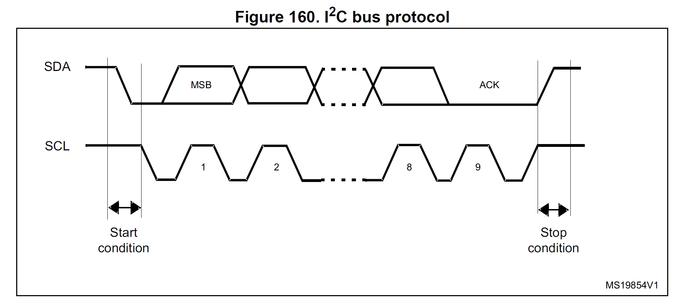
What is Start and Stop Conditions ?
The transmission starts when a START condition is generated by the Master.
This condition occurs when SDA goes from a HIGH to a LOW state when SCL is HIGH.
Similarly, a STOP condition ends the transmission, when SDA goes from a LOW to a HIGH state when SCL is HIGH.

Slide 13

Data transfer
Data is transferred in sequences of 8 bits.
Bits are placed on SDA line with MSB first.
SCL line is then pulsed high and then low.
For every 8 bits transferred, the device receiving the data sends back an acknowledge bit.

Slide 14
Writing to a slave device
Master sends a start sequence. This alerts all the slave devices to an impending transaction and they should listen , in case its for them.
Next the master sends out the device address with read/write bit low. The slave that matches this address will continue the transaction , while others ignore.
Master can now send data byte(s).
Master sends the stop sequence.

Slide 15
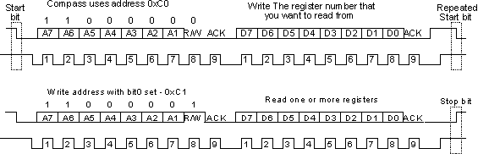
Reading from a slave
Master sends a start sequence.
Master sends the device address with read/write bit high.
Master reads data from the device.
Master sends the stop sequence

Slide 16
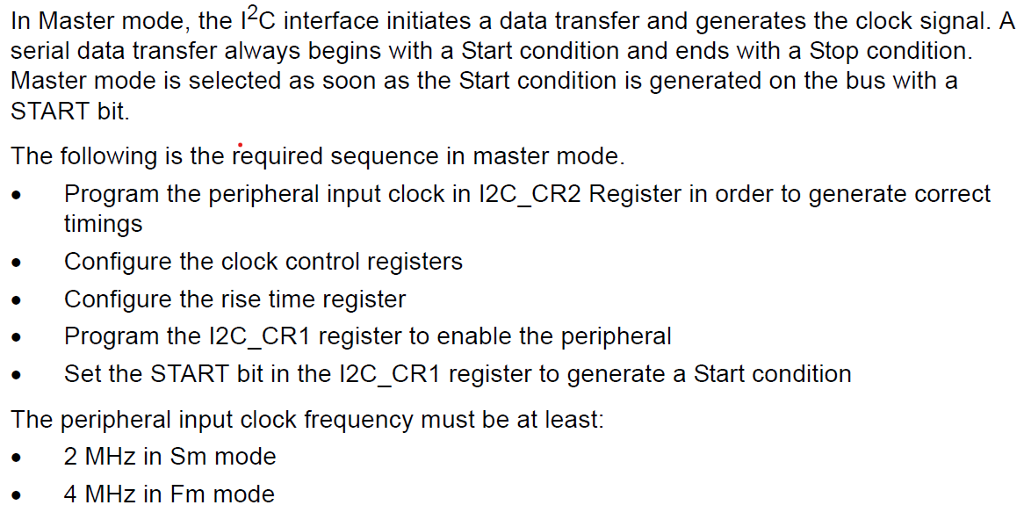
I2C master mode
Sm Mode – Standard Mode
Fm Mode – Fast Mode

Slide 17
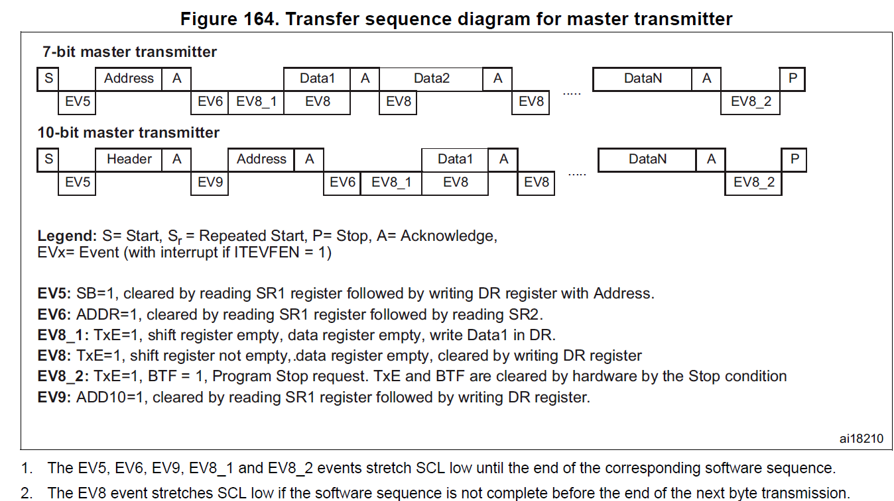

Slide 18
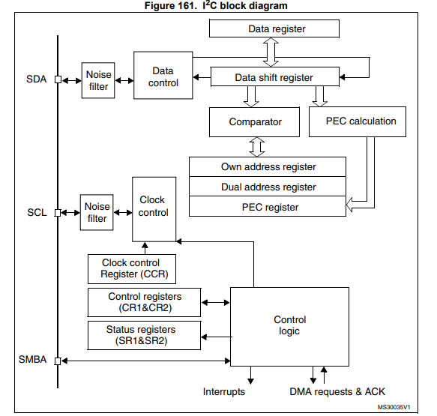
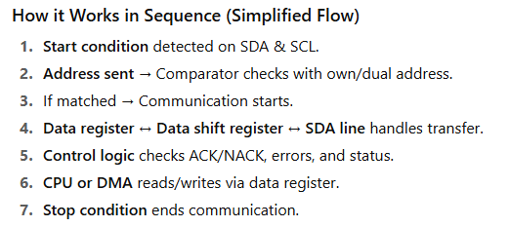
I2C block diagram

Slide 19
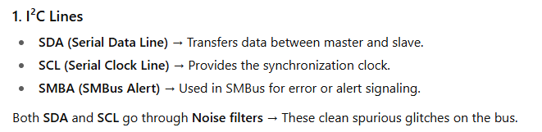
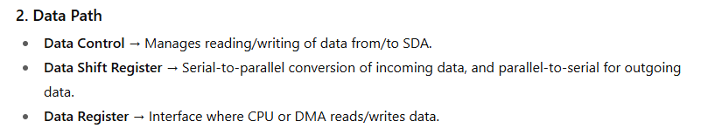
I2C block diagraM

Slide 20
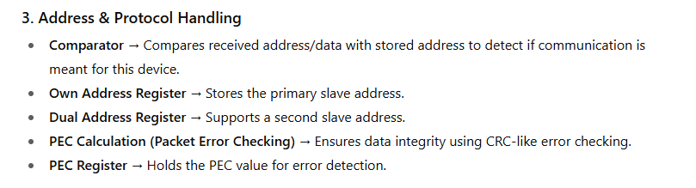
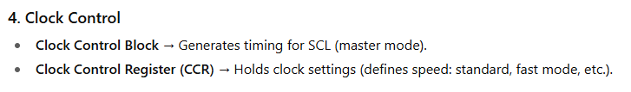
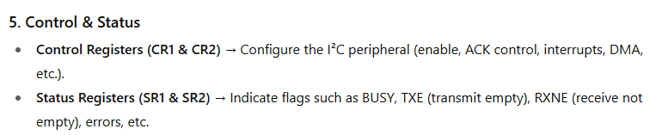
I2C block diagraM

Slide 21
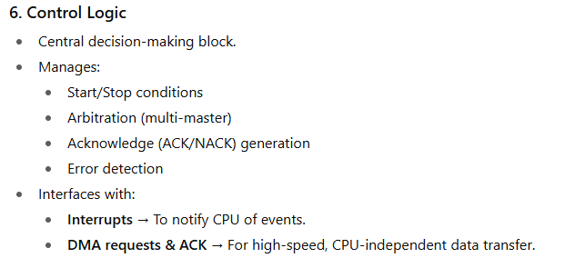
I2C block diagraM

Slide 22
Feature | I2C | UART
Communication Type | Synchronous (requires clock) | Asynchronous (no clock)
Number of Wires | 2 wires (SDA, SCL) | 2 wires (TX, RX)
Devices Supported | Multiple devices (multi-master) | Typically one device (point-to-point)
Speed | 100 kbps to 3.4 Mbps | Varies (9600 to several Mbps)
Data Transfer | Half-duplex (1 direction at a time) | Full-duplex (2 directions simultaneously)
Addressing | Yes (7-bit or 10-bit address) | No addressing
Complexity | More complex (protocol handling) | Simpler to implement
Power Consumption | Typically low | Can be higher, depending on speed
Use Case | Multiple devices on one bus | Point-to-point communication

Slide 23
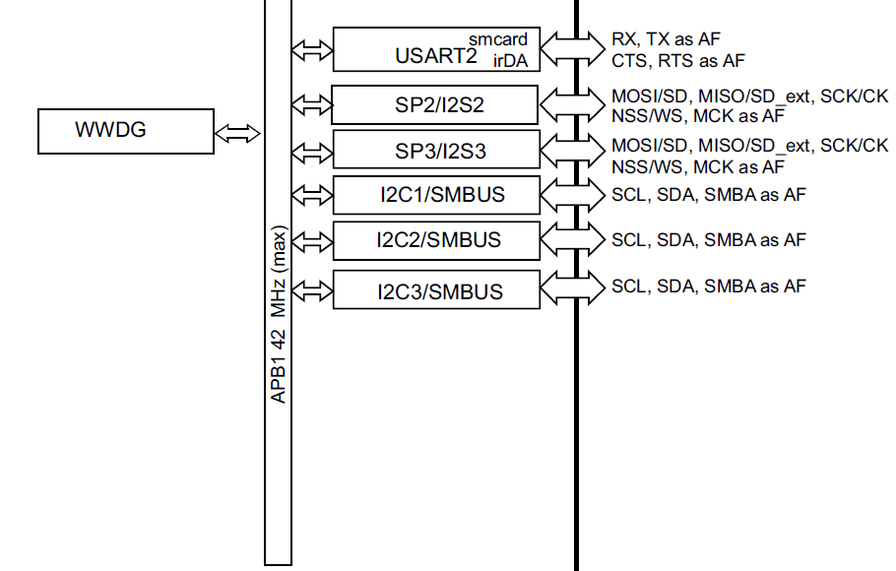
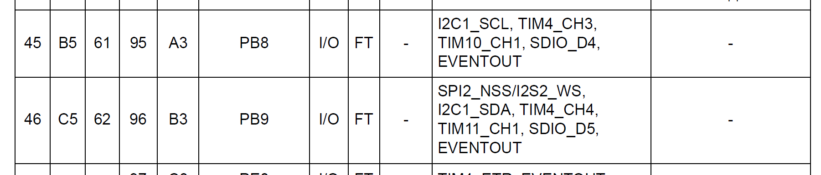
I2C communication using STM32F401CCU6

Slide 24
Registers to Configure
I2C Peripheral Registers
  CR1 (Control Register 1): Enables I2C peripheral, sets master/slave mode, interrupts, and error handling.
  CR2 (Control Register 2): Defines the frequency of the clock, the DMA/interrupts to use, and other communication-related settings.
  OAR1 (Own Address Register 1): Sets the I2C master/slave address.
  DR (Data Register): Holds data to be transmitted/received.
  SR1 and SR2 (Status Registers): Monitor the status of the I2C bus (e.g., bus busy, acknowledgment).

Slide 25
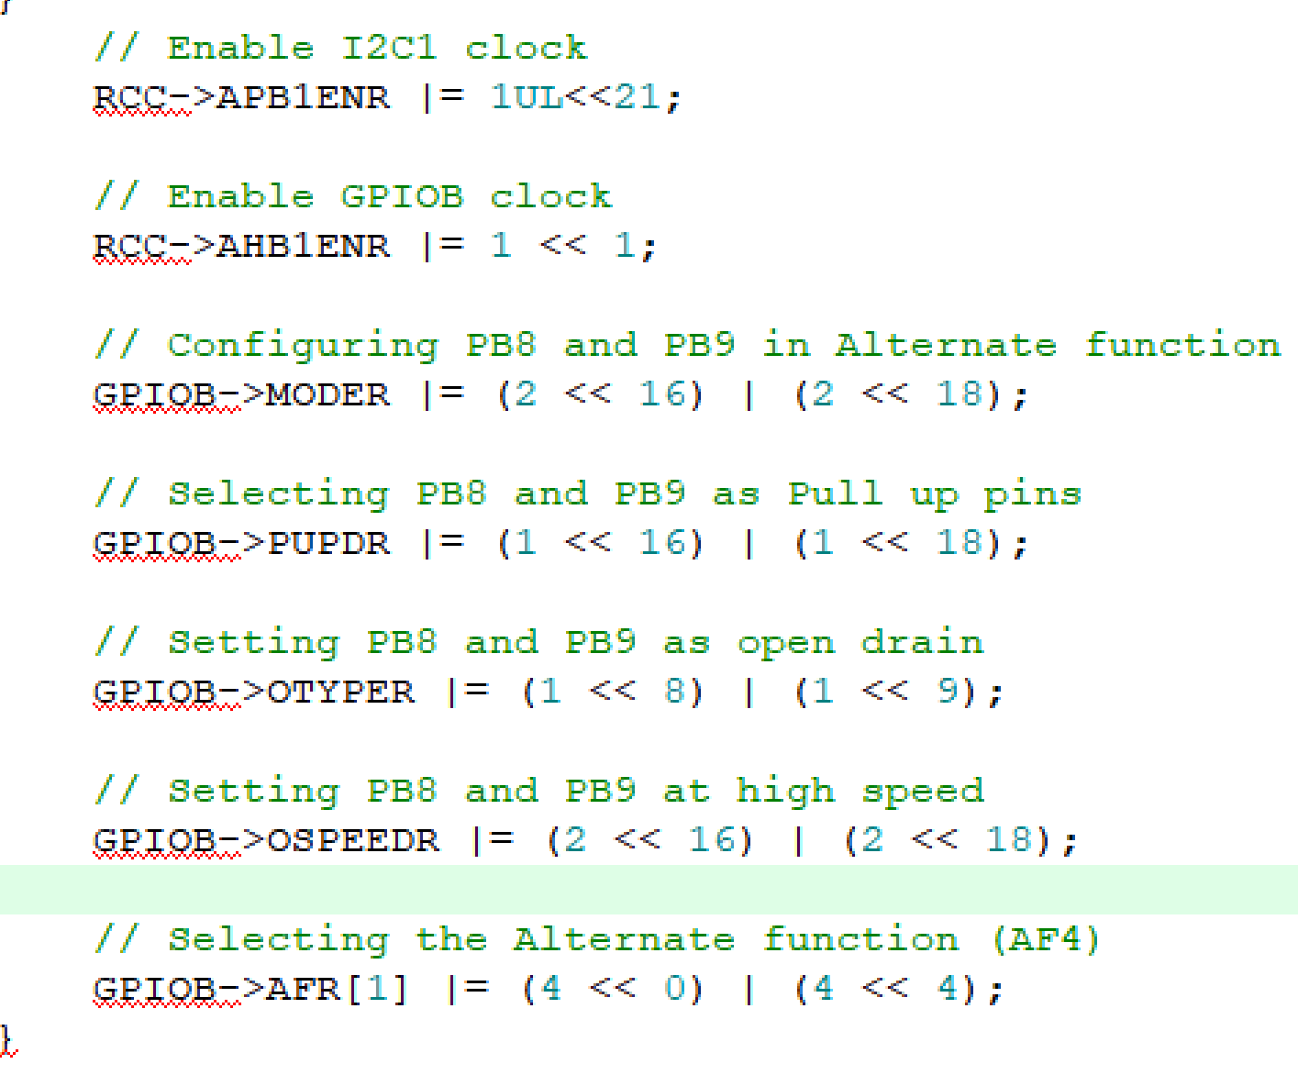
I2C Pin Configuration (GPIO Configuration)
Refer Datasheet for individual register configurations

Slide 26
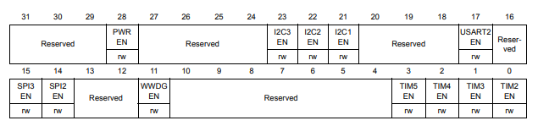

I2C clock Enable

Slide 27
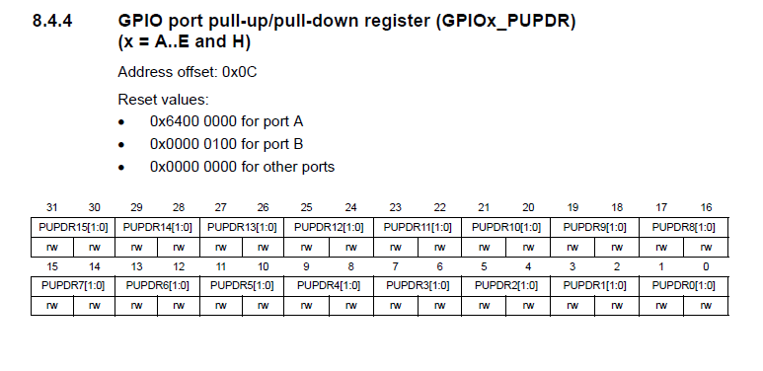
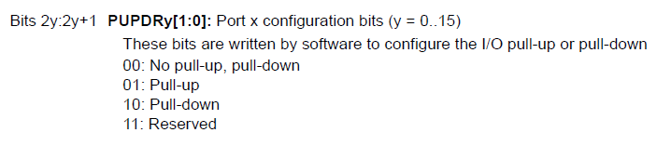

Slide 28
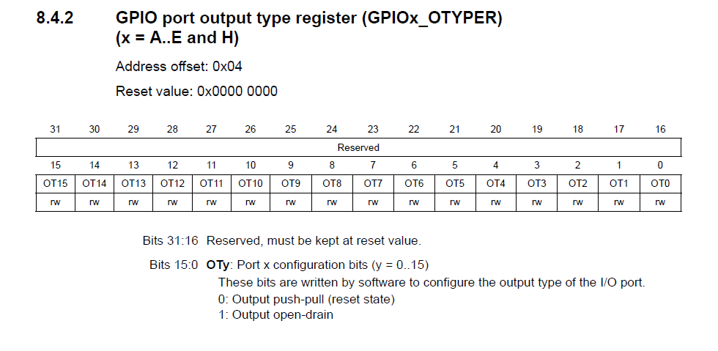
Otype – Output Type Register
Open-Drain (Bit = 1)
In this mode, the output driver can only actively pull the pin to ground.
To get a defined high logic level, an external pull-up resistor is required to pull the pin up to the desired voltage. This is crucial for bus-like communication protocols such as I2C, which require multiple devices to share the same line.

Slide 29
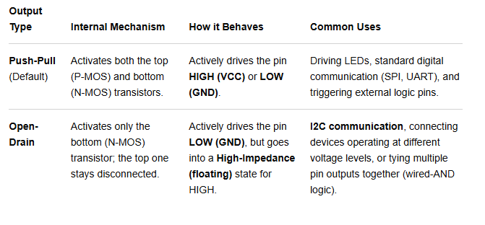
The OTYPE (Output Type) register in an STM32 microcontroller is used to configure whether a GPIO pin acts as a Push-Pull output or an Open-Drain output.
It only applies to pins that you have already configured as Outputs (either general-purpose outputs or alternate function outputs) in the MODER register.

Slide 30
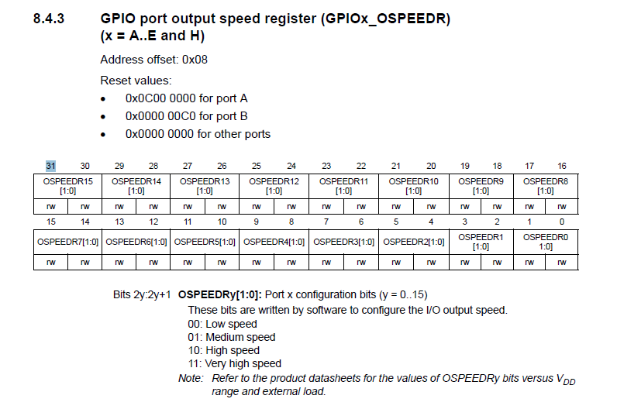

Slide 31
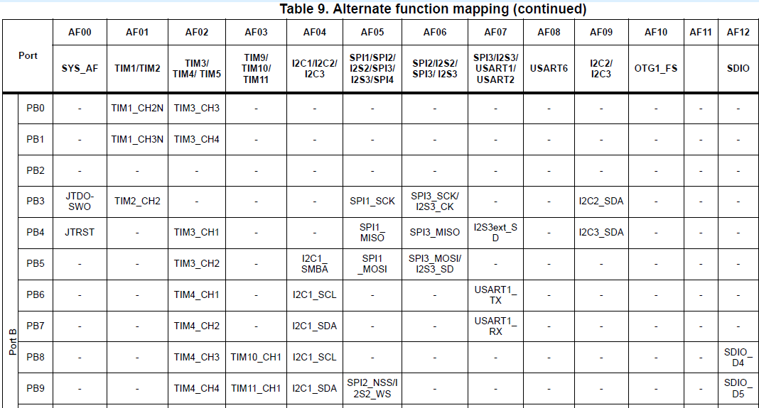

Slide 32
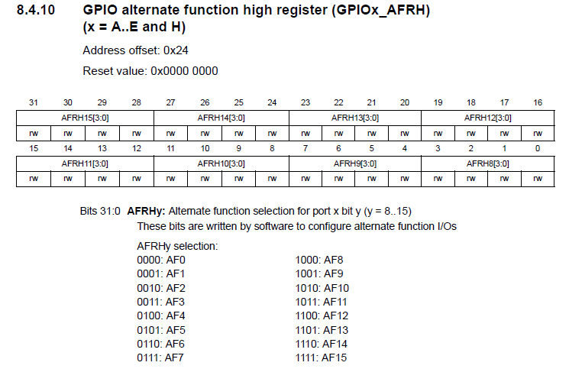

Slide 33
Registers to Configure
I2C Peripheral Registers
  CR1 (Control Register 1): Enables I2C peripheral, sets master/slave mode, interrupts, and error handling.
  CR2 (Control Register 2): Defines the frequency of the clock, the DMA/interrupts to use, and other communication-related settings.
  OAR1 (Own Address Register 1): Sets the I2C master/slave address.
  DR (Data Register): Holds data to be transmitted/received.
  SR1 and SR2 (Status Registers): Monitor the status of the I2C bus (e.g., bus busy, acknowledgment).

Slide 34
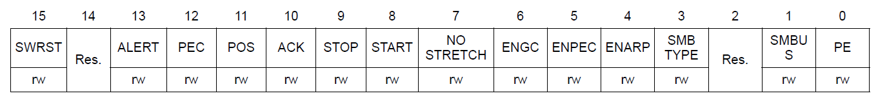
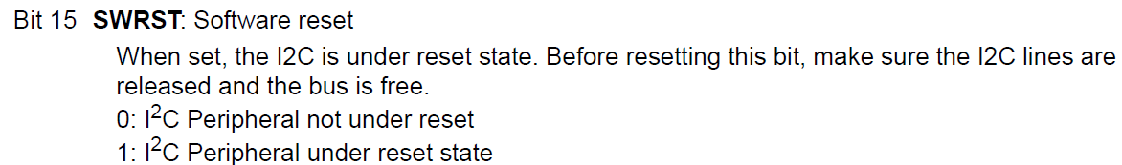
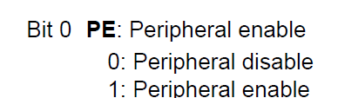
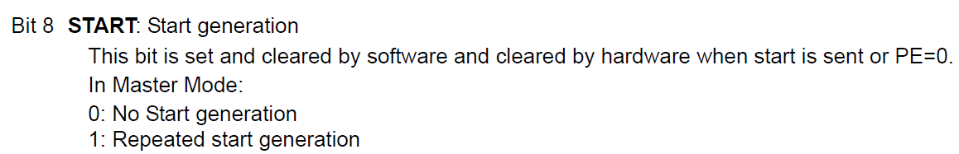
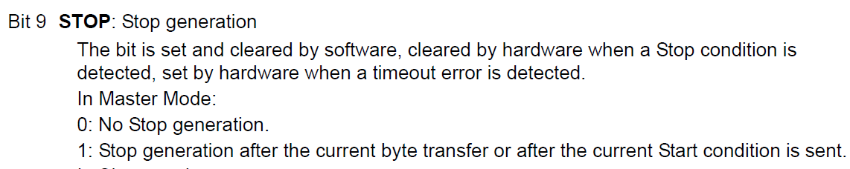
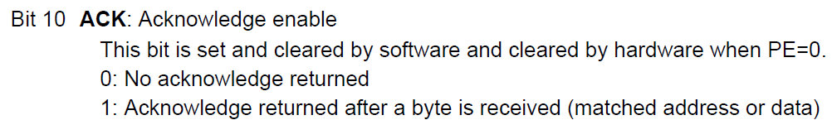
I2C Control register 1 (I2C_CR1)
// Reset I2C
I2C1->CR1 |= 1UL<<15;
I2C1->CR1 &= ~(1UL<<15);

Slide 35
The START generation bit in the I2C control register 1 (I2C_CR1) is a software-controlled bit that initiates an I²C communication session in master mode. Setting this bit to '1' instructs the I²C peripheral to perform the hardware sequence for a START condition on the bus
How it works
The START bit's function is best understood within the sequence of a typical master I²C transmission:
Bus is idle: The master checks that the I²C bus is free (the SDA and SCL lines are high).
Set the START bit: The master writes a '1' to the START bit in the I2C_CR1 register.
Hardware generates START: The I²C peripheral's hardware takes over, pulling the SDA line low while the SCL line remains high. This creates the official START signal on the bus.
Hardware switches to master mode: The I²C peripheral automatically switches to master mode (if it wasn't already).
Status flag is set: The hardware sets a corresponding flag, such as the SB (Start bit) flag in the I2C_SR1 status register, to indicate that the START condition has been generated.
Software proceeds: The microcontroller's software, which is polling the status register, proceeds with the next step of the transmission—sending the slave address.
Hardware clears START bit: The hardware automatically clears the START bit in I2C_CR1 after the START condition is sent, but the software must not write to the register again until this process is complete.
The same START bit is used to generate a "repeated START" condition. This allows the master to initiate a new transaction without first sending a STOP condition and releasing the bus. This is commonly used in read operations where the master sends a device register address (a write operation) and then, without releasing the bus, sends a repeated START and the device address again for a read

Slide 36
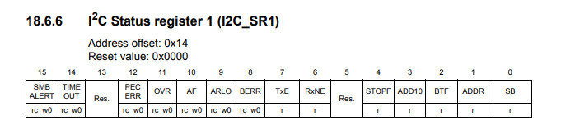
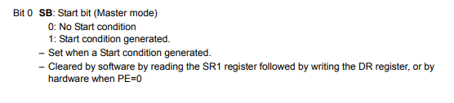
The SWRST bit in the I2C CR1 (Control Register 1) is a software reset bit that forces the I2C peripheral into its default, power-up state. It is most commonly used to recover from an I2C bus lockup or other error conditions.

Slide 37
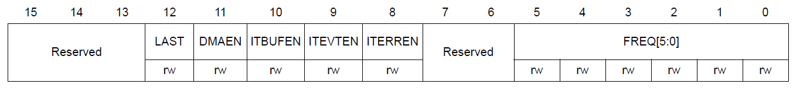
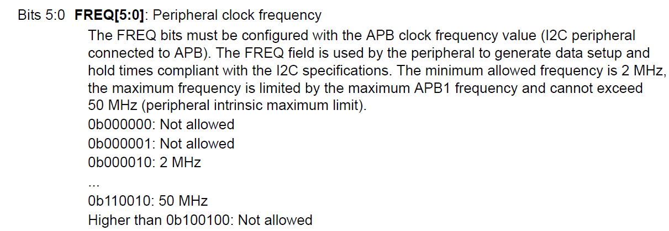
I2C Control register 2 (I2C_CR2)
// // Set I2C clock at 16MHz I2C
I2C1->CR2 |= (16<<0);
Look into the speed mode (standard, fast, very-fast, etc.)

Slide 38
I2C Clock Control Register (CCR) Overview
The CCR register is responsible for controlling the clock speed of the I2C bus.
It plays a crucial role in determining the SCL clock frequency (speed of communication).
This register is typically used when configuring the I2C interface in either Standard Mode (100 kHz) or Fast Mode (400 kHz).
A clock pulse have two edges, rising edge (time taken to stabilize at rising edge is t_{high} ) and falling edge (time to taken to stabilize at falling edge is t_{low} )
T_{w} is time duration of the ‘width of the clock pulse’

Slide 39
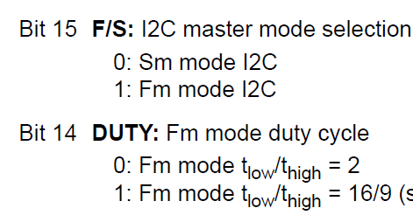
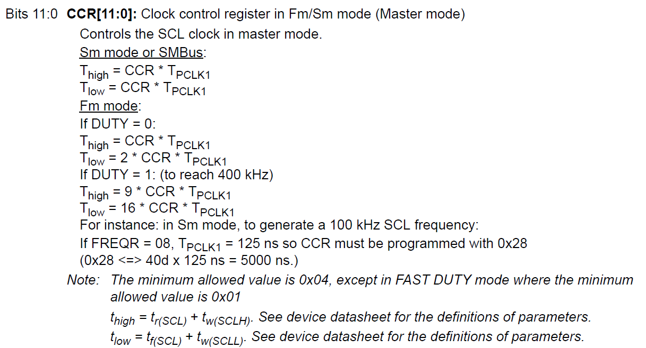
I2C Clock control register (I2C_CCR)

Slide 40
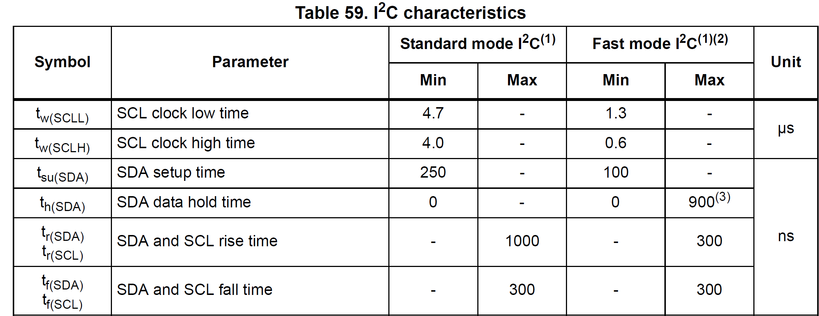

Slide 41
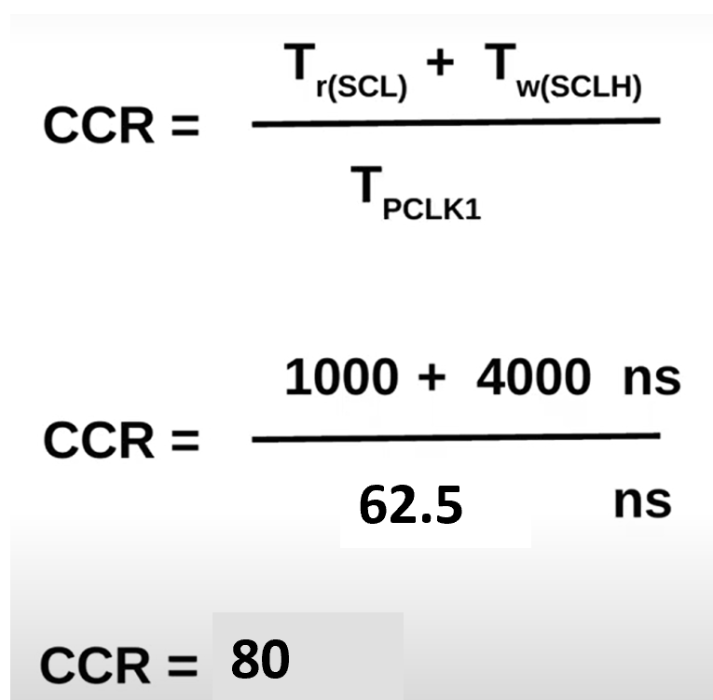
I2C Clock control register (I2C_CCR)
Our peripheral clock is running at 16 MHz, so
// Configure the clock control register
I2C1->CCR = 80;
Tr(SCL): The rise time of the SCL (clock line), which is the time taken for the SCL line to transition from low to high. This is typically configured in the I2C_TRISE register.
Tr(SCLH): The SCL high time, which refers to the duration that the SCL line stays high during the I2C clock period. This is influenced by the CCR value.
Tpclk1: The APB1 clock period, which is the period (inverse of the frequency) of the APB1 bus clock. This clock is used to drive the I2C peripheral.

Slide 42
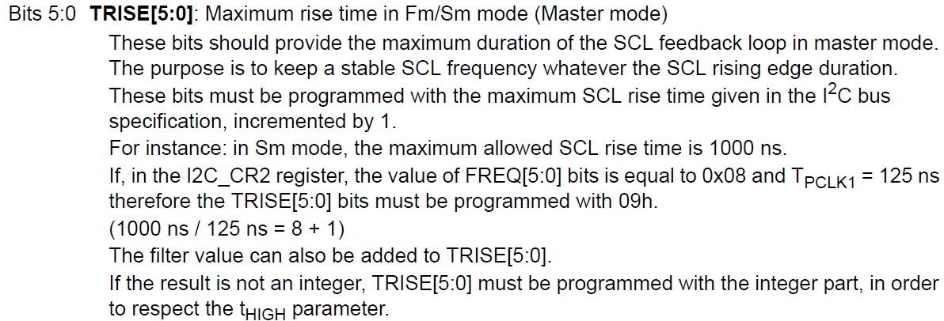
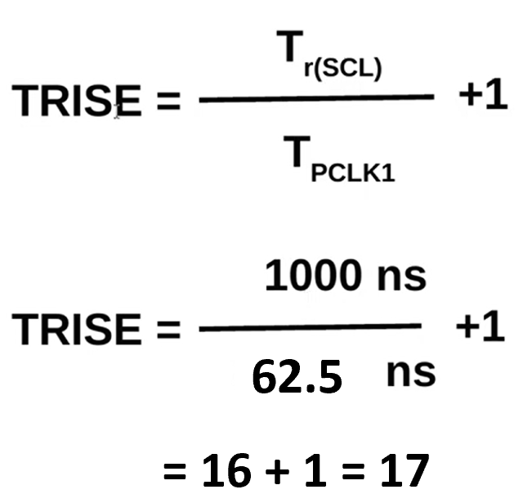
I2C TRISE register (I2C_TRISE)
The I2C_TRISE register in the STM32F401CCU6 microcontroller is used to configure the rise time of the SCL (Serial Clock Line) during I2C communication.
The rise time is important because it affects the timing and synchronization of data transfer between the I2C master and slave devices.
// Configure the rise time register
I2C1->TRISE |= 17;

Slide 43
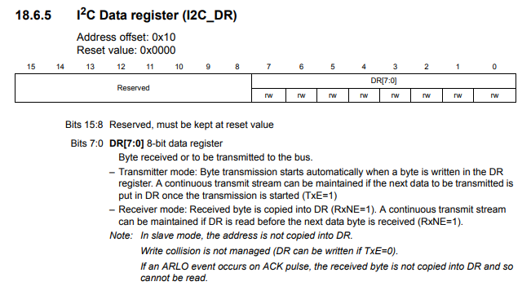

Slide 44
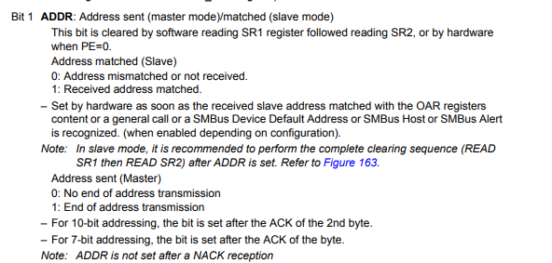

Slide 45
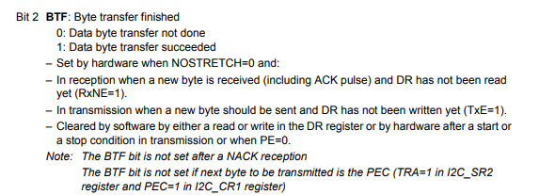

Slide 46
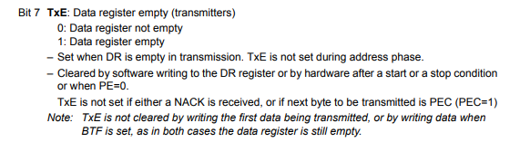

Slide 47
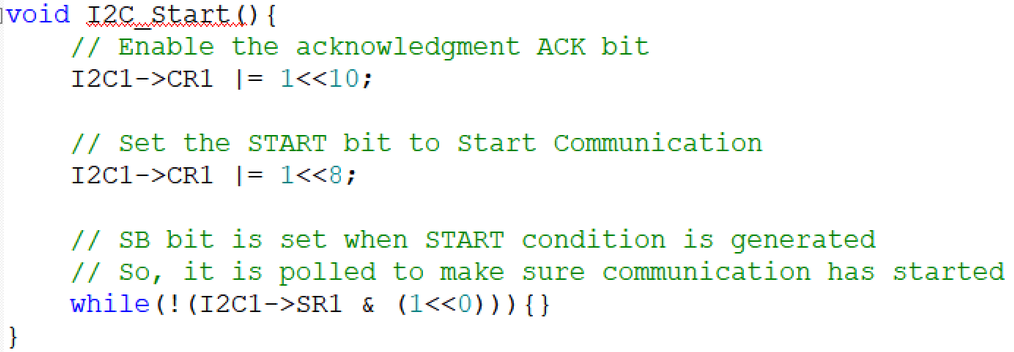
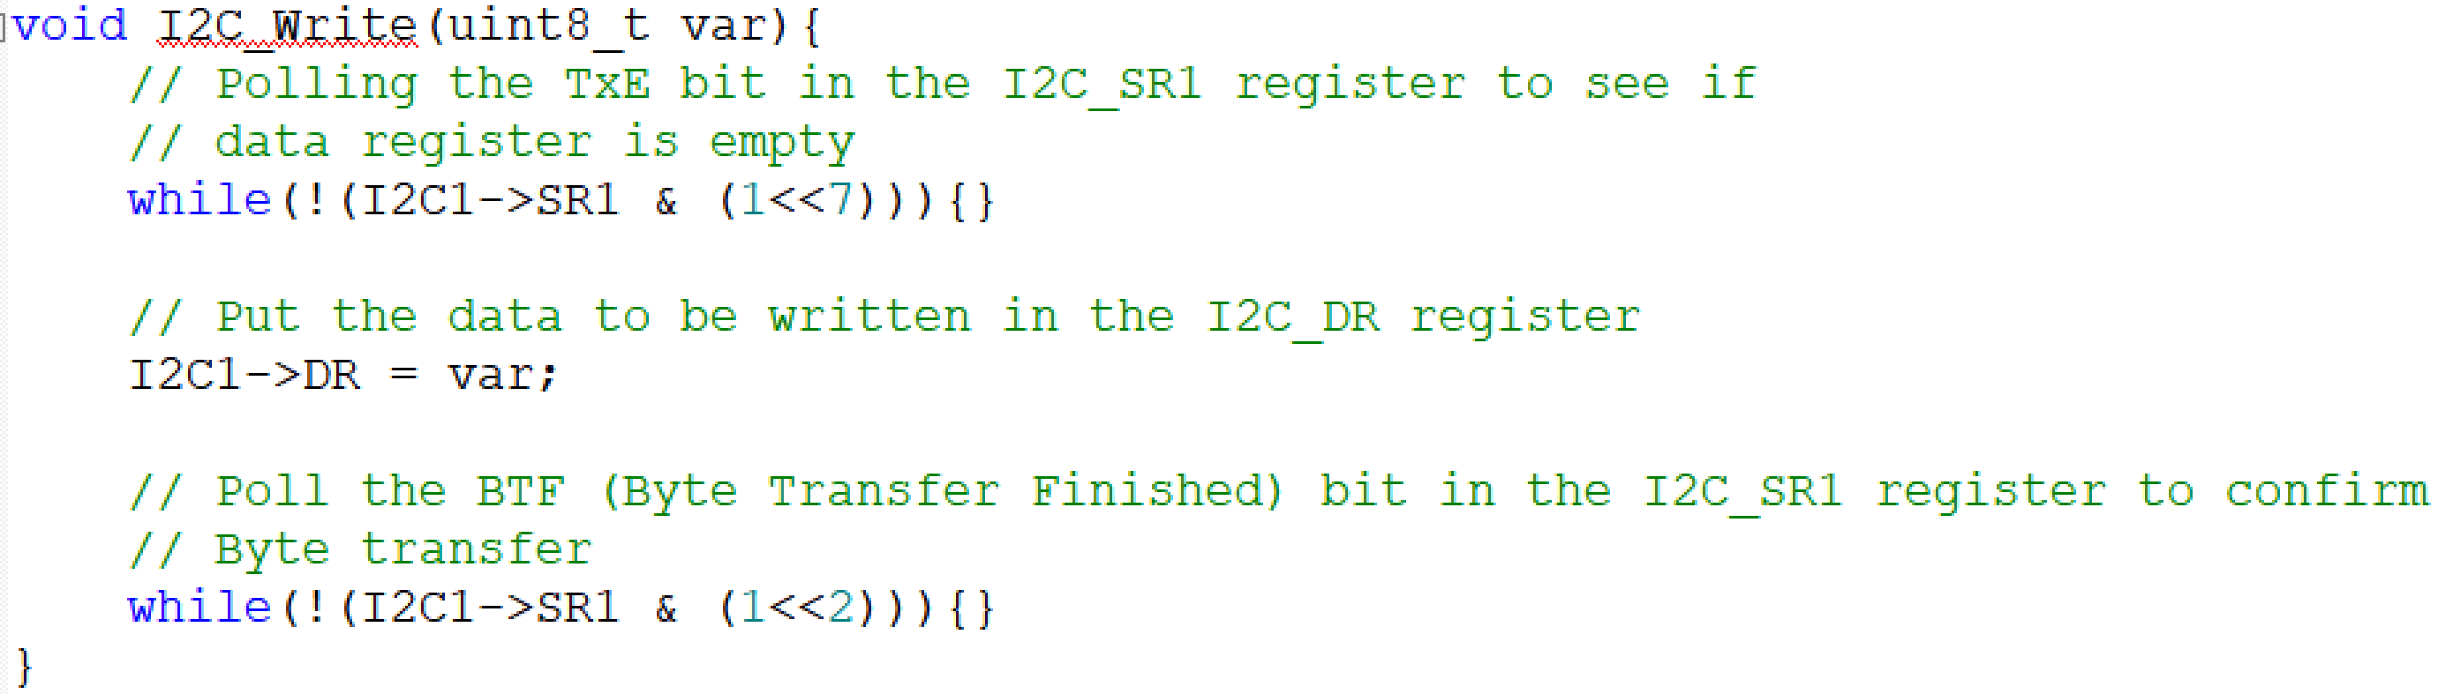
Configurations to transmit data
// Enable I2C
I2C1->CR1 |= 1<<0;

Slide 48
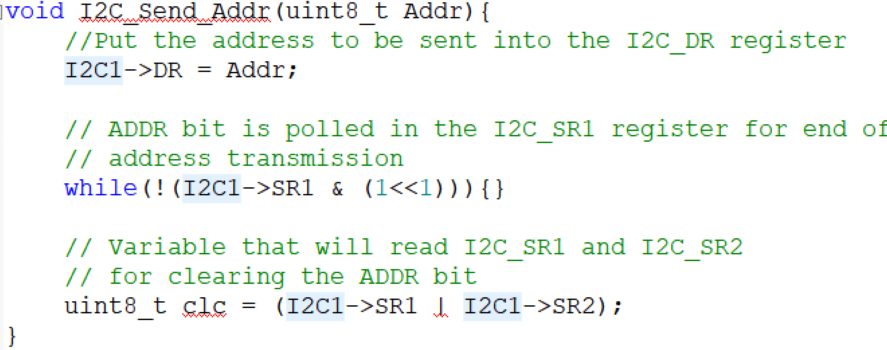


Configurations to transmit data

Slide 49
Thank You

