Slide 1
STM32F401CCU6
ARM Cortex M4 Series MCU

Slide 2
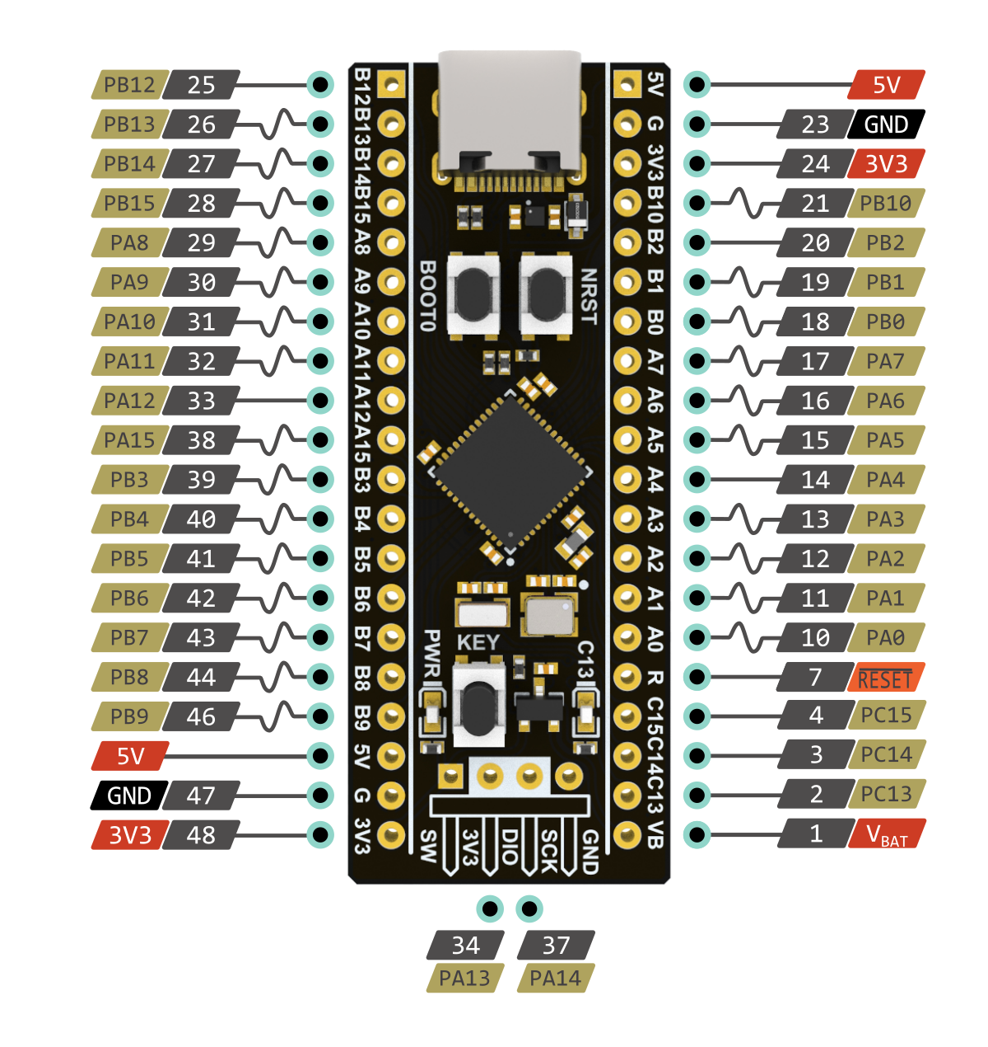
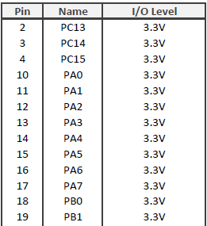
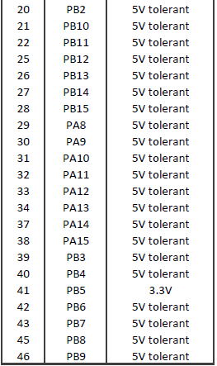

Slide 3
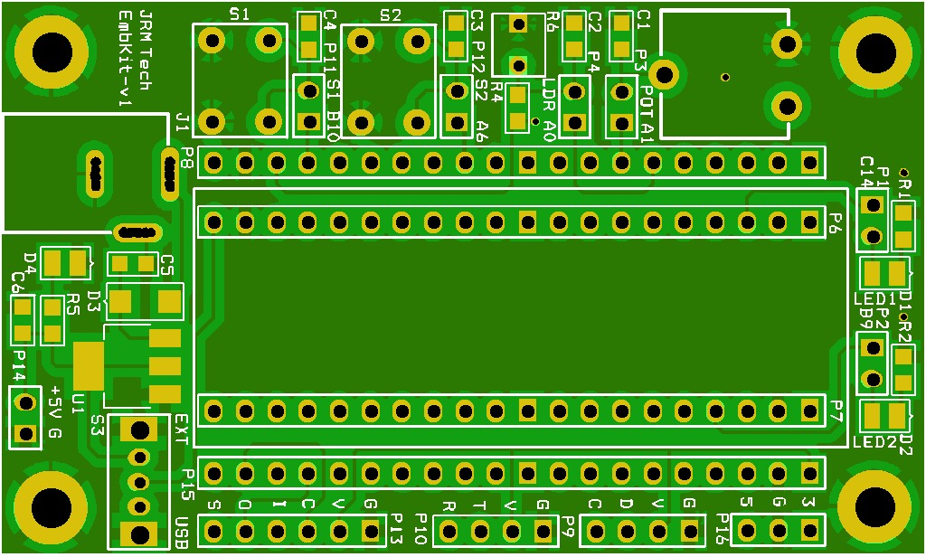

Slide 4
STM32F401-Refmanual.pdf
Refer Section 8 – GPIO 8.4
STM32F411 Black Pill Pinout, Schematic, Datasheet (Dev. Board) (deepbluembedded.com)

Slide 5
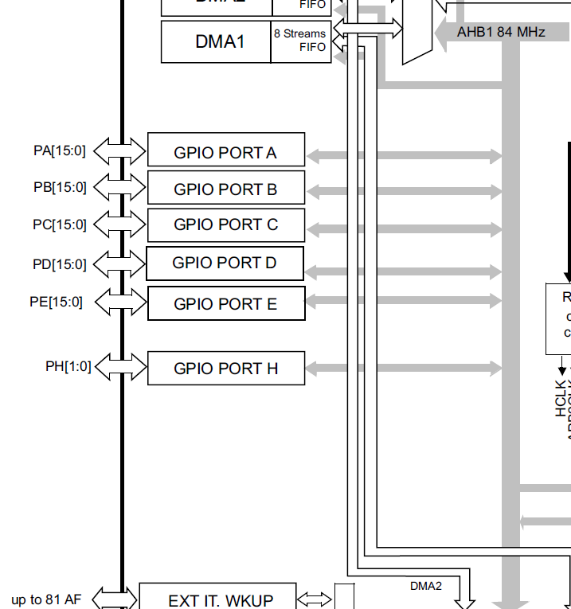
General-purpose I/Os (GPIO)
GPIO F/G/H/I/J/K (except GPIOH0 and GPIOH1) are not available in STM32F401

Slide 6
General-purpose I/Os (GPIO)
Each general-purpose I/O port has four 32-bit configuration registers:
GPIOx_MODER
GPIOx_OTYPER
GPIOx_OSPEEDR
GPIOx_PUPDR
Two 32-bit data registers
GPIOx_IDR and GPIOx_ODR)
A 32-bit set/reset register : GPIOx_BSRR
GPIO F/G/H/I/J/K (except GPIOH0 and GPIOH1) are not available in STM32F401xB/C and STM32F401xD/E.

Slide 7
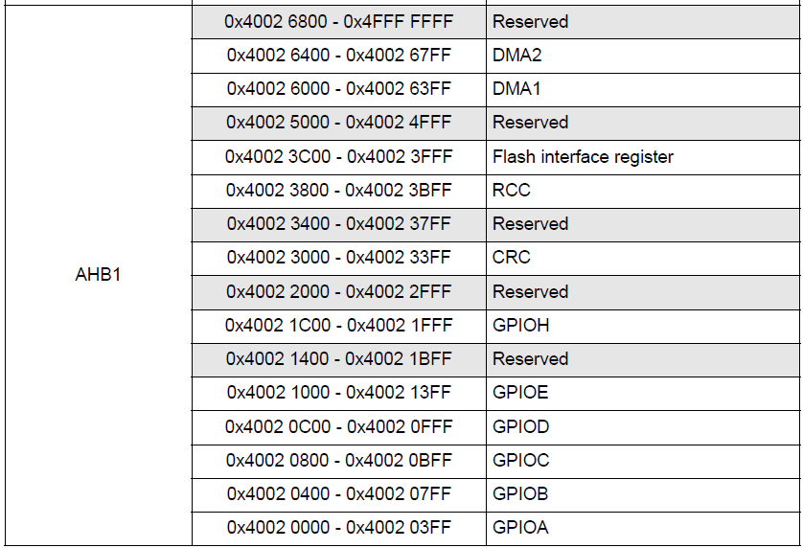
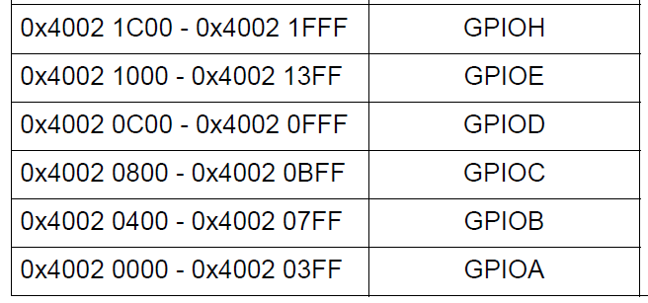
GPIO Registers Address

Slide 8
Reset and Clock Control (RCC)
RCC (Reset and Clock Control): Manages system clocks and resets for the STM32 microcontroller.
Key Functions
Clock Configuration: Controls the system clock (SYSCLK) and peripheral clocks. Can select clock sources like HSE, HSI, and PLL.
Clock Enable/Disable: Manages clocks for AHB, APB1, and APB2 buses, allowing peripherals to be enabled or disabled.
Clock Dividers: Allows different clock speeds for the core and peripherals.
Reset Control: Manages system and peripheral resets to ensure proper initialization.
Clock Security System (CSS): Monitors HSE clock failures and switches to a safe clock source if necessary.
Importance
Power Management: Reduces power consumption by controlling peripheral clocks.
System Stability: Ensures proper clock signals for synchronization and stability.
Peripheral Control: Provides fine-grained control over active peripherals.

Slide 9
RCC_AHB1ENR
Register Name: RCC_AHB1ENR (AHB1 Peripheral Clock Enable Register)
Register Address: 0x4002 3830
Function: Controls the clock for the GPIO ports connected to the AHB1 bus.
Purpose: Enables or disables the clocks for GPIO ports, ensuring they are powered and functional when needed.
Key Consideration: Disabling the clocks for unused GPIO ports helps in reducing power consumption, especially important in low-power applications.
Practical Application
Embedded Systems: Enable only the necessary GPIO ports for your application, ensuring minimal power usage.
Dynamic Control: Clocks can be enabled or disabled dynamically depending on the operational requirements of the system.

Slide 10

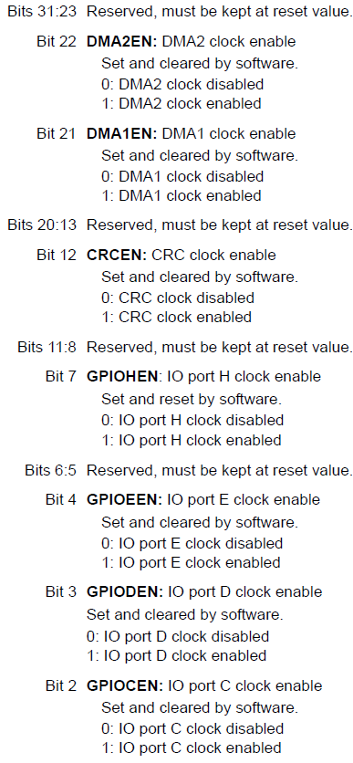
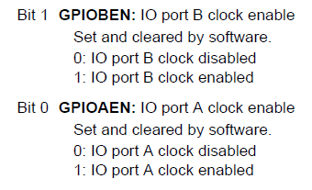
/*1. Enable GPIOA clock by Writing 1 to bit0 of AHB1ENR*/
RCC->AHB1ENR |=(1U<<0);

Slide 11
/*1. Enable GPIOA clock by Writing 1 to bit0 of AHB1ENR*/
RCC->AHB1ENR |=(1U<<0);
/*2. Enable GPIOC clock by writing 1 to bit2 of AHB1ENR*/
RCC->AHB1ENR |=(1U<<2);

Slide 12
GPIOx_MODER

Slide 13
GPIOx_MODER
Function: Configures the mode (input, output, alternate function, or analog) for each pin of the GPIO port.
Register Structure
Register Size: 32 bits
Bit Pairs (2 bits per pin): Each pin of the GPIO port has a corresponding 2-bit field in the GPIOx_MODER register.
Bit Field Values
Each 2-bit field determines the mode of the corresponding GPIO pin:
00: Input mode
01: General-purpose output mode
10: Alternate function mode
11: Analog mode
Importance
Pin Configuration: Essential for defining the function of each pin in your application.
Flexible Control: Allows dynamic reconfiguration of pins for different purposes (e.g., input, output, communication interfaces).
Use Cases
Input Mode: Reading sensors, buttons, or other digital inputs.
Output Mode: Driving LEDs, relays, or other digital outputs.
Alternate Function Mode: Configuring pins for peripheral functions like UART, SPI, I2C, etc.
Analog Mode: Using pins for ADC or DAC operations.

Slide 14


/*2. Set PC13 to output mode by writing 1 to bit10 of MODER*/
GPIOC->MODER |=(1U<<26);

Slide 15
/*3. Set PA0 to input mode by writing 0 to bit0 and bit 1 of MODER*/
GPIOA->MODER &= ~(3U << 0);
/*4. Set PC13 to output mode by writing 1 to bit26 of MODER*/
GPIOC->MODER |=(1U<<26);

Slide 16
GPIOx_OTYPER

Slide 17
This register allows configuring each GPIO pin as either an open-drain or a push-pull output.
0: Configures the pin as a push-pull output.
1: Configures the pin as an open-drain output.
Feature | Push - Pull Output | Open - Drain Output
Drive Capability | Drives both high and low | Drives only low (requires pull-up for high)
Pin States | Low (GND), High (Vdd) | Low (GND), Floating (High impedance)
Common Usage | Driving LEDs, logic signals | I²C, shared interrupt lines, multiple devices on a single bus

Slide 18
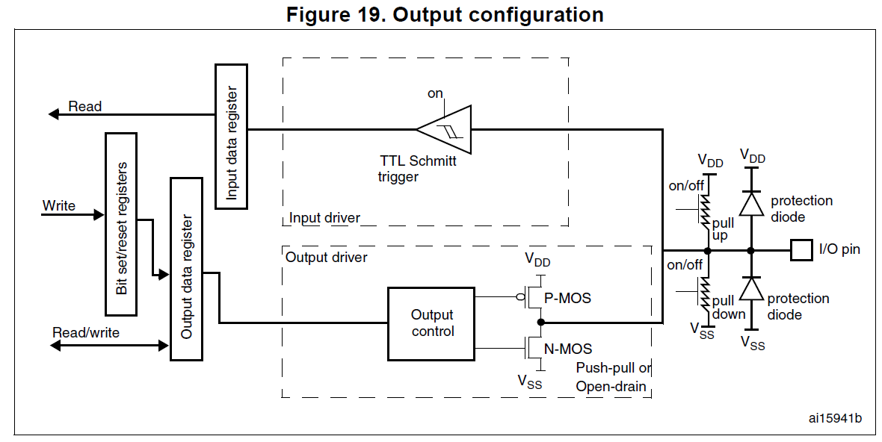

Slide 19
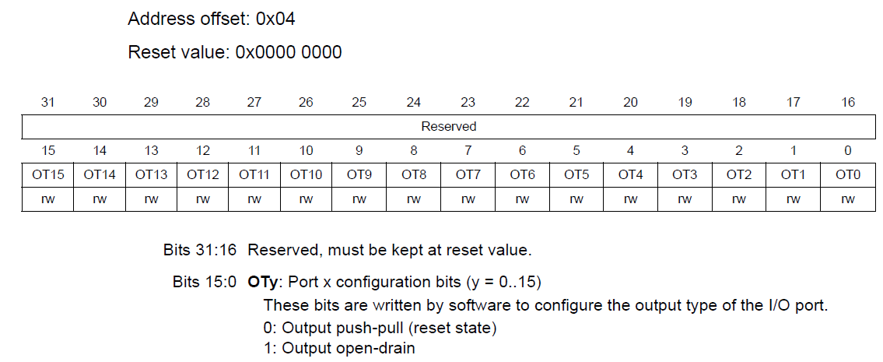

Slide 20
GPIOx_OSPEEDR

Slide 21
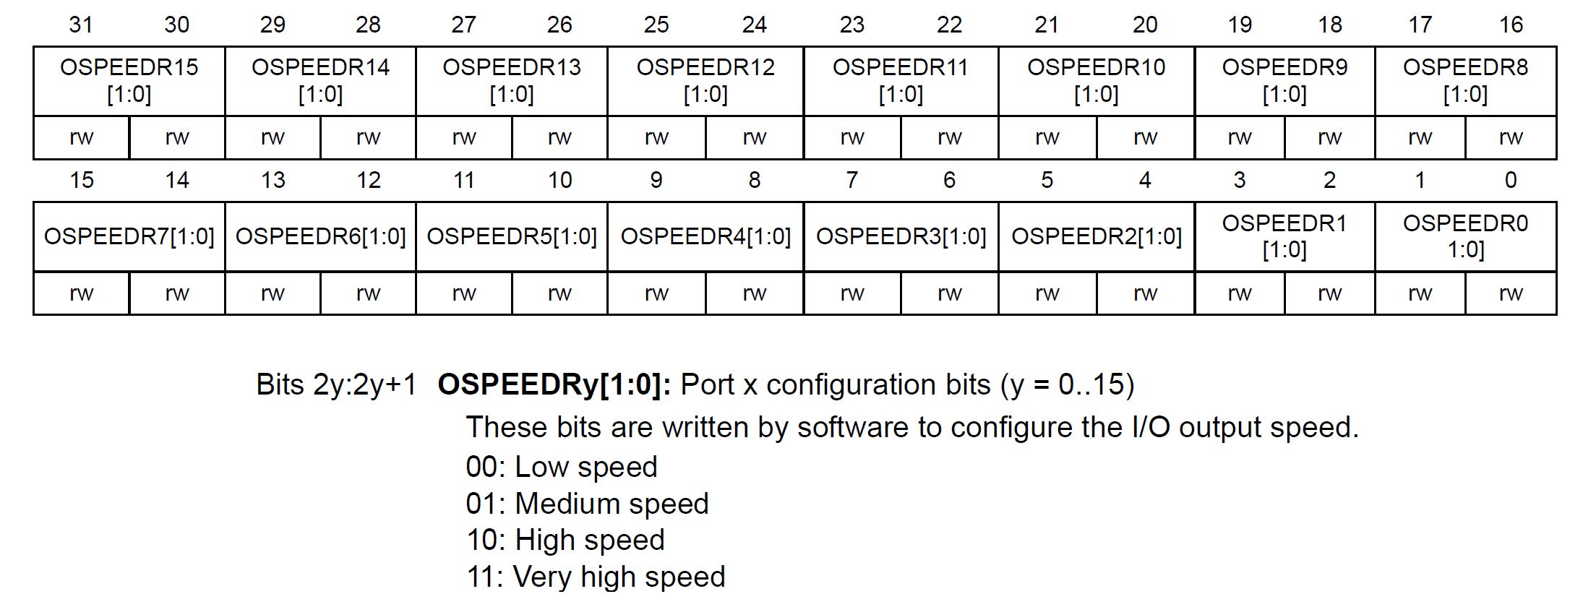

Slide 22
GPIOx_ODR

Slide 23
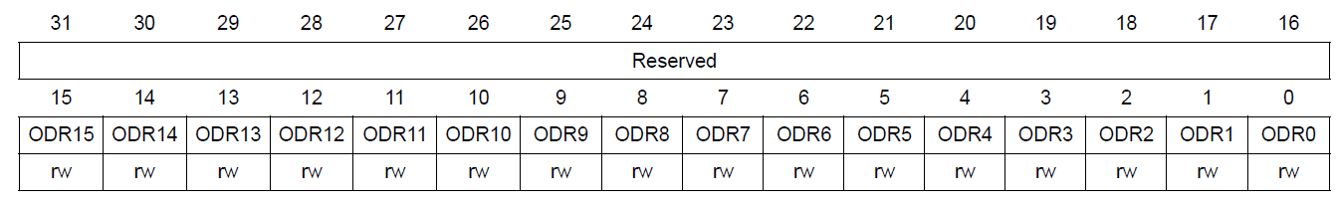
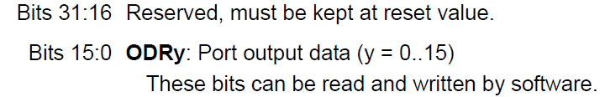
/*3. Turn on PC13 by writing 1 to bit5 of ODR*/
GPIOC->ODR &= ~(1U << 13);
/*5. Turn off PC13 by writing 0 to bit5 of ODR*/
GPIOC->ODR |= (1U << 13);

Slide 24
GPIOx_PUPDR

Slide 25
GPIOx_PUPDR
Pull-Up Resistor (01): When enabled, this pulls the GPIO pin to a high state (logic level 1) when it is not actively driven by another source. This is useful for input pins to ensure they default to a known high state when not connected.
Pull-Down Resistor (10): When enabled, this pulls the GPIO pin to a low state (logic level 0) when it is not actively driven by another source. This is used to ensure the pin defaults to a known low state.
Use Cases:
Input Pins: When configuring a GPIO pin as an input, it’s common to enable either a pull-up or pull-down resistor to prevent the pin from floating, which can cause unreliable readings due to noise.
Button Inputs: Pull-up resistors are often used with buttons or switches to ensure that when the button is not pressed, the input reads as high (logic 1).
Communication Protocols: In some communication protocols, certain lines (like the I2C data line) require pull-up resistors to function correctly.

Slide 26
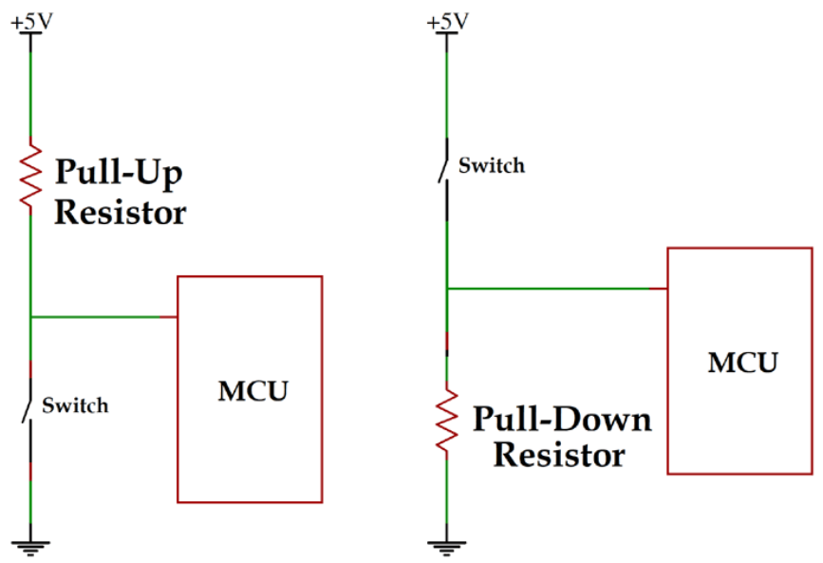
GPIOx_PUPDR

Slide 27
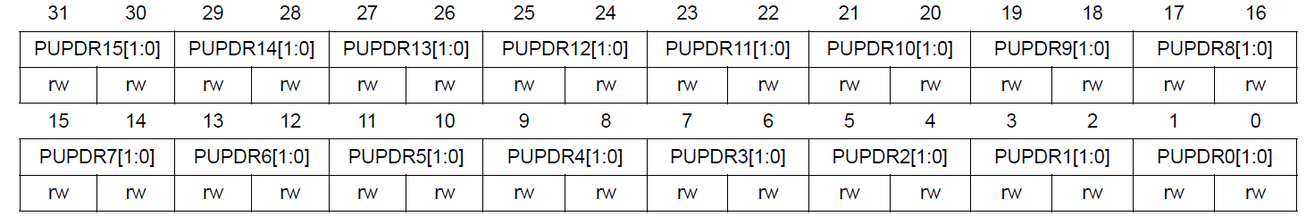
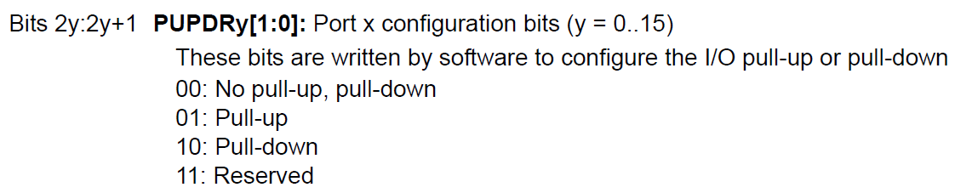
/*5. set pull-up for PA0*/
GPIOA->PUPDR |= 0x00000001;

Slide 28
GPIOx_IDR

Slide 29
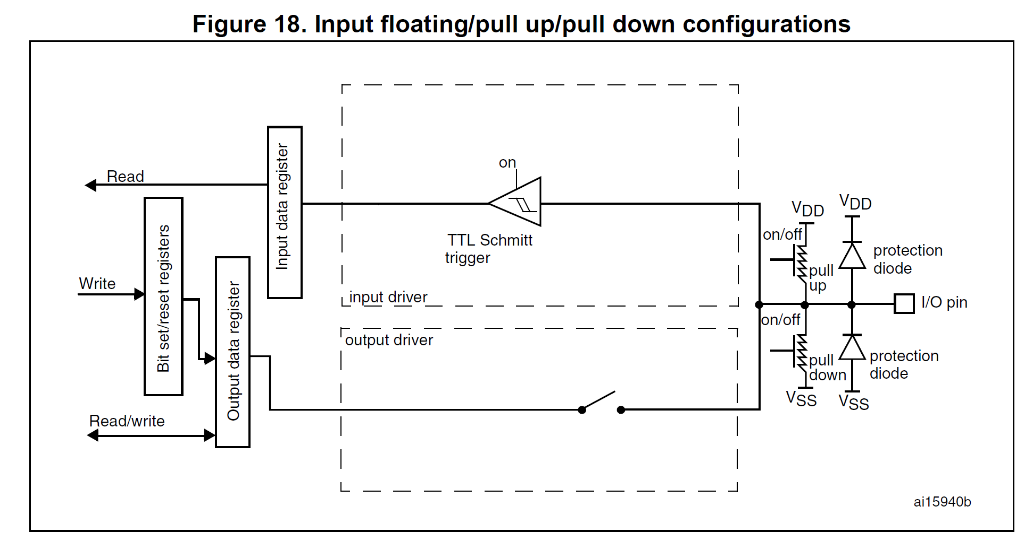
GPIOx_IDR

Slide 30
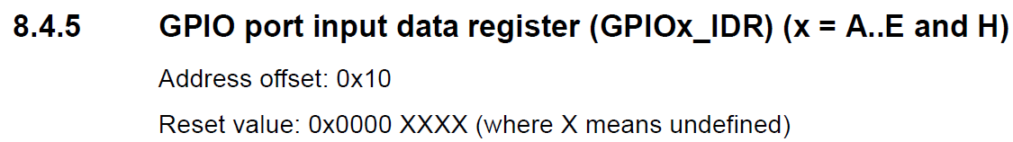
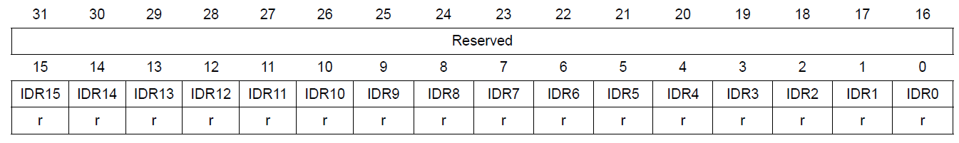
/*5. Check if input is high by checking if bit0 is 1*/
if(GPIOA->IDR & (1U<<0))

Slide 31
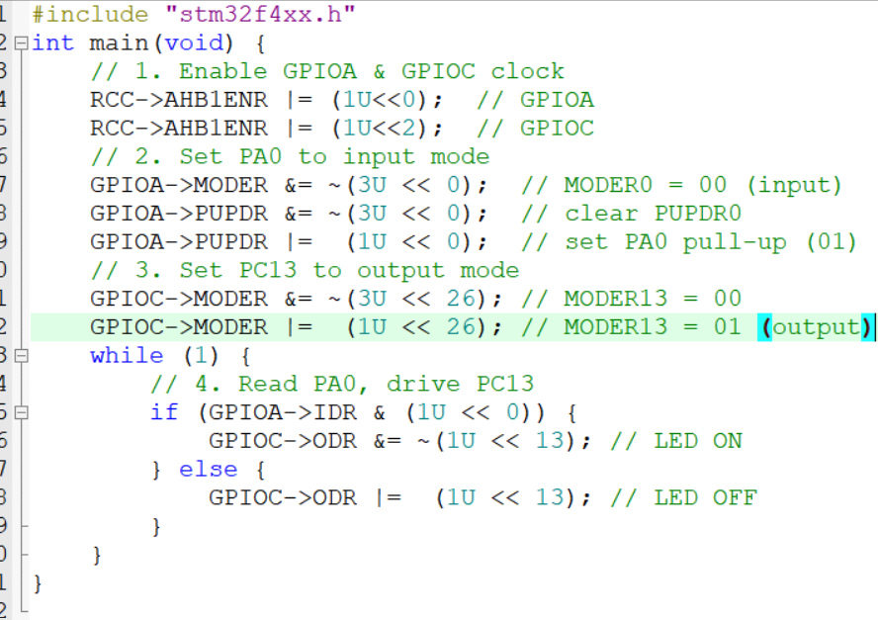

Slide 32
Thank You

