Slide 1

Campus Survey System
Broc, Jude, Kyuss, and Rayleen
3/4/2024

Slide 2
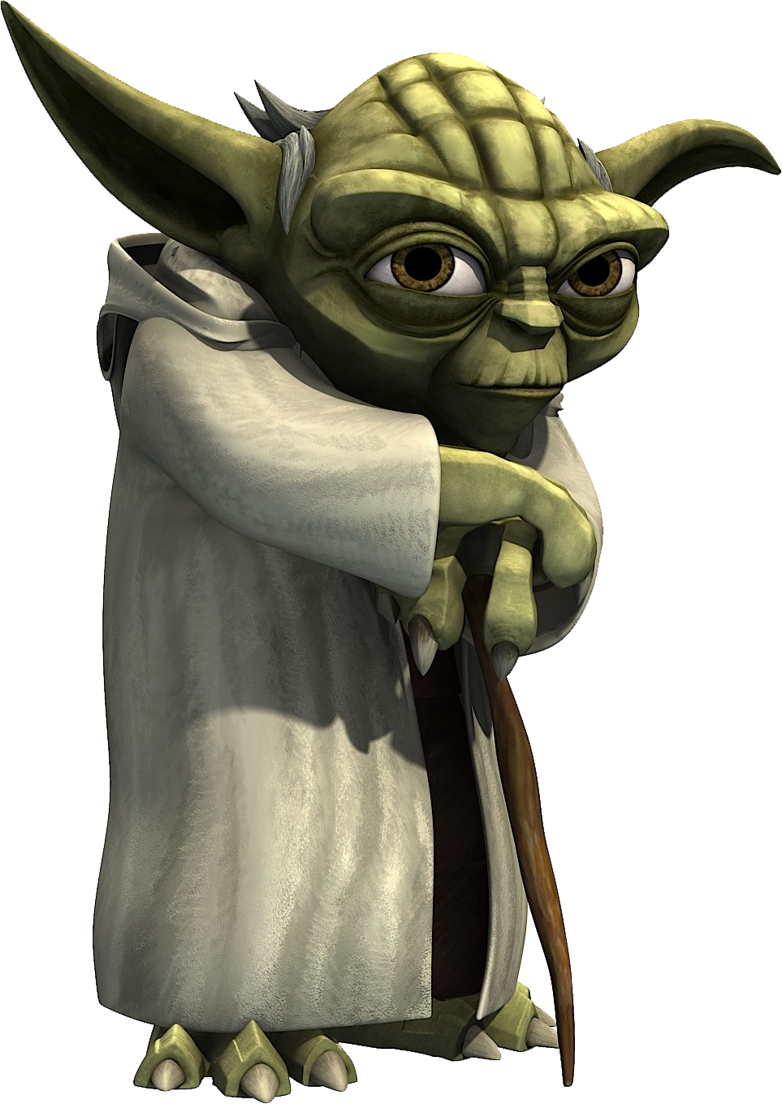
Intro this is....
Long, long ago
In a land far, far away
From a Team that is so Tired, they are no longer making sense
(I mean like seriously, right now we are talking about raspberry pies?)
Comes the most awesomest Software Program Diagrams
That have ever been seen.....
This Photo by Unknown author is licensed under CC BY-NC.

Slide 3
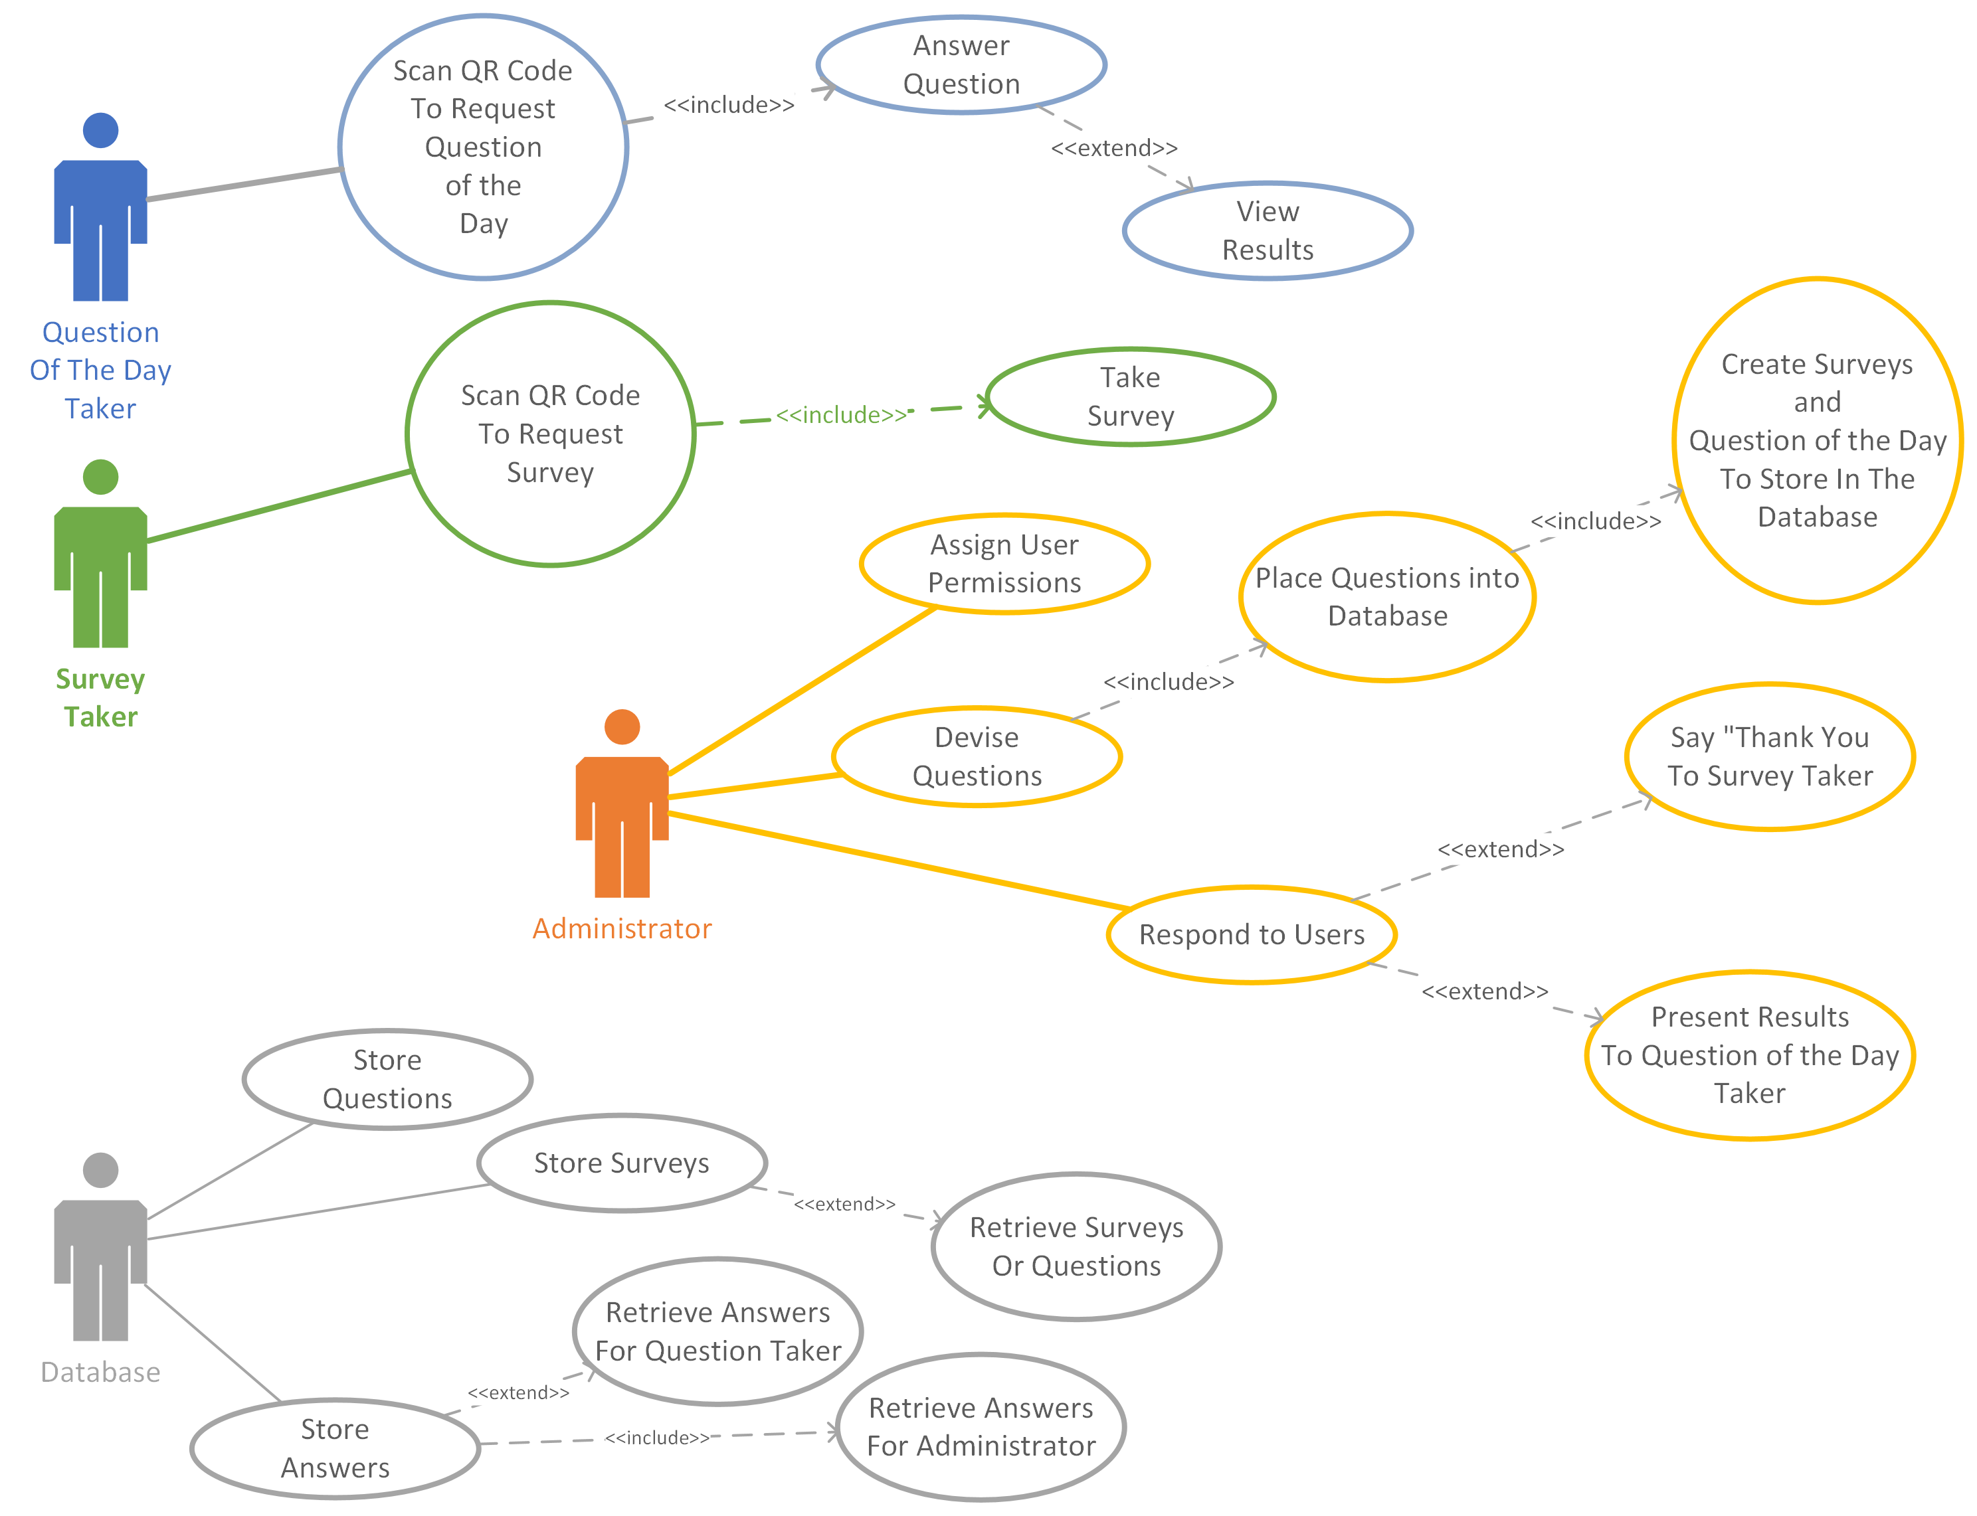
Use Case Diagram

Slide 4
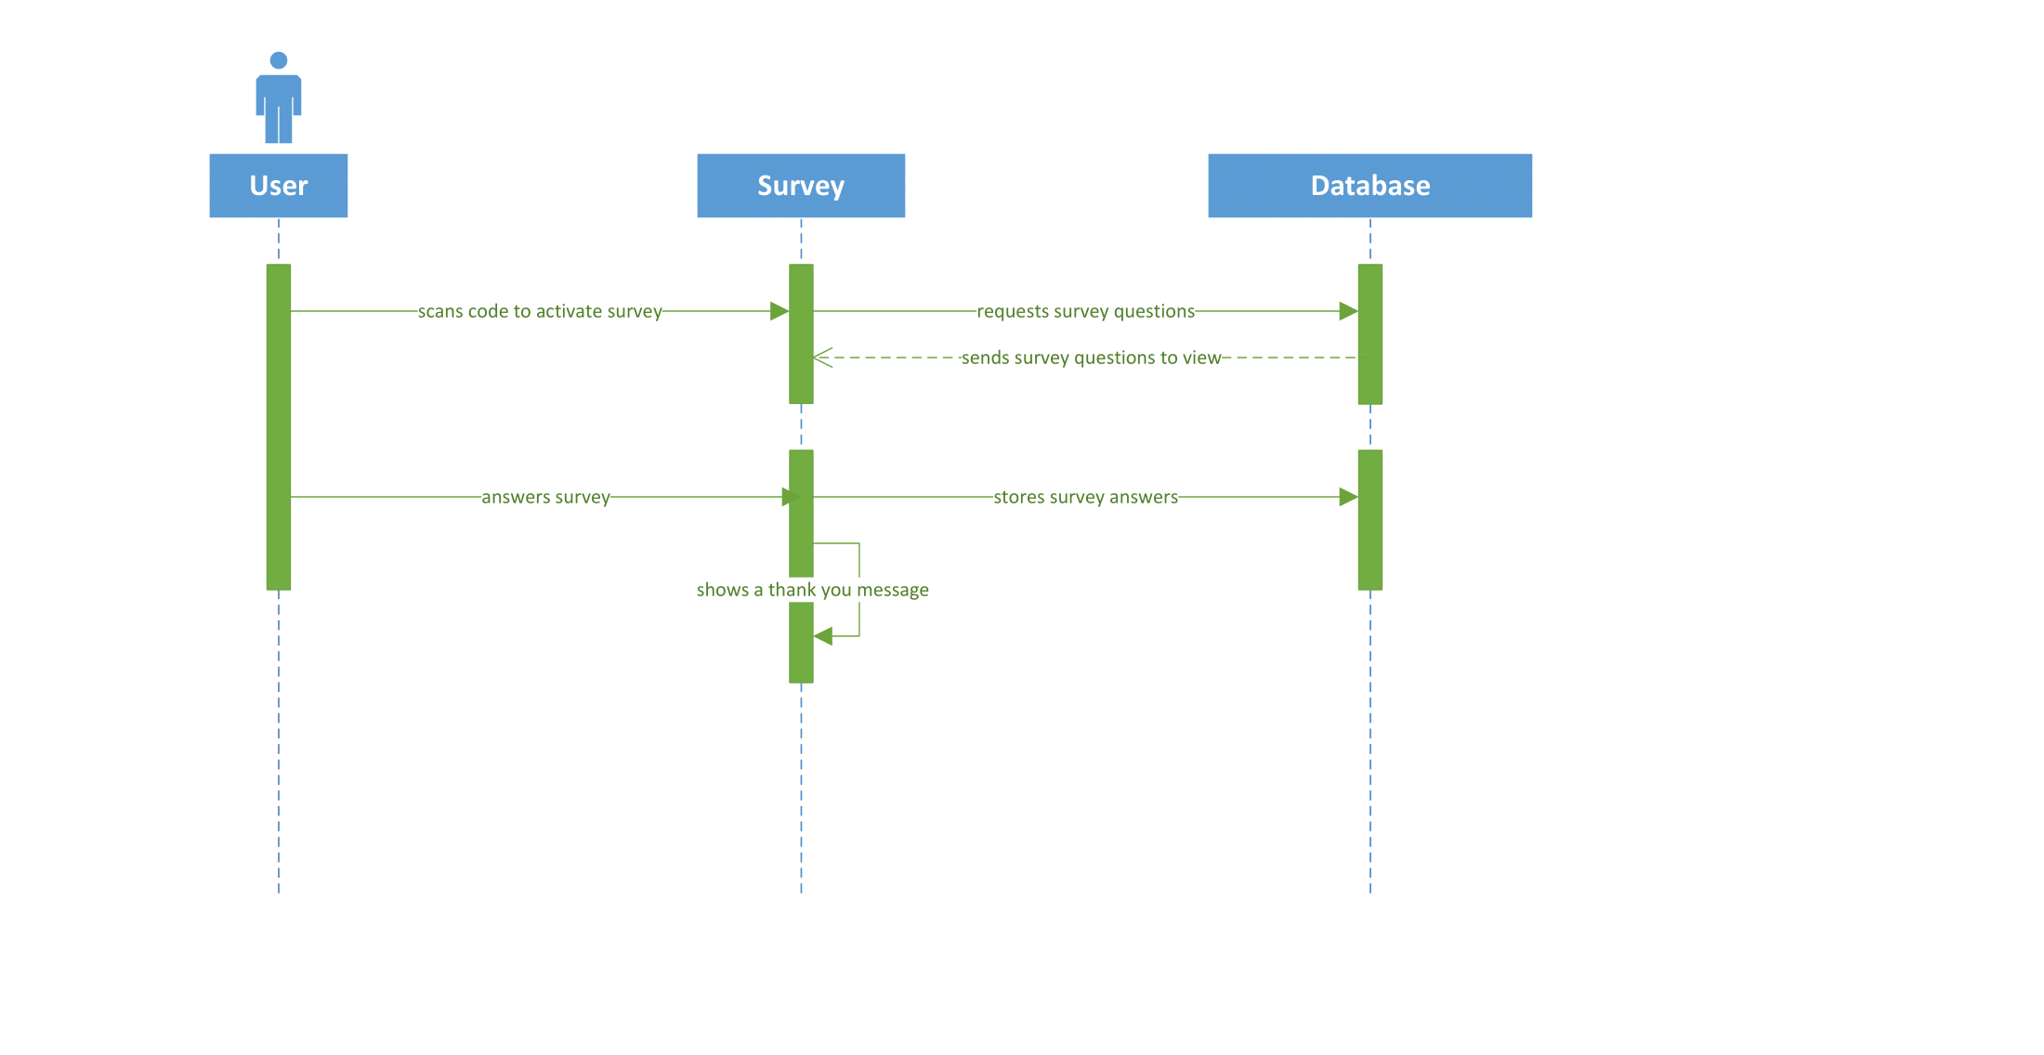

Slide 5
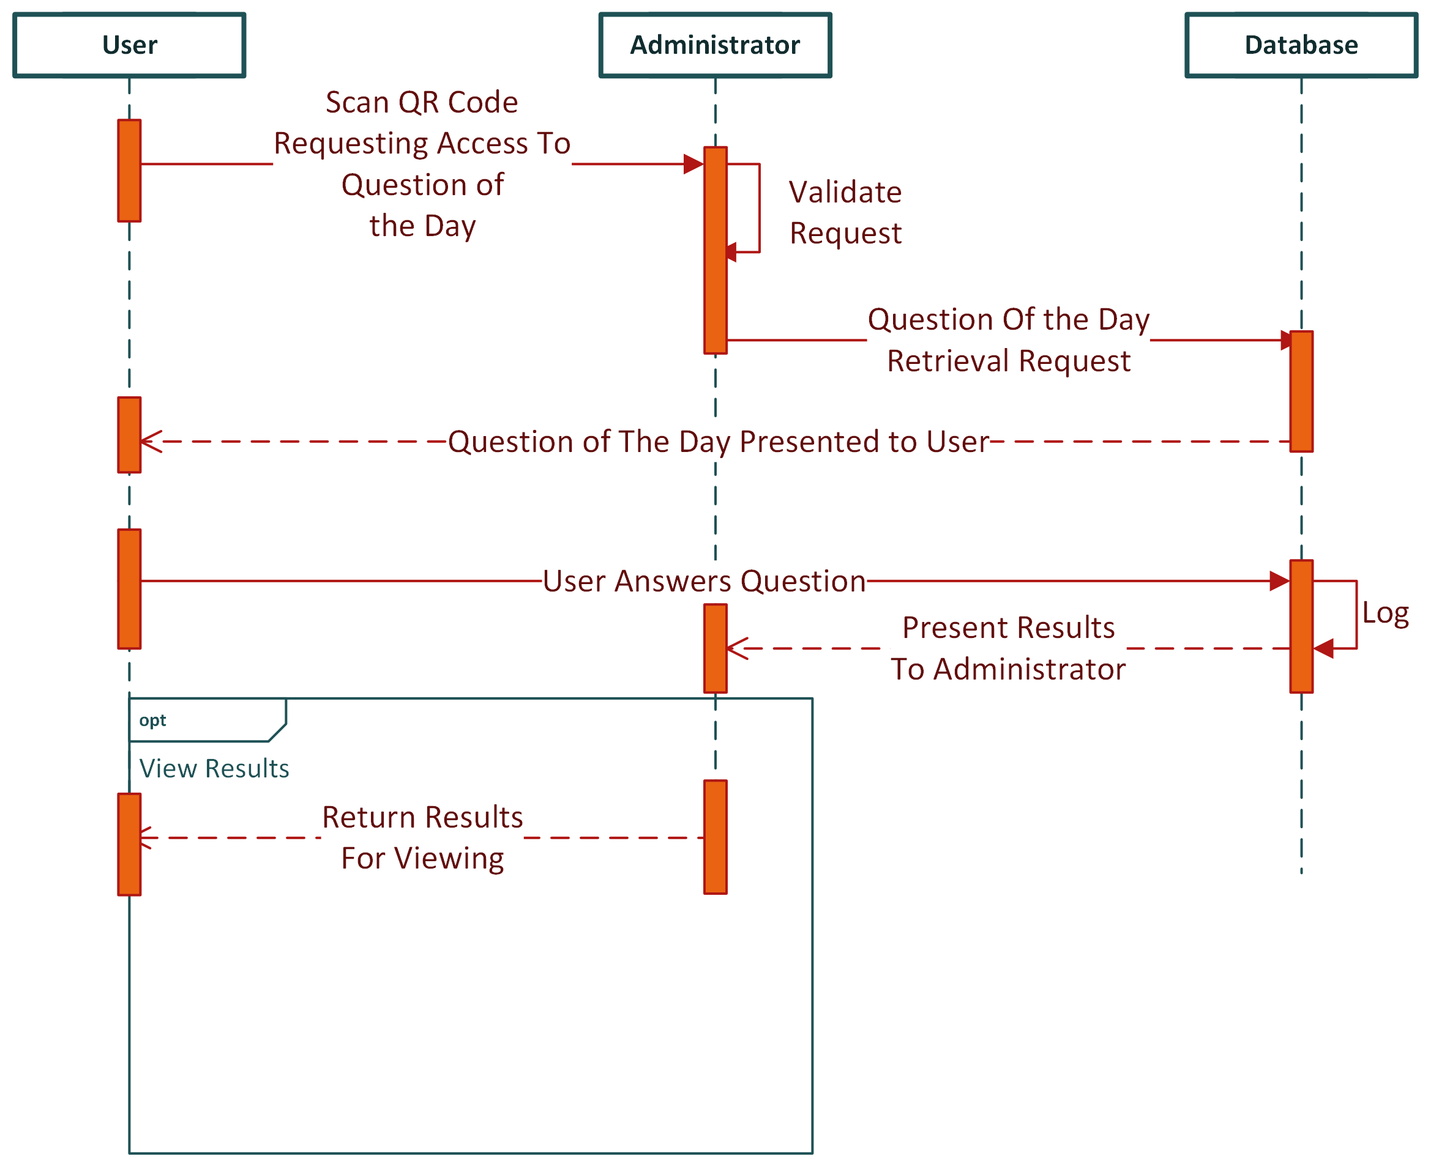
Question of the Day Sequence Diagram

Slide 6
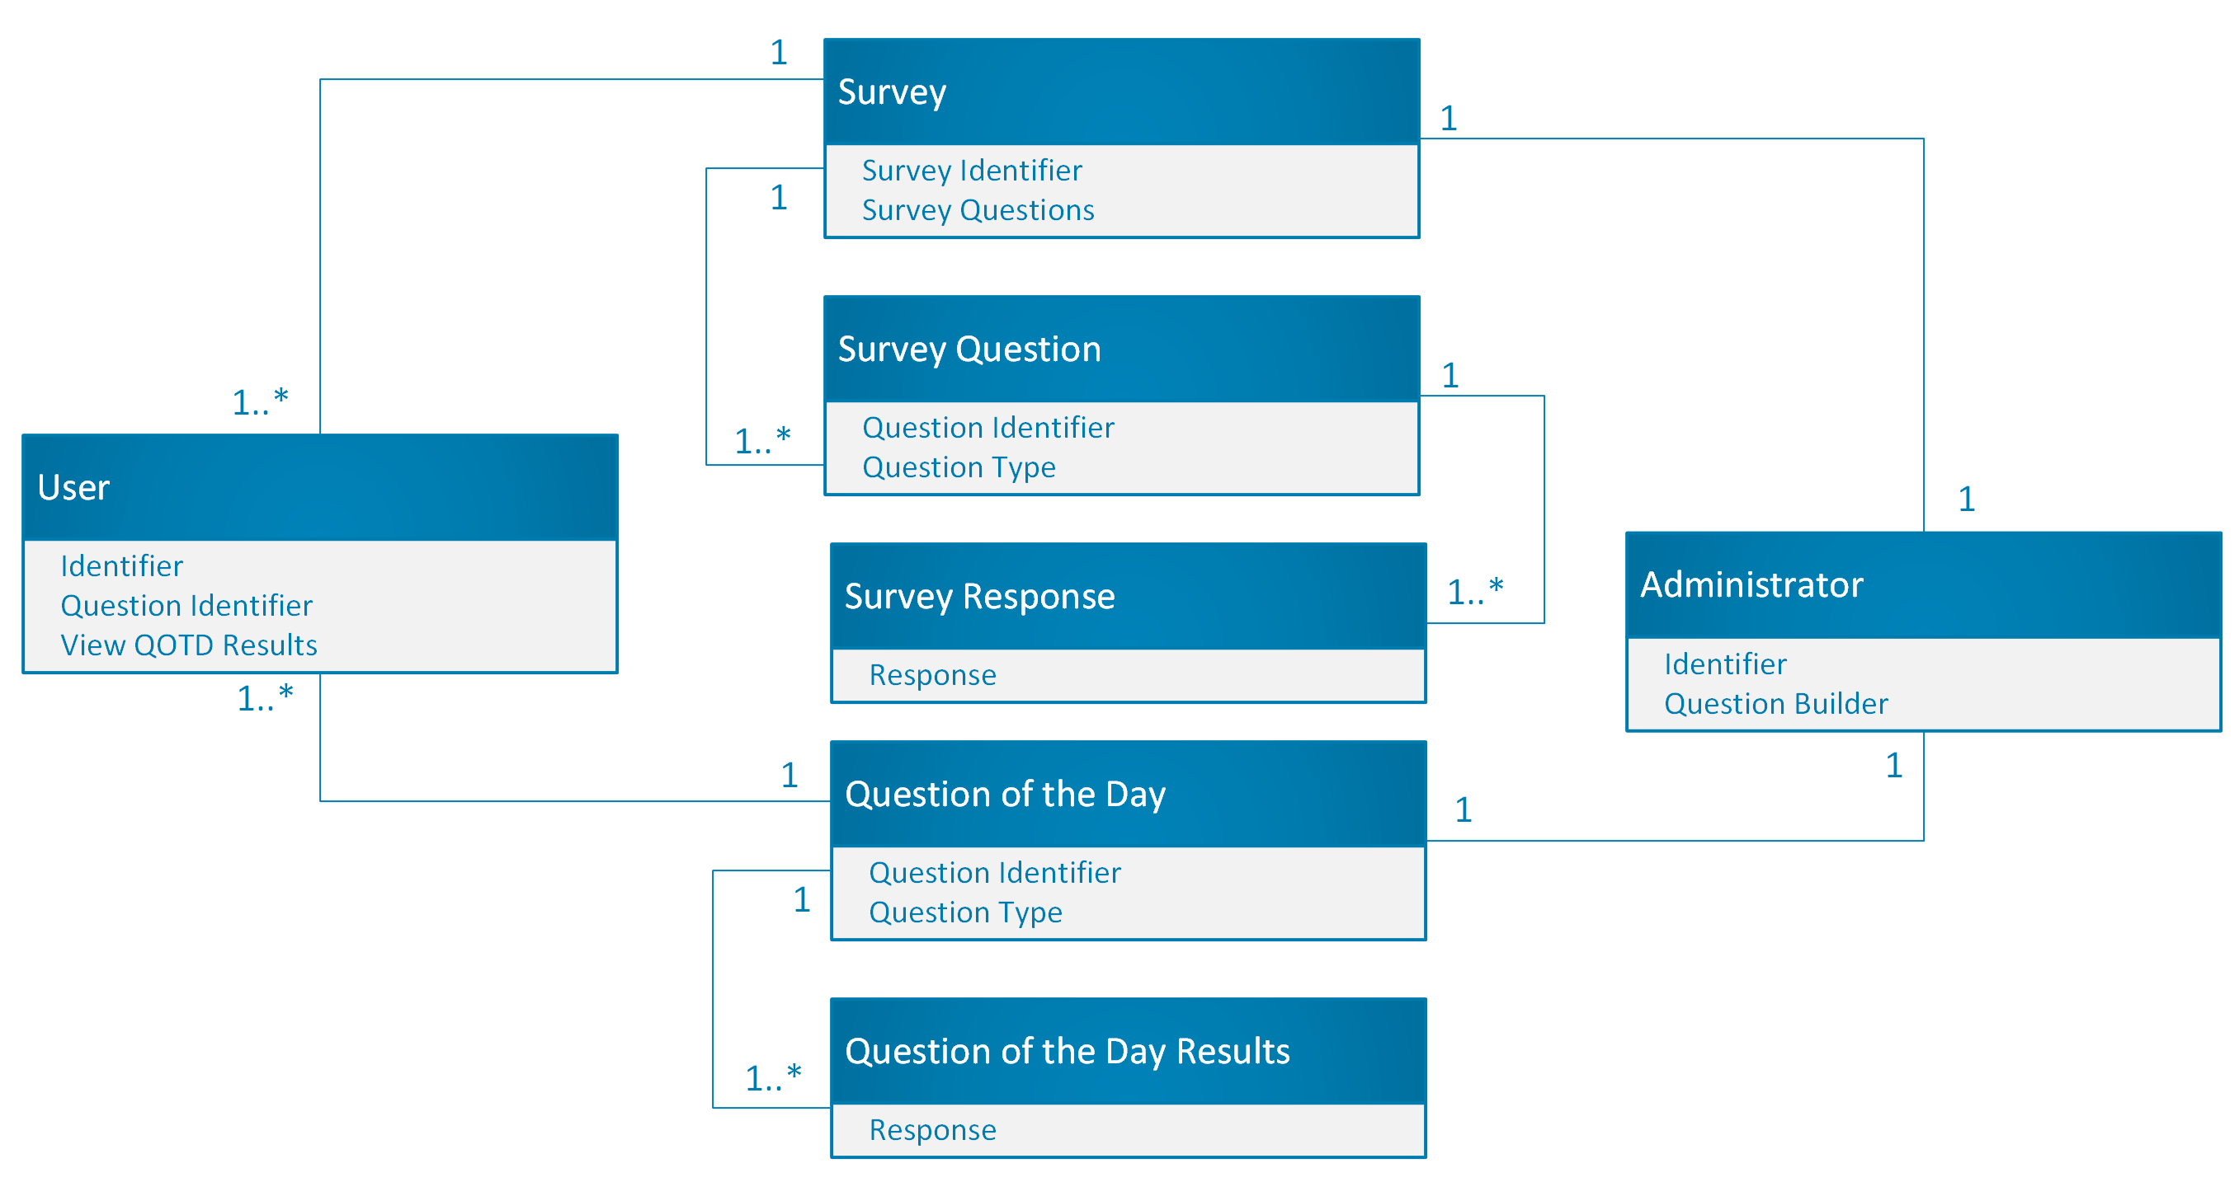

Slide 7
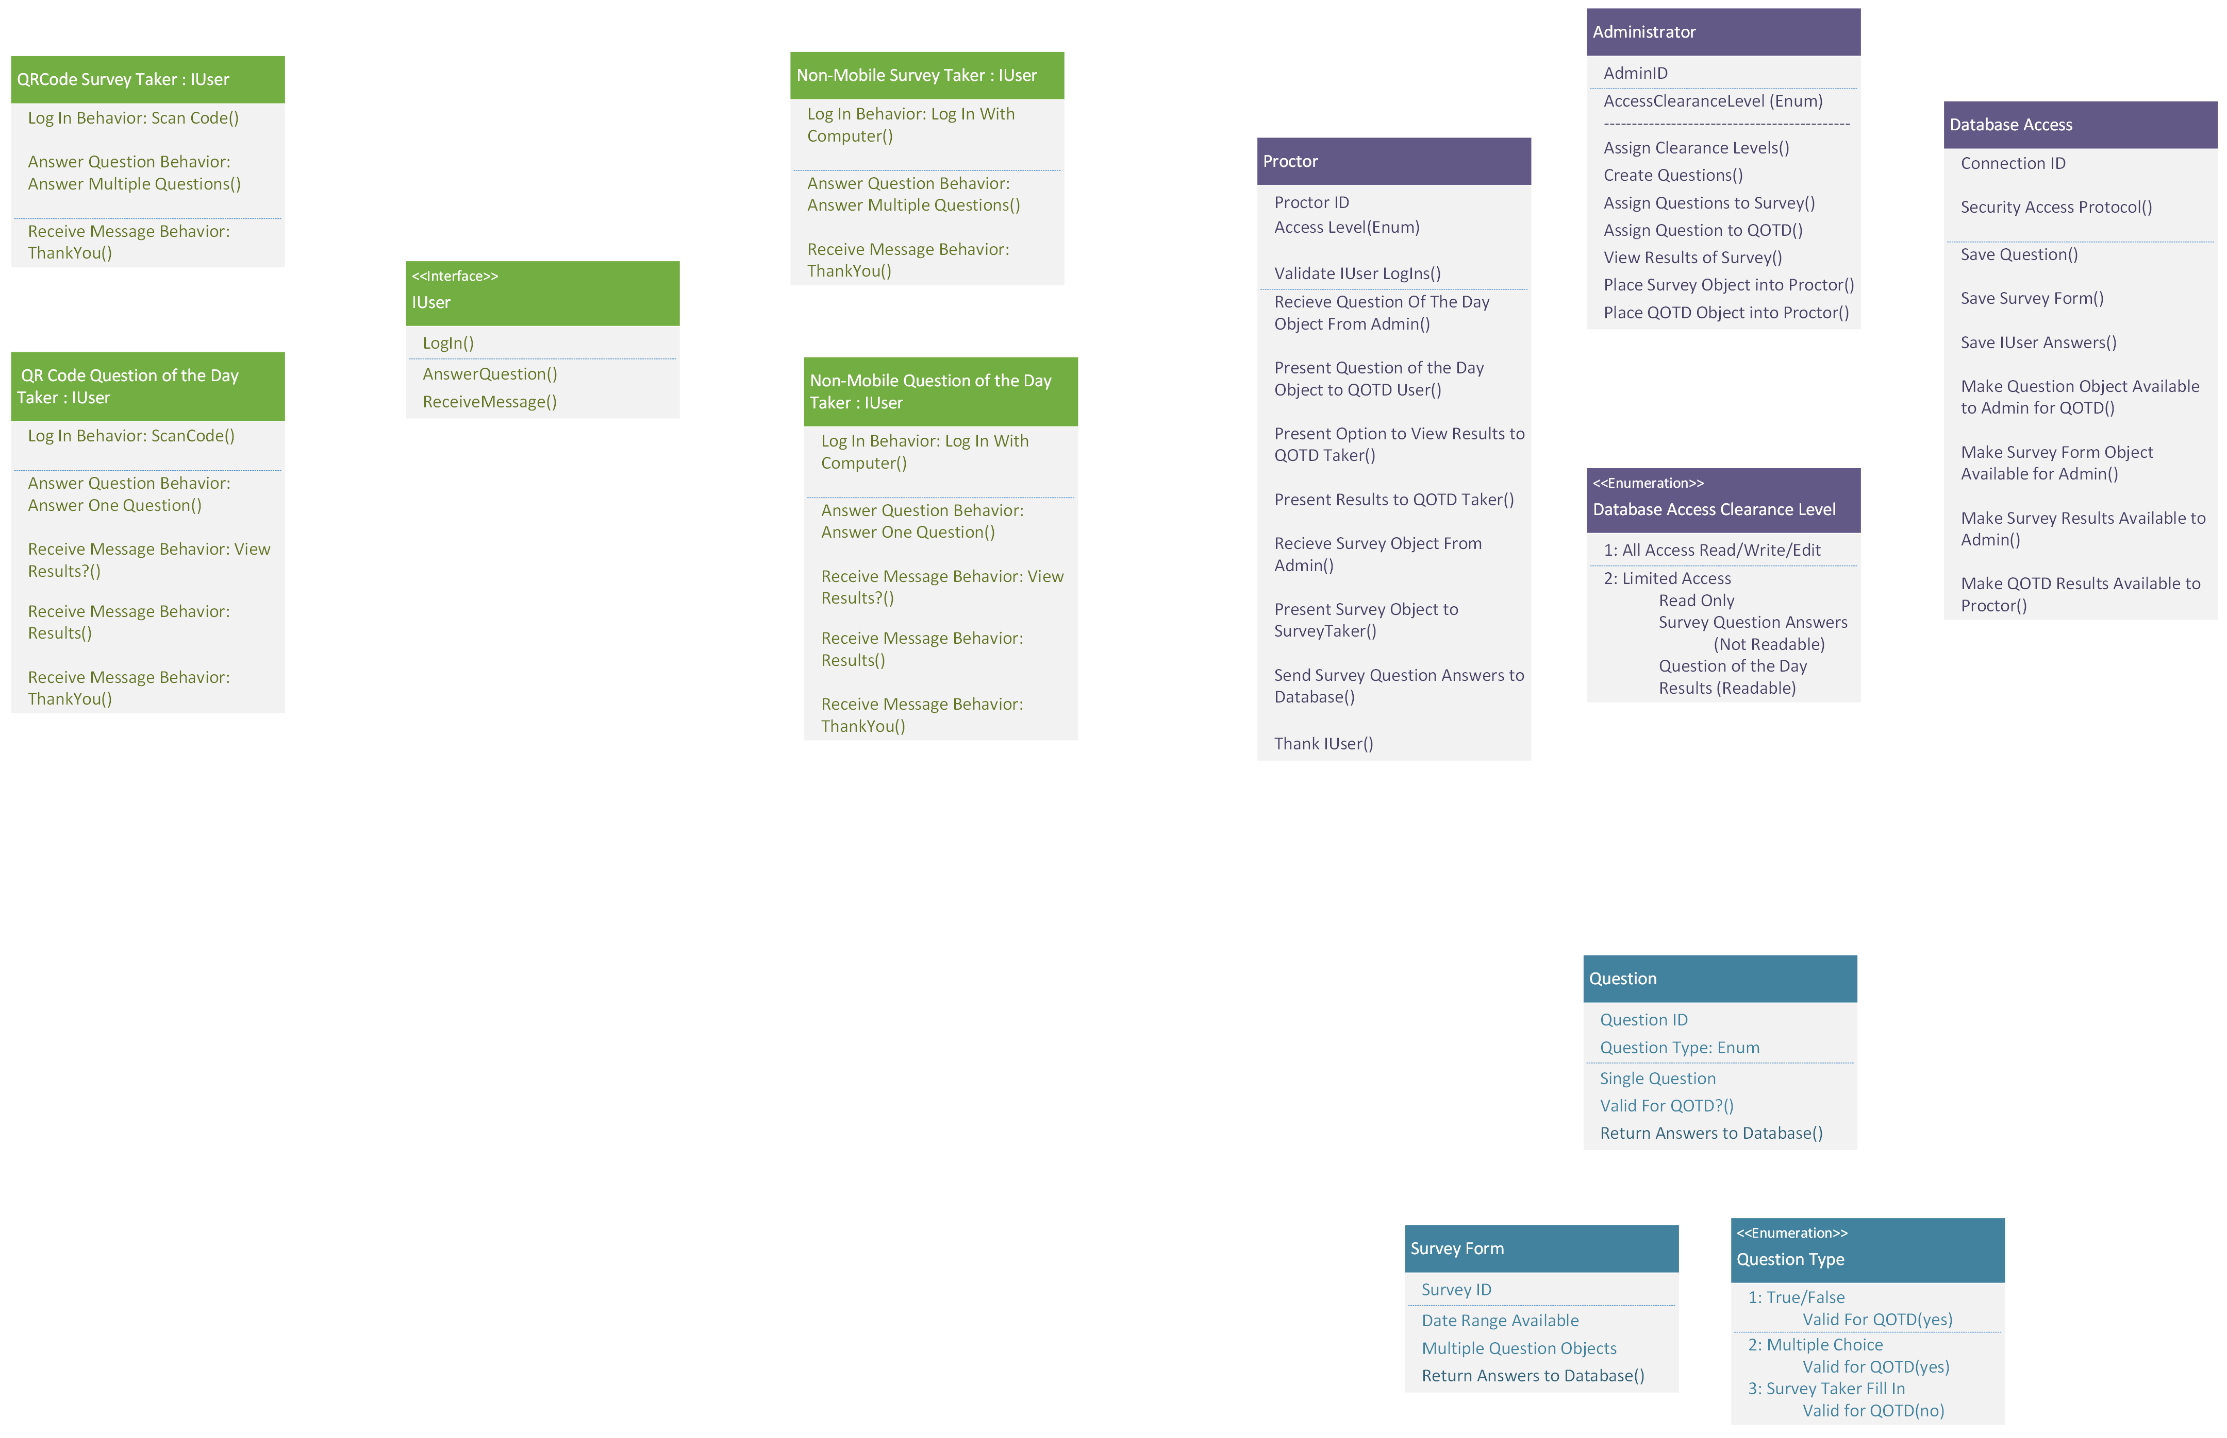
How Do We Make This More Readable

Slide 8
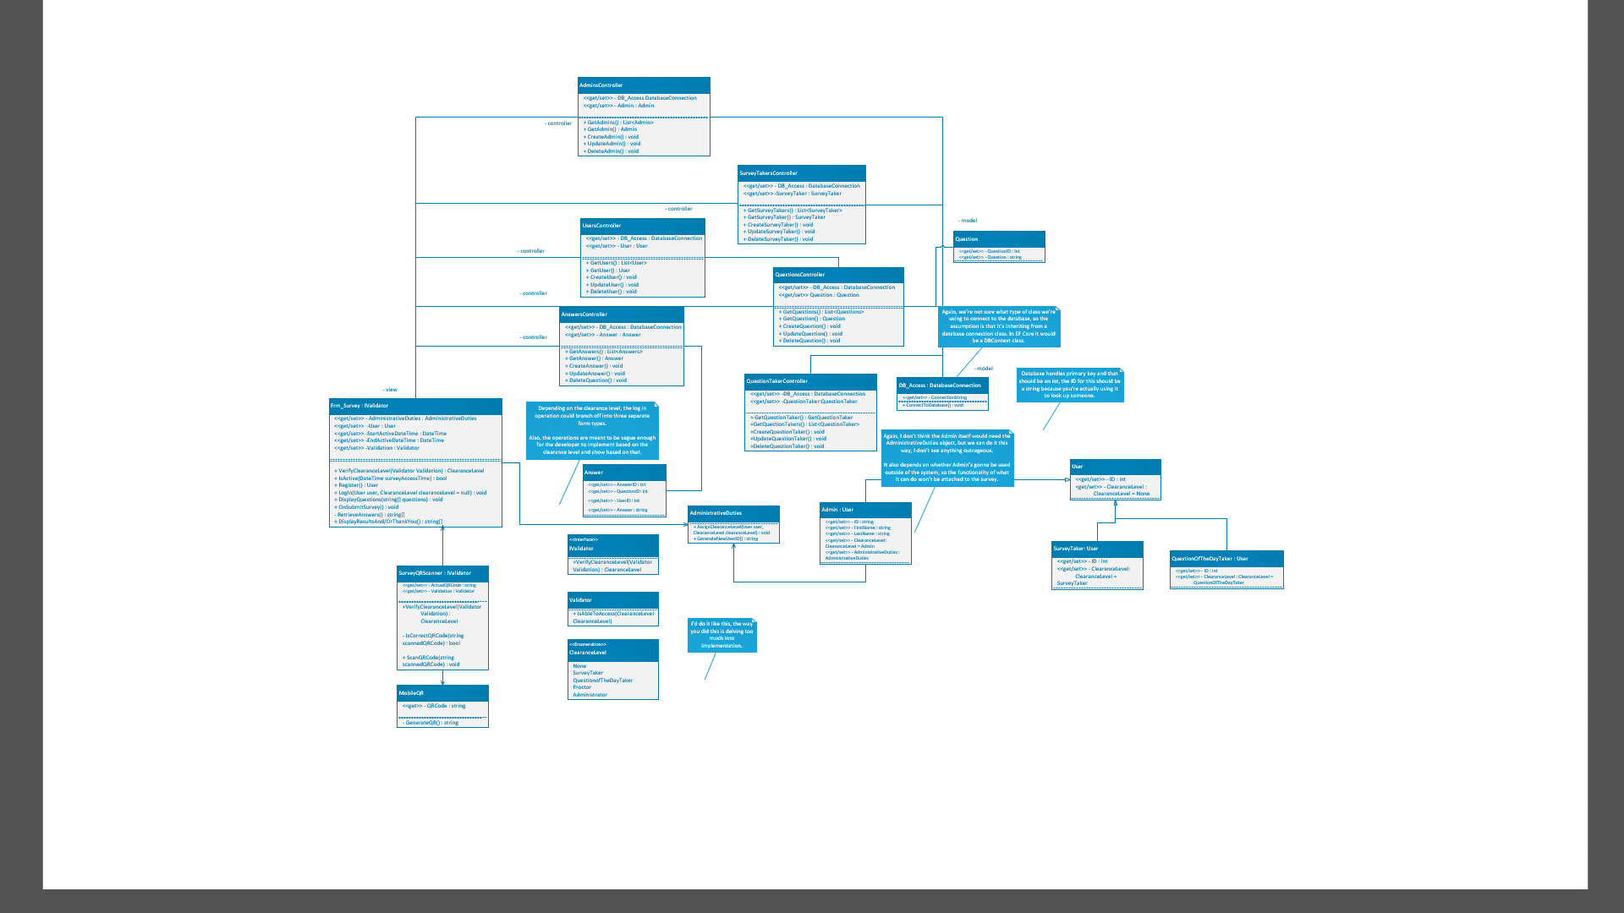

Slide 9
Even more readable....
FinalClassDiagram for Survey.vsdx

Slide 10
Conclusion

