Slide 1


ONLINE VOTING SYSTEM
SUPERVISOR Mr.A.Malarmannan,M.E.,, AP/CSE.
PRESENTED BY
2303811710421188 – G V SANTOSH

Slide 2

PRESENTATION OVERVIEW
Objective
Project Introduction
Problem Statement
Methodologies (Programming concepts relevant to problem statement)
Architecture of the proposed system
List of Modules
Merits
Results and Discussion
Queries

Slide 3
OBJECTIVE
The objective of this Online Voting System is to create a digital platform that facilitates secure and efficient voting for various types of elections, such as governmental, organizational, and educational.
The system aims to eliminate the drawbacks of traditional paper-based voting, including logistical challenges, time constraints, and risks of tampering or fraud.
It seeks to provide a user-friendly interface for voters to cast their votes conveniently and confidentially from anywhere, ensuring inclusivity for all eligible voters, including those with physical disabilities or residing in remote locations.
By leveraging modern technologies, the system strives to maintain the integrity of the election process through robust authentication, data encryption, and secure vote storage. Ultimately, the system aspires to enhance trust in the electoral process while promoting higher voter participation and ensuring accurate and transparent results.

Slide 4
PROJECT INTRODUCTION
The Online Voting System eliminates the limitations of traditional paper-based voting. It leverages modern technologies to provide a seamless and user-friendly platform for voters. The system allows:
Remote and secure voting.
Real-time tracking of votes (optional for admin).
Categorization of elections based on governmental, organizational, or educational needs.

Slide 5
PROBLEM STATEMENT
The traditional voting process has challenges such as:
Time-consuming manual processes.
Higher risk of fraud and tampering.
Reduced accessibility for remote or disabled voters. An online system addresses these challenges by offering a streamlined and secure voting mechanism.

Slide 6
Methodologies (Programming concepts relevant to problem statement)
Relevant Programming Concepts:
AWT (Abstract Window Toolkit): For graphical user interface (GUI) development.
File Handling: For storing and retrieving voter and election data.
Encryption Techniques: For maintaining confidentiality of votes.
Exception Handling: For robust user interaction.
Event Handling: To manage user actions like button clicks.

Slide 7

FLOW DIAGRAM
Eg: Presidential Election Local Election With Candidate Details
User Name
Available Elections
Password
View Elections
Login
We can vote for a candidate in particular Election based on Election ID
Vote for the Candidate
Cast Vote
Register
Logout
Exit

Slide 8
MODULE DESCRIPTION
Login Module:
Authenticates voters.
Voter Registration Module:
Registers eligible voters.
Election Management Module:
Admin functionality to create/manage elections.
Voting Module:
Voters cast votes securely.
Result Calculation Module:
Tallies votes and displays results.

Slide 9
MERITS
Enhanced Accessibility - The system allows voters to cast their votes remotely, eliminating geographical barriers and enabling participation from rural or remote areas.
Inclusivity - It is designed to be accessible to individuals with disabilities by incorporating assistive technologies and user-friendly interfaces.
Time Efficiency - Eliminates the need for manual vote counting and reduces the time required to announce results.
Cost-Effectiveness - Reduces expenditure on physical voting infrastructure, such as ballot papers, polling stations, and staff.
Transparency - By tracking votes digitally (if permissible), the system ensures that results are accurate and tamper-proof, fostering trust in the electoral process.
Eco-Friendly - Reduces the environmental impact by eliminating paper ballots and minimizing energy consumption in physical polling stations.

Slide 10
MERITS
7.Real-Time Monitoring - Administrators can monitor election progress and identify issues promptly, enhancing management efficiency.
8.Scalability - The system can handle elections of varying scales, from small organizational polls to large governmental elections.
9.Multi-Election Support - Supports various election types simultaneously, making it versatile for use in different contexts such as student elections, corporate decision-making, and public voting.
10.Data Analytics - Facilitates post-election analysis with aggregated data, helping stakeholders understand voter behavior and trends.
11.User Convenience - The platform is intuitive and easy to use, requiring minimal training for both voters and administrators.
12.Fraud Prevention - Mitigates risks such as duplicate voting, vote manipulation, or identity theft through secure voter authentication mechanisms.

Slide 11
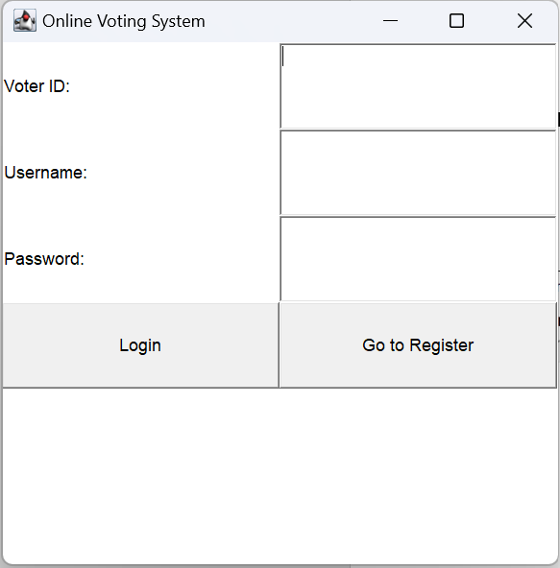
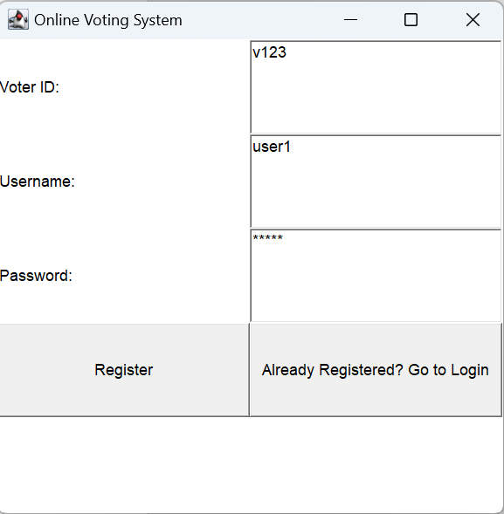
RESULT AND DISCUSSION

Slide 12
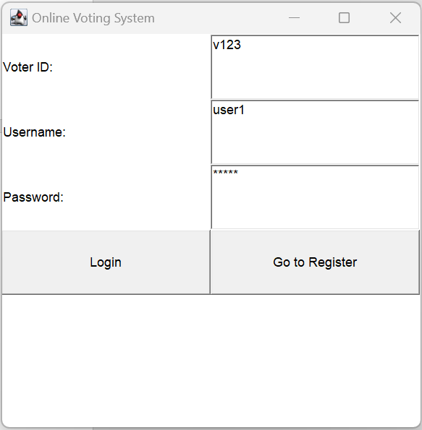
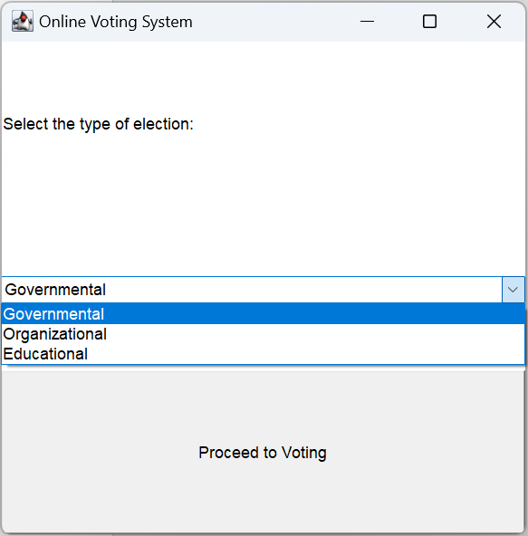
RESULT AND DISCUSSION

Slide 13
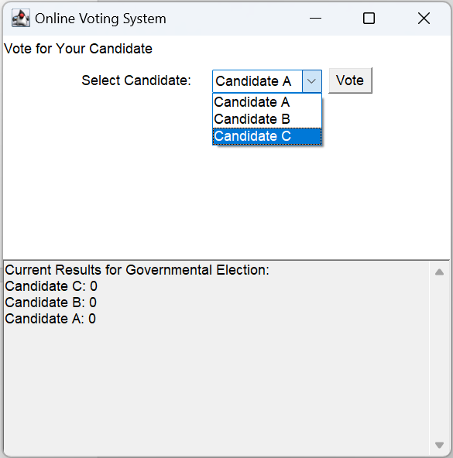
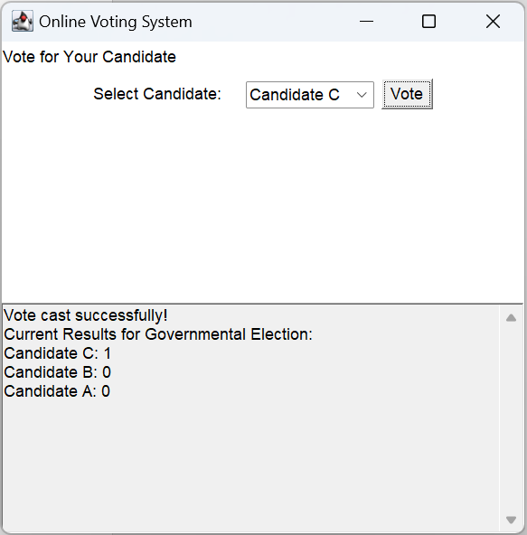
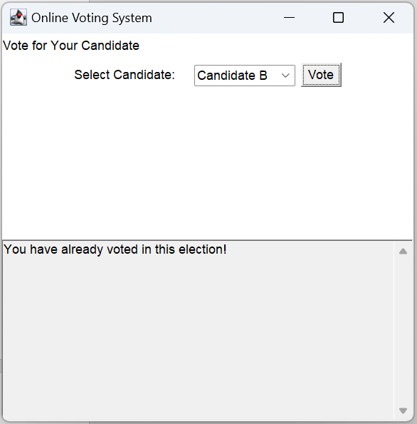
RESULT AND DISCUSSION

Slide 14
ANY QUERIES ?

Slide 15
THANK YOU

