Slide 1


D E P A R T M E N T O F C O M P U T E R S C I E N C E A N D
E N G I N E E R I N G
20CS8504 & PROJECT WORK
END SEMESTER PRACTICAL EXAMINATION - APRIL/MAY - 2026
Batch No : 7
Date: 05/05/2026
Session : FN

Slide 2
Clean City AI-Powered Waste Management Ecosystem
Guide Name :
Ms. P. Karthika AP / CSE
Team Members :
Santosh G.V (23038117104113) Sherwin B (2303811710421146)
Siva Surya S (2303811710421151) Sri Harish S (2303811710421155)

Slide 3
OBJECTIVE
Empower citizens to accurately segregate household waste at the source using AI computer vision to eliminate toxic contamination.
Optimize municipal waste collection routes dynamically using real-time geolocation data to reduce fuel consumption and time.
Incentivize sustainable citizen behavior through a gamified "Green Points" reward system.

Slide 4
INTRODUCTION
India generates massive amounts of unsegregated waste, rendering downstream recycling unviable.
Citizens struggle with the cognitive load of complex segregation rules.
Municipalities rely on static, highly inefficient collection routes that waste resources.
CleanCity solves this via a dual-sided platform: a Citizen App and a B2G Authority Dashboard.
The platform integrates AI edge scanning, real-time map tracking, and data analytics to modernize the entire waste lifecycle.

Slide 5
LITERATURE SURVEY
TITLE OF THE PAPER | AUTHORS | PAPER GIST | TECHNOLOGY USED
IoT-Based Smart Waste Management System: A Solution for Urban Sustainability | IIETA Authors (2024) | Integrates ultrasonic sensors and GPS with cloud analytics to guide dynamic municipal routing, successfully cutting truck mileage by 20% and CO2 emissions by 18%. | IoT, Arduino-ESP8266, Firebase, Ultrasonic Sensors, GPS
A Reliable and Robust Deep Learning Model for Effective Recyclable Waste Classification | MD. Mosarrof Hossen, Molla E. Majid, et al. (2024) | Proposes the RWC-Net model to accurately categorize household waste into 6 distinct classes, achieving over 95% accuracy to improve automated sorting systems at the source. | Deep Learning, DenseNet201, MobileNet-v2, Computer Vision
Real-Time Waste Detection and Classification Using YOLOv12-Based Deep Learning Model | MDPI Journal Authors (2025) | Integrates advanced YOLO architectures for real-time waste detection, offering a highly scalable and fast solution for autonomous waste identification in smart cities. | YOLOv12, Machine Vision, Convolutional Neural Networks (CNNs)
Smart Waste Management System Using IoT and Route Optimization | ResearchGate Authors (2025) | Develops a system where bins continuously monitor waste levels and send real-time data to a central server, applying routing algorithms to determine the most fuel-efficient collection paths. | IoT, Cloud Analytics, Dynamic Route Optimization Algorithms
Waste Classification using YOLO on Raspberry PI | IJERT Authors (2024) | Employs ultralytics YOLO deep learning models deployed on a microcontroller to accurately identify and separate recyclable, non-recyclable, and hazardous waste via a live camera feed. | YOLOv8, Ultralytics, Raspberry Pi, Python
5

Slide 6
EXISTING SYSTEM ARCHITECTURE
Static collection schedules that deploy trucks regardless of actual household waste volumes.
Reliance on manual sorting at material recovery facilities (mrfs), which is highly inefficient and hazardous to workers.
Lack of a digital feedback loop or real-time communication between households and municipal waste collectors.

Slide 7
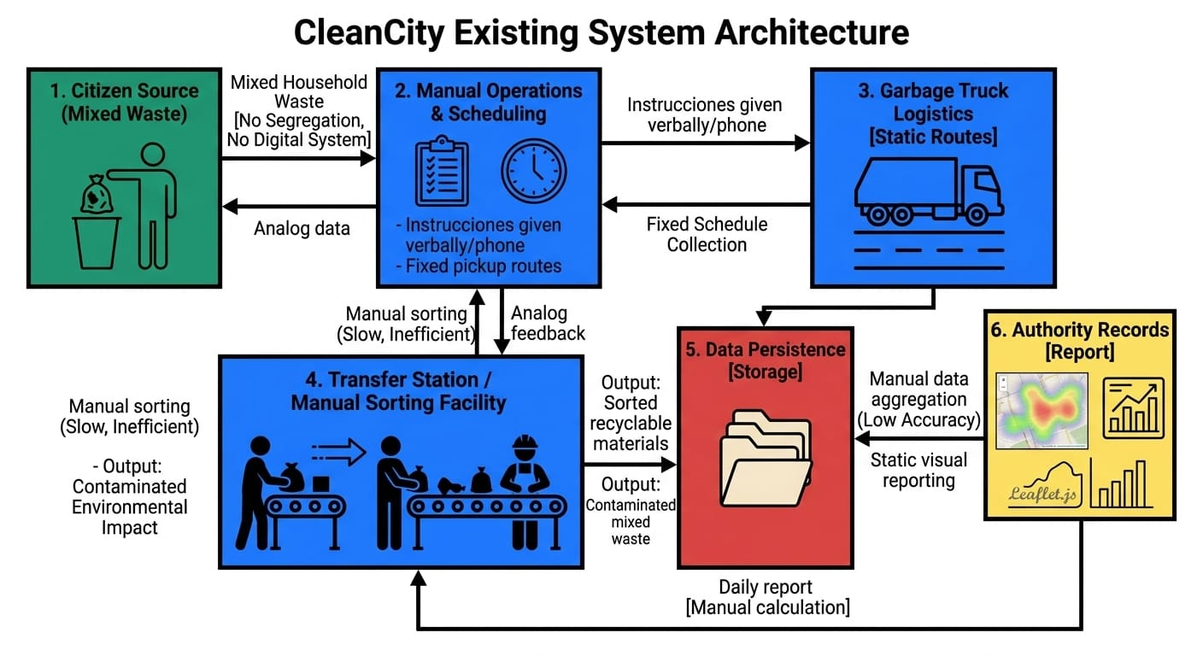

Slide 8
PROBLEM IDENTIFICAITON
Lack of source-level segregation causes severe toxic contamination in landfills.
Homemakers lack instant, reliable guidance on how to dispose of specific, complex packaging.
Inefficient municipal routing wastes fuel and leads to overflowing bins in unmonitored zones.
There is zero motivation or economic incentive for citizens to participate in proper waste management.
Lack of centralized data prevents authorities from analyzing waste generation trends.

Slide 9
PROPOSED SYSTEM ARCHITECTURE
Dual interface approach: Mobile-friendly Citizen interface and Authority Web Dashboard.
AI Edge processing via Google Teachable Machine for instant, offline- capable waste classification.
Cloud-synced database mapping household pickup requests to precise geographic coordinates.
OSRM (Open Source Routing Machine) API integration for algorithmic pathfinding and trip optimization.

Slide 10
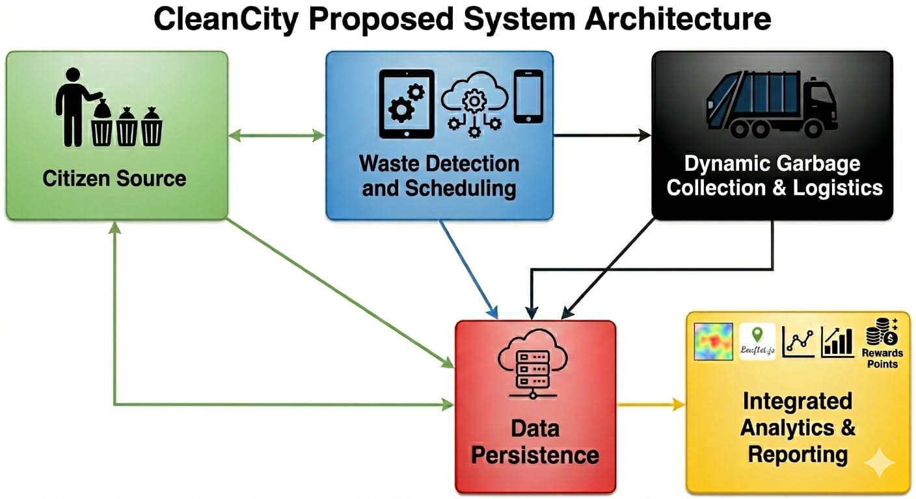

Slide 11
HARDWARE
SOFTWARE AND HARDWARE REQUIREMENTS
SOFTWARE
Frontend: HTML5, Vanilla CSS (Neo-Brutalism UI), JavaScript.
AI & Mapping: TensorFlow.js, Leaflet.js, OpenStreetMap, OSRM.
Backend: Browser LocalStorage (Simulated) / Firebase (Production).
Smartphone (Camera & GPS enabled) for end-users.
PC/Laptop for Municipal Authority Dashboard.
Standard Web Server for hosting.

Slide 12
MODULES
User Authentication & Role Management
AI Waste Scanner & Segregation
Pickup Scheduling & Gamified Rewards (Green Points)
Segregation guide
Route Optimizer
Authority Dashboard & Waste Analytics:
Worker Dashboard
Worker Pickup
Proof

Slide 13
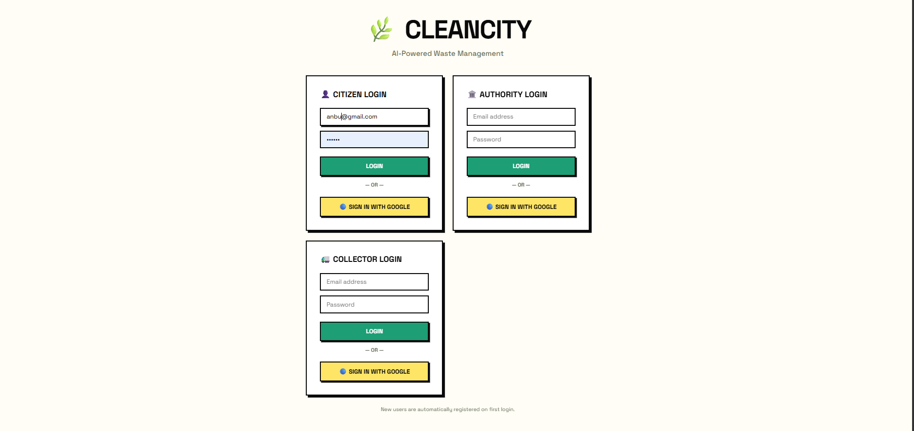
User Authentication & Role Management
IMPLEMENTATION OF MODULE-1
Role-Based Access Control (RBAC).
Secure User Authentication.
Session Management & Authorization.

Slide 14
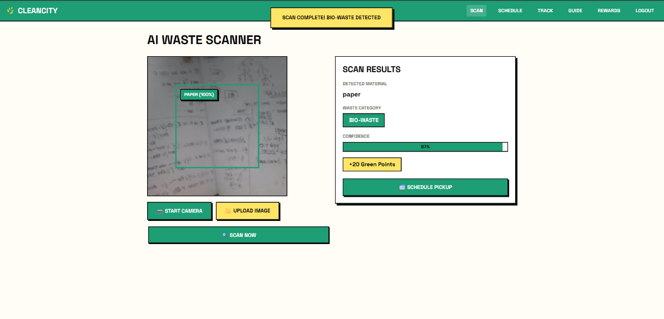
AI Waste Scanner & Segregation
IMPLEMENTATION OF MODULE-2
Image-Based Waste Detection.
Automatic Waste Classification.
Segregation Assistance & Accuracy Improvement.

Slide 15
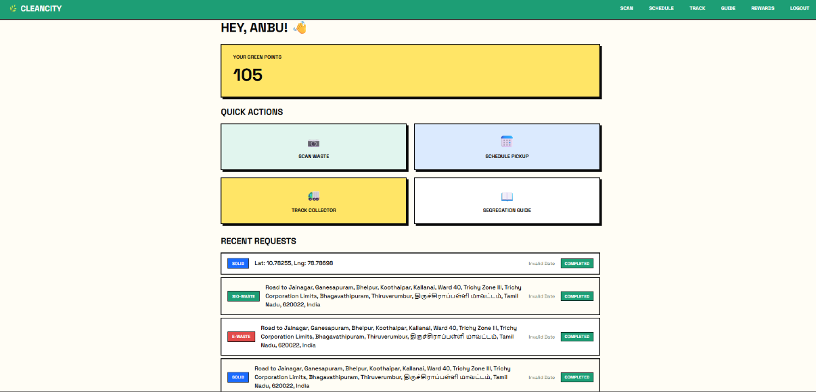
Pickup Scheduling & Gamified Rewards
IMPLEMENTATION OF MODULE-3
Flexible Pickup Scheduling
Time Slot Selection
Automated Pickup
Confirmation Reward Points
System Eco-Friendly
Behavior Incentives
Leaderboard & User
Ranking Achievement
Badges Notification for Rewards

Slide 16
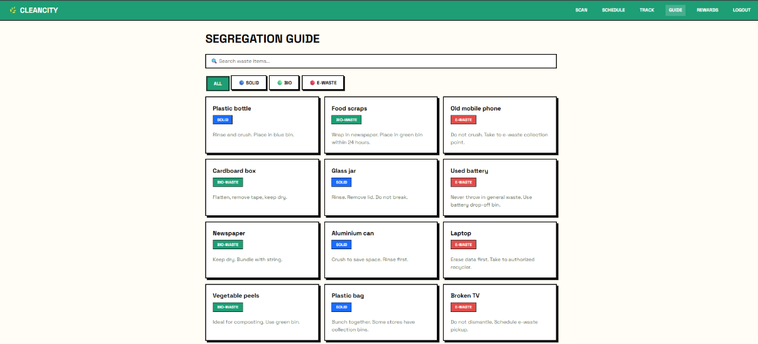
SEGREGATION GUIDE
IMPLEMENTATION OF MODULE-4
Waste Category Guidelines Visual
Identification Support Step-by-Step
Segregation Instructions Do’s and Don’ts of Waste Disposal Color-Coded Waste
Classification Common Waste Examples
User Awareness Tips Error Prevention Suggestions

Slide 17
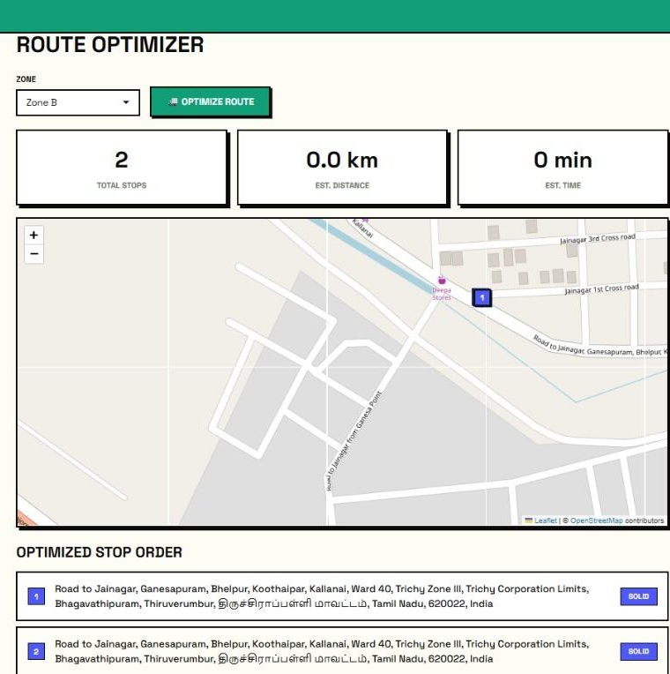
ROUTE OPTIMIZER
IMPLEMENTATION OF MODULE-5
Optimal Path Calculation Shortest Distance
Routing Multi-Stop Route Planning Traffic-Aware Navigation Dynamic Route
Adjustment Fuel Efficiency Optimization
Priority-Based Pickup Scheduling Real-Time Route Updates

Slide 18
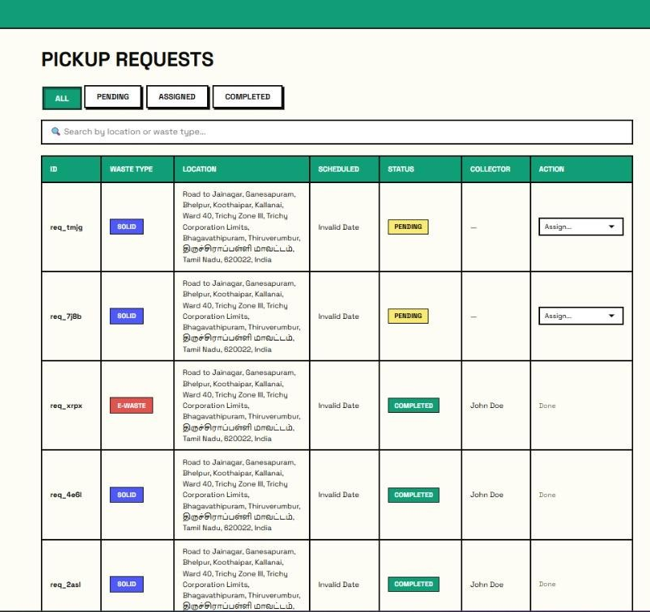
AUTHORITY DASHBOARD & WASTE ANALYTICS
IMPLEMENTATION OF MODULE-6
Centralized Admin Dashboard Real-Time Request Monitoring Area-Wise
Waste Analysis Waste Type
Distribution Vehicle Performance
Tracking Pickup Status Overview
Complaint Management System
Monthly & Yearly Reports

Slide 19
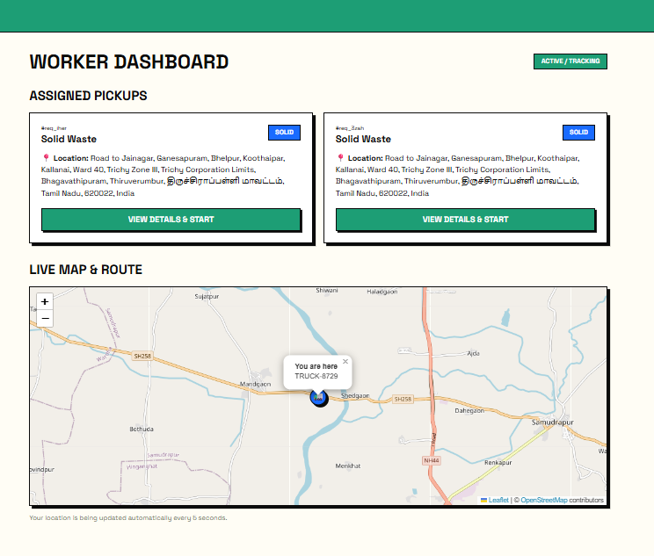
WORKER DASHBOARD
IMPLEMENTATION OF MODULE-7
Assigned Pickup List Daily Task Overview
GPS Navigation Support Route Guidance
Display Pickup Status Update Real-Time
Notifications Missed Pickup Reporting
19

Slide 20
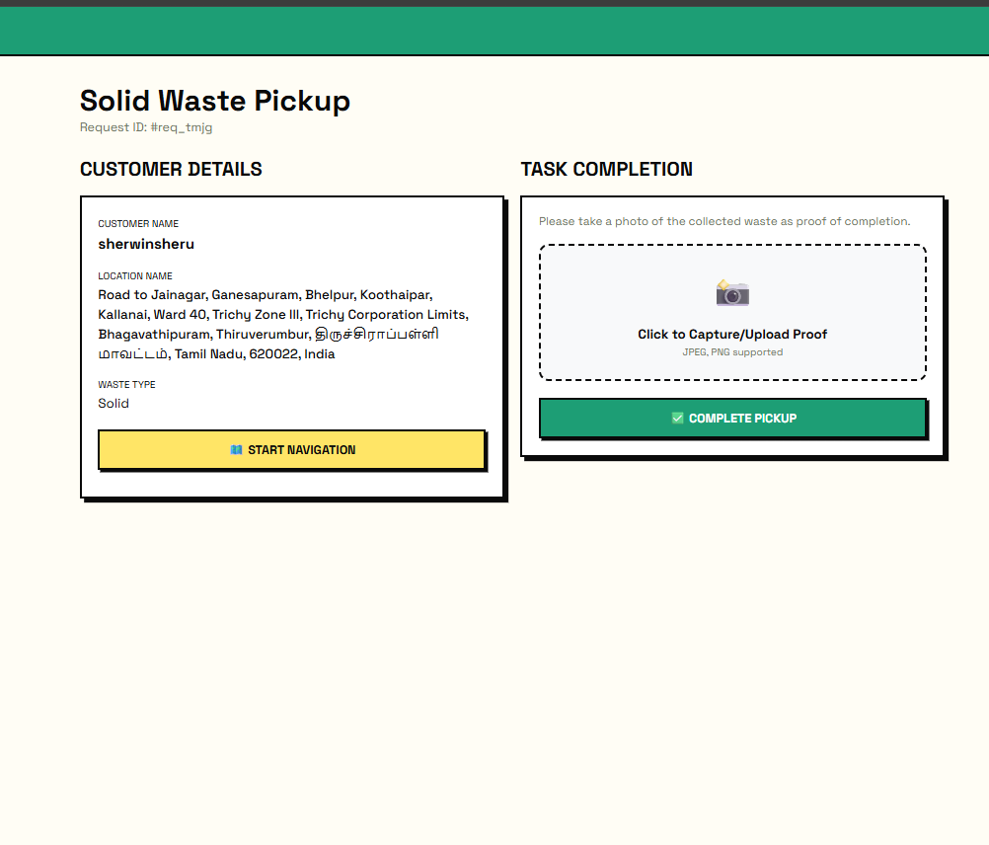
WORKER PICKUP
IMPLEMENTATION OF MODULE-8
Assigned Pickup Details Location-Based Pickup Waste Verification
Confirmation Status Update (Collected/Not Collected) Tracking of Collection
Real-Time Sync with Admin
20

Slide 21

PROOF
IMPLEMENTATION OF MODULE-9
Photo Capture of Collected Waste
Upload Proof to Server Admin Verification
Access User Confirmation Notification
Secure Data Storage
21

Slide 22
CONCLUSION
Clean City successfully bridges the communication and logistical gap between citizens and municipal authorities .
The AI scanner drastically reduces cognitive friction, making accurate source segregation accessible to everyone .
Dynamic OSRM routing transforms municipal logistics from static schedules to data-driven operations, saving significant time and resources.

Slide 23
FUTURE ENHANCEMENTS
Expand the AI model's dataset to accurately recognize crushed, dirty, and highly localized Indian household waste.
Integrate IoT smart bin sensors that automatically sync real- time fill-levels directly to the Authority Heatmap.
Partner with local eco-friendly businesses to allow users to convert digital Green Points into real-world discounts via API integrations.

