Slide 1
E-COMMERCE
A process of doing different transactions through internet.
Transactions include
  Business Transactions
  Payment Transactions
  Product purchase and selling transactions
  Sending and receiving of Particular data

Slide 2
“A modern business methodology ... to cut costs while improving the quality of goods and services and increasing the speed of service delivery.”
What’s
Electronic
Commerce?
Course Objectives:
1. To understand frame work, anatomy and applications of Electronic Commerce.
2. To acquire knowledge about different types of Electronic payment systems and risks in it.
3. To acquire knowledge about corporate digital library application, advertising and marketing.
4. To understand the concept of information search, retrieval and filtering.
5. To understand the overview of Multimedia concepts.
Course Outcomes:
After completion of the course, the student will be able to:
1. organize the frame work and anatomy of E-Commerce applications.
2. compare and contrast features of Electronic payment systems.
3. establish Corporate Digital Library and other applications.
4. apply information Search and retrieval techniques in E-Commerce applications.
5. familiarize various multimedia systems.

Slide 3
Module I
Electronic Commerce: Frame work, anatomy of e-commerce applications, e-commerce consumer applications, e-commerce organization applications, consumer oriented electronic commerce & mercantile process models.
Aim:
The aim of this Module is to:
explain the infrastructure of e-commerce
elucidate the e-commerce framework
discuss the application of e-commerce
The objectives of this Module are to:
explain multimedia content for e-commerce applications•
enlist e-commerce consumer applications
illustrate the benefits of retailing
Learning outcome:
At the end of this chapter, you will be able to:
recognise e-commerce organisation applications•
classify internal processes of multimedia servers•
describe anatomy of e-commerce applications

Slide 4
How can E-commerce be used?
Shopping: Buying and selling goods and services
Community-based services: Payment of utility bills, traffic fines, donations to charity etc.
Communication: E-mail, Net telephony products can be commerce-enabled and serviced via the Net.
Biz-to-Biz applications where the purchase orders are generated and integrated with EDI systems.

Slide 5
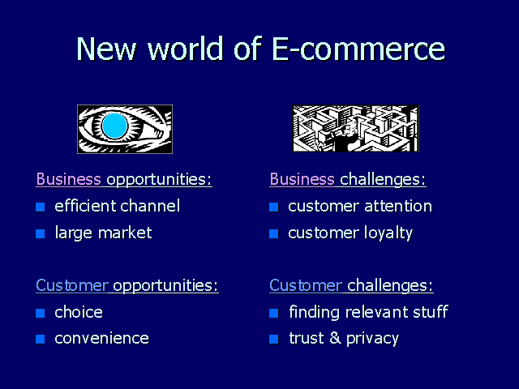

Slide 6
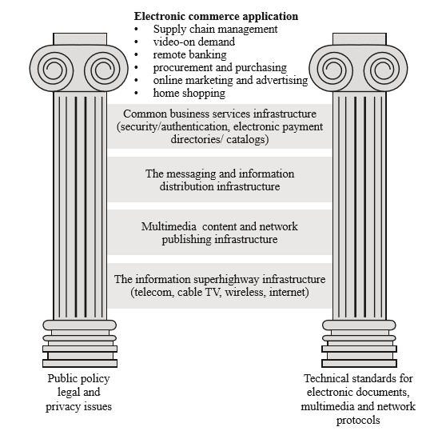
E-Commerce Framework

Slide 7
Module II
Electronic payment systems: Digital token based, smart cards, credit cards, risks in electronic payment systems.
Inter Organizational Commerce: EDI, EDI implementation, value added networks.
The aim of this Module is to:
explain the digital token in e-payment
elucidate e- payment system
Define and discuss EDI implementation
The objectives of this Module are to:
explain the smart cards used in e-payment
enlist the advantages of e-payment , classify the categories of EFT
discuss value added networks, explain the concept of adoption and implementation of EDI
Learning outcome
At the end of this Module, you will be able to:
recognise visa integrated specifications
classify encryption and credit cards
describe credit cards payment on internet, describe processes of typical EDI transaction and enlist the use of EDI

Slide 8
How do you buy Online?
As you browse through the store, that runs an ‘e-commerce server’, the server helps you select an item and place an order. Such servers carry software to verify transactions, perform accounting duties, guarantee payments, and even create digital money.

Slide 9
How Do you pay Online?
Wishing to pay for the item, you send an enciphered request for payment to your bank/third-party payment provider. Your bank will then remit to you, a secure packet of ‘e-cash’. Using Cybercash’s wallet application , you send an enciphered payment request to Cybercash’s server. Once the credit is authorised by Cybercash over secure lines to your bank, ‘money’ in Wallet is used to complete the purchase.(contd...)

Slide 10


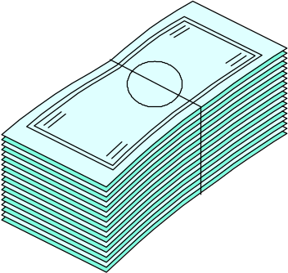


1
Consumer finds something she wants to buy at a “shop” on the Net
6
Verification and remittance of actual funds
Shop
2
Consumer sends on enciphered request for payment to her bank
The electronic bank sends back a secure packet of e-cash
Consumer’s Bank
3
Consumer Public Key
Merchant Server
The shop sends the packet of cash to its bank
5
Consumer sends the e-cash to the shop
4
Shop
Merchant Bank

Slide 11
How safe would it be to use your
Credit Card Online
How do you pay Online
While such a concern is shared by many users, the risk has now been reduced. This has come about due to the development of Secure Internet Protocols and Payment Systems, and Server solutions that can handle electronic transactions.
The Secure Electronic transaction (SET) initiative that major Credit-Card issuers Visa International and Master Card are backing is expected to solve such security risks. The use of Public Key encryption may also go a long way in allaying users fear of safety.

Slide 12
Major components of E-COM
Security issues(security server)
Payments to the server is enabled with the help of a number of security mechanisms
Browser-to-Web server data encryption and integrity with SSL 3.0
Browser to database password authentication by use of encrypted digests (Kerberose,Identix,Cybersafe)
Protection for corporate databases with protocol-enabled firewalls proxying and authenticating user connection requests.
Web Application Server to Browser authentication by use of digital signatures.
Security Server provides a Certificate Authority (CA) function, including generation of public key/private key pairs and issuance of industry-standard X.509 certificates.

Slide 13
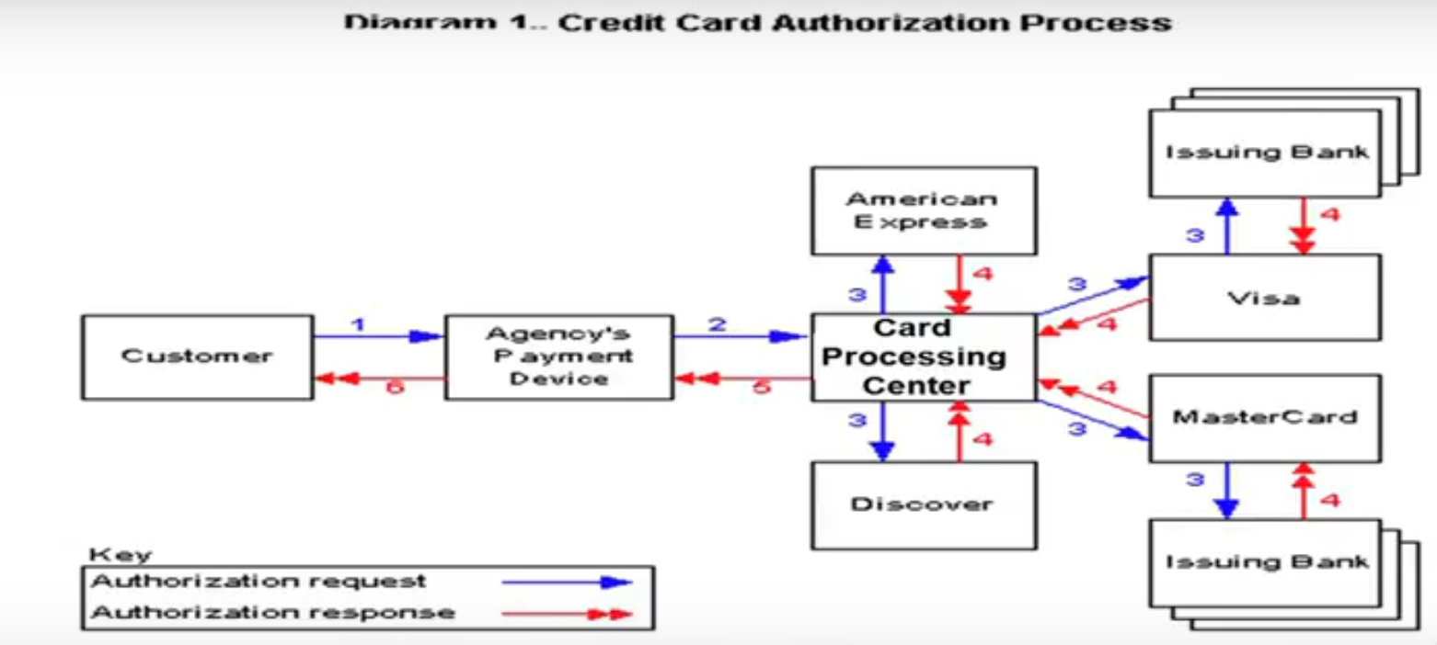

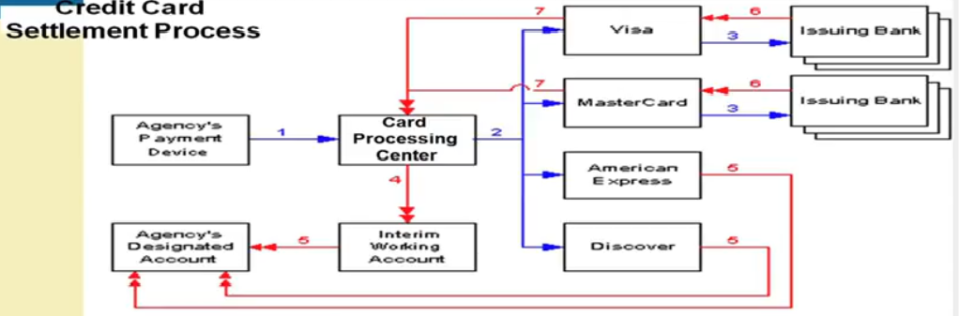

Slide 14
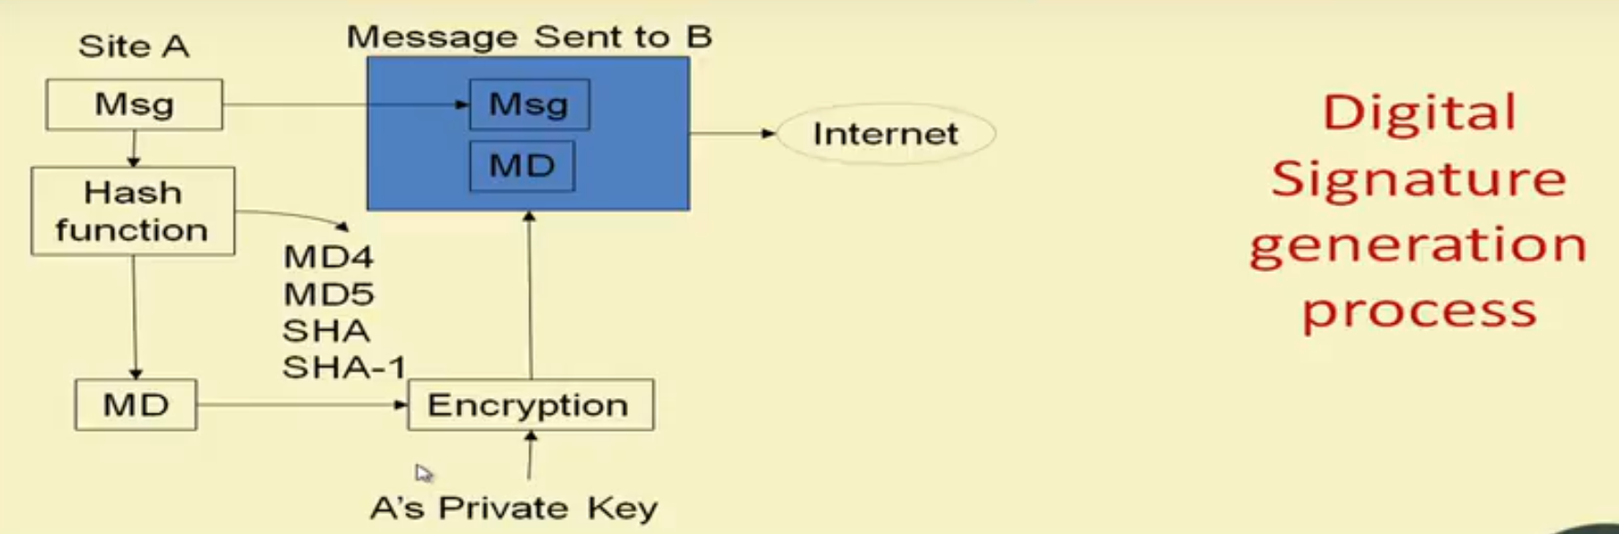
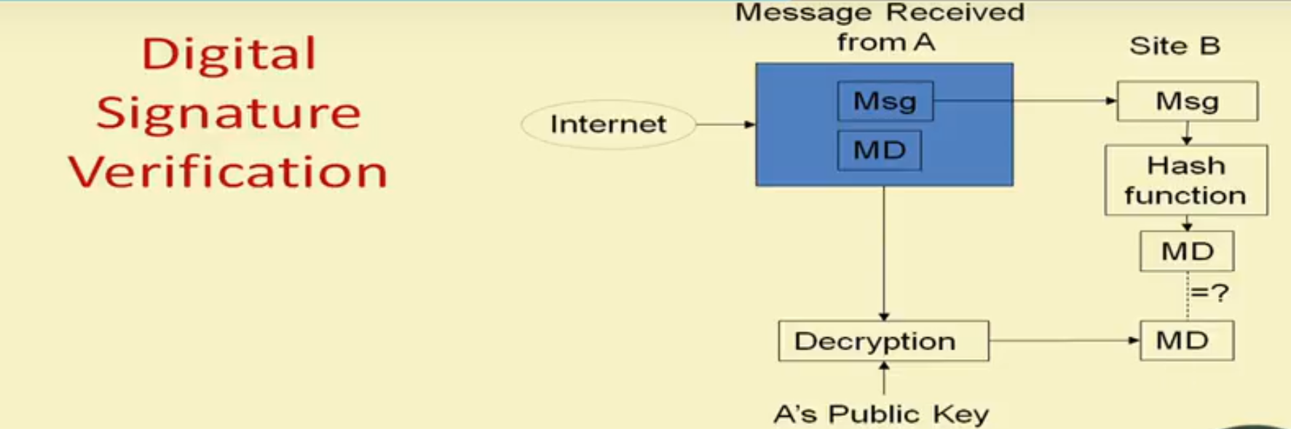

Slide 15
Module III
Intra Organizational Commerce: Work flow, automation customization and internal commerce, supply chain management.
Corporate Digital Library: Document library, digital document types, corporate data warehouses, advertising and marketing, information based marketing, advertising on internet, online marketing process, market research.
The aim of this module is to:
discuss workflow of intra organisational commerce
define work flow automation and enumerate the advantages of work flows
enumerate the types of digital documents
discuss information based marketing and types of micromarketing
The objectives of this module are to:
discuss workflow coordination
explain the concept of customisation and internal commerce
list the functions of supply chain management
discuss standard for structured documents and enlist the document imaging standards
discuss on-line marketing process and explain the concept of direct marketing
enlist the
Learning outcomes:
At the end of this module, you will be able to:
define supply chain management
enumerate key supply chain activities
enlist the impacts of e-commerce on supply chain management
recognise advantages of corporate data warehouses and enlist the types of data warehouses.
describe on-line advertising paradigms

Slide 16
Work flow automation
Customization and internal commerce
supply chain management.
Corporate Digital Library:
  Document library
  Digital document types
  Corporate data warehouses
  Advertising and marketing
  Information based marketing
  Advertising on internet
  Online marketing process & market research

Slide 17
Module IV
Consumer Search and Resource Discovery: Information search and retrieval, e-commerce catalogues, information filtering.
The aim of this module is to:
define the term information search
enlist different types of consumer search activities
The objectives of this module are to:
illustrate the commerce catalogue
discuss the information filtering system
Learning outcomes
At the end of this module, you will be able to:
understand the concept of information retrieval
talk about the mail-filtering agents
define electronic white pages

Slide 18
CONSUMER SEARCH AND RESOURCE DISCOVERY
Information Search: Information Search is a stage in the Consumer Decision Process during which a consumer searches for a product details/ information over the web.
Two fundamental goals of electronic commerce have been to increase the availability and accessibility of useful information.
Availability :which is accomplished through improved publishing tools that provide ready access to a voluminous amount of product information, including descriptive information from sellers (price, features, availability and other qualities) and rating information from third parties
Accessibility might be enhanced through search and retrieval tools. With thousands of databases, it can often take consumers hours or days to utilize the information-processing power of the computer to improve decision making without increasing the time and the effort expended in making choices
Designing flexible ways of navigating, searching, and retrieving pertinent information from on-line databases is important in light of its implications for individual and organizational decision making

Slide 19
Information search challenges
Turnover of the information is rapid, given that electronic market environments tend to be information intensive and constantly changing.
Consumers also experience frequent turnovers in their general stock of knowledge and so must engage in extensive search efforts to keep up to date. Electronic markets impose different types of information processing demands on consumers due to the rate of information change. Challenge is to design search and retrieval process that maximize an individual’s value in terms of time cost and information tools
Information overload contributes to long search times. Users must be able to find a small number of products that form the best alternatives to suit their individual search needs. While consumers may know their individual preferences, they lack knowledge of which products have which attributes
Customers want information about the products and services they buy, they want to make intelligent choices based on “complete” information. The challenge is how to represent this information on the screen in an effective manner
Consumers learn the environment slowly by knowing ‘what is where’. Additionally directories and catalogs may be provided to the consumers that facilitate them to navigate and browse the product information of their choice.
Finally, the focus is on the human-technology interface features that would enhance the customer's ability to make decisions and interact with the on-line environment.

Slide 20
SEARCH AND RESOURCE DISCOVERY PARADIGMS
Three information search and resource discovery paradigms are in use:
  Information search and retrieval
    Information search and retrieval is a process of finding and extracting information according to specifications provided by user.
  Electronic directories & catalogs
    Electronic directories and ctalogs are used for Information organizing and Information browsing
  Information filtering
    Information filtering is a process of selecting only those information that matches the user’s request. The purpose of this process is to eliminate unnecessary data present in the incoming stream.

Slide 21
Goal of information filtering is selecting of data that is relevant, manageable and understandable.
Filters are of two types
  1. Local filter
  2. Remote filter
Local filters: local filters are used for processing incoming stream of data to a PC, such as news feeds.
Remote filters: Remote filters are often software agents that work on behalf of the users. They help users to perform daily task, search and retrieve information, support decision making. They works as a proxy for user that move around the network from one data base to another.

Slide 22
INFORMATION SEARCH AND RETRIEVAL
Searching is a process of identifying/finding the required information from a massive amount of stored unstructured & semi structural data.
The process of searching can be divided into two types:
The end-user retrieval phases: consists of three steps
  First is, the user formulates a text based query to search data.
  Second is, the server interprets users query, performs the search and returns the user a list of documents.
  Third is, the user selects documents from the hit list and browses them, reading and perhaps printing only selected portions of retrieved data.
The publisher indexing phase:
  This phase is responsible for
    Making an entry of a document in the database
    Creating and updating indexes and pointers to facilitate subsequent searches.
  These two phases are highly interdependent

Slide 23
Search Engine:
Search engine is defined as a technique of finding data according to the user typed query without being concerned about its location
Wide area information service (WAIS)
  WAIS is a sophisticated search engine. Search engines are now being designed to go beyond simple, broadband Searches for which WIAS is so popular. To find every item that matches a query, no matter where it is located in the file system. It uses both keywords and information searching to rank the relevance of each document.
Indexing methods:
To accomplish accuracy and conserve disk space, two types of indexing methods are used by search engines.
They are:
1. File-level indexing
2. Word-level indexing

Slide 24
File-level indexing:
  It associates each indexed word with a list of all files in which that word appear at least once. It does not carry any information about the location of words within the file. The advantage of this method is that the disk space is utilized efficiently.
Word-level indexing:
  It is more sophisticated and stores the location of each instance of the word.
  The disadvantage of the word-level indexing is that all the extra information they contain gobbles up a lot of disk space.
We have the following search technologies for effective search:
Hypertext: richly interwoven links among items in displays allow users to move in relatively ad hoc sequences from display to display with in multimedia.
Sound: speech input and output, music and wide variety of acoustic cues include realistic sounds that supplement and replace visual communication.
Video: analog are digital video input from multiple media, including video tapes, CD-ROM, incorporated broadcast videos turners, cables and satellites.
3D-images: virtual reality displays offer a 3D environment in which all portions of the user interface are 3D.

Slide 25
Www Robots, wanderer, and Spiders
  Web Robots, Wanderer, and Spiders are all programs that browses and traverse the www automatically gathering information. These web robots are generally used by search engine like Google to perform the following tasks
    For indexing the web content
    Scanning ht email address
    Creating a copy of visited pages for later processing
    For validating HTML code
    For providing up-to-date information to the users.

Slide 26
ELECTRONIC COMMERCE CATALOGS OR DIRECTORIES
Directories are essential for conducting electronic commerce.
Directories help in finding data or applications that is distributed across the WAN. The main purpose of directories is to provide necessary information about the services, cost and standards that assists customers in making decisions while purchasing any product or service.
There are two types of directories:
1. Electronic white pages
2. Electronic yellow pages
The white pages are used for identifying potential customers or institutions
Yellow pages focus on customers who had made a decision of purchasing product.

Slide 27
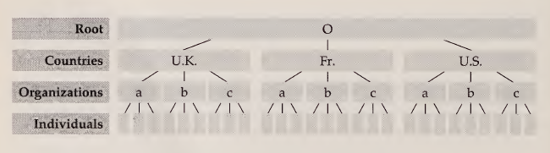
White pages through X.500
Functions of white pages are
  Searching and Retrieving
The directory is composed of a collection of servers known a directory system agents (DSAs). A DSA is essentially a server that stores information according to the X.500 standard, when necessary, exchange data with other DSAs. The DSAs cooperate to provide the overall directory services to directory user agents (DUAs.)
Directory is a collection of DSAs cooperating among themselves to hold information about a variety of objects, thus forming the directory information tree (DIT). The DIT is a hierarchical data structure consisting of a root, below which countries are defined. Below the countries organizations are defined, below organizations persons, or first additional organizational units are defined. The DIT is the representation of the global directory.
White pages DIT

Slide 28
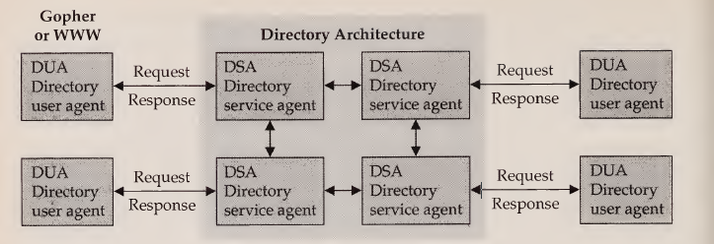
A user accesses the directory through a so-called directory user agent (see the following Fig.). The DUA automatically contacts a nearby DSA by means of which the user may search or browse through the DIT and retrieve corresponding information.
The DUA interacts with the directory by communicating with one or more DSAs. A DUA need not be bound to any particular DSA. For instance, a DUA in London can dial into a DSA in New York to obtain information. The DSA carries out the requests of the DUA. It returns the requested information or obtains the necessary information from other DSAs.
Directory Services Architecture

Slide 29
INFORMATION FILTERING
An Information filtering system is a system that removes redundant or unwanted information from an information stream using (semi)automated or computerized methods prior to presentation to a human user.
Its main goal is the management of the information overload and increment of the semantic signal-to-noise ratio.
A notable application can be found in the field of email spam filters.
Filtering has also been used to describe the process of accessing and retrieving information from remote database.
There are two types of filters used in information filtering system. They are ,
Intelligent filters
  These filters are responsible for searching and retrieving information from large data bases for finding the exact match for user’s query.
Software filters
  These filters are responsible for processing a document, understanding the information and allowing the users to have the following capabilities.
  (a) Speed or scan reading
  (b) Text summarization
  (c) Abstract generation
  (d) Information Extraction. Contd…

Slide 30
Filtering Agents
  There are two types of filtering agents used in information filtering system
Mail filtering agents :
Users of mail-filtering agents can instruct them to watch for items of interest in e-mail in-boxes, on-line news services, electronic discussion forums.
The mail agent will pull the relevant information and put it in the user’s personalized newspaper at predetermined intervals
News filtering agents:
These deliver real-time on-line news. Users can indicate topics of interest, and the agent will alert them to news stories on those topics as they appear on the newswire. Users can also create personalized news clipping reports by selecting from news services. News filtering services are primarily targeted to executives who need to keep current concerning their areas of interest

Slide 31
Module V
Multimedia: Key multimedia concepts, digital video and electronic commerce, desktop video processing, desktop video conferencing.
The aim of this module is to:
explain key concepts of multimedia
elucidate digital video and e-commerce
discuss desktop video conferencing
The objectives of this module are to
explain the concept of securing multimedia e-commerce
describe consumer devices
enlist the benefits of desktop video conferencing
Learning outcomes:
At the end of this Module, you will be able to:
understand multimedia e-commerce formats
identify video delivery and management
describe the benefits of desktop video conferencing

Slide 32
Multimedia and Digital Video
Multimedia:
  _x0001_KEY MULTIMEDIA CONCEPTS
  _x0001_ DIGITAL VIDEO AND ELECTRONIC COMMERCE
  _x0001_ DESKTOP VIDEO PROCESSING
  _x0001_ DESKTOP VIDEO CONFERENCING

Slide 33
In the present and future world of electronic commerce, imagine the following: Your 21- inch monitor displays a rotating 3D graphic of a car you want to purchase in one window; a video of a news anchorwoman reporting on an impending storm in another; an open window for real-time video conferencing with your client is in a third; and a fourth window flashes information about your stock portfolio as the stock market goes through its daily gyrations/rolls. Coming to this most of the networks not sophisticated for this scenario.
Multimedia is defined as an integration of multiple media.

Slide 34
Introduction
The challenge is to build the kind of networking and systems infrastructure that will support multimedia-based electronic commerce applications.
Multimedia information is more than plain text. It includes graphics, animation, sound, and video. Like many other technology terms, multimedia means different things in different circles
Multimedia has come to mean the combination of computers, television, and telephone capabilities in a single device.
One type of multimedia that is becoming a key technology for electronic commerce: digital video.
Notes:
In the future world of electronic commerce, imagine 21- inch monitor displays a rotating 3D graphic of a car we want to purchase in one window; a video of a news anchorwoman reporting on an impending storm in another; an open window for real-time video conferencing with your client is in a third; and a fourth window flashes information about your stock portfolio as the stock market

Slide 35
A multimedia entity (e.g., video image) must pass through a series of stages from inception to display, including:
Image capture/generation
Compression
Storage
Transport.
Desktop processing and display
Notes:
1.The image is captured by a sensor such as a television camera or is generated by an electronic device such as a computer.
2.The volume of information in the raw image may be too large to be sent through an affordable transmission channel. The data must be compressed to reduce its volume in such a way that the picture can be reconstructed without degradation at the receiving end.
3.The compressed data are stored on CD-ROM or network storage servers until ready for transport or display.
4.The data representing the image are prepared for transmission. Each component of a video program such as picture, sound, and associated data is separately organized into packets of data. Address and descriptive information is included in each packet.
5.Once the image is received, the earlier steps are reversed

Slide 36
• Image capture/generation. The image is captured by a sensor such as a television camera or is generated by an electronic device such as a computer.
• Compression. The volume of information in the raw image may be too large to be sent through an affordable transmission channel. Therefore the data must be compressed to reduce its volume in such a way that the picture can be reconstructed without degradation at the receiving end.
• Storage. The compressed data are stored on CD-ROM or network storage servers until ready for transport or display.
• Transport. The data representing the image are prepared for transmission. Each component of a video program such as picture, sound, and associated data is separately organized into packets of data. Address and descriptive information is included in each packet. Packets are aggregated into a single bit stream for transmission. This bit stream is then transmitted through a data communications network. The speed of transmission depends on the characteristics of the medium. Protection against loss or corruption of the signal is provided by adding extra bits to the data stream .
• Desktop processing and display. Once the image is received, the earlier steps are reversed; the bits that were added to aid in transmission are removed. The video, audio, and data streams for each program are separated. The data stream containing the images may be stored until ready for display. The images are then decompressed and formatted for display on a television, computer monitor, or other appliance.

Slide 37
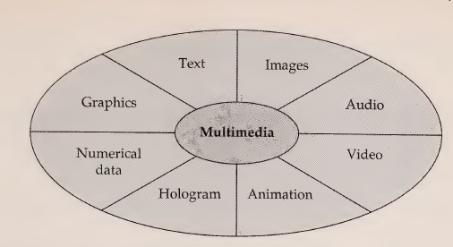
KEY MULTIMEDIA CONCEPTS
Technical definition of multimedia:
The use of digital data in more than one format, such as the combination of text, audio, and image data in a computer file.
Digitizing traditional media—words, pictures, sounds, motion—and mixing them together enables the creation of a new generation of applications.

Slide 38
The size of multimedia data types affects
Storage,
Network bandwidth,
Compression/decompression schemes,
Data content manipulation techniques, and
Processing power.
Notes:
One of the problems and challenges for multimedia developers is the size of new data types and the demand for time synchronization required for video and audio.

Slide 39
Multimedia Data Compression Techniques
The main purpose of the data compression is to decrease the volume of massive data & Data compression works by eliminating redundancy.
I. Sector-oriented disk compression (integrated into the operating system, this compression is invisible to end user)
II. Backup or archive-oriented compression (Program such as PKZIP are often used to Compress file before they are downloaded over telephone lines)
III. Graphics and video-oriented compression (Compress graphics & video files before they are Downloaded)
IV. Compression of data being transmitted over low-speed networks (various compressions schemes that are used in modems and routers can be use to reduce the risk of data loss while transmitting them over low speed N/Ws)
Notes:
1.Integrated into the operating system, this form of compression is invisible to the end user
2.Programs such as PKZIP are often used to compress files before they are downloaded over phone lines or stored on floppy disk.
3.Graphics data in particular can effectively overwhelm any system's on-line storage capability. Compression techniques designed especially for graphics reduce storage requirements by a factor of 100
4. V.42bis compression in modems, as well as techniques used by routers, can reduce the bottleneck caused by sending data over low-bandwidth phone lines.

Slide 40
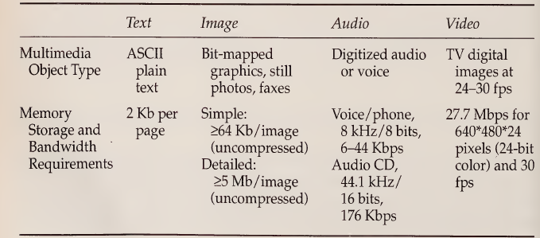
Compression is very important for both data storage and
data transmission.

Slide 41
Compression Techniques
Compression techniques can be divided into two major categories:
Lossy Compression
In this, there is a mismatch between data received and data transmitted.
Two popular standards for lossy graphics compression techniques are known as
MPEG, is used for compressing moving Picture and
JPEG, is used for compressing graphic images.
Lossless Compression
In this, there is no mismatch between data received and data transmitted
Notes:
1.Lossless compression produces compressed output that is exactly the same as the input. Lossless compression is used on text and numeric data. Text always requires lossless compression because a perfect reconstruction of the original is required. Lossless compression yields approximately a 2:1 reduction in space.
2.Lossy compression means that a given set of data will undergo a loss of accuracy or resolution after a cycle of compression and decompression. This type of compression is usually performed on voice, graphics, or video data. Lossy compression often yields a tremendous reduction in space—sometimes on the order of 1000:1.

Slide 42
Multimedia Servers
Multimedia server act as both hardware and software system whose main responsibility is to convert the raw data/rawfacts into usable information which is provided to users on demand.
Multimedia server is also responsible for capturing, processing, managing and delivering text, images, audio and video data.
Electronic commerce applications will require a server to manage application tasks, storage, security, transaction management, and scalability—whereas client devices handle only the user interface aspects .
The difference between client and server applications is that client is responsible for managing user interface issues while multimedia servers deals with critical issues like speed, connectivity, security, etc.
Notes:
critical elements are housed in the multimedia server (speed, connectivity, security, and critical applications).

Slide 43
For true multimedia information management, three different types of techniques are used
  Multiprocessing,
  Multitasking and
  Multithreading
Multiprocessing:
The ability to support the concurrent execution of several tasks on multiple processors.
Types of Multiprocessing techniques:
  i. Symmetric multiprocessing
  ii Asymmetric multiprocessing
Notes:
the gap is expected to be filled with multimedia servers
the choice of platform is a key element of the solution

Slide 44
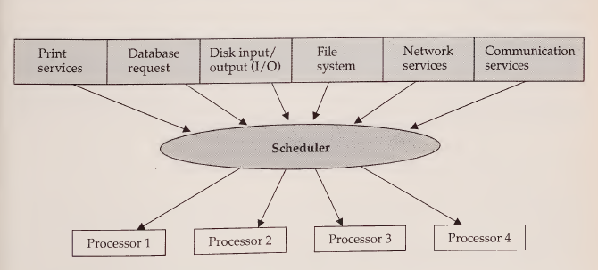
Symmetric Multiprocessing
Symmetric multiprocessing treats all processors as equal.
Symmetric multiprocessing allows a task to be dynamically assigned to any processor that might be free.
This task assignment is usually performed by the network operating system or the server operating system.
Notes:
Any processor can do the work of any other processor
The goal of this approach is to maximize processor usage or total throughput.
processor does not sit idle if there is work to be done.
Window NT are capable of symmetric multiprocessing

Slide 45
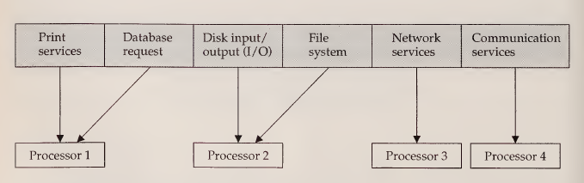
Asymmetric Multiprocessing
ASMP, assigns each task to a specialized processor.
network services are assigned to one processor
disk I/O is assigned to another processor, etc.

Slide 46
Multitasking: The server operating systems can run multiple programs and give the illusion that they are running simultaneously by switching control between them.
Two types of multitasking techniques are used:
Preemptive & Nonpreemptive
Multithreading:
  In a multithreaded environment, a process is broken into independent executable tasks called threads
  It is a sophisticated form of multitasking
  It refers to the ability to support separate paths of execution within a single address space (process).
Notes:
Windows NT offers preemptive multitasking

Slide 47
Multimedia Storage Technology
Multimedia Storage techniques can be divided into two types:
Network-based (disk arrays) and
Desktop-based (CD-ROM)
CODEC: Codec is a technique that performs compression and decompression of either video or audio information for storing massive amount of data.
Codecs can be classified in two types:
Hybrid codec (JPEG & MPEG)
S/W based codec (Cinepak & Indeo)

Slide 48
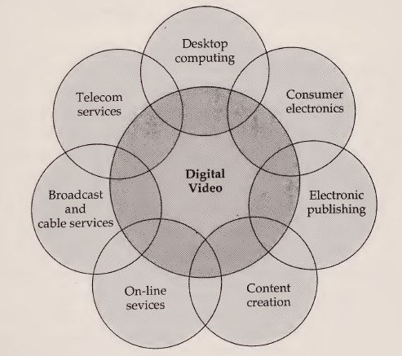
DIGITAL VIDEO AND ELECTRONIC COMMERCE
Digital video is nothing but the representation of data in binary format that represents a sequence of frames, each representing one image.
Digital video as a core element

Slide 49
Characteristics of Digital Video
Digital video first appeared in teleconferencing applications in the early 1980s. In the initial stages, it was cantered on high-definition television (HDTV).
Several characteristics of digital video differentiate it from traditional analog video.
  First, it is possible to edit, send and reproduce the digital signal without recognizing any reduction in the quality level of a picture.
  Second, it allows more flexible routing through packet switching technology.
  Third, digital video compression technology has enabled the development of new applications in consumer electronics, multimedia computers, and communications markets

Slide 50
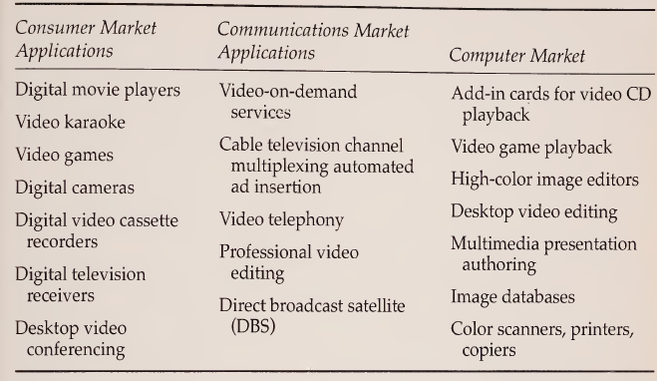
Applications of Digital Video in Electronic Commerce

Slide 51
DESKTOP VIDEO CONFERENCING
Allows business users & distant colleagues to communicate .
Early video conferencing utilized costly equipment to provide room-based conferencing in which all participants at a location gather in a specially equipped conference room.
USES OF Video Conferencing
  Meetings or Collaborations
  Online Teaching
  Business Administration
  Video interviews
  Working from Home
  Distance Diagnostics
  Legal environment

Slide 52
DESKTOP VIDEO CONFERENCING
Connection Oriented Vs Connectionless Communication
Factors Influencing Videoconferencing
Price
Standards
Compression

Slide 53
Data or Document conferencing
Form of screen sharing
Remote user shares one or more windows with a local user
Remote user can review or modify
Uses Windows Graphics device interface (GDI)

Slide 54
Types of video conferencing
Depends on the technology it is using for video transmission
POTS- Used for point to point conferencing
ISDN
Internet

Slide 55
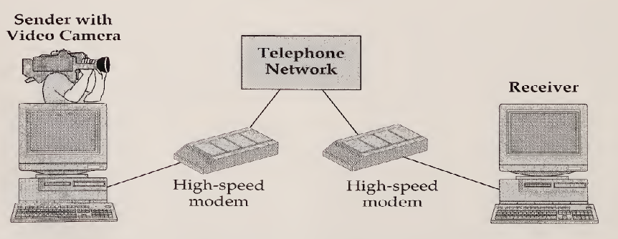
POTS for Videoconferencing
28.8-Kbps V.fast fax/modem,
Color video camera
Combination earpiece/microphone
Two expansion boards.
Uses VATP (Vector Adaptive Transform processing) Codec

Slide 56
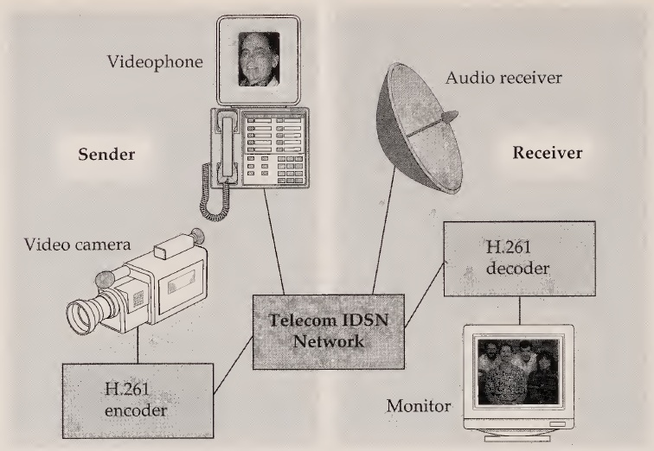
Videoconferencing with ISDN
Offers 128kbps
Requires installation of special hardware
Uses H.261 video compression technology which increases with bandwidth .
When load ↑ bandwidth to video ↓.

Slide 57
Videoconferencing with Internet
CU-SEEME
MBONE
CU-SEEME is a s/w developed for Macintosh and windows OS. This s/w provides support for real-time multyparty video conferencing over internet.
Requirements of CU-SEEME
  A digital camera which attaches to the Macintosh's serial port for sending video
  E.g. Apple's QuickTake and the QuickCam
  Receiving requires only a Mac with a screen capable of displaying 16 grays.

Slide 58
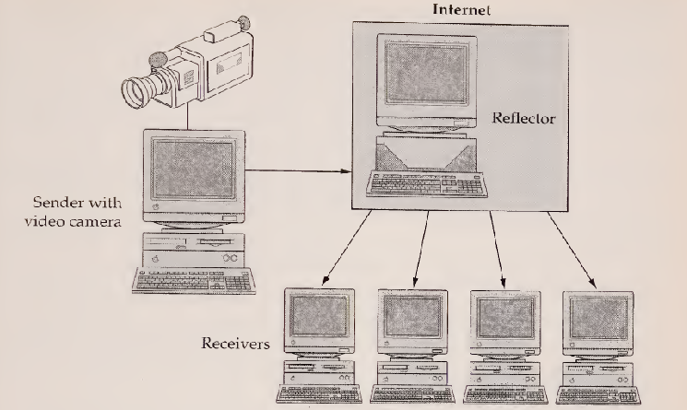
CU-SeeMe
First software available for Macintosh & Windows to support multiparty video conferencing.
Supports one-to-one, 1 to many, several to many conferencing

Slide 59
MBONE(Multicast Back Bone)
MBONE is created for understanding how broadcasting is made possible over internet.
Shares the same physical media as the Internet
Uses a network of routers which support IP multicast
In a packet-based video conference, images are continuously digitized, compressed, and sent to all remote sites.
Composed of islands that support IP multicasting to local clients.

Slide 60
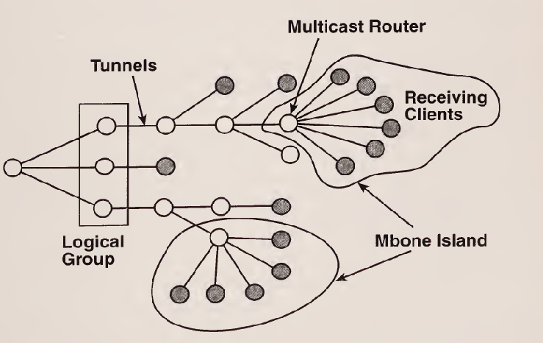
MBone
Islands are connected by virtual point-to-point links called tunnels.
Routing software mrouted (multicast routed) lets UNIX workstations to act as multicast routers.
Multicast IP packets are tunneled into regular IP packets.

Slide 61
Referces:
Text Book(s)
Ravi Kalakota and Andrew B. Whinston, Frontiers of electronic commerce, Pearson, 1996.

