Slide 1
E-COMMERCE
A process of doing different transactions through internet. Transactions include
  Business Transactions
  Payment Transactions
  Product purchase and selling transactions
  Sending and receiving of Particular data

Slide 2
“A modern business methodology ... to cut costs while improving the quality of goods and services and increasing the speed of service delivery.”
What’s
Electronic
Commerce?
Course Objectives:
1. To understand frame work, anatomy and applications of Electronic Commerce.
2. To acquire knowledge about different types of Electronic payment systems and risks in it.
3. To acquire knowledge about corporate digital library application, advertising and marketing.
4. To understand the concept of information search, retrieval and filtering.
5. To understand the overview of Multimedia concepts.
Course Outcomes:
After completion of the course, the student will be able to:
1. organize the frame work and anatomy of E-Commerce applications.
2. compare and contrast features of Electronic payment systems.
3. establish Corporate Digital Library and other applications.
4. apply information Search and retrieval techniques in E-Commerce applications.
5. familiarize various multimedia systems.

Slide 3
How can E-commerce be used?
Shopping: Buying and selling goods and services
Community-based services: Payment of utility bills, traffic fines, donations to charity etc.
Communication: E-mail, Net telephony products can be commerce-enabled and serviced via the Net.
Biz-to-Biz applications where the purchase orders are generated and seamlessly integrated with EDI systems.

Slide 4
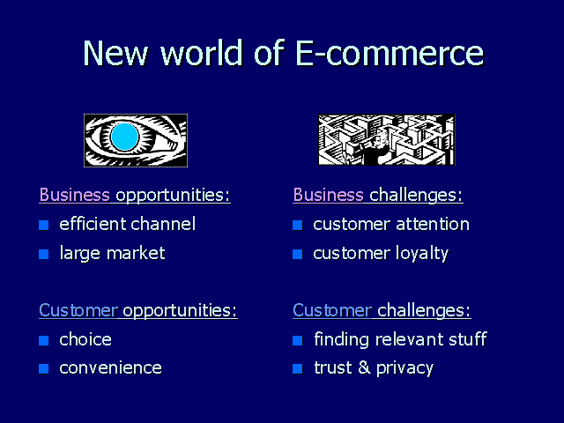

Slide 5
NEW CAPABILITIES THE INTERNET BRINGS TO COMMERCE
The Internet will augment electronic commerce already being conducted between businesses--at a much lower cost--as well as will dramatically increase electronic commerce conducted with consumers. Critical issues such as how to handle electronic payment, security, privacy, and fraud prevention are being addressed with reliable commercial software, and businesses are beginning to use information technology on the Internet to exploit the advantages of conducting business electronically.

Slide 6
Speedier, more accurate transactions through customer self-service
NEW CAPABILITIES THE INTERNET BRINGS TO COMMERCE
The Internet can save time and money and improve accuracy by eliminating middlemen who offer little added value. We will eventually see complex, multiparty transactions conducted over the Internet with no human interaction at intermediate levels whatsoever. As a result of one click by the end-consumer, the order will be placed, paid for, the product depleted from inventory, the shipment arranged, replacement components ordered from suppliers, and a replenishment order initiated. As an example, an airline's Web site may perform the simplest duties of a travel agent--provide access to timetables and fares, and make single-provider reservations--thus removing the agent as an intermediary.

Slide 7
E-Commerce and India
While some blame the high cost of implementation, others worry about the lack of security. The systems needed to transact over the Net are in the early stages of development and are still costly and complicated for Indian Businesses to use. But it’s clear that E-Commerce is in, and the combination of the Internet and the EDI (Electronic Data Interchange) is the next step in building competitive advantage.

Slide 8
EXAMPLES OF ELECTRONIC COMMERCE TODAY
If we consider some of the goals of businesses with regards to electronic commerce: higher revenues through exposure to additional customers; cost reduction; lower product cycle times; faster customer response; and improved service quality, we see how dramatically a company's bottom line can be influenced with the addition of electronic commerce. A number of pioneering firms are implementing electronic commerce solutions today and are finding new ways to save and make money.

Slide 9
Dell Experience
Increasing margins and revenues. Dell understood that the web could take the place of their customer call center replacing sales representatives and technical support staff. Phone and material costs decreased while also speeding up the sales process.

Slide 10
Lessons learnt from the
Dell Experience
The perfect way emerged for business sales. Business users can also find their way onto Dell’s site and Dell is now providing internal “virtual” web stores within large corporate Intranets to aid the purchasing process. This is a new growth segment for Dell’s web-based sales.

Slide 11
How do you buy Online?
As you browse through the store, that runs an ‘e-commerce server’, such as the HP domain commerce server or is part of an ‘electronic mall’, such as IBM’s Net.Commerce, the server helps you select an item (say an Olympic souvenir mug), and place an order. Such servers carry software to verify transactions, perform accounting duties, guarantee payments, and even create digital money.

Slide 12
How Do you pay Online?
Wishing to pay for the item, you send an enciphered request for payment to your bank/third-party payment provider. Your bank will then remit to you, a secure packet of ‘e-cash’. Using Cybercash’s wallet application , you send an enciphered payment request to Cybercash’s server. Once the credit is authorised by Cybercash over secure lines to your bank, ‘money’ in Wallet is used to complete the purchase.
(contd...)

Slide 13


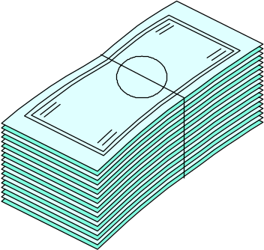


1
Consumer finds something she wants to buy at a “shop” on the Net
6
Verification and remittance of actual funds
Shop
2
Consumer sends on enciphered request for payment to her bank
The electronic bank sends back a secure packet of e-cash
Consumer’s Bank
3
Consumer Public Key
Merchant Server
The shop sends the packet of cash to its bank
5
Consumer sends the e-cash to the shop
4
Shop
Merchant Bank

Slide 14
How safe would it be to use your
Credit Card Online
How do you pay Online
While such a concern is shared by many users, the risk has now been reduced. This has come about due to the development of Secure Internet Protocols and Payment Systems, and Server solutions that can handle electronic transactions.
The Secure Electronic transaction (SET) initiative that major Credit-Card issuers Visa International and Master Card are backing is expected to solve such security risks. The use of Public Key encryption may also go a long way in allaying users fear of safety.

Slide 15
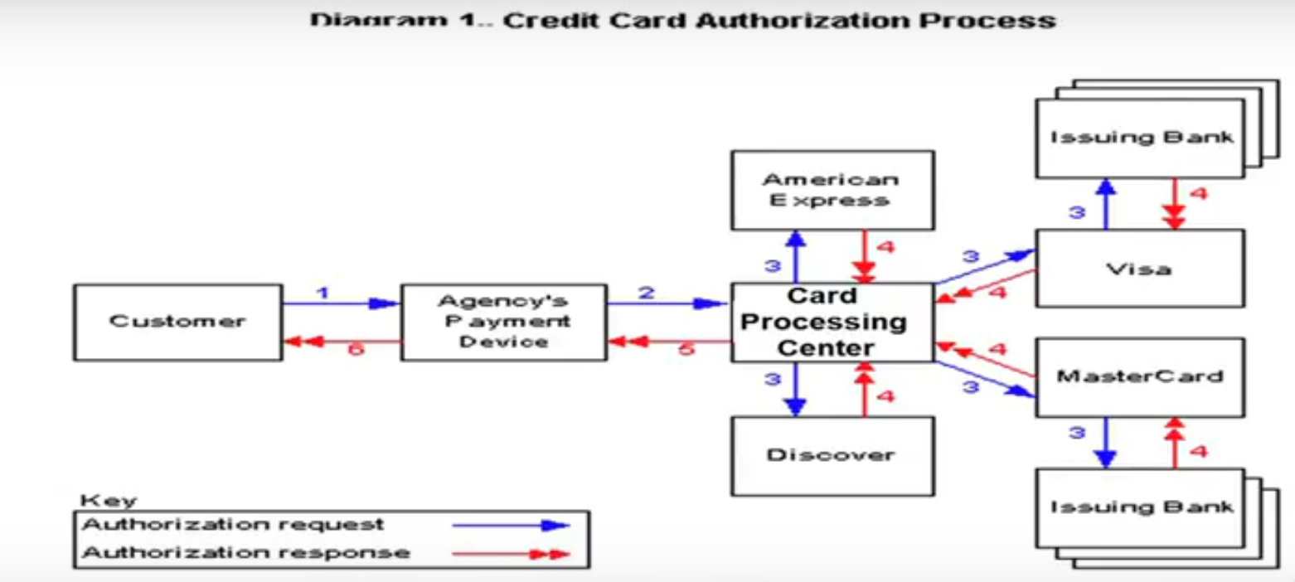

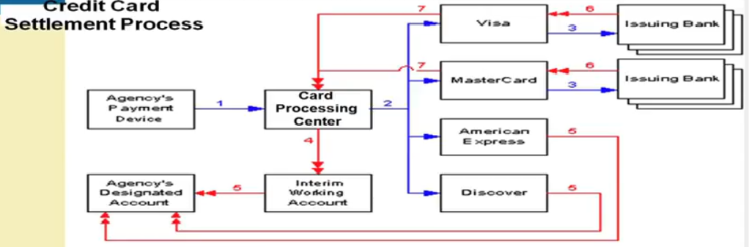

Slide 16
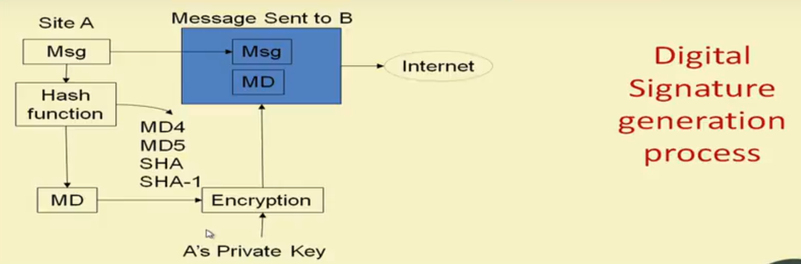
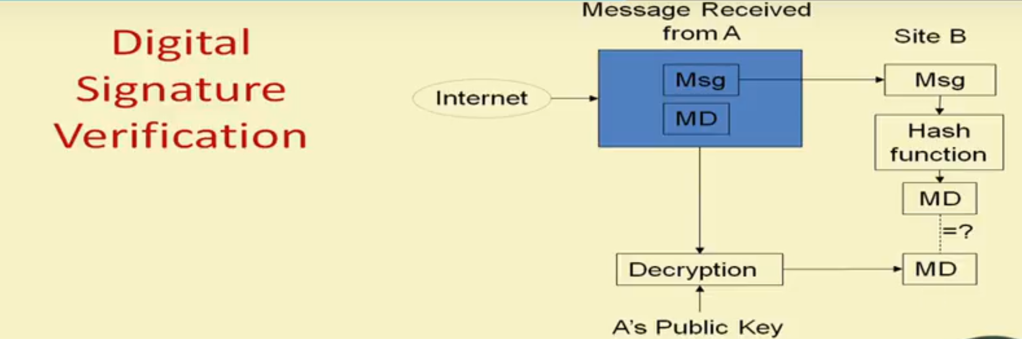

Slide 17
Major components of E-COM
Security issues(security server)
Payments to the server is enabled with the help of a number of security mechanisms
Browser-to-Web server data encryption and integrity with SSL 3.0
Browser to database password authentication by use of encrypted digests (Kerberose,Identix,Cybersafe)
Protection for corporate databases with protocol-enabled firewalls proxying and authenticating user connection requests (Oracle has supplied sql*net proxy to all firewall vendors).
Web Application Server to Browser authentication by use of digital signatures.
Security Server provides a Certificate Authority (CA) function, including generation of public key/private key pairs and issuance of industry-standard X.509 certificates.

Slide 18
CONSUMER SEARCH AND RESOURCE DISCOVERY

Slide 19
Multimedia and Digital Video
Multimedia:
  _x0001_ KEY MULTIMEDIA CONCEPTS
  _x0001_ DIGITAL VIDEO AND ELECTRONIC COMMERCE
  _x0001_ DESKTOP VIDEO PROCESSING
  _x0001_ DESKTOP VIDEO CONFERENCING

Slide 20
Is it safe?
Nobody would want to get into something that wasn’t secure. So when you are ready for e-business you’ll find that many organisations have developed solutions like Real Time Intrusion Detection and Anti Virus software. These along with personal codes and passwords make sure that any transaction that takes place or any information that is shared is seen only by the people it’s meant for.

Slide 21
In Future
While E-Commerce may not completely replace other forms of Commerce, it is likely to be the dominant mode of the commercial transactions in the future.
Colleges and Schools including Business Schools should reflect this trend in the curriculum to train the future generation of Managers.

