Slide 1
Multimedia and Digital Video
Unit-V

Slide 2
Topics
Key Multimedia Concepts
Digital Video and Electronic Commerce
Desktop Video Processing
Desktop Video Conferencing

Slide 3
Introduction
Multimedia content can be considered both fuel and traffic for electronic commerce applications.
Multimedia has come to mean the combination of computers, television, and telephone capabilities in a single device.
The challenge is to build the kind of networking and systems infrastructure that will support multimedia-based electronic commerce applications.
Notes:
In the future world of electronic commerce, imagine 21- inch monitor displays a rotating 3D graphic of a car we want to purchase in one window; a video of a news anchorwoman reporting on an impending storm in another; an open window for real-time video conferencing with your client is in a third; and a fourth window flashes information about your stock portfolio as the stock market

Slide 4
Multimedia information is more than plain text which includes graphics, animation, sound, and video.
One type of multimedia that is becoming a key technology for electronic commerce: digital video.
Notes:
Typical applications of digital video include video conferencing, video on-demand, and distance education.
We will concentrate on the technology—compression, storage, and transport

Slide 5
A multimedia entity (e.g., video image) must pass through a series of stages from inception to display, including:
Image capture/generation
Compression
Storage
Transport.
Desktop processing and display
Notes:
1.The image is captured by a sensor such as a television camera or is generated by an electronic device such as a computer.
2.The volume of information in the raw image may be too large to be sent through an affordable transmission channel. The data must be compressed to reduce its volume in such a way that the picture can be reconstructed without degradation at the receiving end.
3.The compressed data are stored on CD-ROM or network storage servers until ready for transport or display.
4.The data representing the image are prepared for transmission. Each component of a video program such as picture, sound, and associated data is separately organized into packets of data. Address and descriptive information is included in each packet.
5.Once the image is received, the earlier steps are reversed

Slide 6
KEY MULTIMEDIA CONCEPTS
Technical definition of multimedia:
The use of digital data in more than one format, such as the combination of text, audio, and image data in a computer file.
Digitizing traditional media—words, pictures, sounds, motion—and mixing them together ,enables the creation of a new generation of applications.

Slide 7
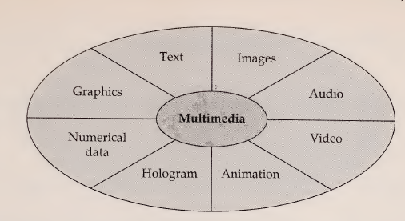
Possible Components of Multimedia

Slide 8
The size of multimedia data types affects
storage,
network bandwidth,
compression/decompression schemes,
data content manipulation techniques, and
processing power.
Notes:
One of the problems and challenges for multimedia developers is the size of new data types and the demand for time synchronization required for video and audio.

Slide 9
Multimedia Data Compression
Data compression attempts to pack as much information as possible into a given amount of storage space.
Ranges from as little as 2:1 to as much as 200:1
Notes:
2.depending on the compression/decompression scheme and level of quality desired.

Slide 10
Compression methods in use include the following:
Sector-oriented disk compression
Backup or archive-oriented compression
Graphics and video-oriented compression
Compression of data being transmitted over low-speed networks
Notes:
1.Integrated into the operating system, this form of compression is invisible to the end user
2.Programs such as PKZIP are often used to compress files before they are downloaded over phone lines or stored on floppy disk.
3.Graphics data in particular can effectively overwhelm any system's on-line storage capability. Compression techniques designed especially for graphics reduce storage requirements by a factor of 100
4. V.42bis compression in modems, as well as techniques used by routers, can reduce the bottleneck caused by sending data over low-bandwidth phone lines.

Slide 11
Data Compression in Action
Data compression works by eliminating redundancy.
Each block of data has an underlying information content, usually expressed as a number of bits.
The goal of data compression is to make the size to the 100 bits of underlying information.
Notes:
A block of text data containing 1000 bits may only have an underlying information content of 100 bits with the rest being white space.

Slide 12
The need for compression is apparent to users who are often amazed at how rapidly digitized video and sound fill up a disk.
Store a full-screen video image of size 640 x 480 pixels, in full color and at a rate of 30 frames per second.
One second of this video will require 27.6 Mb of disk space. Go for a full minute and the requirement exceeds a mind-boggling 1.6 Gb.
Notes:
An 8-bit digitized sound track sampled at 11 kHz requires just 660 Kbps for a one-minute recording.
A 16-bit stereo track sampled at 44 kHz (CD-quality) requires nearly 11 Mb of disk space for a full minute.
would fit on two CD-ROM discs

Slide 13
To understand the challenge better,
let's consider The picture on the screen is made up of dots called pixels.
If the picture is 200 x 200, then the picture has 200 times 200 pixels, or 40,000 pixels or 40 Kb of information for just one frame of video.
Most monitors today support at least 1024 x 768 displays.

Slide 14
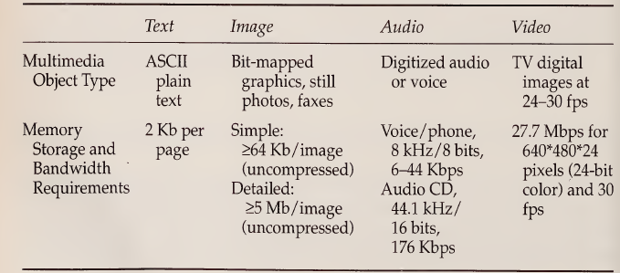

Slide 15
The solution lies in the compression of data.
Compression is very important for both data storage and data transmission.

Slide 16
Compression Techniques
Compression techniques can be divided into two major categories:
Lossless
Lossy
Notes:
1.Lossless compression produces compressed output that is exactly the same as the input. Lossless compression is used on text and numeric data. Text always requires lossless compression because a perfect reconstruction of the original is required. Lossless compression yields approximately a 2:1 reduction in space.
2.Lossy compression means that a given set of data will undergo a loss of accuracy or resolution after a cycle of compression and decompression. This type of compression is usually performed on voice, graphics, or video data. Lossy compression often yields a tremendous reduction in space—sometimes on the order of 1000:1.

Slide 17
Lossy compression is by far the more challenging and important because of benefits offered by a high compression factor .
The input image after compression may sound like an unacceptable compromise, the loss of resolution can be adjusted to be completely undetectable.
Two popular standards for lossy graphics compression are known as MPEG, for the Motion Picture Experts Group, and JPEG, for Joint Photographic Experts Group.
Notes:
JPEG is used to compress single graphics images, while MPEG is used for motion pictures.

Slide 18
Multimedia Servers
A server is a hardware and software system that turns raw data into usable information and then provides that information to users when they need it.
It captures, processes, manages, and delivers text, images, audio, and video.
Electronic commerce applications will require a server to manage application tasks, storage, security, transaction management, and scalability—whereas client devices handle only the user interface aspects
Notes:
critical elements are housed in the multimedia server (speed, connectivity, security, and critical applications).

Slide 19
“Mainframe" platforms are costly, slow, and unable to handle these new data types.
PCs lack scalability and the ability to manage a large number of transactions.
For true multimedia information management, platform choices include
Multiprocessing,
multitasking, and
multithreaded systems
Notes:
the gap is expected to be filled with multimedia servers
the choice of platform is a key element of the solution

Slide 20
Multiprocessing
The ability to support the concurrent execution of several tasks on multiple processors.
The processors can be tightly or loosely coupled.
In loosely coupled systems, each processor has its own local memory.
In tightly coupled systems, a more popular architecture, the processors share common memory.
Notes:
the ability to use more than one CPU for executing programs
Processors interact with memory using a special memory bus. However, each processor has its own RAM cache, which reduces the traffic on the memory bus.

Slide 21
Vendors are implementing multimedia servers on multiple processors to increase multimedia processing speed and performance.
Multiple processors permit servers to do either symmetric or functional multiprocessing.

Slide 22
Symmetric Multiprocessing
Symmetric multiprocessing treats all processors as equal.
Applications are broken down into tasks, processes, and threads, to be run concurrently on any available processor.
Symmetric multiprocessing allows a task to be dynamically assigned to any processor that might be free.
This task assignment is usually performed by the network operating system or the server operating system.
Notes:
Any processor can do the work of any other processor
The goal of this approach is to maximize processor usage or total throughput.
processor does not sit idle if there is work to be done.
Window NT are capable of symmetric multiprocessing

Slide 23
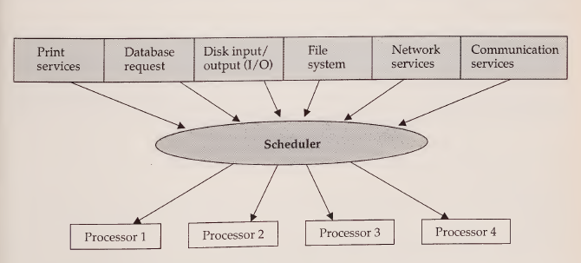
Symmetric multiprocessing

Slide 24
Asymmetric Multiprocessing
ASMP, assigns each task to a specialized processor.
network services are assigned to one processor
disk I/O is assigned to another
database storage and manipulation is assigned to a third

Slide 25
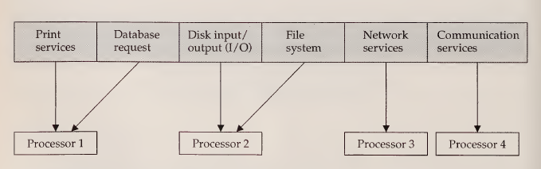
Asymmetric multiprocessing

Slide 26
Multitasking
The server operating systems can run multiple programs and give the illusion that they are running simultaneously by switching control between them.
Two types of multitasking are used:
Preemptive
Nonpreemptive
Notes:
Windows NT offers preemptive multitasking

Slide 27
Multithreading
It is a sophisticated form of multitasking
It refers to the ability to support separate paths of execution within a single address space (process).
In a multithreaded environment, a process is broken into independent executable tasks called threads.

Slide 28
In multitasking, a process is the smallest unit of execution that a system can allocate resources to or schedule to run.
In multithreading, a thread is the smallest unit of execution that a system can schedule to run.
Notes:
A process consists of several threads
Each thread consists of a stack, an instruction pointer, a priority queue, a CPU state, and an entry in the system scheduler about its state.

Slide 29
Multimedia Storage Technology
A key player in electronic commerce because the storage requirements of modern-day information are enormous.
The important characteristic of next generation storage systems is not only the amount of storage but the rate at which data can be read from the disk.
Storage technology can be divided into two types:
Network-based (disk arrays) and
Desktop-based (CD-ROM)

Slide 30
Disk Arrays
Disk arrays store enormous amounts of information and are becoming an important storage technology for firewall servers and other electronic commerce servers.
The main point of RAID is that it offers a high degree of data capacity, availability, and redundancy.
RAID achieves availability through the notion of fault tolerance
Notes:
Small arrays run from 5 to 10 gigabytes, and larger systems provide 50-500 gigabytes of storage.
The technology behind these disk arrays is called RAID (redundant array of inexpensive disks)
The actual degree of fault tolerance varies depending on the RAID level the user chooses

Slide 31
RAID technology has many levels.
Users get extremely high data availability and increased throughput.
All RAID levels (except RAID 0) can reconstruct the data stored on any single failed disk in the array from the information stored on the remaining disks.
RAID interest is increasing as applications require more disk space and multimedia servers become more popular.

Slide 32
CD-ROM
The premiere desktop storage technology for electronic commerce applications is CD-ROM.
The prime reason for its success is an incredible storage density that allows a single CD-ROM disc to contain 530 Mb (audio CD)-4.8 Gb (video CD) of data.
Two new innovations are breaking into the market:
recordable CD, which allows users to repeatedly record and erase digital data, and
CD- video, which is expected to replace videocassette movies.
Notes:
1.44 Mb--3.5-inch floppy disk
CD-ROMs are readonly (the data can only be retrieved and no new data can be added).
To read the CD-ROMs a special drive (the CD-ROM drive) is required.
1.44 Mb for the more common 3.5-inch floppy disk.

Slide 33
CD ROM technology exhibits the following characteristics
High information density
Low unit cost
Read-only medium
Modest random access performance

Slide 34
DIGITAL VIDEO AND ELECTRONIC COMMERCE
Digital video is binary data that represents a sequence of frames, each representing one image.
Digital video may contain a synchronized sound track.
Digital video is a core component in various electronic commerce applications.

Slide 35
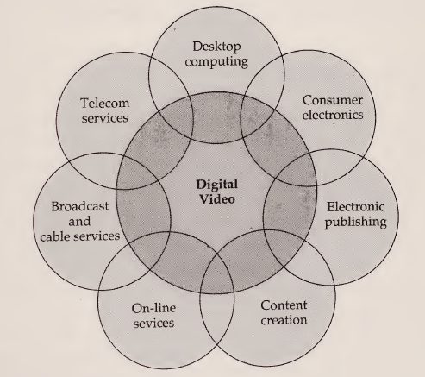
Digital video as a core element

Slide 36
Digital video first appeared in teleconferencing applications in the early 1980s. In the initial stages, it was centered on high-definition television (HDTV).
Virtually all the top computer-system vendors are now actively exploring the market for digital video-based set-top boxes.
The conversion in the 1980s from audio cassettes and LPs to digital CDs is an example of how technological advances and cost reductions in digital technology can change an industry.

Slide 37
The most significant barrier to a similar changeover from analog to digital video has been the vast amount of data that digital video requires.
An hour-long video in digital form would require about 100 CDs to be stored, and transmission of an uncompressed digital video program requires an impractical amount of bandwidth.

Slide 38
Characteristics of Digital Video
Several characteristics of digital video differentiate it from traditional analog video.
First, it can be manipulated, transmitted, and reproduced with no discernible image degradation.
Second, it allows more flexible routing through packet switching technology.
Third, digital video compression technology has enabled the development of new applications in consumer electronics, multimedia computers, and communications markets

Slide 39
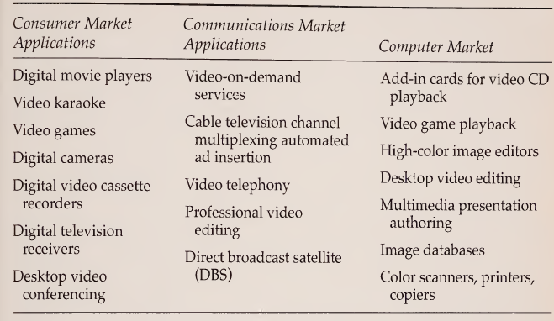
Applications of Digital Video in Electronic Commerce

Slide 40
Digital Video Compression/Decompression
Digital video compression takes advantage of the fact that a substantial amount of redundancies exist in video.
Cost-effective techniques to detect these redundancies, eliminate them during transmission and storage, and then recover them for viewing are needed to make digital video practical.
The process of compression and decompression is commonly referred to as just compression, but it involves both processes.
Notes:
hour-long video that would require 100 CDs would only require one CD if video is compressed.

