Slide 1
Modelling the interplay of metaphor and emotion through multitask learning
verna dankerrs, marek red, martha lewis, ekaterrina shutova
Presented by,
Madhuri sarda
Poonam Kankariya
Rohita goparaju

Slide 2
paper Abstract
Metaphors – convey emotions connecting physical experiences with abstract concepts
Metaphorical phrases more emotionally evocative than literal counterparts
Experimenting with multi-task learning architectures involving varying parameter sharing phenomena
Relationship of metaphor identification and emotion prediction analyzed

Slide 3
introduction
Metaphors help reason abstract concepts through physical experiences
Metaphorical language – systematic association between two disticnt semantic domains of source and target
Metaphorical association project knowledge from source to target inviting new reasoning frameworks
First joint model of metaphor and emotion learning patterns of interaction via flexible parameter sharing techniques

Slide 4
Related work
Computational models of metaphor
Computational models of emotion
Metaphor and emotion

Slide 5
Tasks and datasets
Data sets involved:
VUA Metaphor Corpus
LCC Metaphor Corpus
EmoBank Corrpus
Tasks performed:
Metaphor identification
Emotion detection

Slide 6

VUA metaphor corpus
Subset of British National Corpus
Word annotated – Literally or Metaphorically-used
Over ten thousand sentences sampled from four genres – Academic Writing, News, Conversation, Fiction
Inter-annotator agreement = 0.84 (Fleiss’s $k$)
Metaphor identification at word-level using sequence labelling paradigm

Slide 7
lcc metaphor corpus
Language Computer Corporation metaphor data set with data available in English, Farsi, Spanish and Russian
English portion containing data from ClueWeb corpus and Debate Politics online forum used
Inter-annotator agreement = 92.8%
Nine thousand samples extracted
Normalized average scores assigned by individual annotators
Sentence-level regression via ten-fold cross validation (70-10-20 train, validate, test data ratio)

Slide 8

Emobank corpus
Based on VAD model containing ten thousand sentences from manually annotated sub-corpus of American English and Affective Text corpus
Genres balanced – News headlines, Blogs, Essays, Fiction, Letters, Newspapers, Travel guides
Sentence rating dimensions – perspective of reader and writer
Inter-annotator agreement = 0.61 (reader) / 0.63 (writer) (Pearson’s $r$)
Sentence-level regression via ten-fold cross validation (70-10-20 train, validate, test data ratio)

Slide 9
methodology
Recurrent neural architecture
Word-level metaphor detection in sequence labelling paradigm, when optimized adapts to predict sentence-level metaphoricity score
Emotional prediction follows sentence-level metaphor prediction task

Slide 10

Approaches used
Hard parameter sharing
Cross-stitch network
Gated network

Slide 11
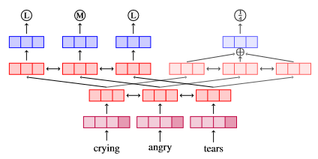
Method – hard parameter sharing
Metaphor detection using emotion prediction
Optimization of two different, related tasks prevents overfitting to either
Word embeddings and lower Bi-LSTM (transformer) layers shared
Output and attentions layers are task specific

Slide 12
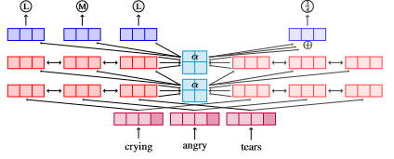
Method – cross-stitch network
Soft-sharing of parallel models
α –parameters regulates information flow, optimized during training
Cross-stitch sharing applied after each recurrent layer computing updated hidden states
Learns single set of shared values during optimization

Slide 13
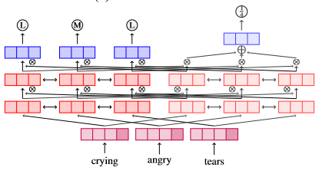
Method – gated network
Network calculating values dynamically for each input sentence, while testing too
Better flexibility & modulation of information flow
α –parameters replaced by gates in parallel layers
Gates modulate information flow from main to auxiliary task & control in opposite direction

Slide 14
experiment
MTL Training Procedure
Hyperparameters
Significance Testing

Slide 15

MTL training procedure
Pairwise joint learning
Training process task selected at random and batch sampled from that task
Distinction of main from auxiliary task through down-weighing of loss of auxiliary task by a factor of $λ$ comprising of 10% of main task’s loss

Slide 16
hyperparameters
Recurrent network input - concatenated ELMo (1024) and GloVe (300) embeddings with appropriate dimensions
Recurrent encode containing three Bi-LSTM layers with dimensionality = 200

Slide 17
Hyperparameters - training model
Batch size = 64 for 2000 steps
Optimizer = Adam
Initial learning rates
Metaphor detection = 4e – 3
Metaphor regression = 1e – 3
Emotion regression = 0.5e – 3
Model selection = random

Slide 18

Hyperparameters - BERT base model
Pretrained BERT Base model with 768 dimensions of inputs and hidden states
12 Transformer layers
Optimizer = Adam
Initial learning rate = 5e – 5
Batch size = 32
Fine tuned for 3000 steps (regression task) and 8000 steps (word-level
Down-scaling $λ$ for difference compensation

Slide 19
Significance testing
Statistical significance testing
One-sided approximate randomization test for metaphor detection
William’s test for regression tasks
Number of samples = Number of unique samples in dataset
Performance measures – averages from models initialised with ten random seeds

Slide 20
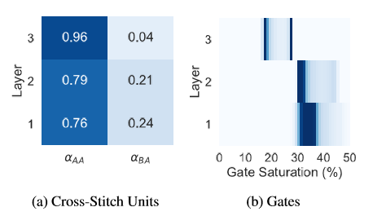
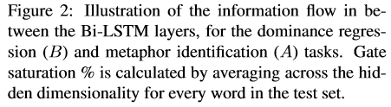
Results

Slide 21
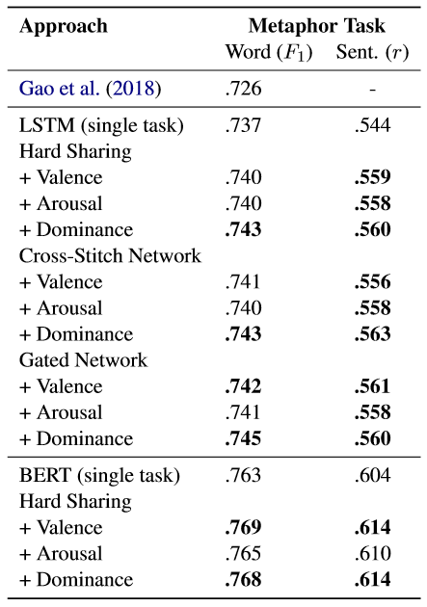
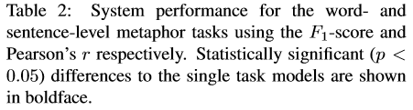
Results
Supports hypothesis on interaction of metaphor and emotion in semantic composition

Slide 22
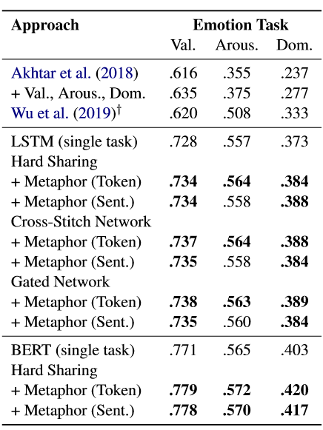
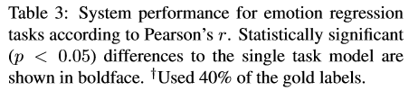
Results
Benefits to include metaphor information into emotion analysis viz. sentiment analysis systems

Slide 23
Data analysis & discussion
Word-level metaphor identification using MTL
STL outputs compared with MTL for prediction
Dominance regression leads to a complex, beneficial task
Misinterpretation resulting in examples of errors
Confusing - “to be knocked out” and “to knock out”
Direction of contribution of words towards emotions
Negative metaphorical terms contributing to positive sentiment and vice versa

Slide 24
conclusion
Introduction of first compositional deep learning model jointly capturing phenomena of metaphor and emotion
Proposed system considered metaphor tasks at word and sentence levels
Modeled emotions using valence, arousal and dominance
Emotional dimension dominance contributes the most to metaphors
Incorporation of a model of metaphors into emotions and sentiment-related NLP applications in the future is supported

