Slide 1
Thematic and Argument Structure Analysis of Plato’s Republic
Using Data Mining Techniques
By Tanishq Daniel, Trevor Ouma, Nate Miller
CIS 635

Slide 2
Introduction
Data Source: Plato’s Republic
Plato’s Republic is a foundational work in philosophy from 375 B.C
Focuses on the meaning and importance of justice
The work follows Socrates who utilizes the Socratic method to explore ideas with his companions
Heavy use of allegories such Plato’s Cave and the ideal city-state (Kallipolis)
Public domain translation (Jowett)
Objectives
Latent Dirichlet Allocation (LDA) to extract themes from the text
Calculate the complexity of the themes in each section of the text
Extract arguments from the text using argumentative markers
Calculate the complexity of the arguments in each section of the text
Examine the relationship between theme and argument complexity

Slide 3
Preprocessing
Extract text in range
Extracts text between a start and end phrase using find and slicing.
Helps isolate specific portions of text.
Preprocess by books
Splits text into books using patterns like "BOOK I", "BOOK II".
Processes each book by:
Tokenization: Splits content into individual words.
Chunking: Divides text into chunks of chunk_size words.
Stopword Removal: Filters common words (e.g., "yes", "said") and punctuation.
Notes:
Splitting up the text into different books
Each book has chunks
Removes stop words, additional words and punctuation
Added more as time went on
Remove copyright text and intro

Slide 4
Extract Themes
LDA is a Bayesian network used to discover topics in large body of text (corpus)
Split text into chunks of about 350 words
Convert chunks of text into numerical representations
Extract human-readable themes from the chunks
Assign strengths of themes to each chunk
Cross-Validation was used to find the best hyperparameters for LDA

Slide 5
Theme Complexity
Measure the thematic complexity of each chunk.
Key Metrics
Weighted Contribution:
Total complexity contribution of each theme
Diversity:
Number of unique themes in the chunk
Entropy:
Distribution of themes in the chunk
Uniform distribution means higher value
Normalization
Z-Score Scaling:
Standardizes individual complexity values
Min-Max Scaling:
Standardizes composite complexity to a 0–1 range for comparison.
Composite Complexity Calculation
60%: Weighted Contribution
20%: Diversity
20%: Entropy
Output
Book/Chunk:
Source location of the argument.
Complexity Scores: Raw and normalized values for each metric.
Theme Complexity:
Final composite score.

Slide 6
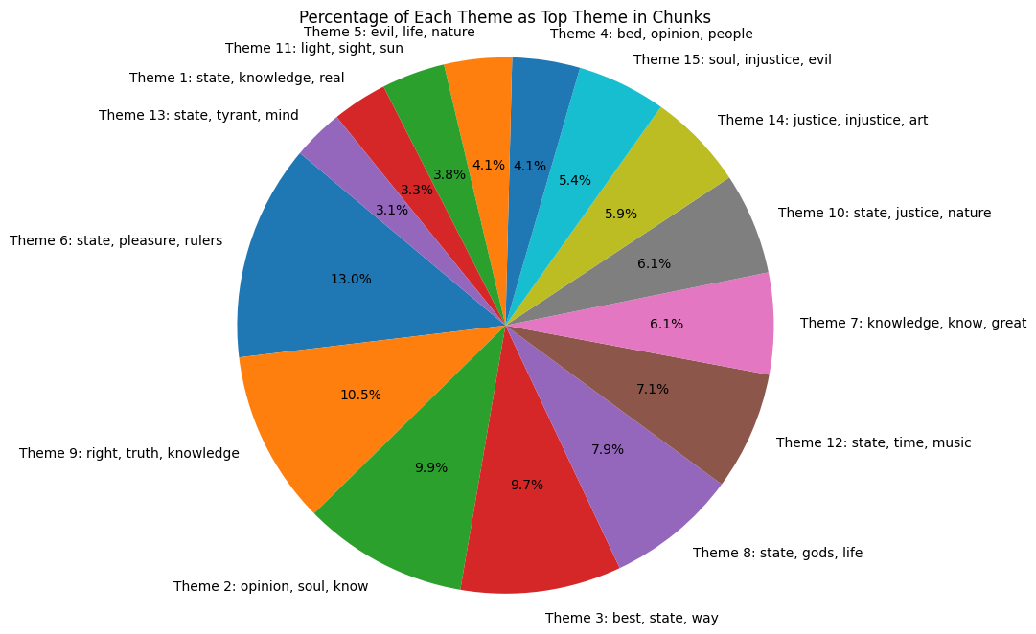

Slide 7
Argument Extraction
Extract logical arguments from text data using markers (e.g., "therefore," "if...then").
Key Steps
Text Isolation:
Extracts relevant text between start_phrase and end_phrase.
Preprocessing:
Splits text into books and chunks using preprocess_by_books.
Argument Detection:
Identifies sentences containing logical markers (e.g., "hence," "because").
Output
Book: The source book of the argument.
Chunk: Location in text.
Argument: Logical sentence detected.

Slide 8
Argument Complexity
Measure the complexity of logical arguments using multiple metrics and weights.
Key Metrics
Number of Keywords:
Count of logical markers (e.g., "because," "if...then").
Word Count:
Total number of words in the argument.
Average Word Length:
Mean character count per word.
Argument Type:
Classifies arguments as "conditional" or "general."
Normalization
Min-Max Scaling:
Standardizes metrics to a 0–1 range for comparison.
Composite Complexity Calculation
Weighted formula combines normalized metrics:
40%: Word Count
40%: Number of Keywords
20%: Average Word Length
Output
Book/Chunk:
Source location of the argument.
Complexity Scores: Raw and normalized values.
Argument Complexity:
Final composite score.

Slide 9
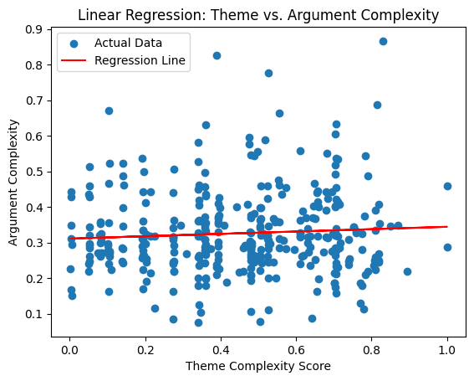

Slide 10
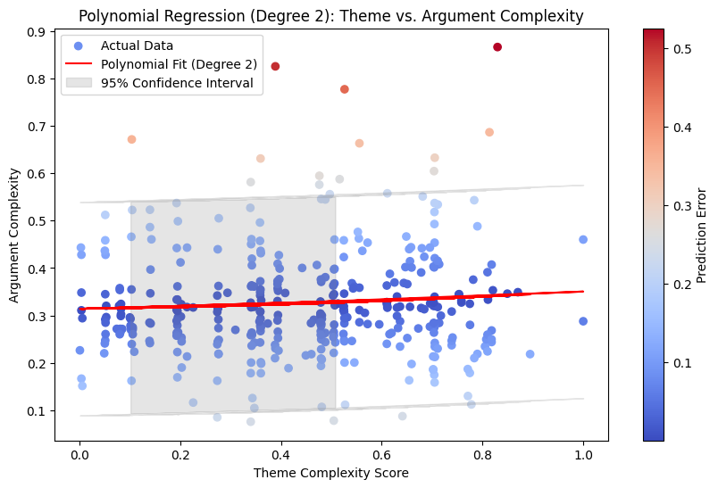

Slide 11
Regression Results
R² Score (0.004): This indicates that the polynomial regression model explains only 0.4% of the variance in argument complexity based on theme complexity. This is extremely low, suggesting that the model does not fit the data well.
Mean Squared Error (0.013): This value is relatively low, however, we considered it in the context of the R² score.
Cross-Validation Mean R² (-0.011): This negative mean R² score from cross-validation indicates that the model performs worse than a simple mean model. This implies that our chosen polynomial regression model is not suitable for predicting argument complexity based on theme complexity.

Slide 12
Correlation Results
Spearman's Correlation Results using
Scipy
Sklearn
Spearman's Correlation Analysis:
Correlation (0.051 using scipy or 0.052 using Sklearn): The weak positive correlation suggests that there is a very minor and non-monotonic relationship between theme complexity and argument complexity.
P-value (0.322): The p-value is much greater than 0.05, indicating that the observed correlation is not statistically significant. This means there isn’t strong evidence to support a meaningful monotonic relationship between the theme complexity and argument complexity.
Metric | Value
Correlation | 0.051987
P-value | 0.322610
Metric | Value
Correlation | 0.052158

Slide 13
Discussion
Our analysis suggests that there is no substantial relationship between theme complexity and argument complexity in the dataset. The polynomial regression results show that the model does not explain the variability in argument complexity well, and cross-validation results further reinforce this by indicating that the model's performance is poor. The Spearman's correlation results also align with regression findings, thus confirming that any relationship between the variables is weak and not statistically significant.

Slide 14
Conclusion
Therefore, it's reasonable to conclude that, theme complexity does not serve as a reliable predictor for argument complexity.
In future, the dataset may require a different approach, such as exploring other predictors or variables that could explain argument complexity; employing more advanced or different modelling techniques, such as feature engineering or machine learning algorithms, to capture more complex relationships; investigating whether a non-linear relationship (other than quadratic) or interactions between variables could be relevant.

