Slide 1

SMART INDIA HACKATHON 2026
Problem Statement ID - SIH25076
Problem Statement - AI-Powered Farmer Query Support And Advisory System
Theme - Agriculture
PS Category - Software
Team ID - 008
Team Name - Titan coders

Slide 2

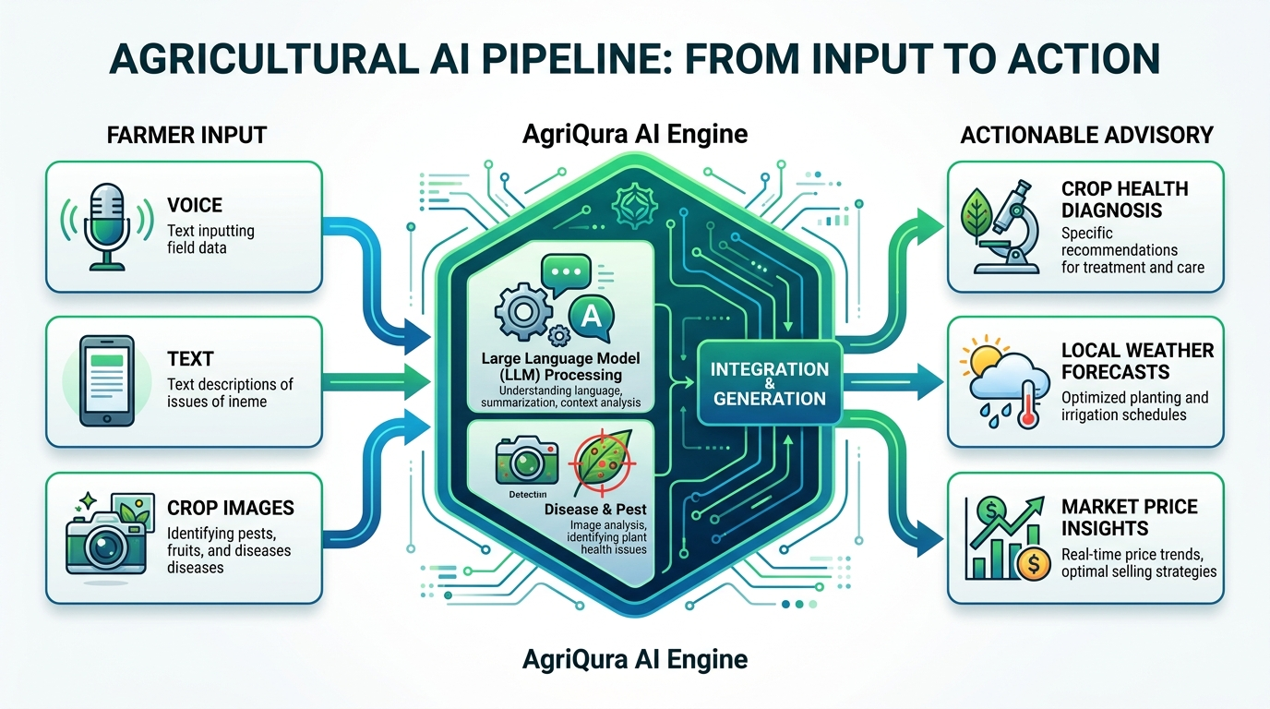
AgriQura
Titan Coders
Detailed Explanation of the Proposed Solution
Problem: Lack of timely, localized, and native-language agricultural advice.
Solution: “ AgriQura “ An AI-driven Farmer Query Support & Advisory System.
Key Features (At a Glance):
AI Voice Assistant: Real-time multilingual support (Groq LLM).
Disease Detection: Image-based crop diagnosis.
Smart Advisory: Weather & soil-based precision farming.
Market & Schemes: Live prices & govt. scheme matching.
Expert Connect: Direct access to agronomists.

Slide 3
TECHNICAL APPROACH
Titan
Coders
Technologies to be Used
Architecture Overview: A robust, scalable Client-Server architecture utilizing the MERN stack with modern build tools and AI integrations.
Frontend (User Interface):
  Framework: React.js powered by Vite for high performance.
  Styling & UI: TailwindCSS for a mobile-first responsive design, enhanced by Framer Motion and GSAP for fluid micro-animations.
  Accessibility: i18next for seamless multi-language support (crucial for rural demographics).
Backend (Core Logic & APIs):
  Framework: Node.js and Express.js RESTful API architecture.
  Security: JWT (JSON Web Tokens), Google OAuth integration, and rate limiting (helmet, express-rate-limit).
Database:
  System: MongoDB with Mongoose ODM for flexible, schema-less data storage handling user profiles, farm data, and advisory history.
AI & 3rd Party Integrations:
  LLM Inference: groq-sdk for ultra-fast, cost-effective conversational AI processing.
  Communications: @emailjs for alerts and notifications.

Slide 4
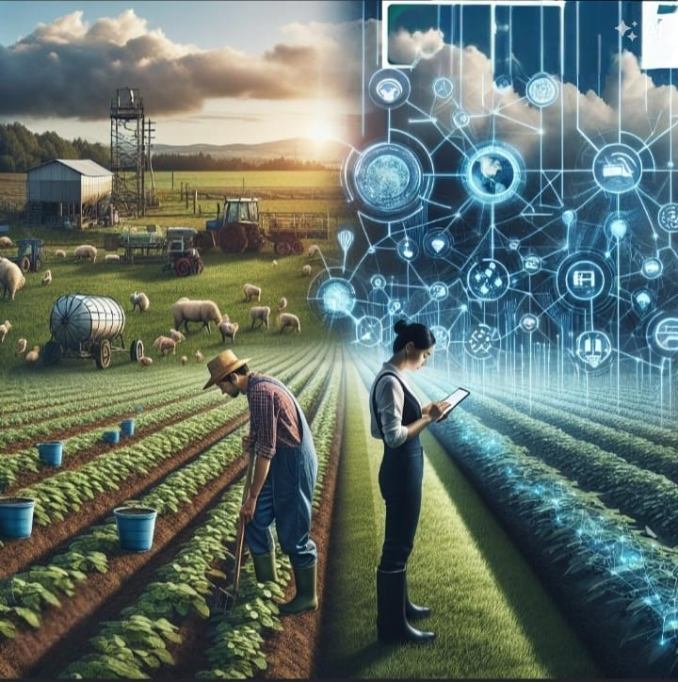
FEASIBILITY AND VIABILITY
Titan Coders
Technical Feasibility:
Built entirely on reliable, open-source technologies (MERN stack).
The use of Groq API ensures high-speed AI capabilities without the need for expensive in-house GPU infrastructure.
The modular, API-first design allows for easy integration with future IoT devices or external weather/market APIs.
Economic Viability & Adoption:
High Accessibility: Designed as a responsive web app, eliminating the friction of app store downloads while functioning smoothly on budget smartphones prevalent in rural India.
Vernacular & Voice-First: Overcomes literacy barriers through voice commands and native language support, ensuring high user adoption.
Sustainable Model: Potential for freemium models for farmers, supplemented by B2B partnerships with Agri-input companies and government bodies.

Slide 5
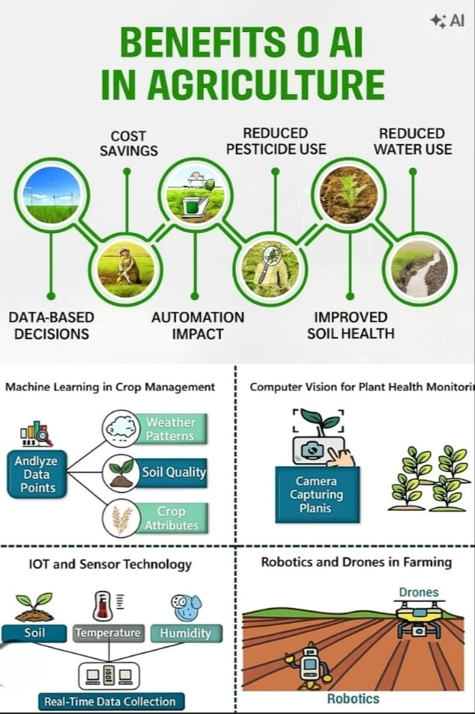
IMPACT AND BENEFITS
Titan Coders
Direct Benefits to Farmers:
Increased Yield & Reduced Loss: Early disease detection and hyper-local weather alerts prevent crop damage.
Cost Optimization: Soil health advisories ensure optimal use of fertilizers and pesticides, reducing input costs.
Better Profitability: Real-time market intelligence prevents distress selling and maximizes revenue.
Socio-Economic & Environmental Impact:
Digital Inclusion: Bridges the digital divide, bringing state-of-the-art AI to the most marginalized farming communities.
Empowerment: Connects farmers to vital government schemes they might otherwise miss.
Sustainability: Promotes eco-friendly farming practices by preventing the overuse of chemical inputs through precise, data-driven recommendations.

Slide 6
RESEARCH AND REFERENCES
Titan
Coders
Market & Demographic Studies: Reports on smartphone and internet penetration in rural India (e.g., IAMAI reports).
Agricultural Challenges: ICAR (Indian Council of Agricultural Research) documentation on crop diseases and yield gaps.
Technology Stack Documentation:
  Groq API: For high-performance LLM inference.
  React & Vite: For modern, performant web development.
AI Training Datasets (Reference): Datasets like PlantVillage used generally for training crop disease classification models.
Government Portals: Integration references from e-NAM (National Agriculture Market) and state agricultural scheme databases.

Slide 7
IMPORTANT INSTRUCTIONS
Please ensure below pointers are met while submitting the Idea PPT:
Kindly keep the maximum slides limit up to six (6). ( Including the title slide)
Try to avoid paragraphs and post your idea in points /diagrams / Infographics /pictures
Keep your explanation precise and easy to understand
Idea should be unique and novel.
You can only use provided template for making the PPT without changing the idea details pointers (mentioned in previous slides).
You need to save the file in PDF and upload the same on portal. No PPT, Word Doc or any other format will be supported.
Note - You can delete this slide (Important Pointers) when you upload the details of your idea on SIH portal.

