Slide 1
RISC-V
Pipelined Processor
Giuliano Verrando

Slide 2
Bubble sort
for(int i=N-1; i>=0; i--){
for(int j=0; j<=i; j++){
if(array[j] CMP array[j+1]){
tmp=array[j];
array[j]=array[j+1];
array[j+1]=tmp;
}
}
}

Slide 3
Bubble sort
main:
lui a1,%hi(.LANCHOR0)
addi a1,a1,%lo(.LANCHOR0)
addi a2,a1,48
j .L2
.L3:
addi a5,a5,4
beq a5,a2,.L7
.L4:
lw a4,0(a5)
lw a3,4(a5)
ble a4,a3,.L3
sw a3,0(a5)
sw a4,4(a5)
j .L3
.L7:
addi a2,a2,-4
beq a2,a1,.L5
.L2:
mv a5,a1
j .L4
.L5:
li a0,0
ret

Slide 4
Bubble sort
main:
addi x1,x0,0 # t=0
addi x2,x1,11 # i=t+N-1
beq x0,x0,11 # go .L2
.L3:
addi x5,x5,1 # j++
beq x5,x2,7 # if j=i → go .L7
.L4:
ld x3,0(x5) # a=array[j]
ld x4,1(x5) # b=array[j+1]
bge x4,x3,-4 # if b>=a → go .L3
sd x4,0(x5) # array[j]=b
sd x3,1(x5) # array[j+1]=a
beq x0,x0,-7 # go .L3
.L7:
addi x2,x2,-1 # i--
beq x2,x1,3 # if i=0 go .L5
.L2:
addi x5,x1,0 # j = 0
beq x0,x0,-9 # go .L4
beq x0,x0,0 # STOP

Slide 5
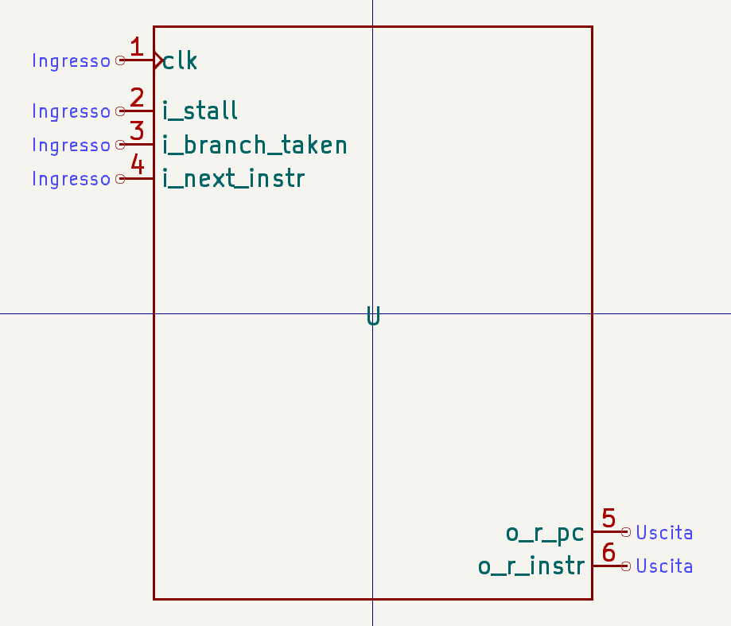
Fetch
Program counter
Text/program memory

Slide 6
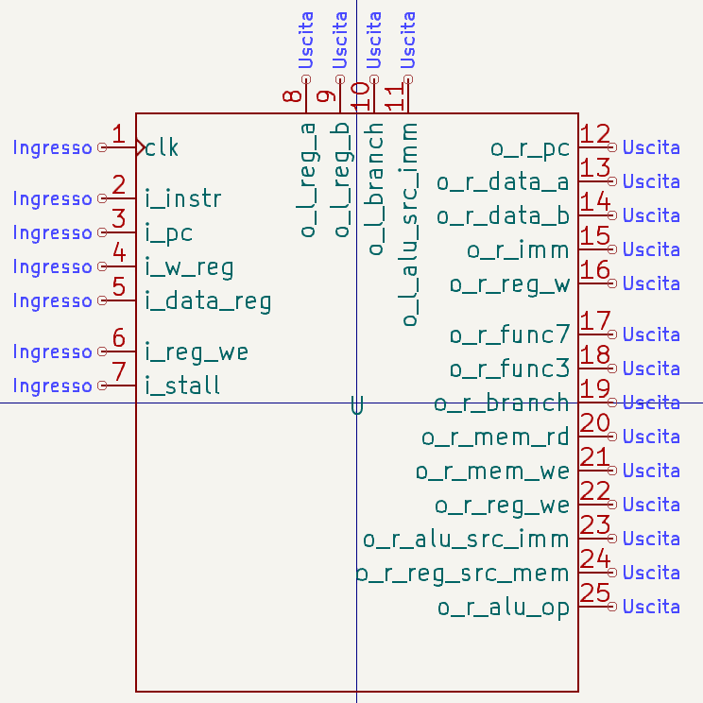
Decode
Register file
Control unit
Immediate gerator

Slide 7
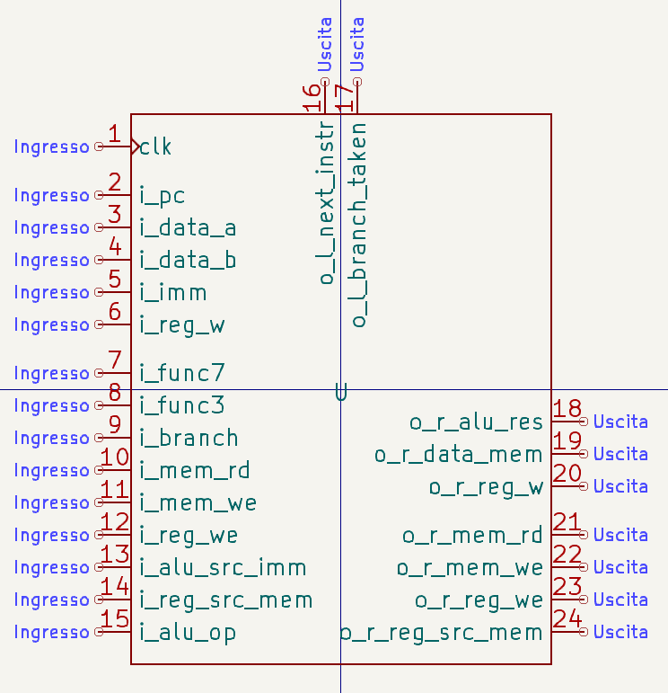
Execute
ALU control
ALU
Adder
Shift

Slide 8
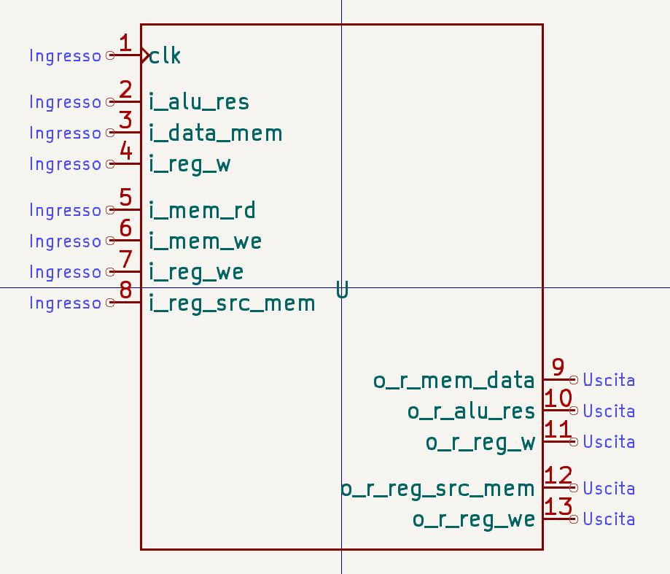
Memory access
ALU control
ALU
Adder
Shift

Slide 9
Write back
Integrated in the top hierarchy entity
Input to decode step
o_r_MemAccess_reg_we
1-bit MUX to differentiate
  o_r_MemAccess_data_reg
  o_r_MemAccess_alu_res
selected with:
  o_r_MemAccess_reg_src_mem

Slide 10
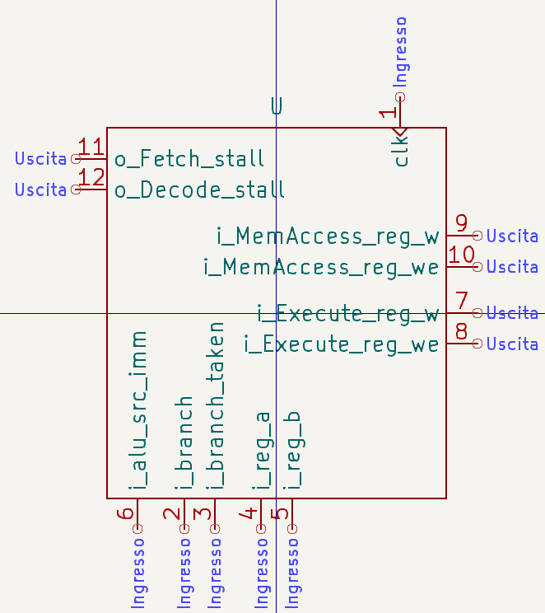
Hazard detection unit

Slide 11
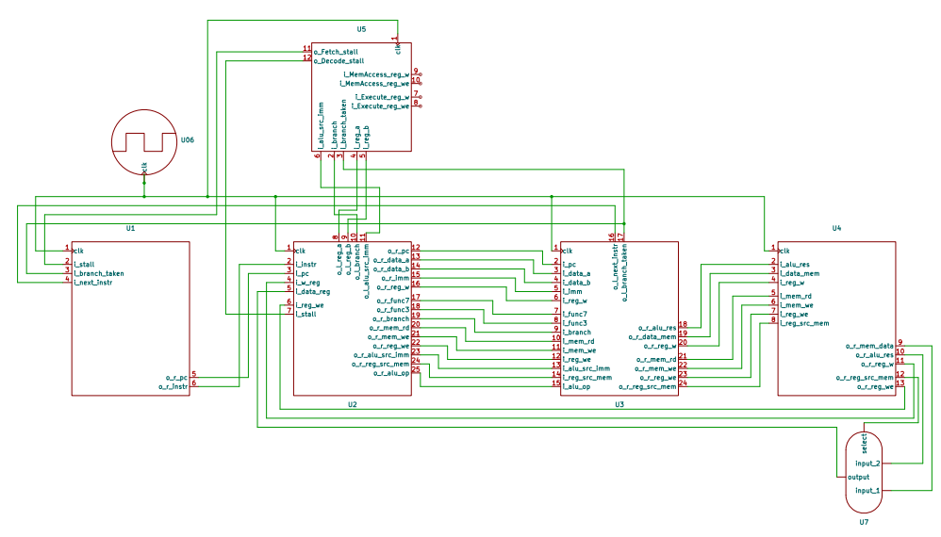
Processor

Slide 12

Results
Array input:
[2,3,5,11,-1,4,5,1,13,-5,0,2]
Array output:
[-5,-1,0,1,2,2,3,4,5,5,11,13]

Slide 13
Thank you for your attention!

