Slide 1
CS 3313 Foundations of Computing: Lab 8

Slide 2
Decidable vs Undecidable problems
Algorithm = Turing machine that halts on all inputs (always halts)
Decision problem: the answer is “Yes” or “No”
A problem is undecidable if there is no algorithm (Turing machine that always halts) that solves the problem
Problem = language
How do we show a problem is undecidable – need to prove the problem is undecidable
A problem is decidable if there is an algorithm (Turing machine that always halt) to solve the problem
How do we show a problem is solvable – provide an algorithm that solves the problem
Key observation: the algorithm can be deterministic or non-deterministic when we are trying to prove it is solvable/decidable

Slide 3
Decidable Problems
A problem is decidable or recursive if there is an algorithm to answer it
Recall: An “algorithm,” formally, is a TM that halts on all inputs, accepted or not
Otherwise, the problem is undecidable.
Language is Turing-recognizable or recursively enumerable if it is accepted by a TM
TM halts and accepts if the string is in the language
However, TM may not halt if the string is not in the language
Notes:
Click 1
When we talk about problems, we use the term “decidable.” it means that there is an algorithm to answer its question – that is, a Turing machine that accepts the encoded instances of the problem for which the answer is “yes,” and halts without accepting the other instances.
So a decidable problem is really the same thing as a recursive language, if we think of the language as encoding a problem.
Click 2
The opposite of decidable is undecidable.

Slide 4
Recall Definitions
Decidable Language: A language L is recursive if there is a Turing machine that accepts the language and halts on all inputs
Turing-recognizable Language: if there is a Turing machine that accepts the language by halting when the input string is in the language
The machine may or may not halt if the string is not in the language
w
M
w ϵ L(M)
Yes
No
w
Yes
M
w ϵ L(M)

Slide 5
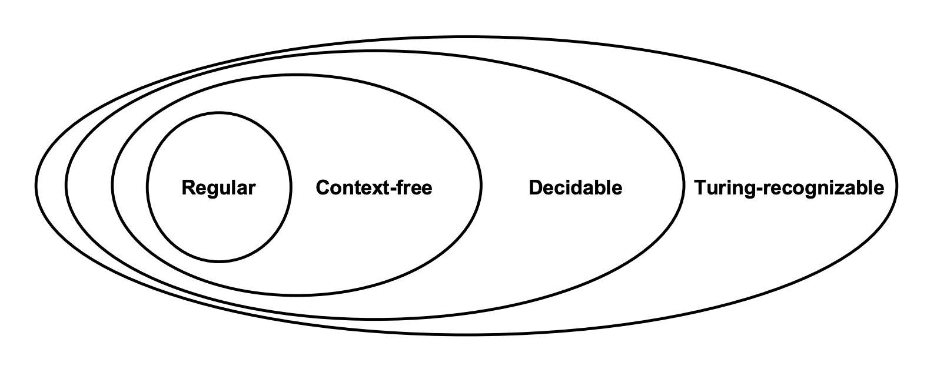
Recall the Relationships Among Language Classes

Slide 6
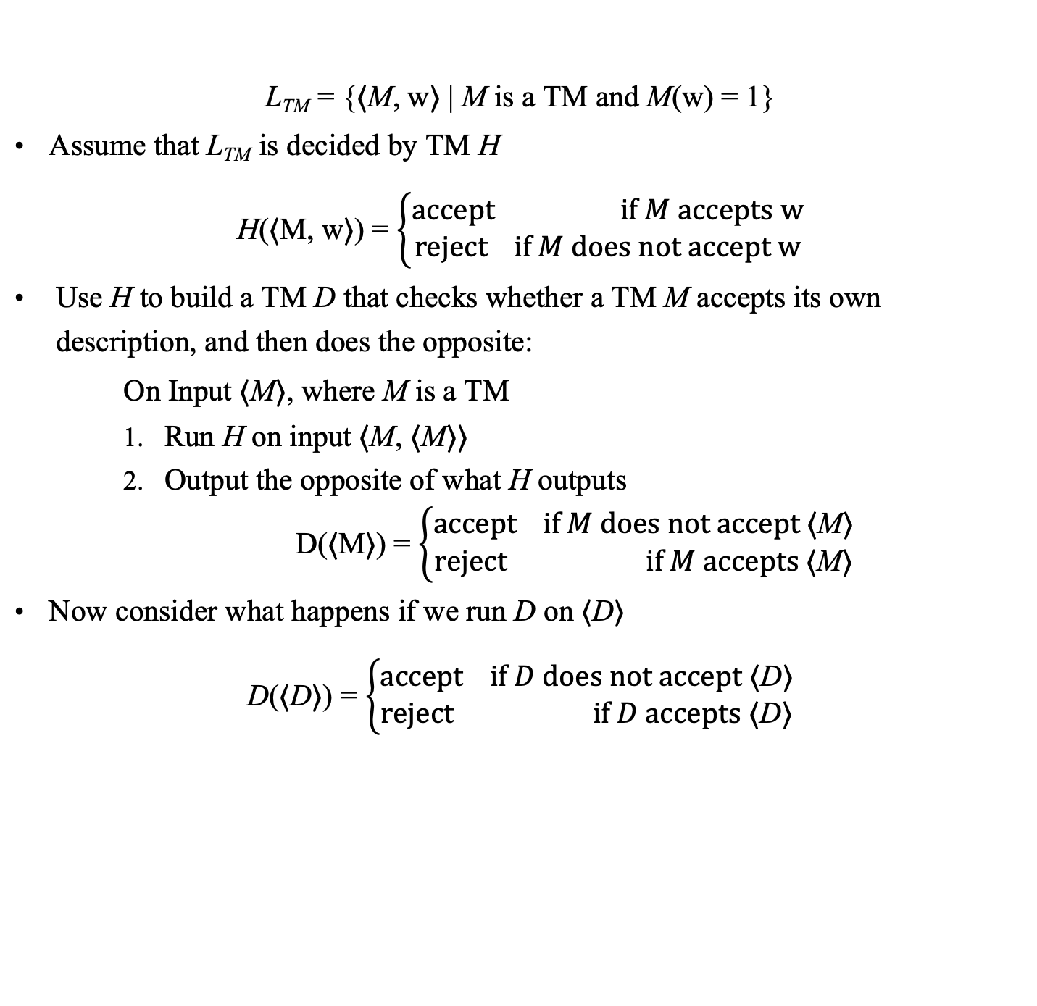
Recall Proof that L_{TM} is Undecidable
L_{TM} = {⟨M, w⟩ | M is a TM and M(w) = 1}
Assume that L_{TM} is decided by TM H
H(⟨M, w⟩) = $\left\{\begin{aligned}accept if M accepts w \\ reject if M does not accept w\end{aligned}\right.$
Use H to build a TM D that checks whether a TM M accepts its own description, and then does the opposite:
On Input ⟨M⟩, where M is a TM
Run H on input ⟨M, ⟨M⟩⟩
Output the opposite of what H outputs
D(⟨M⟩) = $\left\{\begin{aligned}accept if M does not accept \text{⟨}\text{M}\text{⟩} \\ reject if M accepts \text{⟨}\text{M}\text{⟩}\end{aligned}\right.$
Now consider what happens if we run D on ⟨D⟩
D(⟨D⟩) = $\left\{\begin{aligned}accept if D does not accept \text{⟨}\text{D}\text{⟩} \\ reject if D accepts \text{⟨}\text{D}\text{⟩}\end{aligned}\right.$

Slide 7
Exercise 1: L = {⟨M₁, M₂⟩ | L(M₁) ⊆ L(M₂)} is Undecidable
Given any two Turing machines M_{1,} M₂ is the language accepted by M₁ a subset of language accepted by M₂?
Hint: Can you design a TM that accepts the empty set?

Slide 8
Decidability…and Reducibility proof technique
Reducibility of a problem A to problem B
Given two problems A and B, problem A is reducible to problem B if an algorithm for solving B can be used to solve problem A
Therefore, solving A cannot be harder than solving B
If A is undecidable and A is reducible to B, then B is undecidable
Idea: If you had a black box that can solve instances of B, can you solve instances of A using calls to this Black box?
The black box is the assumed Algorithm for B
Crucial step in the proof is the reduction “algorithm”
This process should be an “algorithm” – i.e., a TM that always halts

Slide 9
Example: Proof that the halting problem is undecidable
HALT_{TM} = { w_{i} | M_{i} accepts (halts on) w_{i} }
Given any input and any machine, will the machine terminate or run forever?
Reducibility algorithm R (HALT_{TM} reducible to B): Input is w and output is ⟨M_{i},w_{i}⟩
Use the canonical ordering algorithm to find i, where w = w_{i}
Concatenate code for M_{i} (binary representation of i) and w_{i} to generate ⟨M_{i},w_{i}⟩
Send to hypothetical algorithm B for Halting Problem
B accepts if and only if w is in HALT_{TM}
The proof was all about construction of R!
w ϵ L(M*) iff w=w_{i} and M_{i} accepts w_{i}
M*
w
⟨M_{i},w_{i}⟩
B
w ϵ L(M’)
Yes
Yes
R
No
No
M’

Slide 10
Exercise 2: L = { ⟨M⟩ | M is a TM and L(M)=∅ }
L = { ⟨M⟩ | M is a TM and L(M)=∅ }
Given a Turing machine M, does M accept any input?
(i.e., does M accept the empty set)

